Slide 1
Consent
Marie Tighe, National ADM and Consent Office

Slide 2
Overview
Background
Consent/Informed consent
Next of Kin

Slide 3
Background
Autonomy: comes from the Greek roots auto meaning "self" and nomos meaning "custom" or "law.“ When a person seeks autonomy, he or she would like to be able to make decisions independently.
Autonomy is a fundamental principle in ethics
One’s actions and decisions are one’s own and should be respected.
Respecting the right to consent to or refuse medical treatment.

Slide 4
IHREC
Irish Human Rights and Equality Commission
promote and protect human rights and equality in Ireland
build a culture of respect for human rights, equality and intercultural understanding.
All public bodies in Ireland have responsibility to promote equality, prevent discrimination and protect the human rights of their employees, customers, service users and everyone affected by their policies and plans
Legal obligation - called the Public Sector Equality and Human Rights Duty,
originated in Section 42 of the Irish Human Rights and Equality Act 2014.

Slide 5
What is consent?
“Consent is the giving of permission or agreement for an intervention, receipt or use of a health and social care service or participation in research following a process of communication about the proposed intervention” (NCP 2019)

Slide 6
Informed Consent/Valid and Genuine

Slide 7
Informed/ Valid and Genuine Consent
Depend on the urgency and complexity, nature and level of risk associated with the intervention
Potential benefits, risks, and the likelihood of success of a proposed intervention as well as that of any available alternative
Whether proposed investigation or treatment is experimental or part of a research project
If relevant, that costs will have to be paid and how and where information about these costs may be obtained
Sufficient information
Diagnosis and prognosis including any uncertainties
Option for treating or managing the condition including the option not to treat
Purpose of any proposed intervention and what it will involve

Slide 8
Disclosure – who, what, where and why?
Information to be provided will depend on the urgency, complexity, nature and level of risk involved.
Legal obligation to warn of risks that might affect the judgement of a reasonable person
Giving detailed warning protects healthcare professionals from subsequent litigation
Responsibility of the person providing Rx to discuss it with the person
Delegation is acceptable only where the person seeking consent is suitably trained, has sufficient knowledge of the procedure and understands the risks involved
Timing is important –Fitzpatrick v White (2007)

Slide 9
Capacity to consent
Presumption of capacity
Only question if after all appropriate help and support, the person is unable to understand/retain/weigh up/communicate
Functional approach.

Slide 10
Functional assessment of capacity
Functional capacity test:
To understand the information relevant to the decision
To retain that information for long enough to make a choice
To use or weigh that information as part of the process of making the decision; or
To communicate their decision (whether by talking, sign language, using technology or any other means).

Slide 11
Accessible information
Right to have accessible information
Simple clear language
More time to understand information
And information in a range of different formats to maximise understanding (e.g. easy to read, audio, video, text, pictures)
Use visual images, explanatory videos and diagrams
Offer material in other languages, electronic forms and other IT solutions
Professional interpretation services may be required

Slide 12
Good communication is key!
40% of Irish people have literacy issues
Discussions about options available to the person may take place over a number of consultations.
No set time period for ‘expiry’ of consent but should be refreshed prior to commencement of procedure.

Slide 13
Is consent always necessary?
Consent applies to all decisions from minor to major interventions.
Not always possible e.g. emergencies
The fact that a person may become upset - not a valid reason to withhold information

Slide 14
Documentation of consent
Important to document the consent process particularly if the intervention is invasive, complex or involves significant risks/consequences for the person.
Consent generally need not be given in writing, but if given verbally should be recorded in the person’s notes.

Slide 15
Consent forms
Over-reliance on forms rather than process
Counter-productive.
A negligence action might still be taken alleging lack of consent even if a consent form has been signed
the person may allege he/she was not given the relevant information
or the opportunity to ask questions.
Process of communication is more important than the form.

Slide 16
Next of Kin and Legal Authority
Notes:
Which will impact on the 2015 Act....

Slide 17
Next of Kin

Slide 18
Next of Kin
No Legal Authority to consent or refuse treatment on behalf of another
Notes:
As stated in the National Consent Policy

Slide 19
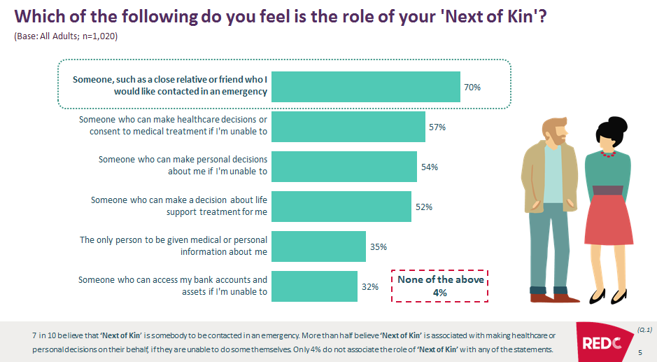
Notes:
Recent study

Slide 20
Current evidence of this in practice:
Notes:
While this is what the policy states, the actual practice is as follows:

Slide 21
Health Records and Personal Data
Next of kin accessing health records and data
Disclosure of information to next of kin without consent of the person

Slide 22
Next of Kin- Forms
Pervasive use of the term next of kin on forms and in practice
Next of kin are consenting and signing for treatment
On occasions intervention/procedure will not be carried out without next of kin/third party consent signing forms.

Slide 23
Consequences
Prevailing view that Next of Kin have decision making rights
Practices and procedures have reinforced this view
Very challenging for staff to address this
Challenging for ‘Next of Kin’ to accept this

Slide 24
DNAR Orders

Slide 25
DNAR Orders
DNAR order is a written order stating that resuscitation should not be attempted if an individual suffers a cardiac or respiratory arrest.
Not legally binding
AHD – legally binding

Slide 26
CPR
The proportion of people who survive cardiorespiratory arrest following CPR is relatively low.
In hospital 15-20%.
Out of hospital 5-10%.
CPR can double if not triple a person’s chance of survival
Without CPR or defibrillation, the chance of survival falls by up to 10% a minute and after just 5 minutes, the person may only have a 50% chance of survival.

Slide 27
Adverse effects of CPR
Rib or sternal fractures,
Hepatic or splenic rupture.
Prolonged Rx in ICU often including artificial ventilation.
Potential brain damage and resulting disability

Slide 28
Adverse effects of CPR
Physical and potentially traumatic experience
Death may occur in a manner that neither the person affected nor those close to them would have wished.
Detailed assessment is crucial to determine whether the benefit of attempting CPR outweighs the risks and burdens.

Slide 29
DNAR Orders
Only applies to CPR
All other appropriate treatment and care should continue
Explained to person - common fear a ‘DNACPR’ decision will lead to withholding treatment.
Ideally Advance Care Plan
Phrase ‘DNACPR’ should be used, rather than ‘DNR/DNAR’.

Slide 30
DNAR Orders
Made by the most senior clinician
Best made in the context of advance care planning
Do not have to put it in place to enter an nursing home/LTC

Slide 31
Next of Kin- DNAR Orders
Next of Kin consenting to DNAR orders in some health and social care settings
Notes:
Recent case of woman who’s mother was in Hospital. Had decision making capacity and was asked to consent for the DNAR order for her mother.

Slide 32
DNAR Orders
National Ambulance Service
Planned
Ambulance transfer
Recent and reliable letter from persons doctor
Unplanned
999 call e.g. regular care giver not there
Recent and reliable clinical source
Still not being used widely

Slide 33
Advance Healthcare Directives
What is an AHD?
Legally recognised statement `by a person 18 years ↑ with capacity setting out your future medical or surgical choices
Comes into effect when the Directive-Maker lacks capacity
Good idea to have one - not obliged to make one

Slide 34
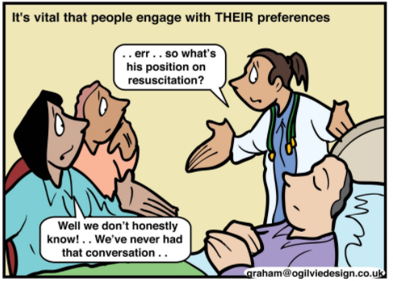

Slide 35
Refusal of treatment
Legally binding provided the AHD is valid and applicable
HSCP are legally required to comply with a refusal of healthcare treatment :
Directive-Maker lacks capacity
Treatment refused is materially the same
Circumstances are materially the same

Slide 36
Request for treatment
May include a request for a specific healthcare Rx.
Not legally binding.
Not available/clinically indicated.
Is unlikely to work; or
Might cause the person more harm than benefit; or
Is likely to cause the person pain, discomfort or distress that will outweigh the benefits it may bring.
Indication of the will and preferences of the individual.
Where a request for a specific healthcare treatment is not complied with, the HSCP must:
Record the reasons in the healthcare record, and
Give a copy of those reasons to the person’s DHR (if any) asap/7 days

Slide 37
Designated Healthcare Representative
Legally recognised role to:
Advise and interpret the Advance Healthcare Directive
Consent or refuse treatment up to and including life sustaining treatment*
Must keep a written record of all decisions made
Can’t delegate their powers to someone else*

Slide 38
Are we ready for Advance Healthcare Directives

Slide 39
Update
Review of National Consent Policy
Education and Training – e learning
Separate DNACPR Policy

Slide 40
National ADM and Consent Office
Caoimhe Gleeson caoimhe.gleeson@hse.ie
Jacqueline Grogan jacqueline.grogan@hse.ie
Elaine McCaughley elaine.mccaughley@hse.ie
Marie Tighe marie.tighe1@hse.ie

