Slide 1
Open Disclosure:
Briefing Presentation
Tullamore October 2nd 2019

Slide 2
Part 1
Introduction

Slide 4
Objectives
At the end of this programme the audience will:
Have an understanding of open disclosure and current developments in
Ireland
Understand the importance of an immediate and on-going
compassionate response to all those involved in and/or affected by
patient safety incidents
Be updated on existing and pending open disclosure legislation
Be updated on the key provisions of the HSE Open Disclosure Policy

Slide 5
The reality of poor communication
“Our family did not get open disclosure. We felt excluded and badly treated and none of the undertakings to give us answers were honoured. We pursued the legal route for three years but that was fraught with lack of conclusions and we feared for our financial security”.

Slide 6
Background
Recommendations: “Building a Culture of Patient Safety 2008”
Joint HSE/SCA approach supported by MPS
Pilot October 2010- March 2013
Launch of national documents November 2013
On-going roll out of policy and programme across all health and social care services since 2013 – national training programme – area and site leads
Independent evaluation of pilot programme published in 2016

Slide 7
QAVD audit of x 4 early adopter sites in 2016
Matters arising in Cervical Check Screening Programme 2018 and Scally Report and Recommendations September 2018
Protective legislation: Commencement of Part 4 of the Civil Liability Amendment Act 2017 – September 2018
Establishment of National OD Office and National Steering Committee 2018-2019
Interim Revision of HSE National Open Disclosure Policy launched in June 2019
Background

Slide 8
Open Disclosure and Empathy
www.youtube.com/watch?v=cDDWvj_q-o8

Slide 9
Part 2
An Overview of Open Disclosure

Slide 10
“An incident which occurs during the course of the provision of a health service” which:
has caused an unintended or unanticipated injury, or harm, to the patient
(b) did not result in actual injury or harm to the patient but was one which the health services provider has reasonable grounds to believe placed the patient at risk of unintended or unanticipated injury or harm or
(c) unanticipated or unintended injury or harm to the patient was prevented, either by “timely intervention or by chance”, but the incident was one which the health services provider has reasonable grounds for believing could have resulted in injury or harm, if not prevented.
Therefore a patient safety incident includes harm events, no harm events and near miss events.
Meaning of Patient Safety Incident (Civil Liability
Amendment Act 2017)

Slide 11
Open disclosure is where a health services provider discloses, at an open disclosure meeting, to—
a patient that a patient safety incident has occurred in the course of the provision of a health service to him or her
a relevant person that a patient safety incident has occurred in the course of the provision of a health service to the patient concerned, or
a patient and a relevant person that a patient safety incident has occurred in the course of the provision of a health service to the patient.
Meaning of Open Disclosure of a Patient Safety Incident (CLA Act 2017)

Slide 12
The HSE defines Open Disclosure as:
“an open, consistent, compassionate and timely approach to communicating with patients and, where appropriate, their relevant person following patient safety incidents. It includes expressing regret for what has happened, keeping the patient informed and providing reassurance in relation to on-going care and treatment, learning and the steps being taken by the health services provider to try to prevent a recurrence of the incident”.
(HSE 2019)
Definition
of Open Disclosure

Slide 13
The Events that Trigger Open Disclosure
Harm events: Always disclose
Suspected Harm Events: Always disclose
No Harm Events: Generally disclose . Rationale – how can you ensure that harm has not occurred if you don’t talk to the patient?
Near Miss Events: Assess on a case by case basis – if potential for future harm always disclose.

Slide 14
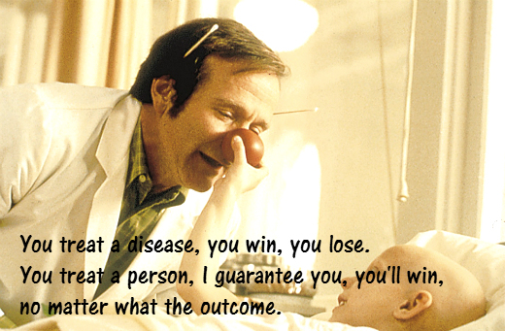
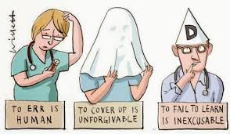
CARE COMPASSION TRUST LEARNING KINDNESS EMPATHY
Notes:
When we engage in open disclosure we are embracing many other HSE initiatives and values as outlined above

Slide 15
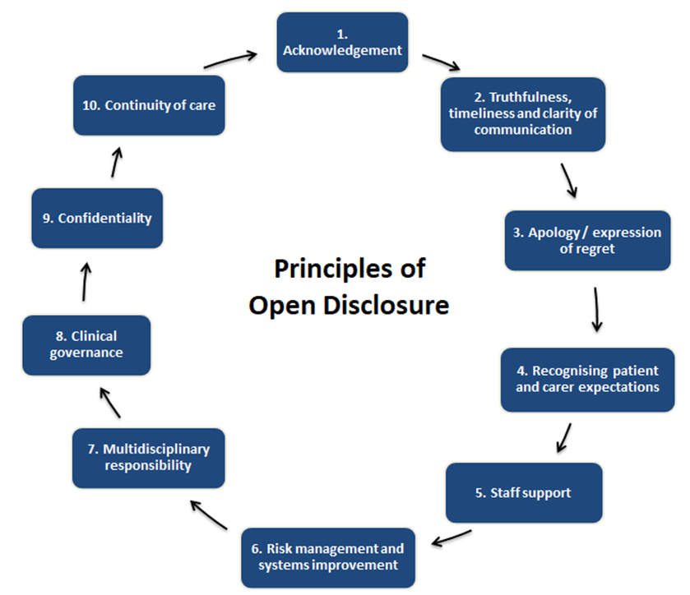
The Principles of Open Disclosure
Acknowledgement
Truthfulness, timeliness and clarity of communication
Apology/Expression of Regret
Recognise Patient and Carer expectations
Staff Support
Risk Management and Systems Improvement
Multidisciplinary Approach
Clinical Governance
Confidentiality
Continuity of Care
CARE COMPASSION TRUST and EMPATHY

Slide 16
Open disclosure involves:
A process of open, honest, transparent and timely communication with patients and/or their relevant person following a patient safety incident
An acknowledgement and factual explanation in relation to what has happened and how/why it happened
Providing a meaningful apology or expression of regret
Demonstrating Empathy and Compassion towards all those involved in the patient safety incident
Listening to the patient and/or their relevant person and hearing their story
Providing reassurance in relation to on going care and treatment, learning and quality improvement
What does
open disclosure involve?

Slide 17
Essential to ensure continuity and consistency
Imperative that details of the patient safety incident are documented in the clinical record including the details of clinical care provided.
The salient points of the open disclosure meeting must be documented in the patient record including the exact wording and context of any apology given.
Documentation of open disclosure on NIMS
Non-clinical communications to be kept in a separate file i.e. risk reviews, minutes of meetings, CLA forms
Refer to pre-during and post documentation checklist in guidelines and on website
Documentation:

Slide 18
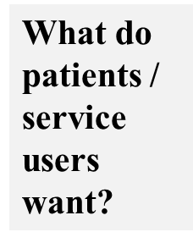
Respect
Honesty
Empathy
To be informed about their situation
by someone who is knowledgeable about it
Dedicated attention
To have their questions answered in language
they understand
Professionalism
Competent, efficient service
To be listened to (and heard)
A timely and comprehensive explanation of what happened and why
Someone to acknowledge and apologise if things went wrong
A reassurance that steps have been taken to ensure the event will not happen again
To be updated in a timely manner
Basic courtesy / friendliness
To be taken seriously
Follow-through

Slide 20
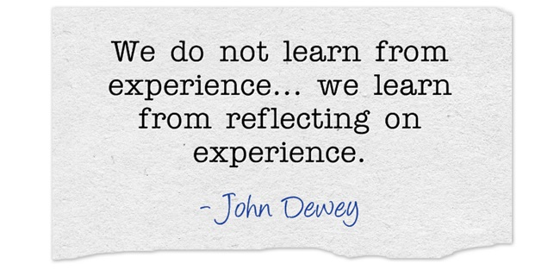
Improved staff recovery
It encourages a culture of honesty and openness.
Staff are more willing to learn from patient safety incidents
It enhances management and clinician relationships
It leads to better relationships with patients and their relevant persons
Maintains personal and professional integrity
Lightens the burden of guilt
Allows for reflective learning
Benefits for Staff

Slide 21
“Open disclosure is not about blame.
It is not about accepting the blame.
It is not about apportioning blame.
It is about integrity and being truly
professional
And the reason:
You hold our lives in your hands and we, as
patients, want to hold you in high regard.”
(Mrs Margaret Murphy)

Slide 22
Part 3
Open Disclosure
The Drivers

Slide 23
Open Disclosure:
The right thing to do
Open disclosure is the professional, ethical and human response to patients involved in/affected by patient safety incidents
It is what patients want
and expect
It is what we would expect for ourselves or a loved one
Learning from past experiences

Slide 24
HSE Policy/Incident Management/YSYS
2 . Professional and Regulatory
NMBI - code
Medical Council - code
HIQA - standards
CORU - code
Mental Health Commission
Pre Hospital Emergency Care Council
Pharmaceutical Society of Ireland (PSI) - code
Open Disclosure:
The Drivers

Slide 25
The Department of Health:
Government Policy/Code of conduct for
staff (2018)
Indemnifying Bodies: SCA/MPS/MDU/MEDISEC
Royal Colleges: RCSI, RCPI, ICO, ICGP, Faculty of Radiologists
WHO
Media
Open Disclosure:

Slide 26
Part 4
Open Disclosure
Legal considerations and Legislation

Slide 27
Culture: Historic Medical Culture of Non disclosure
Institutional Barriers: “Blame and Shame” approach – no institutional support or mechanisms to facilitate disclosure
Feelings of Shame & Embarrassment
Fear of litigation
Fear concerning professional
advancement
Fear with regard to reputation

Slide 28
Fear of being reported to professional body
Fear of the Media
Fear of the patient’s/family’s response
Financial concerns
Uncertainty with regard to extent of information to be disclosed
Lack of training and guidance for healthcare professionals
Why disclosure
can be difficult

Slide 29
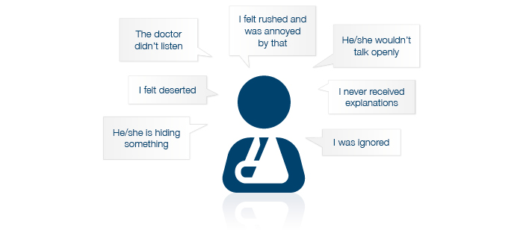
To get answers
The need for acknowledgement
and apology
Patients felt rushed
Felt less time spent/ignored
The attitude of staff
Patients wanted their perceptions
of the event/their story validated
Why do patients sue

Slide 30
The experience of “second harm” – poor or no communication after the patient safety incident occurred
To seek financial compensation
To enforce accountability
To correct deficient standards of care
To try to prevent a recurrence of the incident
Why do patients sue?

Slide 31
2002, Adopted full disclosure policy-
Moved from, “Deny and defend” to
“Apologise and learn when we’re wrong, explain and vigorously defend when we’re right and view court as a last resort”
August 2001-August 2007
Ratio of litigated cases : total reduced from 65-27%.
Average claims processing time reduced from 20.3 months to 8 months.
Insurance reserves reduced by > two thirds.
Average litigation costs more than halved.
Savings invested into patient safety initiatives
Impact of Open Disclosure on Litigation
University of Michigan Health System

Slide 32
Protective legislative provisions in Part 4 of
the Civil Liability Amendment Act 2017 (CLA Act) –
Commenced in September 2018
1. Open disclosure:
(a) shall not constitute an express or implied
admission of fault or liability
(b) shall not, notwithstanding any other
enactment or rule of law, be admissible as
evidence of fault or liability and
(c) shall not invalidate insurance or
otherwise affect the cover provided by
such policy

Slide 33
2. Information provided, and an apology where it is made, shall not
constitute an express or implied admission, by a health practitioner, of fault, professional misconduct, poor professional performance, unfitness to practice
(b) be admissible as evidence of fault, professional
misconduct, poor professional performance,
unfitness to practise, in proceedings to
determine a complaint, application or
allegation

Slide 34
Part 4 of the CLA Act 2017 relates to voluntary open disclosure
There are 8 regulations that accompany Part 4 of the CLA Act 2017
Staff can opt to seek the protective provisions of the Act or not.
To avail of the protective provisions within Part 4 of the Act open disclosure must be managed strictly in accordance with the procedure as set out within the Act and the regulations that accompany Part 4 of the Act
The protections of the Act will be automatic when OD is managed as per the procedure set out in Part 4 of the Act

Slide 35
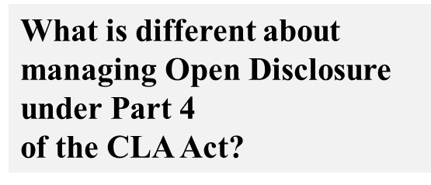
In addition to the HSE Policy requirements:
The relevant prescribed statements (forms) must be prepared and signed by the health services provider and provided to the patient/relevant person, as appropriate.
A copy of all forms must be kept on record by the health services provider – in a file separate to the clinical/care record
The name of the designated person (key contact person) must be documented in a file separate to the healthcare record e.g. OD file/Incident Management File

Slide 36
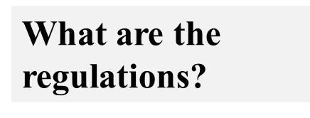
There are 8 regulations
The regulations take the form of prescribed statements which staff are obliged to
Complete
Sign (signed by principal health care practitioner
or another person deemed appropriate by the
health services provider)
Provide (relevant forms) to patients as set out in
the procedure
Maintain on record in a file separate to the
healthcare record e.g. OD file or incident
management file

Slide 37
Form A - Statement of Information Provided at an Open Disclosure Meeting
Form B - Statement of Non-Attendance patient or Relevant Person at open disclosure meeting
Form C - Statement of Non-Attendance patient and relevant person at open disclosure meeting
Form D - Refusal to accept Statement
Form E - Statement of Additional Information
Form F - Request for Clarification Meeting
Form G - Statement of Clarification of Information
Form H - Statement of Steps Taken to Establish Contact
Available:
https://www.hse.ie/eng/about/who/qid/other-quality-improvement-programmes/opendisclosure/open-disclosure-legislation/civil-liability-forms.html

Slide 38
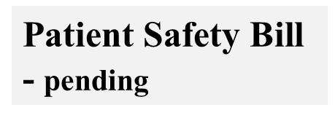
“A Bill to provide for mandatory open disclosure of serious reportable patient safety incidents, notification of reportable incidents, clinical audit to improve patient care and outcomes and extend the Health Information Quality Authority remit to private health services”
(Department of Health 5 July 2018)
Note:
General Scheme of Bill is available via link below https://health.gov.ie/blog/publications/general-scheme-patient-safety-bill-5-july-2018/

Slide 39
Mandatory open disclosure in respect of serious patient safety incidents and serious reportable events.
Mandatory reporting of serious events to the appropriate regulatory authority, such as HIQA or the Mental Health Commission.
Mandatory open disclosure will apply both to individual health practitioners as well as organisations providing healthcare.
It will take account of recommendations relating to Open Disclosure contained in the report by Dr Gabriel Scally 2018.

Slide 40
Part 4
Open Disclosure
Policy Summary and Resources

Slide 41
Patients have the right to have full knowledge about their healthcare and, in particular, have a right to be informed when things go wrong.
Patients must be treated with compassion and empathy.
A person whose decision-making capacity is in question is entitled to open disclosure on an equal basis with others.
Focus first and foremost on the physical needs of the patient through the provision of appropriate medical treatment or other care to manage any harm that has occurred.
All “harm” and “suspected harm” events must be disclosed. “No harm” events should generally be disclosed and “near miss” events must be assessed on a case by case basis. If there is a potential for a “no harm” event or “near miss” event to become a “harm” event in the future the patient must be informed.

Slide 42
6. Initiate OD process as soon as possible and as is practicable
(ideally within 24 - 48 hours after the event occurs or
becomes known
7. Assess the incident and determine level of response required
– low level/high level
8. Adequately prepare for an open disclosure meeting by giving
due consideration to what has happened and the facts
available.
9. The patient must be informed of all the facts available to the
health services provider at the time of the open disclosure
meeting in relation to the patient safety incident.
10. Provide a sincere and meaningful apology in a timely manner
which is personal to the patient and to the given situation.

Slide 43
11. All additional information obtained must be provided to the patient/relevant person in a timely manner and any clarifications sought in relation to information provided responded to openly and honestly.
12. A designated person must be assigned to maintain communication between the health service and patient/relevant person.
13. The salient points of the OD meeting must be documented in the clinical/care record including the details of any apology provided.
14. Appropriate follow up care and communication must be provided
15. The HSE will provide a safe, supportive and caring environment for staff involved in and/or affected by patient safety incidents and ensure that staff access training on the open disclosure policy relevant to their role

Slide 44
16. The deferral of open disclosure must be managed as per the steps set out in the policy. Only in rare and exceptional circumstances would the deferral of open disclosure occur.
17. Disclosure of information to an adult patient’s relevant person must only be undertaken with the consent of the patient, where possible.
18. Effective governance arrangements are required to support timely and effective open disclosure. Primary responsibility and accountability for the effective management of patient safety incidents, including the open disclosure process, remains at organisational level .
19. The health service provider will develop an implementation plan to support the roll out of the OD policy .
20. The implementation of OD policy must be evaluated and audited.

Slide 45
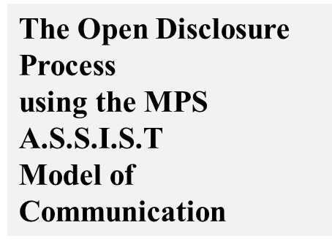
A – Acknowledge – problem and impact
S – Sorry – express regret
S – Story – hear patient’s story and summarise
back to them
I – Inquire – seek questions to be answered,
provide answers, give information
S – Solution – seek patient’s ideas on the way
forward – agree a plan
T – Travel – avoid abandonment – continued care
– increased contact.

Slide 46
The power of an Apology – saying Sorry
What is an apology?
What is the difference between an
“expression of regret” and an “apology?
What are the components of an effective
apology?

Slide 47
Components of an apology
Acknowledgement
Explanation
Reassurance
Reparation

Slide 48
When should an apology occur?
Who should apologise?
Is an apology an admission of liability?
What should never happen during an
apology?
Written v Verbal apology

Slide 49
Provides information for staff on:
The potential normal reactions to what is an abnormal event
How to help yourself
How to support a colleague /peer using the ASSIST
ME model
Advice on when to seek professional assistance i.e.
GP/EAP/OH

Slide 50
A – Acknowledge – what has happened and the impact on staff
member
S – Sorry – express regret for their experience
S – Story –allow the staff member time to talk about what has
happened - listen and summarise back to them
I – Inquire – seek questions to be answered, do not go into
investigative mode - provide answers, give
information
S – Solution – Talk about next steps – the management of the
patient and event – seek their ideas/suggestions –
agree a plan – check if they are ok to remain at work
T – Travel – maintain communication and support – check in regularly avoid abandonment – continued care
M – Monitor - monitor their progress
E - Evaluate – talk to the staff about their experience of the process
End - close the process when staff member feels ready – open door

Slide 51
Further information
www.opendisclosure.ie
National documents
Resources for clinicians, organisations and trainers
Open disclosure site leads/group leads/CHO leads/NAS Leads
Yammer.com support forum
National Open Disclosure Office
Email: opendisclosure.office@hse.ie

Slide 52
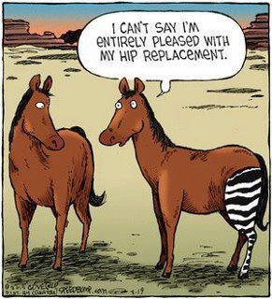
Patient safety incidents happen to
the best people in the best places –
none of us are immune.
We must be honest with our
patients, our colleagues and
with ourselves.
Learning is difficult
where transparency is absent.
Transparency must involve
an empathic approach to the patients and
families, staff and services involved
in/affected by patient safety incidents.
Fact: Things go wrong
despite our best efforts

Slide 53
Contact Details:
Email Opendisclosure.office@hse
www.hse.ie/opendisclosure

Slide 54
Thank you for your time and attention….any questions ?

Slide 55
HSE | Open Disclosure
For further information
Full policy and additional resources (including Staff Support Booklet)
www.hse.ie/opendisclosure
Contact the National Open Disclosure Office
Email: opendisclosure.office@hse.ie

