Slide 1
Buprenorphine/Naloxone (Suboxone©)
Dr Margaret Bourke & Denis O’Driscoll

Slide 2
Learning Objectives
To understand the clinical use, induction process and prescribing of buprenorphine/naloxone containing products
To understand the clinical pharmacology of buprenorphine/naloxone
To understand the principle drug interactions and potential side effects of buprenorphine/naloxone
To understand the relevant regulations regarding the prescribing and dispensing of buprenorphine/naloxone in Ireland

Slide 3
History of Buprenorphine
Developed in 1970’s in an attempt to find a “non addictive” analgesic
Registered in 1980s as an analgesic – (Temgesic™ in Ireland)
“Abuse” of buprenorphine by heroin users in 1980s
Phase II clinical research by mid 1980s with heroin users
Phase III randomised trials late 1980s – early 1990s
Sublingual tablet (Buprenorphine)™
Registered for treatment of opiate dependence
France 1995
UK 1998
Australia 2000

Slide 4
Introduction
In 1978 Dr Donald Jalinski et al first noted the usefulness of buprenorphine as a long term treatment medication for addiction
Buprenorphine shown to significantly reduce heroin use in persons dependent for over 15 years.
Well accepted by a percentage of this cohort.

Slide 5
Introduction
Dr Ed Johnson (Addiction Research Centre, Lexington, KY) stated that it can be used safely.
There are less physical withdrawals.
Duration of action is longer.
‘Lower potential for misuse than other substitutions’. In reality buprenorphine can be and has been misused

Slide 6
Introduction
As a partial agonist Buprenorphine may not provide morphine like subjective effects that are desired by some opioid users
It is another form of OST currently insufficient evidence to recommend one substitute medication above another(UK Guidelines)
Not the ‘magic drug’ perceived by some
Used for maintenance/detoxification

Slide 7
Reasons for its use
Acceptability to the target population
Long duration of action
The ability to block certain effects of opioids
Limited physiological withdrawal syndrome when discontinued abruptly

Slide 8
Buprenorphine
Used as a substitution medication in opioid addiction.
It prevents withdrawal syndrome
May get slight withdrawal syndrome in the first few days when initiating treatment.
Withdrawal from buprenorphine is less intense than withdrawal from morphine or methadone

Slide 9
Buprenorphine
The longer the period of substitution the less intense the withdrawal syndrome
Has the capacity to produce physical dependence
Patients on buprenorphine get withdrawals when heroin or other opioids including codeine are taken.

Slide 10
OTC and Prescribed Opioids Dependence
Limited evidence on value of substitution
Most research is on treatment of heroin use
Patients dependent on prescribed and OTC opioids may respond differently. (UK Guidelines)

Slide 11
The pharmacology of opioid agonists and antagonists
Full agonist
- Binds to the receptor producing a dose-dependent increase in physiological effects
e.g. heroin, methadone, morphine
Antagonist
- Binds to the receptor but does not produce a biological response and is able to block agonist effects
e.g. naloxone and naltrexone
Partial agonist
Binds to the receptor but even at full saturation of receptors exerts less than maximal effects obtained with full agonists
e.g. buprenorphine

Slide 12
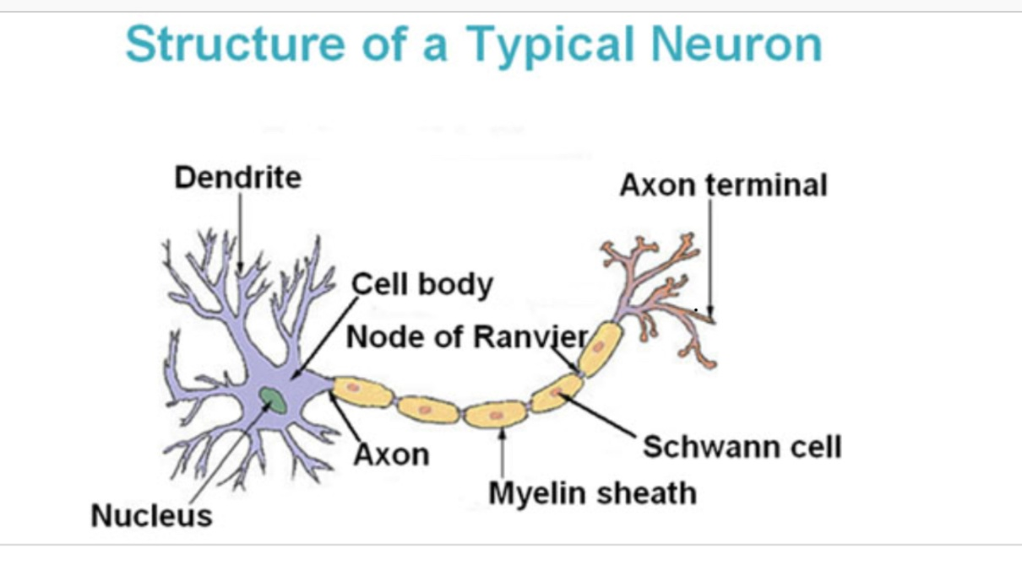
Opioid Receptors
Opioids bind to opioid receptors on the neurons
5 subtypes
Mu
Delta
Kappa
Epsilon
Sigma
Mu is associated with most of effects
Buprenorphine

Slide 13
Opioid Receptors
Most of available opioid analgesics
Act at μ-opioid receptor
Activation of μ-opioid receptor
analgesia, euphoria, respiratory depression, nausea, vomiting, decreased gastrointestinal motility, tolerance, dependence
δ-, κ-opioid receptor
analgesia
dysphoria, Psychotomimetic (κ)
Affective behavior, proconvulsant (δ)

Slide 14
Buprenorphine
A synthetic opioid
Partial agonist acting at the µ receptor
Low intrinsic activity only partially activating opiate receptors
Less sedating and euphoric
Dose – response curve exhibits “ceiling” effect
High affinity for the µ receptor
Binds more tightly to opiate receptors than other opiates or opiate antagonists

Slide 15
Properties
Buprenorphine’s ability to block the effects of concurrently administered opioids,
reduces the risk of relapse in buprenorphine maintained patients who self administer opioids during treatment.
Bell-shaped dose-response curve,
Hence its long duration of activity
Buprenorphine high receptor affinity and slow dissociation from its receptor (binds tightly)
prolongs its agonist action and allows less than daily dosing.
Prevents other opioids occupying the receptors
Greater affinity than Naltrexone/naloxone leading to problems in overdose

Slide 16
Properties
Metabolised by P450 iso-enzyme CYP3A4 in the liver.
The partial µ opioid profile of Buprenorphine
low intrinsic activity contribute to its good safety, decreases misuse potential.
Naloxone does not diminish the efficacy of sublingual buprenorphine
Naloxone is poorly absorbed sublingually.
Parenteral misuse in opioid dependant individuals
reduced by combining Buprenorphine with Naloxone (Suboxone©).
deters illicit diversion, reducing potential for misuse.

Slide 17
Mode of administration
Buprenorphine/Naloxone when administered sublingually reaches peak concentration after 90 – 150 minutes.
The effect lasts up to 12 hours at doses of 4mg and 48 to 72 hours at doses of 16mg - 32mg.
Highest authorised dose of buprenorphine/Naloxone 24mg.
Steady state equilibrium achieved after 3-7 days. Half life 24 to 36 hours
Withdrawal milder and occurs 3-5 days after last dose

Slide 18
Diversion
Like all potent µ-opioids, illicit diversion and parenteral misuse of buprenorphine has been reported worldwide.
The majority of the reported misuse occurs in heroin users who intravenously administer extracts of crushed tablets.
Injecting drug users are at risk of serious bacterial and viral diseases.
Injecting buprenorphine/naloxone causes severe abscess and localised necrotic damage to the area.

Slide 19
Side Effects
Nausea Vomiting
Insomnia
Constipation
Headaches
Mood swings
Sleep disturbances
Drowsiness
Respiratory depression is rare
Acute hepatitis reported at high doses
PRECIPITATED WITHDRAWAL will be dealt with in the context of treatment initiation

Slide 20
Drug interactions
Sedatives
Buprenorphine has additive sedative effects when used in combination with other sedatives
Opioid antagonist
Opioid agonists
Inducers/inhibitors of hepatic enzymes
Unclear as to impact, but likely to be of limited clinical relevance
Deaths reported
Alcohol, Benzodiazepines, Tricyclics, Amphetamine

Slide 21
Suboxone Formulation
Sublingual Buprenorphine/Naloxone 4:1 is as effective as Buprenorphine alone
Taken sublingually it reaches peak plasma concentration after 90 mins.
Naloxone is poorly absorbed sublingually (8 - 10%). Precipitates withdrawal if injected intravenously.

Slide 22
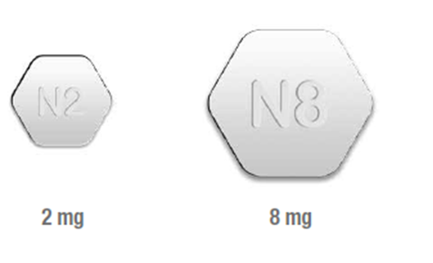
Suboxone
Two Suboxone dosage strengths: 2/0.5 mg, 8/2 mg
Citric flavour increases acceptability
Promotes salivary gland secretion
So diminishes length of supervision time
3 to 5 minutes supervision. May be less.

Slide 23
Recommendations of the Expert Group on the Regulatory Framework for products containing buprenorphine / naloxone and buprenorphine-only for the treatment of opioid dependence (2011)
Patients currently receiving treatment with buprenorphine/ naloxone who should continue to be maintained on buprenorphine/naloxone.
Patients with a specific medical need for whom methadone is contraindicated or not suitable, such as:
patients with prolonged QTc intervals,
patients on neuroleptic medications which also affect QTc interval
patients on high dose methadone treatment, who are also being treated with medicines which inhibit CYP450 enzymes (such as antiretroviral agents e.g. efaverinz or the anti-infective e.g. Rifampicin/ macrolides.) and therefore are at greater risk of drug interactions or

Slide 24
Recommendations of the Expert Group on the Regulatory Framework for products containing buprenorphine / naloxone and buprenorphine-only for the treatment of opioid dependence (2011)
Methadone-naïve patients, including young patients, where detoxification is a primary goal of treatment, provided the prescriber is of the opinion that detoxification is a realistic goal for the patient
Patients being treated for codeine and other pharmaceutical opioid dependencies.
Patients where, having regard to all of the patient’s circumstances, the prescriber is satisfied that there is clear evidence that the patient has been stable, socially, domestically and from a family perspective, for at least a period of six months and particularly where the patient is in stable employment or education and that the patient demonstrates a commitment to compliance with the treatment programme.

Slide 25
Regulations
S.I. No. 522/2017 - Misuse of Drugs (Supervision of Prescription and Supply of Methadone and Medicinal Products containing Buprenorphine authorised for Opioid Substitution Treatment) Regulations 2017
These Regulations replace the Misuse of Drugs (Supervision of Prescription and Supply of Methadone) Regulations 1998 ( S.I. No 225 of 1998 ). The Regulations add certain buprenorphine medicinal products authorised for opioid substitution treatment to the Schedule of products which fall within the scope of these Regulations.

Slide 26
Suitability of Patients for Treatment
They should be opioid dependant (ICD10)
Not poly-drug users
Not alcohol dependant
Not abusing benzodiazepine
Not pregnant or planning pregnancy in the near future : advise contraception

Slide 27
ICD 10
WHO: 3 or more of the following present together at some point in the preceding 12 months
Tolerance/Increasing use of the drug
Withdrawal Syndrome
Compulsion to use
Neglecting commitments
Continued use despite knowledge of harmful effects
Early relapse after withdrawal

Slide 28
Patient Education
Pre treatment consultation essential
Enables treatment to run more smoothly
Helps prevent risk of withdrawal
Stress the need for patient to present in observable clinical withdrawal.

Slide 29
Counselling patients before treatment
What is buprenorphine
Rationale for use
Proposed treatment regime (detoxification/maintenance)
Potential adverse events
Side effects
Precipitated withdrawal reaction
Warn regarding additional drug or alcohol use, driving
The “routine” of treatment
Supervised dosing sublingual tablet
Attendance requirements, including missed doses and take aways
Intoxicated presentations

Slide 30
Treatment
Maintenance doses can be achieved within a week.
Buprenorphine/Naloxone appears safe, most opioid overdose deaths are due to respiratory depression
If the dose is too low then it may not prevent withdrawal signs and symptoms.
Precipitated withdrawal syndrome may occur if another opioid is present in the system in too high a concentration
If occurs patient unlikely to return unless to express their anger and so be lost to treatment

Slide 31
Understanding precipitated withdrawal
Buprenorphine (high affinity) competes with and displaces full opioid agonist (heroin, methadone) from receptors
Buprenorphine has lower intrinsic opioid activity than full agonists
High affinity binds tightly to opiate receptors
Only likely to occur if first dose of buprenorphine is given whilst patient experiencing effects of other opiates

Slide 32
Features of precipitated withdrawal
Considerable variation in severity
More common features include:
Sweating
Abdominal cramps, diarrhoea, nausea
Anxiety, cravings
Commences more than 30 – 90 min after 1st buprenorphine dose
Peak within 90min to 3hours after 1st dose & subside thereafter
Minor symptoms may continue after 2nd or 3rd dose, however, symptoms may persist with continued heroin use

Slide 33
Precautions/ relative contraindications
High risk poly-drug use
Psychiatric condition
Unable to provide informed consent (e.g. psychosis, delirium, severe affective disorder)
Medical condition requiring cautious use of opioid medications
Head injury/elevated ICP/severe respiratory condition/acute abdomen/severe hepatic disease/elderly/debilitated
Chronic Pain

Slide 34
Dose Regimen
Evidence of clinical withdrawal must be identified prior to initiation of treatment.
OOWS and SOWS
Dosages of 4mg or greater are necessary to achieve sufficient blockade.
It is recommended that no opioid be taken for 12 to 20 hours prior to initial dose.
Transferring from methadone a longer period is recommended: no methadone for up to 36 hours.

Slide 35
OOWS and COWS

Slide 36
Reviewing patients during induction
Principle of induction to treatment is regular and frequent review
Patients often need reassurance, particularly if precipitated withdrawal or early side effects
Dose increases should only occur after review with doctor
Review every 1 – 2 days
Should review patient before 3rd dose
Limit duration of prescription to ensure review

Slide 37
Initiation
Initiation is quick and safe
Initial dose of Buprenorphine is 4mg to 8mg.
If commenced on 4mg:
Review in 12 to 24 hours for a further 2mg to 4mg increase.
Commencing on 8mg is possible and effective with experience (UK Guidelines).
If reviewing later in the day 2mg to 4mg increase only.
However with this dose may not need a review until the following day
8mg (probably equivalent to 60mg of methadone)
12mg - 16mg should produce blockade
The maximum dose is 24mg.

Slide 38
Buprenorphine/Naloxone dose increments
Increases can occur with every dose, subject to review of patient by prescribing doctor
Dose increases by 2 – 4 mg at a time
Steady state equilibrium does not occur until 3–7 days after a dose change, so beware of “overshooting” the dose

Slide 39
Maintenance Dose
Dose should be individualised
Optimal doses: 12 – 24mg/day
Maximum authorised dose is 24mg daily
Heroin use is related to dose of buprenorphine
Less heroin use and better treatment retention with higher doses (>16mg)
Some patients cannot stabilise on buprenorphine/naloxone:
if continue to use heroin regularly
or crave the opioids effects (sedation)

Slide 40
Regimen
Day 1 ideally commence on 4mg review in 6 to 8 hours and double dose to 8mg. Very rarely commence on 2 mg and increase dose to 4mgs as above.
If patient commences on 8 mg increase by 2mg to 4mg as above. Often do not need to return until following day

Slide 41
Dosing
Day 2,3 and 4 can increase by 2 – 4 mg if necessary.
Increase to a maximum dose of 20mg if necessary
Review 3 to 4 days later
Increase to a maximum dose of 24 mg

Slide 42
Missed doses
Repeated missed doses need to be discussed with patient
Missing 3 days - Prescriber should be notified by the pharmacist (UK guidelines)
Continue usual single daily dose
Missing 4-7 days
Continue daily dose following assessment and discussion
Missing more than 7 days
Re-induct once not intoxicated

Slide 43
Less than daily dosing
Improves buprenorphine’s clinical acceptability to patients.
Reduces the required number of patients treated at the clinic per day.
Reduces the need for take home medication
Decreases the possibility of illicit diversion and misuse.

Slide 44
Alternate Day Dosing
Relative to daily dosing, a 48 –72 hour inter dose interval does not produce elevated withdrawal ratings.
Patients prefer alternate day dosing schedule over daily dosing.
Highlights the safety of buprenorphine by administering double the patient’s daily dose prior to a 1–2 day dose omission.

Slide 45
Frequency of dosing
Daily maintenance treatment
patient stabilised in treatment
> 4 weeks maintenance treatment
no regular heroin or other illicit/ unprescribed medication
48hour dose = 2 x 24hour doses (to a maximum dose of 24mg at a time)
Review and titrate dose accordingly
Recommend 3 x 48 hour doses & 1 X 24hour dose per week
patient comfortable and stable

Slide 46
Reasons for Transferring from methadone
Patients with QTc prolongation.
Patient request
Employment
Education (greater clarity of mind)
Plan to detoxification
Patients requiring treatment with some anti TB and some Anti Retroviral medications

Slide 47
Transferring from Methadone
When switching from methadone the dose of methadone should be as low as possible to avoid precipitated withdrawal
The last dose of methadone should be administered at least 24-36 hours prior to initiation
Last heroin at least 12 hours.

Slide 48
Transferring to Methadone
Patients request
Doses of buprenorphine/ Naloxone required in excess of 24mg
Pregnancy
Not adhering to treatment (e.g missing days)

Slide 49
Detoxing from maintenance treatment (1)
Withdrawal from maintenance treatment has poor prognosis if
patient continuing heroin
patient misusing/ dependant on other drugs
Medical/ psychiatric conditions requiring on-going opioid use (e.g. chronic pain)
Pregnant
Poor psycho-social functioning
Still engaged in drug using lifestyle
Major lifestyle changes generally achieved after patient in treatment > 1 year
Rehabilitation plan and psychosocial support should be in place

Slide 50
Withdrawing from maintenance treatment (2)
Withdrawal symptoms from buprenorphine are milder and less protracted than for methadone
Onset of symptoms: 1 – 3 days after last dose
Peak symptoms: 3 – 7 days after last dose
Symptoms may continue for 2 – 4 weeks
Dose reduction can be made faster and with less discomfort than methadone withdrawal
However, research on patients withdrawing from buprenorphine maintenance suggests outcomes are similar to methadone withdrawal outcomes
Only 10%-15% of Australian patients in maintenance treatment programs had good prognosis for withdrawal

Slide 51
Withdrawing from maintenance treatment (3)
Additional monitoring, support, more frequent reviews
patient information
Role and limitations of symptoms of symptomatic medications
Post withdrawal treatment
Aim to maintain regular contact for several weeks after last dose
Psycho social interventions
Consider oral naltrexone treatment

Slide 52
Withdrawing from maintenance treatment (4)
Titrate reduction rate in relation to
Drug use
Withdrawal features/cravings
Psycho-social functioning
General health
Suggested reduction rate:
Daily Dose | Reduce dose by
> 16mg | 2 – 4 mg/ week
4 – 16mg | 1 – 2 mg/ week
< 4mg | 0.4 – 2mg/ week

Slide 53
Pain Management
Problematic in patients maintained on Buprenorphine/Naloxone as it is a partial agonist with a high affinity for the mu receptor.
Buprenorphine may block the use of opioids for the management of severe acute pain.
Higher than usual doses may be necessary but must be safe.
Temporary transfer to a full mu agonist

Slide 54
Analgaesia
Be aware Tramadol and Codeine are opioids
Take into account the patients level of tolerance to opioids as there is an increased risk of:
Respiratory depression
Nausea and Vomiting
Sedation

Slide 55
Analgesia for patients on buprenorphine
For short term analgesia
Use non-opioid analgesia where possible
If using other opioids for analgesia and continuing buprenorphine, must titrate opioid dose to achieve analgesia
Management of chronic pain
Complex bio-psycho social issue
Refer to specialist unit
Buprenorphine may not be suitable for some patents with severe pain issues (UK guidelines)

Slide 56
Mild to Moderate Pain
NSAIDS or Paracetamol
Heat/cold packs
Massage
Acupuncture
The more time spent with patient the less ‘pain killer’ needed

Slide 57
Managing overdose in patients on buprenorphine
Buprenorphine on its own is very unlikely to cause overdose
Buprenorphine overdose can be reversed with very high doses of naloxone (10 – 15mg), high affinity
Consider other drug use, particularly non opioid (benzodiazepine, alcohol)
Manage sedative overdose appropriately

Slide 58
Expected numbers
Initially HSE Addiction services only
200 patients
Allocation based on percentage of patients on OST in each CHO area
Cost implications
Finite budget for reimbursement

Slide 59
Procedure
Assessment of suitability
Education
Initiation of treatment
CTL Entry form
Checklist on reverse of entry form
to enable monitoring and evaluation as recommended by the working group
Prescription

Slide 62
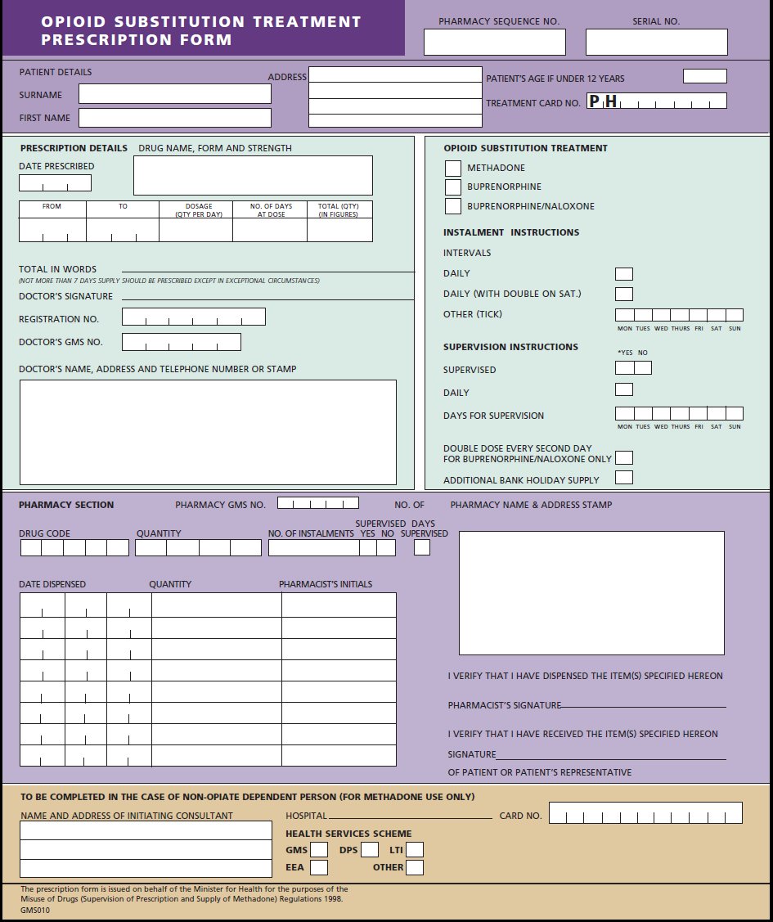

Slide 63
Case Studies Case 1
Past history treatment on methadone detoxed and relapsed
Previous high dose methadone so considered probably would not work agreed to try
Co Infected
Requesting treatment with Buprenorphine
Stabilised on 32mg
Reduced, Double dose, now on 24mg
Attends every 2 weeks

Slide 64
Case2
Presented having being diagnosed with QTc prolongation.
Presented in A & E Cardiac Arrest. Arrested a number of times.
High dose of methadone 160mg poorly monitored in community
No ECG
Poor Communication with community GP
COPD severe LRTI commenced on macrolide. Collapsed and arrested.
Complex past history, Hep B early 1980s, HCV, Leukaemia
Stabilised easily on Suboxone 24mg daily

Slide 65
Case 3
Long term methadone 120mg daily
Co infected. On treatment for HIV. Anti Retroviral changed - developed Torsade de Pointes
Cocaine Misuse which has continued to a lesser extent
Converted poorly in hospital
Severe Precipitated withdrawal
Initial Suboxone 16mg
Cardiac irregularity continued requiring insertion of ICD
Stable on Suboxone attends weekly dose 6mg

Slide 66
Case 4
Long term methadone never stabilised
Requested change stabilised (reasonably stable on Suboxone)
Dabbled, missed days eventually destabilised and dropped out of treatment

Slide 67
Case 5
Patient on Suboxone 16mg
College completed degree
Part time job in a pharmacy stabilised easily on Suboxone
Weekly T/As
Opiate +ve sample patient reported taking codeine for viral infection provided by pharmacist where he worked symptoms worsened but settled in 36hours when pharmacist refused further codeine
Withdrawal

Slide 68
Case 6
Converted from low dose methadone to Suboxone 6mg with a view to withdrawing completely.
Remains on same dose
Has not reduced

Slide 69
Case 7
Patient on methadone DTF 60mg
Hospitalised Cardiac arrest cocaine implicated
Admitted ICU again, 1 month later methadone 60mg transferred to buprenorphine/naloxone
3 weeks later presented at clinic severe chest pain collapsed arrested
Resuscitated arrested again APs unable to resuscitate RIP

Slide 70
Evaluation Form
Thank you

