Slide 1

^{Health Services}
^{People Strategy 2015-2018}
^{Leaders in People Services}

Slide 2
… There is overwhelming evidence linking high staff engagement with beneficial behaviours, better outcomes and improved performance
High Staff engagement
Involvement in ones role
Commitment to ones organisation
Positive feelings towards ones organisation
Desirable behaviours
Outputs
for staff
Outputs for the organisation
Overall performance
Levels of innovation amongst staff
(Gallup 2007)
Willingness to advocate the organisation to
others (Gallup 2006)
Higher job satisfaction
Lower staff sickness absence (Gallup 2006)
Lower staff turnover (Gallup 2006)
Fewer defects in manufacturing
Less inventory shrinkage
Fewer accidents at work (Gallup 2006)
Lower infection rates in hospitals (West 2012)
Greater customer satisfaction or patient experience (IES, Salanova, West)
Increased operating income (Towers Perrin 2006)
Increased productivity (Gallup 2006)
Increased profitability (Gallup 2006)
The causal link from engagement to performance has not been proven.
But longitudinal studies suggest that engagement contributes more than performance to engagement.

Slide 3
People Strategy
Leaders in People Services
Provides a clear framework to shape how we improve people services and support the service delivery system
Based on engagement and evidence of the key people management activities
Clearly focused on outcomes for Safer Better Health Care

Slide 4
Why a People Strategy
The People Strategy is based on our commitment to develop a professional HR Service that is technically competent and responsive to the needs of the organisation. It presents a challenge to start doing things differently in people management recognising the need for a joined up and partnership approach across the system.
The HR Service needs to continue to listen to staff, act on the feedback of staff and advocate on their behalf to improve the working environment and enhance services.
We want to create a modern, inclusive and high performing HR Service – the HR Leadership Team are fully committed to delivering this ambition.

Slide 6
6

Slide 7


Slide 9
Fundamental Concepts
Underpinning People Strategy

Slide 10
People Strategy
improving patient care and public service
To serve healthcare business and clinical priorities, HR needs
to ensure:
  Technically competent and responsive to service needs
  Positioned to support CHOs, Hospital Groups, PCRS, NAS and
  the delivery system overall
  Move to a more facilitative, supportive, developmental
  and enabling approach
  Take up a Business Partnering role at all levels
  Work in partnership with service managers to add value
  and enhance people capability
People Strategy will provide the direction to deliver on this ambition

Slide 11
11

Slide 12
HR Leaders in People Services
The People Strategy Framework gathers the interrelated and inter dependent elements of the Strategy – it is only by working together on all of these elements that we can really bring about significant cultural change in the way we approach people management across the system.
The combined outcomes from each of the priority areas in the People Strategy will result in improved performance, workforce optimisation and a learning Organisation delivering the overall goal of Safer Better Healthcare.

Slide 13
The HR Leadership Team
Rosarii Mannion, Overall Strategy Lead, HR Professional Services
Francis Rogers, Acutes Partner, Lead Leadership and Culture
Dr. Lynda Sisson, Clinical Lead Occ Health & Wellbeing
Frank O’ Leary, Finance Partner, Lead Workforce Planning
Tess O Donovan, Community HR Partner
Pat O’Boyle, Leadership Education & Talent Development
Libby Kinneen, National Lead Staff Engagement
Prof. Eilis Mc Govern, NDTP (National Doctors Training Planning)
Mary Gorry, HBS Partner ( Lead Evidence and Knowledge)
John Delamere, AND ER & Partnering & Performance
Catriona McConnellogue, Communications and Improvement
Siobhan Patten, National Lead Diversity, Inclusion and Equality
Hilary Dolan, HR Projects
OD support re Strategy implementation
HR Future Leaders, will join team on various projects

Slide 14
Organising HR to Deliver
Early Considerations
Strategic HR & Reform Partners
Leadership and Culture
Employee Engagement
Staff Health & Wellbeing
Workforce Planning
Learning & Development
Performance & Partnering
Evidence & Knowledge
Acutes/Community/HBS Strategic Partner
HR Business Partner
Hospital Groups
x 7
HR
User Group
Transitional arrangements
HR Business Partner Community Healthcare Organisations
x 9
PCRS

Slide 15
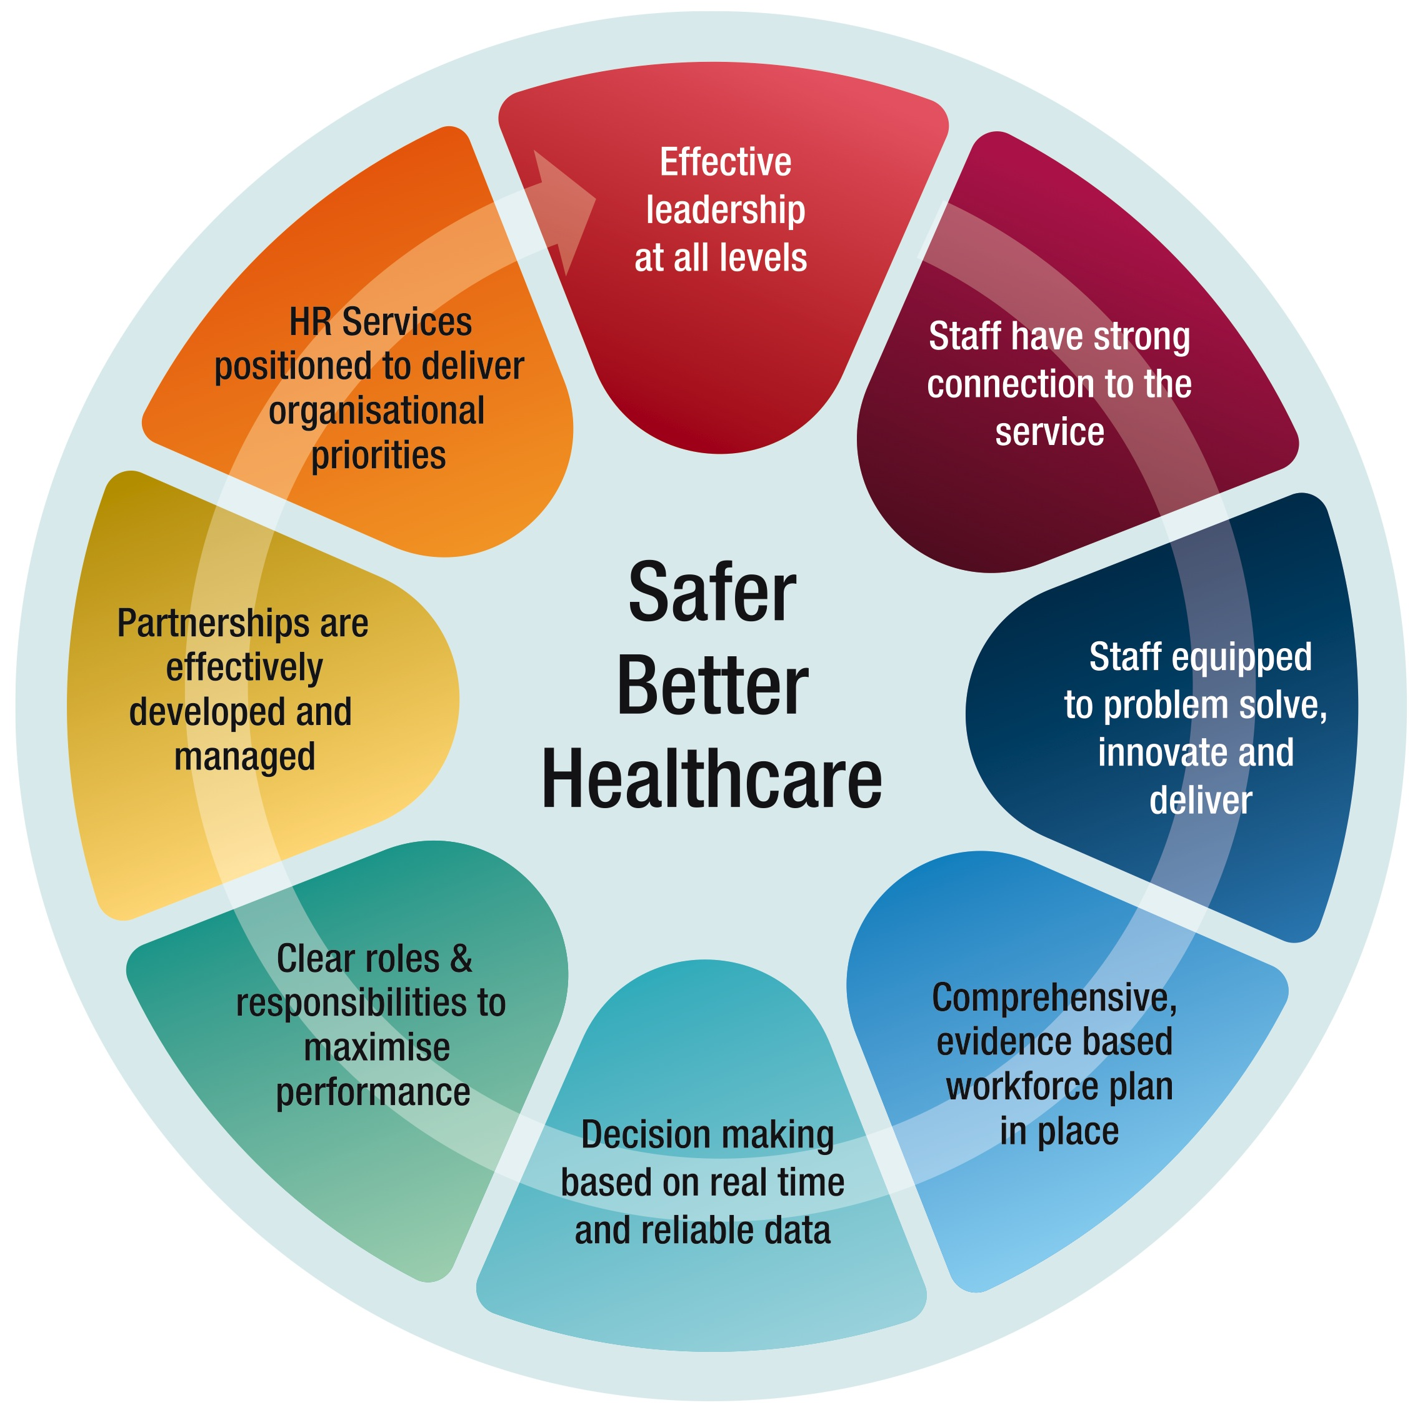

Slide 16
The People Strategy outcomes describe what can be achieved and what can be reliably demonstrated or measured at the end of the Strategy implementation process. Adopting this approach supports our ambition
and challenges the whole organisation to deliver on a common agenda
Relentless implementation / tracking of progress

Slide 17
Members of the HR Leadership Team are taking lead responsibility to
drive and support implementation.
The approach to implementation will be strongly based on partnering
with all the Divisions and with managers and staff within the CHOs, Hospital Groups, PCRS, National Ambulance Services and across the system to ensure ongoing relevance taking a joined up approach to the delivery of the strategic priorities.
We will also be working closely with the System Reform Group
on monitoring implementation of the Strategy.

