Slide 1
Home FIRsT : One Year On
Aoife Dillon
cAdvanced Nurse Practitioner
Older Persons

Slide 2
Role Profiles
cANP for Older Persons -15 years working in Acute & Ambulatory Older Persons Care
Clinical Specialist Physiotherapist – 13 years in SJH incorporating Stroke/Rehab/Older Persons Care
Clinical Specialist Occupational Therapist – 9 years experience & Specilisation in Older Persons Rehabilitation
Senior Medical Social Worker - 23 years in SJH incorporating all specialities/management

Slide 3
Background
Recommended implementation of admission avoidance services and dedicated tailored care of the oldest old in emergency settings
(Kenny & McGarrigle, 2017)

Slide 4
Home FIRsT Aim
Identify
Identify Frailty in ED
Every hour counts ethos
HSCP
Time
Timely decision-making & commencement of appropriate treatment/referral pathways
Assessment: medical, physical, cognitive, functional & social care needs

Slide 5
Cross-directorate work
MedEL
ED
HSCP

Slide 6
Bringing care closer to the patient
Emergency Department
Primary Care
Day Hospital & Ambulatory Care

Slide 7
N = 2,505

Slide 8
Outcomes

Slide 9
Medicine for Older Persons Discharges
Increased workload of ambulatory care services -especially the Day Hospital - without additional services

Slide 10
Primary Care Discharges

Slide 11
The hospital readmission rate of similar patients is 13% over the same time period

Slide 12
Admission Avoidance
Between 1-2 admissions a day prevented
Bed day savings over 1 year-
4,500 - 6,000 days
Notional financial saving
-approx. €6 million euro
>75s | % admitted from ED
Triage category 2-3 (2015-16) | 61%
Triage category 2-4 (2015-2016) | 47%
Home FIRsT patients | 38%

Slide 13
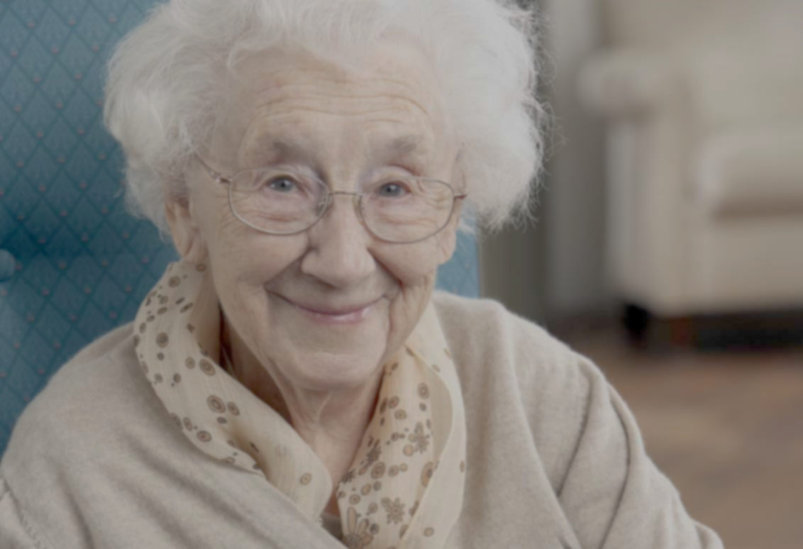
Case Study
97 year old lady
BIBA following injurious, unwitnessed fall (head injury)
Lives with her daughter who works as a HCA
Moved from her home in Kerry 5 years ago
No formal supports, not known to Primary Care
MDT work up
Facilitated D/C from ED with OT outreach visit next day & MedEL OPD 6/7 later

Slide 14
Reflections
Home FIRsT is now embedded in
SJH ED
Interdisciplinary working is essential to achieve the best outcome for patients
When team staffed by senior decision makers daily Geriatrician contact not required
Competence & experience in Older Persons Care
Different from other teams – role profiles & support structures

Slide 15
Future Directions
Continued collaboration
between ED, MedEL & SCOPe
directorates within the hospital is
required to sustain the service
Integration & interdisciplinary
working in the community is imperative
for the longer term development of services for Older People

