Slide 1
Emergency Department Taskforce Unscheduled Care Forum
“Perspective from the Frontline”
Enablers for Improvement - RCSI HG
04 Sept
18
RCSI HG
ACCESS
bit of a ramble, rather than a “case study”
IAN CARTER

Slide 2
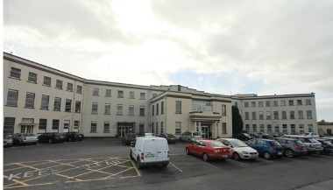
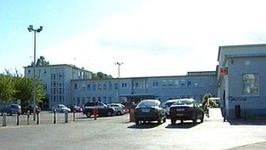
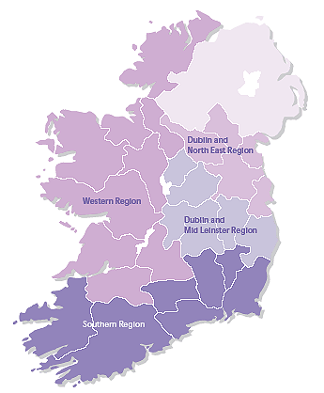
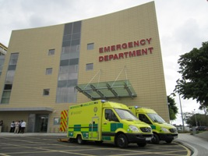
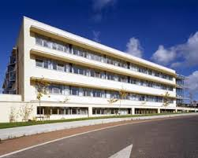
just in case anybody is unsure
Monaghan Hospital
Cavan General Hospital
Louth Hospital
Beaumont Hospital
OLOL (Drogheda)
Rotunda Hospital
Connolly Hospital
+ Academic Partner
Royal College of Surgeons

Slide 3
Context - change factors (to be managed) to effect performance / quality improvement
- 4 “C”s - with obvious overlap
CLINICAL PERFORMANCE
CAPABILITY
CULTURE
CAPACITY
CONTROL
CLINICAL
QUALITY
Focus - today
➔ Actions
➔ Outcomes
➔ what works / what doesn’t
➔ next steps
BUDGET
More with More ➔ More with Less ➔ Less with Less (continuum)

Slide 4
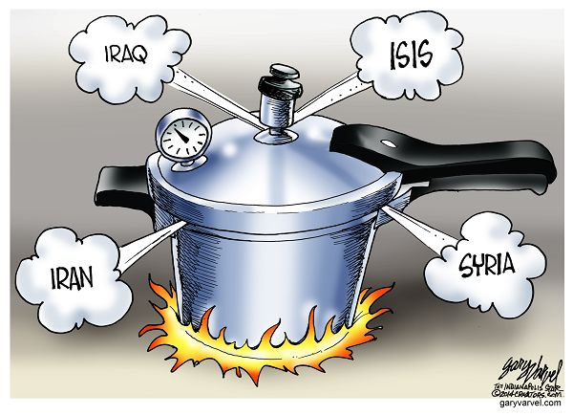
Context
Clinical activity - (ED) - key impactors
Activity | 2015 | 2016 | 2017 | 2015 /2016 |  | 2016 /2017 |  |  | Jan - July 15 | Jan - July 18 | Jan - July 2015/2018
 |  |  |  | Val Var | % Var | Val Var | % Var
 |  |  |  |  |  |  |  |  |  |  | Val Var | % Var
ED New Attendances | 154,778 | 167,306 | 174,821 | 12,528 | 8% | 7,515 | 5% |  | 88,989 | 105,594 | 16,605 | 19%
Emergency Admissions | 67,936 | 72,885 | 74,164 | 4,936 | 7% | 1,279 | 2% |  | 38,750 | 42,562 | 8,812 | 10%
Historic (2015)
➔poor ED access wait time / volume
➔multiple patients routinely waiting >24 hours
➔diminished capacity to treat elective patients and resultant increasing long waiting times
➔poor patient experience
➔ever increasing presentations / admissions
CONTROL
CAPACITY
PRESSURE COOKER
CULTURE
CAPABILITY

Slide 5
Actions / Enablers (2016 - 2018)
considered across the 4 dimensions: Capacity / Capability / Culture/ Control
usage of under utilised facilities, particularly theatre / diagnostics (endoscopy) capacity
Raheny, Connolly, Louth, Cavan
as such considering Hospital Group as an integrated singular capacity construct with limited barriers to patient flow / staff movement ➔ 1 empire not 7
containing patient flow within a specialty control framework i.e. complex / simple
develop ambulatory alternative and additional capacity across multiple sites (elective / non - elective)
Gynae - Connolly Hospital (1140 attendances annually)
Plastics (Trauma) - Connolly Hospital (769 attendances annually)
Vascular - Louth (3-5 patients weekly)
Actions to increase / maximise usage of all available capacity
Capacity
➔ more from a combined whole than separate parts

Slide 6
Actions to increase / maximise internal HG capability
Capability
Focus Beaumont Hospital
admission alternatives
ambulatory / OPD / FIT assessment / MIT
enabling reduction in admission conversion (29% ➔ 26%)
2018: 2.5% reduction in ED admissions despite 6% increase in ED attendances
patient processing
admission identification / alternative pathway - much consultant directly delivered
specialty patient ➔ specialty consultant ➔ specialty ward
➔ specialty alternative ambulatory
➔ specialty OPD
early discharge
early identification of PDD (however ALOS @ 7 days)
twice weekly pan - hospital review of patients LOS > 7 / 10 days
enhanced ability to progress patients requiring LTC / HCP - but still delays

Slide 7
Actions to increase / maximise internal HG capability
Capability
Focus on Hospital Group
develop of specialty provisions whereby sites provide complimentary and supportive service delivery rather than parallel segregated service delivery
➔ Beaumont Hospital complex surgery .v. Louth / Cavan short stay simple surgery
Connolly short stay surgery
Connolly trauma orthopaedic surgery .v. Cavan (bypass)
OLOL trauma / complex surgery .v. Louth Day Care

Slide 8
Actions to maximise performance
Control
creation of formal specialty patient pathways across multiple sites
creation of formal movement of specialty surgical capability to across multiple sites capacity
overall control tight (not a democracy)
bed access / usage function held centrally, actual service delivery held within directorates
access / wait time targets set by hospital seen as important in relationship to directorate / hospital performance
targets simple and realistic not desirable

Slide 9
Actions to maximise performance
Control
focus on target achievement rather than describing efforts and energies
focus on access times rather than pure volume productivity
Internal / external publication of performance - with clear accountability identification across all levels
singular approach to emergency and scheduled care rather than commonly exhibited segregated programmatic approach - requirement to achieve on both (each as important from a patient perspective)
investment based on measurable performance metrics, maintenance of investment based on maintenance of performance

Slide 10
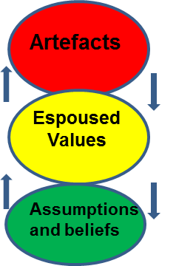
Actions to maximise performance
CULTURE
shift of paradigm of “all external problems requiring external solutions” to “external and internal problems, both requiring external and internal solution / correction” (assertive .v. passive)
whilst innovative solutions ideas incorporated, not always following HSE corporate dictates
performance of hospital held to be very important
open disclosure internally, as to performance in terms of publication – (good or bad results)
internal accountability (yes) but no finger pointing / report card writing / blaming / escalating - focus on identifying and solving rather than describing

Slide 11
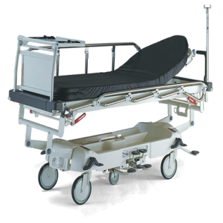
Emergency Department - focus Beaumont Hospital
Performance 2015 / 2016 / 2017 / 2018
16 / 15 - 23% reduction ED Trolley wait 08:00 (n=2064)
ave count 2016 19 / ave count 2015 25 - 24% reduction
18 / 15 74% reduction ED trolley wait 08:00 (n=3958)
ave count 2018 7 / ave count 2015 25 – 74% reduction
17 / 15 57% reduction ED trolley wait 08:00 (n=5131)
ave count 2017 11 / ave count 2015 25 - 56% reduction
Non admitted wait time 2018 (ave) 5.42hrs (2015 – 6.02hrs) - 6% reduction
Admitted wait time 2018 (ave) 12.42hrs (2015 – 21.3hrs) - 40% reduction

Slide 12
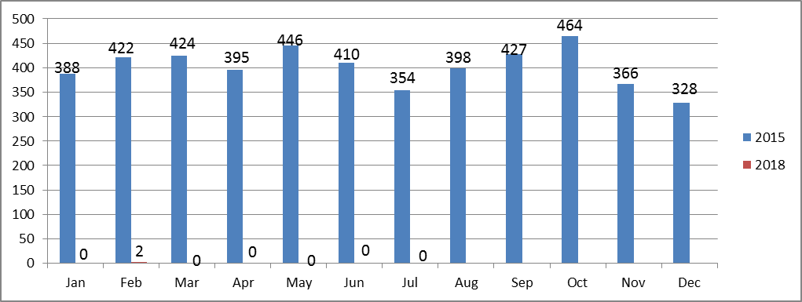
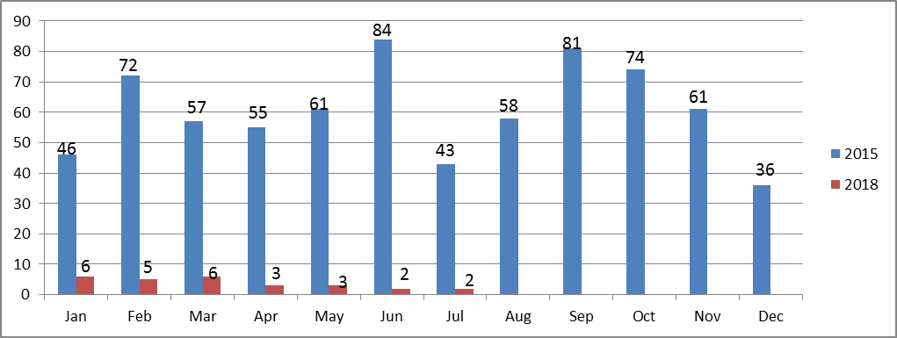
Emergency Department– focus Beaumont Hospital
Performance - January - July 18/17
PET> 24 hour ED breaches reported at 8am per month
focused effort to reduce > 24 hour waits
“zero tolerance” approach
improvement demonstrated
99% cumulative reduction YTD July - (2015 v’s 2018)
Discharges from ED - PET > 24 hrs
focused effort to admit + accommodate or discharge
“zero tolerance” approach
improvement demonstrated, but problem not totally removed
- 94% cumulative reduction YTD July - (2015 v’s 2018)

Slide 13
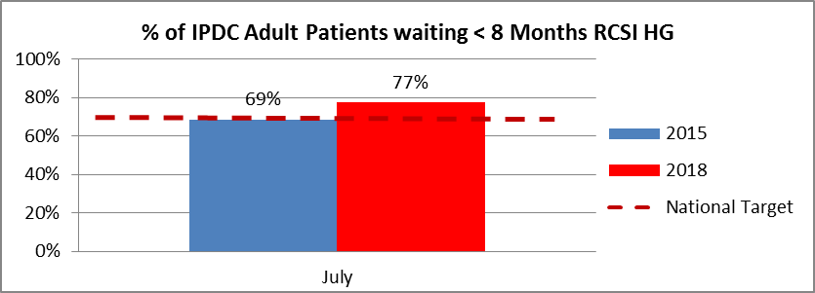
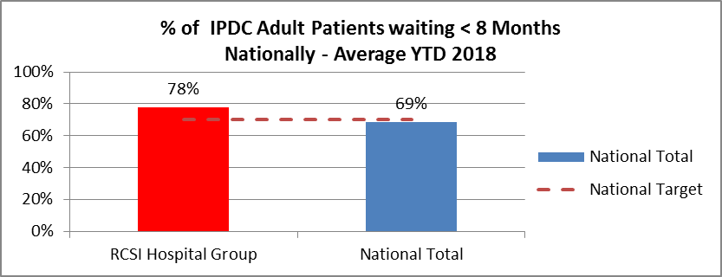
Inpatient / Day Care Elective Access – RCSI HG
Performance
➔focused approach to minimise wait time
experienced as apposed to simply increasing activity, but recognising additional treatment requirement
➔target drive < 8 months - achieved through internal treatment additionality rather than external
RCSI HG exceeding 2018 national target (improving on 2015)
National Performance by Hospital Group Comparator
4.1% increase elective IP.DC treatments for Beaumont 18/17 YTD (n=1720)
RCSI HG exceeding 2018 national performance

Slide 14
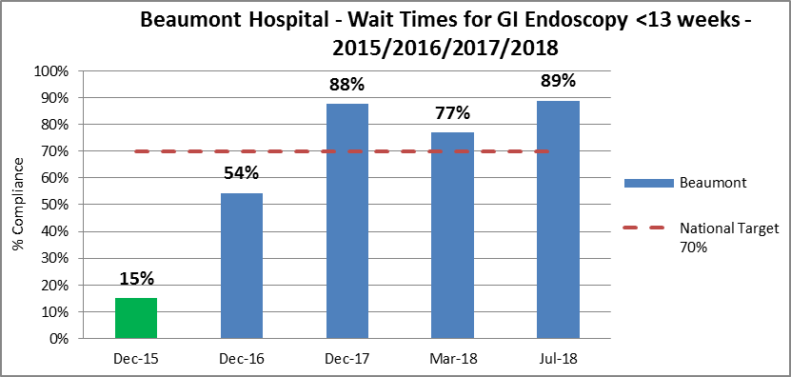
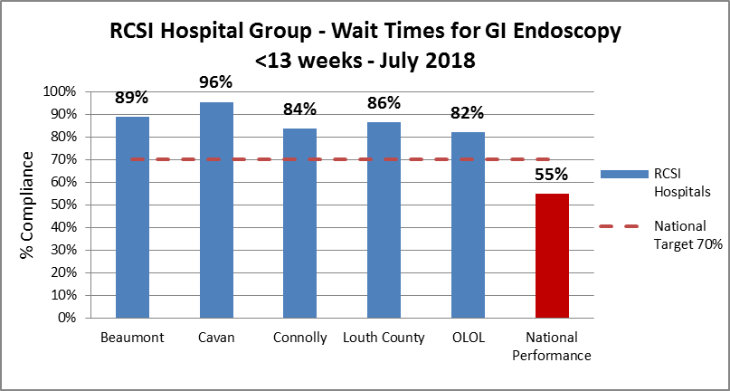
Endoscopy - focus reduce wait time rather than treatment volume increase
Performance
Beaumont / OLOL / Connolly ➔insourcing ➔ Cavan / Connolly 5877 procedures - 2016 / 2017 / 2018

Slide 15
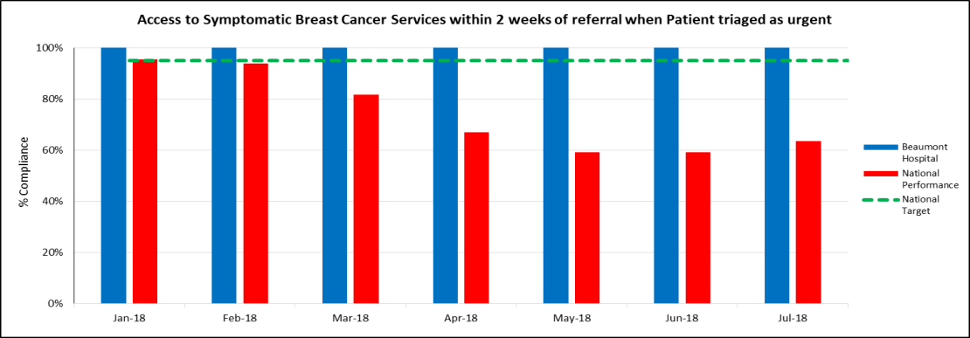
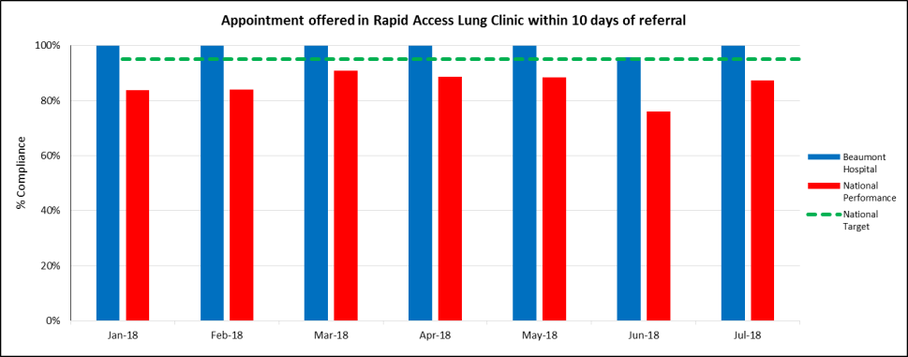
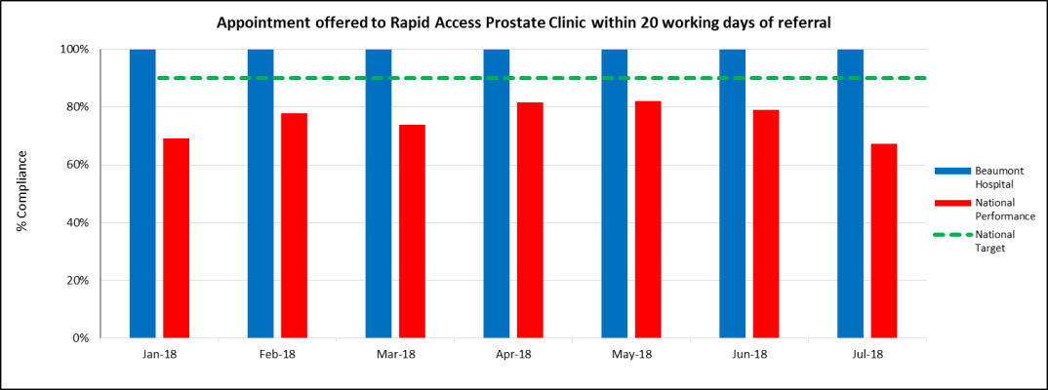
Rapid Access - Beaumont Hospital Cancer Clinics 2018
Beaumont Hospital (100%) / National Performance (63.6%)
Beaumont Hospital (100%) /National Performance (87.3%)
Balance Score Card approach
Beaumont Hospital (100%) / National Performance (67.4%)

Slide 16
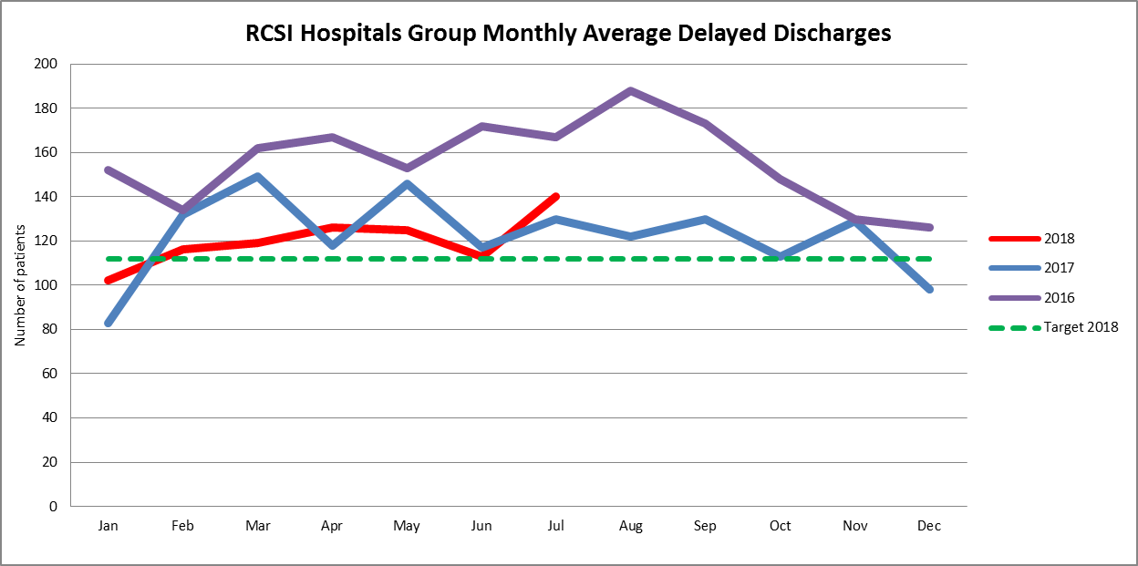
Delayed Discharges
Performance
4% reduction 2018 / 2017 YTD (8% increase Jul-18 vs Jul-17)
however 2018 monthly average 3640 acute bed days not available for acute patient occupancy
equivalent to treatment of 607 patients monthly (based on 6 day ALOS) - 4249 ytd
(14 days total activity equivalent for HG)

Slide 17
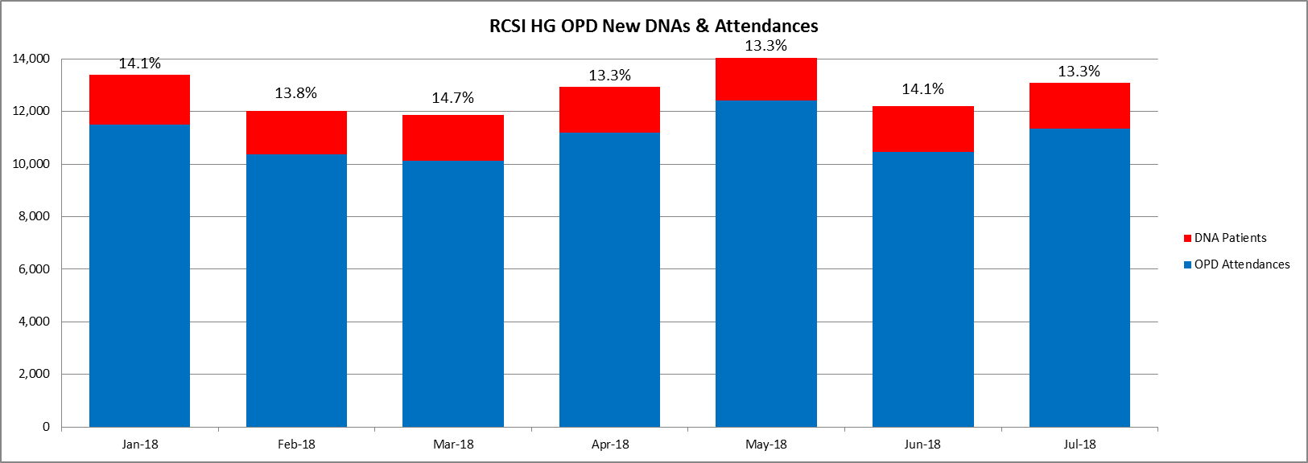
Percent ‘Did not attend’( DNA) of total OPD bookings
Performance
during July 1,745 patients did not attend new scheduled appointment
total DNA value YTD = 43,086
is there a corollary between DNAs and ED new attendances in regard to how patients access the health system?

Slide 18
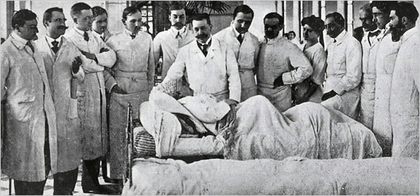
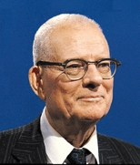
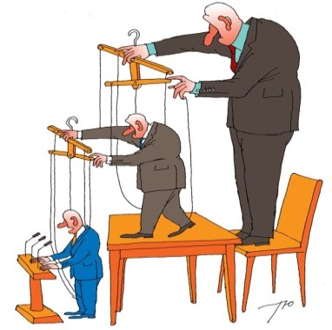
7 Themes
“Are you Rounding twice a day”
Deming (incorrect attribution )
“you can't manage “it” unless you can measure it”
Has become
“If you can’t successfully manage “it’’ then measure very often and exhaustively
Over focus on process description and subsequent validation on whether “process” is being adhered to - rather than outcomes
(2017)
“Heads Will Roll”
(2015)
Dis-enablers
to improvement
belief that solution lies mainly in capability rather than capacity
“crisis is not solely due to lack of money”
Centralised & hierarchical control of operational policy / practise
(2018)
New laws to penalise hospitals for breaking waiting times
(2018)
Application of multi million euro fines (SDU) - €64.19m
(2016)
“Punish poor performing HSE managers”
(2017)

Slide 19
Ending thoughts
further performance improvement / maintenance not possible if ED activity continues to increase
> 98% bed occupancy creates significant dysfunctionality by itself
performance improvements have been achieved, however access times to bed remain too long
given nature of patient presentation i.e. > 75% exacerbation of chronic disease, alternative management model to current (hospital centric) approach needed - this applies to both inpatient and OPD
“standing still” capacity / capability investment needed, as well as parallel funding for a ‘alternative care model’ (community centric)-
problem remains, no designed actual alternative model (in enough detail) that can be described, funded and implemented - continue to talk, but no meaningful algorithm
No CDM DIY book in the HSE library

Slide 20
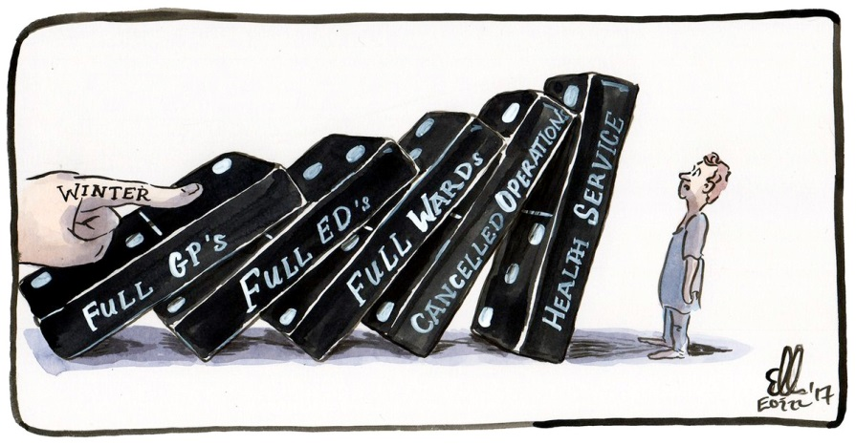
Winter Plan - Status
plans relating to “Winter” requiring “approval” - still not approved
additional funding, where identified, still not agreed / rejected
- bed opening has a lead in time
any target must be realistic, rather than desirable
need consistency in community provision in relationship to LTC / HCP - already examples of services curtailment
short term reactive planning to specific periods of the year, cannot continue to be the solution, (Q1 2018 would be the proof of this)
is the Task Force the ongoing appropriate control solution
no real new practices or ideas, beyond a recognition for alignment and full functionality of necessary capacity, capability and control within HG and CHO
discourse “needs to avoid bombast, insult and outrage” but still contained within an accountability framework (Obama 04.09.18)
should we still be discussing “Winter Planning” when the problem manifests throughout the year

