Slide 1



HSE ACUTE HOSPITALS
Update Only COVID-19
Practical Advice for Healthcare Professionals
ED & Ward
5th May 2020 Version 4update)

Slide 2


1. Accessing the latest information on COVID-19
2. Distancing for staff in hospital
3. Older Person – Symptoms
4. Obesity as a risk factor
5. INEWS - The need for accurate assessment of respiratory rate, O2 saturation levels and increasing O2 requirements
6. VTE Prophylaxis Protocol
7. Managment of Hypotension on the Ward
8. The use of the prone position
9. Respiratory management when escalated to Resus / ICU
10. COVID-19 and CPR
11. Current clinical trials and update on use of experimental antiviral medication
This update includes information on:
AIM
This presentation aims to provide healthcare professionals with safe supportive information that has been updated since COVID-19 Practical Advice for Healthcare Professionals was circulated (20th March 2020).

Slide 3
All healthcare professionals who work in the acute hospital setting involved in care of patients ≥ 16 years
This guidance is effective from
5th May 2020 but may be amended depending on emergence of data and the evolving situation
AUDIENCE

Slide 4

The situation in Ireland with COVID-19 is evolving rapidly.
The latest information regarding: a) Epidemiology, b) Infection prevention and Control guidance (COVID-19) c) Who to test? is available from the Health Protection Surveillance Centre at https://www.hpsc.ie/
1. ACCESS TO LATEST COVID-19 INFORMATION (HPSC)

Slide 5

The Department of Health has published guidance around ethical consideration for PPE use by healthcare workers in a pandemic.
This ethical guidance considers to what extent health care workers have an obligation to provide, or participate in the provision of, a medical intervention where there are constraints on supplies of PPE.
The paper highlights that different procedures involve different levels of risk, and risk will vary between healthcare workers depending on the possible intensity of any exposure and will include personal factors such as certain pre-existing conditions which may put them at an increased risk of serious complications should they contract COVID-19).
This paper can be downloaded here or by copying the following address into your browser:
https://www.gov.ie/en/publication/58d3de-ethical-considerations-for-ppe-use-by-health-care-workers-in-a-pande
1a. Ethical Considerations for PPE Use by Healthcare Workers in a Pandemic

Slide 6
1b. ACCESS TO COVID-19 INFORMATION (HSE)
The HSE have developed a repository for Interim Clinical Guidance intended for the Clinical Community
This site provides a national accessible repository of clinical guidance and latest research evidence to respond to Covid-19.
The content of the site is not meant to replace clinical judgment or specialist consultation. The guidance will be updated as the situation changes.
Please click here or copy this link into your browser
https://hse.drsteevenslibrary.ie/Covid19V2

Slide 7
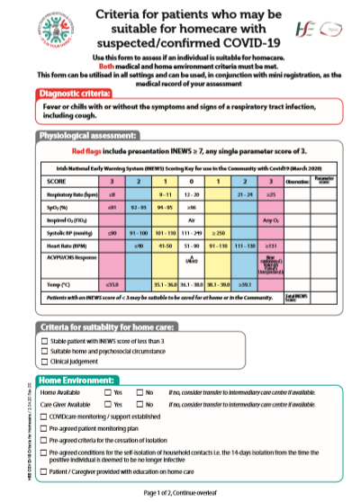
1c. Support Tools Available
In order to determine where and how treatment may be best provided, the following tools may be useful and can be downloaded from the HSE Repository:
Homecare Decision Tool
https://hse.drsteevenslibrary.ie/ld.php?content_id=32820788
Self Care Support Advice https://hse.drsteevenslibrary.ie/ld.php?content_id=32817781
Clinical Decision Tool (Adult)
https://hse.drsteevenslibrary.ie/ld.php?content_id=32809812
Maternity Clinical Decision Tool
https://hse.drsteevenslibrary.ie/ld.php?content_id=32855969

Slide 8



2. SOCIAL DISTANCING AT WORK
It is important that healthcare workers keep to a distance at work of 2m when having lunch, coffee breaks etc. Surgical masks should be worn by all healthcare workers for all encounters, of 15 minutes or more, with other healthcare workers in the workplace where a distance of 2m cannot be maintained.
2M
https://www.hpsc.ie/a-z/respiratory/coronavirus/novelcoronavirus/guidance/infectionpreventionandcontrolguidance/ppe/useofsurgicalmasksinhealthcaresetting/

Slide 9





In older persons, common symptoms may or may not be present and could also include:
CONFUSION
LETHARGY
LOSS OF APPETTITE
UNEXPLAINED CHANGE IN
BASELINE CONDITION
3. WHEN TO SUSPECT COVID-19
in the older person
OTHER SYMPTOMS

Slide 10

4. OBESITY and COVID-18 Disease Severity
There is emerging evidence that obesity may be linked with COVID 19 disease severity.
This is important to consider given the prevalence of obesity in Ireland (23% adults overall, 34% aged 65-75, 28% over age 75)
For advice on managing COVID-10 positive patients please refer to the Guidance from the National Obesity Management Clinical Programme at the HSE repository
https://hse.drsteevenslibrary.ie/c.php?g=679077&p=4845309

Slide 11
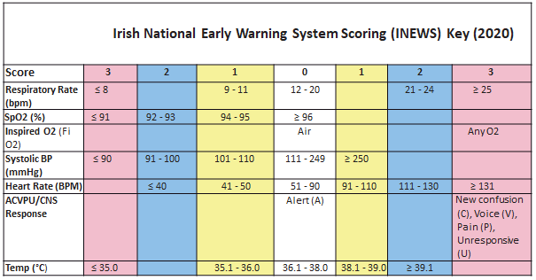

5. INEWS & Covid-19
INEWS is a validated prediction tool for clinical deterioration. Its usefulness is dependent on the accuracy of observations monitoring.
Key early signs of deterioration in ALL patients are:
A change in respiratory rate; RR should be counted for a full 60 seconds every time
A new requirement for supplemental oxygen
An increasing oxygen requirement to sustain SpO2 levels
New confusion/altered mental status
Note : A pyrexia > 38˚C can be associated with Covid-19 presentations
A patient’s INEWS score and/or parameters MUST NOT be amended; what may be amended is the medical response to care

Slide 12
5a. Escalation & Response using INEWS
Consider critical care advice for a deteriorating patient with INEWS ≥ 5
Critical care review for INEWS ≥ 7
Do not offer critical care to patients in advance of critical care review
The final decision on admission to critical care rests with the duty Consultant Anaesthesiologist / Critical Care Physician

Slide 13

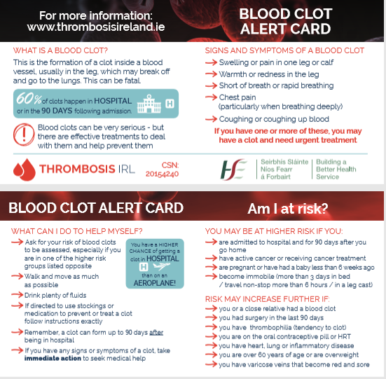
6. VTE Prophylaxis Protocol
For HSE VTE Prevention protocol visit the HSE repository here or copy the following into your browser: https://hse.drsteevenslibrary.ie/Covid19V2/emergencydepartment#COVID19 Interim Clinical Guidance - VTE protocol and patient information for acute hospitals (CD-120 V1 / 21.04.20)
Alternatively, adapt local VTE prevention protocol to include COVID recommendations
Give information to people with COVID and all hospitalised patients about VTE risk, signs and symptoms and what to do. (Use either local leaflets or Alert cards)
Have the PROTOCOL IN PLACE AND FOLLOW IT

Slide 14

7. Managing hypotension in ward setting
Conservative fluid management strategy is recommended
Consider peripheral phenylephrine while awaiting critical care input
Consider Echo as a guide for fluid management / diuretics

Slide 15


8. Patient
Proning on the
Ward
Prone positioning in patients with moderate to severe ARDS on IPPV has been shown to improve survival and prone ventilation is recommended in international guidelines for the management of COVID-19 related ARDS.”
Department Critical Care (EMCrit). 2016. PulmCrit Wee- Proning the non-intubated patient. Retrieved from
https://emcrit.org/pulmcrit/proning-nonintubated/ [Accessed 10th April, 2020]
Given the improvement in mechanically ventilated patients, it has been postulated that adopting the prone position for conscious COVID-19 patients requiring basic respiratory support, may also benefit patients in terms of improving oxygenation, reducing the need for invasive ventilation and potentially even reducing mortality.

Slide 16
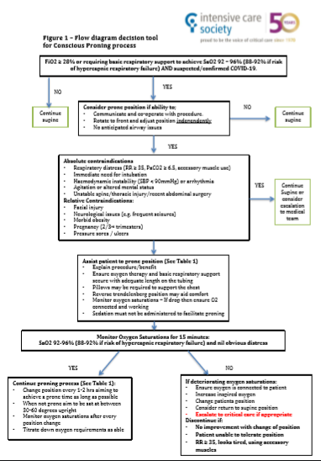
8a. Patient
Proning on the Ward
(Algorithm from ICS)
Available to download from: https://www.ics.ac.uk/ICS/Pdfs/COVID-19/Guidance_for_conscious_proning.aspx

Slide 17

9.
The following guidelines have been developed by the National Clinical Respiratory Programme and the Irish Thoracic society and should be used to inform subsequent respiratory management of patients
with COVID-19 who have been escalated for resuscitation or ICU level care.
Download available from:
https://hse.drsteevenslibrary.ie/Covid19V2/respiratory#appendix1%20021
PAGE 1

Slide 18
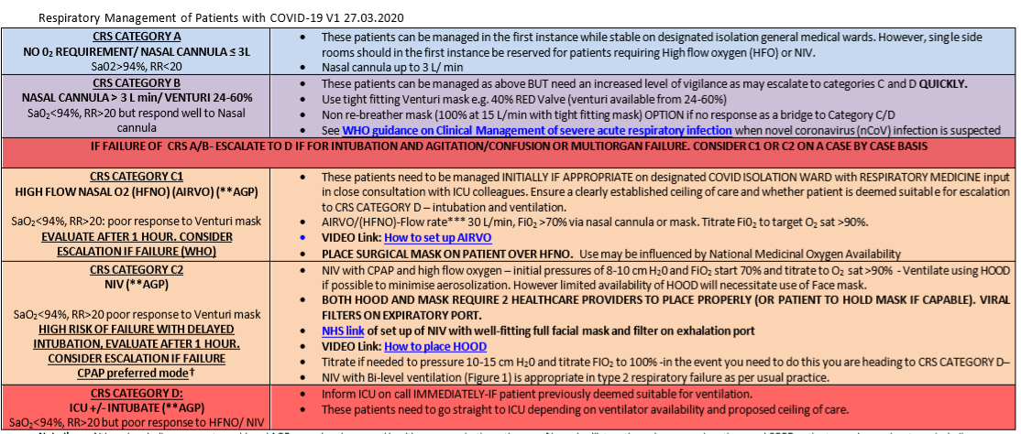
PAGE 2

Slide 19
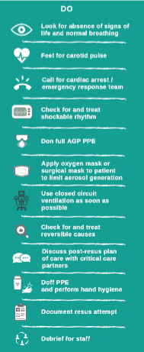
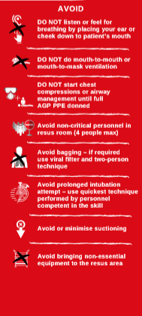

10. In-hospital
Cardiopulmonary
Resuscitation (CPR) for Suspected / Confirmed COVID-19 cases
Download infographic at
http://hse.drsteevenslibrary.ie/ld.php?content_id=32825294

Slide 20

11. Current Clinical Trials in Ireland
Research is being published almost daily on the use of different antivirals for COVID-19 at different stages of disease progression.
For up to date guidance please see the National Guidance Document at: https://www.hse.ie/eng/about/who/acute-hospitals-division/drugs-management-programme/
The administration of any antivirals must be by direction of Infectious Disease / Consultant Microbiologist and ideally within a clinical trial

Slide 21
9a. Current Clinical Trials in Ireland
WHO SOLIDARITY TRIAL
REMAP-CAP
Full Details are included in the full education update on the HSE website here
or at https://hse.drsteevenslibrary.ie/Covid19V2/emergencydepartment
The administration of any antivirals must be by direction of Infectious Disease / Consultant Microbiologist and ideally within a clinical trial

Slide 22

Summary
Anticipate and Monitor for Deterioration
Early Critical Care input is key - they’ll be busy so use INEWS & ISBAR
Personal Safety is essential -IPC & PPE is your safe guard
Evidence on COVID-19 is evolving rapidly; keep up to date by accessing the HSE COVID-19 repository regularly.
Please click here or copy this link into your browser: https://hse.drsteevenslibrary.ie/Covid19V2

Slide 23
Dr Vida Hamilton Consultant Intensivist and National Clinical Advisor and Group Lead (Acute Hospitals)
Prof. Colm Bergin Clinical Lead (Interim), Infectious Diseases, HSE
Dr Yvonne Smyth Consultant Cardiologist Clinical Co-Lead National Acute Medicine Programme
Dr John Bates Consultant Intensivist Dean, Joint Faculty of Intensive Care Medicine of Ireland
Avilene Casey Lead for National Deteriorating Patient Recognition & Response Improvement Programme (DPIP)
Dr. Miriam Bell Project Lead, National Early Warning Systems Guidelines (DPIP)
Ciara Hughes Interim PM (NCAGL Acute Operations) Programme Manager - Sepsis & DPIP
Dr Des Murphy Clinical Lead for the Respiratory Programme
Susan Curtis Respiratory Programme manager
Josephine Galway Director of Nursing ( AMRIC)
HPSC Prof Martin Cormican and the team at the Health Protection Surveillance Centre
Acknowledgements

Slide 24
National repository of clinical guidance and latest research evidence to respond to Covid-19.
Please click here or copy this link into your browser : https://hse.drsteevenslibrary.ie/Covid19V2
Health Protection and Surveillance Centre. www.hpsc.ie website for latest updates on Infection Prevention and control, Guidance , risk assessments etc. Please visit www.hpsc.ie, click here or copy this link into your browser : https://www.hpsc.ie/a-z/respiratory/coronavirus/novelcoronavirus/
Clinical management of severe acute respiratory infection when novel coronavirus (nCoV) infection is suspected. Interim guidance 13th March 2020 Publication Click here https://www.who.int/publications-detail/clinical-management-of-severe-acute-respiratory-infection-when-novel-coronavirus-(ncov)-infection-is-suspected https://bestpractice.bmj.com/topics/en-gb/3000168/guidelines https://www.bmj.com/coronavirus
ECDC: European Centre for Disease Prevention and Control: https://www.ecdc.europa.eu/en
Useful Resources

Slide 25


