Slide 1
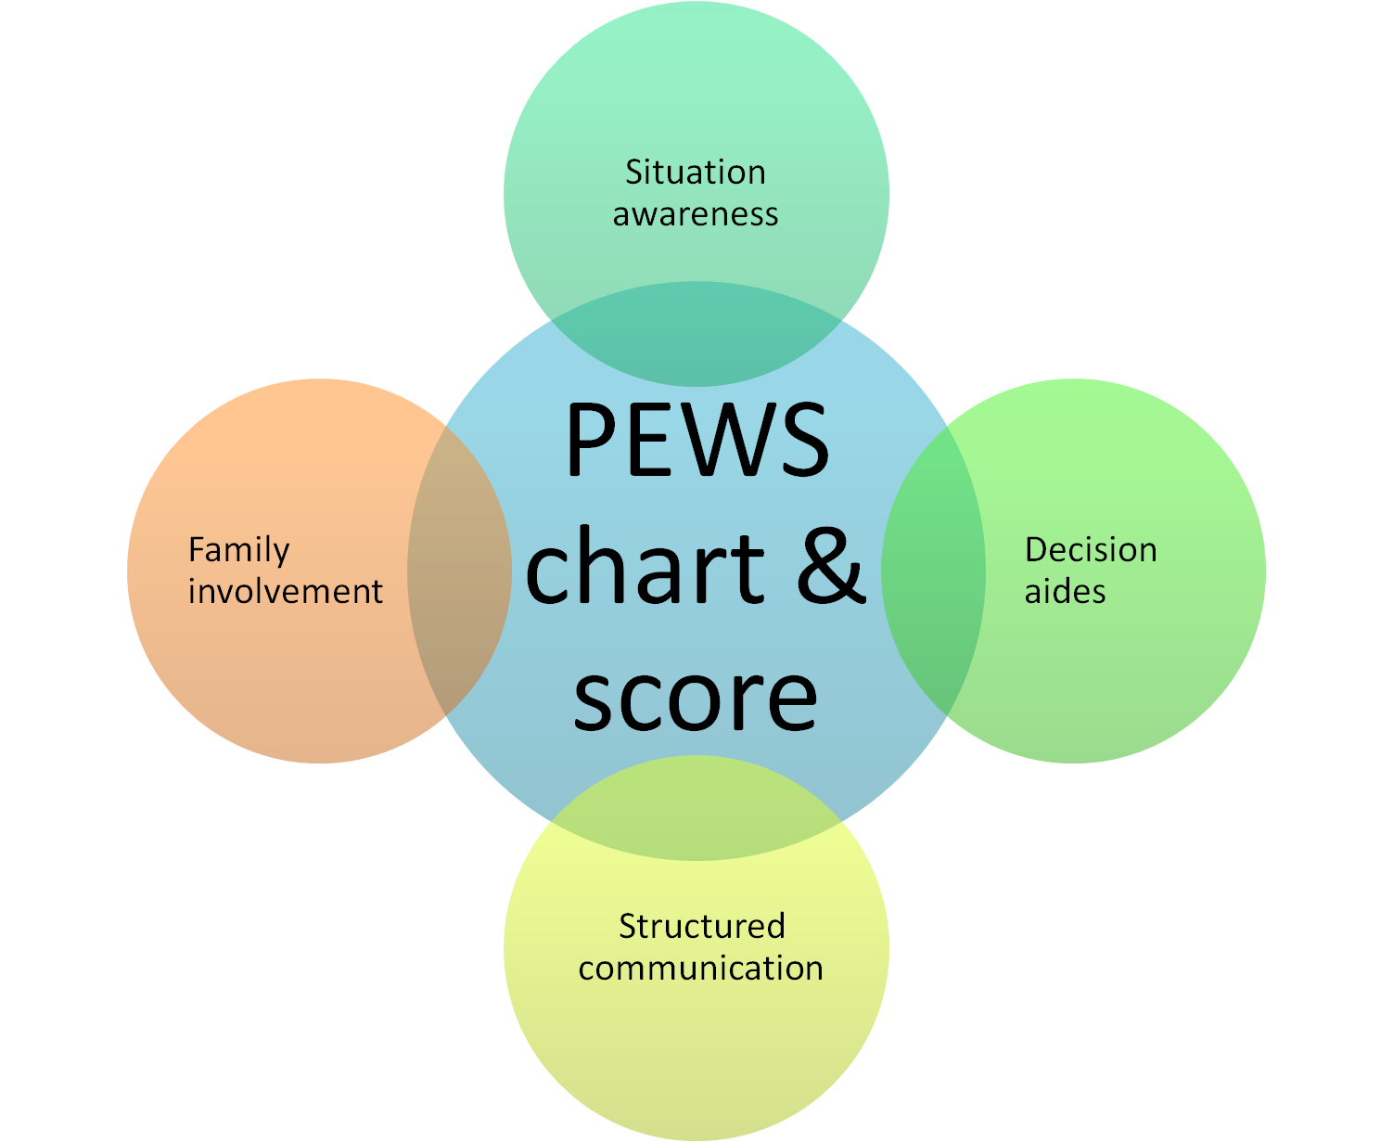




Irish Paediatric Early Warning System (PEWS)
Update No 1 May 2023 to align with National Sepsis Guidance 2021
Update No 2 April 2024 Pews Train the Trainer Programme
Notes:
This slide set represents a national template for PEWS training and as such, reflects a national standard in practice.
Additions should be made to these slides to reflect local arrangements/resources.

Slide 2
Learning Outcomes
By the end of the session, you will be able to:
Discuss the importance of clinical judgement and individualised assessment
Discuss the use of PEWS in clinical practice
Identify PEWS documentation
Demonstrate effective use of PEWS charts
Discuss the appropriate use of variance within PEWS

Slide 3
Aim of PEWS
Assist recognition and response to deterioration
PEWS system
PEWS escalation
Paediatric observation charts
Notes:
The overall aim of the PEWS system is to...

Slide 4
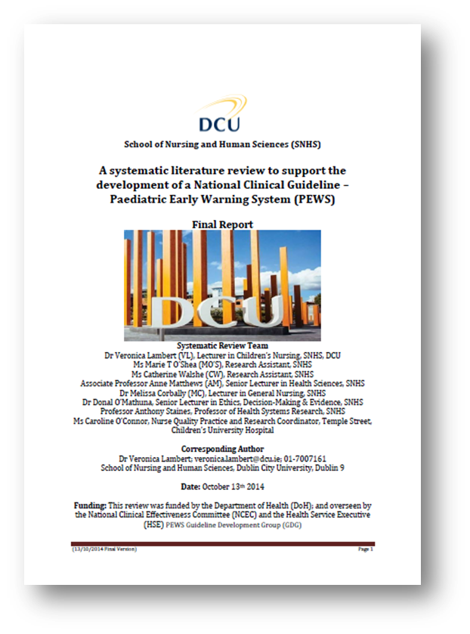

Why PEWS?
Systematic review of 11 clinical guidelines & 70 research articles
Grey literature review & interviews
Review of detection & response systems, implementation & economic impact
“positive directional trends in improving clinical based outcomes”
“there is no consensus and limited evidence about which PEW system is most useful or ‘optimal’ for paediatric contexts”
Notes:
This slide is for trainer use and may be hidden during delivery of local PEWS education.

Slide 5
PEWS is...
PEWS
chart & score
Team work & Communication
Decision aides
Situation Awareness/ Clinical Judgement
Family Involvement
Notes:
PEWS is dependent on a number of critical factors and not any single element alone.
At the heart is a national standard observation chart with integrated scoring tool which is intended to prompt action, never to reassure or encourage step down care
Teamwork is promoted and communication enhanced through the use of standardised format for clinical conversation, ISBAR
Decision aides exist in the form of clinical prompts on the chart and the Paediatric Sepsis 6 plus the escalation guide to provide a clear pathway to senior colleagues or a higher level of care
Situation awareness for clinical judgement is enhanced through looking at the whole child observations and keeping team members informed of changes in the child’s condition
Family involvement is deeply encouraged through the concern parameter. Communication with families should be open, PEWS should be part of that observation and families encouraged to report any worries about a child’s condition.

Slide 6


PEWS is not…
PEWS does not replace:
  Emergency response
  Clinical concern
Notes:
Be clear that your site’s emergency number and team remain in place and should ALWAYS be called if there is an impending emergency. LOCAL SLIDES MAY BE INSERTED TO REFLECT LOCAL PROTOCOLS.
PEWS should never prevent action. PEWS should prompt action if the clinician is not sure. Always be mindful of the clinical presentation of the child and your own clinical judgement, do not be put off escalation if the PEWS is lower than expected. The child who is not improving may be the next child to deteriorate.
PEWS is just a tool and therefore it is up to the user to make best use of the tool.
PEWS will trigger if a child is demonstrating haemodynamic disturbances but may not detect a child who is sick from other causes or who is compensating within normal physiological limits or tiring and within acceptable limits but their general presentation/condition should be concerning.
This is a KEY POINT and must be reiterated continuously!

Slide 7
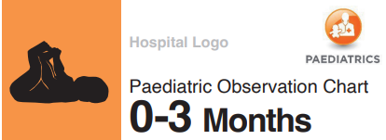
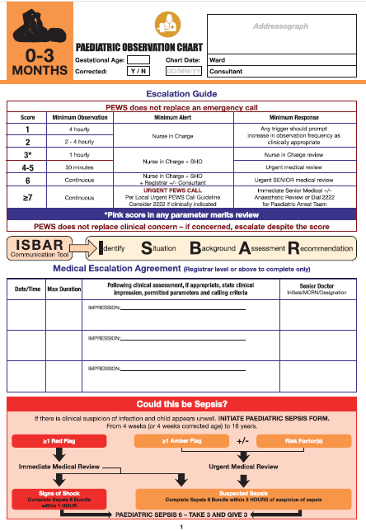




Paediatric Observation Charts
To: 12 weeks or 12
corrected weeks
Use this chart for gestationally corrected infants up to 12 weeks corrected age e.g. 24/40 ex-prem born 18 weeks ago is corrected to 2/52 will be on this chart until he is 28 weeks of age (12 weeks corrected age)
From: 12 weeks,1 day
To: eve of the 1st
birthday
From: 1st birthday
To: eve of the 5th
From: 5th birthday
To: eve of the 12th
birthday
From: 12th birthday
To: eve of 16th birthday or local policy
As per paediatric model of care, 16 is the cutoff age for paediatrics but this may vary between national settings
Notes:
There are 5 age-specific charts for use in the paediatric setting, ranging from 0-3 months of age to over 12 years.
0-3 months is for the infant presenting to a paediatric inpatient setting (not postnatal, not SCBU, not NICU) until the infant is 3 months of age (by DOB) or until the gestationally corrected age reaches 3 months corrected. BE MINDFUL OF THE CALCULATION OF CORRECTED GESTATIONAL AGE. User Manual should be used to calculate this.
4-11 months is for an infant from the first day of the 4th month post birth until the day before the child’s 1st birthday
1-4 years is for the child from the day of their 1st birthday until the day before their 5th birthday
5-11 years is for the child from the day of their 5th birthday until the day before their 12th birthday
12 plus years is for any child from the day of their 12th birthday for as long as they are admitted to a paediatric inpatient setting.
NB if a child has a ‘birthday’ (including a 3 month birthday!) during admission which changes their chart – start a new chart.
Charts are for paediatric patients in a hospital setting (ED from decision to admit, not PICU, yes ICU, not in theatre, not OPD). REFER TO page 27 in NCG No 12 and TO LOCAL AGREEMENTS.
INEWS is for non-pregnant adult patients over 16 years of age. It is not recommended that adult patients are admitted to paediatric areas or vice versa
It is not recommended to have INEWS and PEWS in place in any one clinical area unless governance is clear on the appropriate response.
INEWS and PEWS have differences in their chart design, placement of parameters (BP and HR are swapped, RE is not recorded, concern is not recorded) and different values are given to triggers as well as different response arms. Education for both is very different.
The PEWS chart does not state an upper limit in recognition of the fact that practices are different in all national sites. However, the Paediatric Model of Care sets the upper age limit for paediatric care at 16.

Slide 8
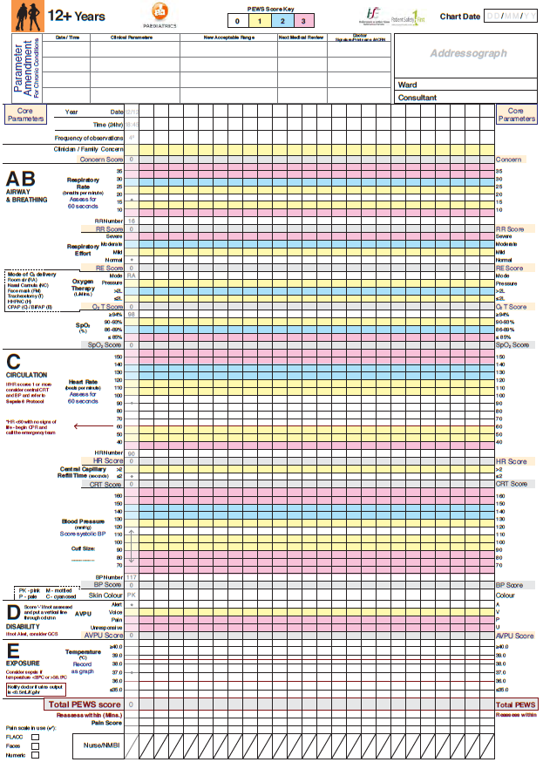
Start date
Variance
6 Core parameters
Decision aides
Additional parameters
Total score
Notes:
This is the N3 template – TYPE A above. TYPE B to be used in sites without a 24 hour Paediatric medical cover.

Slide 9
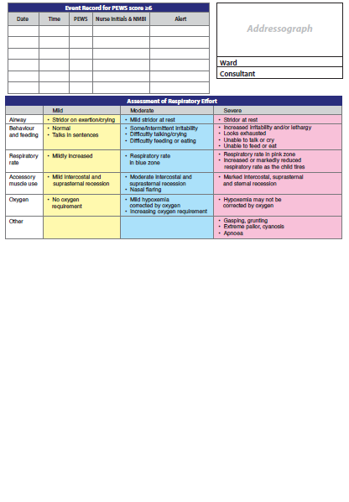
Aid to audit & handover
Respiratory assessment tool
Notes:
The white space here is filled by local arrangement. As available, this slide should be amended to show the local PEWS chart

Slide 10
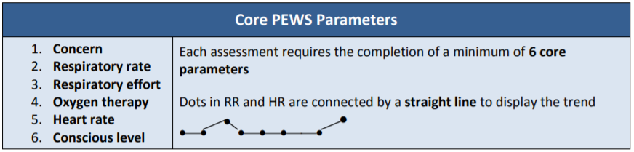
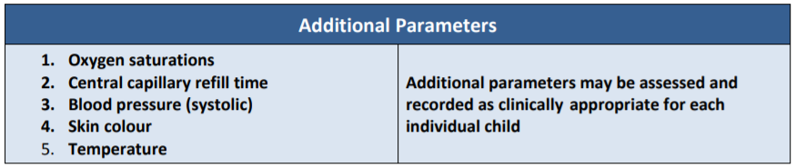
PEWS Parameters
The 6 core scoring parameters are assessed and recorded every time for every patient.
Additional parameter measurement is determined on a case-by-case basis for an individual child
The PEWS chart and score is specifically designed to enhance the identification of trends in vital signs.
Notes:
Core
AVPU – caution in neurology seizure patients, acceptable to use the incomplete symbol to avoid wakening the child and inducing a seizure.
When a child triggers always check the chart age is correct.
Use this chart for gestationally corrected infants up to 12 weeks corrected age e.g. 24/40 ex-prem born 18 weeks ago is corrected to 2/52 will be on this chart until he is 28 weeks of age (12 weeks corrected age)
Examples of when additional parameters are warranted
Baseline Assessment on arrival
Commencement of each shift
Presenting complaint
Patient History
Medication dependent (blood products etc)
Pre and Post Operative
If core are triggering

Slide 11
Examples of when additional parameters are warranted
Baseline Assessment on arrival
Commencement of each shift
Presenting complaint
Patient History
Medication dependent (blood products etc)
Pre and Post Operative
If core are triggering
Treatment protocol/guideline stipulation
Notes:
These are examples of when additional parameters should become core parameters.

Slide 12
Using the PEWS Chart
First time
  Addressograph x 3
  Year
  Start date
  Planned frequency of observations
Every time
  Date
  Time of observations
  Nurse initials and NMBI PIN
As required
  Frequency of observations (Reassess within)
  Event Record
Notes:
Frequency of observations should be completed on admission, on the first set of observations on any chart and if there is a change to the documented previous planned frequency. It is included to reflect a continuous thought process of clinical judgement and awareness of fluctuations in a patient’s condition. This is often a nursing decision and should be based on the minimum advised in the escalation guide and expanded in the manual. Clearly, the frequency may be increased at any time.
What is expected of nursing students in your area(s)?

Slide 13
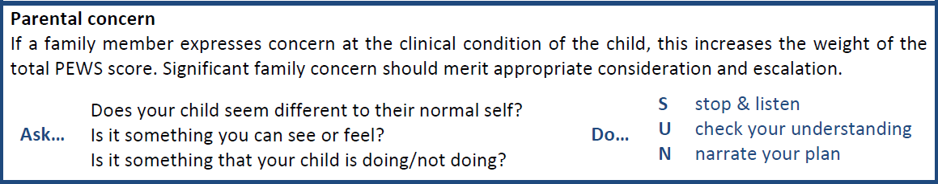
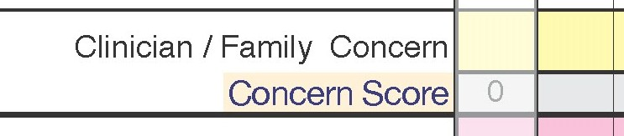
Concern (Clinical/Family)
What is concern?
How should it be assessed?
Dot if present, score 1
Blank if not present, score 0
Document the concern in notes
•
Consider scoring concern if escalating care
1
Notes:
Concern may be on the part of the clinician or parent/carer. Presence of any concern scores a 1 but if significant, may warrant an escalated response.
PEWS is designed to trigger if there are haemodynamic signs present but may not trigger if a child is unwell from another cause, is compensating within an acceptable range or has only subtle signs of illness. The value of the concern parameter is particularly significant in these cases. A clinician may be have an instinct or gut feeling that is suggestive that something is wrong or a parent / carer may feel that their child is worryingly unwell or ‘just not right’.
Concern of course will also be apparent for the child who is deteriorating or who’s condition is worrying.
There are resources available for use to engage with parents on the HSE PEWS website. Information about PEWS and concern scoring should be provided on admission and at appropriate intervals during a child’s stay in hospital.

Slide 14
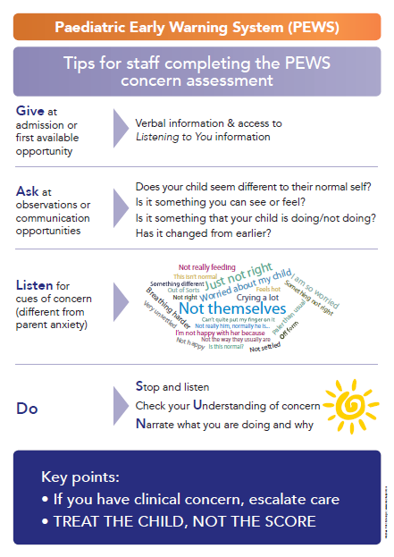
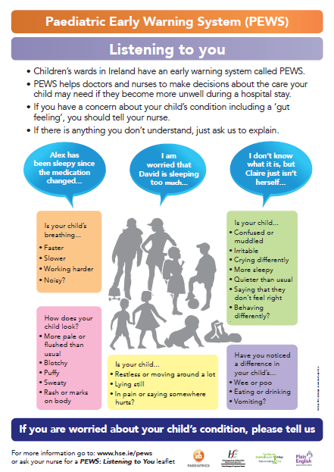
Listening to You
Notes:
These resources are in the Parent Engagement Toolkit on www.hse.ie/pews and should be displayed prominently in all areas using PEWS (minimum size A3)

Slide 15
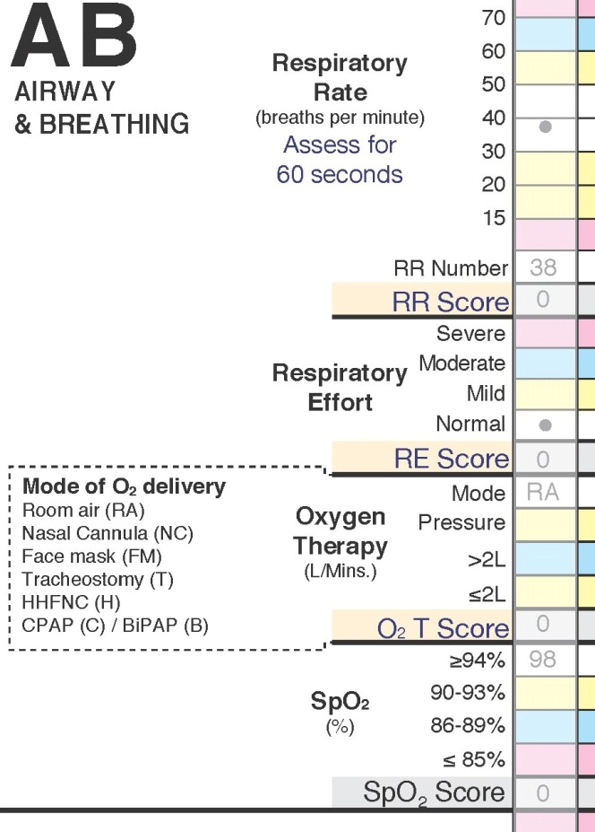
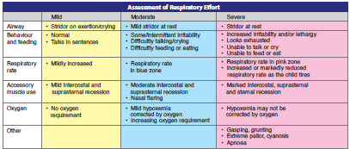
Airway + Breathing
Respiratory Rate - RR
Respiratory Effort – RE
Oxygen Therapy – O₂T
(mode, O₂, pressures)
Oxygen saturations – SpO₂
Notes:
All assessment techniques should be taught in line with RCN Guidelines (see NCG No.12 or PEWS manual for reference) and follow the ABCDE pathway as per PALS or APLS guidelines.
Respiratory rate should be counted for one minute.
Patients in HHFNC therapy should not have a Parameter Amendment put in place but may have a Medical Escalation Agreement considered.
Pressure includes flow in litres.
Refer to the Respiratory Assessment table for RE assessment. Emphasis on global assessment of respiratory wellness to help with the distinction (manual).
Oxygen Therapy has several factors:
- is the child receiving any oxygen therapy? Record the mode of delivery (see code on chart) and no. L of flow
- is the child receiving any airway support? Record the pressure delivered by the device and monitor closely for increased requirements
Oxygen saturations is an additional parameter – may be required to become a core parameter in a respiratory admission for example

Slide 16
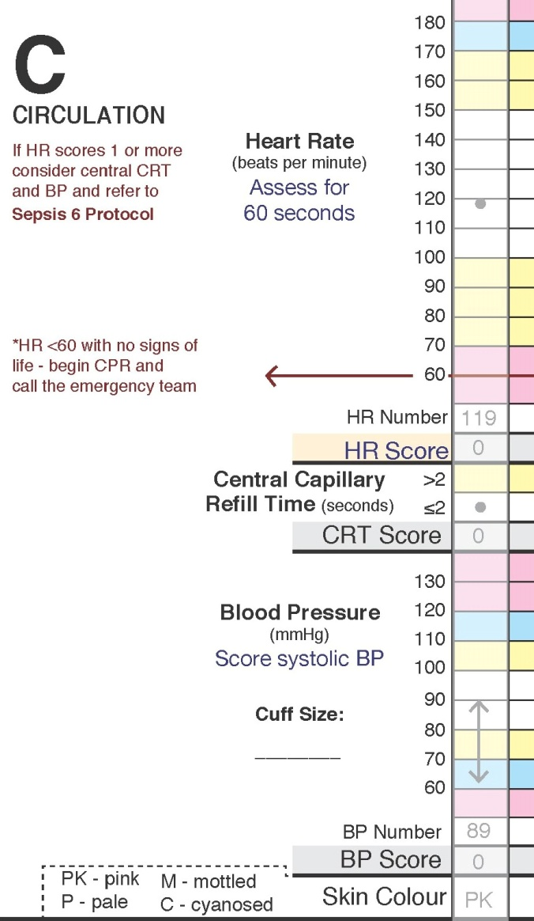
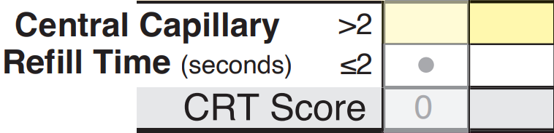
Circulation
Heart Rate – HR
Central Capillary Refill Time – CRT
Systolic Blood Pressure – BP
Skin Colour (no score)
Mean BP = x
∧
x | ∧
∨ | x
 | ∨
4
1
Notes:
Heart rate must be counted over one minute. Heart rate may be assessed via physical pulse check or auscultation but must NEVER be read from a pulse oximeter.
Blood pressure is an additional parameter and should be measured and recorded as dictated by the condition of the child and/or the child’s plan of care. Unless local practices dictate otherwise, both systolic and diastolic should be recorded as per slide but only systolic is scored. Caution for changes in diastolic pressure that may signify cause for concern.
Central capillary refill time is an additional parameter which should be considered if the child has signs of circulatory triggers. It should be measured according to according to PALS or APLS guidelines. Press firmly on the sternum or forehead for 5 seconds. Release and count seconds until capillary return. Score as per example line on chart and manual. (note: this should not be confused with limb perfusion assessment)

Slide 17
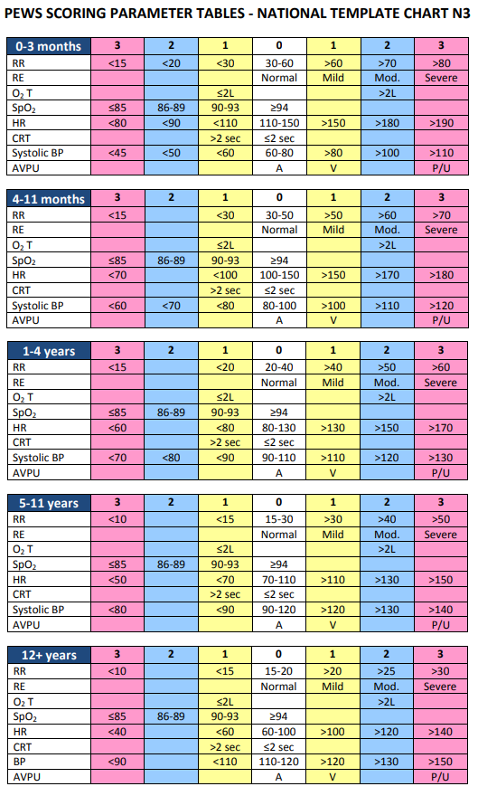

Slide 18
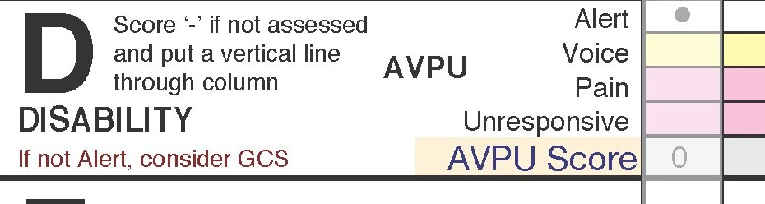
Disability
AVPU
Don’t ever forget glucose!! Check a blood sugar if abnormal AVPU.
• | •
0 | 0 | ⎯
Highlight a fact or statistic
with a short statement

Slide 19
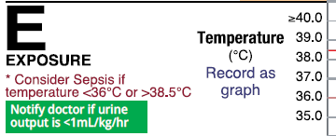
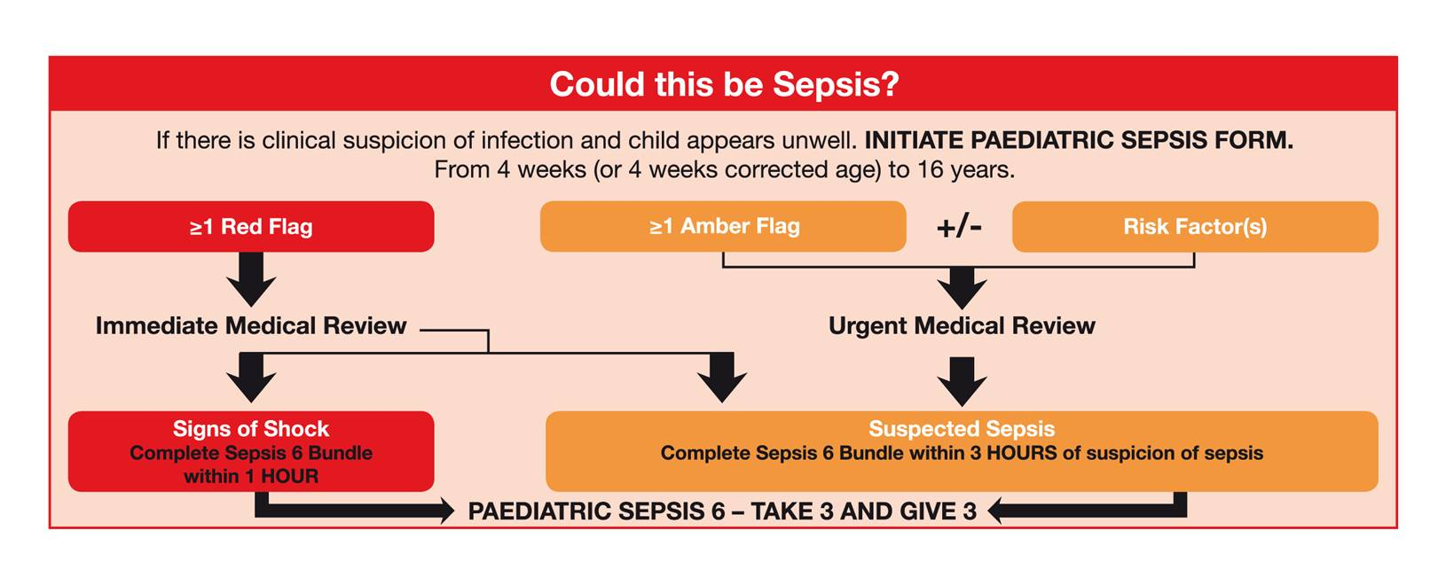
Exposure
Temperature (no score)
Urine output (no score)
Urine output notifiable to medical team if : <1ml/kg/hr in <12 years or <0.5ml/kg/hr in >12 years of age
Notes:
Not a scoring parameter but may indicate sepsis. Refer to sepsis prompts on chart. Assessing whether or not a child is at risk of sepsis, starts with a suspicion of infection. If infection is suspected and the child appears unwell, initiate the paediatric sepsis form. Following screening for sepsis, patients who trigger a “red flag” require immediate medical review, patients with an amber flag +/- risk factors, have an increased risk of deterioration from sepsis and need to be reviewed promptly. If following medical review, there are signs of septic shock or if sepsis is suspected, then the child should receive the components of the Sepsis 6 bundle within the recommended timeframe.
Escalate to senior colleagues quickly.
Important Teaching Point: Get to know the normal baseline temperature of your patient who may read beyond the expected normal temperature ranges. Also consider the temperature range accepted for patients receiving oncology/haematology care as per national Shared Care Guideline.
Urine output should be closely monitored. Prompt for minimum acceptable is on the chart – different for 12+ age group.

Slide 20
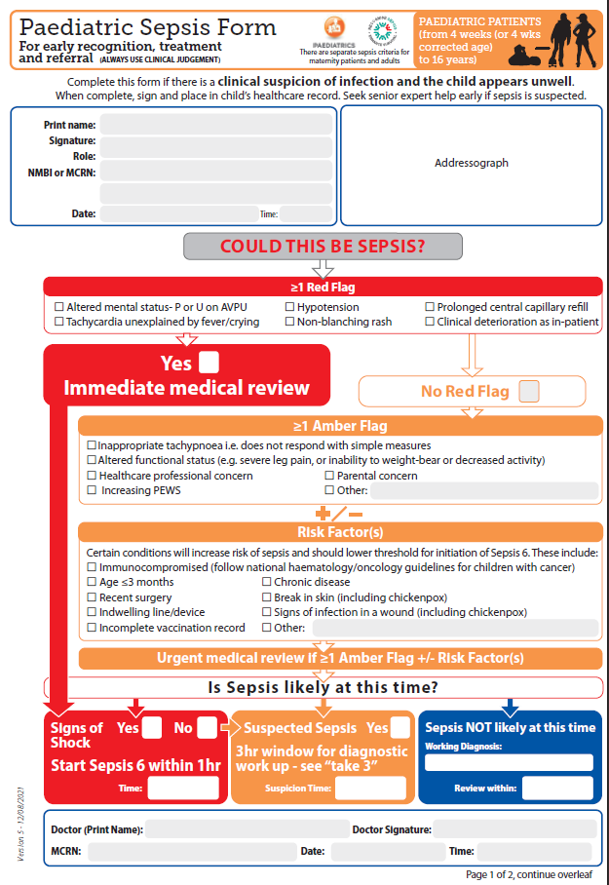
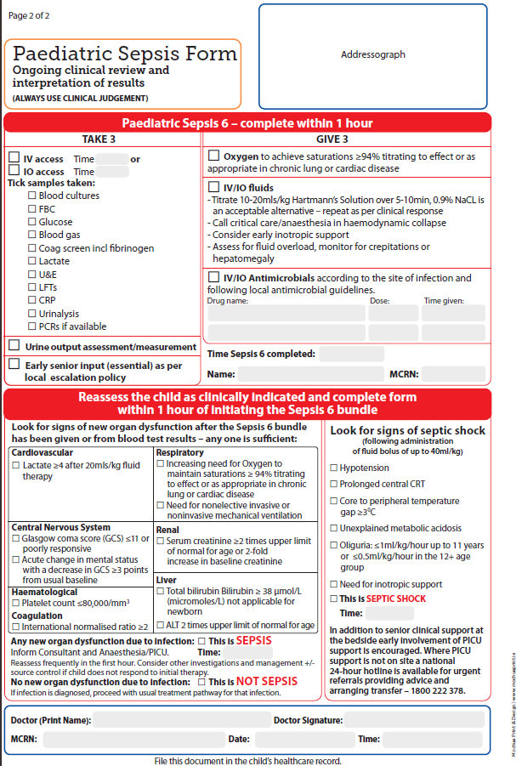
Paediatric Sepsis Form

Slide 21
Recording the Observations
Example column (Ghosting in Greyscale)
  ‘draw the dot, join the line’
  Baseline + trending essential in recognition
  Individual parameter score → total PEWS score
              Consider
                Frequency of observations
                Reassess within
Additional Information
  DNAR
  Blood/blood product transfusion
Notes:
Drawn-dots or numerical values are required to complete the National Paediatric Observation Charts. It is not possible on the charts, given the great range of ‘normal’ for paediatric vital signs, to devote one line per decade score so each upper and lower limit carries a ≥ or ≤ symbol.
In addition, the tool is looking for complete accuracy for trends so the drawn-dots should be joined with straight lines only.
In the case of an adjustment to the frequency due to a change in the child’s condition, new directions from the medical team, as a response to an increase or decrease in a PEWS Score or a change in scoring parameters, the ‘reassess within’ line below the Total PEWS Score should be completed in minutes to reflect the clinical judgement of the observing nurse. Student nurses or less experienced nurses may be prompted by the escalation guide to notify the Nurse in Charge of these changes.
A child with a valid ‘Do Not Attempt Resuscitation’ agreement or equivalent who then triggers a PEWS score on their observations should always receive a nursing / medical response to the change in their condition. A decision not to attempt Cardiopulmonary Resuscitation (CPR) applies only to CPR. It does not apply to any other aspect of treatment and all other treatments and care that are appropriate for the individual should continue.
NB: Observations During Blood Transfusion
Children undergoing blood or blood product transfusion must have all observations recorded on the paediatric observation chart and additionally on the unit’s dedicated blood transfusion documentation should this be required by local governance.

Slide 22
CHI Example Participation in care: Nursing Students role in PEWS
Post Registration Children’s Nursing Students (PRCNS) Student¹ can perform under INDIRECT/DISTANT SUPERVISION of Registered Nurse^{2*} | PEWS – any PEWS that triggers a score of 1 or above, must be reported to the registered nurse and counter signed.
Internship: Undergraduate Nursing Students Student¹ can perform under DISTANT SUPERVISION of Registered Nurse^{2*}
Stage 4: Supernumerary Undergraduate Nursing Students Student¹ can perform under DISTANT SUPERVISION of Registered Nurse^{2*} | PEWS – any PEWS that triggers a score of 1 or above, must be reported to the registered nurse who will immediately review & counter-sign. Note: The preceptor must be assured that the student is able to correctly calculate a PEWS score. At the end of the shift the preceptor will collectively countersign all PEWS entries.
Stage 3: Supernumerary Undergraduate Nursing Students Student¹ can perform under INDIRECT SUPERVISION of Registered Nurse^{2*}
Stage 2: Supernumerary Undergraduate Nursing Students Student¹ can perform under CLOSE SUPERVISION of Registered Nurse^{2*}
Stage 1: Supernumerary Undergraduate Nursing Students Student¹ can perform under DIRECT SUPERVISION of Registered Nurse^{2*} | PEWS – all PEWs assessment documentation must be reviewed & signed by a registered nurse within 1 hour of PEWS/vital signs being taken.

Slide 23
Escalation
PEWS does not replace an emergency call
Score | Minimum Observations | Minimum Alert | Minimum Response
1 | 4 hourly | Nurse in charge | Any trigger should prompt increase in observation frequency as clinically appropriate
2 | 2-4 hourly
3* | 1 hourly | Nurse in charge + 1st Doctor on call | Nurse in charge review
4-5 | 30 minutes |  | Urgent medical review
6 | Continuous | Nurse in charge + 1st Doctor on call + Senior Dr. + Consultant | Urgent SENIOR medical review
≥7 |  | URGENT PEWS CALL | Immediate local response team
*Pink score in any parameter merits review
PEWS does not replace clinical concern
Notes:
If your escalation guide has additional details then this should be added here.
Important Teaching Point: Continuous observations indicates careful consideration should be given for electronic monitoring if appropriate/available.
Assessment and documentation of observations should continue to be undertaken as clinically appropriate to the child’s needs agreed with senior nursing/medical personnel and
observations should be documented on a PEWS chart at a minimum of 15-30 minute intervals.
Deviation from the minimum observation in patients with or without a MEA in place must be collaboratively agreed and medically documented.
Reminder: this is an Escalation Guide, not protocol. Safe use means applying clinical judgement to the suggested actions. A low score should not reassure a concerned clinician. Also remember that parental concern can be an indicator of subtle, early signs of deterioration.

Slide 24
Urgent PEWS Call
Response pathway to PEWS Score ≥7
All urgent PEWS must have an outcomes measure recorded i.e. form or desktop log
Notes:
Amend to reflect local arrangements – personnel to respond, bleep or phone number for example. (Slides 25 and 26 may be hidden once your local Urgent PEWS Call pathway has been included.)
Note: there may be occasions when a child has a high score but the appropriate care can be provided by personnel present and an ‘Urgent PEWS call’ may not be required. Clinical judgement should determine whether additional help is required. The score should be recorded on the Event Record and noted for hospital audit regardless of whether the Urgent PEWS Pathway was activated.

Slide 25
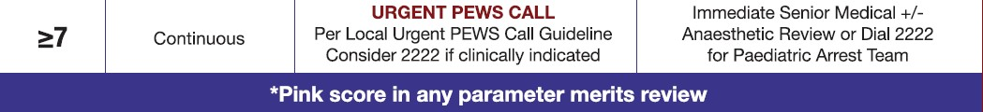
Urgent PEWS Call
Response pathway to PEWS Score ≥ 7
Refer to local SOP
ISBAR stickers (per local agreement)

Slide 26
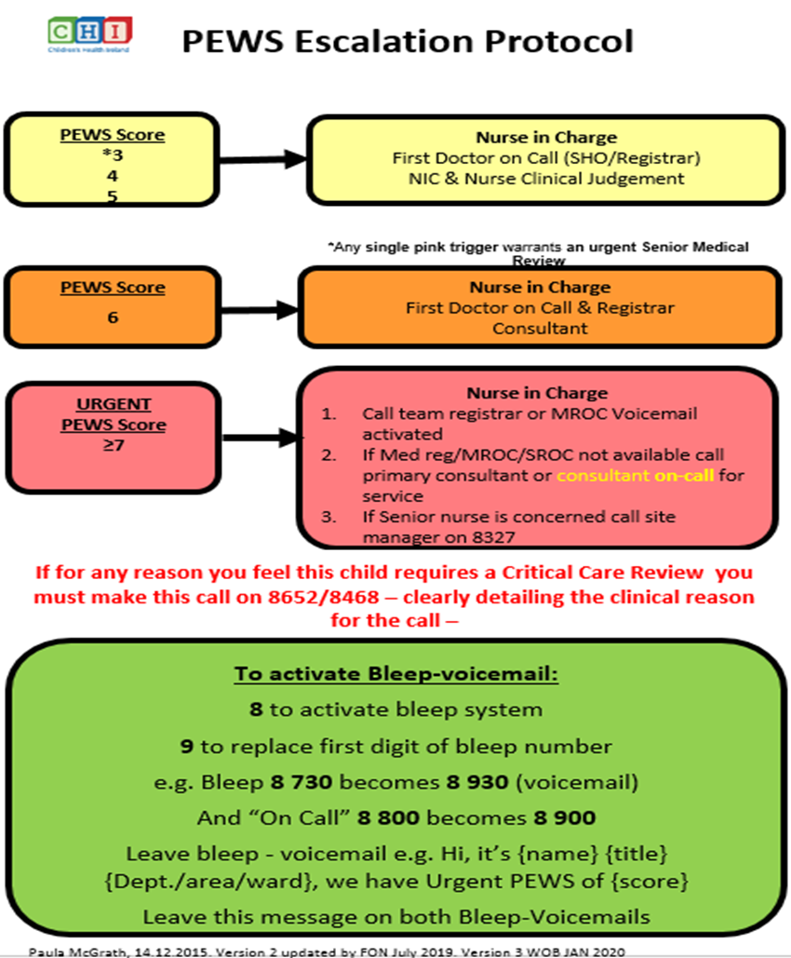
Urgent PEWS Call≥7
CHI at Crumlin
Notes:
INSTRUCTIONS:
Add your site’s local arrangements including how to activate the Urgent PEWS Call and who will respond
Note: there may be occasions when a child has a high score but the appropriate care can be provided by personnel present and an ‘Urgent PEWS call’ may not be required. Clinical judgement should determine whether additional help is required. The score should be recorded on the Event Record and noted for hospital audit regardless of whether the Urgent PEWS Pathway was activated.

Slide 27
Communication
Identify | You Recipient of information Patient
Situation | “The situation is… “ Concerns, observations, PEWS score etc.
Background | “The background is…” (age, reason for admission, relevant medical/surgical history, relevant current treatment/interventions)
Assessment | “My assessment is…” Give relevant ABCDE assessment information What do you think the problem is?
Recommendation | “My recommendation is…” What do you need them to do? Recipient should provide any necessary clinical instruction.
Notes:
The key focus is on the language used i.e. ‘the situation is’, ‘the background is’ will assist a clinician to frame the conversation.
Some sites may use ISBAR escalation stickers which should be used to reflect each episode of escalation for medical review.

Slide 28
Documentation
Management plans following review should include:
  Date, time and clinician grade recorded each time
  Impression
  Plan for intervention
  Plan for observations
  Plan for review
  Calling criteria
Notes:
Calling criteria may include escalation for review for patients with a low score but presence of clinical concern.

Slide 29
Variance
Clinical judgement essential
3 levels
  Special situations
  Parameter amendments (chronic conditions)
  Medical escalation agreement (acute illness)
Notes:
PEWS also has decision aids and situational awareness systems to allow for good clinical judgement in certain situations to give flexibility to nurses and clinicians. There are 3 levels of adjustment possible, however, these decisions may only made by senior members of the nursing and medical teams:
Special situations (senior or experienced nurse)
Amended parameters (registrar or above instruction only)
Temporary agreement of medical escalation (registrar or above instruction only)

Slide 30
Special Situations
Special situations
  Transient, simple cause for PEW increase
  Nurse-led decision not to escalate
  Must be documented
  Must have reassessment within a short timeframe
Example…
Felix, age 6, admission post-tonsillectomy.
Observations 30mins following return to ward:
  Felix crying that he is in pain
  RR 34, HR 140, systolic BP 99
Drug chart indicates paracetamol may be given.
Total PEWS Score?
Reasonable action?
Notes:
Special situations – distressed child, pyrexial child – transient hike in PEWS due to stress etc. If this is reliably determined to be the cause of the increase in PEWs, it may be reasonable to agree a timeframe for review with the parent/nurse in charge as necessary and document this on the chart – ‘reassessment within’ and return to recheck within stated, reasonable timeframe
All student nurses and staff nurses must discuss any scoring child with the nurse in charge who will be responsible for taking the above decisions
Decisions should be documented
Note:
PEWS scoring for Felix:
Concern ?
RR 1
HR 2
Total PEWS Score 3-4 = notification to Nurse in Charge and 1st responder medical team …but…Felix is due pain relief. If parent/carer is amenable, paracetamol may be given as prescribed, in conjunction with other comfort/reassurance measures, and the observations re-done in a short, agreed timeframe.

Slide 31
Parameter Amendment (Chronic Conditions)
Senior medical decision
Pre-existing conditions
Not for acute presentation
Amended range scores 0
Outliers trigger pink 3
Notes:
Be clear what children may require amended parameters i.e. only pre-existing conditions that cause the child to have an alternative normal physiological baseline for age
Doctors of Registrar level or above only may decide amendments to parameters
The new acceptable parameter entry must have a range (upper and lower value)
Draft: RE should never be amended for a child with a cardiac condition and should be used with caution for any other child (example, a child with laryngomalacia may have an ongoing stridor that is ‘normal’ for them. If it is decided to amend this child’s parameter to Mild it must be very clearly written that this is for a mild stridor only, not for any other respiratory element and that parent input would be of great significance in determining a change in the child’s condition).
Only to be used for children with pre-existing conditions affecting their normal vital sign criteria (i.e. Cyanotic cardiac disease-SpO₂ or renal unit BP, a child with cerebral palsy may have a lower heart rate than expected for their age) Use a local example if possible.
Not to be used for children whose current illness is causing the transgression from their normally accepted ranges (i.e. symptomatic asthma or bronchiolitis presentation who will trigger frequently over the early part of the admission)
Amended range scores 0, all outliers of the amended parameters score 3 – colour code is either white (0) or pink (3) thereby meriting escalation to a medic for urgent review
How to document & when to review amended parameters
Doctor of Registrar level or above to decide and complete parameter amendment box on centre pages of the chart and a clear medical note in the healthcare record with impression, acceptable normal range for the specific physiological criteria and acknowledge timeframe for review and calling criteria for transgressions from the amended score 0
Nurses should enter the value in the correct box but score 0 provided the value lies within the amended range.
Future Opportunity Consider the role of ANP in PA

Slide 32
Parameter Amendment example
Parameter Amendment for Chronic Conditions | Date/Time | Clinical Parameters | New Acceptable Range | Next medical Review | Doctor Signature/Print name/MCRN
 | 12.04.16 | O2 saturations | 75-90% | 1/52 | Dr ###
Notes:
Example …
Abigail, age 3months, Hx Tetralogy of Fallot, due for repair procedure at 6 months of age
Admitted for monitoring of increasing frequency of ‘spells’
Usual SpO2 values of 78-84% (from parents and previous admission charts)

Slide 33
Medical Escalation Agreement
Conditional
Senior medical decision
Scoring due to current presentation/illness
Wording: ‘escalation not required if’, ‘no escalation provided’ ... state specific parameter ranges
Score appropriately – continue trending and monitor for changes
Caution in: cardiac conditions, newly admitted, newly discharged from PICU/ICU, on-call, non-respiratory parameters…
Notes:
If the child’s transgression from normally accepted ranges are related to the current illness and the child is considered ‘sick but stable’ on assessment by registrar or consultant and not necessarily requiring the level or frequency of assessment and escalation as suggested i.e. bronchiolitis/asthma and the child is likely to have recurrent triggers for RR, SpO₂, O₂ , RE, HR for example due to the natural course of the admission complaint, the medical team (registrar or above) may complete the medical escalation agreement box on the chart (NB not the parameter amendment section) and clearly state the impression, currently acceptable parameters and triggers and timeframe for review. NB: this is a strictly conditional adjustment, a reasonable timeframe should be set for review NB – different to the parameter amendment section, the values and scores must be completed. Care must be taken to maintain clinical judgement as to the need to further escalate care at anytime.
All student nurses and junior nurses must discuss with the nurse in charge any scoring child. The senior/nurse in charge will hold responsibility for taking the above decisions. All deviations from the escalation guide should be documented.

Slide 34
Medical Escalation Agreement
Medical Escalation Agreement
Date/Time | Max Duration | Following clinical assessment, if appropriate, state clinical impression, permitted parameters and calling criteria | Senior Doctor Initials/MCRN/Designation
Start date: 22/8 Start time: 03.30hrs End date: 22/8 End time: 05.30hrs | 2 hrs (05.30) or sooner if any concerns | Impression: acute asthma – new admission Escalation not required if: RR 25-45 RE Moderate (wheeze, I/C recession) SpO₂ 94% Alert for change in condition | Dr ###
Start date: 22/8 Start time: 05.45hrs End date: 22/8 End time: 14.45hrs | 8 hours (14.45) or sooner if any concerns | Impression: acute asthma – responding No escalation required if: RR 15-35 RE Mild No oxygen requirement SpO₂ 98% | Dr ###
Notes:
Example…
Suzie, age 13, Hx asthma, atopy
Admission due to exacerbation of asthma
Prescribed 2-hourly nebulisers plus prn
Note two separate agreements for shorter length to ensure stability and then longer period when improvement more marked.
Doctor can and should be contacted for consultation/alert as the child’s condition changes.
Next medical review is the planned review
End date / time is the discontinuation of the plan

Slide 35
Scenario 1
Bridget, aged 11 weeks, admitted with respiratory distress
Initial candidate briefing Infant Bridget was admitted at 2am with respiratory distress, reduced feeding and low SpO2 (90%)
Medical Hx: ex 32/40 SVD, 2/52 SCBU, 1/52 CPAP.
Feeding 4 hourly EBM, 75-100ml.
On 1LO2 via nasal prongs.
Comfort feeding at present but for review at morning rounds. IV access established and receiving half maintenance fluids IV.
Medical instructions are to monitor, provide O2 and maintain SpO2 >94%.
Mum has just fed Bridget 110ml EBM and calls you because she is worried about how she looks.
‘As the nurse, you should carry out your assessment on Bridget now’

Slide 36
Completion – scenario 1
11 week old(EX 32/40), Bronchiolitis
  RR 60
  RE Mild
  1lt supplemental oxygen via nasal prongs
  HR170
  Mottled skin
  Eye opening to mother’s voice, ‘flat’
What is the score so far?
What needs to be done now?..............
Slide 1 of 2
Notes:
The next few slides contain cases to familiarise candidates with completing the charts, scoring PEWS and escalation guidelines. The examples should be changed to suit the local clinical setting. Trainers may choose to present one case at different points in time rather than 2 or 3 separate cases. Use an age range appropriate to the audience and a local case if available
History to describe to the class: This infant presented to the ED with his mother with 2/7 of poor feeding and ‘just not right’.
Ask the group to individually in pairs or in groups work through the chart to record the findings presented on the slide and suggest that they do not total the score yet
These are the core criteria plus easily observable colour and temperature as often completed in infants.
Go through the scores for each parameter in turn and allow the prompts below to guide conversation:
Concern (1) Ask if they have concern about this infant? Do they feel that there is parental concern?
RR 50 (score 1)
RE normal (0)
No oxygen (0)
HR 170 (1) Ask how would they would have assessed the HR. Reiterate the RCN standards
Mottled
AVPU – likely ‘V’ but allow the room to discuss this – what do they think? This is a good opportunity to discuss the meaning of ‘A’ as alert rather than awake
Febrile Ask how they would have assessed the child’s temperature. Reiterate the RCN standards
Invite the group to suggest what they would do next for this child...click to the next slide to show values for SpO₂ measurement, and BP +CRT

Slide 37
Additional Parameters
CRT >2
BP not recorded
Urine Output Dry
Blood Glucose provide if tested

Slide 38
Questions…
?

Slide 39
The next slide is for Train the Trainer only

Slide 40
PEWS Training Tips
- Who are you training?
- Create schedule
- Venue/ environment
- AV requirements
- Pre-course organisation
Notes:
- Who are you training?
Why are you here? What is your area of expertise? Who are you responsible to? Who will you be teaching? Colleagues? Nursing / medical staff? What are the challenges? Plus your slide information
- Create schedule
Identify relevant areas and medical and nursing staff numbers requiring PEWS Training: liaise with line managers. Interdisciplinary teaching very much encouraged
Create a training schedule- allow reasonable time to plan for release of staff; be clear regarding duration of session and attendance – certification only on full attendance.
- Venue/ environment
Source and book suitable venue: spacious, warm, adequate seating. Do you need to provide a map/directions? Do you need to provide parking advice? Do you need to organise refreshments?
AV requirements
Do you need to organise AV (laptop, USB for lectures, projector/screen)
Check everything works and is compatible. Do you need to book additional equipment? Do you need a pointer?
- Pre-course organisation
Provide staff with manual 1-2 weeks before training session. Are you going to provide pdf by email or printed copies? Is the file on the hospital intranet/ in the library?
Become familiar with slides and notes underneath
Know the particular arrangements within your hospital/site/area for escalation and Urgent PEWS, documentation requirements etc.
Prepare all training paperwork and supplemental teaching materials including cases and charts

Slide 41
PEWS Training Tips
Urgent medical review: what does this mean in your site?
URGENT PEWS CALL: what does this mean in your site?
Emergency call: what does this mean in your site?
Introduce escalation guideline – national guidelines on chart that hospitals/institutions should adapt to take account of local resources/arrangements
Cumulative response in all columns: must do previous actions PLUS whatever is noted in the current score level
NB: this is the minimum recommended action to be taken for each score
NB: Any child may have their observation frequency increased as clinically required according to the discretion of the nursing team.
NB: Higher escalation possible at any time and 2222/emergency call NOT replaced by PEWS
Urgent PEWS response team will be decided at local level. Reminder that the charts are a national template that will be amended for local use for national roll out. The local PEWS implementation group should support the Team Leaders to implement the PEWS system
Continuous monitoring = cardiac monitor/ECG tracing but does not replace intermittent assessment and recording
Full set of observations – as discussed, not every criterion must be assessed every time but if certain scores are triggered then other parameters are required or considered and everything must be checked once PEWS single trigger (pink) 3 or >3.
NB: 3 places to document, student nurse entries to be countersigned
NB any deviation from the stated escalation guide must be documented and rationale given: amended parameters, temporary escalation agreement or special situations as previously discussed. Variances must have clear action plan for reassessment.

