Slide 1
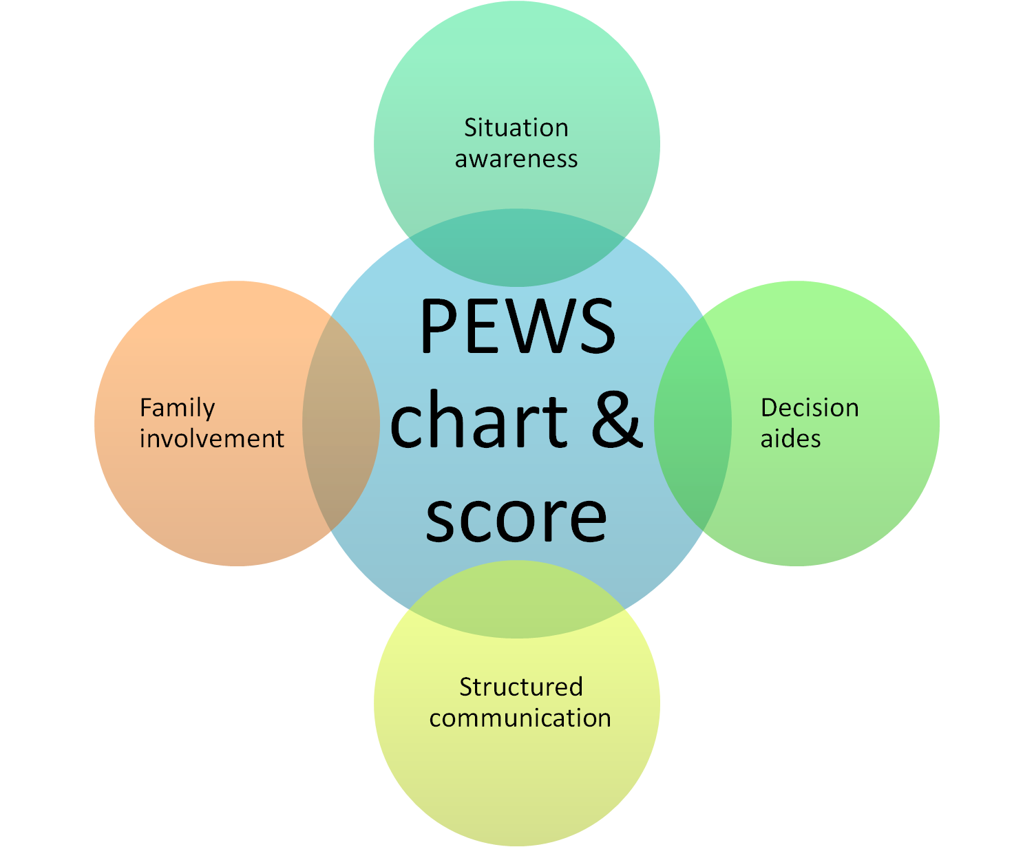
Irish Paediatric Early Warning System (PEWS) Update
Notes:
This slide set represents a national template for PEWS training and as such, reflects a national standard in practice.
Additions should be made to these slides to reflect local arrangements/resources.
It is essential to refer to PEWS implementation/training guide, PEWS User Manual and National Clinical Guideline No.12 PEWS before using this slide-set.

Slide 2
Learning Outcomes
By the end of the session, you will be able to:
Discuss the importance of clinical judgement and individualised assessment
Discuss the use of PEWS in clinical practice in <<ward or hospital>>
Demonstrate effective use of PEWS charts and the escalation guide in <<ward or hospital>>
Discuss the appropriate use of permitted variance/special situations within PEWS in <<ward or hospital>>
Notes:
INSTRUCTIONS:
1. Add ward or hospital details as appropriate
2. Delete as appropriate from the final bullet point

Slide 3
Aim of PEWS
Assist recognition and response to deterioration
Improved situation awareness
Standardised communication
Use of a common language
Earlier opportunity to rescue
Notes:
The overall aim of the PEWS system is to...

Slide 4
Notes:
INSTRUCTIONS:
You will need to upload the relevant video to your ward / hospital into this slide. Download the video from www.hse.ie/pews and save it to a folder with these slides. You can then link the two.
Note: Long version with permitted modifications is 17 minutes
Generic (short) version with no permitted modifications is 15 minutes

Slide 5
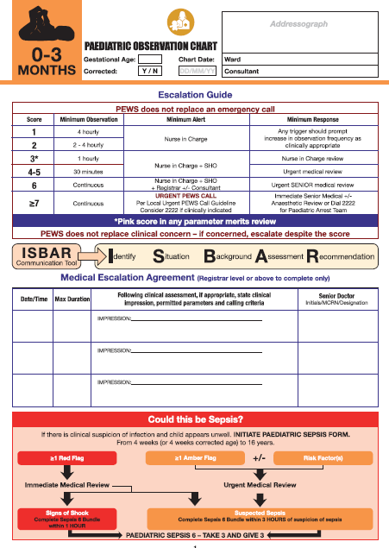
Paediatric Observation Charts
Notes:
INSTRUCTIONS:
Upload your own site’s front page image here

Slide 6
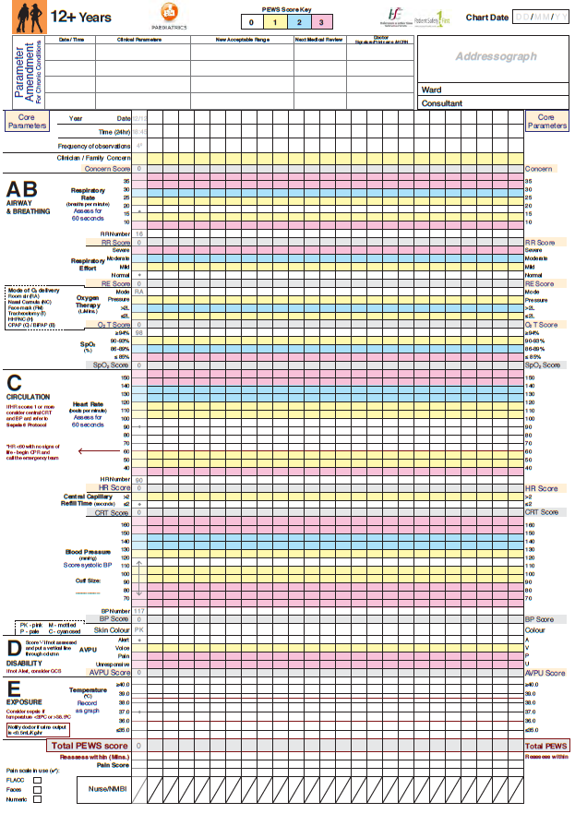
Notes:
INSTRUCTIONS:
Upload your site’s central page(s) here

Slide 7
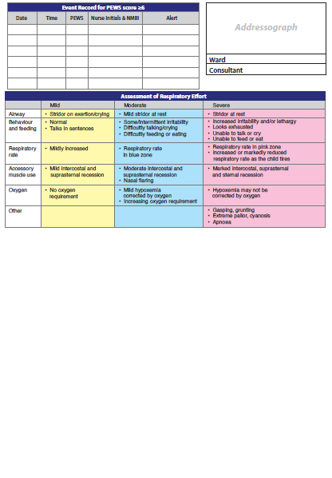
Notes:
INSTRUCTIONS:
Upload your site’s back page (& any additional pages) here

Slide 8
Key Points
6 core parameters every time
Additional only as required for individual child
‘Draw the dot, join the straight line’
Baseline + trending essential in recognition
Individual parameter score → total PEWS score
Consider
Frequency of observations
Reassess within

Slide 9
Escalation Guide
PEWS does not replace an emergency call
Score | Minimum Observations | Minimum Alert | Minimum Response
1 | 4 hourly | Nurse in charge | Any trigger should prompt increase in observation frequency as clinically appropriate
2 | 2-4 hourly
3* | 1 hourly | Nurse in charge + 1st Doctor on call | Nurse in charge review
4-5 | 30 minutes |  | Urgent medical review
6 | Continuous | Nurse in charge + 1st Doctor on call + Senior Dr. +/- Consultant | Urgent SENIOR medical review
≥7 |  | URGENT PEWS CALL | Immediate local response team
*Pink score in any parameter merits review
PEWS does not replace clinical concern
Notes:
INSTRUCTIONS:
Upload your site’s escalation guide here

Slide 10
Urgent PEWS Call
Response pathway to PEWS Score ≥7
Notes:
INSTRUCTIONS:
Add your site’s local arrangements including how to activate the Urgent PEWS Call and who will respond
Note: there may be occasions when a child has a high score but the appropriate care can be provided by personnel present and an ‘Urgent PEWS call’ may not be required. Clinical judgement should determine whether additional help is required. The score should be recorded on the Event Record and noted for hospital audit regardless of whether the Urgent PEWS Pathway was activated.

Slide 11
Optional Modules
Case discussion
Case presentation
Audit results and recommendations
Question & answer session
Notes:
OPTIONS:
You may consider the following options for inclusion in site specific training to suit the needs of the audience:
Case discussion: use the template to build a case and take the class through a practical discussion of the observations, trending, escalation requirements etc
Case presentation: present an example from local practice that demonstrates the key points within PEWS or highlights good practice etc.
Key learning from local audit: show areas for improvement and highlight achievements
Question and answer session: to offer clarity and deal with local challenges and facilitate discussion around examples of good practice

Slide 12
Questions…
?

Slide 13
PEWS Key Points
PEWS score is a tool only
Monitor the child for trends in
vital signs and PEWS Score
Use clinical judgement + clinical trends to interpret the Escalation Guide
Listen for parent concern
Notes:
Leave this slide up for the rest of the session
PEWS is not a system for reassuring a clinician that the child is well.
PEWS is a safety net that will detect changes in a child’s physiology when vital sign observations err outside of ‘normal’ but until that happens and while the scores remain low (remember the ability of infants and children to compensate) a clinician’s judgement, impression and partnership with the family regarding clinical concern is paramount.
PEWS works most effectively when it is remembered that the scoring tool is simply one element of a care bundle that also includes enhanced personal and team situation awareness, empowerment through a clear escalation pathway and use of a structured framework for clinical communication and strong engagement with the child and family as an additional defence against deterioration events.
The class will now move to desktop exercises to ‘put it all together’.
Refer to the case study template, guidelines and cases 1-4 for this section of the education programme.
Following the case studies, you should distribute the quiz and give candidates 5-10 minutes to complete. The answers may be discussed as a class; some of the quiz answers are intentionally included to prompt critical thinking to again highlight important points for reiteration.

Slide 14
The next slide is for Train the Trainer only

Slide 15
PEWS Training Tips
- Who are you training?
- Create schedule
- Venue/ environment
- AV requirements
- Pre-course organisation
Notes:
Discuss local arrangements for trainers/champions. What is expected of them?
- Who are you training?
Why are you here? What is your area of expertise? Who are you responsible to? Who will you be teaching? Colleagues? Nursing / medical staff? What are the challenges? Plus your slide information
- Create schedule
Identify relevant areas and medical and nursing staff numbers requiring PEWS Training: liaise with line managers. Interdisciplinary teaching very much encouraged
Create a training schedule- allow reasonable time to plan for release of staff; be clear regarding duration of session and attendance – certification only on full attendance.
- Venue/ environment
Source and book suitable venue: spacious, warm, adequate seating. Do you need to provide a map/directions? Do you need to provide parking advice? Do you need to organise refreshments?
AV requirements
Do you need to organise AV (laptop, USB for lectures, projector/screen)
Check everything works and is compatible. Do you need to book additional equipment? Do you need a pointer?
- Pre-course organisation
Provide staff with manual 1-2 weeks before training session. Are you going to provide pdf by email or printed copies? Is the file on the hospital intranet/ in the library?
Become familiar with slides and notes underneath
Know the particular arrangements within your hospital/site/area for escalation and Urgent PEWS, documentation requirements etc.
Prepare all training paperwork and supplemental teaching materials including cases and charts

