Slide 1
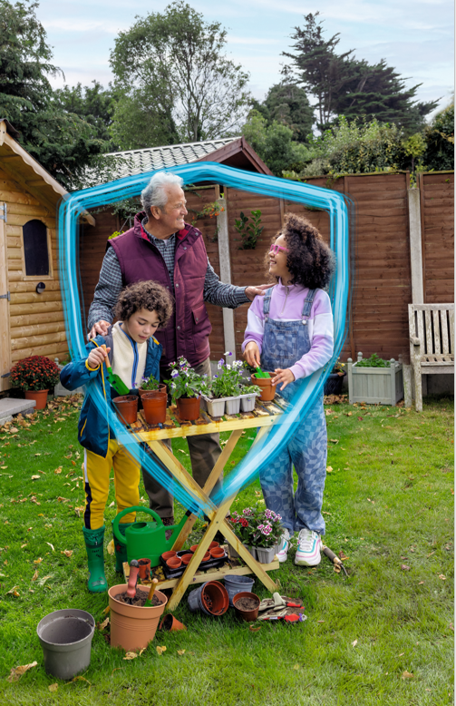
Autumn/winter Campaigns
Partner Pack
October 2023 – February 2024

Slide 2
Campaigns Overview
The HSE will be running a range of advertising campaigns throughout the autumn and winter months to promote winter vaccines, encourage people to take care when they are ill, and let them know what they can do if they need medical help.
The themes are:
Autumn/winter vaccines:
‘Top-up’ - encourages to check what vaccines are recommended for them on hse.ie.
Children’s flu vaccine - encourages parents and guardians or children aged 2 to 12 to contact a participating GP or pharmacist for their children’s nasal spray flu vaccine
Pregnancy vaccines – encourages people who are pregnant to get their recommended vaccines – flu, COVID-19 and whooping cough.
The Pneumococcal vaccine campaign promotes the pneumococcal vaccine to people aged 65 or over
Care when you need it: promoting HSE Injury Units and other care options available
Winter illnesses: advice on dealing with common winter illnesses at home

Slide 3
1. Vaccines – Time to Top-up
‘Time to Top-Up’ encourages people to get their recommended autumn/winter vaccines (flu and COVID-19).
Our message – Flu and COVID-19 vaccines give your immune system the top-up it needs to help protect you from serious illness.
This campaign brings flu and COVID-19 vaccines together for our key audiences – older people, anyone who is pregnant, healthcare workers, and people with long-term conditions.
.

Slide 4
Top-up channels and assets
On air 2 October 2023
TV and Video-on-demand (VOD) will be on air from 2 October. Watch the English version of the TV ad here and the Irish version here.
Radio ads will run on national, local and digital radio from 2 October. Listen to our ads below:
General radio ad in English and Irish
Ad targeted specifically at pregnancy in English and Irish
A range of online digital display messages will roll out over the winter.
Social media messages are always on across Facebook, Instagram, Twitter, YouTube, Pinterest, TikTok and Snapchat.

Slide 5
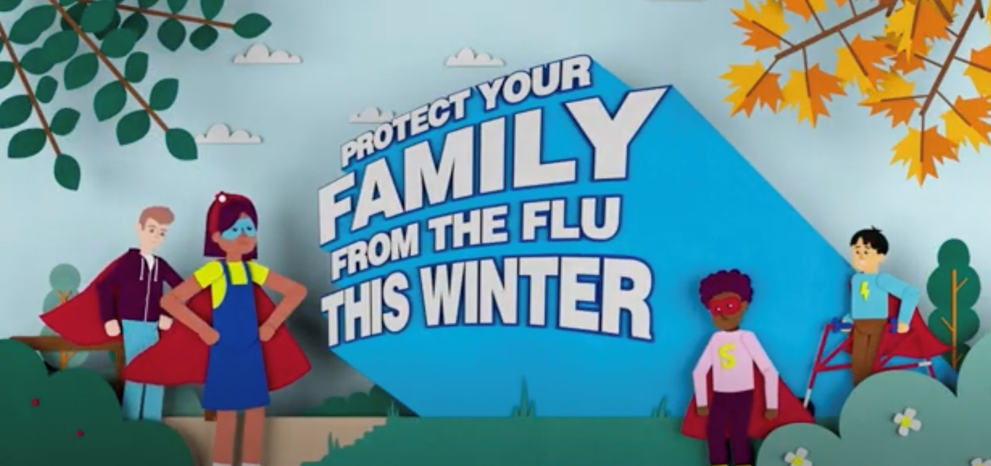
Children’s flu vaccine
The children’s flu campaign aims to promote the free nasal flu vaccine to parents of all children age 2 to 12.
Our messages:
Children are twice as likely as adults to catch the flu
Children aged 2 to12 can get their flu nasal spray flu vaccine
Available at participating GPs and pharmacies
For the first time this year, senior infants classes at some schools may be offered the vaccine at school.

Slide 6
Children’s flu vaccine channels and assets
On air 9 October 2023
VOD Video-on-demand (VOD) will be on air from 9 October. Watch the English version of the VOD ad here and the Irish version here.
Radio Radio ads will run on national, local and digital audio from 9 October. Listen to our children’s flu ad in English and Irish, targeted at all adults.
Digital display: A range of online digital display messages will roll out over the winter.
Social media: messages are always on across Facebook, Twitter, Instagram and TikTok.

Slide 7
Vaccine social media assets and suggested posts
Top-up your immunity with the COVID-19 and flu vaccines to make sure you're protected in the months ahead. See what vaccines are recommended for you and make an appointment today.
https://bit.ly/3ru5SIG
If you are pregnant, your flu, COVID-19 and whooping cough vaccines will help protect you and your baby. Book an appointment today or speak to your doctor or midwife.
https://bit.ly/3ETerzS

Slide 8
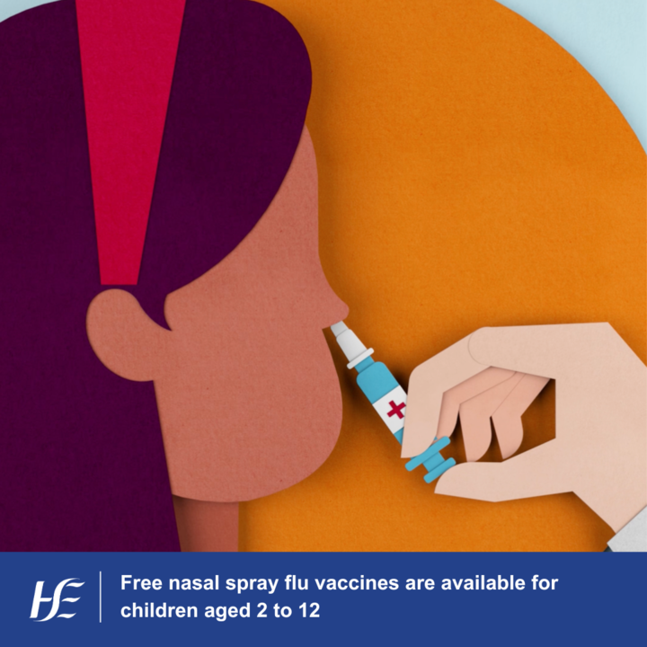
Vaccine social media assets and suggested posts
The flu vaccine is free for kids aged 2-12. It’s given as a nasal spray, is safe and gives effective protection. Book a free appointment with your GP or pharmacist.
Visit www.hse.ie/flu
If you’re 65 or over, you are more at risk of serious illness from pneumococcal disease. You only need to get the vaccine once to be protected. Talk to your GP today about getting the pneumococcal vaccine.
Learn more: https://bit.ly/48xkec6

Slide 9
2. Care When You Need It
Promotes the HSE Injury Units and other care options available.
Our message:
When care is needed, consider all the options.
Channels:
Local radio advertising and geo-targeted programmatic audio to promote injury units locally – listen to the radio adverts here. There is also a search and social media campaign supporting injury units.
Search and social to promote public know-how and confidence for self-care and service finding.

Slide 10
3. Winter Illnesses
The ‘Winter illnesses’ campaign gives advice on dealing with common winter illnesses at home.
The 3 streams for this campaign:
Thank You campaign – encouraging people with symptoms of flu, COVID-19 or other viruses to stay at home if they feel unwell. Video on Demand (VOD), radio, digital audio ads will launch on 30 October. This will also be promoted on social media.
Watch our ad for Video on Demand (VOD) here. Links to radio ads will be provided shortly.
Keep well this winter – messages on good self-care, avoiding falls, keeping well, vaccination, check your medication list. This will be promoted on search and social media.
Parents – advise on winter illnesses. Promoted across search and social media.

Slide 11
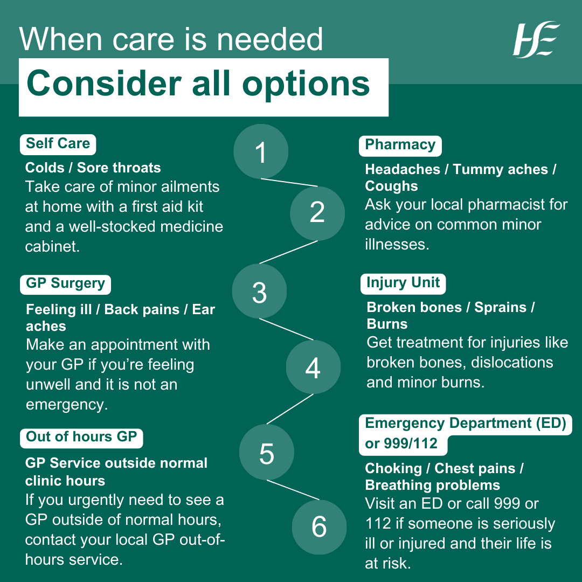
Winter social media assets and suggested posts
Injury units treat injuries that are unlikely to need hospital admission and are more convenient and often quicker than an emergency department. Injury units treat broken bones, dislocations, minor burns and more. Find your nearest injury unit.
https://bit.ly/465bp7D
If you or your family feel unwell and need some care, consider all the options.
https://bit.ly/3ruMeMM

Slide 12
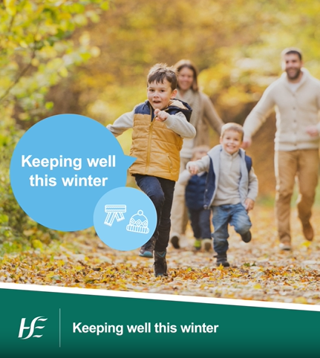
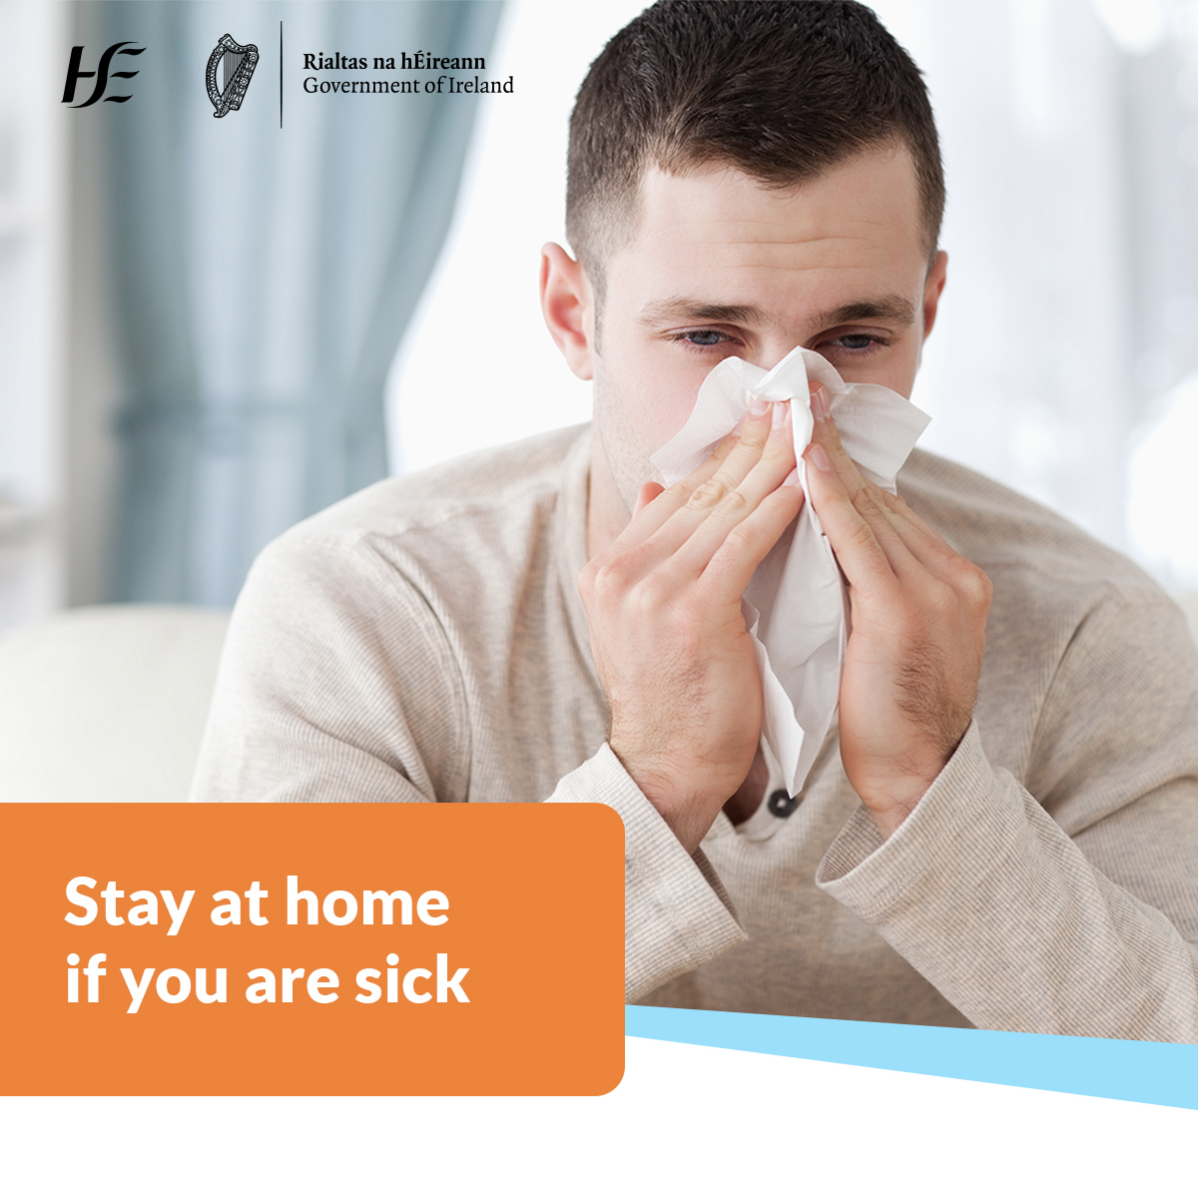
Winter social media assets and suggested posts
Viral infections are very contagious and can spread quickly before you notice the symptoms. Find out how to avoid catching common illnesses like coughs, colds and flu this winter.
https://bit.ly/3ruMeMM
Viruses can spread quickly. If you feel unwell stay at home and visit hse.ie for advice.
https://bit.ly/3LE8NFr

Slide 13
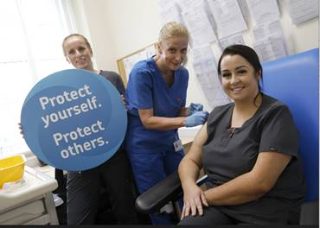
Healthcare worker key messages
As a healthcare worker, it’s free and easy to get your COVID-19 and flu vaccines. Flu and COVID-19 vaccines may be available where you work, or you can go to a participating GP or Pharmacy. You can get both vaccines at the same appointment.
If you work in healthcare, you’re at increased risk of being exposed to flu and COVID-19. It’s important to get your flu vaccines this autumn/winter to protect yourself and the people you care for each day. You’re risk of getting flu and COVID-19 is much higher than the general public, especially if you work in a healthcare setting.
The vaccines are safe and effective. The HSE only uses vaccines when they meet the required standards of safety and effectiveness and after the European Medicine’s Agency (EMA) has licensed them. Vaccines offer strong protection. Though specific levels of effectiveness can vary from person to person, if vaccinated people do get sick, they are likely to have milder symptoms.
12345

Slide 14
Healthcare worker key messages
Vaccination is the best protection from COVID-19 and flu. It’s important to follow infection prevention control measures to prevent the spread of winter viruses. However, the best protection from catching and getting seriously ill from flu and COVID-19, is vaccination.
Everyone is at risk of getting COVID-19 and flu. The risk of serious illness from flu and COVID-19 is higher in older people but anyone can catch the flu or COVID-19 and be unwell.
Immunity from infection and previous vaccination weakens over time. Your COVID-19 and flu vaccine will top up your protection for the months ahead.
Details of the clinics available to staff for COVID-19 and flu vaccinations will be published on www.hse.ie/staffvaccinationclinics
12345

Slide 15
Contact Information
Thank you for sharing these campaigns.
For queries or ideas, please contact:
Ciara Browne, HSE Programmes and Campaigns, ciara.browne1@hse.ie
Cairín Conway, HSE Programmes and Campaigns, cairin.conway@hse.ie

