Slide 1
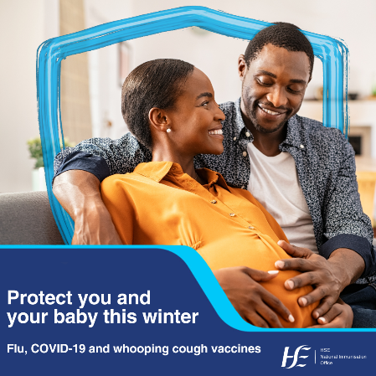
Slide Templates
For HSE and Funded Agencies
Protect you and your baby this winter – flu,
COVID-19 and whooping cough vaccines
NIO Campaign Pack Autumn-Winter 2023

Slide 2
Protect you and your baby this winter
Flu, COVID-19 and whooping cough vaccines
Autumn-Winter 2023
Background
As part of the HSE’s Autumn-Winter Vaccinations campaign, the NIO has developed a partner pack on the vaccines recommended in pregnancy. The HSE will issue a Press Release on 16th November to encourage those pregnant to get their COVID-19, flu and whooping cough vaccines.
This pack includes social media assets and messaging to support the campaign.
The flu, COVID-19 and whooping cough vaccines give pregnant women and people and their babies the best protection from these diseases, which can be serious. The vaccines are available for free. You can find a local pharmacy giving flu and COVID-19 vaccines on the HSE website. You can get your whooping cough vaccine through your GP practice.
We want to inform those who are pregnant the importance of getting vaccinated during their pregnancy to protect them and their baby from serious illness.
If you are pregnant, getting your free flu, COVID-19 and whooping cough vaccines will protect you from serious illness. The vaccines not only protect you, but also your baby as protection from the vaccines can pass to them. This means the vaccines can protect the baby in their earliest, most vulnerable months.
We want to remind those who are pregnant when to get vaccinated and reassure them it is safe to get their recommended vaccines at the same time.
If you are pregnant during the flu season (early October to late April), you should get the flu vaccine. The flu vaccine changes each year so you need to get vaccinated each flu season.
Pregnant women and people have also been prioritised for the autumn/winter COVID-19 vaccine as they are more at risk of being seriously ill from the COVID-19 virus. COVID-19 infection can also put their babies at risk of being born prematurely.
The whooping cough vaccines is also recommended during pregnancy to protect you and your baby from whooping cough (also called pertussis). If you are pregnant, you should get the vaccine between 16 and 36 weeks of your pregnancy. This is when the vaccine is most effective.
You can get the flu or COVID-19 vaccine at any stage in pregnancy. It is safe to get all three vaccines at the same time.
We want to encourage action and urge anyone pregnant to go to their GP practice or pharmacist to get vaccinated.
All three vaccines are available for free. You can find a local pharmacy giving Flu and COVID-19 vaccines on the HSE website.
You can get your whooping cough vaccine through your GP practice.
If you have questions, you can talk to your GP (doctor) or a trusted health and care professional. You can also visit hse.ie to learn more about your recommended vaccines.

Slide 3
Protect you and your baby this winter
Flu, COVID-19 and whooping cough vaccines
Autumn-Winter 2023
Audiences
Pregnant women
Health and care professionals
Partner organisations
Key messages
If you are pregnant, you are more at risk of serious illness from flu, COVID-19 and whooping cough.
It is important to make sure you are protected for the winter months ahead. The flu, COVID-19 booster and whooping cough vaccine will give you and your baby the best protection against the diseases.
The protection you get from the vaccines pass to your baby to help protect them in the first few months of life, when they are most vulnerable.
You can get the flu vaccine and COVID-19 booster at any stage in your pregnancy. You should get the whooping cough between 16 and 36 weeks of your pregnancy. It is safe to get more than one vaccine at the same time.
You can get your free flu and COVID-19 vaccines at participating GP practices and pharmacies. You can find a local pharmacy giving Flu and COVID-19 vaccines on the HSE website. You can get the whooping cough vaccine at your GP practice for free.
Visit the HSE website to read more about the vaccines recommended during pregnancy. If you have questions, speak to your GP (doctor) or a trusted health and care professional.

Slide 4
Protect you and your baby this winter
Flu, COVID-19 and whooping cough vaccines
Autumn-Winter 2023
Media briefing notes
COVID-19 and Flu
Awareness:
Flu is a severe infection caused by a virus. The flu virus infects your lungs and upper airways. Each autumn it is important to get their Flu vaccine to get protected. The National Immunisation Advisory Committee have recommended health and care workers, people from 6 months with conditions that put them at high risk of serious illness from flu, children aged 2-12 and people aged 65 and older get their flu vaccine. Women who are pregnant have a higher risk of severe complications if they get flu, it is recommended that the Flu vaccine be given at any stage of pregnancy.
COVID-19 has not gone away. NIAC have recommended this autumn and winter that health and care workers, people aged 5 years and older with a weak immune system, people aged 5-49 with conditions that put them at high risk of serious illness from COVID-19 and people aged 50 and older get their COVID-19 vaccine. Pregnant women have also been prioritised for the autumn COVID-19 booster as they are at increased risk of severe COVID-19, and serious infection may put their babies at risk of being born prematurely.
Reminder: Getting vaccinated will give your immune system the top up it needs to help protect you from serious illness.
Call-to-action: Visit www.hse.ie, call HSELive on 1800 700 700 or talk to a participating GP or Pharmacy.
Impact of COVID-19 vaccination programme
A study undertaken by the Health Protection Surveillance Centre (HPSC), examined the impact of the COVID-19 vaccination programme in Ireland between December 2021 and March 2023.
Between December 2021 and March 2023, the study estimated that the COVID-19 vaccination programme in Ireland prevented:
36% of expected symptomatic COVID-19 presentations to primary care/community testing centres,
53% of expected ED presentations,
81% of expected hospitalisations,
89% of expected ICU admissions and
87% of expected deaths.

Slide 5
Protect you and your baby this winter
Flu, COVID-19 and whooping cough vaccines
Autumn-Winter 2023
Media briefing notes
Pregnancy and Flu Vaccine
Why do pregnant women need the Flu vaccine?
Women who are pregnant have a higher risk of severe complications if you get flu. The flu vaccine protects you against the flu during your pregnancy, and it will also provide protection to your newborn baby during their first few months of life. Babies under 6 months are the children most likely to be admitted to hospital if they get flu and they are too young to be given a flu vaccine. Developing flu can be very serious for a small number of pregnant women and their babies, and can leave women at greater risk of complications such as bronchitis – a chest infection that can develop into pneumonia. In rare cases flu infection in pregnancy can lead to stillbirth, maternal death and an increased risk of miscarriage.
Pregnant women have also been prioritised for the autumn COVID-19 booster as they are at increased risk of severe COVID-19, and serious infection can put their babies at risk of being born prematurely.
Pregnant women can get the Whooping Cough vaccine between week 16 and 36 of pregnancy. Whooping cough (also known as pertussis) is highly contagious and can be life-threatening for babies. The vaccine stimulates your immune system to produce high levels of antibodies to the whooping cough bacteria. These antibodies will also pass to your baby in the womb and protect them during the first few months of life and will protect you and your baby from whooping cough.
At what stage of pregnancy should I get the flu vaccine?
If you are pregnant during the flu season, you should get the flu vaccine. Flu vaccine can be given at any stage of pregnancy, but the sooner you get it, the sooner you are protected.
Is it safe for pregnant women to get the vaccine?
Extensive research and clinical evidence show that vaccines are safe for pregnant women, both the World Health Organisation and the European Centre for Disease Control strongly endorse the use of vaccination for pregnant mothers. The vaccines given to pregnant women are made with inactivated or non-live components, which means they are safe for both the pregnant woman and the child.
I was pregnant at the end of the last flu season and received flu vaccine then. I am still pregnant, so should I receive flu vaccine now?
Yes. The flu vaccine for this flu season is different from last season’s vaccine and this vaccine will now give you immunity (protection) from the flu strains (types) expected this flu season
How long does it take the vaccine to work?
The vaccine starts to work within two weeks.

Slide 6
Protect you and your baby this winter
Flu, COVID-19 and whooping cough vaccines
Autumn-Winter 2023
Media briefing notes
Pregnancy and Flu Vaccine (cont.)
Who should not get the flu vaccine?
You should not get the flu vaccine if you have had a severe allergic reaction (anaphylaxis) to a previous dose of flu vaccine or any part of the vaccine. You should not get the vaccine if you are taking medicines called combination checkpoint inhibitors (for example, ipilimumab plus nivolumab) which are used to treat cancer. You should not receive any flu vaccine if you have severe neutropoenia (low levels of a type of white blood cell); except for those with primary autoimmune neutropenia.
When should you delay getting the vaccine?
There are very few reasons why you should delay getting the vaccine. However, you should re-schedule your vaccine appointment if you are unwell with a fever (temperature) greater than 38°C. Talk to your GP (Doctor) or pharmacist about the best time to reschedule your appointment.
What should someone do if they develop a reaction from the vaccine while pregnant?
If you are concerned about your symptoms, you can contact your GP or maternity team for further advice. https://www.bmj.com/company/newsroom/no-link-between-flu-vaccine-in-pregnancy-and-later-health-problems-in-children/
Whooping Cough
What is whooping cough?
Whooping cough is also known as pertussis. The disease causes long bouts of coughing and choking in children making it hard to breathe. A child may turn blue from lack of air, or vomit after a coughing spell. Between these coughing spells a child gasps for air causing the characteristic ‘whoop’ sound. Not all children get the ‘whoop’. A child with whooping cough can have difficulty eating, drinking or even breathing. The disease can last up to three months. Whooping cough is most serious in babies under 12 months of age, often requiring admission to hospital and may be fatal.
How do people get whooping cough?
Whooping cough is a very contagious disease; it is very easily spread from person to person. It is caused by bacteria called Bordetella Pertussis that live in the mouth, nose and throat. Whooping cough is spread by personal contact, coughing and sneezing. Infection is often transmitted to young children in the home from older siblings or adults who may be harbouring the bacteria in their nose and throat.
Whooping cough can occur at any age. Although most reported cases occur in children less than five years, cases are reported amongst adolescents and adults every year. In 2016, 142 cases of whooping cough were reported in the first 8 months of the year and one infant died from whooping cough infection. In 2019 165 cases were reported however during the Covid -19 pandemic in 2021 there were only 3 confirmed cases of whooping cough.
Many reported cases occur among infants, some of whom are too young to have received the three primary doses of vaccine necessary to provide protection. Since 2013 pertussis vaccine has been recommended for during each pregnancy to provide protection to infants in the first few months of life.

Slide 7
Protect you and your baby this winter
Flu, COVID-19 and whooping cough vaccines
Autumn-Winter 2023
Media briefing notes
Whooping Cough (cont.)
Whooping cough vaccine
Women should get whooping cough vaccine during each pregnancy. Pregnant women's immunity to whooping cough wanes during pregnancy and is unlikely to protect the baby. Therefore she should get vaccinated between 16 and 36 weeks of pregnancy. This is considered to be the best time in pregnancy to provide protection for the baby during the first few months of life.
How does the Whopping cough vaccine protect you and your baby?
The vaccine stimulates your immune system to produce high levels of antibodies to the whooping cough bacteria. These antibodies will also pass to your baby in the womb and protect them during the first few months of life. If you or your baby are in contact with whooping cough the antibodies will attack these bacteria and will protect you and your baby from whooping cough. The antibodies you pass to your baby in the womb decline rapidly in the first six months of life so it is important your baby gets the routine childhood vaccines (which include whooping cough vaccine) on time at 2, 4 and 6 months.
How often should pregnant women get the vaccine?
The antibodies you develop after vaccination decline over time so you need to get the vaccine again in your next pregnancy .You should get whooping cough vaccine during every pregnancy so that high levels of these antibodies are passed to each of your babies in the womb.
What vaccine should pregnant women get?
You should get a Tdap vaccine. This is a low dose tetanus (T), diphtheria (d) and low dose pertussis (ap) booster vaccine which protects against tetanus, diphtheria and whooping cough (pertussis).
How long does it take the vaccine to work?
The vaccine starts to work within two weeks.
Can I get the vaccine if I am breastfeeding?
The vaccine is safe to give if you are going to or are breastfeeding.
Can I get the Whooping cough vaccine after pregnancy?
Whooping cough vaccine should be offered to women in the week after birth who have not had a whooping cough vaccine in the past ten years to protect themselves and their baby.
Can the Tdap vaccine be given at the same time as the flu and the COVID-19 vaccine during pregnancy?
Yes. You can have Tdap, Flu and COVID-19 vaccines at the same time. The vaccines are usually given in each arm.
.

Slide 8
Protect you and your baby this winter
Flu, COVID-19 and whooping cough vaccines
Autumn-Winter 2023
Media briefing notes
Whooping Cough
The following resources have been developed to support discussions about the Whooping cough vaccine.
Vaccination and pregnancy video: https://youtu.be/MbNXTdcmp3k
Whooping cough vaccine for pregnant women leaflet: https://www.hse.ie/eng/health/immunisation/pubinfo/pregvaccs/pertussis/engpertussis1218.pdf
Whooping cough and pregnancy poster: https://www.hse.ie/eng/health/immunisation/hcpinfo/othervaccines/pertussis/engpospert.pdf
Both the poster and leaflet option are available in additional languages here

Slide 9
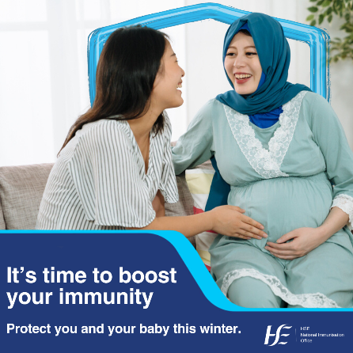
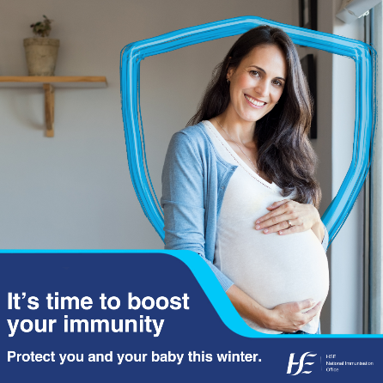
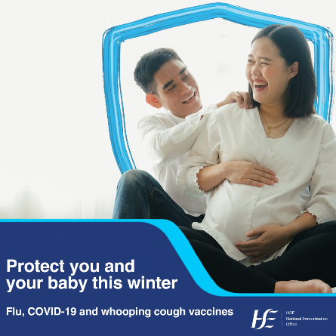
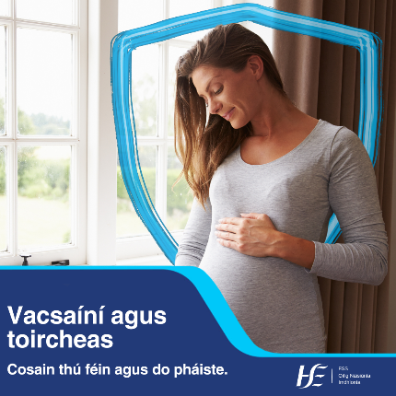
Protect you and your baby this winter
Flu, COVID-19 and whooping cough vaccines
Autumn-Winter 2023
Sample social media messages
The vaccines recommended for you if you are pregnant give you and your baby important protection from serious illness. You can get your free flu vaccine at the same time as your free whooping cough or COVID vaccine. Make an appointment with your healthcare provider.
https://bit.ly/45XLJZT
If you are pregnant, it’s time to boost your immunity so you and your baby are protected this winter. You can get your free flu vaccine at the same time as your COVID-19 booster or whooping cough vaccine. Make an appointment with your healthcare provider.
https://bit.ly/45XLJZT
Má tá tú ag iompar clainne féadann tú do vacsaíní saor in aisce a fháil. Tuilleadh eolais: https://bit.ly/45XLJZT

Slide 10
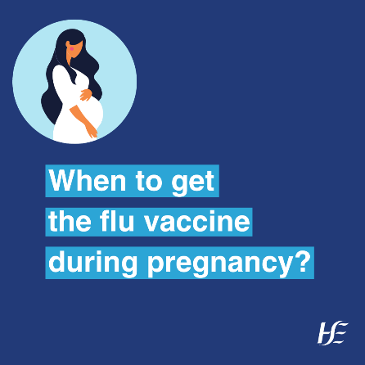
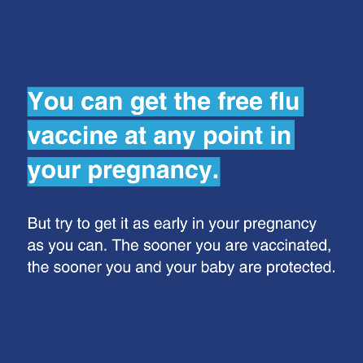
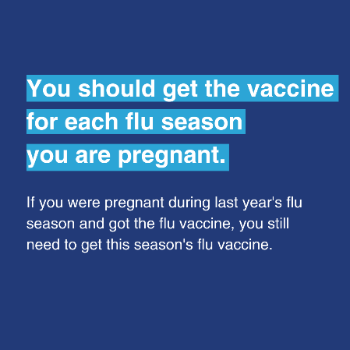
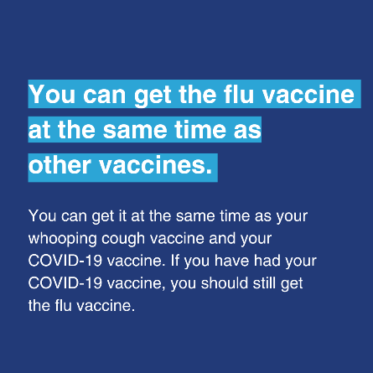
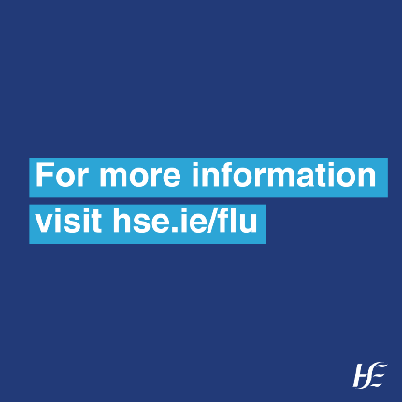
Protect you and your baby this winter
Flu, COVID-19 and whooping cough vaccines
Autumn-Winter 2023
Sample social media messages
Swipe -> to learn when you should get the flu vaccine in your pregnancy. The flu, COVID-19 and whooping vaccines are recommended for you if you are pregnant to give you and your baby important protection from serious illness.
You can get your free flu vaccine at the same time as your whooping cough or COVID vaccine. You can get your flu vaccine or COVID-19 booster at any stage in your pregnancy. You should get the whooping cough vaccine between 16 and 36 weeks of your pregnancy.
Speak with your healthcare provider to make an appointment to get vaccinated.
Visit hse.ie to learn more. Link in bio.

