Slide 1
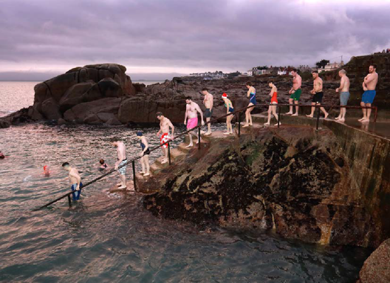
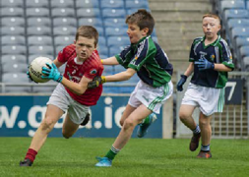
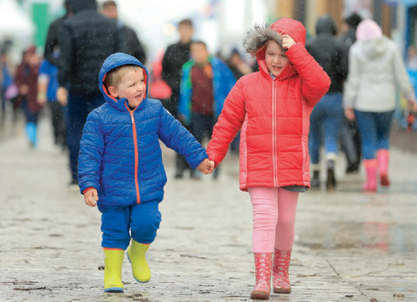
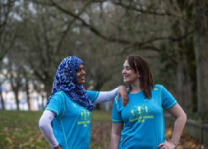
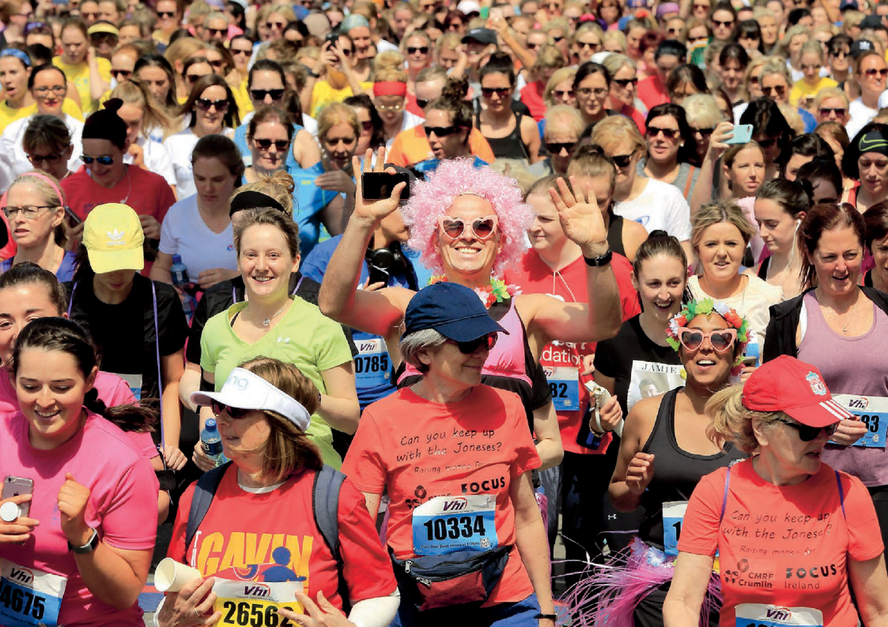
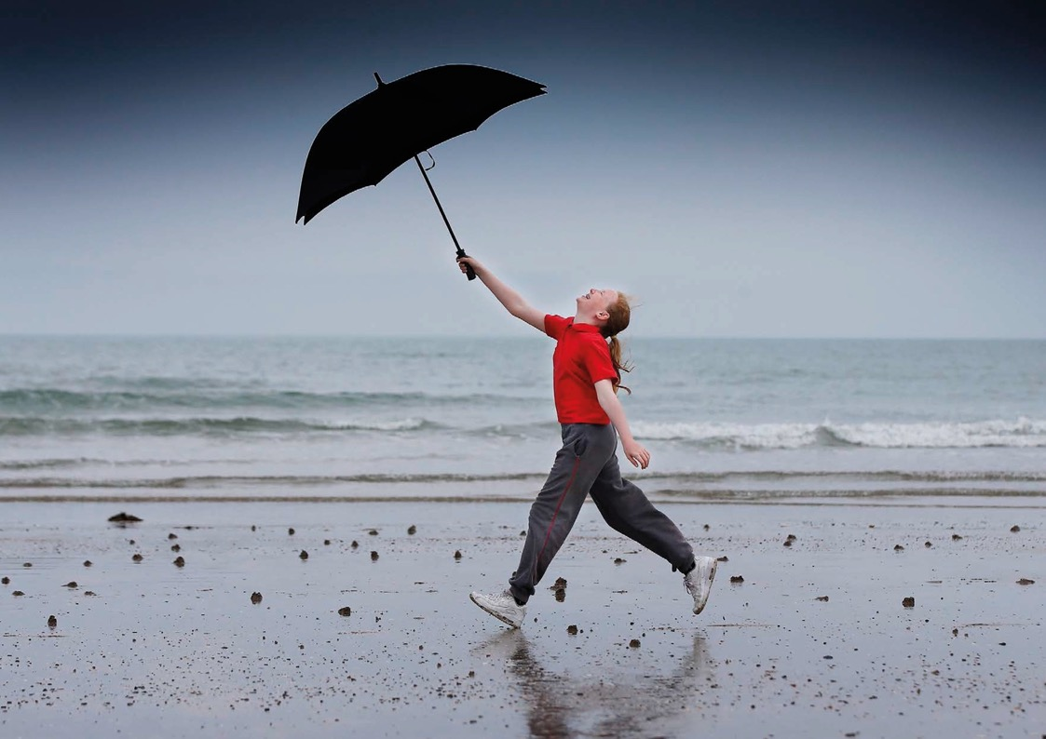
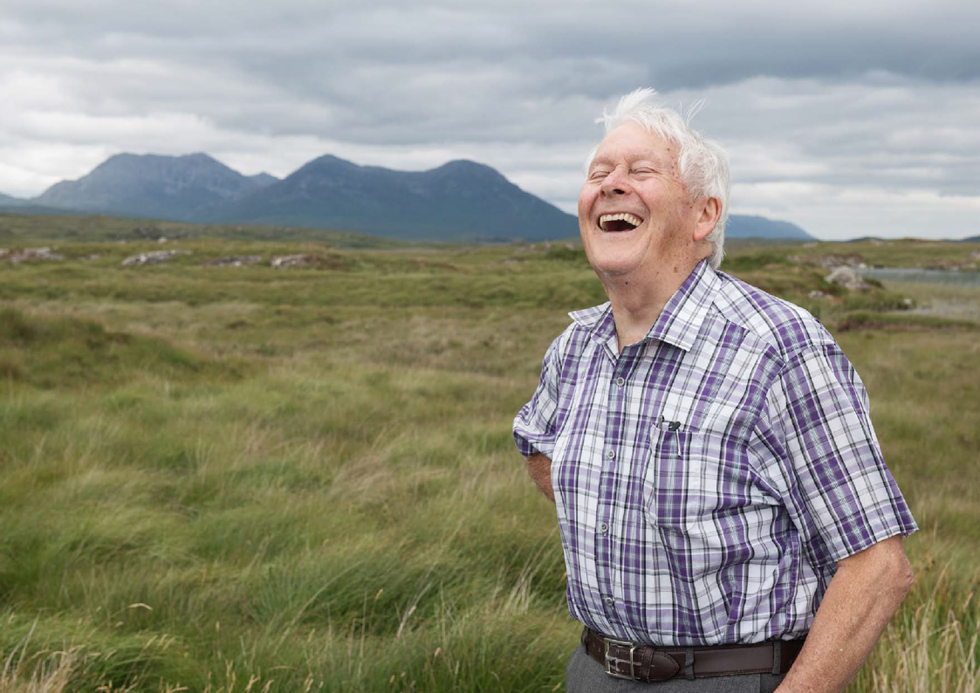
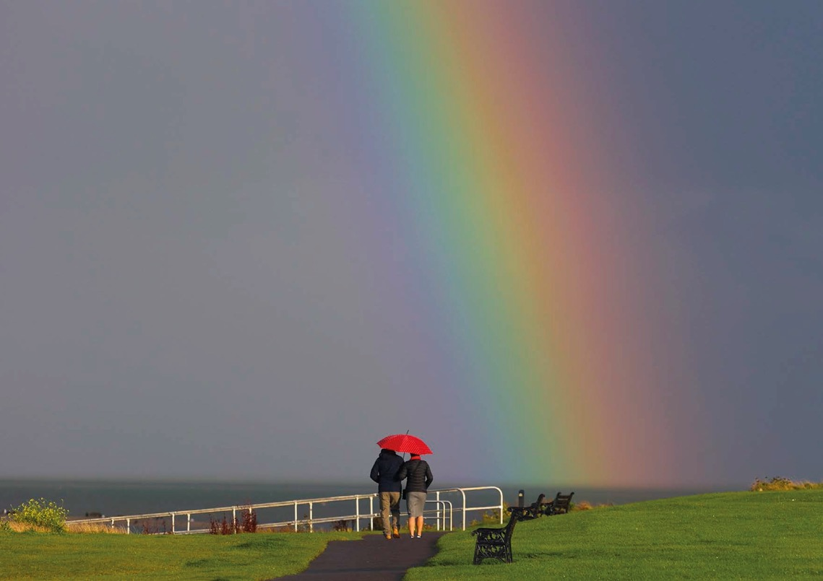

Slide 2
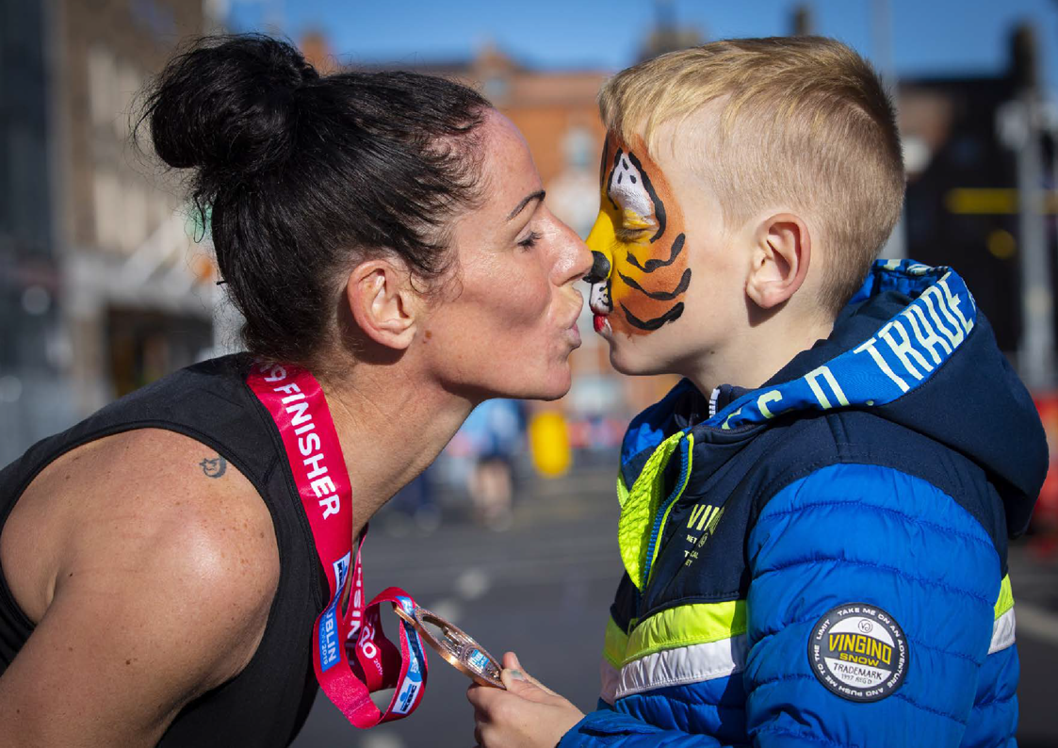
SEALED WITH A KISS
PHOTOGRAPH: FERGAL PHILLIPS
Finnula Heaney is congratulated by her son Dylan after finishing the Dublin Marathon.

Slide 3
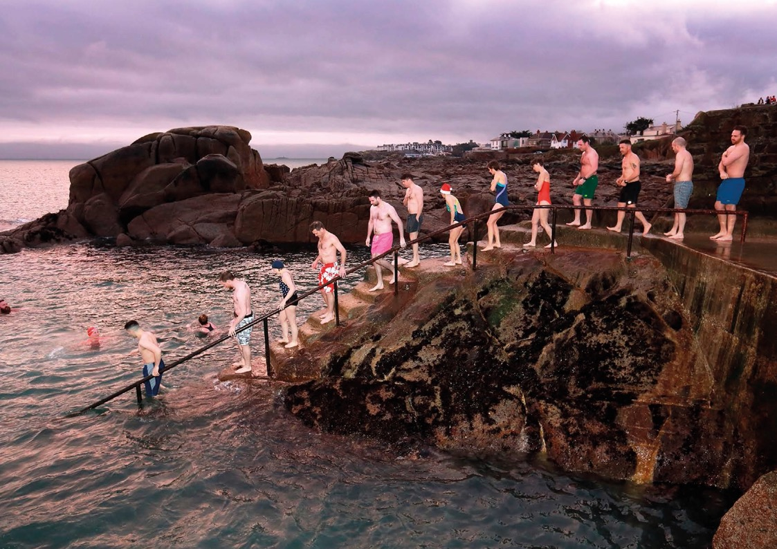

Slide 5
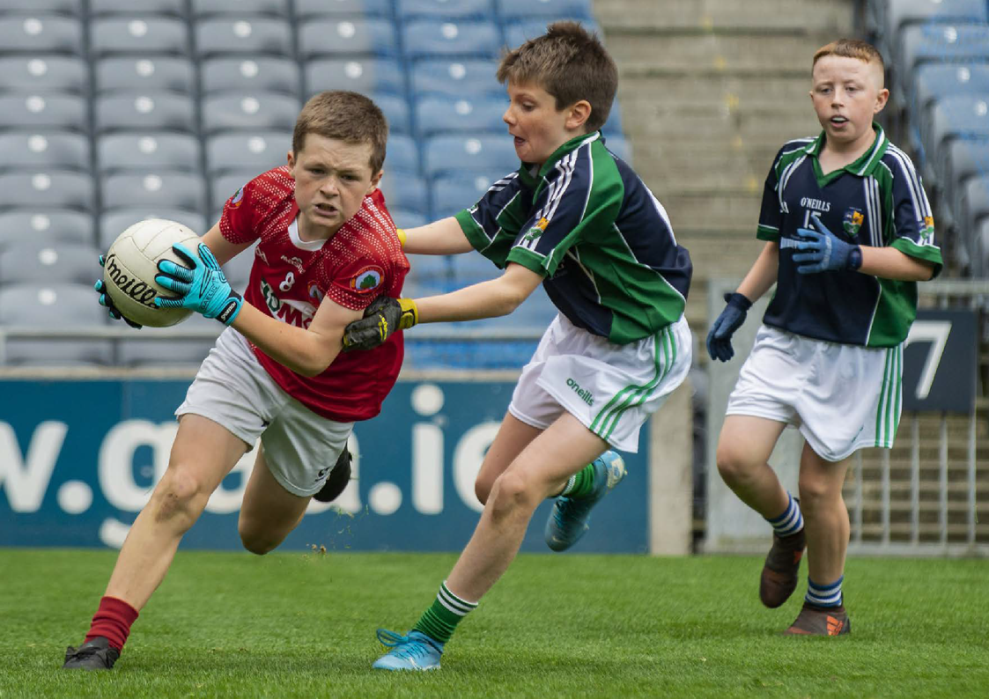

Slide 6
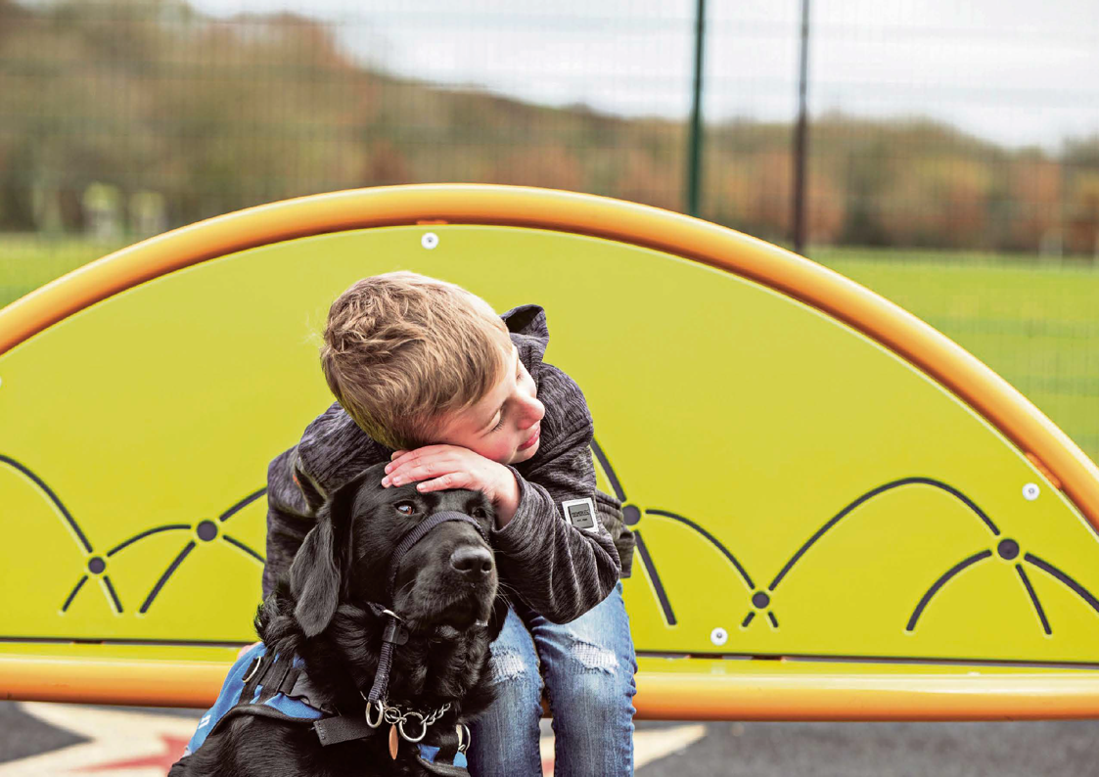

Slide 8
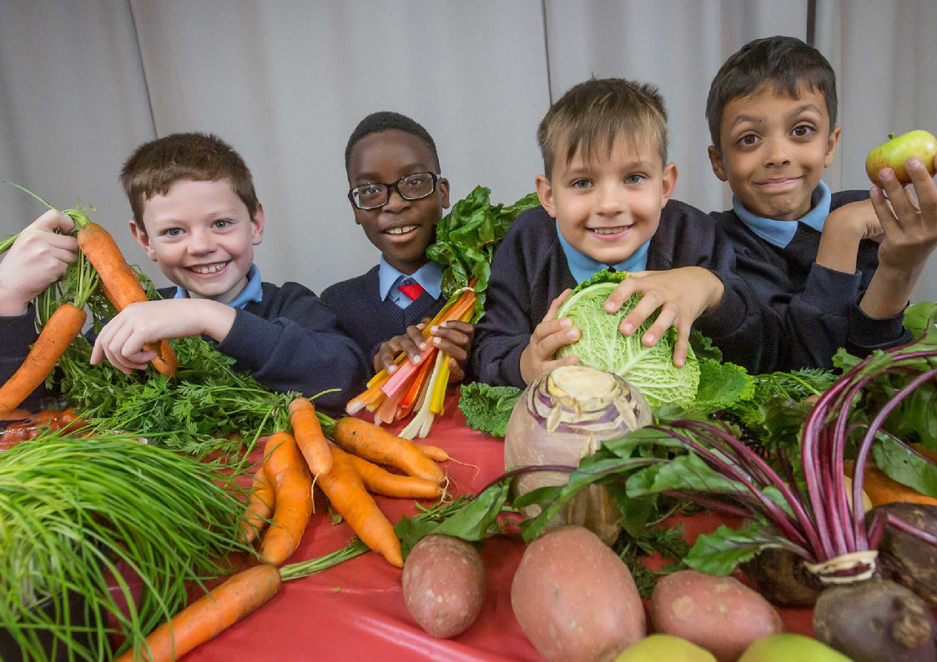

Slide 9
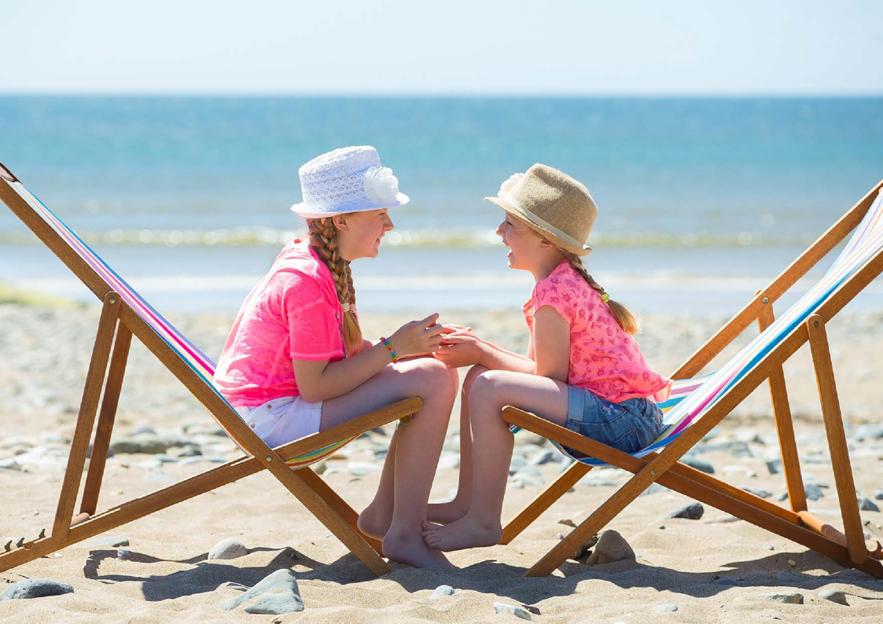

Slide 10
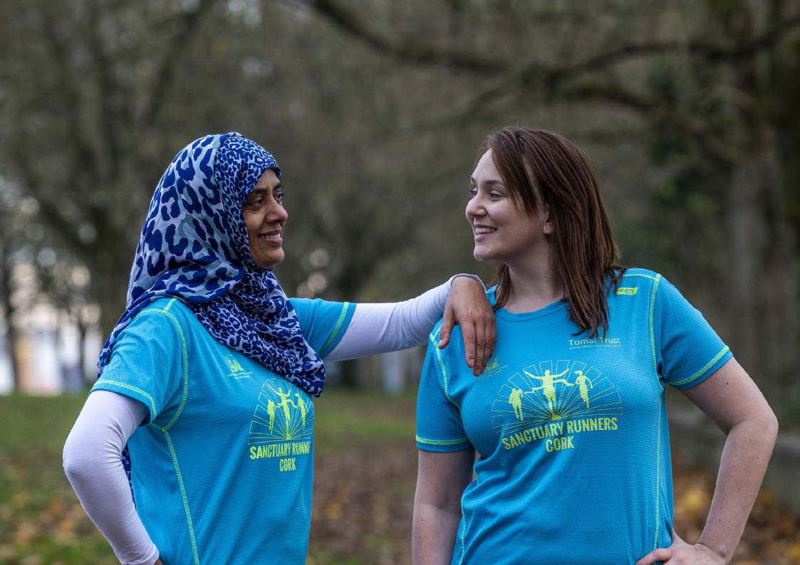

Slide 13
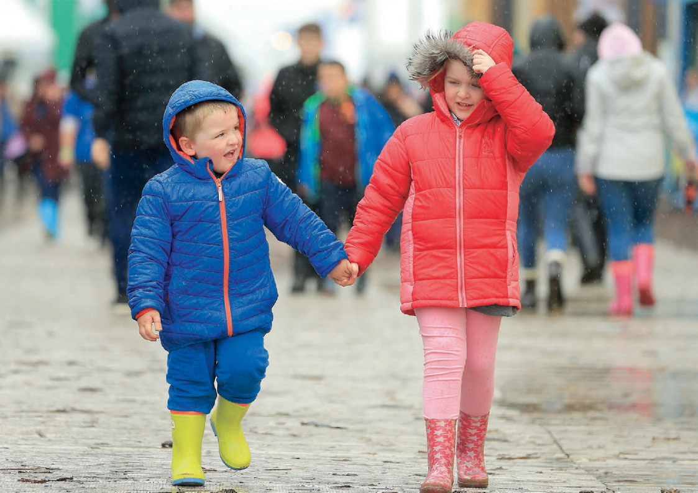

Slide 14
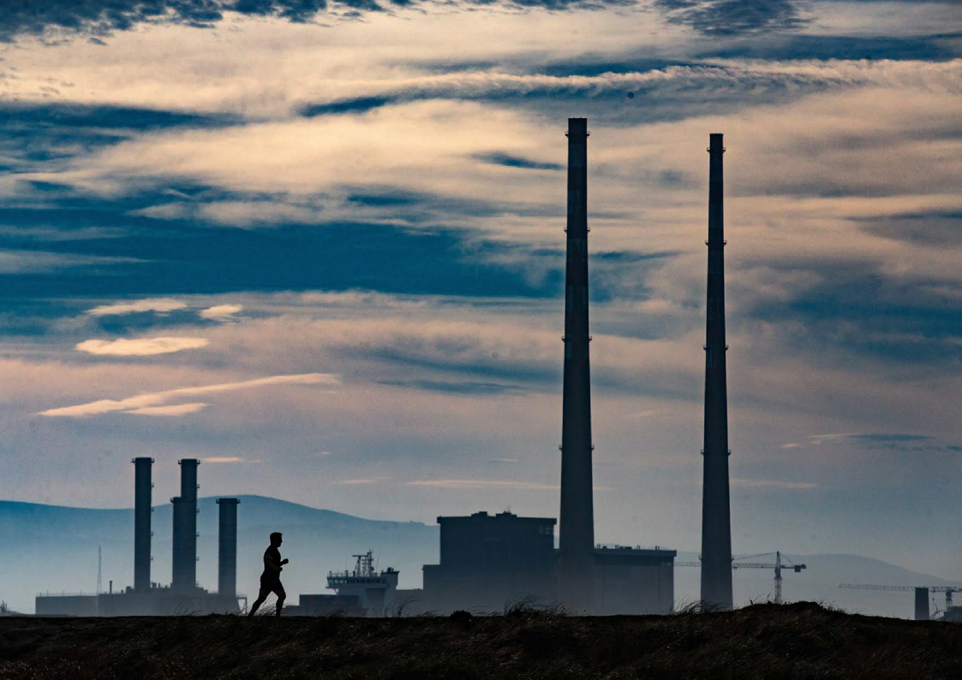

Slide 16
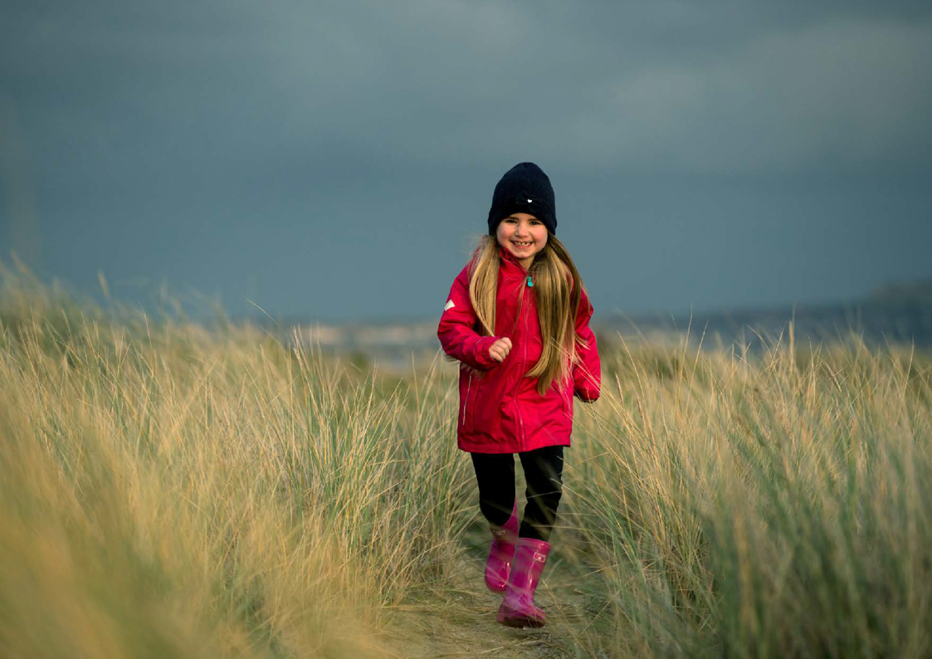
RUNNING FOR SMILES
PHOTOGRAPH: MARK CONDREN
Eight-year-old Emma Purcell runs through the sand dunes.

Slide 17
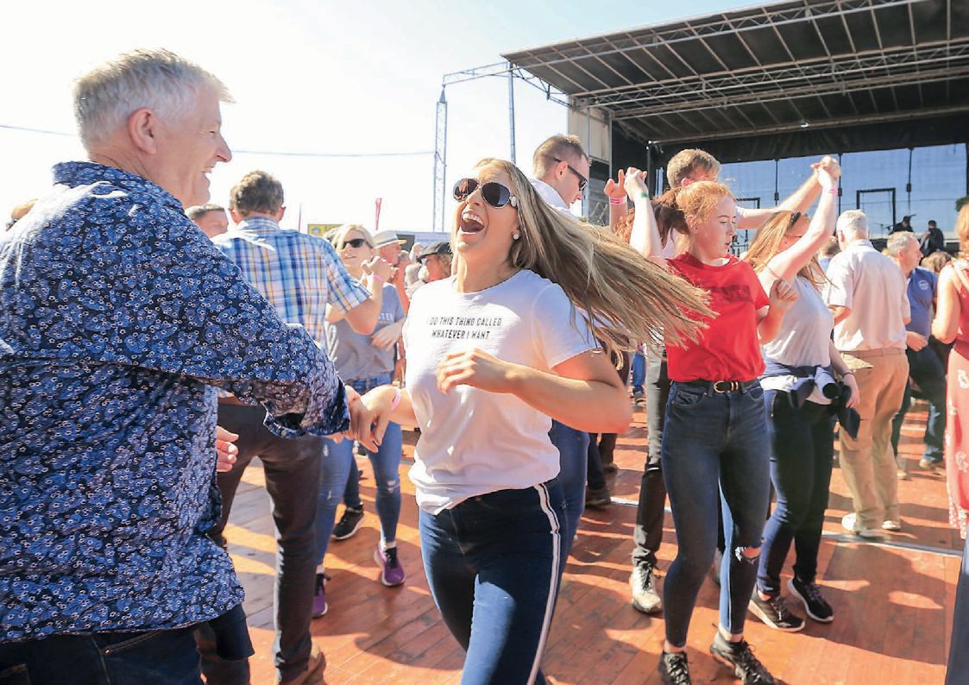
DANCE NATION
PHOTOGRAPH: GERRY MOONEY
Shay Wade from Blanchardstown and Shell Haverty from Loughrea, Co Galway get in to the swing of things as Derek Ryan and his band play on the main entertainment stage at the National Ploughing Championships.

