Slide 1
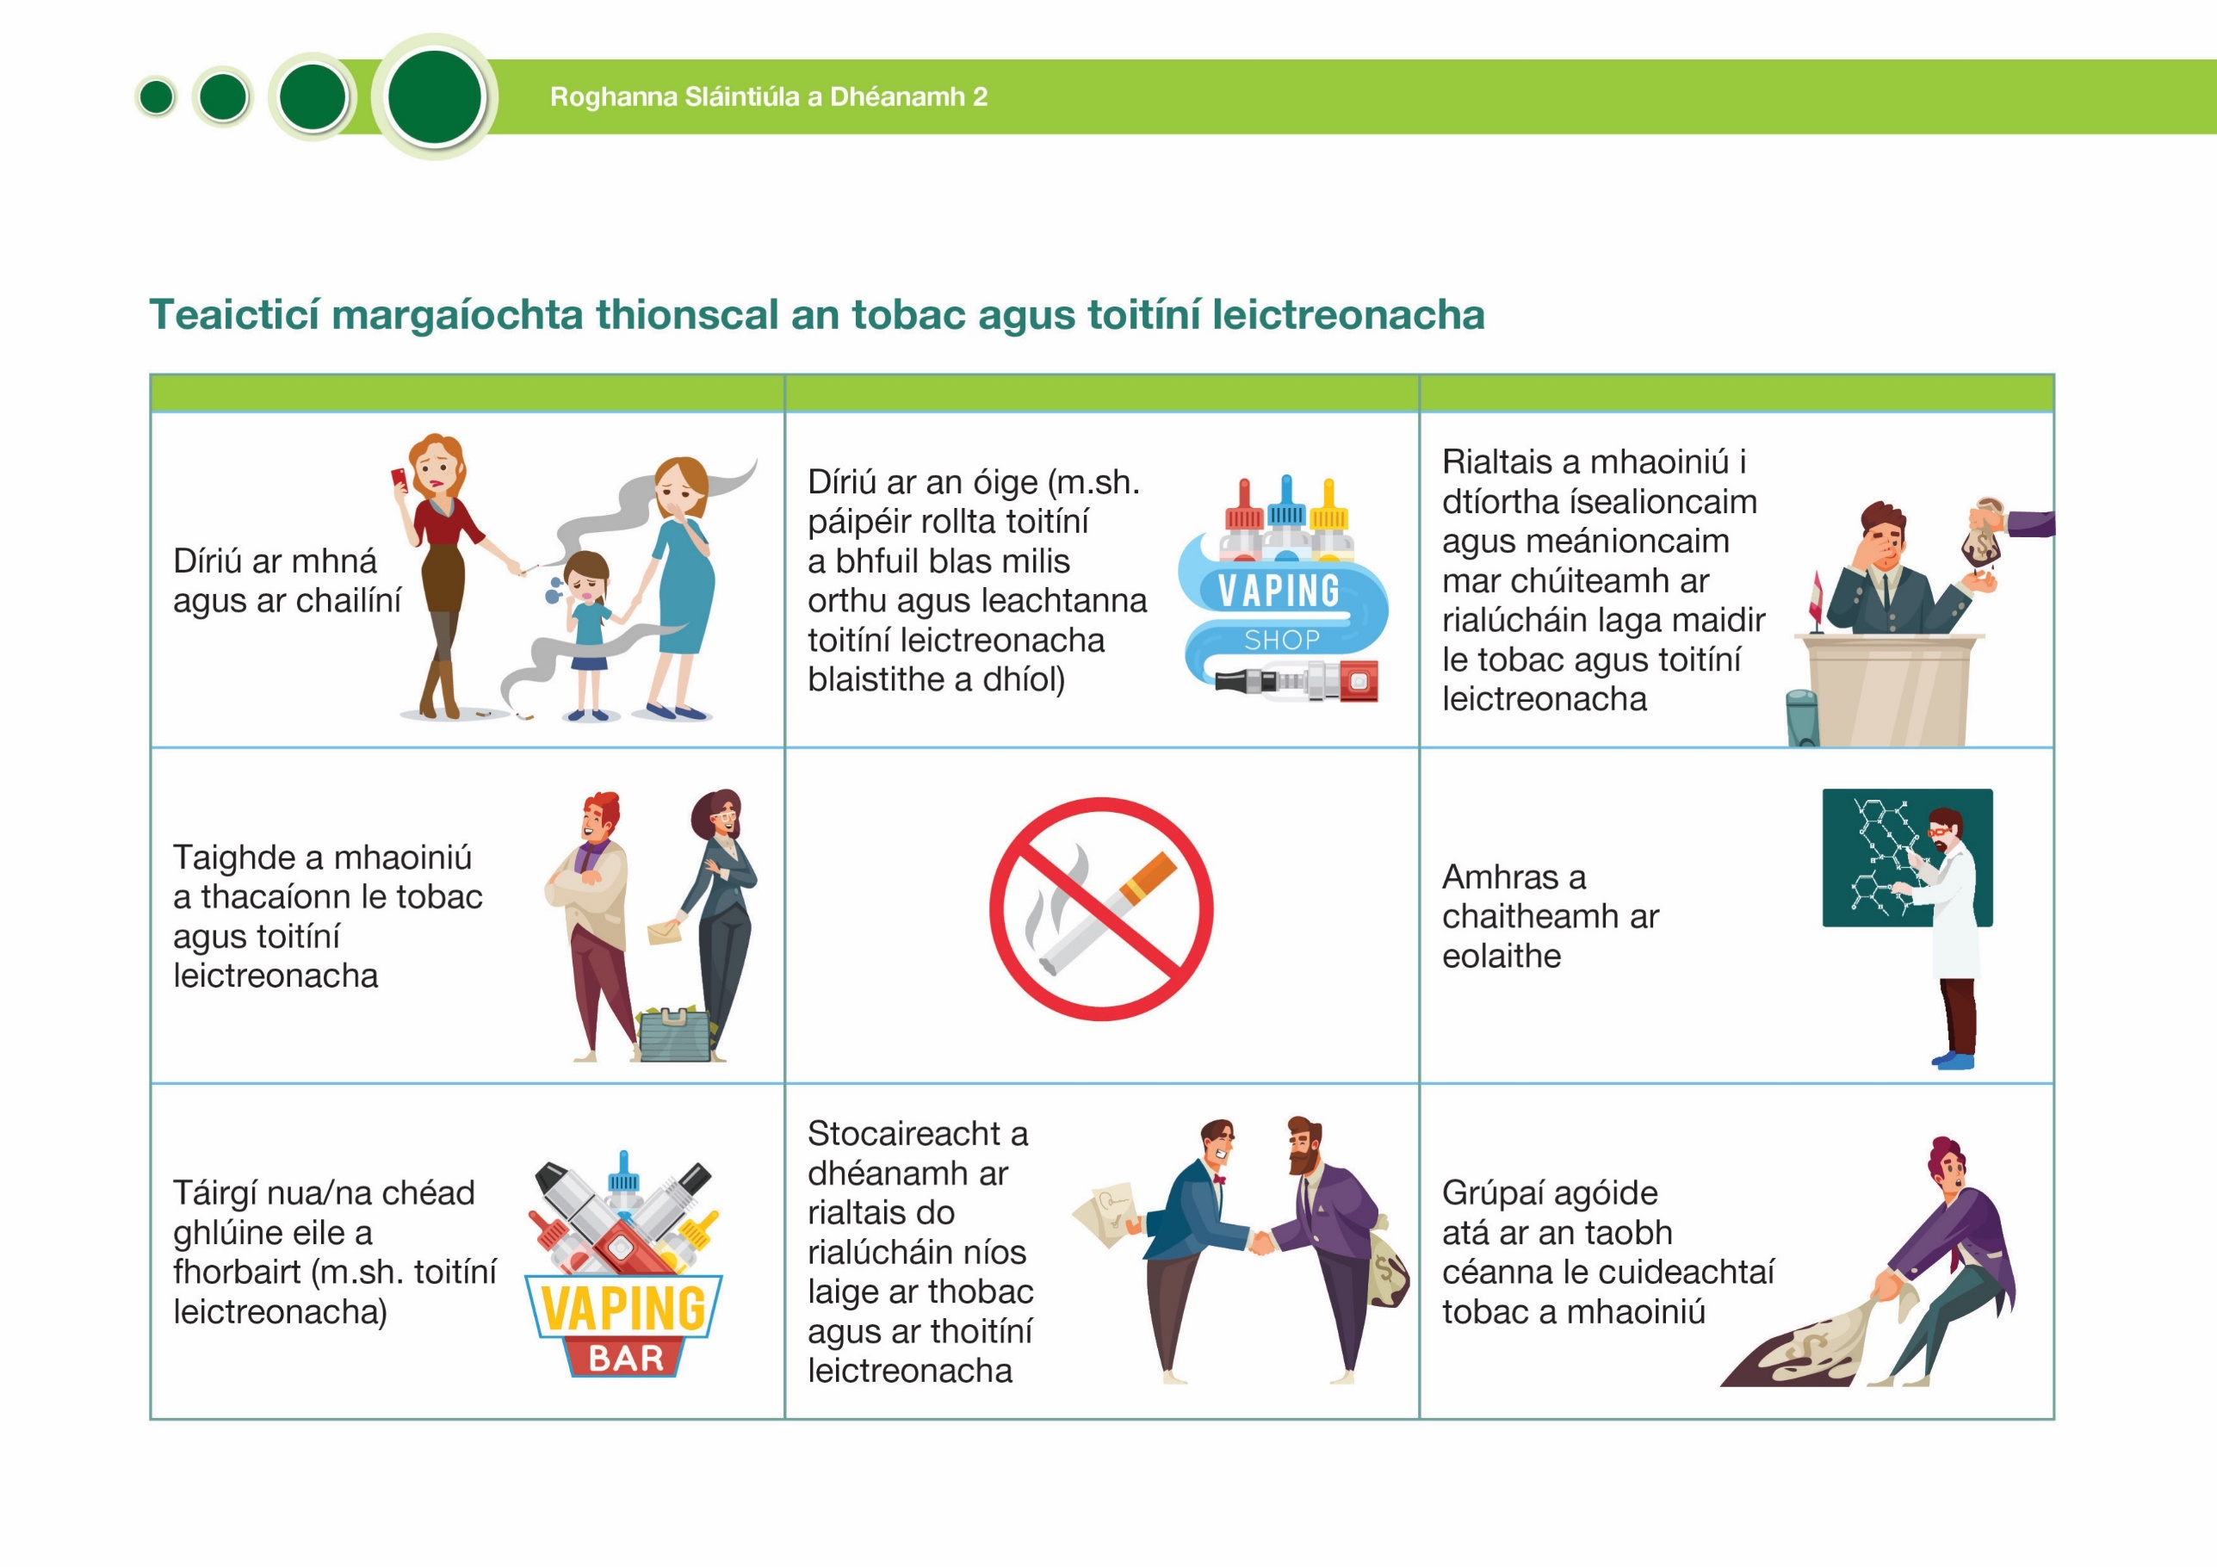








Tobacco and e-cigarette industry marketing tactics
Targeting women and girls | Targeting youth (e.g. selling sweet- flavoured cigarette rolling papers and flavoured e-liquids) | Funding governments in low- and middle- income countries in exchange for weak tobacco and e-cigarette regulations
Funding pro-tobacco and e-cigarette research |  | Discrediting scientists
Developing new/ next-generation products (e.g. e-cigarettes) | Lobbying governments for weaker regulations on tobacco and e-cigarettes | Funding protest groups who are on the same side as tobacco companies

