Slide 1
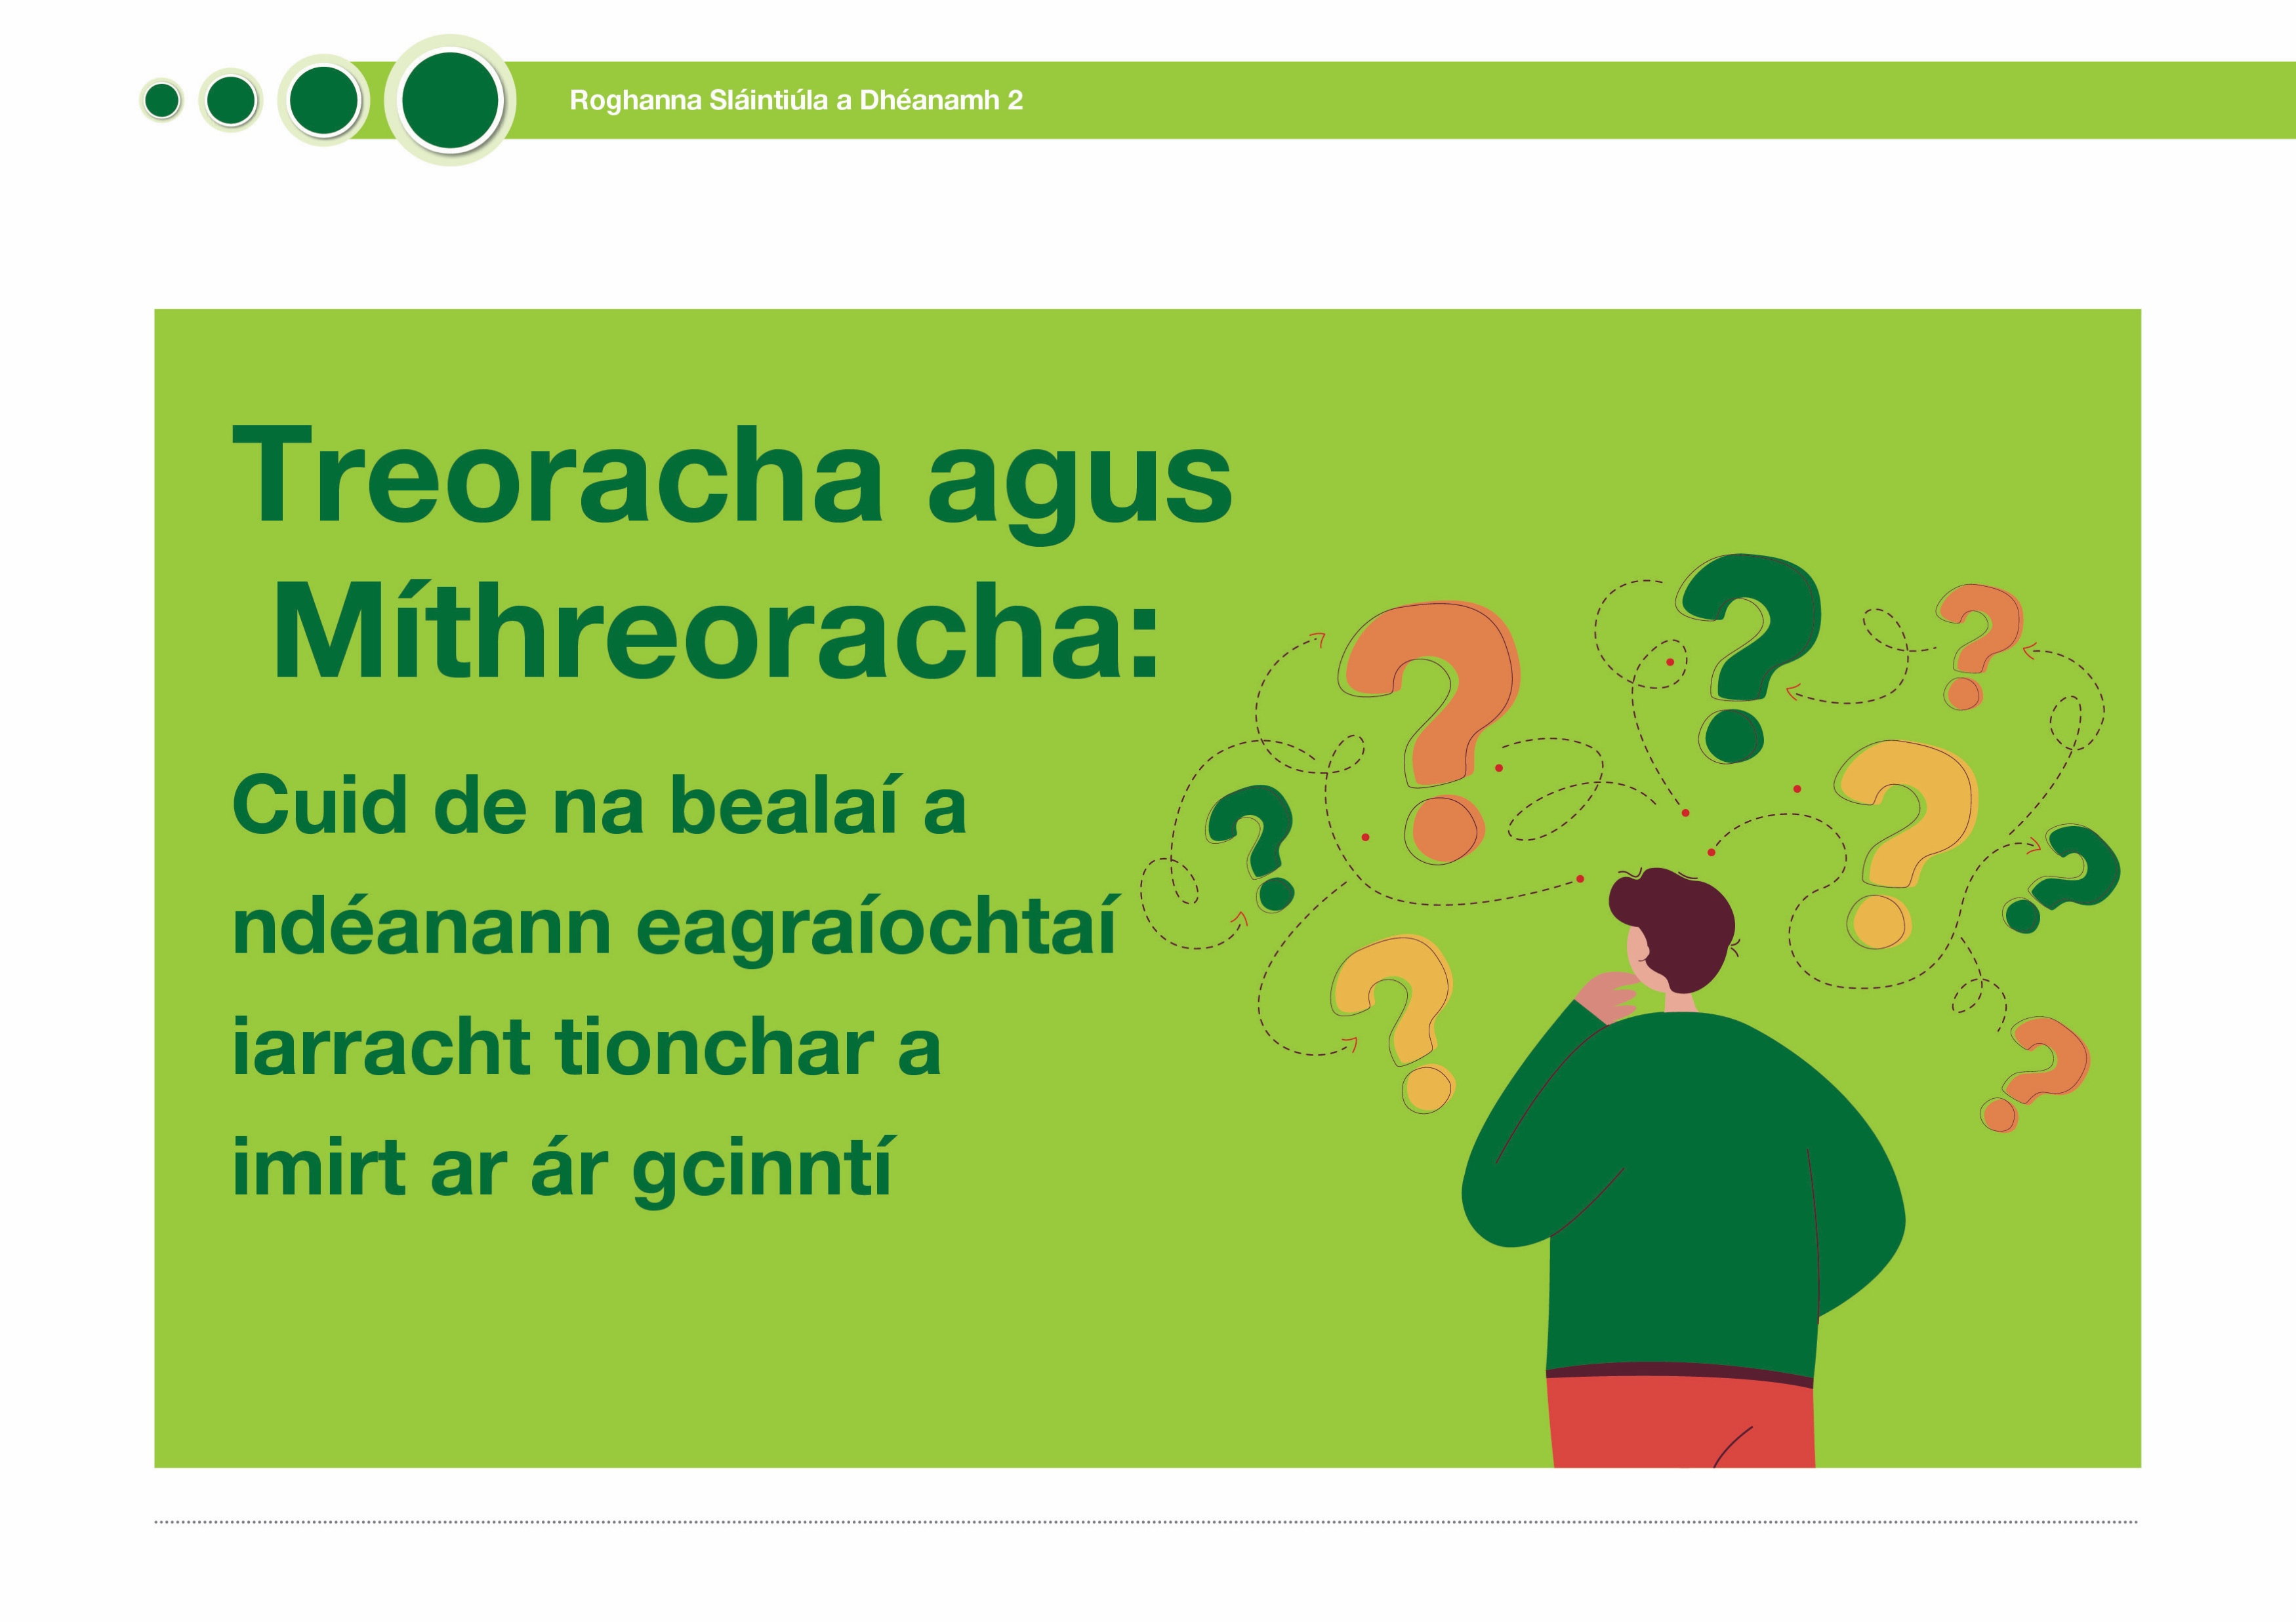
Being healthy 2

Slide 2
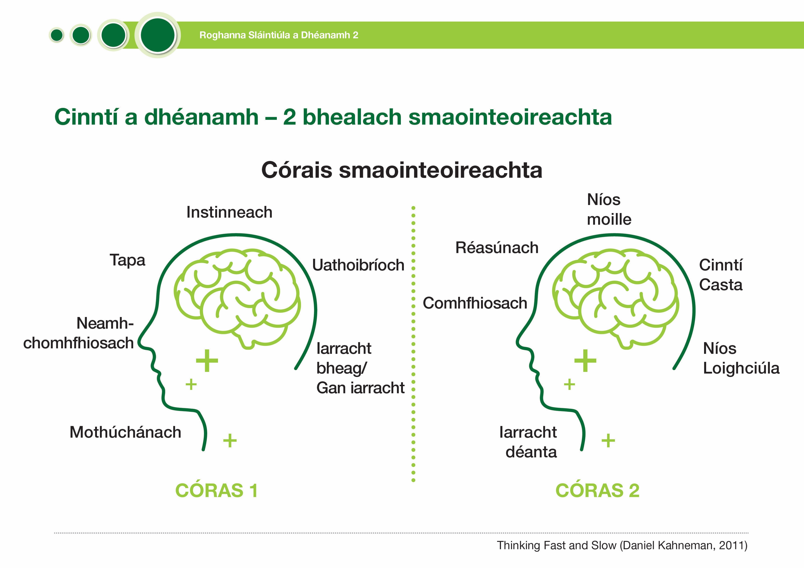
Being healthy 2

Slide 3
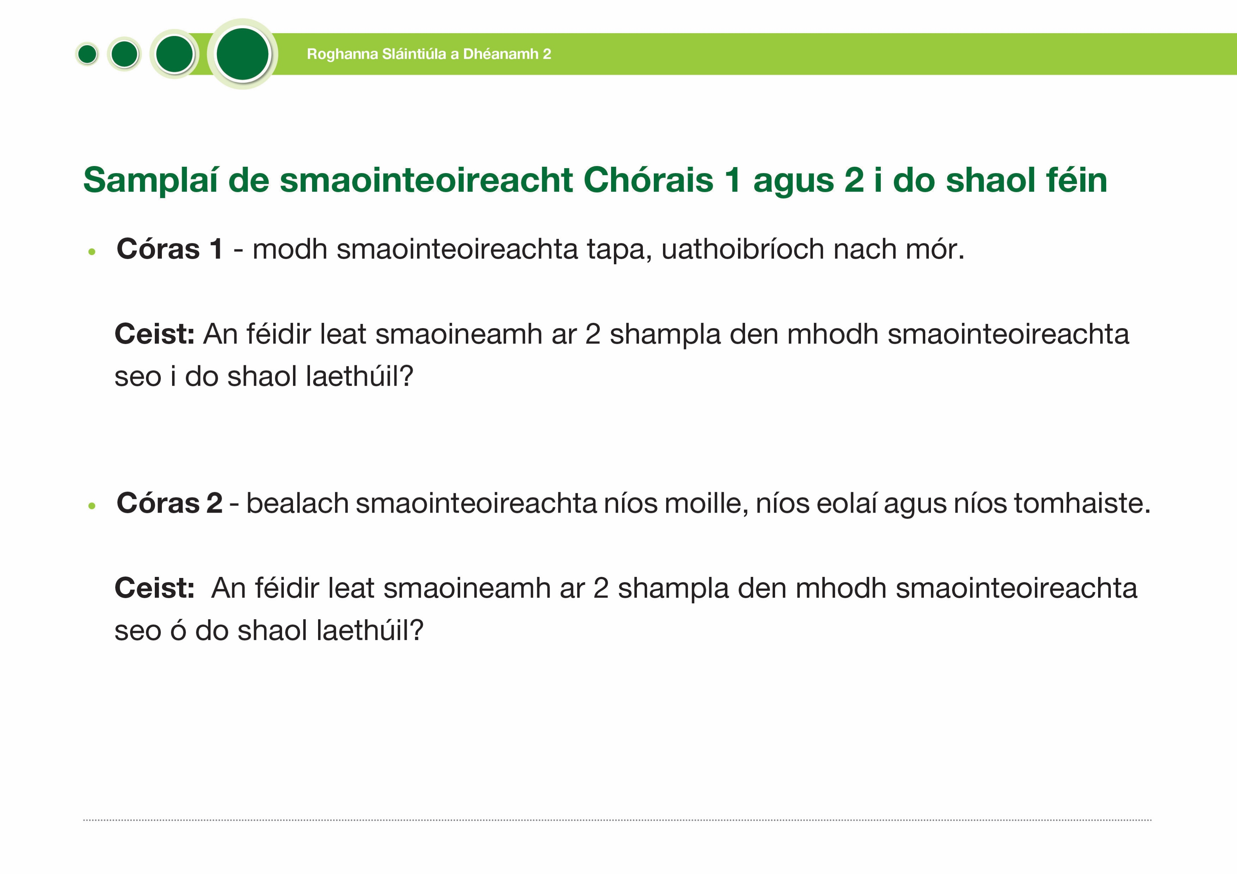

Being healthy 2

Slide 4
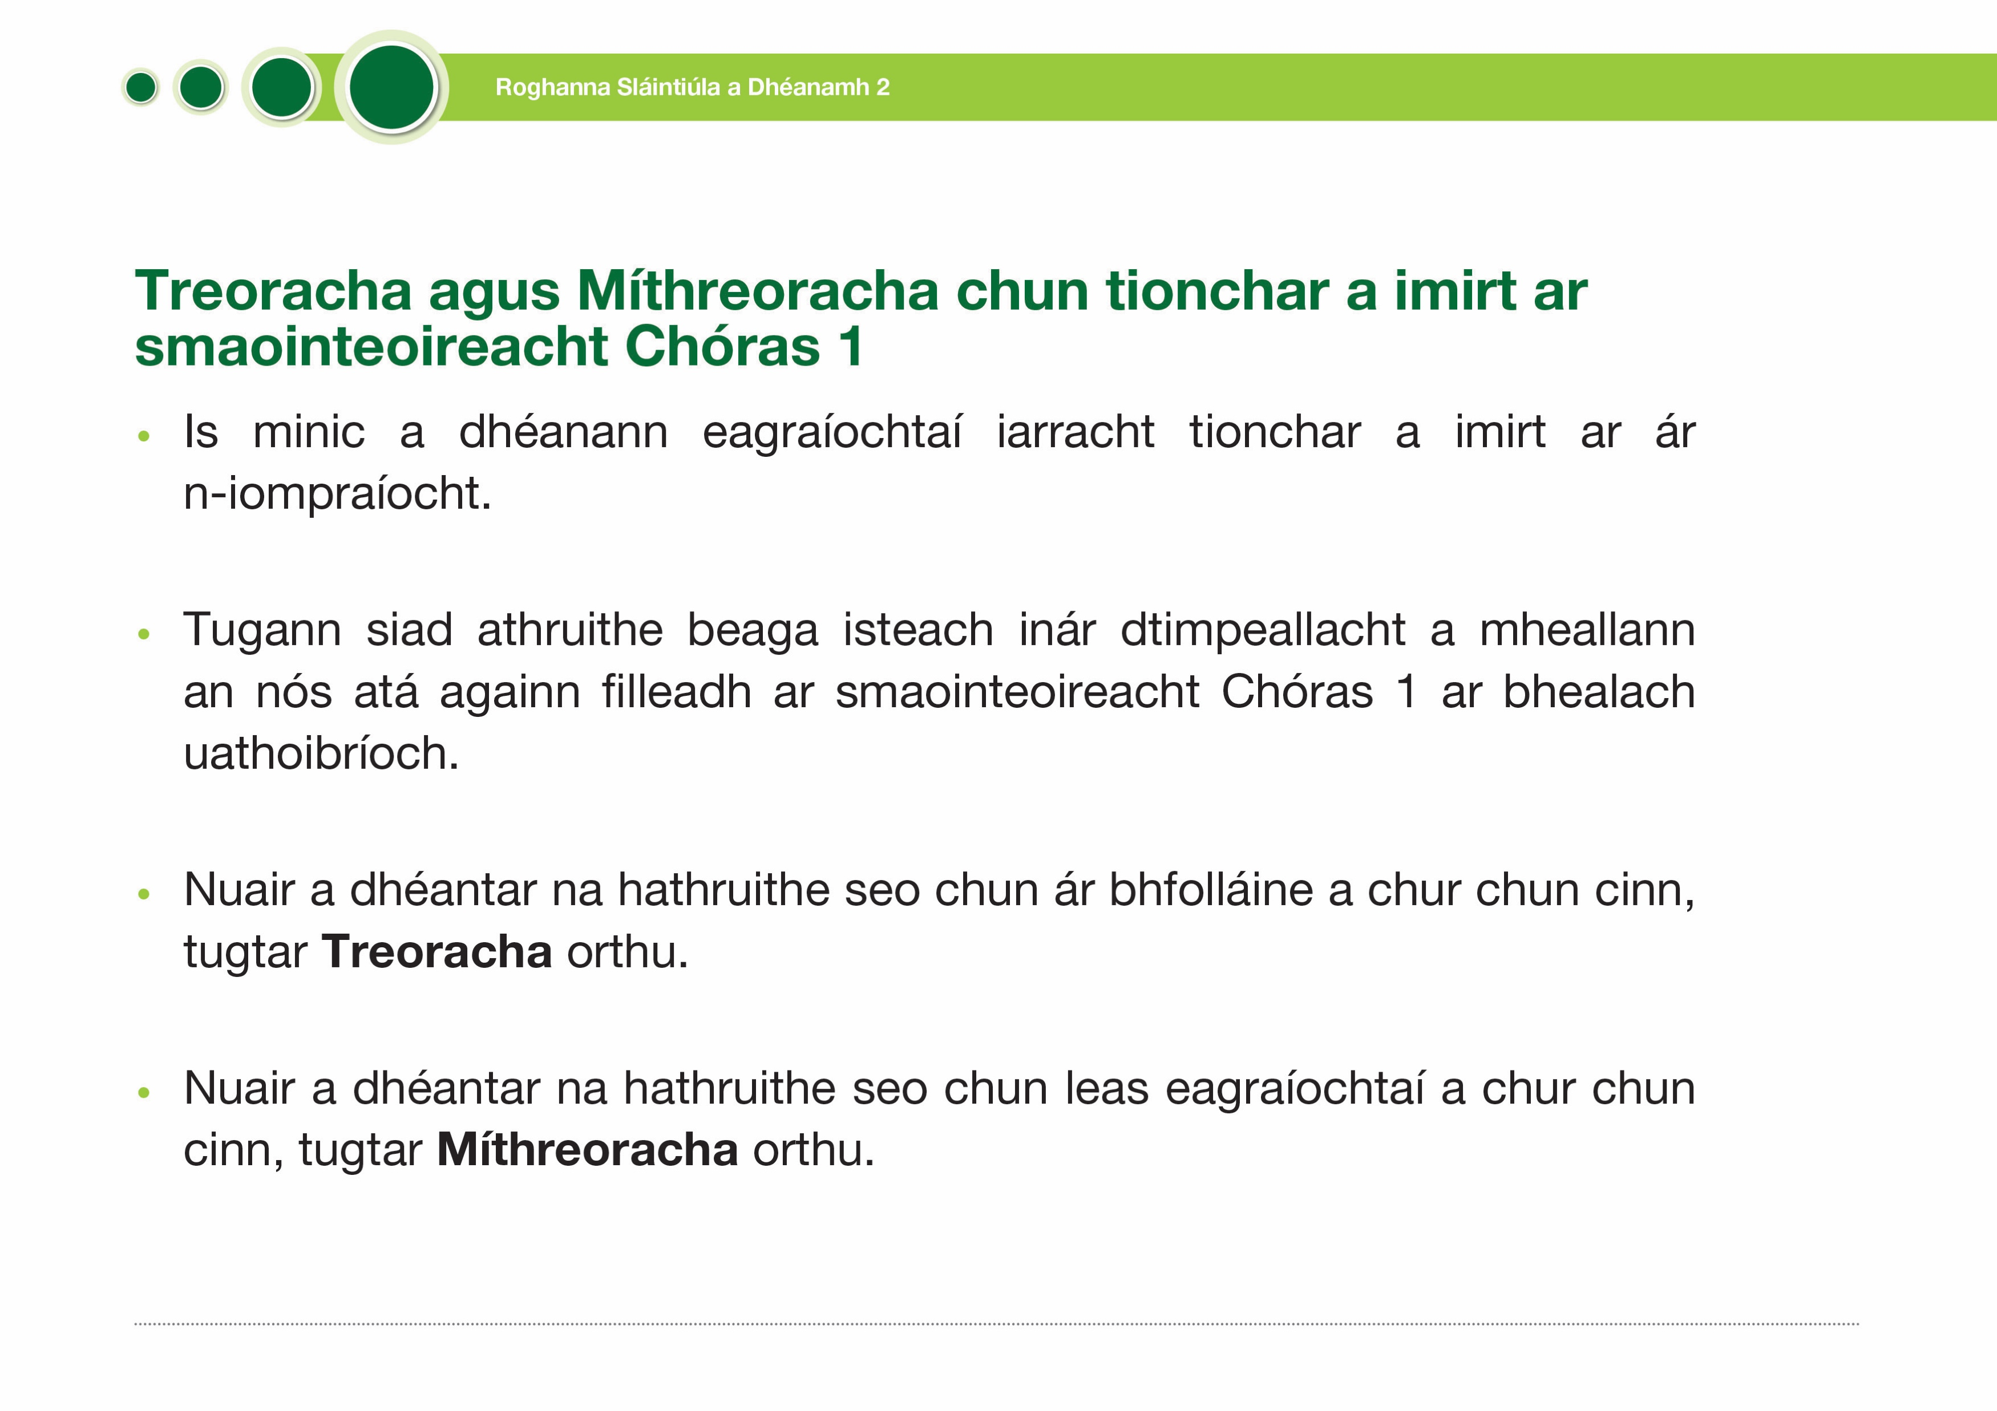

Nudges and Sludges to influence our System 1 thinking
Being healthy 2
Organisations often try to influence our behaviour.
They introduce small changes to our environment that appeal to our habit of default, less conscious, System 1 thinking.
When these small changes are to promote our wellbeing, they are called
Nudges.
When these small changes are to promote the organisations interests, they are called Sludges.

Slide 5
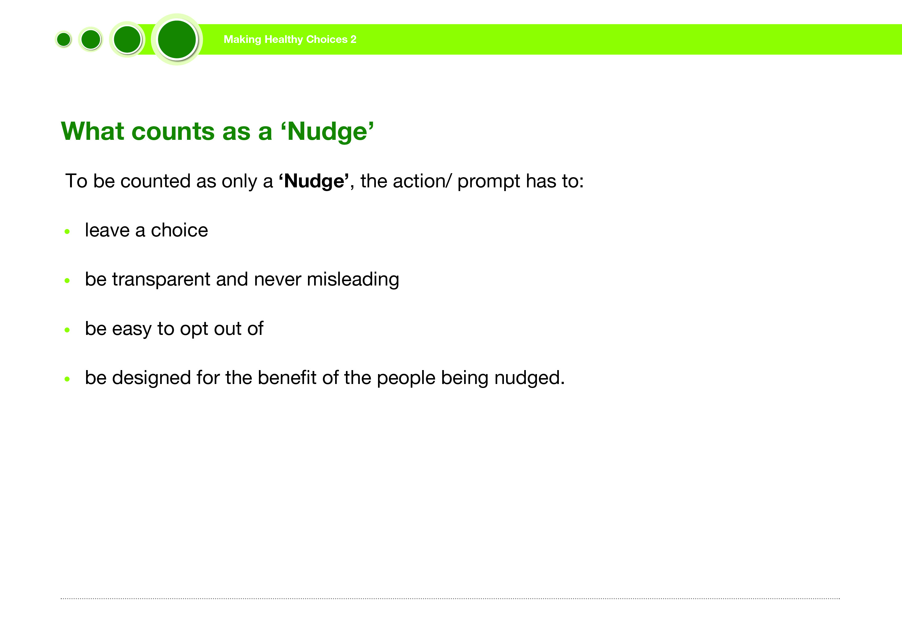
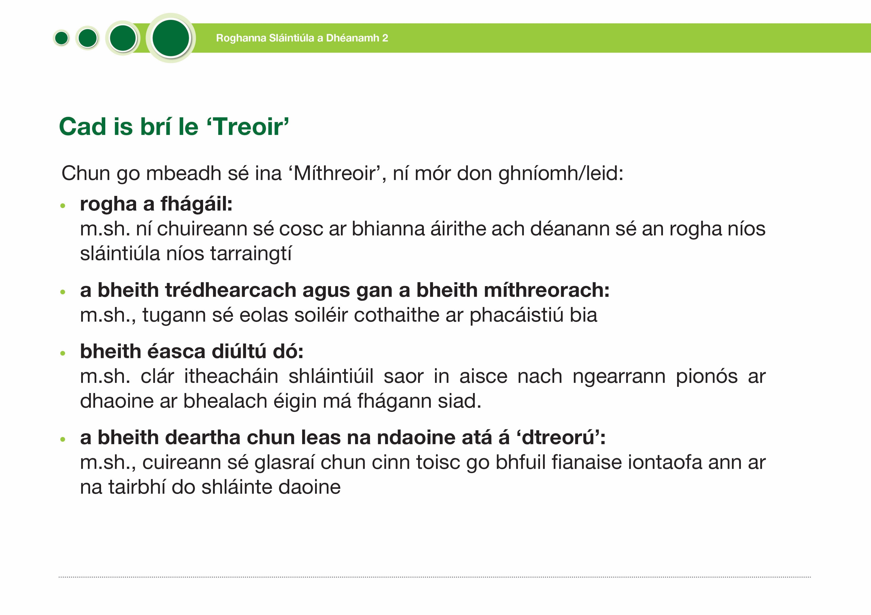
What counts as a ‘Nudge’
Being healthy 2
To be counted as only a ‘Nudge’, the action/ prompt has to:
leave a choice
be transparent and never misleading
be easy to opt out of
be designed for the benefit of the people being nudged.

Slide 6
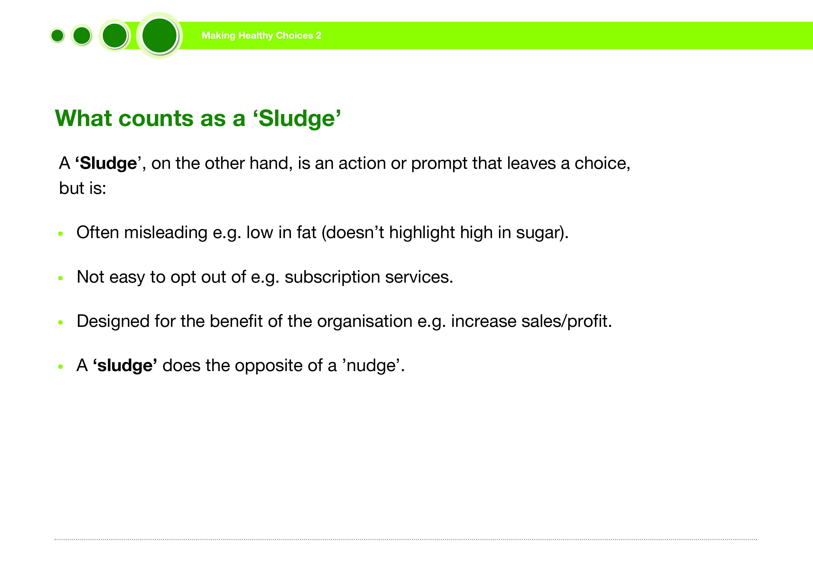
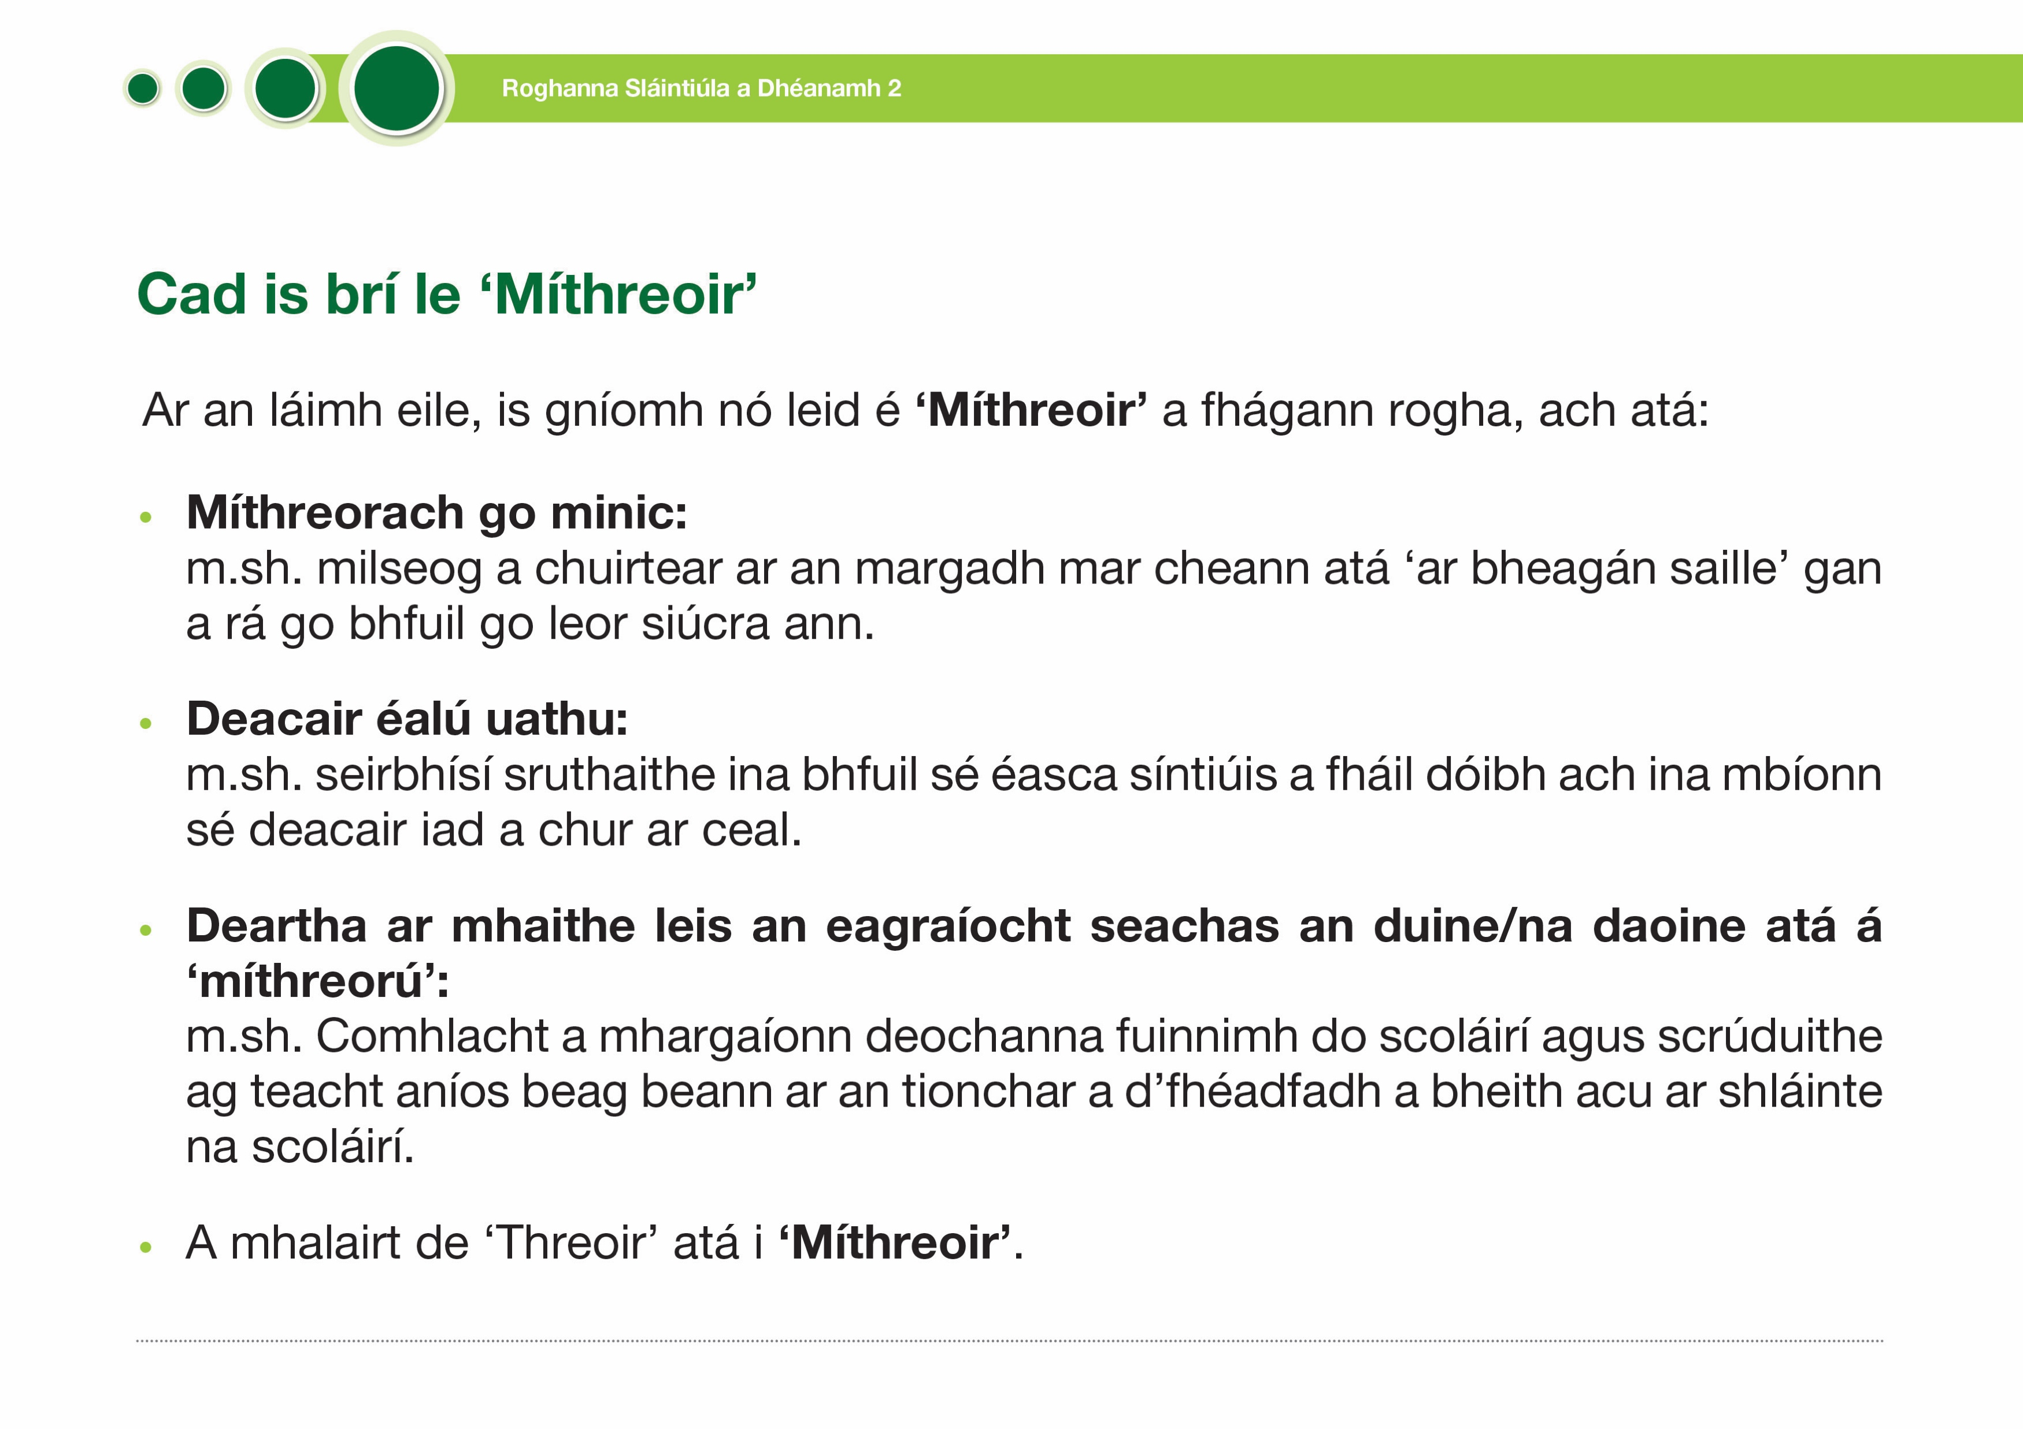
What counts as a ‘Sludge’
Being healthy 2
A ‘Sludge’, on the other hand, is an action or prompt that leaves a choice, but is:
Often misleading e.g. low in fat (doesn’t highlight high in sugar).
Not easy to opt out of e.g. subscription services.
Designed for the benefit of the organisation e.g. increase sales/profit.
A ‘sludge’ does the opposite of a ’nudge’.

Slide 7
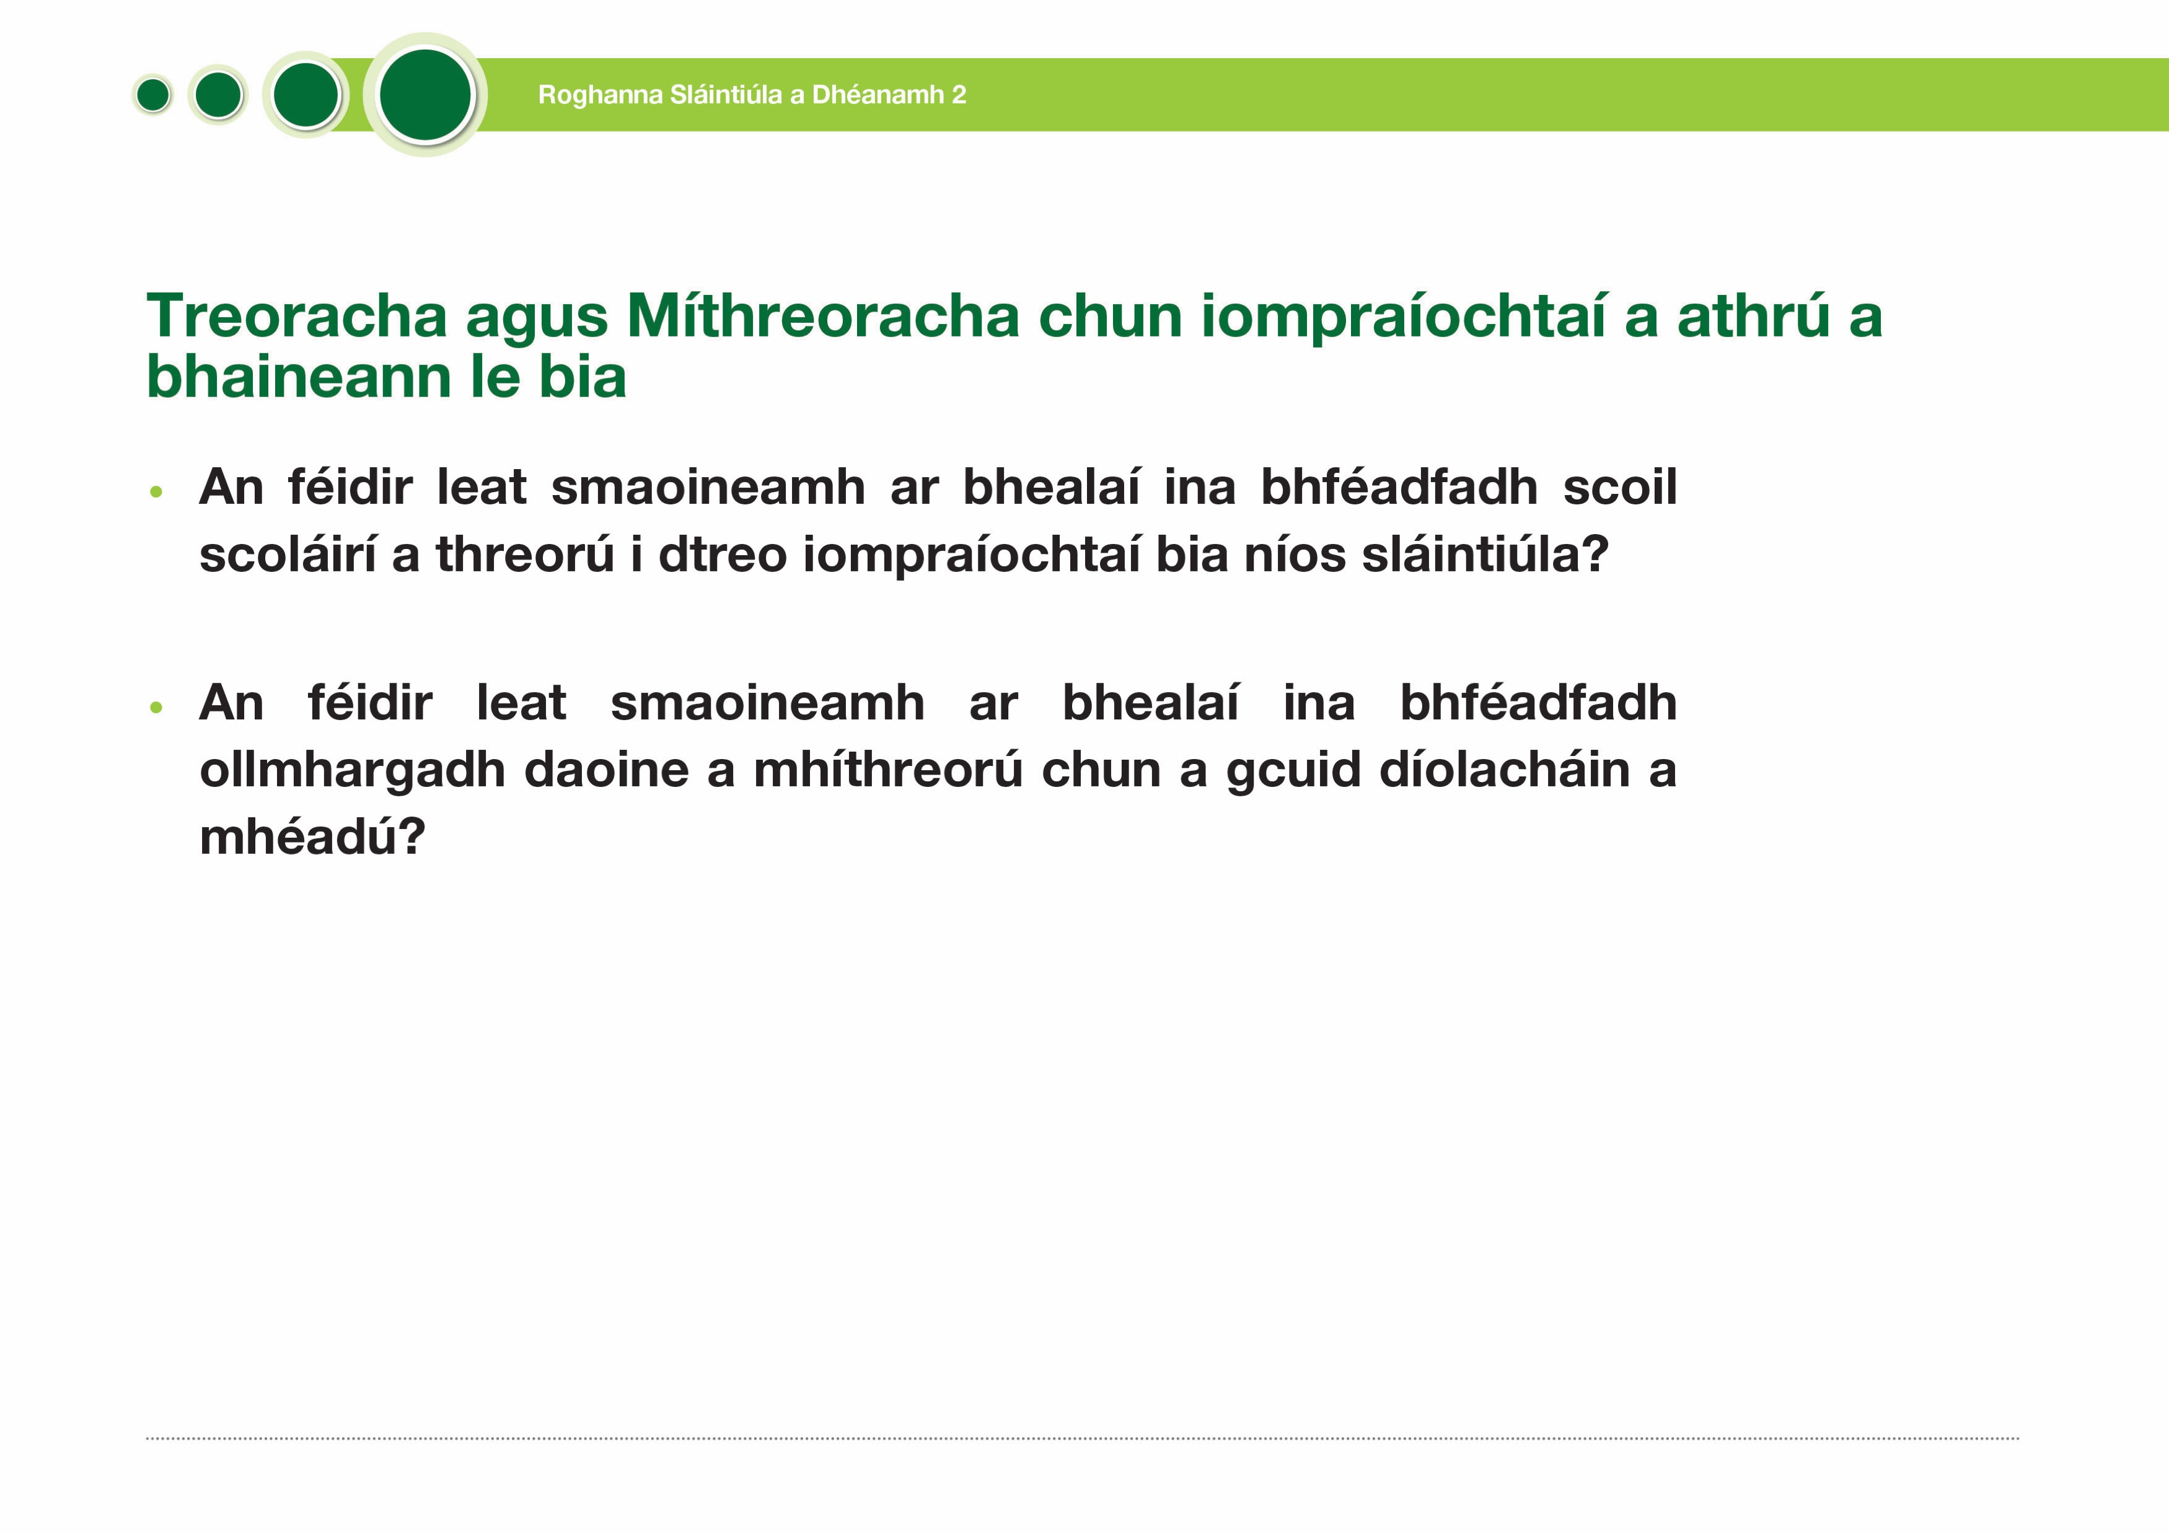
Nudges and Sludges to change food- related behaviours
Being healthy 2
Can you think of ways a school might nudge students towards healthier food behaviours?
Can you think of ways in which a supermarket might sludge people to increase their sales?

