Slide 1
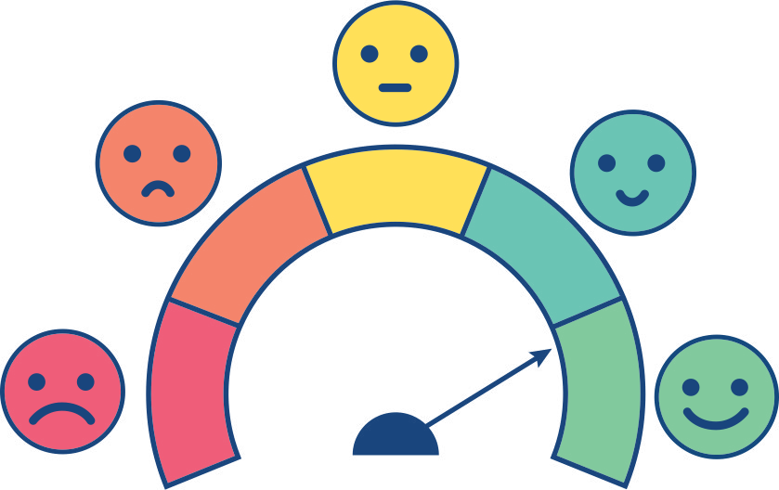
Managing Emotions
Activity 3, SPHE Emotional Wellbeing, Unit 2
Emotional Wellbeing 2 | Activity 3, ‘Managing Emotions’
Check In

Slide 2
Emotional Wellbeing 2 | Activity 3, ‘Managing Emotions’
Check In
Step 1: Emotional check-in
Check In!
Which Are You Today?

Slide 3
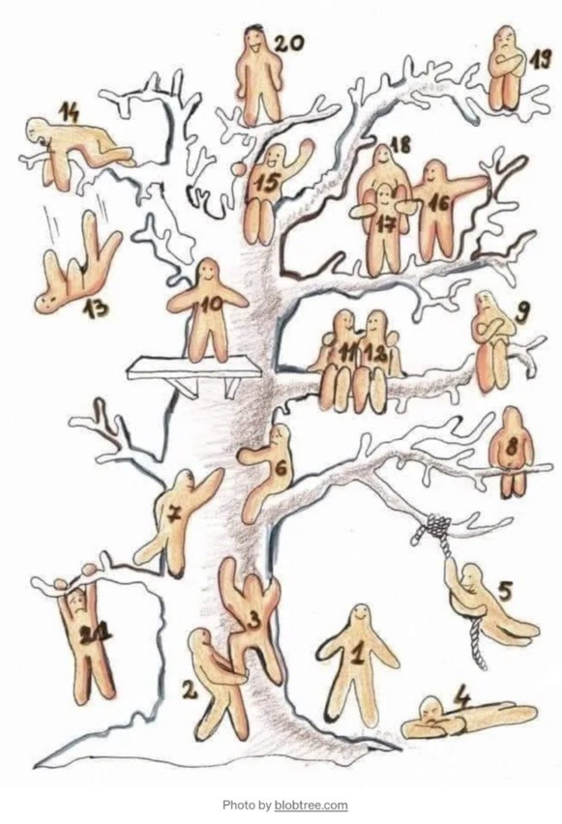
Which Tree Blob Are You Today?
Emotional Wellbeing 2 | Activity 3, ‘Managing Emotions’
Check In

Slide 4
Emotional Wellbeing 2 | Activity 3, ‘Managing Emotions’
Check In

Slide 5
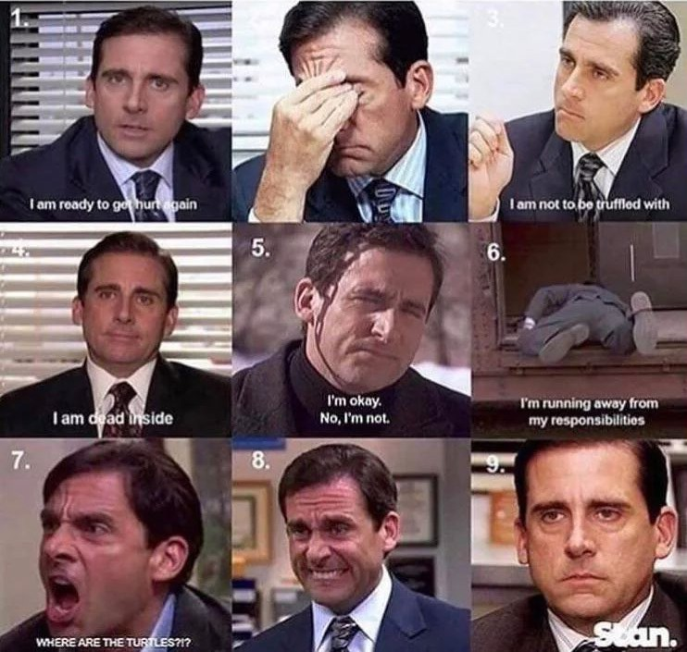
Which Michael Scott are you today?
Emotional Wellbeing 2 | Activity 3, ‘Managing Emotions’
Check In

Slide 6
Which Dog Are You Today?
Emotional Wellbeing 2 | Activity 3, ‘Managing Emotions’
Check In

Slide 7
Which Meme Are You Today?
Emotional Wellbeing 2 | Activity 3, ‘Managing Emotions’
Check In

Slide 8
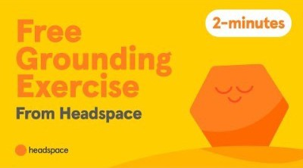
Emotional Wellbeing 2 | Activity 3, ‘Managing Emotions’
Check In
Mindful Moment (Optional) – Headspace, ‘Letting go of Feelings’

Slide 9
Step 2: Managing Our Emotional Dashboard
Emotional Wellbeing 2 | Activity 3, ‘Managing Emotions’
Check In
Fuel Light
Speedometer
Warning Light

Slide 10
Emotional Wellbeing 2 | Activity 3, ‘Managing Emotions’
Check In
What types of emotions might a person be feeling if they are receiving this signal?
How might a person’s body communicate these feelings to them?
Fuel Light
What would be some useful strategies for a person to use in this moment?

Slide 11
Emotional Wellbeing 2 | Activity 3, ‘Managing Emotions’
Check In
What types of emotions might a person be feeling if they are receiving this signal?
How might a person’s body communicate these feelings to them?
Speedometer
What would be some useful strategies for a person to use in this moment?

Slide 12
Emotional Wellbeing 2 | Activity 3, ‘Managing Emotions’
Check In
What types of emotions might a person be feeling if they are receiving this signal?
How might a person’s body communicate these feelings to them?
Warning Light
What would be some useful strategies for a person to use in this moment?

Slide 13
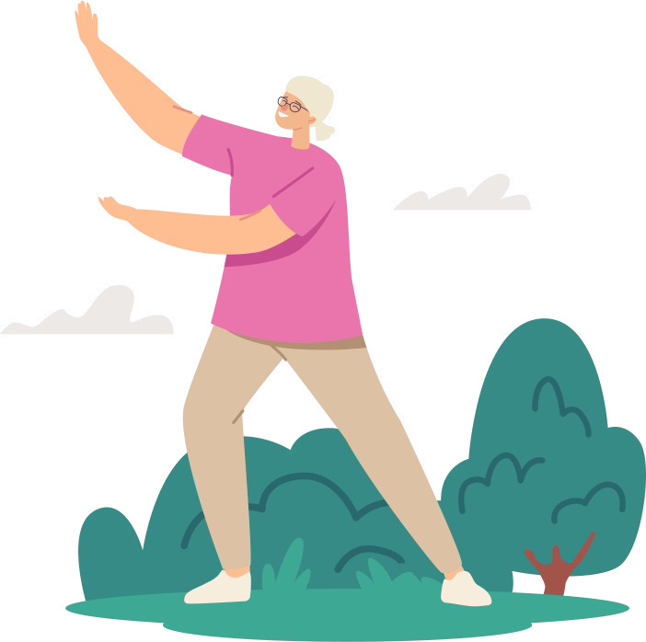
Move Your Body
Emotional Wellbeing 2 | Activity 3, ‘Managing Emotions’
Step 2
Check In
Regular exercise releases feel-good endorphins.
Endorphins are natural brain
chemicals that can improve your sense of well-being.
Adding five minutes of
activity (stretching, exercises, mobility) several times throughout the day has the capabilities of boosting your mood, energy, and general wellbeing.

Slide 14
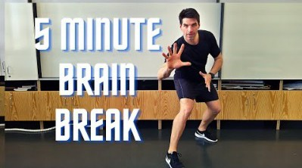
Emotional Wellbeing 2 | Activity 3, ‘Managing Emotions’
Check In
Need to Refuel? Try moving your body

Slide 15
Need to slow down?
Emotional Wellbeing 2 | Activity 3, ‘Managing Emotions’
Check In
Progressive Muscle Relaxation can help you feel more calm, less tense, and physically relaxed. It can also help reduce physical problems such as stomach-aches and headaches, and improve your sleep. It involves tensing and relaxing your muscles one by one. With practice, you can begin to tell the difference between tense and relaxed muscles. Then, when you feel your muscles tense as a response to certain emotions, you are better able to relax your muscles yourself.

Slide 16
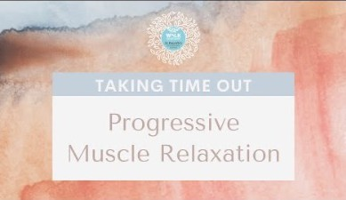
Emotional Wellbeing 2 | Activity 3, ‘Managing Emotions’
Check In
Need to Slow Down? Try Progressive Muscle Relaxation

Slide 17
Breathing
Emotional Wellbeing 2 | Activity 3, ‘Managing Emotions’
Check In
The square breathing, or box breathing, technique involves breathing in for 4 seconds, holding the breath for 4 seconds, and exhaling for 4 seconds, and holding
for 4 seconds before inhaling
again. This breathing pattern aims to reduce anxiety or help people get to sleep

Slide 18
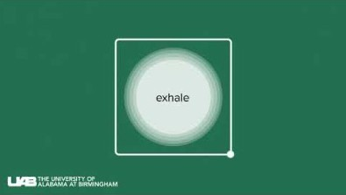
Emotional Wellbeing 2 | Activity 3, ‘Managing Emotions’
Check In
Need to Stop? Try square breathing

