Slide 1
Understanding & Recognising Stress
Emotional Wellbeing 2 | Activity 6, ‘Understanding & Recognising Stress’
Activity 6, SPHE Emotional Wellbeing, Unit 2

Slide 2
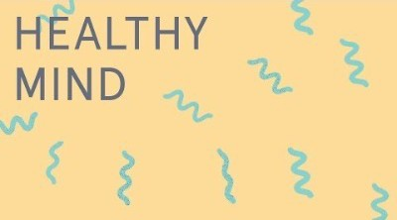
Emotional Wellbeing 2 | Activity 6, ‘Understanding & Recognising Stress’
Mindful Moment (Optional) Headspace ‘Letting Go of Stress’.

Slide 3
Stress Snowballs
Emotional Wellbeing 2 | Activity 6, ‘Understanding & Recognising Stress’
Draw an image that represents something that young people find stressful.
(Optional) crumple up their piece of paper into a ‘stress snowball’, place it in a basket and ‘let it go’.

Slide 4
Stress is a mind-body reaction in response to changes, demands, and challenges (stressors) in our lives.
Emotional Wellbeing 2 | Activity 6, ‘Understanding & Recognising Stress’
We can understand the type of stress we are experiencing by noticing how the stress is affecting us.
What is Stress?
Signs of stress in the body include: Some signs of stress in the body include increased heart rate, increased breathing rate, sweating, cold hands, headaches, and stomach-ache.

Slide 5
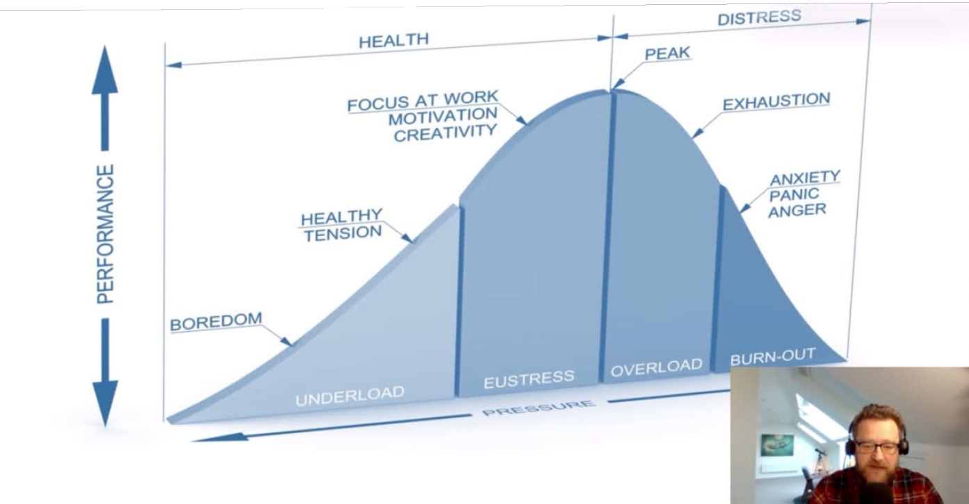
Step 2: Understanding positive, tolerable & toxic stress
Emotional Wellbeing 2 | Activity 6, ‘Understanding & Recognising Stress’
*Video Source: RCSI Centre for Positive Psychology & Health, ‘The Science of Health & Happiness for Young People,’ Week 5 - This is What Stress Feels Like, Dr Pádraic Dunne. Video option 1.

Slide 6
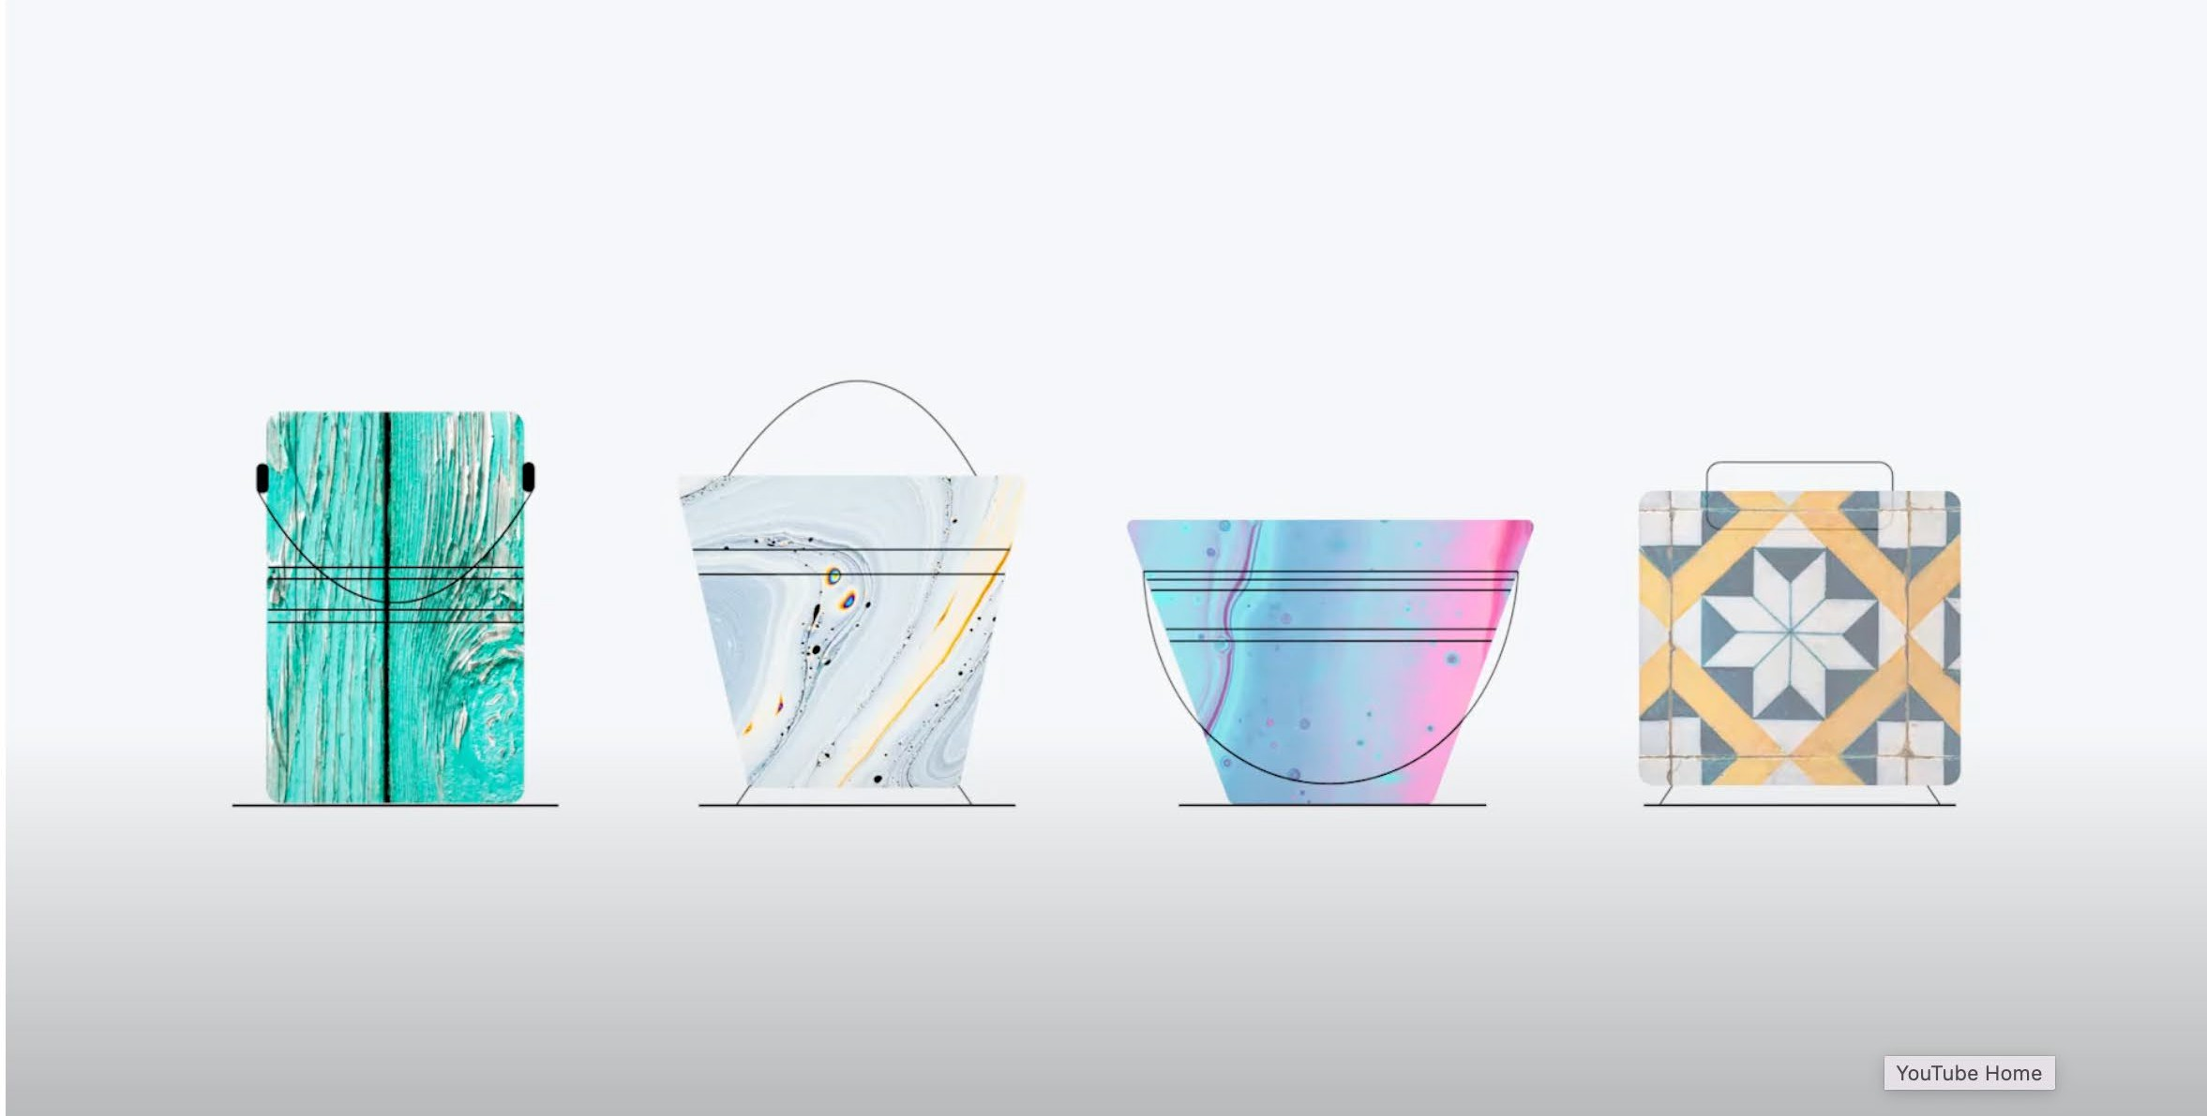
Step 2: Understanding positive, tolerable & toxic stress
Emotional Wellbeing 2 | Activity 6, ‘Understanding & Recognising Stress’
Video Source: Headspace by Stride, ‘What is stress?’. Video option 2.

Slide 7
Positive, Tolerable, and Toxic Stress
Emotional Wellbeing 2 | Activity 6, ‘Understanding & Recognising Stress’
Positive stress can boost our motivation and help us to perform better. For example, if we are taking part in a sport/drama/ music/art competition, this can be a source of positive stress.
Tolerable stress can be handled with management strategies and/or support and doesn’t impact our performance or our functioning. For example, challenging assignments and preparing for exams can motivate us to prepare, and stress can help us to manage our time well.
Toxic stress negatively impacts our performance and functioning, especially if it lasts a long time, and if we do not have support to manage it.

Slide 8
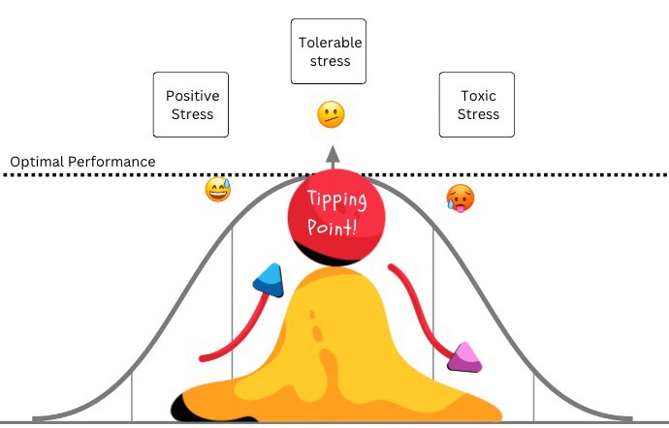
The Stress Continuum
Emotional Wellbeing 2 | Activity 6, ‘Understanding & Recognising Stress’
Tolerable stress
Positive stress
Toxic stress
Optimal performance

Slide 9
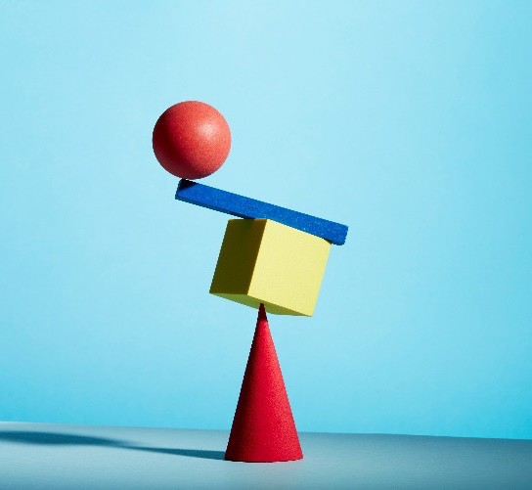
Emotional Wellbeing 2 | Activity 6, ‘Understanding & Recognising Stress’
How do young people think/act/ feel when they are experiencing positive stress/toxic stress?
What supports are available to them?

Slide 10
Emotional Wellbeing 2 | Activity 6, ‘Understanding & Recognising Stress’
Step 4: Visualising My Peaceful Space

Slide 11
“Imagine a place where you can feel calm, peaceful and safe.”
Emotional Wellbeing 2 | Activity 6, ‘Understanding & Recognising Stress’
This might be a place that you have been to before, somewhere you dream of going to, or somewhere you have seen a picture of.
What colours are in your peaceful space? Write/Colour
What does your peaceful space sound like? Write/Draw
What does your peaceful space look like? Write/Draw
Imagine a name, a word, or a phrase that you can call your peaceful space, that you can use to bring this image back any time you wish.

