Slide 1
MINDOUT
SESSION 04
.................................................................................................
Coping with Challenges

Slide 2
MINDOUT
To identify a range of helpful coping
strategies that can be used to deal with stressful situations.
SESSION
GOAL
------------------
OBJECTIVES
------------------
Students will
•
Identify different types of coping strategies
they can use to deal with stress.
Discuss and reflect on how people cope
differently.
Compare which coping strategies are likely
that
•
•
to
be helpful to those likely to be less helpful in
different situations.

Slide 3
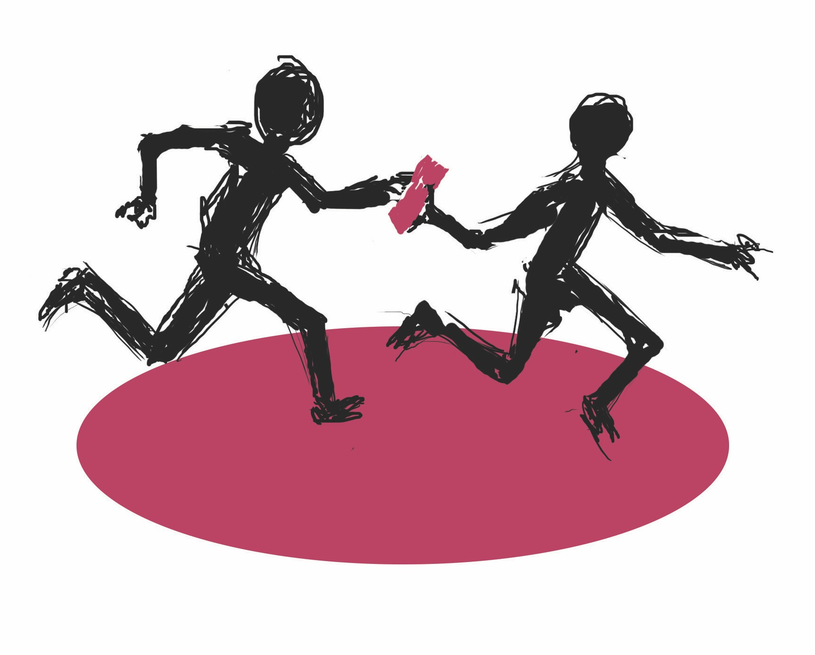
Coping Relay
(3 mins)
MINDOUT
Get
and
into your
groups
line up behind
each other facing
your chart paper

Slide 4
MINDOUT
Practice at home
Over the next week, ask students to:
•
Think about the top helpful coping strategies they
often use.
•
Consider “Why do these coping strategies work for
me?”
•
Think about any unhelpful or harmful coping strategies
they use when stressed and what helpful coping strategy they could try instead.
•
Go online for ideas on managing and dealing with
stress and try some of them out!

