Slide 1
MINDOUT
SESSION 06
.................................................................................................
Walking in Someone
Else’s Shoes

Slide 2
MINDOUT
To help students increase their awareness
SESSION
GOAL
of the thoughts and feelings of others
show compassion.
and to
------------------
OBJECTIVES
------------------
Students will
•
Become more aware
of others.
of the thoughts and feelings
•
Understand that people feel emotions differently
and that it is important that they learn to respect
each other’s feelings.
Reflect on the personal actions they can take in order to show support for other people.
•

Slide 3
MINDOUT
What
we
see
What
we
do
not
see

Slide 4
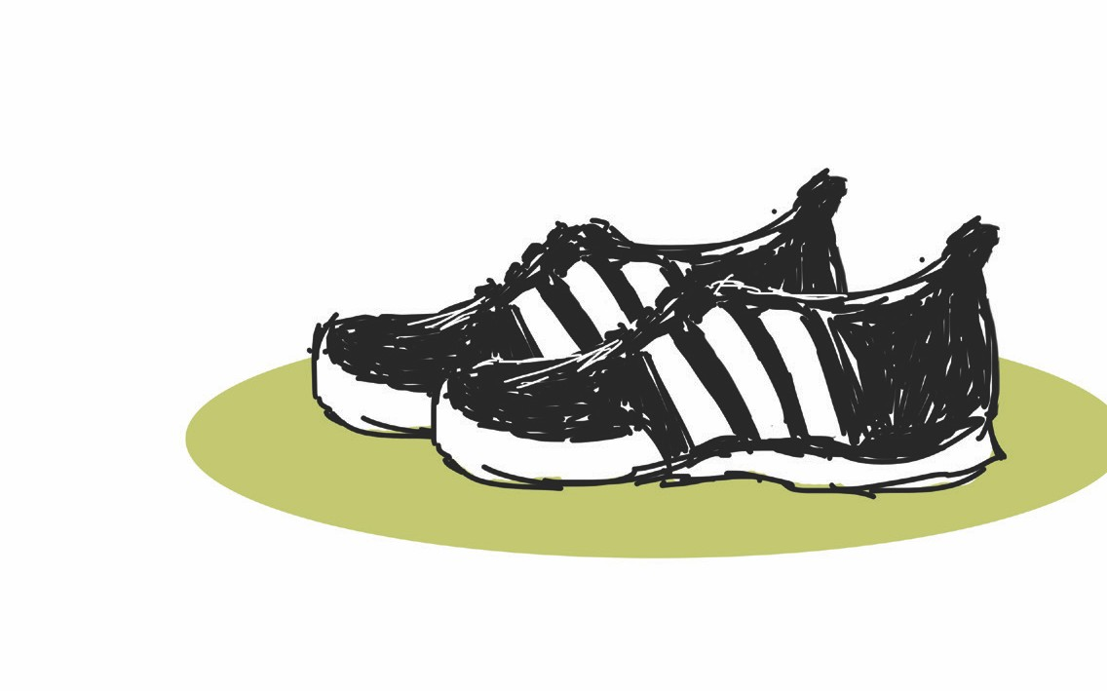
Walking in Someone
Else’s Shoes
MINDOUT
1
Imagine how you would feel if you were in
their shoes.
2
Imagine what thoughts you might have.
3
How you might act if you were this person?
4
How could others support you and show you that they
there for you?
are

Slide 5
MINDOUT
Practice at home
Over the next week, ask students to:
•
Practise putting themselves in someone else’s shoes and
become aware of others’ thoughts and feelings.
•
Find a book, song, TV show/movie and try to think about the
thoughts and feelings of the character.
•
Reflect on how the character felt, the type of thoughts
they might be having and how someone could support this character.

