Slide 1
Unit 1: Lesson 2
Notes:
Introduction to Unit 1
In Unit 1 you will explore the concept of health, think about your own views on health in general and your personal health. Lifestyle and risky behaviours especially among university students will be examined. Key guidelines for health will be explored in relation to alcohol, smoking, exercise and diet with the key health messages discussed in the context of health promotion.
Unit 1: Learning Outcomes
1.1 Assess attitudes & behaviours towards own health & wellbeing
1.2 Define health with reference to the key concepts and determinants of health
1.3 Access and interprets health status data for the Irish population
1.4 Promote key health messages and recommendations

Slide 2
Health and Personal Wellness
Lesson 2: The Biopsychosocial Model of Health
Notes:
Introduction to Lesson 2
In this lesson we look at the biopsychosocial model of health and you will be asked to participate in some activities based around this model including rating your self-perceived physical, mental, and social health. You will also be asked to reflect on the case studies provided.
• Brief recap Unit 1 Lesson 1
• Introduction to Biopsychosocial Model
• Dimensions of Biopsychosocial Model
• Illustration of Biopsychosocial model through case studies

Slide 3
Making Every Contact Count
Play your part
in changing lifestyle behaviours
and help prevent chronic disease
Notes:
Making Every Contact Count is a programme being implemented within the HSE to support the prevention of chronic disease by promoting lifestyle behaviour change. The health behaviours which are the focus of this programme are the four main lifestyle risk factors for chronic disease: tobacco use; physical inactivity; harmful alcohol consumption and unhealthy eating.
Making Every Contact Count is about health professionals using their routine consultations to empower and support people to make healthier choices to achieve positive long-term behaviour change. To do this, the health service needs to build a culture and operating environment that supports continuous health improvement through the contacts that it has with individuals.
This approach will allow health professional to move to a position where discussion of lifestyle behaviour is routine, non-judgemental and central to everyone’s role.
As a healthcare student and future healthcare professional you will be asked to make each routine contact that you have with patients count in terms of chronic disease prevention.

Slide 4
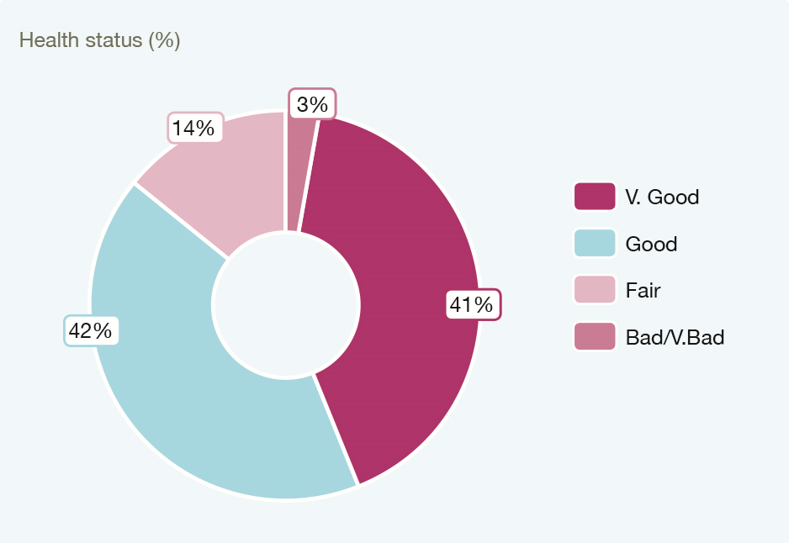
Recap Unit 1 Lesson 1
Definitions of Health
Mental Health
Self-perceived health status Irish population
Rate your own health 1-10
Adapted from National Health Survey, 2015,
published by CSO 2016
Notes:
Can you remember what was covered in Lesson 1?
In Lesson 1 we explored some of the definitions of health. We talked about the Healthy Ireland Framework and the self-perceived health status of the nation based on the findings from a National Health Survey conducted in Ireland.
A Healthy Ireland is:
“where everyone can enjoy physical and mental health and wellbeing to their full potential, where wellbeing is valued and supported at every level of society and is everyone’s responsibility” (Department of Health, 2013).
In 1948, the WHO defined health as “a state of complete physical, mental and social well-being, and not merely the absence of disease or infirmity” (World Health Organisation, 1948).
The WHO (2004) definition reflects the changing approach to mental health promotion:
‘A state of well-being in which the individual realises his or her own abilities, can cope with the normal stresses of life, can work productively and is able to make a contribution to his or her community’ (p.1)

Slide 5
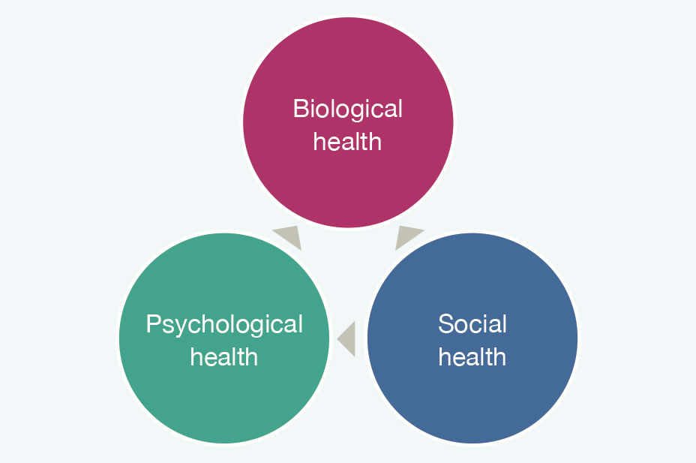
The Biopsychosocial Model of Health
(Adapted from Dogar 2007).
Notes:
The Biopsychosocial Model of Health
The biopsychosocial model of health is a holistic, integrated approach to health recognising the role that behavioural, social and physical factors play in our experiences of health (Dogar, 2007).
Biological, psychological and social influences constantly interact and influence causes, treatment choices and the outcome of illnesses.
Health and illness are a consequence of the interplay of biological, psychological and social factors.
An individual’s health, susceptibility to disease, subjective experience of illness and recovery processes are influenced by biological and psychosocial factors (Dogar, 2007; Engel, 1978; Schwartz, 1982).
Biological Health: this dimension is concerned with physical and physiological status including the functioning of the body. In other words, a body that is working well physically and physiologically is a healthy body. This dimension refers to the mechanistic functioning of the body
Social Health: this dimension is concerned with the ability to establish and maintain relationships with other people. It also incorporates cultural and environmental influences on experiences and occurrence of illness.
Psychological health: being psychologically healthy is about recognising and dealing with emotions including anger, stress, joy and being able to cope with and express emotions appropriately. Psychological factors play a role in how we experience and react to illness.
Critical discourse around BPS model and others eg. Biomedical, may be considered in other areas of curriculum as applicable to individual healthcare student groups/disciplines

Slide 6
Activity 1.2: Self perceived dimensions of health
Rate your Biological Health on a scale from 1-10
Not at all Completely
Healthy Healthy
1 | 2 | 3 | 4 | 5 | 6 | 7 | 8 | 9 | 10
Reasons for your ……………………………………………………………..
Health rating ………………………………………………………………
Notes:
*Activity 1.2: National Undergraduate Curriculum for Chronic Disease Prevention and Management, Page 44 (Hand-out)
Complete this Worksheet on self-perceived dimensions of health
Biological Health: this dimension is concerned with physical and physiological status including the functioning of the body. In other words, a body that is working well physically and physiologically is a healthy body. This dimension refers to the mechanistic functioning of the body.
For Activity 1.2 (face-to-face/online). Present as worksheet (provided with this Lesson). Students are not required to share their ratings only if they wish. Focus instead on their understanding of what each dimension means. If online consider providing a summary (anonymized) of ratings for all students to see.

Slide 7
Activity 1.2: Self perceived dimensions of health
Rate your Social Health on a scale from 1-10
Not at all Completely
Healthy Healthy
1 | 2 | 3 | 4 | 5 | 6 | 7 | 8 | 9 | 10
Reasons for your ……………………………………………………………..
Health rating ………………………………………………………………
Notes:
*Activity 1.2: National Undergraduate Curriculum for Chronic Disease Prevention and Management, Page 44 (Hand-out)
Complete this Worksheet on self-perceived dimensions of health
Social Health: this dimension is concerned with the ability to establish and maintain relationships with other people. It also incorporates cultural and environmental influences on experiences and occurrence of illness.
For Activity 1.2 (face-to-face/online). Present as worksheet (provided with this Lesson). Students are not required to share their ratings only if they wish. Focus instead on their understanding of what each dimension means. If online consider providing a summary (anonymized) of ratings for all students to see.

Slide 8
Activity 1.2: Self perceived dimensions of health
Rate your Psychological Health on a scale from 1-10
Not at all Completely
Healthy Healthy
1 | 2 | 3 | 4 | 5 | 6 | 7 | 8 | 9 | 10
Reasons for your ……………………………………………………………..
Health rating ………………………………………………………………
Notes:
*Activity 1.2: National Undergraduate Curriculum for Chronic Disease Prevention and Management, Page 44 (Hand-out)
Complete this Worksheet on self-perceived dimensions of health
Psychological health: being psychologically healthy is about recognising and dealing with emotions including anger, stress, joy and being able to cope with and express emotions appropriately. Psychological factors play a role in how we experience and react to illness.
For Activity 1.2 (face-to-face/online). Present as worksheet (provided with this Lesson). Students are not required to share their ratings only if they wish. Focus instead on their understanding of what each dimension means. If online consider providing a summary (anonymized) of ratings for all students to see.

Slide 9
Activity 1.3
Think about your life at the moment:
How do physical / biological, social and psychological factors contribute to your health and well-being?
How many of these factors are interlinked or overlap?
Give examples of things you do to stay
Healthy & Well
Biological/
Physical
Psychological
Social
Notes:
*Activity 1.3: National Undergraduate Curriculum for Chronic Disease Prevention and Management, Page 41 (Hand-out)
The bio-psychosocial model of health recognises that there are many facets contributing to health and well-being
In each box, jot down all the factors that are important to you or that you do to stay healthy and well.
Written to support face-to-face or online idelivery including activities & discussion points
If face-to-face, a flip chart could be used to take feedback.
Allow open brainstorm and explore new thoughts

Slide 10
How adequately do you think the biopsychosocial model of health captures all aspects of health that are important to you?
Are there other dimensions of health that you would add to this model?

Slide 11
Activity 1.4: Case Study -John
John is 22 years old. He left school at 16 and has been working in construction since then; he is considered to be a good worker and gets on well with his colleagues and supervisors. Unfortunately, because of the recession, there has been a slow-down in work and John has been let go. Others who had formal qualifications and trades have been kept on. Since then John has been doing some part time work for other builders and neighbours. His old workmates have encouraged him to go back to college or to do a trade but John feels he cannot afford it and doesn’t want to bother his parents as his Dad is out of work and is suffering from depression. Due to his reduced income he has had to move in with his sister and her young family, John is helping her with child minding and general odd jobs. He used to regularly play football with friends a few times a week and go for a few pints afterwards but lately he has been attending less frequently as he feels unfit, he also can’t afford to socialise with this gang and instead finds it cheaper and easier to have cans at home with his brother in law. John goes to see his GP because he is having trouble sleeping but also says he feels constantly exhausted. He is also anxious about what he is going to do with his life. He says he sees no way out of his situation and is conscious that he is becoming a burden on his sister.
Notes:
*Activity 1.4: National Undergraduate Curriculum for Chronic Disease Prevention and Management, Page 42 (Hand-out)
Now that you have been introduced to the biopsychosocial and have considered its relevance to your health, the following two case studies offer examples of a holistic account of an individual’s health:
In keeping with the philosophies of health promotion for chronic disease prevention and person-centred care, underpinning this Curriculum, consider the case studies and respond to the questions provided. Take each case separately:
What aspects of the case study seem most relevant to each dimension of health – biological/physical, social and psychological?
Do any of the factors impacting on health interact or overlap?
What solution(s) might you come up with for each situation?
What barriers to improving health might be encountered by John/Tara?

Slide 12
Activity 1.4: Case Study -Tara
Tara is 19 years old, she is a first year student in university, undertaking a 4 year Nursing degree programme. She left home 10 weeks ago and moved in with other students in rented accommodation near to the college. Until now Tara has enjoyed the comfort of her parent’s home cooked meals after school, regular exercise with her school football team and a relatively structured study plan which she adhered to in the quiet of her home environment.
Lately, Tara has found that she is snacking a lot throughout the day at college. She doesn’t always mean to but she doesn’t have time for breakfast and there are so many high calorie snacks available at the college restaurant. So she consoles herself that it’s not all her fault.
Exercise is a thing of the past because she no longer plays football. She feels that she is beginning to get a bit stressed about college assignments and exams. She can’t seem to study in the noisy rented accommodation and she doesn’t want to stay out too late at the library. She is unable to sleep through the night and feels exhausted during the day.
Notes:
*Activity 1.4: National Undergraduate Curriculum for Chronic Disease Prevention and Management, Page 42 (Hand-out)
In keeping with the philosophies of health promotion for chronic disease prevention and person-centred care, underpinning this Curriculum, consider the case studies and respond to the questions provided. Take each case separately:
What aspects of the case study seem most relevant to each dimension of health – biological/physical, social and psychological?
Do any of the factors impacting on health interact or overlap?
What solution(s) might you come up with for each situation?
What barriers to improving health might be encountered by John/Tara?

Slide 13
What aspects of the case study seem most relevant to each dimension of health – biological/physical, social and psychological?
Do any of the factors impacting on health interact or overlap?
What solution(s) might you come up with for each situation?
What barriers to improving health might be encountered by John/Tara?
Notes:
In keeping with the philosophies of health promotion for chronic disease prevention and person-centred care, underpinning this Curriculum, consider the case studies and respond to the questions provided. Take each case separately:

