Slide 1
Unit 1: Lesson 3
Notes:
Introduction to Unit 1
In Unit 1 you will explore the concept of health, think about your own views on health in general and your personal health. Lifestyle and risky behaviours especially among university students will be examined. Key guidelines for health will be explored in relation to alcohol, smoking, exercise and diet with the key health messages discussed in the context of health promotion.
Unit 1: Learning Outcomes
1.1 Assess attitudes & behaviours towards own health & wellbeing
1.2 Define health with reference to the key concepts and determinants of health
1.3 Access and interprets health status data for the Irish population
1.4 Promote key health messages and recommendations

Slide 2
Health and Personal Wellness
Lesson 3: Lifestyle Influences on Health
Notes:
Introduction to Lesson 3
In Lesson 3 you will be introduced to the topics of lifestyle behaviours and the lifestyle areas that can adversely influence health.
Brief Recap Unit 1 Lessons 1 & 2
Introduction to Lifestyle and relevance to chronic disease prevention
Brief introduction to determinants of health
Four lifestyle areas critical to chronic disease prevention (diet, exercise, tobacco use, alcohol intake)
Irish data on lifestyle risks
ACTIVITY 1.5
Rating of individual perceptions of lifestyle risk factors

Slide 3
Making Every Contact Count
Play your part
in changing lifestyle behaviours
and help prevent chronic disease
Notes:
Making Every Contact Count is a programme being implemented within the HSE to support the prevention of chronic disease by promoting lifestyle behaviour change. The health behaviours which are the focus of this programme are the four main lifestyle risk factors for chronic disease: tobacco use; physical inactivity; harmful alcohol consumption and unhealthy eating.
Making Every Contact Count is about health professionals using their routine consultations to empower and support people to make healthier choices to achieve positive long-term behaviour change. To do this, the health service needs to build a culture and operating environment that supports continuous health improvement through the contacts that it has with individuals.
This approach will allow health professional to move to a position where discussion of lifestyle behaviour is routine, non-judgemental and central to everyone’s role.
As a healthcare student and future healthcare professional you will be asked to make each routine contact that you have with patients count in terms of chronic disease prevention.

Slide 4
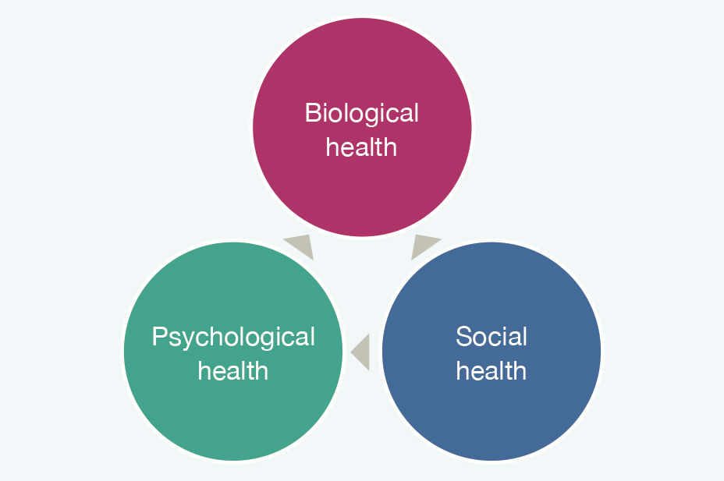
Recap Unit 1 Lesson 1-2
Definitions of Health
Mental Health
Self-perceived health status Irish population
Rate your own health 1-10
The Biopsychosocial model of health
Self-perceived dimensions of health
Case studies- John/Tara
Notes:
Can you remember what was covered in Lesson 1 & 2?
In previous lessons we explored some of the definitions of health. We talked about the Healthy Ireland Framework and the self-perceived health status of the nation based on the findings from the National Health Survey. We looked at the biopsychosocial model of health and you participated in some activities based around this model; including self-rating your self-perceived dimensions of health and reflecting on case studies.

Slide 5
Lifestyle
Lifestyle involves the behaviours and activities that make up an individual’s daily life.
Important role in:
Promoting health
Preventing the onset of chronic diseases
(diabetes, cardiac disease and respiratory disease)
These chronic conditions along with cancer are among the leading causes of mortality in Ireland and in the world.
Notes:
Lifestyle involves the behaviours and activities that make up individual’s daily life.
These behaviours are important to promoting health and are especially important to preventing the onset of chronic diseases particularly diabetes, cardiac disease and respiratory disease.
These chronic conditions along with cancer are among the leading causes of mortality (death) in Ireland and in the world.
A healthy lifestyle prevents the onset of chronic disease.
At the personal level, having a philosophy about good health being desirable and achievable has potential to lead to health promoting behaviours for better health. Therefore, it is important to consider a person-centred approached when working with people to promote health and positive lifestyle changes and behaviours.
Many countries including Ireland have the prevention of chronic disease as a government priority with a specific focus on improving lifestyle behaviours. The Making Every Contact Count national curriculum is an example of how Ireland is implementing a prevention strategy.
Just as one’s lifestyle can influence positive health, so too can lifestyle lead to poor health and chronic disease. Lifestyle behaviours are therefore key determinants of health.

Slide 6
According to the WHO, it is important to keep in mind that the context of people’s lives determine their health. Individuals may not be able to directly control many determinants of health such as income and social status, level of education, health service access. Therefore,
“blaming individuals for having poor health or
crediting them for good health is inappropriate”
(WHO accessed at http://www.who.int/hia/evidence/doh/en/)
Notes:
Lifestyle behaviours are therefore key determinants of health.
Other determinants of health are:
The social and economic environment
The physical environment
Although individuals may not have control over all the factors or determinants that influence their health, they can be helped to make healthier lifestyle choices and that can be adapted to their personal needs. By working with a person-centred approach, then adopting a biopsychosocial approach to assessment of individual needs should assist in the provision of targeted health information and intervention.

Slide 7
What is Health Promotion?
“the process of enabling people to increase control over and to improve their health”; it focuses on promoting and protecting the positive health and wellbeing of individuals, groups and communities (Ottawa Charter for Health Promotion, WHO, 1986).
Health promotion is a key role of all
professional groups working in healthcare
Notes:
Health Promotion is defined by the Ottawa Charter as “the process of enabling people to increase control over and to improve their health”; it focuses on promoting and protecting the positive health and wellbeing of individuals, groups and communities (Ottawa Charter for Health Promotion, WHO, 1986).
Health promotion is a key role of all professional groups working in healthcare. Health Promotion is defined by the Ottawa Charter as “the process of enabling people to increase control over and to improve their health”; it focuses on promoting and protecting the positive health and wellbeing of individuals, groups and communities (World Health Organisation, 1986). In preventing the leading chronic diseases in Ireland (diabetes, cardiac disease and respiratory disease), there are 4 key lifestyle areas that are critical to address. These are:
Unhealthy eating
Tobacco use
Physical activity
Alcohol and drug use

Slide 8
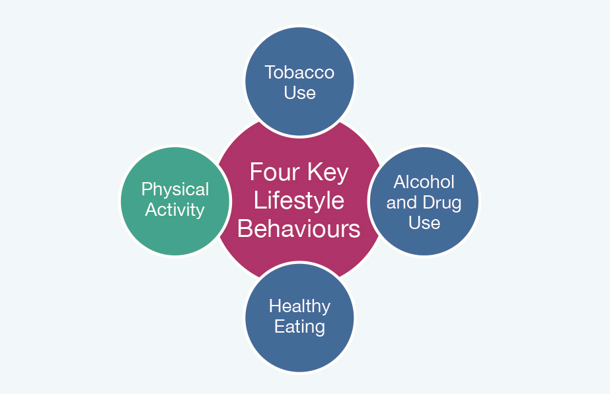
Preventing chronic diseases in Ireland
Key lifestyle areas
Unhealthy Eating
Tobacco use
Physical Activity
Alcohol & drug use
Notes:
In preventing the leading chronic diseases in Ireland (diabetes, cardiac disease and respiratory disease), there are 4 key lifestyle areas that are critical to address.
Unhealthy eating
Tobacco use
Physical activity
Alcohol and drug use
Each of the above four lifestyle areas are risk factors that can adversely influence health. Here is a snapshot of some findings from surveys on lifestyle behaviours specific to Ireland including predictions on future lifestyle trends.

Slide 9
Survey of Lifestyle, Attitudes and Nutrition in Ireland
Department of Health and Children (2009) SLÁN 2007:
https://www.publichealth.ie/sites/default/files/documents/files/slan.pdf)
Central Statistics Office (2016) Irish Health Survey 2015
http://www.cso.ie/en/releasesandpublications/ep/p-ihs/irishhealthsurvey2015/
&
http://health.gov.ie/wp-content/uploads/2015/10/Healthy-Ireland-Survey-2015-Summary-of-Findings.pdf)
Health Ireland Survey 2016;
Department of Health and Children (2016), Summary of Findings. Dublin: Stationary Office.
Notes:
Three major surveys that offer national data in Ireland are:

Slide 10
What differences in trends can you see from 2007 to 2015 for each of the risk factors?
What factors do you think might have influenced the change in trends?
Do any of the findings surprise or even shock you?
If yes, which ones and why?
Review the findings from the Irish Health Survey 2015 & Slán 2007 survey*
Notes:
*National Undergraduate Curriculum for Chronic Disease Prevention and Management, Page 47 (Hand-out)
Distribute Table 1.4: Irish Health Survey 2015 & Slan 2007 survey
These survey findings are intended to raise your awareness of lifestyle risks in our everyday lives. These risks read to negative impacts on our health and ultimately can lead to one or more chronic diseases. Tackling these risk factors is a crucial step in the prevention of chronic disease. Consider the old saying
Prevention is better than cure

Slide 11
Activity 1.5: Individual perception of Lifestyle Risk Factors
Rate your Dietary Lifestyle Risk on a scale from 1-10
No High
Risk Risk
1 | 2 | 3 | 4 | 5 | 6 | 7 | 8 | 9 | 10
Reasons for …………………………………………………………….
Your rating …………………………………………………………….
Notes:
*Activity 1.5: National Undergraduate Curriculum for Chronic Disease Prevention and Management, Page 50 (Hand-out)
Having looked at the Irish data for lifestyle risks, let’s now look at how you perceive yourself to be at risk.
Students are not obliged to share this information with their peers.
Rather, the purpose of the activity to become aware of what they perceive to be their level of risk.
Just as individuals’ perceptions about their health status differ and are subjective noted earlier in Lesson 1, so too are individuals’ perceptions about lifestyle risk factors subjective.
Often times, an individual’s perception of risk is not informed by accurate facts of what counts as a level of risk e.g. the amount of alcohol consumed, the amount of physical activity per week; or dietary intake.

Slide 12
Activity 1.5: Individual perception of Lifestyle Risk factors
Rate your Tobacco Lifestyle Risk on a scale from 1-10
No High
Risk Risk
1 | 2 | 3 | 4 | 5 | 6 | 7 | 8 | 9 | 10
Reasons for …………………………………………………………….
Your rating …………………………………………………………….
Notes:
*Activity 1.5: National Undergraduate Curriculum for Chronic Disease Prevention and Management, Page 50 (Hand-out)
Having looked at the Irish data for lifestyle risks, let’s now look at how you perceive yourself to be at risk.
Students are not obliged to share this information with their peers.
Rather, the purpose of the activity to become aware of what they perceive to be their level of risk.
Just as individuals’ perceptions about their health status differ and are subjective noted earlier in Lesson 1, so too are individuals’ perceptions about lifestyle risk factors subjective.
Often times, an individual’s perception of risk is not informed by accurate facts of what counts as a level of risk e.g. the amount of alcohol consumed, the amount of physical activity per week; or dietary intake.

Slide 13
Activity 1.5: Individual perception of Lifestyle Risk factors
Rate your Physical Activity Lifestyle Risk on a scale from 1-10
No High
Risk Risk
1 | 2 | 3 | 4 | 5 | 6 | 7 | 8 | 9 | 10
Reasons for …………………………………………………………….
Your rating …………………………………………………………….
Notes:
*Activity 1.5: National Undergraduate Curriculum for Chronic Disease Prevention and Management, Page 50 (Hand-out)
Having looked at the Irish data for lifestyle risks, let’s now look at how you perceive yourself to be at risk.
Students are not obliged to share this information with their peers.
Rather, the purpose of the activity to become aware of what they perceive to be their level of risk.
Just as individuals’ perceptions about their health status differ and are subjective noted earlier in Lesson 1, so too are individuals’ perceptions about lifestyle risk factors subjective.
Often times, an individual’s perception of risk is not informed by accurate facts of what counts as a level of risk e.g. the amount of alcohol consumed, the amount of physical activity per week; or dietary intake.

Slide 14
Activity 1.5: Individual perception of Lifestyle Risk factors
Rate your Alcohol Lifestyle Risk on a scale from 1-10
No High
Risk Risk
1 | 2 | 3 | 4 | 5 | 6 | 7 | 8 | 9 | 10
Reasons for …………………………………………………………….
Your rating …………………………………………………………….
Notes:
*Activity 1.5: National Undergraduate Curriculum for Chronic Disease Prevention and Management, Page 50 (Hand-out)
Having looked at the Irish data for lifestyle risks, let’s now look at how you perceive yourself to be at risk.
Students are not obliged to share this information with their peers.
Rather, the purpose of the activity to become aware of what they perceive to be their level of risk.
Just as individuals’ perceptions about their health status differ and are subjective noted earlier in Lesson 1, so too are individuals’ perceptions about lifestyle risk factors subjective.
Often times, an individual’s perception of risk is not informed by accurate facts of what counts as a level of risk e.g. the amount of alcohol consumed, the amount of physical activity per week; or dietary intake.

Slide 15
Activity 1.6: Group Field Activity
Distribute copies of Field Activity 1.6 and Key Health Messages Fact Sheet
Self-directed observation exercise on lifestyles/health promoting messages.
Take note & report back on the patterns of behaviour of people
in your
College/University
Home town,
Public place etc.
Group findings presentation
and discussion at tutorial
Unit 1 Lesson 4
Notes:
*Activity 1.6: National Undergraduate Curriculum for Chronic Disease Prevention and Management, Page 51-53 (Hand-out)
This completes Lesson 3. Between now and the next tutorial based Lesson
you are being asked to carry out a field activity. You will be provided with a factsheet and activity guidance handout to direct you to carry out an observation exercise on lifestyles and health promoting messages.
Suggested activity time1 hr
You are now being asked to do a self-directed field visit with an observation exercise on lifestyles and health promoting messages. The field visit involves taking note of the patterns of behaviour of other people as you walk around your College/University and also any other place that you would normally spend time in your everyday live e.g. your home town, walking through any public place. As you stroll around, or pause and sit to observe, take note of the age profile overall of people you meet/see. Also, take note of people’s behaviours that you think are relevant to health. Is there anything in particular that strikes you as ‘risky’ about these behaviours or as positive in promoting health.
Observe for evidence of health promoting information in your town, university and community. Use the fact sheet provided on the key health messages and monitor where you see evidence of these messages in your everyday surroundings. Keep notes of your observations and in the next lesson we will ask you to share your thoughts on what you observed.
In the second unit of Making Every Contact Count, we will explore health behaviours in more depth and models of health behavioural change (HBC) that are helpful in supporting individuals to change their lifestyle behaviours for the better. In the next, and final Lesson of this unit of study, you will be introduced to the importance of prevention and health promotion to reduce the risk and avoid the onset of chronic disease.

