Slide 1
Unit 1: Lesson 4
Notes:
Introduction to Unit 1
In Unit 1 you will explore the concept of health, think about your own views on health in general and your personal health. Lifestyle and risky behaviours especially among university students will be examined. Key guidelines for health will be explored in relation to alcohol, smoking, exercise and diet with the key health messages discussed in the context of health promotion.
Unit 1: Learning Outcomes
1.1 Assess attitudes & behaviours towards own health & wellbeing
1.2 Define health with reference to the key concepts and determinants of health
1.3 Access and interprets health status data for the Irish population
1.4 Promote key health messages and recommendations

Slide 2
Health and Personal Wellness
Lesson 4: Key Health Messages
Notes:
Introduction to Lesson 4
In this Lesson the key messages from Healthy Ireland recommendations are explored in the context of health promotion including: 1) tobacco use 2) alcohol & drug use 3) healthy eating, and 4) physical activity.
Feedback from the field activity is discussed during face to face tutorial.

Slide 3
Making Every Contact Count
Play your part
in changing lifestyle behaviours
and help prevent chronic disease
Notes:
Making Every Contact Count is a programme being implemented within the HSE to support the prevention of chronic disease by promoting lifestyle behaviour change. The health behaviours which are the focus of this programme are the four main lifestyle risk factors for chronic disease: tobacco use; physical inactivity; harmful alcohol consumption and unhealthy eating.
Making Every Contact Count is about health professionals using their routine consultations to empower and support people to make healthier choices to achieve positive long-term behaviour change. To do this, the health service needs to build a culture and operating environment that supports continuous health improvement through the contacts that it has with individuals.
This approach will allow health professional to move to a position where discussion of lifestyle behaviour is routine, non-judgemental and central to everyone’s role.
As a healthcare student and future healthcare professional you will be asked to make each routine contact that you have with patients count in terms of chronic disease prevention.

Slide 4
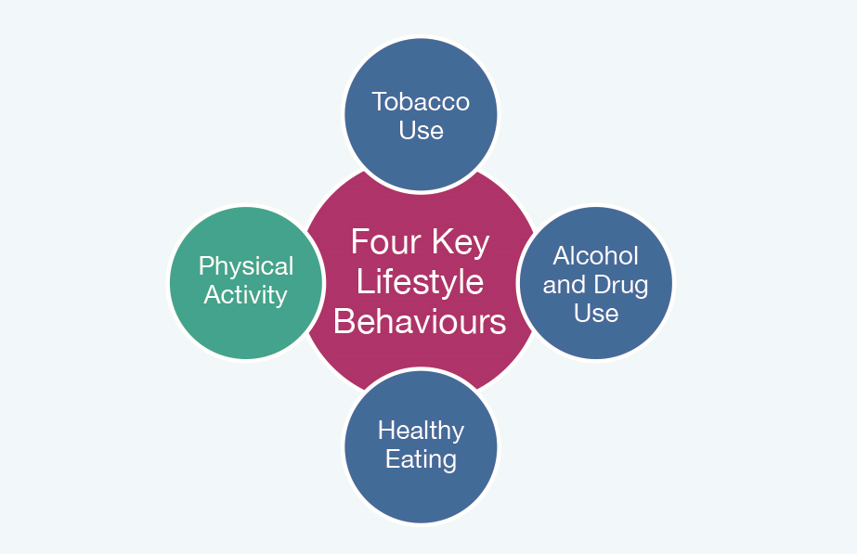
Recap Unit 1 Lesson 1-3
Definitions of Health
Mental Health
Self-perceived health status Irish population
Rate your own health 1-10
Biopsychosocial model of health
Self-perceived dimensions of health
Lifestyle & Health
Health Promotion
Individual perception of Lifestyle Risk Factors
Notes:
Recap Unit 1 Lessons 1, 2 & 3
Can you remember what was covered in previous Lessons?
In previous Lessons we explored some of the definitions of health, the Healthy Ireland Framework and findings from the National Health Survey. We looked at the biopsychosocial model of health and you explored your self-perceived dimensions of health. We explored lifestyle behaviours and the lifestyle factors which can adversely influence health.
It is important to know the key health messages that promote positive lifestyle choices and contribute to a “Healthy Ireland”. We will look at the four key lifestyle behaviours Figure 1.3 and explore the key health recommendations for each topic.

Slide 5
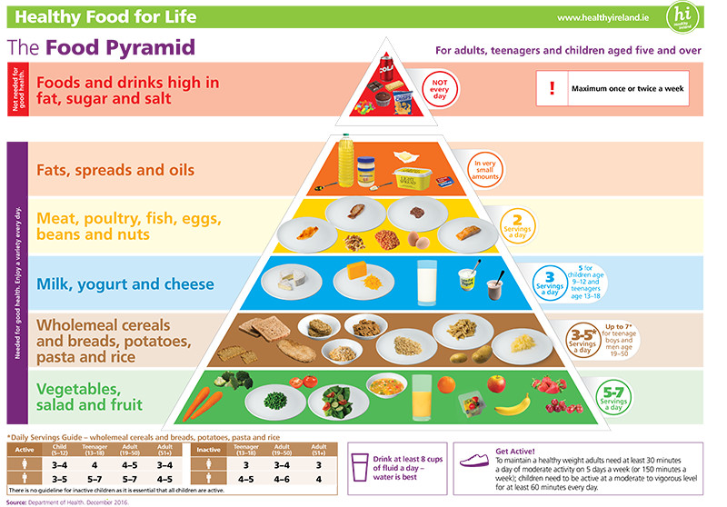
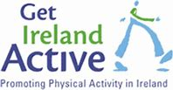
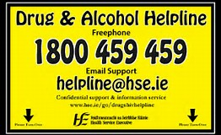
Distribute Factsheet View websites for more information
Key Health Messages:
Notes:
Distribute copies of Activity 1.6: National Undergraduate Curriculum for Chronic Disease Prevention and Management, Page 52 (Hand-out) or cover slides 5-19
Read the Fact Sheet accompanying this Lesson, Fact Sheet Key Health Messages, this will provide you with a basic understanding of some of the information that you will need to enable health promoting conversations in your professional healthcare career.
More information on each of the topics is available on the websites outlined in slide * Hyperlinked to websites

Slide 6
Tobacco Use
The World Health Organisation has classified smoking as a chronic disease?
Cigarettes contain many health harming ingredients and many more are created in the burning process when cigarettes are smoked.
The ingredients in cigarettes are not only harmful to the smoker but the smoke from cigarettes also contains many health harming compounds which can cause adverse health effects to people who are in the environs of smokers on a regular basis.

Slide 7
Why do people smoke?
Tobacco use is a complex behaviour influenced by a range of physiological, behavioural and cognitive factors which is why people continue to smoke, despite widely publicised evidence of the health, social and financial burden it causes.

Slide 8
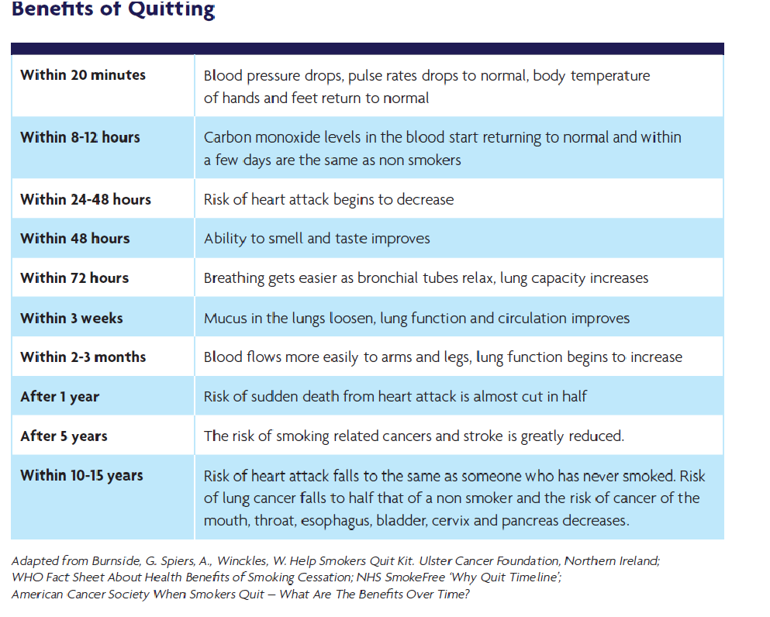
Key Messages: Smoking Cessation
Quitting smoking has many benefits.

Slide 9
For more information www.quit.ie

Slide 10
Alcohol & Drug Use
When we drink an alcoholic beverage, there are so many variables that it is difficult to keep track of how much alcohol we are
consuming.
Glasses, cans and bottles come in different sizes.
Different drinks contain different percentages of alcohol.
The simplest way to measure your intake of alcohol is in
Standard Drinks.

Slide 11
What is a standard drink?
In Ireland, a standard alcoholic drink contains about 10 grams of pure alcohol. A standard drink is:
• a small glass of wine (100 ml, 12.5% volume)
(a bottle of wine at 12.5% alcohol contains around seven standard drinks)
• a pub measure of spirits (35.5 ml)
• a half pint of beer or lager (284 ml)
• an alcopop (275 ml bottle)

Slide 12
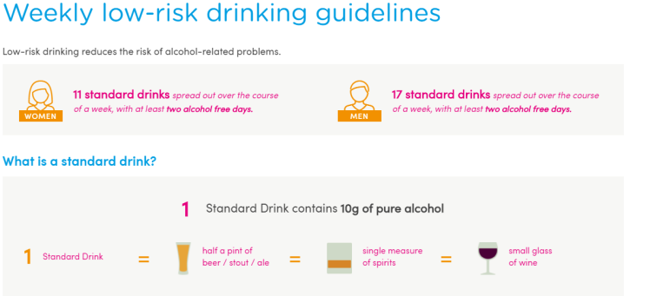
Key Messages: Alcohol Use
You should not consume more than 6 standard drinks on any one occasion
You have 2-3 alcohol free days each week to minimise tolerance and habit formation
Your liver can only remove about one standard drink per hour.

Slide 13
For more information
www.askaboutalcohol.ie
www.drugs.ie

Slide 14
Physical Activity
Being physically active is one of the most important steps that people of all ages can take to improve their health and wellbeing

Slide 15
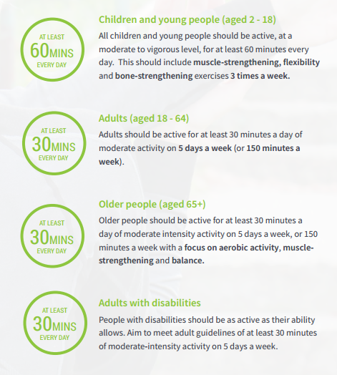
National Guidelines for Physical Activity

Slide 16
For more information
www.getirelandactive.ie

Slide 17
Healthy Eating
Dietary factors are the most important risk factors undermining health and wellbeing in every single country in the
WHO European Region.

Slide 18
Healthy Eating
Research shows that:
excess consumption of foods high in fats, salt and sugar
as well as low levels of vegetables and fruit intake
play a significant role in increasing our risk of developing chronic diseases such as :
heart disease, type 2 diabetes and cancer.

Slide 19
Key Messages: Healthy Eating
Limit high fat, sugar and salt foods from the top shelf of the Pyramid to no more than once or twice a week
Eat more fruit and vegetables, at least 5 to 7 servings a day
Use the Pyramid as a guide for serving sizes and remember that portion size matters

Slide 20
For more information visit
www.healthyireland.ie

Slide 21
References:
Department of Health. (2016). Healthy Food for Life – the Healthy Eating Guidelines and Food Pyramid. Dublin. Available at: https://www.healthpromotion.ie/hp-files/docs/HPM00796.pdf
Department of Health and Children. (2009). National Physical Activity Guidelines. Dublin. Available at: http://health.gov.ie/wpcontent/uploads/2014/03/active_guidelines.pdf

Slide 22
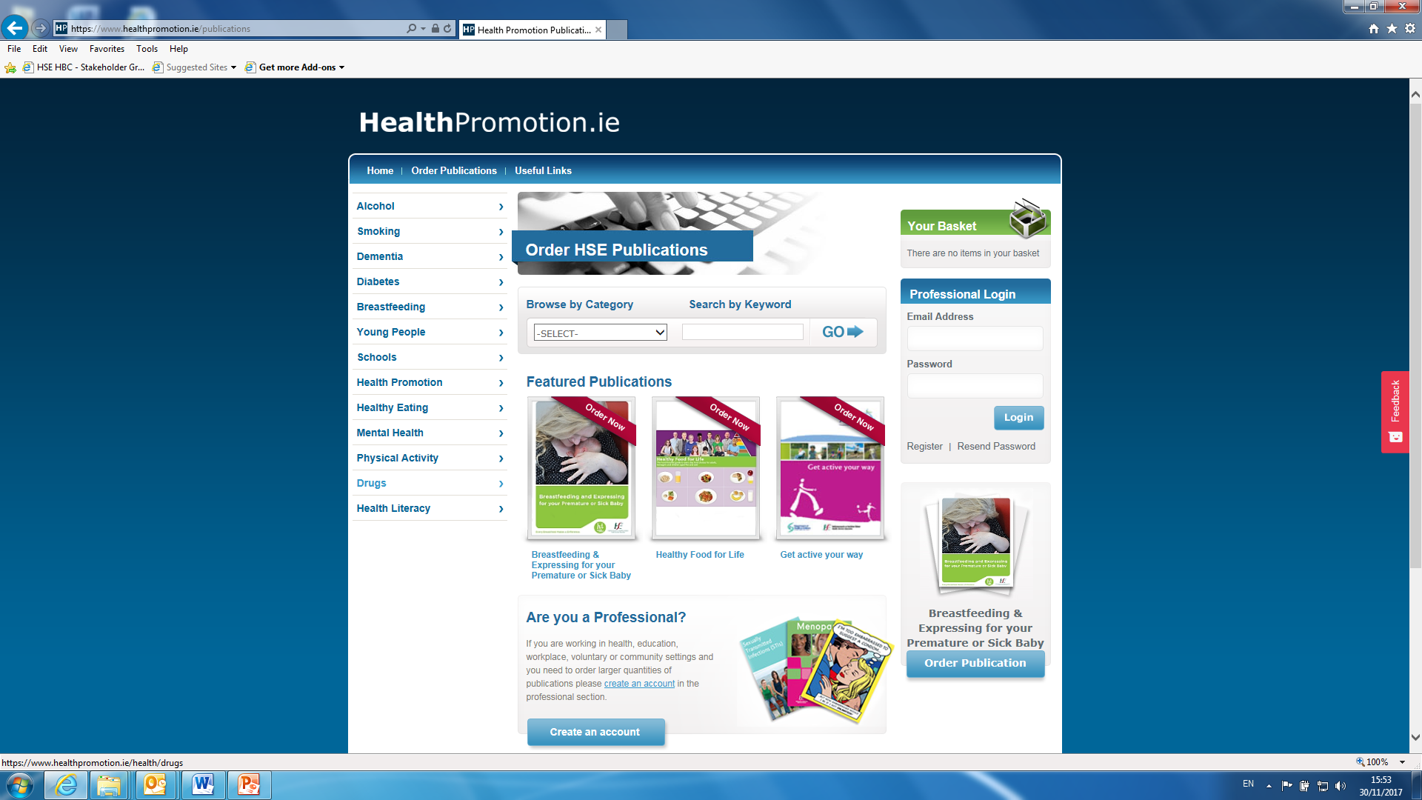
To order HSE Publications
https://www.healthpromotion.ie/publications

Slide 23
Feedback from Field Study Groups
Notes:
Reminder of the field study undertaken
You are now being asked to do a self-directed field visit with an observation exercise on lifestyles and health promoting messages.
The field visit involves taking note of the patterns of behaviour of other people as you walk around your College/University and also any other place that you would normally spend time in your everyday live e.g. your home town, walking through any public place.
As you stroll around, or pause and sit to observe, take note of the age profile overall of people you meet/see.
Also, take note of people’s behaviours that you think are relevant to health.
Is there anything in particular that strikes you as ‘risky’ about these behaviours or as positive in promoting health.
Observe evidence of health promoting information in your town, university and community.
Use the fact sheet provided on the key health messages and monitor where you see evidence of these messages in your everyday surroundings.
Keep notes of your observations and in the next lesson we will ask you to share your thoughts on what you observed.
Feedback
Students will be given an opportunity to provide feedback and discussion on their
field activity findings.
Summary
In this Lesson we talked about the four key lifestyle behaviours (tobacco use,
alcohol and drug use, healthy eating and physical activity) including the impacts of
the lifestyle behaviour on health. You carried out a field activity and observed the
behaviours and health promoting messages evident in your communities.

