Slide 1
Unit 2: Lesson 1

Slide 2
Lifestyle Behaviours and Personal Responsibility for Health
Lesson 1: Health Behaviour
Notes:
INTRODUCTION TO UNIT 2
In this Unit we look specifically at health behaviour practices among student groups. You will be asked to explore a personal health behaviour which you would like to change (Activity 2.3), and we will examine some of the theories of behaviour change.
Brief recap of Unit 1
Health behaviours
Activity 2.1 Personal Health Behaviour Questionnaire
CVD Risk Factors
Summary
Activity
2.1 Personal Health Behaviour Change Questionnaire

Slide 3
Making Every Contact Count
Play your part
in changing lifestyle behaviours
and help prevent chronic disease
Notes:
Making Every Contact Count is a programme being implemented within the HSE to support the prevention of chronic disease by promoting lifestyle behaviour change. The health behaviours which are the focus of this programme are the four main lifestyle risk factors for chronic disease: tobacco use; physical inactivity; harmful alcohol consumption and unhealthy eating.
Making Every Contact Count is about health professionals using their routine consultations to empower and support people to make healthier choices to achieve positive long-term behaviour change. To do this, the health service needs to build a culture and operating environment that supports continuous health improvement through the contacts that it has with individuals.
This approach will allow health professional to move to a position where discussion of lifestyle behaviour is routine, non-judgemental and central to everyone’s role.
As a healthcare student and future healthcare professional you will be asked to make each routine contact that you have with patients count in terms of chronic disease prevention.

Slide 4
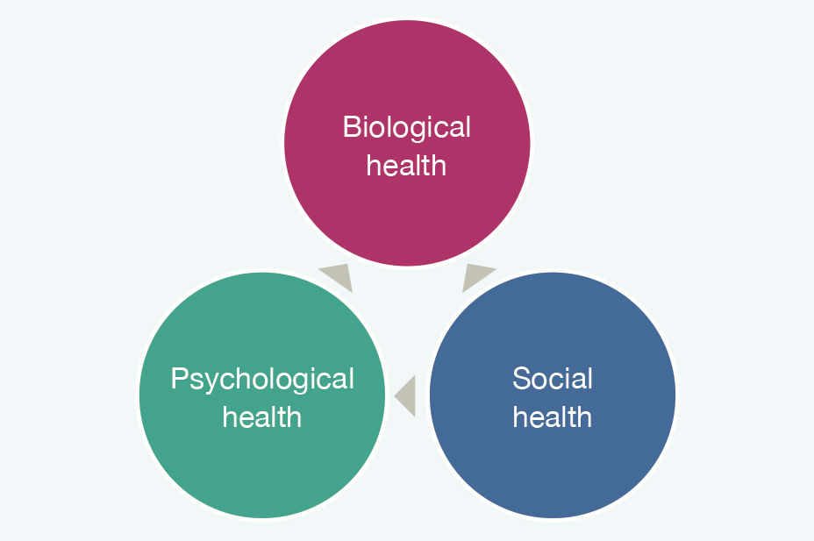
RECAP UNIT 1
The concept/definition of health
& personal wellness
The Biopsychosocial Model of Health
Four lifestyle areas critical to chronic disease prevention
- Diet, Exercise, Tobacco use and Alcohol
Notes:
In Unit 1 Health and Personal Wellness, you looked at the topic of health and explored various definitions of health.
Do you remember any definitions of health?
We discussed the biopsychosocial model of health where you were asked to think about your own personal health and to self-rate your physical, social and psychological health.
In Unit 1 you were briefly introduced to the topic of health behaviours and the factors which influence health behaviour and the relationship between health behaviour and health. We understood that adopting a healthy perspective leads to health promoting behaviours for better health.
Health is a broad concept which can mean different things to different people. Our perceptions and views on health and our health priorities are shaped by a wide range of influential factors such as age, gender, family, upbringing, culture, ethnicity and social / political environment
Healthy Ireland states that a Healthy Ireland is:
“where everyone can enjoy physical and mental health and wellbeing to their full potential, where wellbeing is valued and supported at every level of society and is everyone’s responsibility” (Department of Health, 2013).
The biopsychosocial model of health is a holistic, integrated approach to health recognising the role that behavioural, social and physical factors play in our experiences of health (Dogar, 2007).
Determinants of health : Although individuals may not have control over all the factors or determinants that influence their health (income and social status, level of education, health service access) they can be helped to make healthier lifestyle choices and that can be centred to their personal needs. By working with a person-centred approach, then adopting a biopsychosocial approach to assessment of individual needs should assist in the provision of targeted health information and intervention.

Slide 5
What is Health Behaviour?
• Health behaviours are activities undertaken by a patient believing him/herself to be healthy for the purpose of preventing disease or detecting it at an asymptomatic stage (Kasl & Cobb, 1966).
• “…any activity undertaken for the purpose of preventing or detecting disease or for improving health and well-being” (Norman & Conner, 1996).
Notes:
What do you think the term health behaviour means?
• Anything a person does in response to internal or external events.
• Behaviours are physical events that occur in the body and
are controlled by the brain

Slide 6
Health Behaviours Vs Health Outcomes
Aiming to eat 3 pieces of fruit a day
Reducing blood pressure
Having the confidence to ride a bike
Losing weight
Walking in the park
Drinking non-alcoholic beer on a night out
Reducing cholesterol
Speaking with a louder voice
Walking to work instead of driving
Which of the following are health behaviours?
Notes:
Health Behaviours Vs Health Outcomes
Sometimes there is confusion between desired health outcomes and the health behaviour needed to achieve that outcome. For example the health outcome maybe a reduced BMI or reduced waist circumference for a patient that would like to lose weight; however the health behaviour required to achieve this outcome may be any of the following behaviours including increased activity, cycling to work
instead of driving and/or reducing sugar intake etc.
Which of the following are health behaviours?

Slide 7
Activity 2.1
Personal Health Behaviour Questionnaire
What behaviour do you do routinely, to prevent yourself getting ill, and to maintain or promote good health?
List these behaviours in the categories below:
Behaviour which prevents ill health (e.g. taking daily vitamins) …………………………………………………………………………………….
Behaviour which promotes good health (e.g. taking regular exercise)…………………………………………………………………………..
Behaviour which sustains good health (e.g. brushing/flossing teeth three times a day)………………………………………………..
Now make a list of some of your behaviour that you would consider to be “unhealthy” ……………………………………………..
(e.g. smoking; not getting enough leisure or relaxation)
Do you hold any inconsistent behaviours?(e.g. eating a healthy, calorie controlled diet but not taking any exercise)
……………………………………………………………………………………………………………………………………………………………………………………..
6. Which behaviour has changed over time, and why (e.g. did you smoke when you were a teenager, or drink more alcohol than you do now? Have you recently started exercising regularly?) ……………………………………………………………………………..
6.1. Reason for change?................................................................................................................................................
Notes:
*Activity 2.1: National Undergraduate Curriculum for Chronic Disease Prevention and Management, Page 65 (Hand-out)
The exercise on Activity 2.1 will demonstrate that most of us incorporate healthy (and unhealthy) behaviours into our everyday lives as a matter of routine. Of course, some people are more health conscious than others, and some are readier to take risks with their health than others.

Slide 8
Who/What influences our health behaviour?
Notes:
Why do we behave the way we do?
There are numerous factors which influence our health behaviour, for example;
Shifting focus on preventive health
Opinions of our family, friends, those we respect and admire and want to model ourselves on, media, superstitions….

Slide 9
Health behaviour: Cause & Effect?
~ 75% of all cancer deaths are related
to lifestyle behaviour
Lifestyle Behaviour | Cancer Deaths
Smoking | 30%
Alcohol | 3%
Diet | 35%
Reproductive/sexual behaviour | 7%
Does this information surprise you?
What other factors could be responsible for poor health?
Doll and Peto (1981)
Notes:
It has been suggested that 50% of mortality from the ten leading causes of
death is due to behaviour.
Doll and Peto (1981) reported estimates of the different potential causal factors related to types of cancer and concluded that
smoking accounted for 30% of all cancer deaths;
alcohol for 3%,
diet for 35%
reproductive and sexual behaviour for 7%.
Does this information surprise you?
Of course the picture is more complex. What other factors can you think of that could be responsible for poor health?

Slide 10
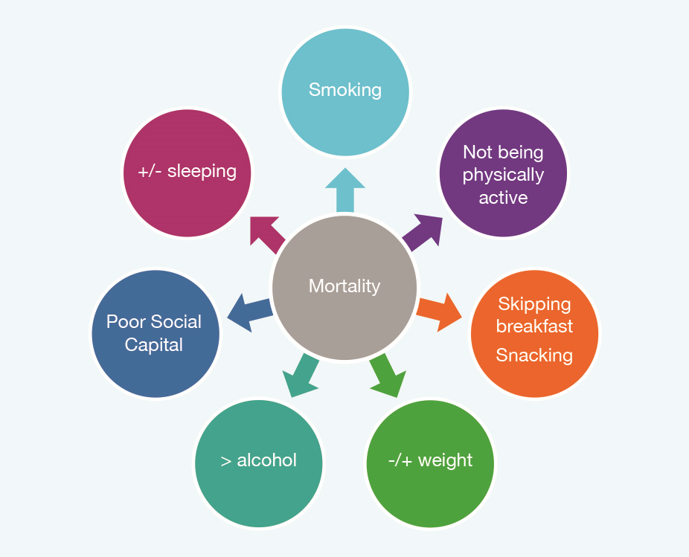
Lifestyle factors predicting mortality
Notes:
Let’s look at some of the social influences on our health & health behaviour
Social and economic disadvantage
Harmful health behaviour (smoking, unhealthy diet, lack of exercise etc.) is not the only related cause of poor health. It is well known that social and economic disadvantage is strongly linked with damaging health behaviour and creates most difficulty in adopting new healthier behaviour. This reinforces the importance of adopting a person-centred approach to health promotion ensuring that all factors, including social influences of health and health behaviours are considered.
The Alameda County Study conducted in 1965 in California in the United States was one of the first studies to identify health behaviours predictive of mortality.

Slide 11
Social influences on health/health behaviour
Alameda County Study (1965)
Social and economic disadvantage
Notes:
Let’s look at some of the social influences on our health & health behaviour
Social and economic disadvantage
Harmful health behaviour (smoking, unhealthy diet, lack of exercise etc.) is not the only related cause of poor health. It is well known that social and economic disadvantage is strongly linked with damaging health behaviour and creates most difficulty in adopting new healthier behaviour. This reinforces the importance of adopting a person-centred approach to health promotion ensuring that all factors, including social influences of health and health behaviours are considered.
The Alameda County Study conducted in 1965 in California in the United States was one of the first studies to identify health behaviours predictive of mortality.

Slide 12
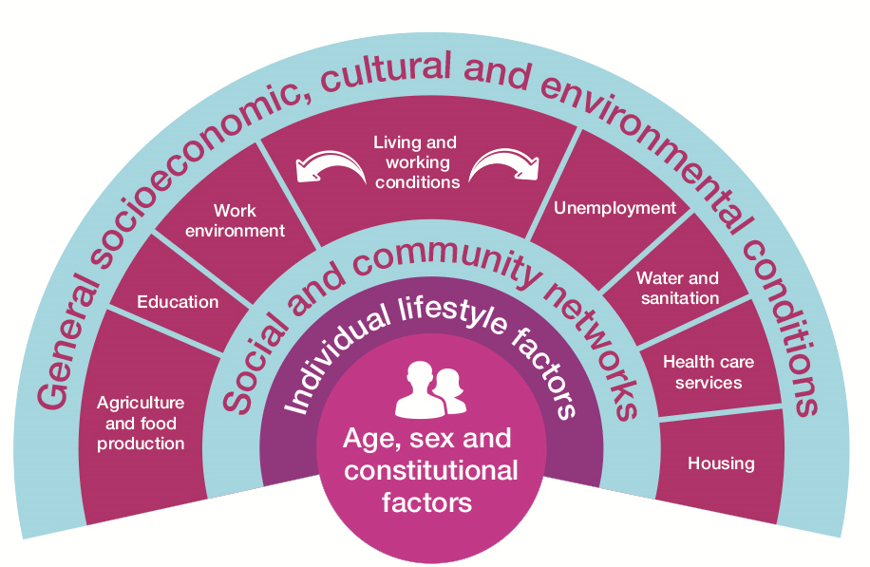
Health Determinants
Dahlgren-Whitehead Model (1991)
Notes:
According to Dahlgren and Whitehead (1991), factors such as age, sex and genetics
are non-modifiable and cannot be altered to promote our health. There are multiple
other factors however or “layers of influence” which are modifiable such as:
1. Personal behaviours and lifestyles
2. Support and influence within communities which can sustain or damage
health
3. Living and working conditions and access to facilities and services
4. Economic, cultural and environmental conditions such as standards of
living or employment.
The core of Dahlgren and Whitehead’s model contains the non-modifiable factors
(biological and genetic traits). These elements play a key role in determining
health and are non-modifiable which means that they are not influenced by health
There are a number of other key health determinants which are modifiable and are
depicted as layers extending from the core of the model:
Layer 1: Individual Lifestyle Factors, This layer refers to the lifestyle “choices”
or behaviours we adopt such as smoking, alcohol and drug use, unhealthy diet
etc.
Layer 2: Social and Community Networks. This layer refers to our family, friends
and broader social supports which can play a positive and protective role in health.
Layer 3: Living and Working Conditions. Here the model refers to basic needs
including sanitation, food, housing. Also included are factors such as access to
healthcare, education, welfare services and amenities.
Layer 4: General Socio-Economic, Cultural and Environmental Conditions. The
factors represented here (employment, salary, taxation etc.) are thought to have
direct influence on government’s spending capacity influencing health and social
policy priorities.

Slide 13
Determinants of Health
Non-modifiable
Modifiable
Age
Sex
Genetics
Personal lifestyle and behaviours
Social support
Community networks
Living and working conditions
Access to facilities and services
Economic, cultural and environmental conditions

Slide 14
How might this model be relevant/applicable to patients with chronic disease?
Notes:
How could this model be applied in the context of a person-centred approach to health promotion for chronic disease prevention?

Slide 15
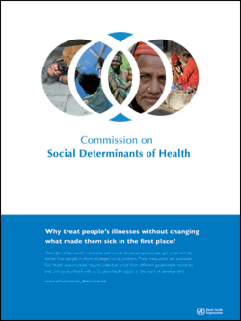
Why treat people’s illness without changing what makes them sick in the first place?
Notes:
Summary Unit 2 Lesson 1
In this Lesson we explored health behaviours. We looked at what is meant by the term health behaviour. We focused on the factors which influence health behaviours and we examined the relationship between health behaviour and poor health. In Lesson 2 we are going to look in more detail at health behaviours among
students, what the research tells us about students and health, and you will have an opportunity to offer your opinions on the topics.

