Slide 1
Unit 2: Lesson 2

Slide 2
Lifestyle Behaviours and Personal Responsibility for Health
Lesson 2: Student Health Behaviour
Notes:
Introduction to Lesson 2
In this lesson we are going to focus on health behaviours in student populations and you will be provided with recommended reading and guided questions.
Brief recap of Unit 2 Lesson 1
Student data – Health Behaviours
Research findings/Papers reading
Discussion Points
2.2 Critical Reading Activity

Slide 3
Making Every Contact Count
Play your part
in changing lifestyle behaviours
and help prevent chronic disease
Notes:
Making Every Contact Count is a programme being implemented within the HSE to support the prevention of chronic disease by promoting lifestyle behaviour change. The health behaviours which are the focus of this programme are the four main lifestyle risk factors for chronic disease: tobacco use; physical inactivity; harmful alcohol consumption and unhealthy eating.
Making Every Contact Count is about health professionals using their routine consultations to empower and support people to make healthier choices to achieve positive long-term behaviour change. To do this, the health service needs to build a culture and operating environment that supports continuous health improvement through the contacts that it has with individuals.
This approach will allow health professional to move to a position where discussion of lifestyle behaviour is routine, non-judgemental and central to everyone’s role.
As a healthcare student and future healthcare professional you will be asked to make each routine contact that you have with patients count in terms of chronic disease prevention.

Slide 4
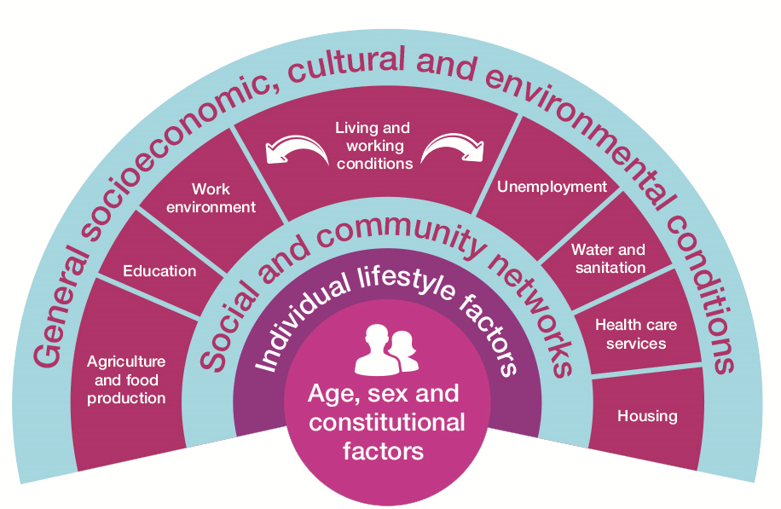
RECAP Lesson 1
Health Behaviour & its impact on Health
What influences our Health & Health Behaviour?
Determinants of Health
Notes:
In lesson 1 we explored health behaviours. We looked at what is meant by
the term health behaviour and we focused on the various influences on our health behaviours.
We examined the relationship between health behaviour and
poor health.
We discussed the Determinants of health: Modifiable Vs Non Modifiable

Slide 5
Students & Health Behaviours
Research indicates that undergraduate student’s lifestyle practices are not always optimal and raising awareness about healthy lifestyle behaviour is important at undergraduate level
(Mazurek Melnyk, Slevin, Militello, Teall, & McGovern, 2016).

Slide 6
Today’s students = Tomorrow’s Healthcare Professionals

Slide 7
Pause, Reflect & Discuss
“When you’re drunk in a bar, you want to smoke constantly. When you have to go outside to smoke you won’t smoke as much”.
(Berg et al., 2011)
What conflicting health messages are evident?
Notes:
Read this quote, it is a response from a university student to research on the
smoking ban in public places in the USA. What conflicting health messages are evident?

Slide 8
First year university students are known to gain weight due to
poor eating habits and lack of exercise
(Gropper, Simmons, Connell, & Ulrich, 2012).
Think about your diet and exercise patterns
Do you eat a healthy balanced diet?
Do you exercise regularly?
Notes:
This causes concern because obesity, poor dietary habits and physical inactivity are risk factors for cardiovascular disease, cancer and diabetes (World Health Organisation, 2006).

Slide 9
Another lifestyle risk for university students is that they can suffer from high stress levels, (Ferrara, 2009) and from increased incidence of depression and anxiety (Eisenberg, Speer, & Hunt, 2012).
Think about your psychological health.
Can you think of positive ways in which students can promote psychological health?
Notes:
Most people at some point or other feel worried, stressed or even down about things that are going on in their lives. Difficult experiences in life, of whatever sort, can have an impact on our mental health.
We all go through tough times. When we do, little things can make a big difference to how we feel and how we cope with life’s ups and downs.
Just like we all have physical health, we also all have mental health. Our mental health operates along a scale from feeling well to feeling unwell. Every day, we experience these ups and downs.
The following website may be a useful resource to learn more about how to mind your mental health but will also provide information on what do to if you or someone you care about needs more support : www.yourmentalhealth.ie/
: www.yourmentalhealth.ie/

Slide 10
Mind your Mental Health
Every single one of us will experience tough times in our lives. YourMentalHealth.ie is a place to learn about mental health in Ireland, and how to support yourself and the people you love.

Slide 11
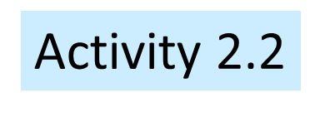
Key Reading
Read any one of these papers and consider the questions listed on next slide
Lovell, G., Sharman, R., & Lane, B. (2015) “A cross-sectional investigation of depressive, anxiety, and stress symptoms and health-behaviour participation in Australian university students”, Nursing and Health Sciences, 17, pp. 134–142.
Montauti, S.B., & Bulmer, S.M. (2014) “A Research Update on Correlates of Heavy Episodic Drinking Among Undergraduate College Students”, American Journal of Health Education, 45(3), pp. 142-150.
Morrell, H., Cohen, L., & Dempsey, J.P. (2008) “Smoking Prevalence and Awareness Among Undergraduate and Health Care Students”, The American Journal on Addictions, 17, pp. 181–186.
Berg, C.J., Lessard, L., Parelkar, P.P., Thrasher, J., Kegler, M.C., Escoffery, C., Goldade, K., & Ahluwalia, J.S. (2011) “College student reactions to smoking bans in public, on campus and at home”, Health education research, 26(1), pp. 106-18.
Notes:
*Activity 2.2: National Undergraduate Curriculum for Chronic Disease Prevention and Management, Page 68 (Hand-out)
Distribute the reading list Activity 2.2 & Answer the questions or follow slides 11-12
Please note these papers are examples and may be substituted with other programme specific material

Slide 12
Activity 2.2
What are the key messages from the paper you have read?
In your experience, is this a true reflection of the lifestyle practices mentioned?
Can you think of ways to improve student health behaviours?
Notes:
Summary
In this lesson we talked about health behaviours among student populations and looked at some of the literature on the topic. In the next lesson we are going to talk about changing personal health behaviours.

