Slide 1
Unit 2: Lesson 3

Slide 2
Lifestyle Behaviours and Personal Responsibility for Health
Lesson 3: Behaviour Change
Notes:
In this lesson we are going to talk about changing health behaviours. You will be asked to complete an activity on a personal health behaviour you would like to change and we will address some of the challenges of behaviour change.
Brief Recap of Unit 2 Lesson 1 & 2
Changing behaviours
Activity 2.3
2.3 Decisional Balance Personal Health Behaviour Questionnaire

Slide 3
Making Every Contact Count
Play your part
in changing lifestyle behaviours
and help prevent chronic disease
Notes:
Making Every Contact Count is a programme being implemented within the HSE to support the prevention of chronic disease by promoting lifestyle behaviour change. The health behaviours which are the focus of this programme are the four main lifestyle risk factors for chronic disease: tobacco use; physical inactivity; harmful alcohol consumption and unhealthy eating.
Making Every Contact Count is about health professionals using their routine consultations to empower and support people to make healthier choices to achieve positive long-term behaviour change. To do this, the health service needs to build a culture and operating environment that supports continuous health improvement through the contacts that it has with individuals.
This approach will allow health professional to move to a position where discussion of lifestyle behaviour is routine, non-judgemental and central to everyone’s role.
As a healthcare student and future healthcare professional you will be asked to make each routine contact that you have with patients count in terms of chronic disease prevention.

Slide 4
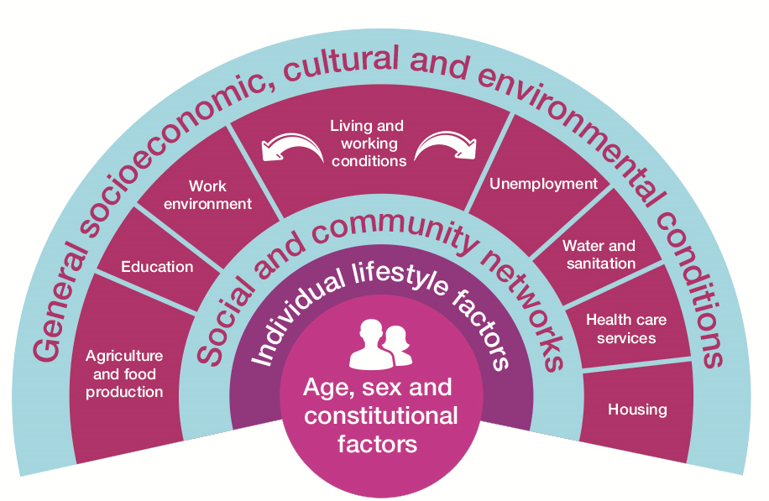
RECAP Lesson 1 & 2
Health Behaviour & its impact on Health
What influences our Health & Health Behaviour?
Determinants of Health
Health behaviour of students
Key messages from research papers
Notes:
Recap of Unit 2 Lessons 1 & 2
Can you remember what was covered in previous lessons?
In previous lessons we looked at behaviour change, factors which influence our health behaviour and the health behaviours of student groups.

Slide 5
Changing Behaviours
Impair Health | Protect & Promote Health
Smoking Unhealthy diet Binge drinking Unsafe sexual practices Sedentary lifestyle Etc. | Not smoking Regular health/screening checks Regular dental checks/repairs Balanced diet Being physically active Drinking within sensible limits Etc.
Notes:
Changing Behaviours
The main reason why someone might want to change a behaviour is because, on balance, that behaviour has a negative value to them.
Our society, on the whole, assumes that to adopt health promoting or healthy behaviour is ‘better’ than persisting with unhealthy behaviour.
One of the key principles related to Health Promotion for Chronic Disease Prevention is that lifestyle change is considered to be the best way to prevent the onset of chronic disease.
Health behaviours can be classified into 2 types.
1. Those that impair health (e.g. smoking, eating a high fat diet, excessive binge drinking, unsafe sexual practices, sedentary lifestyle).
2. Those that protect and promote health (not smoking, having regular health and screening checks, regular dental checks and necessary repairs, eating a balanced diet, regularly taking the recommended amount of exercise, drinking within sensible limits and so on).
Changing behaviours can be challenging yet it is a central aspect of health promotion for chronic disease prevention.
Health Behaviours People practice health behaviours for a variety of reasons. Some behaviours are adhered to because they promote or benefit health e.g. getting enough sleep and always eating breakfast; other behaviours are practised to avoid health risks, for example not smoking cigarettes and keeping your weight within recommended healthy limits; other habits maintain good health, such as having regular dental check-ups and engaging in regular exercise.
People may of course practice apparently inconsistent health behaviours. For instance, someone may eat a high fat diet because they don’t want to offend the person who is preparing their food and yet take regular exercise to compensate and may also be a committed non-smoker.
Similarly, behaviour may change over time as people’s life circumstances change

Slide 6
Activity 2.3
Decisional Balance Tool
Complete the
Decisional Balance Tool
for a health behaviour
you would like to change
Reasons to stay the same (Resistance/Barriers) | Reasons to change (Motivation)
List the positives of staying the same? | List the negatives of staying the same?
Notes:
*Activity 2.3: National Undergraduate Curriculum for Chronic Disease Prevention and Management, Page 70 (Hand-out)
Distribute the Decisional Balance Tool Activity 2.3
So why do we behave the way we do?
People acquire healthy and unhealthy behaviours through learning processes, either by direct experience or through observing the behaviour of others. If the behaviour becomes well established it tends to become habitual - that is the person often performs it automatically or without awareness.
Think of the smoker who, despite having a heavy cold and bronchial cough, reaches automatically for the packet of cigarettes to light up after lunch.
Think of the woman on a diet who automatically eats the leftovers off her
children’s plates without considering that these add to her calorie intake. Changing behaviour implies learning new habits to replace those that have become established practice.
Changing health behaviours is not an easy task. It is difficult to change your own behaviours and this power point presentation Changing Behaviours will remind you of the difficulties attached to changing a given behaviour. You can begin to imagine the challenges involved in encouraging somebody else to change a given health behaviour (PPP Unit 2 Lesson 3 Changing Behaviours).

Slide 7
Changing behaviours can be challenging,
yet it is a central aspect of
Health Promotion
for chronic disease prevention.
Notes:
People practice health behaviours for a variety of reasons. Some behaviours are adhered to because they promote or benefit health e.g. getting enough sleep and always eating breakfast; other behaviours are practised to avoid health risks, for example not smoking cigarettes and keeping your weight within recommended healthy limits; other habits maintain good health, such as having regular dental check-ups and engaging in regular exercise.
People may of course practice apparently inconsistent health behaviours. For instance, someone may eat a high fat diet because they don’t want to offend the person who is preparing their food and yet take regular exercise to compensate and may also be a committed non-smoker.
Similarly, behaviour may change over time as people’s life circumstances change

Slide 8
So why do we behave the way we do?
Learned behaviours- experience/observation
Habit- Behaviours performed automatically/without awareness
Changing behaviours implies learning new habits to replace
those that have become established practise
Notes:
So why do we behave the way we do?
People acquire healthy and unhealthy behaviours through learning processes, either by direct experience or through observing the behaviour of others. If the behaviour becomes well established it tends to become habitual - that is the person often performs it automatically or without awareness.
Think of the smoker who, despite having a heavy cold and bronchial cough, reaches automatically for the packet of cigarettes to light up after lunch.
Think of the woman on a diet who automatically eats the leftovers off her
children’s plates without considering that these add to her calorie intake. Changing behaviour implies learning new habits to replace those that have become established practice.
Changing health behaviours is not an easy task. It is difficult to change your own behaviours and this power point presentation Changing Behaviours will remind you of the difficulties attached to changing a given behaviour. You can begin to imagine the challenges involved in encouraging somebody else to change a given health behaviour
Summary
In this Unit we explored the topic of behaviour change and the some of the
reasons why a person would want to change a health behaviour. You were asked to think about changing a personal health behaviour and we addressed some of the challenges of behaviour change.
In Lesson 4 we are going to look at some of the theories that have been written to help explain behaviour change and how behaviour change occurs.

