Slide 1



Unit 2: Lesson 4

Slide 2

Lifestyle Behaviours and Personal Responsibility for Health
Lesson 4: Theories of Behaviour Change
Notes:
Introduction to Lesson 4
In this lesson we are going to talk about the theories that have been written to help explain behaviour change and how behaviour change occurs.
Brief Recap Unit 2 Lesson 1-3
Theories of Health Behaviour Change
Trans-theoretical Model of Behaviour Change
Health Belief Model
COM-B Model
Healthcare Student as Health Promoter
Activity 2.4 Health Promotion Topic

Slide 3


Making Every Contact Count
Play your part
in changing lifestyle behaviours
and help prevent chronic disease
Notes:
Making Every Contact Count is a programme being implemented within the HSE to support the prevention of chronic disease by promoting lifestyle behaviour change. The health behaviours which are the focus of this programme are the four main lifestyle risk factors for chronic disease: tobacco use; physical inactivity; harmful alcohol consumption and unhealthy eating.
Making Every Contact Count is about health professionals using their routine consultations to empower and support people to make healthier choices to achieve positive long-term behaviour change. To do this, the health service needs to build a culture and operating environment that supports continuous health improvement through the contacts that it has with individuals.
This approach will allow health professional to move to a position where discussion of lifestyle behaviour is routine, non-judgemental and central to everyone’s role.
As a healthcare student and future healthcare professional you will be asked to make each routine contact that you have with patients count in terms of chronic disease prevention.

Slide 4

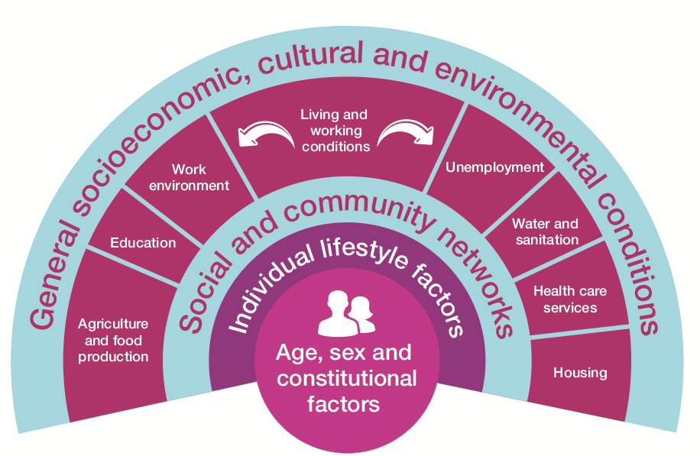
RECAP Lesson 1-3
  Health Behaviour & its impact on Health
  What influences our Health & Health Behaviour?
  Determinants of Health
  Health behaviour of students
  Key messages from research papers
  Challenges of changing behaviour
Notes:
Recap Unit 2 Lessons 1-3
Can you remember what was covered in previous lessons?
In previous lessons we looked at health behaviour, influences of health behaviour, student health behaviours and the challenges of changing behaviours.

Slide 5
Behaviour Change Models
Help to understand why people behave the way that they do so that they can be encouraged and supported to make and maintain healthy lifestyle choices
Behaviour change can be very complex- behaviour change models help us to understand the process
Notes:
Introduction to Lesson 4
In this lesson we are going to talk about the theories that have been written to help explain behaviour change and how behaviour change occurs.
Theories of behaviour change
Why are Behaviour Change Models Important?
Behaviour change models help to understand why people behave the way that they do so that they can be encouraged and supported to make and maintain healthy lifestyle choices.
Behaviour change can be very complex, particularly encouraging individuals to adopt healthy behaviours.
Behaviour change models can make it easier to understand the process of health behaviour change. Many models and theories have been developed to understand and explain the influences on health related behaviours.

Slide 6
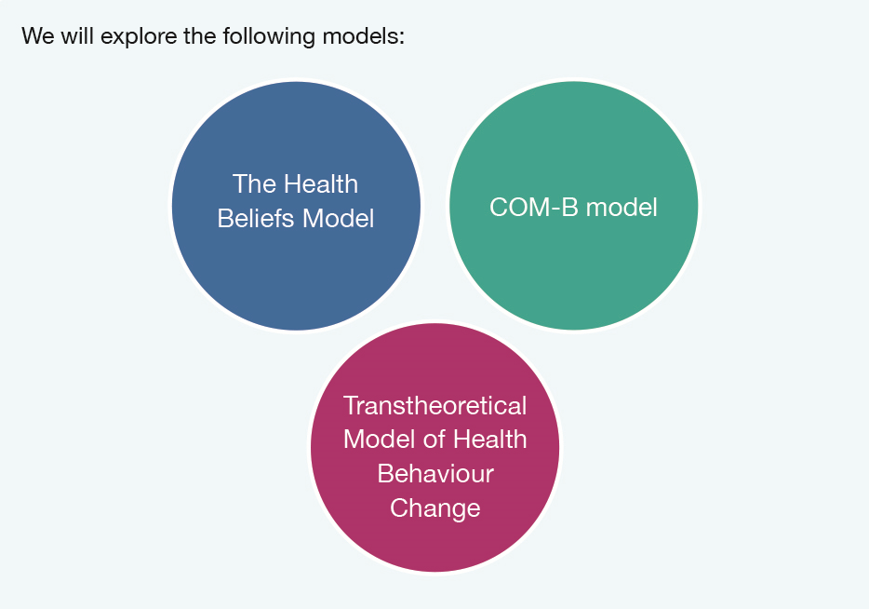

Slide 7
Models of Behaviour Change
Transtheoretical Model/ Stages of Change Model
Health Belief Model
COM-B Model

Slide 8
Transtheoretical Model/ Stages of Change Model
Prochaska & DiClemente, 1984)
Notes:
NOTED THAT SOME MODELS REFERRED TO ARE DATED HOWEVER IT HAS BEEN AGREED TO INCLUDE THEM AS AN UMBRELLA TO ENCOURAGE BROAD UNDERSTANDING OF ALL AS THEY ARE STILL EVIDENT AND IN USE.
1 The Trans-Theoretical Model of Health Behaviour Change
The trans-theoretical model of health behaviour change is also known as the cycle of change and was developed by Prochaska and Di Clemente. The model posits that health behaviour change takes place over a series of stages and that interventions should reflect this (Prochaska & DiClemente, 1992).
Prochaska theorised that people have different levels of motivation and readiness to act on a health behaviour and therefore therapeutic interventions should be stage matched; it can also be used to guide the individual through the various stages (Prochaska & Velicer, 1997).
The five stages of change are:
• Pre-contemplation: Patient feels that current health behaviour is not a problem and is therefore not considering change.
• Contemplation: Patient is thinking about making a health behaviour change but is ambivalent about doing so.
• Preparation: Patient is ready to change their health behaviour and is starting to make plans on how to do this.
• Action: Patient is actively working at making health behaviour changes
• Maintenance: Patient is focussing on maintaining the health behaviour changes they have made
• Another important stage that sits outside the stages of change model is Relapse, where a patient has regressed into old health behaviours.
Figure 2.4 Stages of Change (Prochaska & DiClemente, 1992)
The core construct proposed by Prochaska’s theory reflects the individual’s relative weighing of the pros and cons of change (Prochaska & Velicer, 1997). In the early stages the cons of changing outweigh the pros, as one progresses through the cycle the cons are decreasing and are surpassed by the pros and in the final stages the pros outweigh the cons.
Evidence has shown that when health programmes or services are ‘stage-matched’ to suit the individuals they have more success in recruitment, retention and progress in smoking cessation, the model has also been applied to treatment of addictive behaviours with success, however patients with addictive behaviour often recycle through the process a number of times before they exit (Prochaska & DiClemente, 1992, p. 149; Prochaska, DiClemente, & Norcross, 1993; Prochaska & Velicer, 1997).

Slide 9
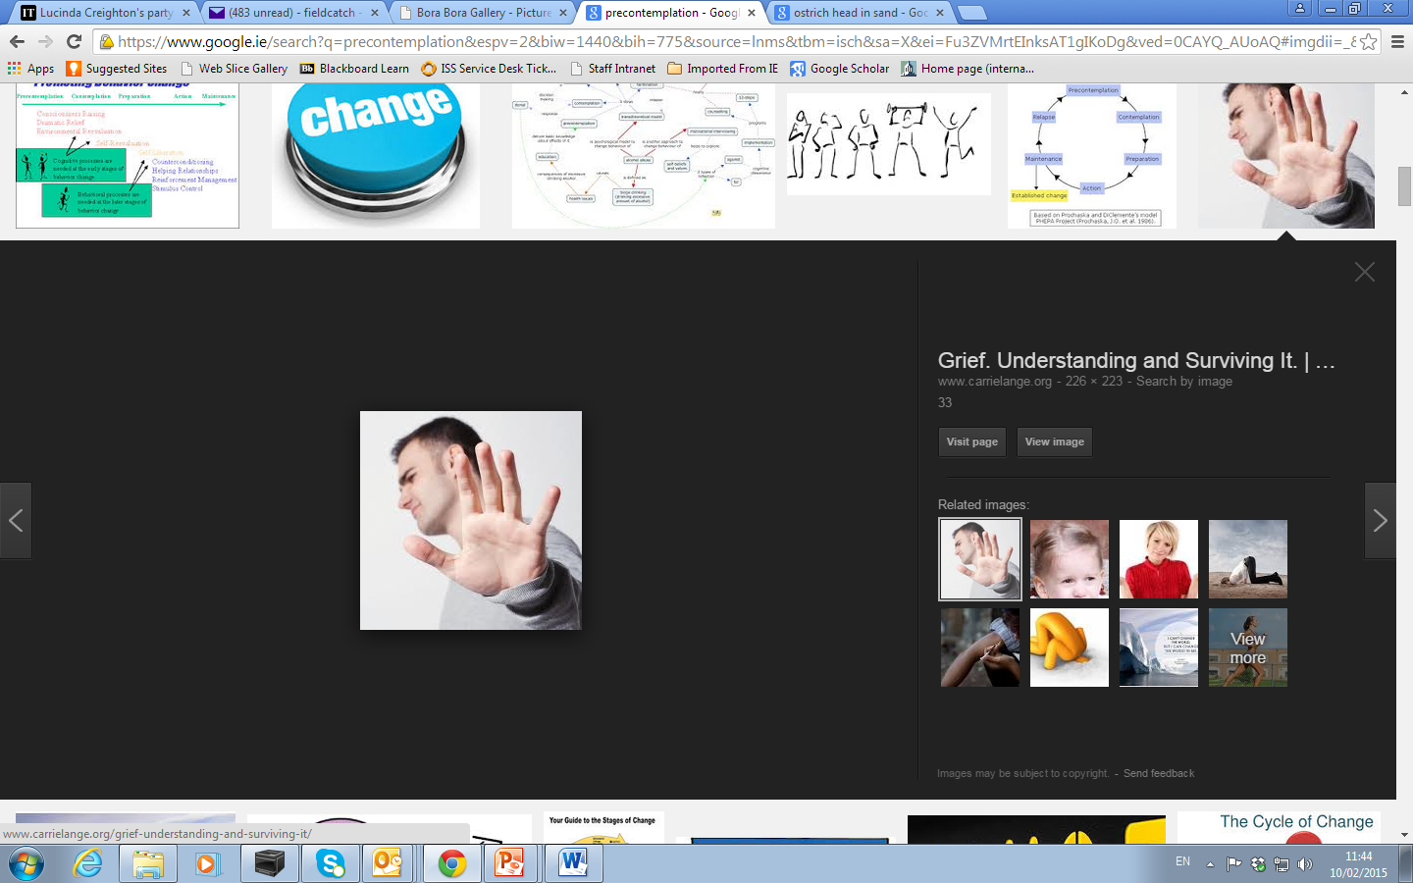
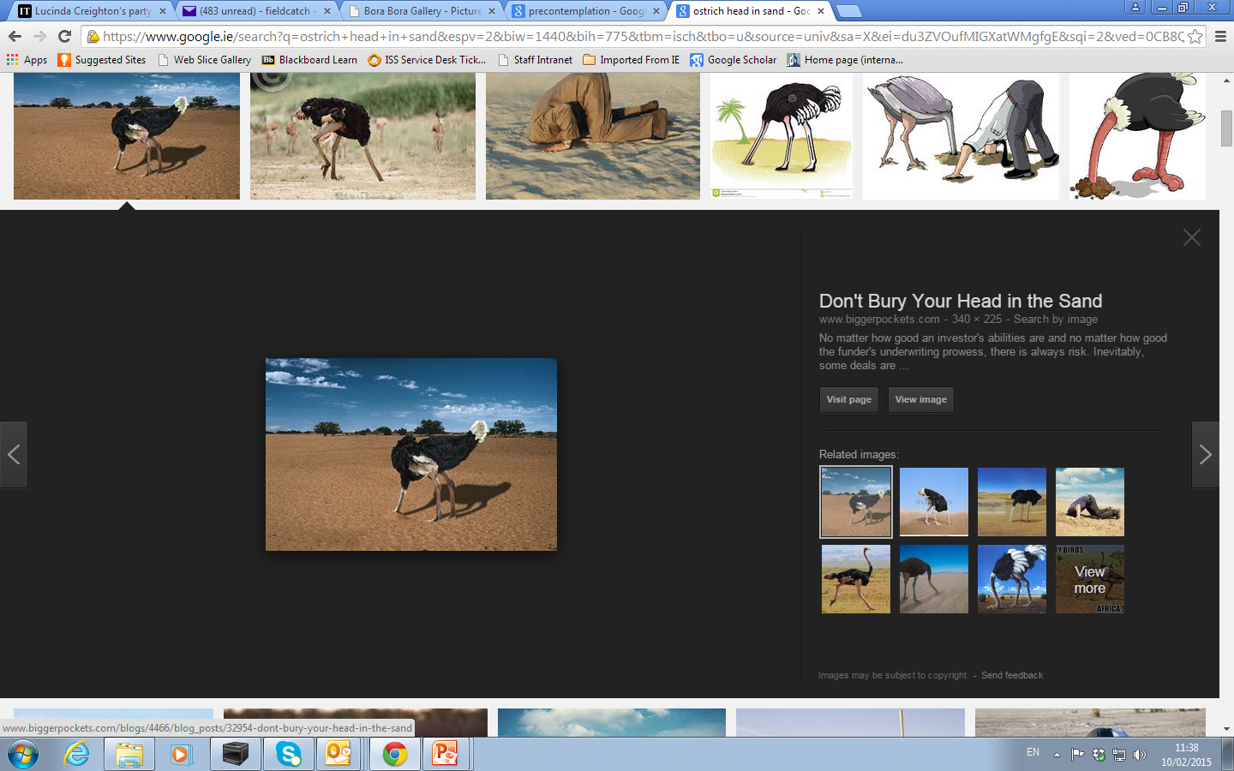
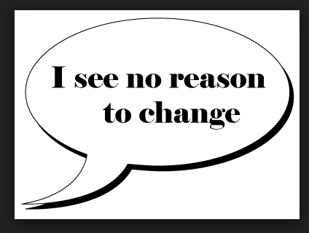
Pre-contemplation
Patient feels that current health behaviour is not a problem and is therefore not considering change.
Notes:
The five stages of change are:
• Pre-contemplation: Patient feels that current health behaviour is not a problem and is therefore not considering change.
• Contemplation: Patient is thinking about making a health behaviour change but is ambivalent about doing so.
• Preparation: Patient is ready to change their health behaviour and is starting to make plans on how to do this.
• Action: Patient is actively working at making health behaviour changes
• Maintenance: Patient is focussing on maintaining the health behaviour changes they have made
• Another important stage that sits outside the stages of change model is Relapse, where a patient has regressed into old health behaviours.

Slide 10
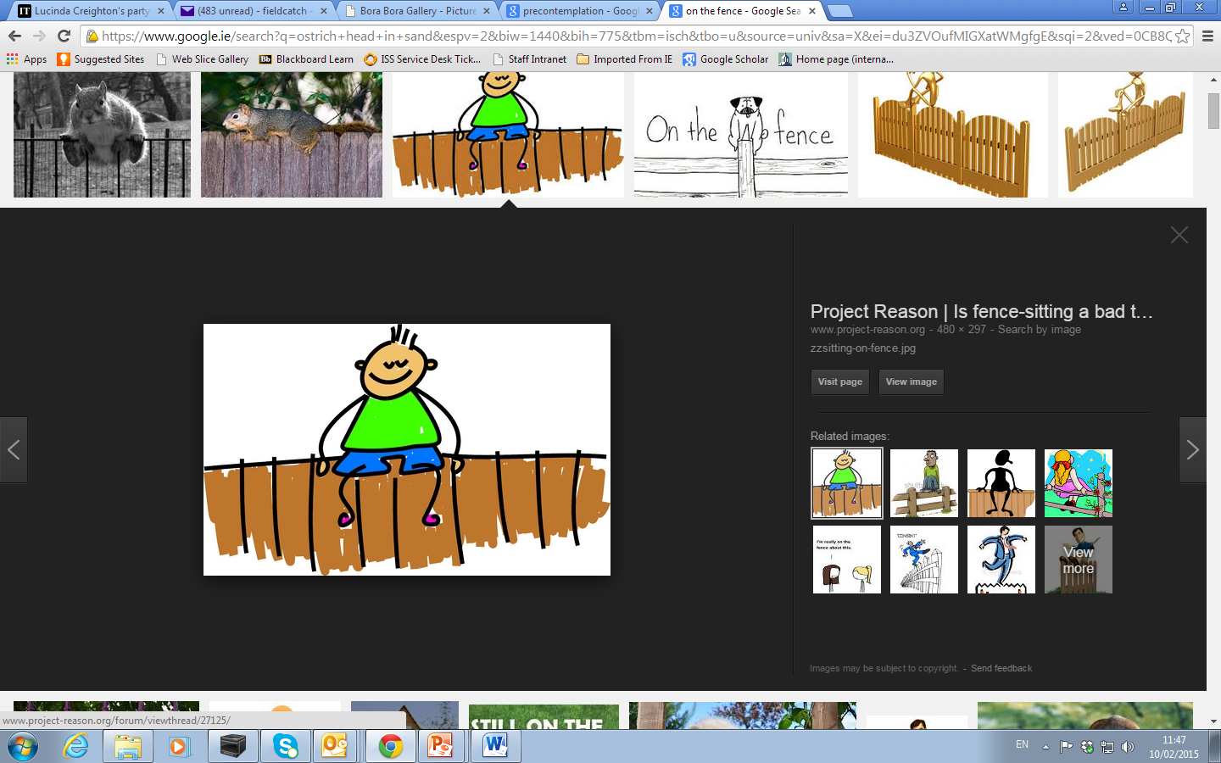
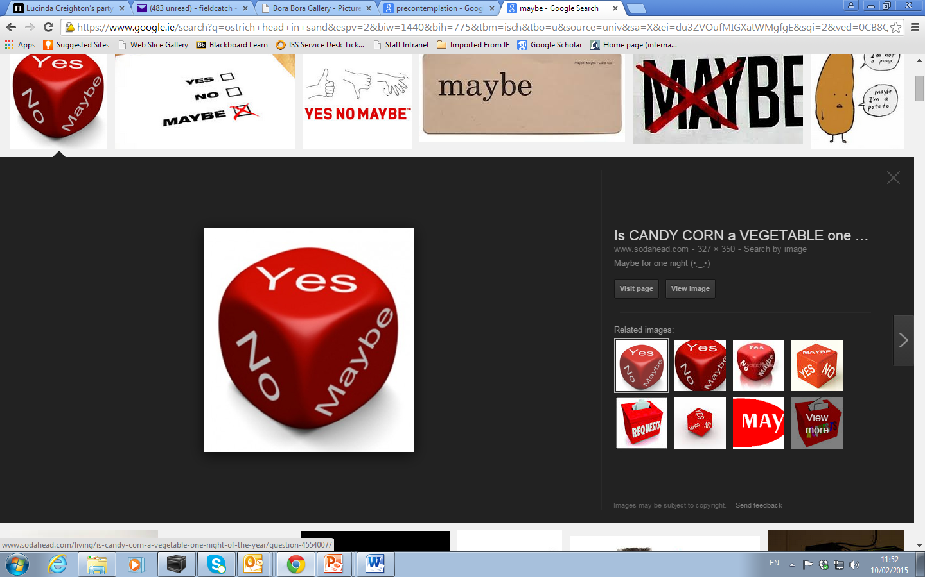
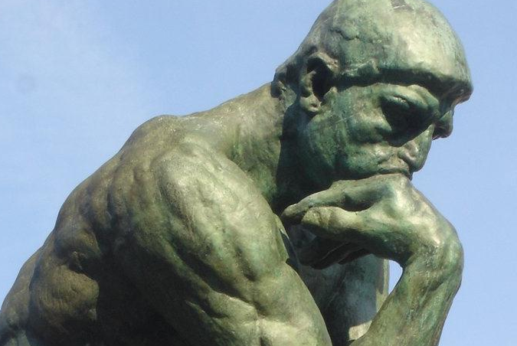
Contemplation
Patient is thinking about making a health behaviour change but is ambivalent about doing so.
Notes:
The five stages of change are:
• Pre-contemplation: Patient feels that current health behaviour is not a problem and is therefore not considering change.
• Contemplation: Patient is thinking about making a health behaviour change but is ambivalent about doing so.
• Preparation: Patient is ready to change their health behaviour and is starting to make plans on how to do this.
• Action: Patient is actively working at making health behaviour changes
• Maintenance: Patient is focussing on maintaining the health behaviour changes they have made
• Another important stage that sits outside the stages of change model is Relapse, where a patient has regressed into old health behaviours.

Slide 11
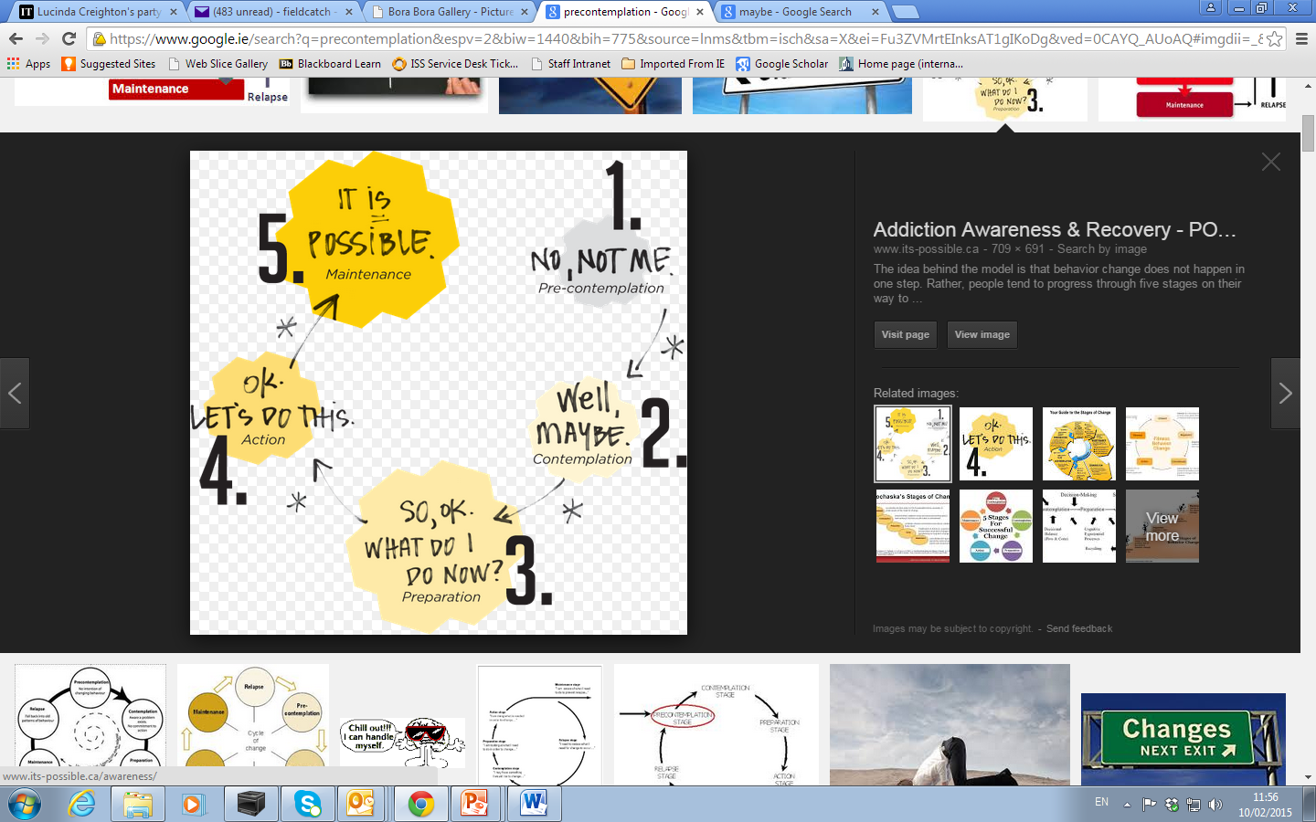
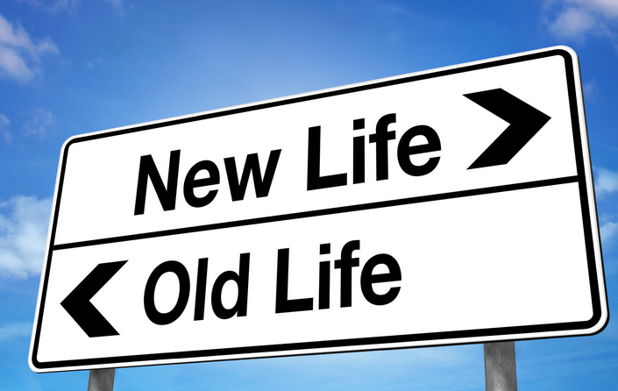
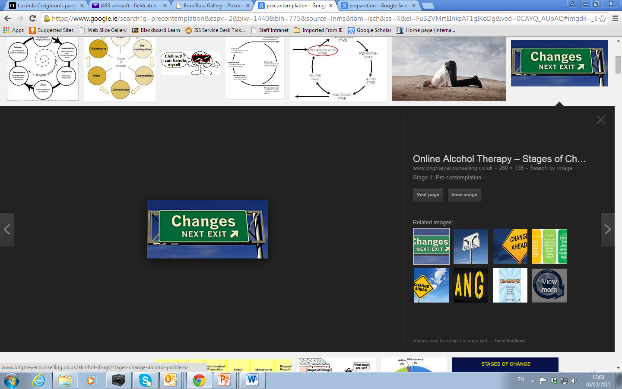
Preparation
Patient is ready to change their health behaviour and is starting to make plans on how to do this.
Notes:
The five stages of change are:
• Pre-contemplation: Patient feels that current health behaviour is not a problem and is therefore not considering change.
• Contemplation: Patient is thinking about making a health behaviour change but is ambivalent about doing so.
• Preparation: Patient is ready to change their health behaviour and is starting to make plans on how to do this.
• Action: Patient is actively working at making health behaviour changes
• Maintenance: Patient is focussing on maintaining the health behaviour changes they have made
• Another important stage that sits outside the stages of change model is Relapse, where a patient has regressed into old health behaviours.

Slide 12
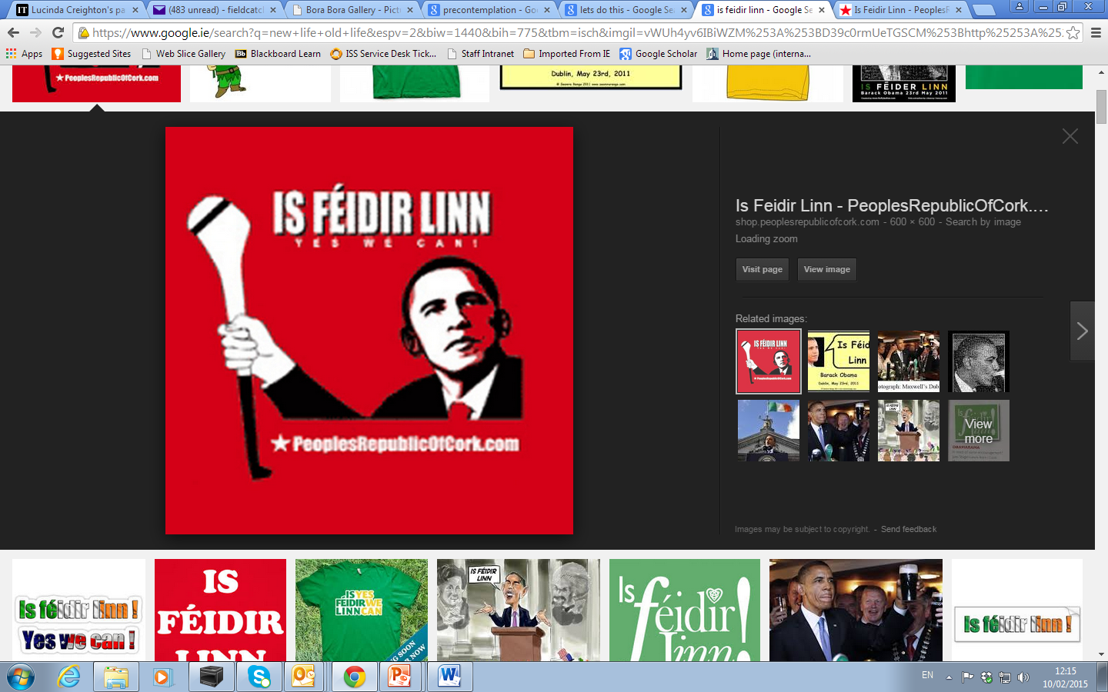
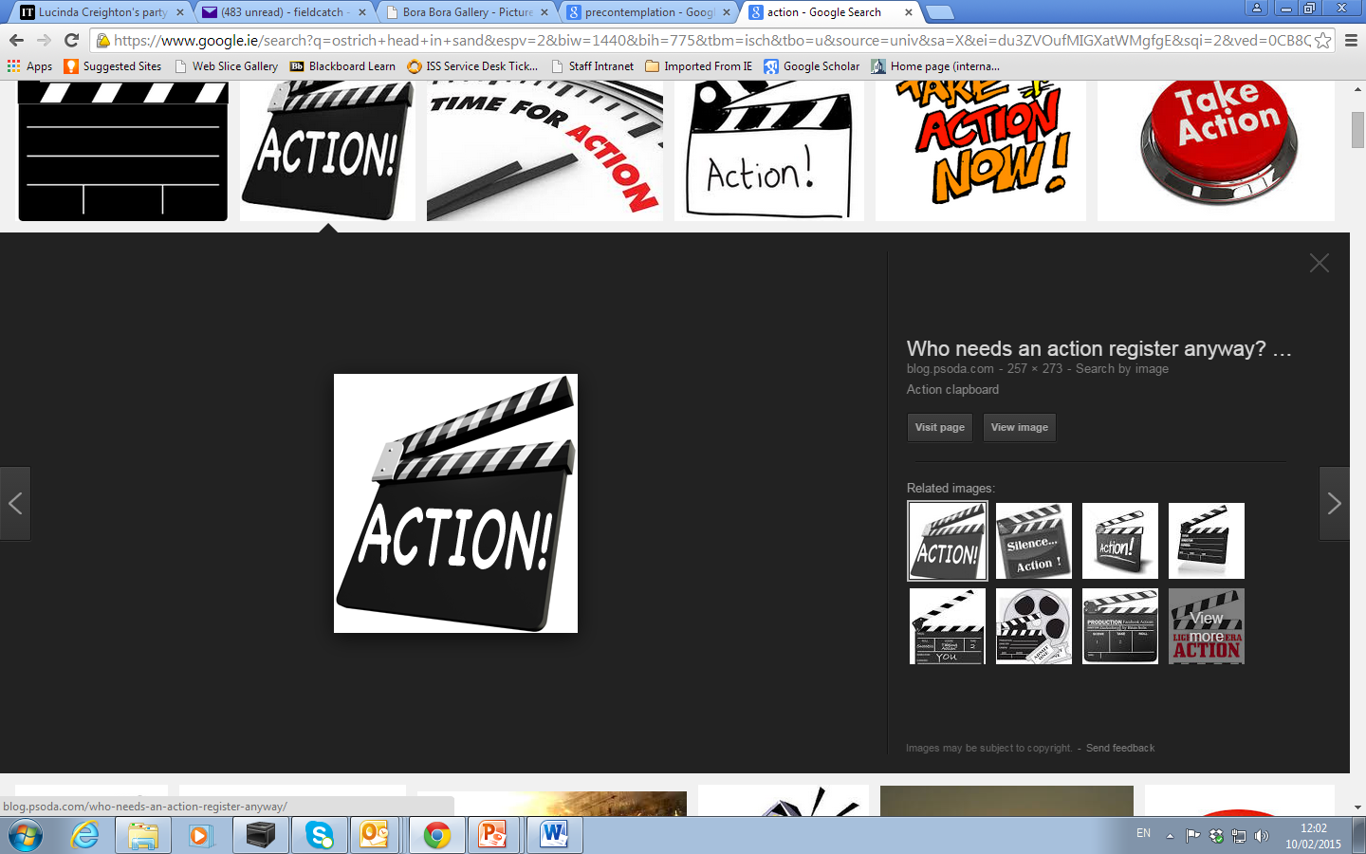
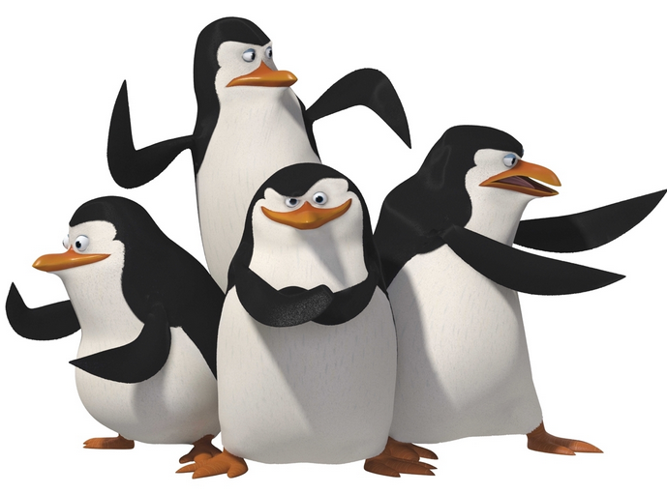
Action
Patient is actively working at making health behaviour changes
Notes:
The five stages of change are:
• Pre-contemplation: Patient feels that current health behaviour is not a problem and is therefore not considering change.
• Contemplation: Patient is thinking about making a health behaviour change but is ambivalent about doing so.
• Preparation: Patient is ready to change their health behaviour and is starting to make plans on how to do this.
• Action: Patient is actively working at making health behaviour changes
• Maintenance: Patient is focussing on maintaining the health behaviour changes they have made
• Another important stage that sits outside the stages of change model is Relapse, where a patient has regressed into old health behaviours.

Slide 13

Maintenance
Patient is focussing on maintaining the
health behaviour changes they have made
Notes:
The five stages of change are:
• Pre-contemplation: Patient feels that current health behaviour is not a problem and is therefore not considering change.
• Contemplation: Patient is thinking about making a health behaviour change but is ambivalent about doing so.
• Preparation: Patient is ready to change their health behaviour and is starting to make plans on how to do this.
• Action: Patient is actively working at making health behaviour changes
• Maintenance: Patient is focussing on maintaining the health behaviour changes they have made
• Another important stage that sits outside the stages of change model is Relapse, where a patient has regressed into old health behaviours.

Slide 14
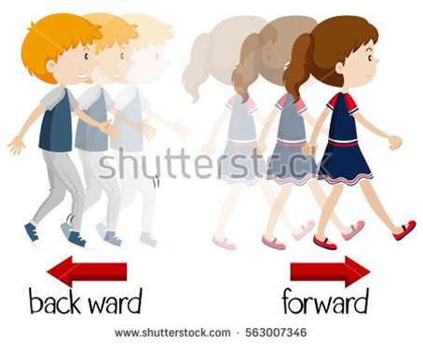
Relapse
Where a patient has regressed into
old health behaviours
Notes:
The five stages of change are:
• Pre-contemplation: Patient feels that current health behaviour is not a problem and is therefore not considering change.
• Contemplation: Patient is thinking about making a health behaviour change but is ambivalent about doing so.
• Preparation: Patient is ready to change their health behaviour and is starting to make plans on how to do this.
• Action: Patient is actively working at making health behaviour changes
• Maintenance: Patient is focussing on maintaining the health behaviour changes they have made
• Another important stage that sits outside the stages of change model is Relapse, where a patient has regressed into old health behaviours.

Slide 15

Can you recall any health behaviour that you have changed or thought about changing?
Can you relate to any of the stages mentioned here?
Figure 2.4 Stages of Change (Prochaska & DiClemente, 1992)
Notes:
The five stages of change are:
• Pre-contemplation: Patient feels that current health behaviour is not a problem and is therefore not considering change.
• Contemplation: Patient is thinking about making a health behaviour change but is ambivalent about doing so.
• Preparation: Patient is ready to change their health behaviour and is starting to make plans on how to do this.
• Action: Patient is actively working at making health behaviour changes
• Maintenance: Patient is focussing on maintaining the health behaviour changes they have made
• Another important stage that sits outside the stages of change model is Relapse, where a patient has regressed into old health behaviours.

Slide 16
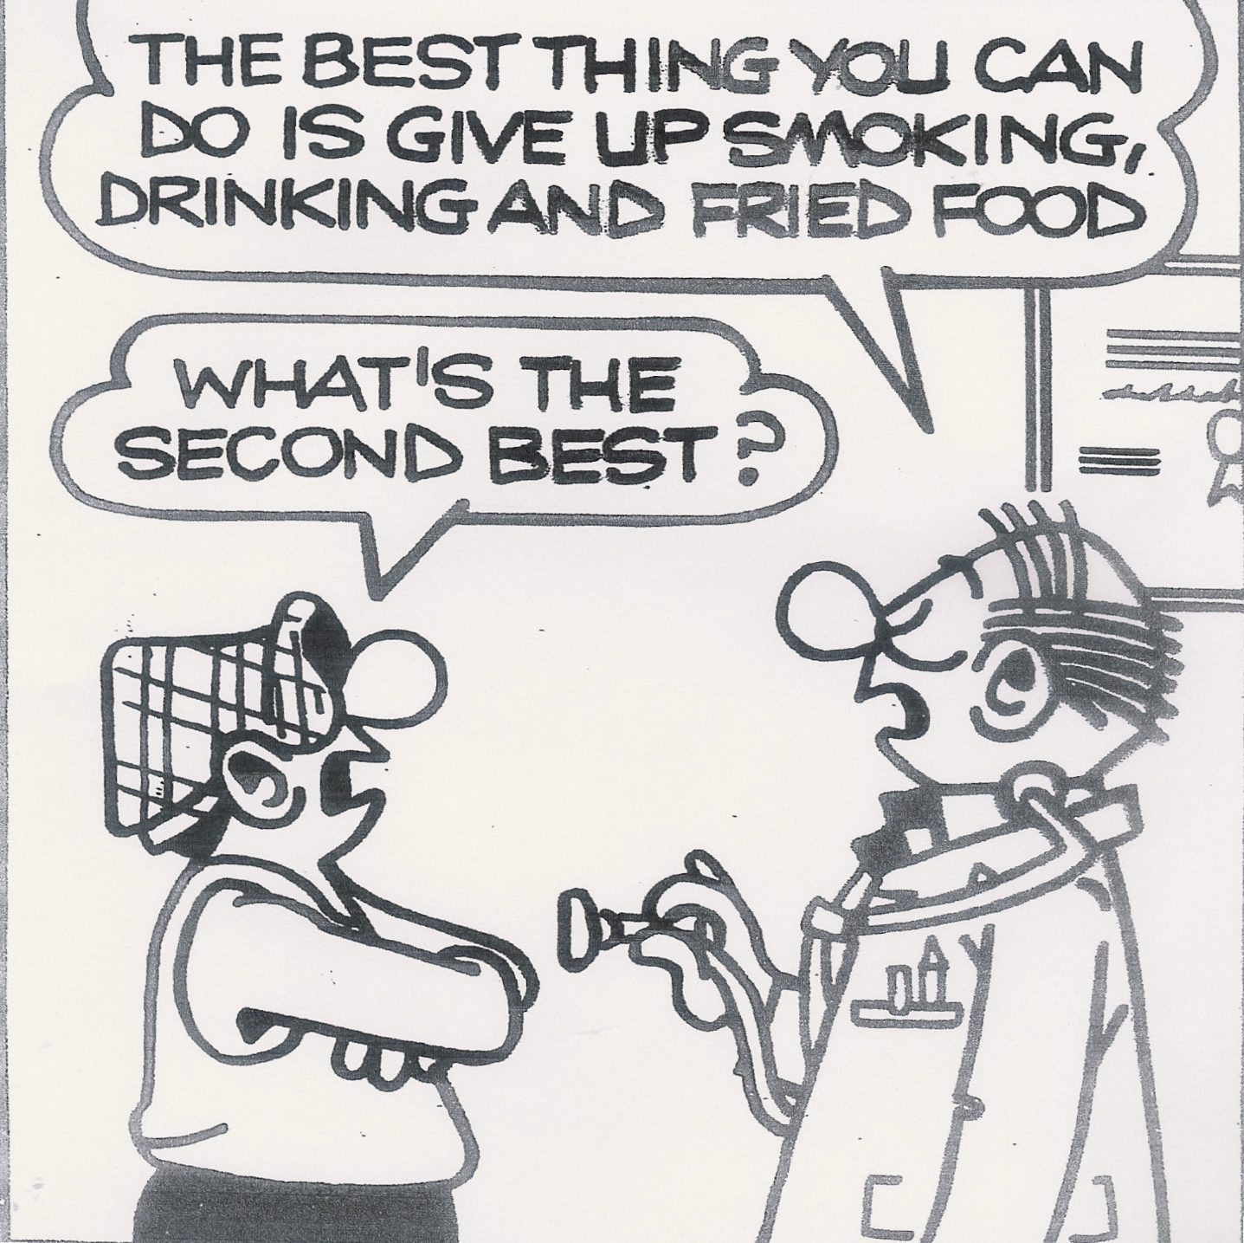
When health programmes or services are ‘stage matched’ to suit the individuals they have more success in recruitment, retention and progress in smoking cessation.
‘Meet the patient where
they are at’
Notes:
The core construct proposed by Prochaska’s theory reflects the individual’s relative weighing of the pros and cons of change (Prochaska & Velicer, 1997). In the early stages the cons of changing outweigh the pros, as one progresses through the cycle the cons are decreasing and are surpassed by the pros and in the final stages the pros outweigh the cons. Evidence has shown that when health programmes or services are ‘stage matched’ to suit the individuals they have more success in recruitment, retention and progress in smoking cessation, the model has also been applied to treatment of addictive behaviours with success, however patients with addictive behaviour often recycle through the process a number of times before they exit (Prochaska & DiClemente, 1992, p. 149; Prochaska, DiClemente, & Norcross, 1993; Prochaska & Velicer, 1997)
Pre-contemplation: Encouraged to think about change and become more ‘mindful’
Contemplation: Encourage to continue towards change concentrating on pros / cons
Preparation: Encouraged to prepare themselves and take support from family / friends / services
Action: Encouraged to strengthen commitment to change and altering old behaviours

Slide 17
Prochaska’s Theory
The model has also been applied to treatment of addictive behaviours (alcohol, drugs and tobacco ) with success, however patients with addictive behaviour often recycle through the process a number of times before they exit.

Slide 18
Models of Behaviour Change
Transtheoretical Model/ Stages of Change Model
Health Belief Model
COM-B Model

Slide 19
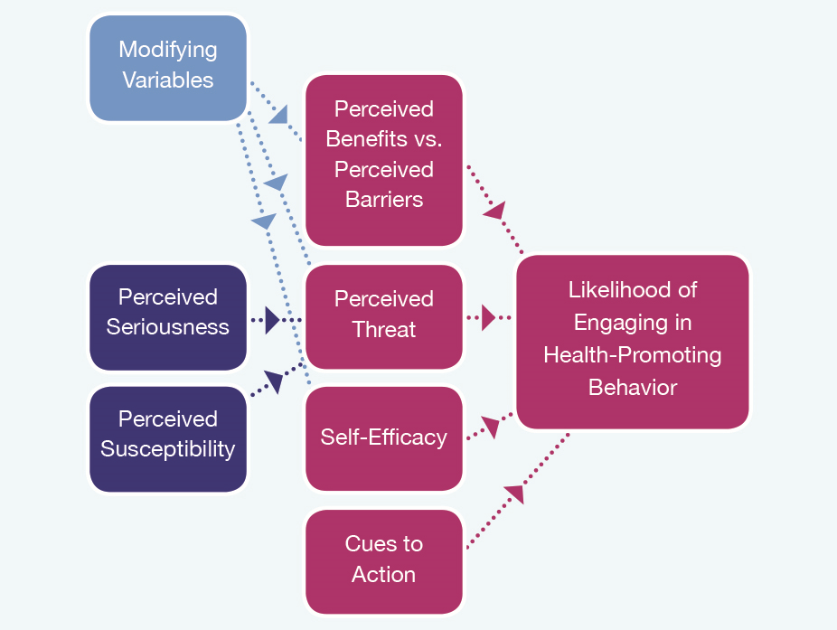
The Health Belief Model
Notes:
2 The Health Belief Model
The Health Belief Model proposes that to change behaviour in relation to their
health, people need to have a signal or prompt to take action (Naidoo & Wills, 2016). This model highlights the role of beliefs in decision-making. It suggests that whether or not people change their behaviour will be influenced by an individual assessing the feasibility of making the change, the benefits of adopting the change versus the cost (social, monetary, effort etc.).
The Health Belief model postulates that people make considered judgements about the value of the behaviour to them; the relative strength in which they perceive the threats of continuing the behaviour; the perceived seriousness of the health problem and their perceived susceptibility of succumbing to it.
The Health Belief Model further postulates that in weighing up the balance of likelihood (the pros and cons) of contracting a health problem, people arrive at a decision as to whether the perceived benefits of changing behaviour outweigh the perceived barriers or costs of changing.
For example, the perceived barriers to taking regular exercise might include:
“it will cost me a lot of money to join a gym”;
“I don’t look good in shorts, everyone else will look really trim and healthy”;
“I haven’t got the time”; “I don’t want to turn into a fitness freak”,
“I’m too old to start exercising – the gym will be full of youngsters”.
The outcome of weighing the perceived barriers against the perceived benefits will determine whether or not the person embarks on an exercise regime!

Slide 20
Health Belief Model
Perceived seriousness of a health problem
People consider how severe the health and social consequences of persisting with a particular behaviour are likely to be.
“well, I’ve got to die of something, so I may as well enjoy my smoking now…….”
Notes:
Perceived seriousness of a health problem: People consider how severe the health and social consequences of persisting with a particular behaviour are likely to be. For example, someone thinking about giving up smoking may consider the chances of getting lung cancer, and may think “well, I’ve got to die of something, so I may as well enjoy my smoking now and live with the possible consequences later, and anyhow, it may not happen to me, not all smokers get lung cancer.” The strength or seriousness which they ascribe to the link between lung cancer and smoking will determine their likelihood of giving up.

Slide 21
Health Belief Model
Perceived susceptibility to a health problem
A person considers their personal chances or likelihood of developing health problem e.g. lung cancer
“Most of my family smoke and they haven’t got
lung cancer- I won’t either ”
Notes:
They also consider their personal chances or likelihood of getting lung cancer (or some other smoking–related disease). This is the perceived susceptibility to the health problem. The more vulnerable someone perceives them self to be the more likely they are to take action to change the health behaviour. For example, if most people in their family have been regular smokers but none has contracted lung cancer, they may not rate their chances of getting lung cancer very highly, and have little regard for any other smoking-related disease.

Slide 22
Health Belief Model
Demographic variables: age, sex, race, and ethnic background
Socio-psychological variables: including personality traits, social class and social pressure
Structural variables: such as knowledge about or prior contact with the health problem
Notes:
In addition, three other factors are implicated in people’s perceived threat of illness or injury. These factors are: demographic variables, which include age, sex, race, and ethnic background; socio-psychological variables, including personality traits, social class and social pressure; and structural variables such as knowledge about or prior contact with the health problem. Thus, for example, an elderly person whose close friends have developed cancer or heart disease, might perceive themselves to be far more susceptible to getting similar problems than a young adult whose friends are in good health.

Slide 23
Models of Behaviour Change
Transtheoretical Model/ Stages of Change Model
Health Belief Model
COM-B Model
Notes:
3 COM-B Model (Michie, van Stralen, & West, 2011)
When discussing behaviour change frameworks, Michie et al. (2011) suggest that
“none are comprehensive and conceptually coherent”. While distinction is often made between population-level and individual-level interventions this is not always practical, for example, a national smoking cessation programme run through GP clinics could be viewed as a population programme, however the advice and support is provided to the individual during their GP appointment in the clinic, so it could also be considered an individual-level approach (Michie et al., 2011);
“In order to choose the interventions likely to be most effective, it makes sense to start with a model of behaviour” (Michie et al., 2011, p. 3). The behaviour change wheel has been developed with the aim of overcoming the limitations of former models and frameworks of behaviour change. The benefits of this framework are that is has been derived “from classifications already available and therefore covering concepts that have previously been considered to be important, and using an over-arching model of behaviour to link interventions to potential behavioural targets” (Michie et al., 2011, p. 7).
In developing the Behaviour Change Wheel authors sought to develop a “systematic method that incorporates an understanding of the nature of the behaviour to be changed, and an appropriate system for characterising interventions and their components that can make use of this understanding” (Michie et al., 2011, p. 2).

Slide 24
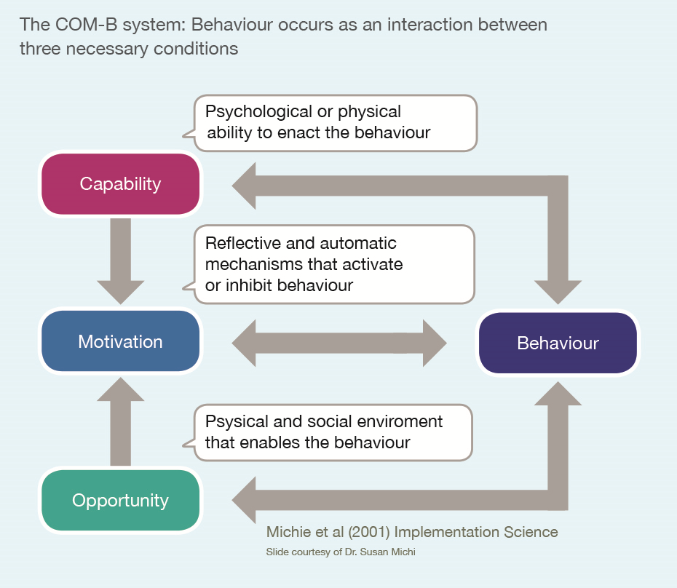
Notes:
Michie et al. (2011) explain the ‘COM-B’ system, the central component of the behaviour change wheel, as follows:
Capability, opportunity and motivation interact to generate behaviour that in turn influences these components.
The COMB element helps to understand the behavioural issue to be addressed.
For example, in the case of overweight children of school age,
capability might identify a lack of understanding among parents and teachers on portion sizes and an inability to read food labels correctly.
Motivation in this case could refer to lack of confidence or perceived need by parents and teachers to make changes to portions or food purchases and the influence of pester power from children.
Opportunity, in this example might be a perceived lack of time to look at labels and correctly divide portions was an issue as well as support from other children and adults in the family or classroom.

Slide 25
The COM- B system example
Capability - lack of understanding among parents / teachers on portion sizes and an inability to read food labels correctly.
Motivation - lack of confidence or perceived need by parents / teachers to make changes and the influence of children.
Opportunity - perceived lack of time to look at labels / portions and support from other children and adults in the family or classroom.
Overweight children
of school age
Notes:
Interact to generate behaviour that in turn influences these components.

Slide 26

Michie, S., M Van Stralen, M., and West, R. (2011) ‘The behaviour change wheel: A new method for characterising and designing behaviour change interventions’, Implementation Science, 6(1), p. 42
Sinnott, C., Mercer, S., Payne, R., Duerden, M., Bradley, C., and Byrne, M. (2015) ‘Improving medication management in multimorbidity: development of the Multimorbidity Collaborative Medication Review and Decision Making (MY COMRADE) intervention using the Behaviour Change Wheel’, Implementation Science, 10, p. 132.

Slide 27

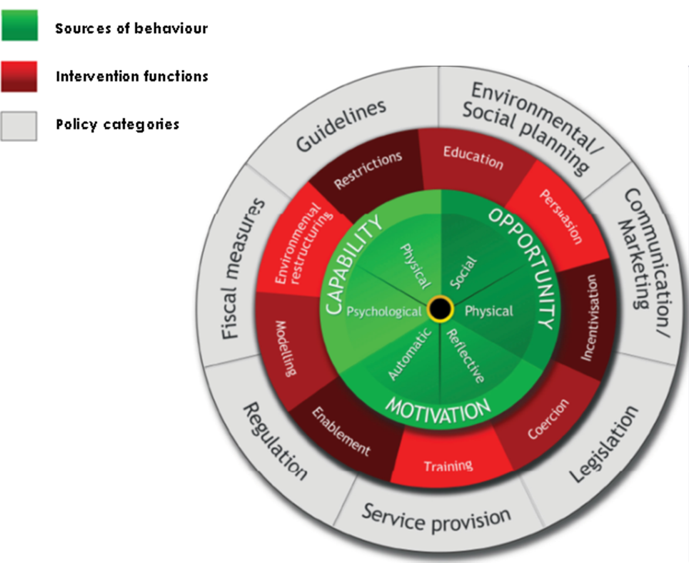
Recommended Viewing
The Behaviour Change Wheel
https://www.youtube.com/watch?v=XKwLplsPapc
Notes:
Professor Susan Michie, behaviour change expert at UCL provides an insight track into her theories and her unique approach to behaviour change.

Slide 28
Healthcare Students
as
Health Promoters
Notes:
In Unit 1 we talked about the key health recommendations and the importance of promoting health and healthy behaviours. Everyone who works as a healthcare professional is involved in the promotion and improvement of the health and well-being of individuals / patients. As you study to become a healthcare professional it is important to reflect on what health promotion means to you and to reflect on your role as heath promoter.

Slide 29

As a healthcare student
What role do you play in Health Promotion?
What skills do you think are needed to promote health in others?
Can you think of a time when you have promoted health in others?

Slide 30
Do you agree with these statements?
Ideally, healthcare professionals should lead a healthy lifestyle as they are perceived to be role models for individuals and communities
(Alpar, Senturan, Karabacak, & Sabuncu, 2008; Staib, Fusner, & Consolo, 2006).
There is an apparent reluctance among health care professionals to address alcohol consumption with their patients due to their own use and enjoyment of alcohol (Lock et al., 2002).
Personal health practices can influence counselling skills effectiveness
(Alpar et al., 2008).
Notes:
Discuss these research findings and their potential impact on health care
Some argue that to effectively promote health in others you should lead a healthy lifestyle.
Do you agree with these statements?
Adopting healthy lifestyle behaviours as students could positively influence how you approach health promotion and your future professional practice as a health promoter.
However, some of the research on this topic demonstrates suboptimal lifestyle practices among healthcare student groups, for example, medical students’ alcohol intake was found to be relatively high despite potentially greater knowledge of the harms and risks associated with it (Davoren, Shiely, Byrne, & Perry, 2015; Newbury-Birch, White, & Kamali, 2000).
Irish evidence has found that 65% of medical students reported hazardous drinking, the second highest student group in that study.
A UK study found just under half of medical students studied reported high risk and hazardous drinking levels and 27% reported binge drinking (Davoren et al., 2015; Newbury-Birch et al., 2000).
Also in the UK, Pre-registration nurses were found to have relatively poor health practicing behaviours (Blake, Malik, Mo, & Pisano, 2011).
As future health professionals and health advocates, especially in areas such as substance misuse. It would be concerning if these behaviours were to continue given that they may become obstacles to effective health promotion.

Slide 31
Adopting healthy lifestyle behaviours as students could positively influence how you approach health promotion and your future professional practice as a health promoter.

Slide 32
Suboptimal Healthcare student lifestyle practices
Medical students’ alcohol intake was found to be relatively high despite potentially greater knowledge of the harms and risks associated with it (Davoren et al., 2015; Newbury-Birch et al., 2000).
Irish evidence has found that 65% of medical students reported hazardous drinking, the second highest student group in that study.
A UK study found just under half of medical students studied reported high risk and hazardous drinking levels and 27% reported binge drinking (Davoren et al., 2015; Newbury-Birch et al., 2000).
Notes:
However, some of the research on this topic demonstrates suboptimal lifestyle practices among healthcare student groups, for example, medical students’ alcohol intake was found to be relatively high despite potentially greater knowledge of the harms and risks associated with it (Davoren, Shiely, Byrne, & Perry, 2015; Newbury-Birch, White, & Kamali, 2000).
Irish evidence has found that 65% of medical students reported hazardous drinking, the second highest student group in that study.
A UK study found just under half of medical students studied reported high risk and hazardous drinking levels and 27% reported binge drinking (Davoren et al., 2015; Newbury-Birch et al., 2000).
Also in the UK, Pre-registration nurses were found to have relatively poor health practicing behaviours (Blake, Malik, Mo, & Pisano, 2011).
As future health professionals and health advocates, especially in areas such as substance misuse. It would be concerning if these behaviours were to continue given that they may become obstacles to effective health promotion.

Slide 33
Also in the UK, Pre-registration nurses were found to have relatively poor health practicing behaviours
(Blake et al., 2011).
As future health professionals and health advocates these behaviours could become obstacles to effective
health promotion.
Notes:
As future health professionals and health advocates, especially in areas such as substance misuse. It would be concerning if these behaviours were to continue given that they may become obstacles to effective health promotion.
These are examples of poor health behaviour practices, there are numerous health promoting and healthy lifestyle behaviours that student groups participate in. Are you aware of any initiatives which promote health within your college?

Slide 34
Health Promotion in Your College
Are you aware of any initiatives which promote
health within your college?

Slide 35

Activity 2.4
In groups, decide on a health promotion topic that you consider to be an important area for student groups.
How can you, as a healthcare student, successfully promote this health promotion topic among your peers?
Feedback to the rest of the group
Notes:
Group work
Summary
In this lesson we looked at some theories that have been written to help explain behaviour change and how behaviour change occurs; focusing on the Trans theoretical Model of Health Behaviour Change, The Health Beliefs Model and the COM-B model. We addressed the role of the student as health promoter. In the next Unit Communication for Healthy Lifestyles and Health Behaviour Change we will explore the communication skills you need to effectively talk to others about health and health behaviour change.

