Slide 1
Unit 3: Lesson 1
Notes:
Unit 3
Learning Outcomes
3.1 Analyse the principles of interpersonal communication for health behaviour change (HBC)
3.2 Adopt a person-centred approach to communicating for HBC
3.3 Communicate in a supportive, non-directive manner with individuals for HBC
3.4 Demonstrate effective communication skills in the context of health conversations with individuals
3.5 Demonstrate the core elements of communication in practice for HBC.
3.6 Identify opportunities to integrate Making Every Contact Count into everyday consultations so that you can carry out brief interventions.
3.7 Demonstrate understanding of raising the issue of healthy eating, alcohol & drug use, physical activity and tobacco in routine and regular conversations with patients.
3.8 Observe and reflect on video footage of Healthcare professionals interacting with patients in a variety of scenarios

Slide 2
Communication for Healthy Lifestyles & Health Behaviour Change
Lesson 1: Communication Skills for
Brief Intervention
Notes:
In this lesson you will learn about the communications skills that you will need as a Health Professional to effectively communicate with patients about health behaviour changes. You will spend time learning and experiencing active listening skills as well as learning how to ‘ask the right questions’. These skills will form the basis of conducting Brief Interventions and motivational interviewing which will be discussed further in lessons 2 & 3 and in depth in Unit 4.
Brief Recap Units 1 & 2
Introduction to Lesson 1
Talking about health & the skills needed for health conversations.
Communication skills necessary for health conversations
Active listening and open questioning
Activity
3.1 Active Listening
3.2 Open Questioning

Slide 3
Making Every Contact Count
Play your part
in changing lifestyle behaviours
and help prevent chronic disease
Notes:
Making Every Contact Count is a programme being implemented within the HSE to support the prevention of chronic disease by promoting lifestyle behaviour change. The health behaviours which are the focus of this programme are the four main lifestyle risk factors for chronic disease: tobacco use; physical inactivity; harmful alcohol consumption and unhealthy eating.
Making Every Contact Count is about health professionals using their routine consultations to empower and support people to make healthier choices to achieve positive long-term behaviour change. To do this, the health service needs to build a culture and operating environment that supports continuous health improvement through the contacts that it has with individuals.
This approach will allow health professional to move to a position where discussion of lifestyle behaviour is routine, non-judgemental and central to everyone’s role.
As a healthcare student and future healthcare professional you will be asked to make each routine contact that you have with patients count in terms of chronic disease prevention.

Slide 4
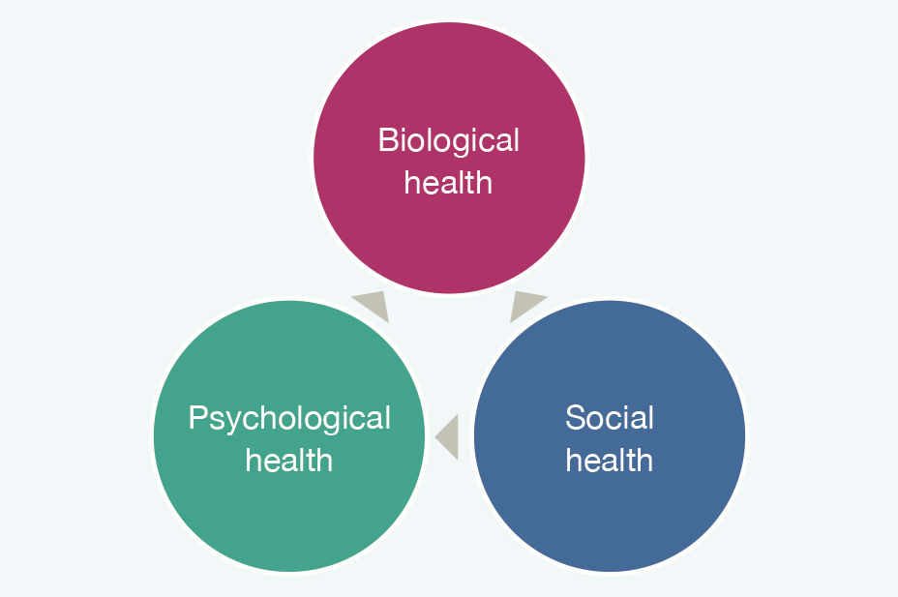
RECAP UNIT 1
The concept/definition of health
& personal wellness
The Biopsychosocial Model of Health
Four lifestyle areas critical to chronic disease prevention
- diet, exercise, tobacco use and alcohol
Notes:
In Unit 1 Health and Personal Wellness, you were introduced to the topic of health and to the Healthy Ireland Framework and we explored various definitions of health. We discussed the biopsychosocial model of health where you were asked to think about your own personal health and to self-rate your physical, social and psychological health. We explored how these elements are inter-related.
We also looked at some statistics from the Irish Health Survey (2015)(Central Statistics Office, 2016) and SLÁN (2007) Survey (Department of Health and Children, 2009).
In Unit 1 you were also briefly introduced to the topic of lifestyle influences on health behaviours and health. You self-rated your perceived health risk for diet, tobacco, activity and alcohol. The Key Health Messages (Irish National Policy Priority Programmes HSE) were presented, which are important messages for you to know personally and in your role as health promoter.

Slide 5
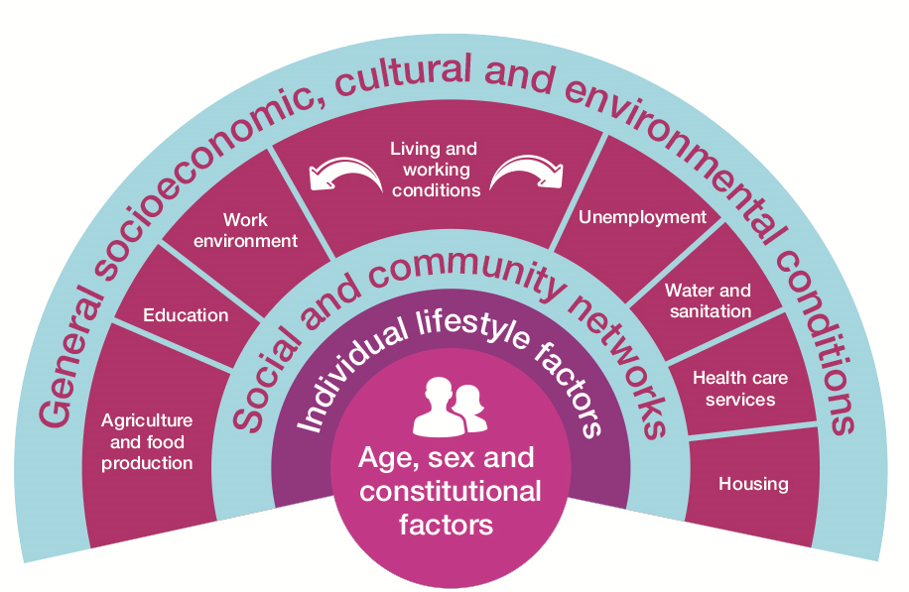
RECAP Unit 2
What influences our Health & Health Behaviour?
Health Determinants
Health behaviour of students
Challenges of changing behaviour
Trans Theoretical Model of Behaviour Change/Health Belief Model/COM-B-Model
Notes:
In Unit 2 Lifestyle Behaviours and Personal Responsibility for Health you explored health behaviours with a specific focus on the health behaviour practices of student groups. You were introduced to the topic of health behaviour change and you were asked to think about a personal health behaviour that you would like to change.
We examined some of the theories of behaviour change namely: The Trans-Theoretical Model of Behaviour Change, the Health Belief Model and the COM-B Model. The role of the healthcare student as health promoter was introduced.

Slide 6
Let’s Talk about
“Talking about Health”
Notes:
Let’s talk about “talking about health”
Effectively communicating with the person about health behaviour change in ways that are empowering and sensitive to the person’s needs is one of the core principles of person-centred care.
Communication is a key element in promoting healthy life-style behaviour
Questions to prompt discussion
What are the things you currently engage in to ensure a healthy lifestyle?
What might you like to change?
How do you feel when people talk to you about your health? When your family members or friends ask you about your lifestyle behaviours?
Do you get defensive because you think they are interfering or do you feel that they only ask because they care?
Do you think that they are nagging and not concerned?
Does the conversation ever end in conflict?

Slide 7
What are the things you currently engage in to ensure a healthy lifestyle?
What might you like to change?
How do you feel when people talk to you about your health? When your family members or friends ask you about your lifestyle behaviours?
Do you get defensive because you think they are interfering or do you feel that they only ask because they care?
Do you think that they are nagging and not concerned?
Does the conversation ever end in conflict?
Notes:
Let’s talk about “talking about health”
Effectively communicating with the person about health behaviour change in ways that are empowering and sensitive to the person’s needs is one of the core principles of person-centred care.
Communication is a key element in promoting healthy life-style behaviour
Questions to prompt discussion
What are the things you currently engage in to ensure a healthy lifestyle?
What might you like to change?
How do you feel when people talk to you about your health? When your family members or friends ask you about your lifestyle behaviours?
Do you get defensive because you think they are interfering or do you feel that they only ask because they care?
Do you think that they are nagging and not concerned?
Does the conversation ever end in conflict?

Slide 8
Talking about Health
Elements of a successful
health conversation?
Notes:
Consider the magnitude of illnesses, chronic diseases and risk factors for ill health that HCPs have to address with their patients. Now imagine that you are a patient and a healthcare professional wants to talk about health behaviour change. Talking about communication is important when it comes to HBC because talking about health and lifestyle behaviours can be a sensitive issue. Here is an example of some elements which help to make a “health conversation” successful, can you think of anymore?
Being Person centred enables honest conversation to take place between the health professional and the patients about their lifestyle behaviour in a way that is supportive and empowering for the person and respectful of their circumstances. It also allows the patient to hear the health messages and can motivate them to take small steps towards actions that will impact positively on their health.
Showing Empathy towards the person help the health care professional to understand and feel the emotions of the patient. This can help them understand the complexes of lifestyle behaviour change for the patient and the emotions intertwined in same.
Being conscious and avoiding judging others based on your own standards will help health conversations to be more open and effective. It is important to make a conscious effort not to be critical of the actions or thoughts of others.
(D) Support & Self-efficacy: Communicating effectively will support the patient to help themselves by building their confidence in their ability to change their own health behaviour and also to direct them to supports available if they wish

Slide 9
Communicating with patients for Health Behaviour Change
What challenges, if any, could healthcare professionals encounter?
What skills are needed for effective communication?
What factors promote and impede Health Behaviour Change conversations between patients and healthcare professionals ?
Notes:
When Communicating with patients for Health Behaviour Change
Can you think of any challenges HCPs encounter when communicating with patients for Health Behaviour Change?
What skills do you think are needed to communicate effectively for Health Behaviour Change?
What factors promote and impede conversations about Health behaviour Change between patients and Healthcare Professionals?

Slide 10
A Patient Centred Approach
A patient-centred approach to communicating for HBC may improve interactions between patients and HCPs.
With this approach, patients are provided with an opportunity to identify and actively plan to resolve health behaviour risks.
Person-centred care recognises the importance of individuals having a partnership role with health care professionals in managing their health (Furze, 2015).

Slide 11
WHO video on person-centred care
https://www.youtube.com/watch?v=pj-AvTOdk2Q

Slide 12
Communication skills for a Patient Centred Approach to Health Behaviour Change
Figure 3.2 Person Centred Approach to HBC, adapted from Rollnick, Mason, and Butler (1999)
Notes:
To achieve a Person-centred approach to HBC the following communication
skills are required:

Slide 13
Reflecting listening focuses on the emotional overtones of a message
How? | Examples
Consciously pick up on some key words/phrases the patient used and introduce them into your own side of conversation | ‘It sounds as though you are feeling guilty because you started drinking again’ ‘You sound really frustrated because you haven’t lost as much weight as you hoped’
Notes:
(a) Use of Reflective listening focuses on the emotional overtones of a message (looking for relationship between content and emotional aspect of the message).
Consciously pick up on some key words/phrases the patient used and introduce them into your own side of conversation
E.g. ‘It sounds as though you are feeling guilty because you started drinking again’
‘You sound really frustrated because you haven’t lost as much weight as you hoped’

Slide 14
Clarifying | Summarising
Seeking to understand the message by asking for more information | Every so often sum up in a few succinct sentences what has been discussed
Example: ‘You stated earlier that you were concerned about your blood pressure. Can you tell me more about what concerns you?’ | Example: ‘Before moving on I would like to go over with you what I think we have accomplished so far…’
Notes:
b) Clarifying and Summarising: every so often sum up in a few succinct sentences what has been discussed. Summaries can help to bring focus to a session (drawing the strands together)
• E.g. ‘Before moving on I would like to go over with you what I think we have accomplished so far…’
Clarification: seeking to understand the message by asking for more information
• E.g. ‘I’m not sure I understand what you mean; can you give me an example?
• ‘You stated earlier that you were concerned about your blood pressure. Can you tell me more about what concerns you?’

Slide 15
Verbal/Non-verbal prompts | Open ended questions
Be sincerely attentive and demonstrate that you have taken in what has been said to you | Simple questions that encourage the patient to tell more of their story rather than elicit yes/no responses
Example: Nod of the head, tone of voice, sitting forward and interested. | Examples: Can you tell me a little about …..? How can I help you with…..? Help me understand…….? How would you like things to be different…..?
Notes:
Verbal and Non-verbal prompts: Listening involves not only hearing but also understanding linguistic, paralinguistic (e.g. tone of voice) and nonverbal aspects of the message (remember non-verbal makes up most of an interaction). You need to be sincerely attentive and find ways to demonstrate that you have taken in what has been said to you and show that you value the speaker and their opinion e.g. nod of the head, sitting forward and interested.
(c) Asking simple open ended questions
Questions should be kept simple and encourage the patient to tell more of their story rather than elicit yes/no responses. This is discussed in more detail later

Slide 16
Think of a time you really felt listened to? | Think of a time you didn’t feel listened to?
How did you feel? | How did you feel?
How did you react? | How did you react?
How did you know the person was actively listening to you? | How did you know the person wasn’t listening to you?
Notes:
Take notes on flipchart to facilitate discussion

Slide 17
Active Listening
A
Patient Centred Approach
for
Health Behaviour Change involves
Active Listening
Notes:
WHEN YOU ASK A PATIENT A QUESTION, YOU NEED TO ACTIVELY LISTEN TO THE RESPONSE
HCPs must listen to their patients and understand their readiness to change, the importance of change to them and their confidence in their ability to change.
Listening is fundamental to healthcare communication. Think about what it means to listen actively
Enabling someone to talk about a problem or concern is known as engaging and relational listening
We need to also think about what obstacles people must overcome to listen well.
(Duck & McMahan, 2015).

Slide 18
BECOMING AN ACTIVE LISTENER
Notes:
WHEN YOU ASK A PATIENT A QUESTION, YOU NEED TO ACTIVELY LISTEN TO THE RESPONSE
Often you ‘the listener’ is frequently pausing merely awaiting the opportunity to speak again
Active listening means more than simply being there and letting peoples’ words reach you
Listening involves not only hearing but also understanding linguistic,
paralinguistic and nonverbal aspects of the message (remember nonverbal makes up most of an interaction)
You need to be sincerely attentive and find ways to demonstrate that you have taken in what has been said to you and show that you value the speaker and their opinion

Slide 19
Listening and Self Awareness
In Active Listening it is important to:
Be aware of one’s own thoughts/feelings/posture and actions
Detain one’s own autobiography
Eliminate internal sources of distraction
Increase awareness of one’s own values/beliefs/feelings and prejudices
Notes:
Listening is strongly linked to the concept of self-awareness –listening to oneself, to others and self-disclosure
Listening to oneself and being constantly aware of one’s own thoughts and feelings, posture and actions is vital in improving the skill of listening to others
Listening to others = detaining one’s own autobiography (avoiding the temptation of relating the patients story back to your own story)
Eliminate internal sources of distraction and concentrate on the patient
Increased awareness of own values, beliefs, feelings and prejudices will enhance active listening and focus on the patient and his/her needs. We must be able to regulate our own emotional state so that we can focus on the patient.

Slide 20
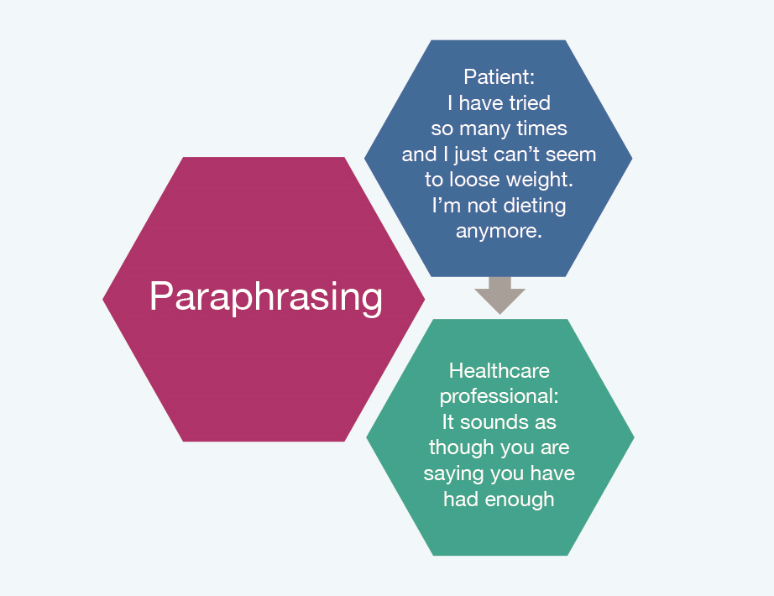
Paraphrasing
Involves repeating back to the patient in your own words what they have told you without losing the meaning of their message.
Notes:
Paraphrasing: helps patient elaborate more on cognitive aspect (content) of message
Involves repeating back to patient in your own words what they have told you (i.e. You take the patients original message and transform it into your own words
without losing the meaning of the message).
This demonstrates you have been listening and prevents misinterpretation of information.

Slide 21
Activity 3.1
Practice the skill of active listening in pairs.
Talk about what you did last weekend.
You cannot interrupt each other, just ask questions to clarify and then feedback each other’s story to gain confirmation that you have heard correctly.

Slide 22
Asking the Right Questions
Notes:
Now that you have spent some time listening we are going to discuss “talking” and what type of questions you should ask individuals during a brief intervention.
EXAMPLES OF TYPES OF QUESTIONING
• Closed Questions – was it difficult when you stopped smoking before?
• Open Questions - Tell me about how it was for you to stop smoking?
• Focused Question - Tell me the ways in which you find quitting difficult?
• Leading Questions - I guess you must be find quitting difficult?
• Circular Questions - The last time you quit, what was most helpful?
COMBINING OPEN AND CLOSED QUESTIONS
• The best option in health professional-patient communication is to use a combination of open and closed questions.
• Use open questions at the outset of an interaction to explore the patient’s perspective / obtain broad information. Best to follow up with prompts, paraphrasing, repeating and closed questions to clarify points and elicit more specific information.
• Using a combination encourages patients to talk, demonstrates the health professional’s interest in listening to what the patient has to say and enables the health professional gather specific information needed – as a result the patient feels valued and cared for as an individual.
Examples of useful questions
Can you tell me a little about …..?
How can I help you with…..?
Help me understand……._?
How would you like things to be different….._?
What are the good things about_? And what are the less good things about it?
When would you be most likely to_?
What do you think you will lose if you give up_?
What have you tried before to make a change_?
What do you want to do next_?

Slide 23
EXAMPLES OF TYPES OF QUESTIONING
Question Type | Example
Closed Questions | Was it difficult when you stopped smoking before?
Open Questions | Tell me how it was for you to stop smoking?
Focused Question | Tell me the ways in which you find quitting difficult?
Leading Questions | I guess you must find quitting difficult?
Circular Questions | The last time you quit, what was most helpful?
Notes:
EXAMPLES OF TYPES OF QUESTIONING
• Closed Questions – was it difficult when you stopped smoking before?
• Open Questions - Tell me about how it was for you to stop smoking?
• Focused Question - Tell me the ways in which you find quitting difficult?
• Leading Questions - I guess you must be find quitting difficult?
• Circular Questions - The last time you quit, what was most helpful?
COMBINING OPEN AND CLOSED QUESTIONS
• The best option in health professional-patient communication is to use a combination of open and closed questions.
• Use open questions at the outset of an interaction to explore the patient’s perspective / obtain broad information. Best to follow up with prompts, paraphrasing, repeating and closed questions to clarify points and elicit more specific information.
•
Using a combination encourages patients to talk, demonstrates the health professional’s interest in listening to what the patient has to say and enables the health professional gather specific information needed – as a result the patient feels valued and cared for as an individual.
Examples of useful questions
Can you tell me a little about …..?
How can I help you with…..?
Help me understand……._?
How would you like things to be different….._?
What are the good things about_? And what are the less good things about it?
When would you be most likely to_?
What do you think you will lose if you give up_?
What have you tried before to make a change_?
What do you want to do next_?

Slide 24
Combining open and closed questions
The best option in health professional-patient communication is to use a combination of open and closed questions.
Use open questions at the outset of an interaction to explore the patient’s perspective / obtain broad information.
Follow up with prompts, paraphrasing, repeating and closed questions to clarify points and elicit more specific information.
Notes:
Using a combination encourages patients to talk, demonstrates the health professional’s interest in listening to what the patient has to say and enables the health professional gather specific information needed – as a result the patient feels valued and cared for as an individual.

Slide 25
Examples of useful questions
Can you tell me a little about …..?
How can I help you with…..?
Help me understand…….?
How would you like things to be different…..?
What are the good things about…..? And what are the less good things about it?
When would you be most likely to……?
What do you think you will lose if you give up…….?
What have you tried before to make a change…….?
What do you want to do next……?
Notes:
Using a combination encourages patients to talk, demonstrates the health professional’s interest in listening to what the patient has to say and enables the health professional gather specific information needed – as a result the patient feels valued and cared for as an individual.

Slide 26
Activity 3.2
Asking open ended questions is very important when it comes to talking
about Health and Health Behaviour Change
Work in pairs
Pick a health topic that you both agree to discuss
Ask each other five open ended questions about that topic
Notes:
Asking open ended questions is very important when it comes to talking about health and HBC.
Work in pairs, pick a health topic that you both agree to discuss. Each person is to ask the other five open ended questions about that topic.

Slide 27
Did you find it difficult to ask open questions?
If so, what was difficult about it?
What kind of questions did you ask?
Notes:
Take notes on flipchart to facilitate discussion
Examples of useful questions
Can you tell me a little about …..?
How can I help you with…..?
Help me understand……._?
How would you like things to be different….._?
What are the good things about_? And what are the less good things about it?
When would you be most likely to_?
What do you think you will lose if you give up_?
What have you tried before to make a change_?
What do you want to do next_?

Slide 28
Rollnick, S., Mason, P., & Butler, C. (1999). Health Behavior Change: A Guide for Practitioners (1st ed.). London: Churchill Livingstone
Notes:
Summary:
In this lesson we discussed the importance of “talking about health conversations”. To help individuals achieve health behaviour change you must develop a particular set of communication skills. We looked at the importance of active listening and asking the right questions during brief intervention. In the next lesson we are going to introduce the topic of a Brief Intervention and motivational interviewing and explore how the skills we talked about can be used to effectively assess importance of behaviour change and motivation to change.

