Slide 1
Unit 3: Lesson 3

Slide 2
Communication for Healthy Lifestyles & Health Behaviour Change
Lesson 3: Interacting for Behaviour Change
Notes:
In this lesson we are going to observe a range of videos focusing on the skills that you need to help you to carry out “health conversations” with individuals. We will watch a number of healthcare interactions and you will critically evaluate the healthcare professional’s communication skills using the framework provided.

Slide 3
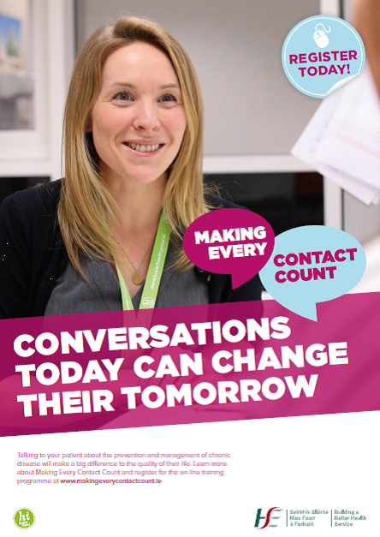
Making Every Contact Count
Play your part
in changing lifestyle behaviours
and help prevent chronic disease
Notes:
Making Every Contact Count is a programme being implemented within the HSE to support the prevention of chronic disease by promoting lifestyle behaviour change. The health behaviours which are the focus of this programme are the four main lifestyle risk factors for chronic disease: tobacco use; physical inactivity; harmful alcohol consumption and unhealthy eating.
Making Every Contact Count is about health professionals using their routine consultations to empower and support people to make healthier choices to achieve positive long-term behaviour change. To do this, the health service needs to build a culture and operating environment that supports continuous health improvement through the contacts that it has with individuals.
This approach will allow health professional to move to a position where discussion of lifestyle behaviour is routine, non-judgemental and central to everyone’s role.
As a healthcare student and future healthcare professional you will be asked to make each routine contact that you have with patients count in terms of chronic disease prevention.

Slide 4
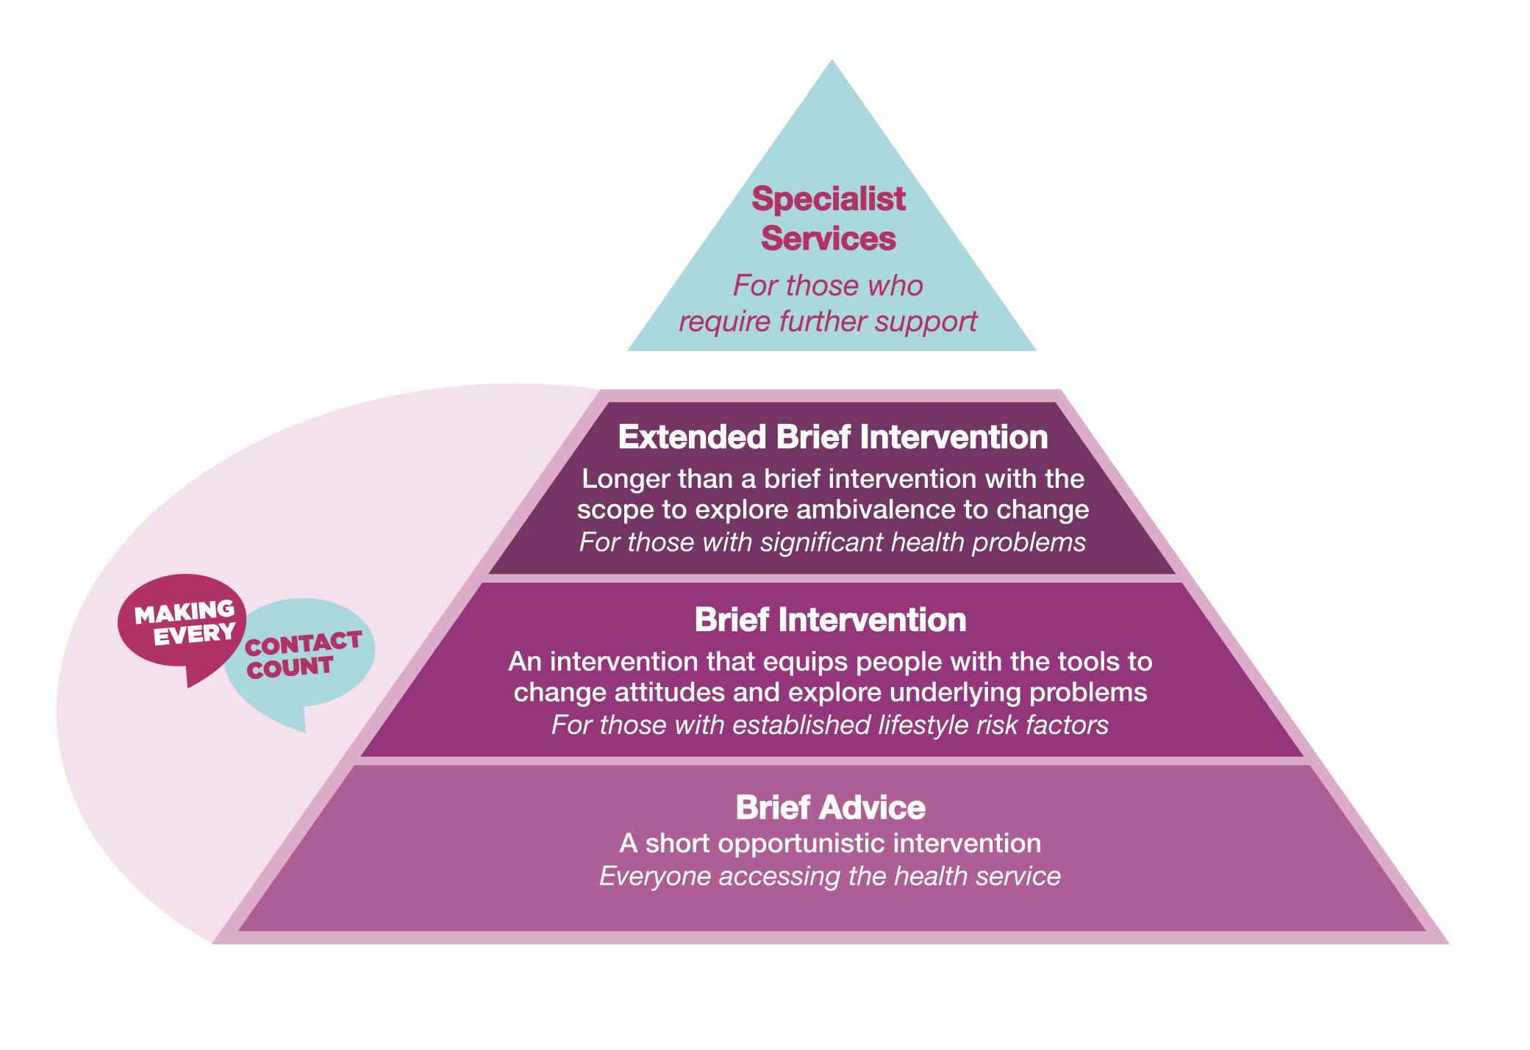
RECAP UNIT 3 Lesson 1-2
“Talking about Health”
Person Centred Approach
Active Listening Skills
Different types of Questions- open/closed …
Brief Interventions
Motivational Interviewing
Scaling Question: Importance/Confidence
Decisional Balance
Notes:
Can you remember what was covered in Lessons 1 & 2?
In lesson 1 we discussed “talking about health”. We explored some of the issues around having health conversations. We addressed the fact that talking about health can be a sensitive issue and that developing effective communication skills is fundamental to successful health conversations. In lesson 2 you were introduced to communication skills needed for motivational interviewing.
In this lesson you will watch a number of videos, (developed by the HSE), and critique the communication skills displayed in the video using the tool supplied.

Slide 5
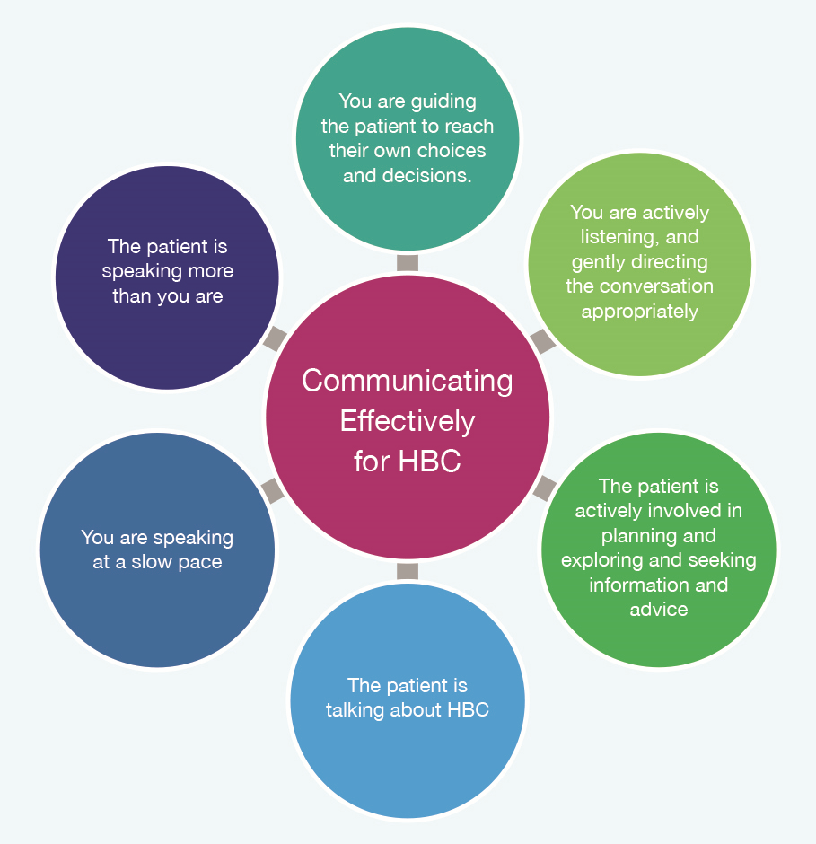
Indications of Effective Communication for HBC
(Rollnick et al., 1999, p. 34).
Notes:
In this lesson you will watch a number of videos, (developed by the HSE), and critique the communication skills displayed in the video using the tool supplied.
Remember the interaction is going well if… The patient is talking themselves toward an action plan and the HCP is asking simple questions and clarifying.
How do you know when you are communicating correctly for Health Behaviour Change (HBC)?
Indications of effective communication for HBC adapted from (Rollnick et al., 1999, p. 34).

Slide 6
Activity 3.4
Observe these healthcare interaction videos & critically evaluate the healthcare professional’s communication skills using the framework provided.
View videos through
www.hse.ie/mecc-undergradcurriculum
Notes:
Activity 3.4: National Undergraduate Curriculum for Chronic Disease Prevention and Management, Page 130 (handout)

Slide 7
Video Critique
Did the healthcare provider demonstrate sufficient skills in the following areas? | Score from 1-5 (1 is best use of skill and 5 is least) | Provide examples here
(A) Use of Interpersonal Communication Skills
Use of positive non-verbal communication
Use of Reflective Listening
Demonstrate empathy
Video Critique
Notes:
Activity 3.4: National Undergraduate Curriculum for Chronic Disease Prevention and Management, Page 130 (handout)

Slide 8
B. Encourage Dialogue Assessment of Importance & Motivation | Score from 1-5 (1 is best use of skill and 5 is least) | Provide examples here
Assess how important it is for the patient to change behaviour
Assess how motivated the patient is to change behaviour
Ask open ended questions
Provide opportunity for the patient to speak
Notes:
Activity 3.4: National Undergraduate Curriculum for Chronic Disease Prevention and Management, Page 130 (handout)

Slide 9
C. Adopt a patient-centred approach | Score from 1-5 (1 is best use of skill and 5 is least) | Provide examples here
Use of appropriate vocabulary easily understood by the patient
Provide information that was geared toward the patient’s readiness to change
OVERALL COMMENTS
Notes:
Activity 3.4: National Undergraduate Curriculum for Chronic Disease Prevention and Management, Page 130 (handout)
In this lesson you were introduced to the communication skills necessary for health behaviour change which you will continue to develop over the course of your healthcare programme and professional career. We discussed some of the elements involved in communicating effectively such as person-centeredness, non-judgemental attitudes, being respectful and supportive. We practiced the skills of active listening and asking open-ended questions.
In unit 4 you will utilise these skills to practice the provision of brief interventions in preparation for making every contact count in your healthcare student role.

