Slide 1
Unit 3: Lesson 4-5

Slide 2
Communication for Healthy Lifestyles & Health Behaviour Change
Lesson 4-5: Online eLearning for
Making Every Contact Count
Notes:
The Making Every Contact Count training programme can be accessed from your institutions virtual learning environment.
What you will cover in this lesson: This lesson consists of six eLearning modules. These eLearning modules will cover the basics of health behaviour change as well as information on four different topic areas and a skills practise module. This eLearning training was developed through collaboration between the HSE, HEIs and subject matter experts in the fields of health behaviour change and experts in the health topic areas of healthy eating, physical activity, tobacco and Alcohol & Drug use. This eLearning course can be assessed online at www.makingeverycontactcount.ie

Slide 3
Making Every Contact Count
Play your part
in changing lifestyle behaviours
and help prevent chronic disease
Notes:
Making Every Contact Count is a programme being implemented within the HSE to support the prevention of chronic disease by promoting lifestyle behaviour change. The health behaviours which are the focus of this programme are the four main lifestyle risk factors for chronic disease: tobacco use; physical inactivity; harmful alcohol consumption and unhealthy eating.
Making Every Contact Count is about health professionals using their routine consultations to empower and support people to make healthier choices to achieve positive long-term behaviour change. To do this, the health service needs to build a culture and operating environment that supports continuous health improvement through the contacts that it has with individuals.
This approach will allow health professional to move to a position where discussion of lifestyle behaviour is routine, non-judgemental and central to everyone’s role.
As a healthcare student and future healthcare professional you will be asked to make each routine contact that you have with patients count in terms of chronic disease prevention.

Slide 4
RECAP UNIT 3 Lesson 1-3
Lesson 1
Health Conversations
Person centred approach
Active Listening
Open/Closed questions
Lesson 2
Brief interventions
Motivational Interviewing
OARS
Scaling questions
Lesson 3
Video observation & critique
Notes:
Recap Lesson 1
Can you remember what was covered in Lesson 1?
In lesson 1 we discussed “talking about health”. We explored some of the issues around having health conversations. We addressed the fact that talking about health can be a sensitive issue and that developing effective communication skills is fundamental to successful health conversations.
Recap Lesson 2
In lesson 2 you were introduced to the communication skills needed for successful health conversations with patients. The importance of person centred communication was discussed highlighting the use of active attentive listening and asking open ended questions to develop open and honest dialogue with patients.
OARS= Open ended questions, Affirmations, Reflective listening and Summarising
Recap Lesson 3
You learned about brief interventions and motivational interviewing. You also worked through various scenarios that you might encounter in your work as a health professional and practised using good communication skills when having health conversations with patients.

Slide 5
Making Every Contact Count
Module No. | Title
1 | Core Learning: Behaviour Change Module
2 | eLearning Knowledge Module: Alcohol & Drug use
3 | eLearning Knowledge Module: Healthy Food for life
4 | eLearning Knowledge Module: Tobacco Free
5 | eLearning Knowledge Module: Physical Activity
6 | Core Learning: Skills into Practise Module
Notes:
Making Every Contact Count- eLearning Modules
Duration: Approx. 30 Minutes per Module
The eLearning course consists of six modules in total.
Modules 1 and 6 are core eLearning modules and form the basis of all successful health conversations with patients and are key in the study of health behaviour change. The content of these core modules is transferrable to all interventions, irrespective of the topic area.
Modules 2-5 are eLearning topic knowledge modules on the Key Lifestyle Behaviours important to Chronic Disease Prevention and are designed to give you basic information on each topic area to support you in discussing lifestyle choices.
There is an online assessment on completion of the six modules in the eLearning course and a certificate of completion will be issued when you have completed all modules.

Slide 6
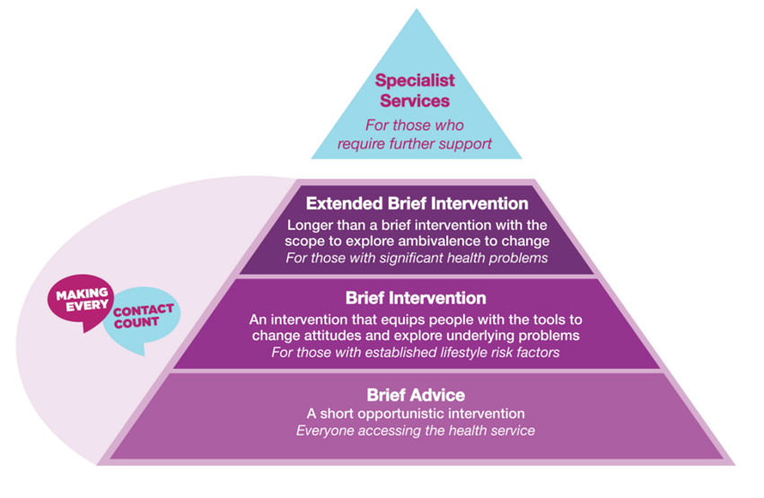
Module1: Introduction to Behaviour Change
Aim: To increase your knowledge in relation to behaviour change and to develop your confidence in carrying out a Brief Intervention with patients.

Slide 7
Module 1:Introduction to Behaviour Change
Aim: To increase your knowledge of HBC and to develop your
confidence in carrying out a BI with patients
On completion you will have the knowledge needed to:
Identify opportunities to integrate Making Every Contact Count into everyday consultations so that you can carry out brief interventions.
Describe the approach and skills underpinning effective brief interventions.
Describe how you can enquire about the risk factor and support patients in changing their lifestyle behaviour.
Notes:
The aim of this module is to increase your knowledge of HBC and to develop your confidence in carrying out a BI with patients.
By completing this module we will help develop your skills to enable you to:
Identify opportunities to integrate Making Every Contact Count into everyday consultations so that you can carry out brief interventions.
Describe the approach and skills underpinning effective brief interventions.
Describe how you can enquire about the risk factor and support patients in changing their lifestyle behaviour.

Slide 8
Module 2:Alcohol and Drug Use
Aim: To increase your knowledge and support you to develop your confidence in raising the issue of alcohol and drug use in routine conversations with patients
On completion you will have the knowledge needed to:
Communicate the health risks and harms of alcohol and drug use
Inform patients of the benefits of reducing alcohol consumption and drug use
Screen for alcohol consumption levels and drug use to identify those at risk
Signpost patients to the supports available to help them reduce the harm from these substances
Notes:
The aim of this module is to increase your knowledge and support you to develop your confidence in raising the issue of alcohol and drug use in routine conversations with patients
By completing this module, you will have the knowledge needed to:
Communicate the health risks and harms of alcohol and drug use.
Inform patients of the benefits of reducing alcohol consumption and drug use.
Screen for alcohol consumption levels and drug use to identify those at risk.
Signpost patients to the supports available to help them reduce the harm from
these substances.

Slide 9
Module 3: Healthy Food for Life
Aim: To increase your knowledge and support you to develop your confidence to raise the issue of healthy eating in routine and regular conversations with patients
On completion you will have the knowledge needed to:
Outline the prevalence of poor dietary habits in Ireland and the associated risk factors
Communicate key messages on healthy eating to patients
Signpost patients to practical resources to help them make changes
Notes:
The aim of this module is to increase your knowledge and support you to develop your confidence to raise the issue of healthy eating in routine and regular conversations with patients.
By completing this module and associated work-based activities you will have the knowledge needed to:
Outline the prevalence of poor dietary habits in Ireland and the associated risk factors.
Communicate key messages on healthy eating to patients.
Signpost patients to practical resources to help them make changes.

Slide 10
Module 4: Tobacco Free Ireland
Aim: To increase your confidence to raise the issue of smoking in routine and regular conversation with patients and support them to make a quit attempt.
On completion you will have the knowledge needed to
Communicate the risks and harm associated with smoking
Inform patients of the benefits of quitting and offer strategies to help them quit.
Signpost patients to local and national support services
Support and promote tobacco free environments
Notes:
The aim of this module is to increase your confidence to raise the issue of smoking in routine and regular conversations with patients and support them to make a quit attempt.
By completing the module and associated work-based activities you will have the knowledge needed to:
Communicate the risks and harm caused by smoking.
Inform patients of the benefits of quitting and offer strategies to help them quit.
Signpost patients to local and national quit support services.
Support and promote tobacco free environments.

Slide 11
Module 5: Get Ireland Active
Aim: To increase your knowledge and support you to develop your confidence to discuss physical activity in routine and regular conversations with patients
On completion you will have the knowledge needed to:
Outline the prevalence of physical activity in Ireland and the associated risk factors
Communicate key messages on physical activity to patients
Signpost them to practical resources to help them make changes
Notes:
The aim of this module is to increase your knowledge and support you to develop your confidence to discuss physical activity in routine and regular conversations with patients.
By completing this module and associated work-based activities you will have the knowledge to:
Outline the prevalence of physical activity in Ireland and the associated risk factors.
Communicate key messages on physical activity to patients.
Signpost them to practical resources to help them make changes.

Slide 12
Module 6: Skills to Practice module
This module brings together all the knowledge from the previous modules and demonstrates how to do this in a series of recorded interventions with a range of healthcare professionals.
www.makingeverycontactcount.ie
Notes:
Summary
This eLearning module is designed to introduce you to all the basic skills and knowledge for you to engage in an effective health conversation with your patient. These modules may be accessed at any time in order to help you refresh and increase your confidence in engaging with health conversations with patients.
By completing this module, you will see how to carry out an effective BI with a patient. This module brings together all the knowledge from the previous modules and demonstrates how to do this in a series of recorded interventions with a range of HCPs.
By completing this module you will be able to:
• Recognise how best to carry out effective Brief Interventions.
• Identify how to seek permission for and raise the issue of lifestyle behaviour with a patient in a supportive way.
• Develop your confidence in applying what you have learned to carry out Brief Interventions in a patient-centred and non-judgemental way.
• Know how to incorporate the Making Every Contact Count Recording Tool into your intervention.

