Slide 1
Unit 4: Lesson 1
Notes:
INTRODUCTION TO THE UNIT OF STUDY
In Unit 4 we are going to learn how to Make Every Contact Count by learning and practicing the skills which are needed to provide opportunistic brief advice and to undertake BIs. We will be using the tools and techniques which you have explored in Unit 3, and will practice applying them in a BI.
Unit 4 Learning Outcomes
4.1.1 Describe the theoretical and practical context for Making Every Contact Count for health behaviour change (HBC)
4.1.2 Identify individuals for whom a brief intervention (BI) is appropriate.
4.2.1 Use validated screening and assessment tools to assess individual’s readiness to change and respond to this assessment supportively.
4.2.2 Deliver a BI in an empathetic and non-confrontational manner using the principles of motivational interviewing (MI).
4.2.3 Assess own performance in delivering BI using self-reflective practice.
4.2.4. Demonstrate the procedure for signposting and referral to support services
4.2.5 Understand how to maintain accurate records in patient documentation/medical chart of delivery of a BI, and how to flag further actions for follow-up.

Slide 2
Making Every Contact Count: Providing Opportunistic Brief Advice and Undertaking Brief Interventions
Lesson 1a: Recap Units 1-3
Lesson 1b: Theoretical and Practical Context for Brief Interventions for Health Behaviour Change
Notes:
What you will cover in this Lesson:
• Outline what brief advice, brief interventions (BIs) and motivational interviewing (MI) are and the differences between them as distinct approaches to health behaviour change (HBC).
• Identify opportunities for BI in your role as a healthcare professional (HCP).
• Identify patients for whom a BI is appropriate.
• Identify situations when BIs may not be appropriate.
INTRODUCTION TO THE UNIT OF STUDY
In Unit 4 we are going to learn how to Make Every Contact Count by learning and practicing the skills which are needed to provide opportunistic brief advice and to undertake BIs. We will be using the tools and techniques which you have explored in Unit 3, and will practice applying them in a BI.
Recap Unit 1: Lifestyle choices and personal behaviours, Unit 2: Lifestyle behaviours and personal responsibility for health, Unit 3: Communication for Healthy Lifestyles and Health Behaviour Change
• Outline what brief advice, BIs and MI are and the differences between them as distinct approaches to behaviour change.
• Identify opportunities for BI in your role as a HCP
Activity
Activity 4.1 Access the most recent Healthy Ireland Survey
Activity 4.2 Video Critique
Activity 4.3 Use of Tools in Behaviour Change
Activity 4.4. Identify scenarios when it may not be appropriate to raise the issue of lifestyle behaviour change with a patient

Slide 3
Making Every Contact Count
Play your part
in changing lifestyle behaviours
and help prevent chronic disease
Notes:
Making Every Contact Count is a programme being implemented within the HSE to support the prevention of chronic disease by promoting lifestyle behaviour change. The health behaviours which are the focus of this programme are the four main lifestyle risk factors for chronic disease: tobacco use; physical inactivity; harmful alcohol consumption and unhealthy eating.
Making Every Contact Count is about health professionals using their routine consultations to empower and support people to make healthier choices to achieve positive long-term behaviour change. To do this, the health service needs to build a culture and operating environment that supports continuous health improvement through the contacts that it has with individuals.
This approach will allow health professional to move to a position where discussion of lifestyle behaviour is routine, non-judgemental and central to everyone’s role.
As a healthcare student and future healthcare professional you will be asked to make each routine contact that you have with patients count in terms of chronic disease prevention.

Slide 4
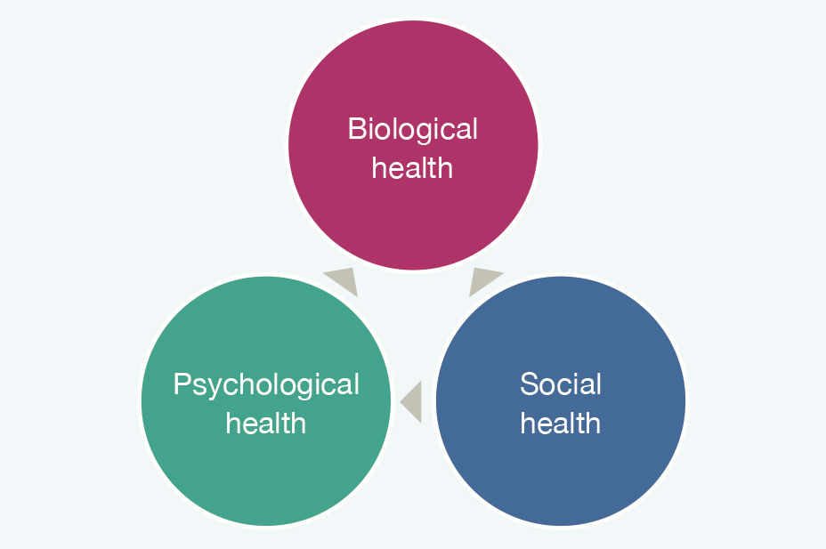
RECAP UNIT 1
The concept/definition of health
& personal wellness
The Biopsychosocial Model of Health
Four lifestyle areas critical to chronic disease prevention
- diet, exercise, tobacco use and alcohol
Notes:
In Unit 1 Health and Personal Wellness, you were introduced to the topic of health and to the Healthy Ireland Framework and we explored various definitions of health. We discussed the biopsychosocial model of health where you were asked to think about your own personal health and to self-rate your physical, social and psychological health. We explored how these elements are inter-related.
We also looked at some statistics from the Irish Health Survey (2015)(Central Statistics Office, 2016) and SLÁN (2007) Survey (Department of Health and Children, 2009).
You were also provided with some statistics from Irish Health Surveys.
Did you know that health surveys are carried out in Ireland each year?
In Unit 1 you were briefly introduced to the topic of lifestyle influences on health behaviours and health and you self-rated you perceived health risk for diet, tobacco, activity and alcohol.
What other key health determinants can you think of?
Unit 1 ended with a presentation of the Key Health Messages, which are important messages for you personally and in your role as health promoter.

Slide 5
Activity 4.1
Access the most recent Healthy Ireland Survey
Healthy Ireland surveys are carried out annually
www.health.gov.ie

Slide 6
RECAP Unit 2
What influences our Health & Health Behaviour?
Determinants of Health
Health behaviour of students
Challenges of changing behaviour
Trans Theoretical Model of Behaviour Change/
Health Belief Model/COM-B-Model
What can you remember about these models?
Notes:
Recap Unit 2
In Unit 2 Lifestyle Behaviours and Personal Responsibility for Health you explored health behaviours with a specific focus on the health behaviour practices of student groups. You were introduced to the topic of HBC and you were asked to think about a personal health behaviour that you would like to change.
We examined some of the theories of behaviour change. We looked at the Trans-Theoretical Model of Behaviour Change, the health Belief Model and the COM-B Model.
Note that some of the models referenced are dated however it has been agreed to include them as an umbrella to encourage broad understanding of all as they are still evident and in use.

Slide 7
Think about a health behaviour that you have ever changed.
What made you change the behaviour?
Was it difficult to change?
What helped you to change your behaviour?
What factors made it difficult to change the behaviour?
Did you relapse at any time? How many times?
What has helped you to sustain the behaviour change?

Slide 8
Recap Unit 3
Communication skills
Person Centred Approach
Active Listening
Asking the right questions
Brief Interventions- Do they work?
Effective communication for Behaviour change
Video Critique
Making Every Contact Count: eLearning modules 1-6
Notes:
Recap Unit 3
In Unit 3 Communicating with Individuals about Promoting Healthy Lifestyle Behaviours for HBC we explored the communication skills which are necessary for health behaviour change. You were broadly introduced to the topics of BI and MI in preparation for the skills that you will learn in Unit 4.
You will have completed the modules from the Making Every Contact Count training programme.

Slide 9
Do you remember the communication skills required to communicate effectively for HBC?

Slide 10
Can you explain what is meant by the term
Making Every Contact Count?
Notes:
At the beginning of each Unit you have heard about Making Every Contact Count
Making Every Contact Count
• Making Every Contact Count aims to prevent chronic disease.
• It is about enabling health professionals to use routine consultations to support patients to make health behaviour changes to achieve positive health outcomes.
• This will result in patients being routinely asked about the main lifestyle behaviours - smoking, alcohol/substance misuse, diet, physical activity and weight management for child and adult obesity.
• Disease prevention and health improvement is every health professional’s responsibility.

Slide 11
Making Every Contact Count
Play your part
in changing lifestyle behaviours
and help prevent chronic disease
Notes:
Making Every Contact Count
• Making Every Contact Count aims to prevent chronic disease.
• It is about enabling healthcare professionals to use routine consultations to
support patients to make HBC to achieve positive health outcomes.
• This will result in patients being routinely asked about the main lifestyle
behaviours - smoking, alcohol and drug use, diet, physical activity and weight
management for child and adult obesity.
• Disease prevention and health improvement is every HCPs’ responsibility

Slide 12
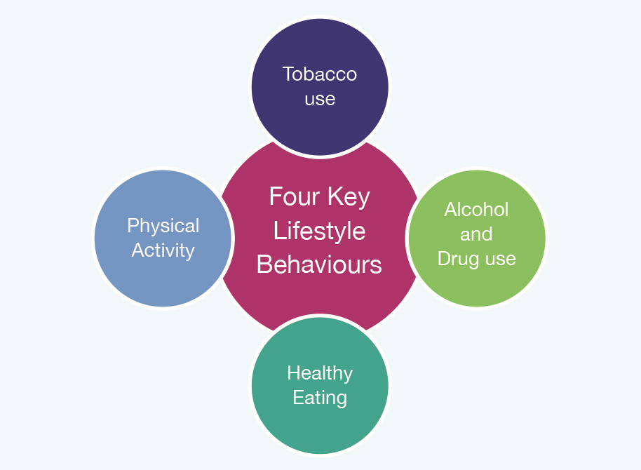
What are the main lifestyle behaviours we discussed in relation to chronic disease?

Slide 13
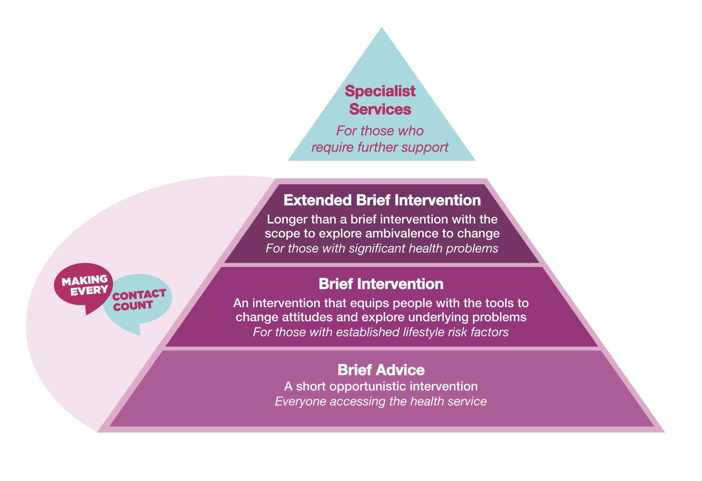
How to Make Every Contact Count
Notes:
How to Make Every Contact Count
As you know, lifestyle behaviours play a role in health and in disease prevention and health improvement is every health professional’s responsibility.
To ensure that we Make Every Contact Count we need to become proficient at providing brief advice and brief interventions using a Motivational Interviewing (MI) approach (Introduced in Unit 3).
You have already covered some of the theory behind the MI approach to HBC from Unit 3, and we are going to discuss MI further in this lesson. Firstly, let’s take a look at the Making Every Contact Count Framework for delivering behaviour change interventions:
The diagram outlines the model for behaviour change from the Making Every Contact Count framework.
We will now talk about each of the four levels of behavioural intervention in the Making Every Contact Count framework, including brief advice, brief intervention, extended brief interventions and specialist services and watch a video demonstrating each approach in practice.

Slide 14
Level 1: Brief Advice
A short opportunistic intervention that
directs people where to go for further help
for modifying unhealthy behaviours.
3 A’s
- Ask about behaviour
- Advise on the need for behaviour change
- Act to refer/signpost people to additional support (3As)
Notes:
Level 1: BRIEF ADVICE
Brief advice is defined as a short opportunistic intervention that directs people where to go for further help for modifying unhealthy behaviours. The aim of this type of opportunistic advice is to raise awareness of the impact of lifestyle behaviour on the individual and to refer / signpost the person to further supports. Brief advice is less in-depth and more informal than a brief intervention and usually involves giving information about the importance of behaviour change and simple advice to support behaviour. (See Unit 4, Lesson 3, for further information about services and support). Key components
- Ask about behaviour
- Advise on the need for behaviour change
- Act to refer or signpost people to additional support (3As)
A ‘a brief advice’ intervention should take no more than 3 minutes.

Slide 15
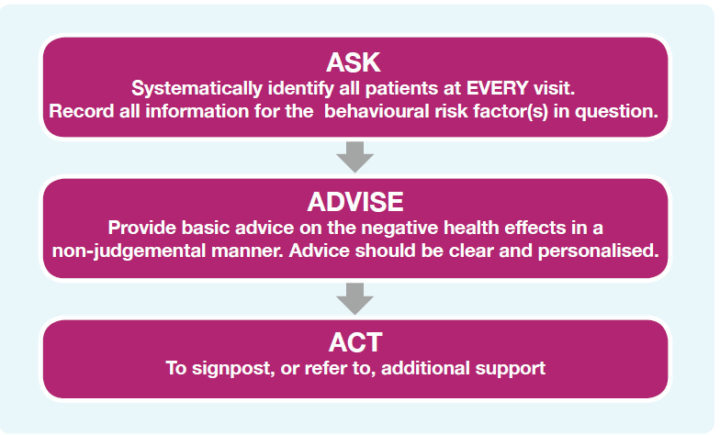
3 A’s
Ask
Advise
Act
Notes:
Key components
- Ask about behaviour
- Advise on the need for behaviour change
- Act to refer or signpost people to additional support (3As)

Slide 16
Level 1: Brief Advice
Target Audience: Everyone accessing the health service
Watch the video demonstrating brief advice www.hse.ie/mecc-undergradcurriculum

Slide 17
Level 2: Brief Intervention
An intervention that aims to equip people with tools to change attitudes and explore underlying problems
Usually involves
Discussion
Negotiation and encouragement
With or without follow-up
5 A’s
Ask
Advise
Assess
Assist
Arrange
Notes:
Brief intervention (BI) is defined as an intervention that aims to equip people with tools to change attitudes and explore underlying problems. It involves discussion, negotiation and encouragement with or without follow-up by the health professional. The aim of a brief intervention is to raise awareness of the risks associated with the behaviour, to equip people with the skills to change and signpost to further supports.
In Unit 3, you learned about effective communication skills for promoting behaviour change. As part of a range of methods, BIs may contain a patient-centred discussion, and may use an MI approach in their delivery.
A useful framework for delivering a BI is the 5 As. The Making Every Contact Count programme advises the use of the 5A’s framework as a guide for carrying out a brief intervention.

Slide 18
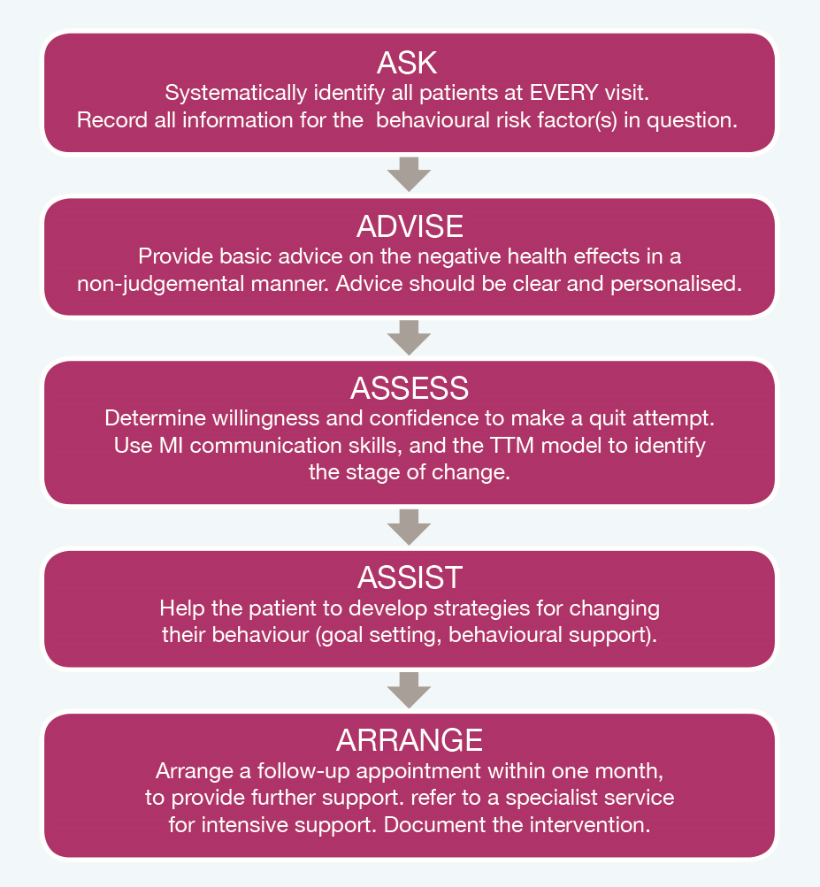
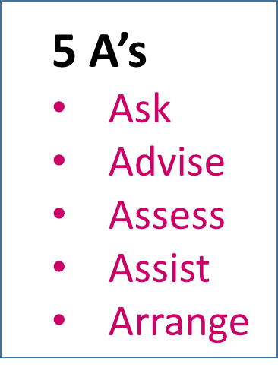
Figure 4.3 The 5As framework for Brief Intervention for Health Behaviour Change
Notes:
The 5As framework for Brief Intervention for Health Behaviour Change. Source: World Health Organisation (2014) Toolkit For Delivering the 5a’s. For more information on the application of the 5As framework, see http://www.who.int/tobacco/publications/smoking_cessation/9789241506953/en/

Slide 19
Level 2 Brief Intervention
Target Audience: Patients with established lifestyle risk factors
or chronic condition
Watch the video demonstrating brief intervention www.hse.ie/mecc-undergradcurriculum
Notes:
Note: A suite of video scenarios has been produced as part of the Making Every Contact Count training programme and can be accessed using the URL above. These scenarios have been produced using arrange of health professionals and various lifestyle behaviour change issues. You can choose which scenario is most relevant to the student group you are delivering this curriculum to.

Slide 20
Activity 4.2
Critique the video using the template provided
Notes:
Activity 3.4: National Undergraduate Curriculum for Chronic Disease Prevention and Management, Page 130 (handout)

Slide 21
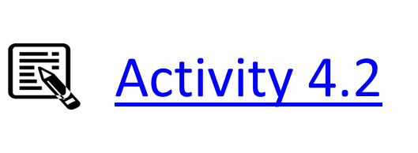
Video Critique
Did the healthcare provider demonstrate sufficient skills in the following areas? | Score from 1-5 (1 is best use of skill and 5 is least) | Provide examples here
(A) Use of Interpersonal Communication Skills
Use of positive non-verbal communication
Use of Reflective Listening
Demonstrate empathy
Video Critique
Notes:
Activity 3.4: National Undergraduate Curriculum for Chronic Disease Prevention and Management, Page 130 (handout)

Slide 22
B. Encourage Dialogue Assessment of Importance & Motivation | Score from 1-5 (1 is best use of skill and 5 is least) | Provide examples here
Assess how important it is for the patient to change behaviour
Assess how motivated the patient is to change behaviour
Ask open ended questions
Provide opportunity for the patient to speak
Notes:
Activity 3.4: National Undergraduate Curriculum for Chronic Disease Prevention and Management, Page 130 (handout)

Slide 23
C. Adopt a patient-centred approach | Score from 1-5 (1 is best use of skill and 5 is least) | Provide examples here
Use of appropriate vocabulary easily understood by the patient
Provide information that was geared toward the patient’s readiness to change
OVERALL COMMENTS
Notes:
Activity 3.4: National Undergraduate Curriculum for Chronic Disease Prevention and Management, Page 130 (handout)

Slide 24
Level 3: Extended Brief Intervention
Similar in content to a brief intervention, but usually takes longer and consists of an individually focussed discussion and follow-up.
Useful exercises
OARS Conversation skills
The 80:20 Rule
The 0-10 scaling exercise
The Decisional Balance Sheet
Notes:
Extended brief intervention (EBI) is similar in content to a brief intervention, but usually takes longer and consists of an individually focussed discussion and follow-up.
The aim of an EBI is to raise awareness of the risks associated with the risk behaviour and to equip people with the skills to change.
An EBI-based discussion involves more intensive MI techniques. Useful tips for delivering an EBI involve:
Exploring ambivalence regarding behaviour change within the person.
For EBI, use exercises such as:
1. OARS Conversation skills: (outlined in next section);
2. The 80:20 Rule
3. The 0-10 scaling exercise (outlined in next section);
4. The Decisional Balance Sheet exercise (outlined in next section).

Slide 25
Level 3: Extended Brief Intervention
Target Audience
Patients with significant health problems
Patients who have found it difficult to change, or haven’t benefitted from a Brief Intervention
Patients who are involved in risky behaviour, or have been identified as at increased risk of harm

Slide 26
Watch the video demonstrating an
extended brief intervention
www.hse.ie/mecc-undergradcurriculum

Slide 27
Level 4: Specialist Services
Interventions which are delivered by a specially trained
health professional to support an individual
through a complex behaviour change.
Notes:
Specialist services are defined as interventions which are delivered by a specially trained health professional to support an individual through a complex behaviour change.
As a health professional, your role is to refer complex cases to appropriate specialist support services. Examples of these services may be a smoking cessation counsellor (smoking), an addiction counsellor (alcohol), a dietician (diet), a physiotherapist (exercise), a weight management programme (diet/exercise), a psychologist (risk of self-harm).

Slide 28
Level 4: Specialist Services

Slide 29
Level 4: Specialist Services
Target Audience
Those who require further support, and have not benefitted from Brief Interventions or Extended Brief Interventions
Those who are at high risk of causing harm to their health or wellbeing
Those with a serious medical condition that needs specialist advice and monitoring

Slide 30
Watch the video demonstrating an example of a specialist service
www.hse.ie/mecc-undergradcurriculum

Slide 31
Notes:
Table 4.1: National Undergraduate Curriculum for Chronic Disease Prevention and Management, Page 123-124 (handout)
Please note that the examples of staff or patients given are not exclusive to those named here. In the implementation of this framework service managers will need to identify those who are best placed to conduct and receive the relevant level of intervention (Source: Health Service Executive (2017) Making Every Contact Count: A Health Behaviour Change Framework and Implementation Plan for Health Professionals in the Irish Health Service. Dublin).

Slide 32
Notes:
*Hyperlinked for use as a Handout
Table 4.1 Please note that the examples of staff or patients given are not exclusive to those named here. In the implementation of this framework service managers will need to identify those who are best placed to conduct and receive the relevant level of intervention (Source: Health Service Executive (2017) Making Every Contact Count: A Health Behaviour Change Framework and Implementation Plan for Health Professionals in the Irish Health Service. Dublin).

Slide 33
Motivational Interviewing
A process of exploring a person’s motivation to change
through interview
in order to assist them in moving toward change.
Notes:
Motivational Interviewing (MI)
You learned about active listening skills for MI in Unit 3. To recap, MI is described as a process of exploring a person’s motivation to change through interview in order to assist them in moving toward change.
Simply giving patients advice to change is often unrewarding and ineffective. Telling, judging and advising may not be the most effective way of bringing about behaviour change.
In an MI structured conversation, the health professional does not attempt to persuade the individual to change. The patient is allowed and encouraged to voice their own uncertainties and problem-solve themselves.
Conversations using the principles of MI can be used by a range of health professionals in a range of settings.
MI is deliberately non-confrontational – the key questions within the conversation are:
• ‘What are some of the good things about your present behaviour?’
• ‘What are the not-so-good things about your present behaviour?’
Other key elements and strategies include:
• Expressing empathy by the use of reflective listening (see Unit 3).
• Avoiding arguments by assuming that the individual is responsible for the decision to change
• ‘Rolling with resistance’ rather than confronting or opposing it
• Supporting self-efficacy and optimism for change
MI is often a more intensive intervention than a BI carried out by a HCP but the approach and ethos of MI is applicable to helping a HCP to have more effective BI with patients.

Slide 34
Motivational Interviewing
The Health Professional does not attempt to persuade the individual to change.
The patient is allowed and encouraged to voice their own uncertainties and problem-solve themselves.
Notes:
You learned about active listening skills for MI in Unit 3. To recap, MI is described as a process of exploring a patient’s motivation to change through interview in order to assist them in moving toward change.
Simply giving patients advice to change is often unrewarding and ineffective.
Telling, judging and advising may not be the most effective way of bringing about behaviour change.
In an Motivational Interviewing structured conversation, the health professional does not attempt to persuade the individual to change.
The patient is allowed and encouraged to voice their own uncertainties and problem-solve themselves.

Slide 35
Motivational Interviewing is deliberately non-confrontational
Key Questions
‘What are some of the good things about your present behaviour?’
‘What are the not-so-good things about your present behaviour?’
Notes:
Motivational Interviewing is deliberately non-confrontational – the Key questions within the conversation are:
• ‘What are some of the good things about your present behaviour?’
• ‘What are the not-so-good things about your present behaviour?’
Other key elements and strategies include:
• Expressing empathy by the use of reflective listening (see Unit 3).
• Avoiding arguments by assuming that the individual is responsible for the decision to change
• ‘Rolling with resistance’ rather than confronting or opposing it
• Supporting self-efficacy and optimism for change

Slide 36
Other key elements and strategies include:
• Express empathy/using active listening
• Avoiding arguments
• ‘Rolling with resistance’
• Supporting self-efficacy and optimism for change
Notes:
Other key elements and strategies include:
• Expressing empathy by the use of active listening (see Unit 3).
• Avoiding arguments by assuming that the individual is responsible for the decision to change
• Supporting self-efficacy and optimism for change
• ‘Rolling with resistance’ rather than confronting or opposing it.
Resistance to change is a common occurrence in HBC interventions, and a patient may be defensive in response to a perceived attack on their current behaviour. To avoid making a patient feel threatened or confronted about health risk behaviours, it is important to respect a patient’s resistance, express empathy and approach the conversation in a non-judgemental manner.
MI is often a more intensive intervention than a BI carried out by a HCP but the approach and ethos of MI is applicable to helping a HCP to have more effective BI with patients.

Slide 37
Useful Tools
Conversation using OARS acronym
The 80:20 Rule:
The Bubbles Technique
The Decisional Balance exercise
The 0-10 scaling question

Slide 38
1: OARS
O – Open ended questions
A – Affirming the patient
R – Reflective listening
S – Summarising
Notes:
O – Open-ended questions
• Cannot be answered in one word
• Create forward moving momentum
• Encourages the patient to talk and express themselves
• Helps establish an atmosphere of trust and acceptance
A – Affirming the patient
• Noticing what is right about someone
• A recognition and acknowledgement – of strengths, values, effort, achievement
• More than simple praise: ‘well done’
R – Reflective listening
• Help the patient feel listened to and understood
• Check you have understood them correctly
• Encourage the patient to keep talking
• Sometimes help the patient understand themselves better
S – Summarising
• Summaries involve capturing elements of what the patient has been saying,
and saying them back without any advice giving or interpretation or judgement.

Slide 39
1: OARS- Open-ended questions
Cannot be answered in one word
Create forward moving momentum
Encourages the person to talk and express themselves
Helps establish an atmosphere of trust and acceptance

Slide 40
1: OARS- Affirming the patient
• Noticing what is right about someone
• A recognition and acknowledgement – of strengths, values, effort, achievement
• More than simple praise: ‘well done’

Slide 41
1: OARS- Reflective listening
• Help the other person feel listened to and understood
• Check you have understood them correctly
• Encourage the other person to keep talking
• Sometimes help the other person understand themselves better

Slide 42
1: OARS- Summarising
Summaries involve capturing elements of what the person has been saying, and saying them back without any advice giving or interpretation or judgment.

Slide 43
2: The 80:20 Rule
The patient should do 80% of the talking,
and the healthcare professional 20%.
The patients view must be heard and listened to,
even if you think they are incorrect.
Notes:
In an MI structured conversation for HBC, it is important to remember that your role as a health professional is to guide the conversation and engage in active, reflective listening.
The patient should do 80% of the talking, and the healthcare professional the other 20%.
The patients view must be heard and listened to, even if you think they are incorrect.

Slide 44
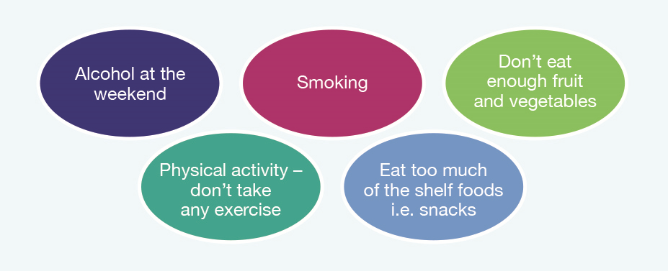
3: The Bubbles Technique
Notes:
3. The Bubbles Technique
The bubbles technique is a useful tool to use to identify which behaviour you will discuss with a patient. It helps patients with multiple lifestyle issues to identify the behaviour that they feel they would like to discuss and also keeps a record of the other behaviours.
The bubbles technique involves asking a patient about a number of lifestyle behaviours:
Question: Tell me about your smoking ?
HCP writes the word smoking on a page and circles it
Repeat this process for other behaviours. Ask the patient if there is any other lifestyle behaviour they would like to discuss.
HCP then asks patient to pick which lifestyle factor they would like to talk about today
Figure 4.5 The Bubble Technique
HCP then asks the patient to pick which lifestyle factor they would like to talk about today.

Slide 45
4: Decisional Balance
Action | Disadvantages | Advantages
No Change
Change
Notes:
One exercise that may help a patient clarify their barriers to successful behaviour change is to list in one place the benefits and costs of changing or continuing their current behaviour. Seeing the full array of costs and benefits can make it easier to decide if you should change.

Slide 46
5: Scaling Questions
On a Scale of 1-10 how important is it that you become more active?
Not at all Very
Important Important
1 | 2 | 3 | 4 | 5 | 6 | 7 | 8 | 9 | 10
Reasons for your ……………………………………………………………..
answer ………………………………………………………………
Notes:
You can use a ‘scaling question’ for solution focussed approaches to help the person think about and articulate their reasons for changing their behaviour, asking:
On a Scale of 1-10 how important is it that you become more active?
Assume they said 4. You might then ask:
‘Why 4 and not lower? Why is it important to you?
See what they say. Use reflections to help them develop their arguments for change.
Perhaps ask:
‘And why else?’
Keep fishing for reasons.
Do not ask: ‘why isn’t it higher?’
We want people to articulate and strengthen their reasons, their motivation.
As they verbalise their reasons, they may become more real for them.
Then perhaps ask to summarise back the reasons they have for becoming more active

Slide 47
Activity 4.3
In groups of two, think of a behaviour that you
would like to change
Use the Decisional Balance Sheet and the 0-10 Scaling Question to assist you.
Feed back to the group on how useful you found these tools.
Notes:
Activity 4.3: National Undergraduate Curriculum for Chronic Disease Prevention and Management, Page 132 (handout)

Slide 48
Motivational Interviewing Used in Primary Care. A Systematic Review and Meta-analysis. VanBuskirk KA, Wetherell JL. Journal of behavioral medicine. 2014;37(4):768-780.
Motivational Interviewing, Third Edition: Helping People Change (Applications of Motivational Interviewing). Rollnick, S., Miller, WR (2012) London: Guildford Press

Slide 49
Video demonstrating motivational interviewing
www.hse.ie/mecc-undergradcurriculum

Slide 50
Activity 4.4.
Identify scenarios where it may not be appropriate
to raise the issue of lifestyle behaviour change
with a patient
Notes:
Making Every Contact Count is about raising the issue of lifestyle behaviour change routinely with patients. However, a brief intervention may not always be appropriate. If students are in doubt they should ask a supervisor.
Level of Risk
Some patients may have complex care needs and BIs may not be sufficient to address these. E.g. CAGE scores for alcohol consumption may indicate alcohol dependency, which may require Specialist Services. Screening tools are explained in the next Lesson.
Timing of the intervention
Even when a BI is appropriate for a patients’ level of risk, the timing for delivering a BI must be carefully considered. E.g. not appropriate during sensitive treatment visits, delivering bad news, etc.
Lesson 4 will discuss how to maintain accurate records and flag patients for follow-up. Recognise the limitations of your role in delivering BIs in relation to specific health behaviours, and choosing which lifestyle topic to discuss with a patient
Often patients present with multiple risk factors for chronic disease or with multiple problem lifestyle behaviours. As a HCP you can’t discuss all behaviours at every contact with patients so it is important to prioritise which behaviour to discuss with the patient.
The bubbles technique is a useful tool to use to identify which behaviour you will discuss with a patient.

Slide 51
The Bubbles Technique: Identifying which behaviour to focus on with a patient
Video demonstrating ‘The Bubbles Technique’ www.hse.ie/mecc-undergradcurriculum
Notes:
Summary
In this Lesson we have revisited each of the units which you have studied in relation to HBC and BIs so far. We have explored brief advice, BIs and MI and the differences between them as distinct approaches to HBC. We identified opportunities for BI in your role as a HCP. We also identified patients for whom a BI is appropriate and situations when BIs may not be appropriate. In Lesson 2 we will look at assessment, screening and reporting of BI and carrying out BIs

