Slide 1



Unit 4: Lesson 2

Slide 2

Making Every Contact Count: Providing Opportunistic Brief Advice and Undertaking Brief Interventions
Lesson 3: Brief intervention Skills Workshop
Notes:
Lesson 3: Brief intervention Skills Workshop
Duration: 2 hour Skills Workshop
What you will cover in this lesson:
• Use validated screening and assessment tools to assess a patient’s readiness to change and respond to this assessment supportively.
• Deliver a brief intervention in an empathetic and non-confrontational manner using the principles of motivational interviewing.
• Assess your own performance in delivering a brief intervention using self-reflective practice.

Slide 3


Making Every Contact Count
Play your part
in changing lifestyle behaviours
and help prevent chronic disease
Notes:
Making Every Contact Count is a programme being implemented within the HSE to support the prevention of chronic disease by promoting lifestyle behaviour change. The health behaviours which are the focus of this programme are the four main lifestyle risk factors for chronic disease: tobacco use; physical inactivity; harmful alcohol consumption and unhealthy eating.
Making Every Contact Count is about health professionals using their routine consultations to empower and support people to make healthier choices to achieve positive long-term behaviour change. To do this, the health service needs to build a culture and operating environment that supports continuous health improvement through the contacts that it has with individuals.
This approach will allow health professional to move to a position where discussion of lifestyle behaviour is routine, non-judgemental and central to everyone’s role.
As a healthcare student and future healthcare professional you will be asked to make each routine contact that you have with patients count in terms of chronic disease prevention.

Slide 4
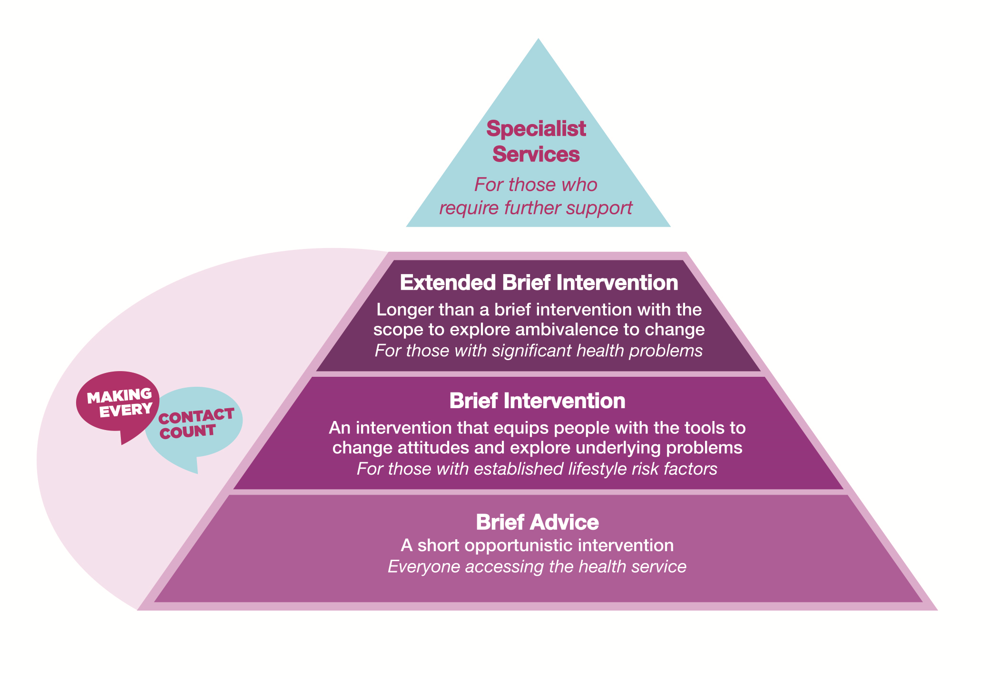
Recap Lesson 1
Making Every Contact Count
Framework
Motivational Interviewing
OARS
Scaling Questions
Decisional Balance
The 80:20 Rule
The Bubbles Technique
Notes:
Recap Lesson 1:
In lesson 1 you completed an online module and had opportunity to discuss the theory of brief advice, brief intervention and motivational interviewing for HBC.
Oars-
Open ended questions
Affirming the patient
Reflective listening
Summarising
Scaling
On a scale of 1-10 how important is it that you change … (Health Behaviour)
Decisional Balance
Advantages & Disadvantages of changing the health behaviour
The 80:20 rule: Patients do 80% of the talking the Health professional the remaining 20%
The Bubbles Technique: helps the patient and Health Professional decide on which health behaviour they would like to talk about

Slide 5

Screening Tools for Identifying Behavioural Risk Factors
Use validated tool/method
Quick & easy
Once an individual is identified as ‘at risk’ for an illness,
a treatment pathway should determine the appropriate course of action
Brief advice, Brief Intervention, Extended Brief Intervention, Specialist Services
Notes:
Screening of patients using a validated method or tool is the first step in identifying people that are at risk of developing (or worsening) a health problem as a result of a health behaviour.
Screening tools should be quick and easy to do so that they can be routinely used by appropriately trained staff accurately within a few minutes.
Once an individual is identified as ‘at risk’ for an illness, a treatment pathway should determine the appropriate course of action – whether this involves brief advice, BI, EBI or Specialist Services. There should be no delay in treating identified patients.
Some commonly used screening tools for common problem health behaviours are:

Slide 6
Smoking: Heaviness of Smoking Index
Developed to measure nicotine dependence by using two questions
Time to first smoking in the morning
Number of cigarettes per day
Notes:
Heaviness of Smoking Index
The Heaviness of Smoking Index (HSI) was developed as a test to measure nicotine dependence by using two questions from the Fagerstrom Tolerance Questionnaire and the Fagerstrom Test for Nicotine Dependence: time to first smoking in the morning and number of cigarettes per day. It uses a six-point scale calculated from the number of cigarettes smoked per day (1-10, 11-20, 21-30, 31+) and the time to first cigarette after waking (less than/equal to 5 minutes, 6-30 minutes, 31-60 minutes, and 61+ minutes). Nicotine dependence is then categorized into a three-category variable: low (0-1), medium (2-4), and high (5-6). The HSI provides a simple way for health professionals to classify their patients prescribing dependency-based treatments to classify their patients.
It is calculated by multiplying the number of packs of cigarettes smoked per day by the number of years the person has smoked. For example, 1 pack-year is equal to smoking 20 cigarettes (1 pack) per day for 1year, or 40 cigarettes per day for half a year, and so on. Research shows that among smokers, patients with ≤ 15 pack year history of smoking have a longer median survival than patients who had smoked > 15 pack years

Slide 7
Key Reading
Measuring the heaviness of smoking: Using self-reported time to the first cigarette of the day and number of cigarettes smoked per day. Heatherton TF, et al. Addiction. 1989;84:791–800.
Determinants of tobacco use and renaming the FTND to the Fagerstrom Test for Cigarette Dependence. Fagerstrom K. Nicotine Tob Res. 2012;14: 75-78

Slide 8
Smoking: Calculation of Pack Years:
Number of packs of cigarettes smoked per day
Number of years the person has smoked
Pack Years
X
=
Patients with a ≤ 15 pack year history of smoking
have a longer median survival
than patients who had smoked > 15 pack years
Notes:
2. Calculation of Pack -Years:
It is calculated by multiplying the number of packs of cigarettes smoked per day by the number of years the person has smoked. For example, 1 pack-year is equal to smoking 20 cigarettes (1 pack) per day for 1year, or 40 cigarettes per day for half a year, and so on. Research shows that among smokers, patients with ≤ 15 pack year history of smoking have a longer median survival than patients who had smoked > 15 pack years

Slide 9
Key Reading
Janjigian YY, et al. Pack Years of Cigarette Smoking as a Prognostic Factor in Patients with Stage IIIB/IV Non-Small Cell Lung Cancer. Cancer. 2010;116(3):670-675. doi:10.1002/cncr.24813.

Slide 10
Alcohol & Drug Use
The Audit C Tool
Notes:
Audit C Tool : National Undergraduate Curriculum for Chronic Disease Prevention and Management, Page 135-136 (handout)

Slide 11

Drug Use-DUDIT screening tool
How many times in the past year have you used an illegal drug or used a prescription medication for non medical reasons?
Question
Never reinforce abstinence
Positive result further assessment using DUDIT screening tool.
Answer
The DUDIT tool can be assessed through the following website
www.drugs.ie/NDRICdocs/protocol1/templates/DUDIT.pdf
Notes:
Drug use is assessed using the DUDIT screening tool but you first need to ask the patient one question: how many times in the past year have you used an illegal drug or used a prescription medication for non medical reasons?
If the answer is never reinforce abstinence. Any positive result requires further assessment using DUDIT screening tool. The DUDIT tool can be assessed through the following website
www.drugs.ie/NDRICdocs/protocol1/templates/DUDIT.pdf

Slide 12

Healthy Eating
Assessment of weight and health risk involves using two key measures:
1: Body Mass index
2: Waist circumference
BMI > 25 = Brief intervention
Notes:
BMI > 25 = Brief intervention in relation to healthy eating and physical activity
should be delivered to the patient by the health care professional

Slide 13
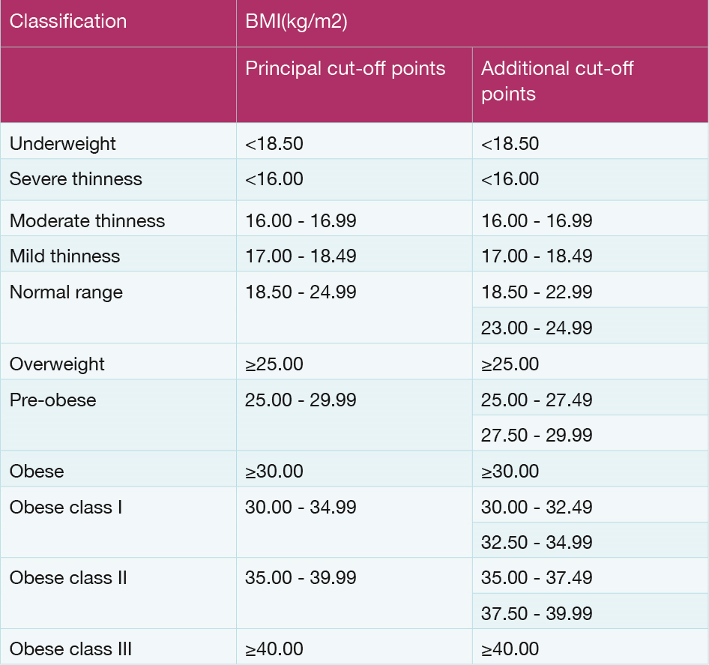
1: Body mass index (BMI)
Figure 4.5 Adapted from WHO, 1995, WHO, 2000 and WHO 2004.
Notes:
Body Mass Index Table 4.3: National Undergraduate Curriculum for Chronic Disease Prevention and Management, Page 137
Weight management:
Assessment of weight and health risk involves using two key measures:
1. Body mass index (BMI)

Slide 14

2: Waist circumference
> 35 inches for women
> 40 inches for men.
= Higher risk for heart disease and type 2 diabetes
Notes:
2. Measuring waist circumference helps screen for possible health risks that come with overweight and obesity.
If most of your fat is around your waist rather than at your hips, you are at a higher risk for heart disease and type 2 diabetes. This risk goes up with a waist size that is greater than 35 inches for women or greater than 40 inches for men.
To correctly measure your waist, stand and place a tape measure around your middle, just above your hipbones. Measure your waist just after you breathe out

Slide 15
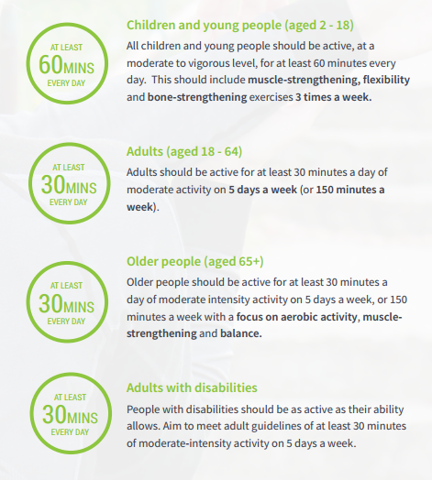
National Guidelines on Physical Activity for Ireland
Notes:
The National Guidelines on Physical Activity for Ireland are based on international expert evidence and describe appropriate levels of health enhancing physical activity for the Irish population.
The next slides shows the questions on the Making Every Contact Count recording tool to help to identify if patients are achieving the guidelines for physical activity. This graphic outlines the National Physical activity guidelines as a reminder when interpreting the results of the questions

Slide 16
Physical activity may include: walking or cycling for recreation or to get to and from places; gardening; and exercise or sport which lasts for at least 10 minutes
Recommended Physical Activity is at least 30 minutes of moderate intensity physical activity 5 days per week
Notes:
Physical activity Questions: National Undergraduate Curriculum for Chronic Disease Prevention and Management, Page 139
Physical activity may include: walking or cycling for recreation or to get to and from places; gardening; and exercise or sport which lasts for at least 10 minutes
Recommended Physical Activity is at least 30 minutes of moderate intensity physical activity 5 days per week
For more information see National Physical activity guidelines for Ireland- Get Ireland Active, www.getirelandactive.ie
Adults (18-64yrs) need at least 30 minutes a day of moderate activity on 5 days a week or 150 minutes a week
Older people need at least 30 mins a day of moderate activity on five days a week or 150 minutes a week
Adults with disabilities should be as active as their ability allows. They should aim to meet the adult guidelines of at least 30 minutes a day of moderate intensity activity on 5 days a week.
Children and young people (2-18) should be active at a moderate to vigorous level for at least 60 minutes everyday

Slide 17
Making Every Contact Count: Recording Tool
Important to record information on patient records.
Allows Healthcare Professionals to
  review when an issue has been raised in the past
  and how an intervention was conducted.
Specific recording tool developed for consistency
Paper format (patient record) and electronic patient records
Recording Tool is currently integrated into the
national electronic patient records for maternity services.
Notes:
MECC Recording Tool: National Undergraduate Curriculum for Chronic Disease Prevention and Management, Page 141-142 (handout)
Recording your interventions – Making Every Contact Count Recording Tool
The aim of Making Every Contact Count is to identify patients who are at risk from their current lifestyle behaviours and carry out a BI to support them to make a lifestyle behaviour change to improve their risks. Recording this information on patient records is an important part of implementing this programme as HCPs can then review when an issue has been raised in the past and how an intervention was conducted. While some HCPs record this information currently on patient records this doesn’t happen in a consistent way.
The Making Every Contact Count recording tool has been developed to record information on:
1. Patients lifestyle risk factors in relation to smoking, physical activity, healthy eating and alcohol.
2. Any intervention that a health Professional carries out having identified a risk from the patients lifestyle behaviours.
The intention is that this recording tool will eventually be incorporated into electronic patient records as the develops within all health services across Ireland in hospitals and primary care services. Currently the fields on the recording tool have been integrated into electronic patient records across all maternity hospitals in Ireland. These fields have also been incorporated into GP practice electronic systems.
You will encounter this recoding tool in many ways on placement and as you proceed to work in Irish Health services and indeed you could encounter this tool as part of a paper patient record in many services. When on placement or working in the health service you should ask a supervisor for information on how the tool is being used and integrated into the particular service you are working in.
You may also encounter the tool in your clinical placement logbook where you can record when you conduct an intervention and the outcome.
Note to student to ask a supervisor or senior staff member in the service how recording of information is carried out within the service and what local policies and procedures are in place to guide this.
Note to students when recording information in their log book in relation to interventions do so anonymously without identifying and particular patient .i.e. no patient names or other identifying factors.

Slide 18
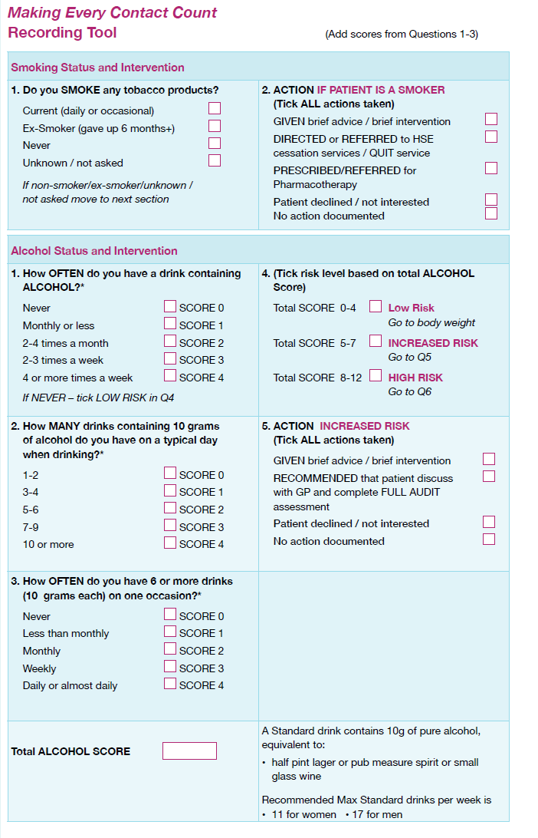
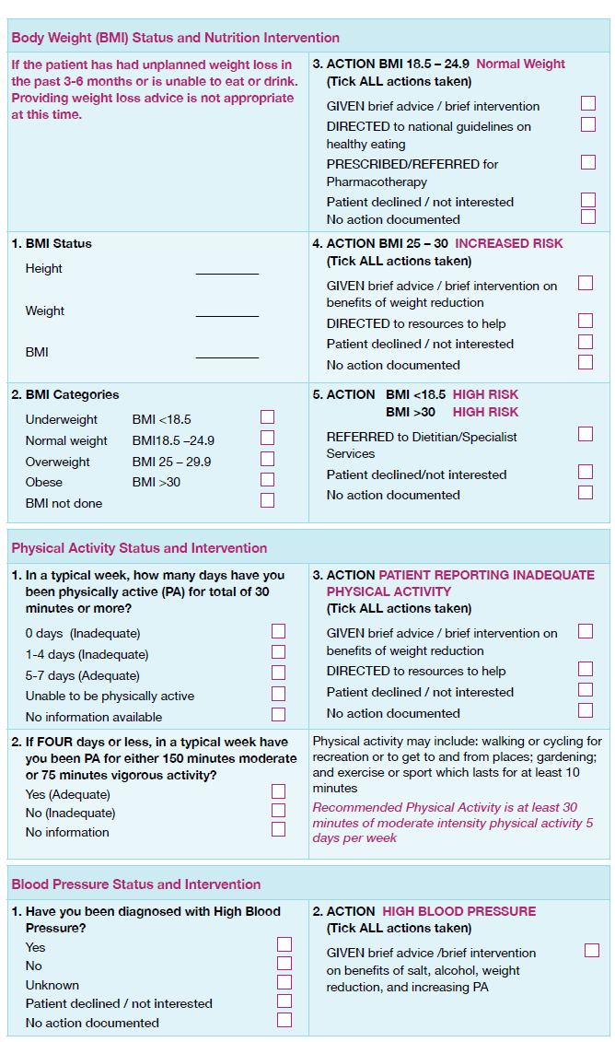
MECC Recording Tool
Notes:
MECC Recording Tool: National Undergraduate Curriculum for Chronic Disease Prevention and Management, Page 141-142 (handout)

Slide 19

Skills Workshop
Notes:
DELIVERING A BRIEF INTERVENTION- SKILLS WORKSHOP
We are now going to practice applying what we have learned in relation to carrying out a BI.

Slide 20
Delivering a Brief Intervention
Throughout the brief intervention remember to:
Develop and maintain rapport and empathy
Emphasise the patient’s personal responsibility for their own decisions
Remember the 5 As
Notes:
DELIVERING A BRIEF INTERVENTION- SKILLS WORKSHOP
We are now going to practice applying what we have learned in relation to carrying out a BI.
The framework below provides a useful reference for when you are conducting a BI to ensure that you cover all aspects of a BI.
Throughout the brief intervention remember to:
- Develop and maintain rapport and empathy
- Emphasise the patient’s personal responsibility for their own decisions

Slide 21
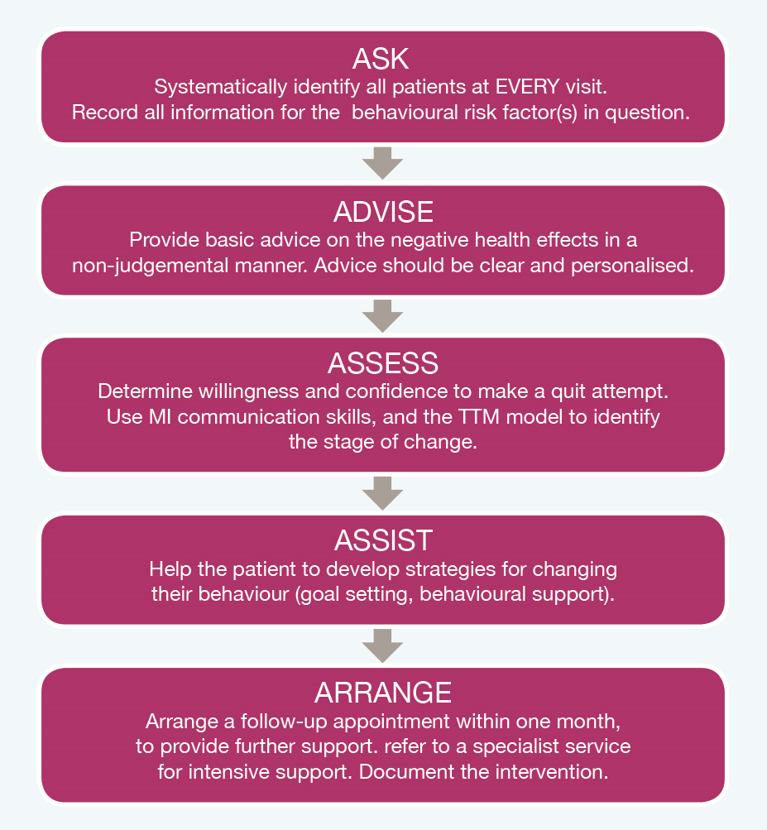
5 A’s

Slide 22
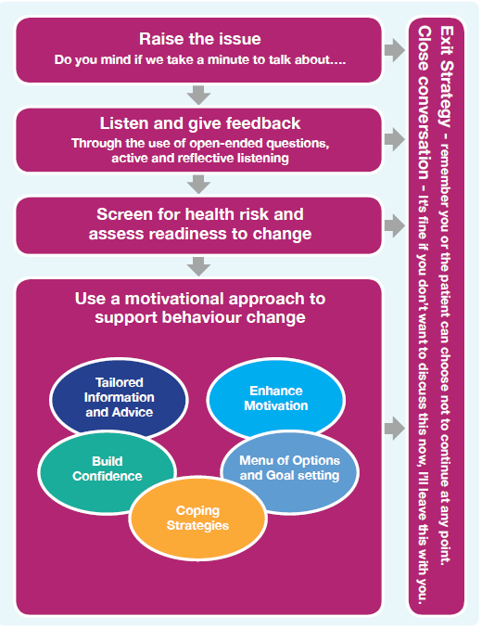

Slide 23

Activity 4.5 Real Play Exercise
Pick a personal lifestyle behaviour that you would like to change and that you are comfortable discussing in your small group.
Alternatively, you can pick a behaviour that may have come across in your clinical training to date.
Take turns to role play each of the following:
Health professional, Patient, Observer
Notes:
Activity 4.5: National Undergraduate Curriculum for Chronic Disease Prevention and Management, Page 145 (handout)
You are going to use a “Real play exercise” to practice carrying out a brief Intervention. Pick a personal lifestyle behaviour that you would like to change and that you are comfortable discussing in your small group. Alternatively, you can pick a behaviour that may have come across in your clinical training to date.
In groups of 3, students take turns to role play each of the following roles:
Health professional: try to imagine being in the patient’s situation. What stage of change do you think he/she is at? What processes are important for them right now that you could target in your intervention?
The health professionals task is to:
1. Identify the stage of change that the person is at.
2. Which type of intervention would be suitable for this type of patient
3. Record at least three open-ended questions you may wish to ask the patient
4. Use the 0-10 scaling exercise to explore ambivalence with the patient
5. Use the Decisional Balance exercise to identify barriers and facilitators to HBC.
6. Provide factual information neutrally, and correct any misinformation.
7. Use a patient centred approach
8. Remember the OARS principles
➢ Open-ended questions
➢ Affirmations,
➢ Reflective listening and
➢ Summarising skills.
Patient
What are the barriers to change for you?
What do you think are the advantages and disadvantages to HBC for you right now?
What other factors are important to you at the moment?
How responsive are you to an intervention from the health professional?
How do you react to their conversation with you?
Observer- use observer checklist handout provided with this lesson
Observe the interaction between the health professional and patient.
Can you identify the skills the health professional is using, and how they impact on the patient?
Who is doing most of the talking?
What is the quality of the interaction – how do you think the patient feels?

Slide 24

Directions
10 minutes for each real play
3 minutes for your feedback
Be strict about time.
However……. unlike in real life, in these role plays the participants can ‘rewind the tape’ if they get stuck, do something wrong or want to improve the interaction. They can ask one another for help, and then continue with the real play.
Notes:
Activity 4.5: National Undergraduate Curriculum for Chronic Disease Prevention and Management, Page 145 (handout)

Slide 25
Health Professional
1. Identify the stage of change that the person is at.
2. Which type of intervention would be suitable for this type of patient
3. Record at least three open-ended questions you may wish to ask the patient
4. Use the 0-10 scaling exercise to explore ambivalence with the patient
5. Use the Decisional Balance exercise to identify barriers and facilitators to HBC.
6. Provide factual information neutrally, and correct any misinformation.
7. Use a patient centred approach
8. Remember the OARS principles: Open-ended questions/ Affirmations/Reflective listening & Summarising skills.
Notes:
Activity 4.5: National Undergraduate Curriculum for Chronic Disease Prevention and Management, Page 145 (handout)

Slide 26
Patient
What are the barriers to change for you?
What do you think are the advantages and disadvantages to HBC for you right now?
What other factors are important to you at the moment?
How responsive are you to an intervention from the health professional?
How do you react to their conversation with you?
Notes:
Activity 4.5: National Undergraduate Curriculum for Chronic Disease Prevention and Management, Page 145 (handout)

Slide 27
Observer
Observe the interaction between the health professional and patient.
Can you identify the skills the health professional is using, and how they impact on the patient?
Who is doing most of the talking?
What is the quality of the interaction – how do you think the patient feels?
Notes:
Activity 4.5: National Undergraduate Curriculum for Chronic Disease Prevention and Management, Page 145 (handout)
And observer checklist handout page 155-156 (handout)

Slide 28
Managing challenging statements
.
Activity 4.6
Statement 1: “I’ve tried to exercise more so many times in the past and it just doesn’t work”
Statement 2: “What’s the point – the damage is done already”
Notes:
Activity 4.6: National Undergraduate Curriculum for Chronic Disease Prevention and Management, Page 148
Format – class discussion
Facilitator reads out examples of challenging statements from the patient, and the class identify at least three responses to these statements using the MI skills covered in Unit 3 and Unit 4.
Statement 1: “I’ve tried to exercise more so many times in the past and it just doesn’t work”
Statement 2: “What’s the point – the damage is done already”
In this lesson we have also practised delivering a brief intervention using a “real play” scenario to using the tools and techniques of motivational interviewing.
If time allows in the classroom the video below showing a HCP outlining how they have dealt with challenging statements can be viewed or alternatively students can be directed to view in their own time.

Slide 29

How did that exercise go for you?
Have you encountered challenging conversations in your training to date?
How did you react in these situations?
Notes:
Summary of lesson
In this lesson you have learned about screening tools for each of the lifestyle areas and viewed the Making Every Contact Count Recording tool for use inpatient records to record your interventions. You have also had the opportunity to practice a brief intervention and assess your own performance in doing so.
In the next and final lesson in relation to Making Every Contact Count you will explore signposting and referral services to support you with the “Arrange” part of the BI.

