Slide 1
Unit 4: Lesson 3

Slide 2
Making Every Contact Count: Providing Opportunistic Brief Advice and Undertaking Brief Interventions
Lesson 3: Signposting and referral to support services
Notes:
Lesson Aims: What you will cover in this lesson
Lessons 1 & 2 outlined what brief interventions are, when such interventions are appropriate, and gave you the practical skills for delivering brief interventions.
The aim of Lesson 3 is to outline what needs to happen next. You will learn to:
• Identify additional services and specialists to whom you can refer patients who require additional supports.
• Maintain accurate records of the nature of brief interventions that were delivered in reports and/or medical charts and how to flag further actions for follow-up.
Group Activity Signposting & referral to support services

Slide 3
Making Every Contact Count
Play your part
in changing lifestyle behaviours
and help prevent chronic disease
Notes:
Making Every Contact Count is a programme being implemented within the HSE to support the prevention of chronic disease by promoting lifestyle behaviour change. The health behaviours which are the focus of this programme are the four main lifestyle risk factors for chronic disease: tobacco use; physical inactivity; harmful alcohol consumption and unhealthy eating.
Making Every Contact Count is about health professionals using their routine consultations to empower and support people to make healthier choices to achieve positive long-term behaviour change. To do this, the health service needs to build a culture and operating environment that supports continuous health improvement through the contacts that it has with individuals.
This approach will allow health professional to move to a position where discussion of lifestyle behaviour is routine, non-judgemental and central to everyone’s role.
As a healthcare student and future healthcare professional you will be asked to make each routine contact that you have with patients count in terms of chronic disease prevention.

Slide 4
Recap lesson 2
Screening Tools
Heaviness of smoking Index/Pack Years calculation
Audit C tool/DUDIT screening tool
Body Mass Index/Waist circumference
Physical activity questionnaire
MECC recording Tool
Skills workshop
Real play exercise
Managing challenging statements
Notes:
Lessons 1 & 2 outlined what brief interventions are, when such interventions are appropriate, and gave you the practical skills for delivering brief interventions.
Recap Lesson 2
In lesson 2 you practiced MI skills for delivering a BI for HBC. You touched on the topic of screening and looked at some of the screening instruments which are used in practice.

Slide 5
Patient referral
Changing lifestyle behaviours and maintaining healthier choices is extremely challenging.
It is important that patients who receive brief interventions are linked with additional services and resources that can provide them with on-going support to achieve positive long-term behaviour change.
Notes:
Identifying additional services and specialists to whom you can refer patients who require additional supports.
Changing lifestyle behaviours and maintaining healthier choices is extremely challenging. It is therefore important that patients who receive BIs are linked with additional services and resources that can provide them with ongoing support to achieve positive long-term behaviour change.
Factsheet: Signposting and referral to Support Services: National Undergraduate Curriculum for Chronic Disease Prevention and Management, Page 150-151 (handout)

Slide 6
Smoking Cessation
The evidence shows that a brief intervention doubles a patient’s chances of making a successful quit attempt.
Smokers are four times more likely to quit and stay quit using behavioural support and medication
Notes:
Factsheet: Signposting and referral to Support Services: National Undergraduate Curriculum for Chronic Disease Prevention and Management, Page 150-151 (handout)

Slide 7
Smoking Cessation
Quit website: www.quit.ie.
• Free helpline: 1800 201 203.
• Email support: support@quit.ie.
• Free text support: text QUIT to 50100.
• Facebook: facebook.com/HSEquit.
• Twitter: @HSEQuitTeam.
• ‘One-to-one’ support at Smoking Cessation clinics.
Notes:
Factsheet: Signposting and referral to Support Services: National Undergraduate Curriculum for Chronic Disease Prevention and Management, Page 150-151 (handout)
Support services and referral for Smoking cessation
Signpost patients thinking about quitting to the QUIT support options which are all accessible through the www.quit.ie website. It provides a range of information and supports for patients that would like to quit smoking including details on how to access more intensive support. Supports include:
• Quit website: www.quit.ie.
• Free helpline: 1800 201 203.
• Email support: support@quit.ie.
• Free text support: text QUIT to 50100.
• Facebook: facebook.com/HSEquit.
• Twitter: @HSEQuitTeam.
• ‘One-to-one’ support at Smoking Cessation clinics.

Slide 8
Referral to specialist services
Patients can self-refer to Specialist smoking cessation support by accessing information on www.quit.ie.
Healthcare professionals can also refer patients to the Quit service through local referral systems
Notes:
Factsheet: Signposting and referral to Support Services: National Undergraduate Curriculum for Chronic Disease Prevention and Management, Page 150-151 (handout)
Referral to specialist services
Patients can self-refer to Specialist smoking cessation support by accessing information on www.quit.ie. HCP’s can also refer patients to the Quit service through local referral systems which have been set up.
Ref- West, R. (2012) Stop smoking services: increased chances of quitting. NCSCT Briefing #8. London; National Centre for Smoking Cessation and Training

Slide 9
Alcohol and Drugs
A brief intervention is a highly effective approach for tackling harmful alcohol consumption.
One in eight people will lower their alcohol consumption following a brief intervention
Recent research has found that brief interventions
can also be effective in reducing drug use.
Notes:
Factsheet: Signposting and referral to Support Services: National Undergraduate Curriculum for Chronic Disease Prevention and Management, Page 150-151 (handout)

Slide 10
Alcohol Support Services
www.askaboutalcohol.ie provides a one stop shop for information and supports to help patients cut down and maintain low risk drinking behaviours.
It provides
• Online information on alcohol
• County by county service finder : Support/
counselling services.
• Online support resources
Self-assessment tool / Drinks calculator
Tips for cutting down/ Tips for staying on track
Notes:
Factsheet: Signposting and referral to Support Services: National Undergraduate Curriculum for Chronic Disease Prevention and Management, Page 150-151 (handout)
Alcohol and Drugs
The Ask about alcohol website www.askaboutalcohol.ie provides a one stop shop for information and supports to help patients cut down and maintain low risk drinking behaviours. It provides the following:
• Online information on alcohol
• County by county service finder to help connect people to support and counselling services.
• Online support resources
➢ Self-assessment tool
➢ Drinks calculator
➢ Tips for cutting down
➢ Tips for staying on track

Slide 11
Drugs Support Services
www.drugs.ie provides a one stop shop for information and supports to help patients that are taking drugs.
It provides:
Online information on drugs and alcohol
County by county service finder to help connect people to support and counselling services.
Online drug test self-assessment
Online live help chat service: This is a free, secure and confidential online chat service. Time: 10:00am-1:00pm and 2:30pm-5:00pm, Monday to Friday
Notes:
Factsheet: Signposting and referral to Support Services: National Undergraduate Curriculum for Chronic Disease Prevention and Management, Page 150-151 (handout)

Slide 12
Referral to specialist support services for alcohol and drugs
Using assessment/screening questions for alcohol consumption and drug use will help identify patients with dependence that need to be referred.
Notes:
Factsheet: Signposting and referral to Support Services: National Undergraduate Curriculum for Chronic Disease Prevention and Management, Page 150-151 (handout)
Health professionals often don’t know when to refer patients to specialist alcohol and drug addiction services. Patients with alcohol or drug dependence need to be referred to specialist addiction services. Using assessment/screening questions for alcohol consumption and drug use will help identify patients with dependence that need to be referred.

Slide 13
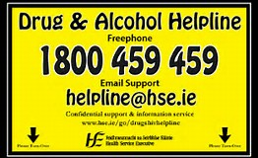
Unsure about the most appropriate help ?
Call the HSE Drug and Alcohol Helpline: 1800 459 459
Email support: helpline@hse.ie
If you need urgent help you should contact the patients GP or nearest Emergency Department
Notes:
Factsheet: Signposting and referral to Support Services: National Undergraduate Curriculum for Chronic Disease Prevention and Management, Page 150-151 (handout)
This helpline provides support, guidance and referral to anyone with a question or concern related to drug and alcohol use

Slide 14
Physical activity
1 in every 12 patients are likely to increase their physical activity following an intervention from a healthcare professional.
Notes:
Factsheet: Signposting and referral to Support Services: National Undergraduate Curriculum for Chronic Disease Prevention and Management, Page 150-151 (handout)
Most patients will need some support to be more active.
• Give them the booklet Get Active Your Way and encourage them to take the activity challenge
• Check out www.getirelandactive.ie for information, hints and tips
• Follow Get Ireland Active on Facebook, Twitter and Instagram for regular motivation and support from the HSE
• Be aware of local initiatives that your patients may find helpful, e.g. Local Sports Partnership programmes, walking clubs, local Saturday morning parkrun, FitforLife
If the patient has a medical condition and is worried about being more active, suggest they visit their GP for a checkup.

Slide 15
Physical activity
Most patients will need some support to be more active.
• Get Active Your Way activity challenge
• www.getirelandactive.ie for information, hints and tips
• Follow Get Ireland Active on Facebook, Twitter and Instagram
• Local initiatives: Local Sports Partnership programmes, walking clubs, local Saturday morning parkrun, FitforLife
Notes:
Factsheet: Signposting and referral to Support Services: National Undergraduate Curriculum for Chronic Disease Prevention and Management, Page 150-151 (handout)
Most patients will need some support to be more active.
• Give them the booklet Get Active Your Way and encourage them to take the activity challenge
• Check out www.getirelandactive.ie for information, hints and tips
• Follow Get Ireland Active on Facebook, Twitter and Instagram for regular motivation and support from the HSE
• Be aware of local initiatives that your patients may find helpful, e.g. Local Sports Partnership programmes, walking clubs, local Saturday morning parkrun, FitforLife
If the patient has a medical condition and is worried about being more active, suggest they visit their GP for a checkup.

Slide 16
Healthy Eating
There is evidence that brief interventions that communicate specific healthy eating messages
(e.g. Increase fruit & vegetables, limit high fat, sugar and salty foods, reduce portion size)
can help support people to eat healthily.
Notes:
Factsheet: Signposting and referral to Support Services: National Undergraduate Curriculum for Chronic Disease Prevention and Management, Page 150-151 (handout)

Slide 17
Healthy Eating - Supports available
Healthy Food for Life resources on the HSE website
Local initiatives e.g. community cooking programmes
Local community based weight management support groups, e.g. Weight Watchers or Slimming World
Refer to a Dietitian for medical conditions requiring specialist input
Notes:
Factsheet: Signposting and referral to Support Services: National Undergraduate Curriculum for Chronic Disease Prevention and Management, Page 150-151 (handout)
Healthy Eating
Changing eating habits is complex and it can take time to change unhealthy habits. Most patients need support to achieve this.
• Check out the Healthy Food for Life resources on the HSE website
• Be aware of local initiatives that your patients may find helpful, e.g. community cooking programmes
• For those who want to lose weight, signpost them to local community based weight management support groups, e.g. Weight Watchers or Slimming World
If the patient has a medical condition that needs specialist input, refer them to a dietitian.
Information on referral to local dietetic service should be available in the department or service you are working in.

Slide 18
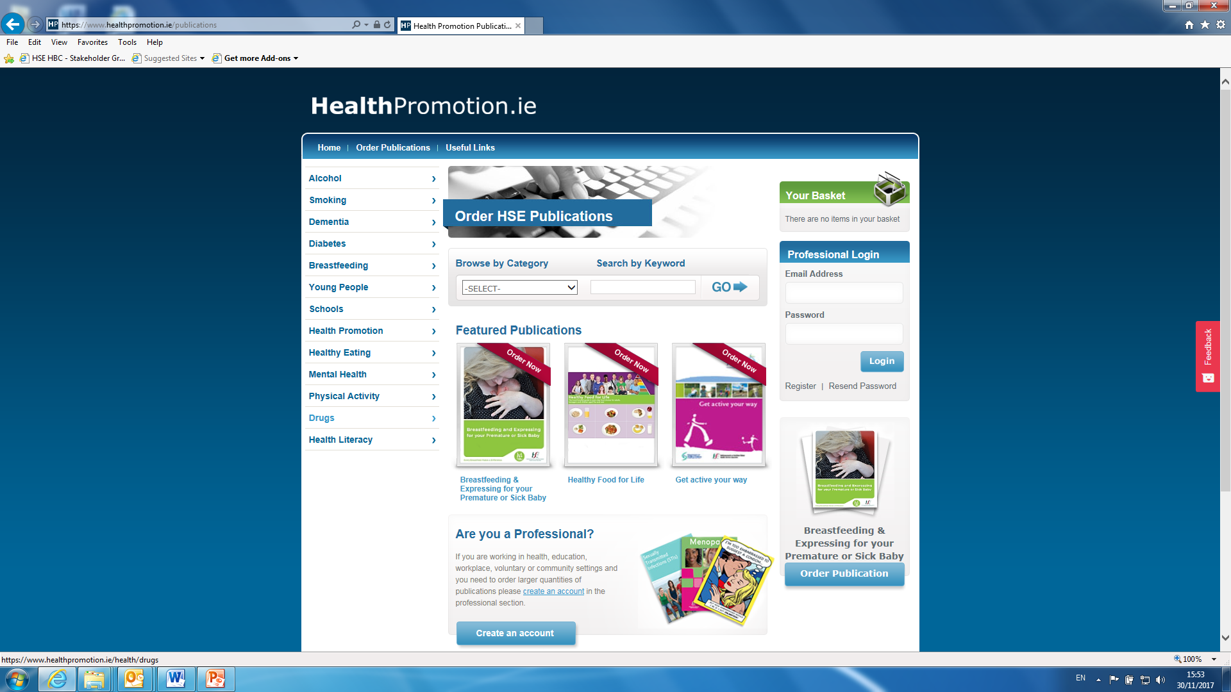
To order HSE Publications
https://www.healthpromotion.ie/publications
Notes:
Register as a health professional

Slide 19
Activity 4.7 Website Research
In groups visit the websites identified and try and identify the information outlined
Did you find any additional useful information?
Present back to the class with an outline of what is available for each lifestyle area
Notes:
In groups visit the websites above.
Try and identify the information outlined above.
Did you find any additional useful information?
Present back to the class with an outline of what is available for each lifestyle area:

Slide 20
Maintaining accurate records
What lifestyle behaviour(s) you asked the patient about
What screening tools (if any) you used and the outcomes of these
What actions you took
Any additional information that is important for follow-up
For students on clinical placement, this information may also be flagged to the clinical supervisor.
Notes:
Maintaining accurate records of the nature of brief interventions that were delivered in reports and/or medical charts and flagging further actions for follow-up.
After you have spoken with a patient about a lifestyle behaviour and/or delivered a brief intervention it is important that there is an accurate record of this in their medical chart. This is important so that the behaviour is documented (for example, the patient’s smoking status) and that other health care providers interacting with the patient know what actions were taken. It is also important to flag any actions for follow-up in the future. In some settings you will be able to record information on the Making Every Contact Count recording tool.
When recording information in a medical chart/Making Every Contact Count recording tool you should state:
1. What lifestyle behaviour(s) you asked the patient about
2. What screening tools (if any) you used and the outcomes of these (for example, the Audit C)
3. What actions you took (for example, whether you gave the patient brief advice and/or what additional resources and/or services you provided information on)
4. Any additional information that is important for follow-up (for example, following up with the patient about their smoking status at future visits or other lifestyle behaviours that were not discussed during this visit but that should be addressed in the future).
5. For students on clinical placement, this information may also be flagged to the clinical supervisor.

Slide 21
Key Reading
Health Service Executive (2013). National standard for tobacco cessation support programme.
Dublin: Health Service Executive, 2013.

Slide 22
What identified supports are available to you as a health professional to support lifestyle behaviour change?
What supports do these services provide directly to patients in relation to behaviour change?

Slide 23
What direct referral services are available to you in your role as a health professional to which you can refer patients to?
In your role as a health professional is it always necessary for you to refer or signpost a patient to change their behaviours.

Slide 24
Notes:
Recap on the entire Making Every Contact Count units 1-4
Summary Unit 4
In Unit 4 you learned how to Make Every Contact Count and you practiced the skills which are needed to provide opportunistic brief advice and to undertake brief interventions. You covered the theory of brief advice, brief interventions and motivational interviewing and the differences between them as distinct approaches to behaviour change.
You Identified opportunities for brief interventions in your role as a HCP and identified the patients for whom a brief intervention is appropriate.
You were introduced to validated screening and assessment tools to assess a patient’s readiness to change and how to respond to this assessment supportively. You were also introduced to the Making Every Contact Count Recording tool. You had opportunity to assess your own performance in delivering a brief intervention using self-reflective practice.
You have now completed the Making Every Contact Count Undergraduate Curriculum content lessons. Included in this has been the completion of the HSE’s Making Every Contact Count eLearning training modules. These modules have been developed so that all healthcare professionals can revisit them again and again and particularly to engage with the Extend My Learning sections of : Do more, Learn More, Read More to help you integrate BIs as part of routine clinical practise with every patient.

