Slide 1

HSE National Open Disclosure Programme
Skills Workshop
Updated 20/06/2023

Slide 2

Welcome and Introductions
Welcome to today’s workshop:
Introductions – Hello my name is….
Housekeeping
Participant self reflection
CPD
Workshop Objectives
Ways of Working
Resource Pack

Slide 3
Objectives
The aim of this Face to Face workshop
To build the capacity of attendees to prepare for and manage open disclosure meetings with patients, services users and their relevant person following patient safety incidents. This is a follow on module to the Open Disclosure E- learning Modules 1 and 2.
By the end of the workshop participants will:
Be more knowledgeable about the National Open Disclosure programme including relevant legislation and resources.
Recognise the impact of communication and importance of being empathic, person centred and be more aware of their own communication style.
Have an opportunity to practice the key skills required to effectively manage an open disclosure meeting to get the best outcome for the patient/ relevant person and staff involved.
Be more confident in managing the open disclosure process and associated challenges as part of a team.
Be aware of the patient perspective, the support needed and supports available for them.
Recognise the importance of team dynamics, support for each other and their own support needs throughout the open disclosure process.

Slide 4
Context of Open Disclosure Programme
A. Policy: It is the policy of the HSE that staff will:
Communicate with patients in an open, honest, transparent and empathic manner following patient safety incidents.
Provide patients with a sincere and meaningful apology when they are harmed as a result of a patient safety incident.
Begin the communication process within 24 – 48 hours of the incident occurring or becoming known to the health services provider.
B. Legislation: The Patient Safety Act makes provision for mandatory open disclosure of
a number of Notifiable Patient Safety incidents.
C. Training: Open Disclosure Training is mandatory for all staff with refresher training required every 3
years.

Slide 5
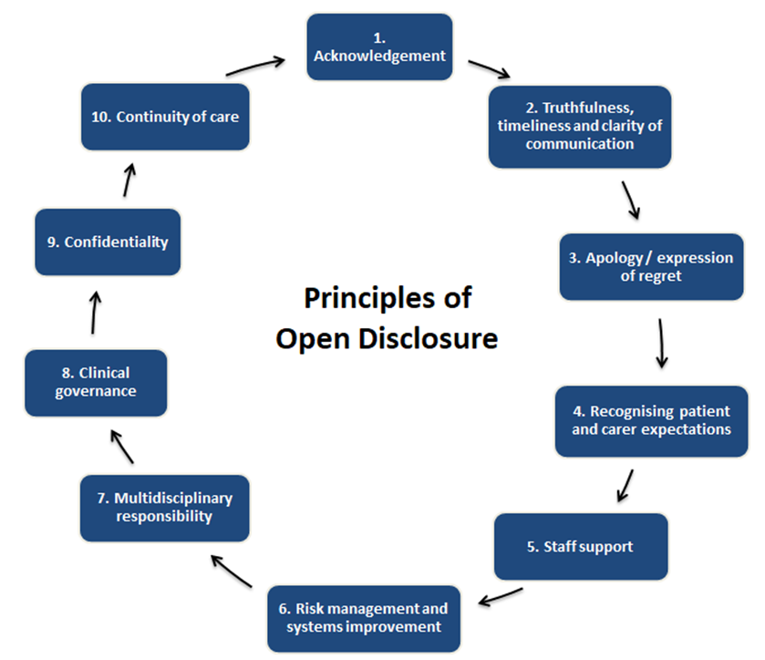
THE PRINCIPLES OF OPEN DISCLOSURE
Acknowledgement
Truthfulness, timeliness and clarity of communication
Apology/Expression of Regret
Recognise Patient and Carer expectations
Staff Support
Risk Management and Systems Improvement
Multidisciplinary Approach
Clinical Governance
Confidentiality
Continuity of Care
CARE COMPASSION TRUST AND EMPATHY

Slide 6


Incident Management Process

Slide 7

IM Training Team
Provide Training to support the implementation of the IMF:
Serious Incident Management Team Training
  Self directed learning- 3 hours HSELand
  Virtual Classroom- 3 Hour Session via MS Teams
Systems Analysis Review of a Patient Safety Incident Training
  2 day training programme
  Interactive face to face training, including practical examples, scenarios and role play.
  Plan to run half day follow up session for trainees to support them to implement the learning

Slide 8
Legislation: Legislative process to date
Civil Liability (Amendment) Act 2017
(Part 4)
Commenced September, 2018
Civil Liability (Open Disclosure) (Prescribed Statements) Regulations 2018
Commenced September 2018
Patient Safety (Notifiable Incidents and Open Disclosure) Act 2023
Signed into law
2 May 2023
(not yet commenced)
Patient Safety Act : Provisions for mandatory open disclosure.
List of 14 Notifiable patient safety incidents
There will be a lead in time to commencement and a National
Implementation Programme

Slide 9
The Civil Liability (Amendment) Act 2017
Protective legislative provisions in Part 4 of the CLA commenced in September 2018
Information provided and an apology given at an open disclosure meeting:
shall not constitute an express or implied admission of fault or liability in relation to the incident or any clinical negligence action arising from the incident
will not be admissible as evidence of fault or liability in Court in relation to the incident or clinical negligence action arising from the incident
will not invalidate the indemnity or insurance cover of the health service provider
shall not constitute an express or implied admission of fault, professional misconduct, poor professional performance or unfitness to practice in relation to any complaint made by the patient to a regulatory body subsequently.
shall not be admissible as evidence of fault, professional misconduct, poor professional performance, unfitness to practise a health service, or other failure or omission, in proceedings to determine a complaint, application or allegation
Relates to Voluntary Open Disclosure
The Civil Liability ( Open Disclosure) ( Prescribed Statements) Regulations 2018 are prescribed statements(forms) to be completed, signed and provided to the patient/relevant person at various stages throughout the OD process
Part 4 of the CLA is now under review to align with the PSB
Available: HSE Open Disclosure website
https://www.hse.ie/eng/about/who/qid/other-quality-improvement-programmes/opendisclosure/open-disclosure-legislation/civil-liability-forms.html

Slide 10
Patient Safety (Notifiable Incidents and Open Disclosure) Act 2023
This Act provides for :
mandatory open disclosure of a number of serious notifiable patient safety incidents;
certain restrictions on the use of the information and any apology provided in such disclosures;
mandatory open disclosure of Part 5 reviews (cancer screening);
procedures in respect of clinical audit, and the data obtained in clinical audit;
notification of notifiable incidents to certain persons i.e. HIQA, MHC, Chief Inspector;
the amendment of the Health Act 2007 to provide for the application of standards set by the Health Information and Quality Authority to private hospitals,
the review by the chief inspector of certain incidents occurring in the course of the provision of a health service to a person by certain entities (i.e. nursing homes);
the amendment of the National Treasury Management Agency (Amendment) Act 2000 and Part 4 of the Civil Liability (Amendment) Act 2017.
This Act applies to all public and private health and social care service providers
For more information access the Oireachtas website: https://www.oireachtas.ie/en/bills/bill/2019/100/

Slide 11

Serious Notifiable Incidents
Schedule 1: Part 1: Unintended and unanticipated patient death which did not arise from or was a consequence of an illness/underlying condition
Following wrong patient surgery
Following wrong site surgery
Following wrong surgical procedure
Following unintended retention of a foreign object
Following elective surgery
Directly related to treatment
Due to transfusion of incompatible blood or blood components
Associated with medication error
Death of a woman while pregnant or within 42 days of delivery
Still born child born without foetal abnormality at prescribed gestational age/ birth weight not related to underlying condition of the child
Perinatal death of a child who was alive at the onset of care in labour who had reached a prescribed gestational age and a prescribed birth weight
Suicide of patient while being cared for at a place or premises where care is being provided

Slide 12
Serious Notifiable Incidents
Schedule 1: Part 2:
Serious notifiable incidents related to delivery of a baby:
A baby who
(a)in the clinical judgment of the treating health practitioner requires or is referred for therapeutic hypothermia
or
(b)has been considered for but did not undergo therapeutic hypothermia as in the clinical judgment of the health practitioner such therapy was contraindicated due to the severity of the presenting condition.

Slide 13
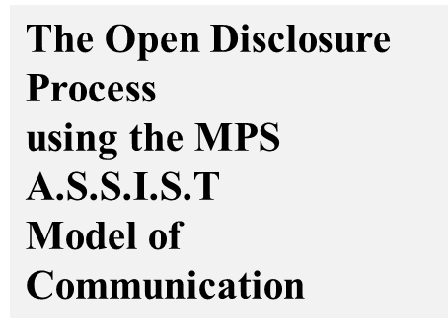
ASSIST Model
A – Acknowledge – what has happened and the
impact
S – Sorry – express regret
S – Story – hear their story and summarise
back to them
I – Inquire – seek questions to be answered,
provide answers, give information
S – Solution – seek their agreement for the way
forward – agree a plan
T – Travel – avoid abandonment – outline plan for
their continued care and contact arrangements

Slide 14

Role Play Activities
Warning
During this workshop, we will be discussing some challenging conversations and scenarios. These may echo with some experiences in your life which may be upsetting. If this happens, please feel free to let us know, to take time out from the workshop if required or to sit out a particular scenario that may be too upsetting for you.

Slide 15
Activity 1: Managing Low Level Open Disclosure
Managing Low Level Open Disclosure using the ASSIST Model of Communication
A low level response is usually initiated for patient safety incidents where there has been no harm to the patient or harm is minimal (predominately Category 3 incidents as per the HSE Risk Impact Table). This may involve just one meeting to discuss what has happened. The need for a further meeting can be assessed at this meeting in discussion with the patient/relevant person.
Key Learning:
Participants have an opportunity to use the ASSIST Model of communication to support and guide an open disclosure discussion with a patient following a low level incident.

Slide 16

Activity 1- Role Play
Please break into groups of three.
Conduct the role play in your group with each group member playing each role in this activity.
Identify roles of patient / service user, discloser and observer using the role sheets provided.
Conduct a 3 minute role play followed by 2 minute discussion and then rotate roles and repeat.

Slide 17
Activity 1- Group Discussion
What communication skills did you observe that supported the process?
How do you feel the ASSIST Model supported the interaction between the discloser and the patient/ service user/relevant person?
How will this meeting be documented?

Slide 18
Formal Open Disclosure Process
Managing the Formal Open Disclosure Process following a High Level Incident
A high level response involves the full open disclosure process and is initiated for patient safety incidents where the patient has suffered a moderate or higher level of harm (i.e. Category 1 and Category 2 Incidents as per the HSE Risk Impact Table).
This level of response may involve an initial discussion with the patient to acknowledge that a patient safety incident has occurred followed by a further formal OD meeting(s) to update the patient as additional information becomes available.

Slide 19


Activity 2: Managing Emotions
Focus on Managing the Emotions and Feelings of all those affected by the Patient safety Incident
Prioritise the immediate clinical needs of the patient
Consider the importance of being aware of the impact of patient safety incidents on the staff involved and the management of their emotions/feelings.
Consider how the ASSIST ME model of staff support may be used to support a colleague.
Demonstrate awareness of the emotional needs of the patient/ relevant person following patient safety incidents and how to respond to their needs with compassion and empathy.
Consider the key communication skills involved.

Slide 20
Activity 2: Managing Emotions
Two Groups
Review scenario and time allocated: 10 minutes
Group A to:
Review role card, consider this incident from the perspective of the staff member(s) involved, the impact on them, possible reactions and use of the ASSIST Me Model of staff support.
Group B to:
Review role card, consider the impact of this incident on the patient / service user (emotional, psychological, social and physical impact) and their reaction and what communication skills the disclosure team will need to use to manage the various reactions/responses.
Conduct a 5 minute Role Play of the initial discussion with family.

Slide 21
Activity 2: Group Discussion
What communication skills were used during the role play to manage the patient’s/relevant person’s emotions and responses?
How does the ASSIST ME Model of staff support assist the management of emotions?
How do the team support each other before and during this meeting?

Slide 22



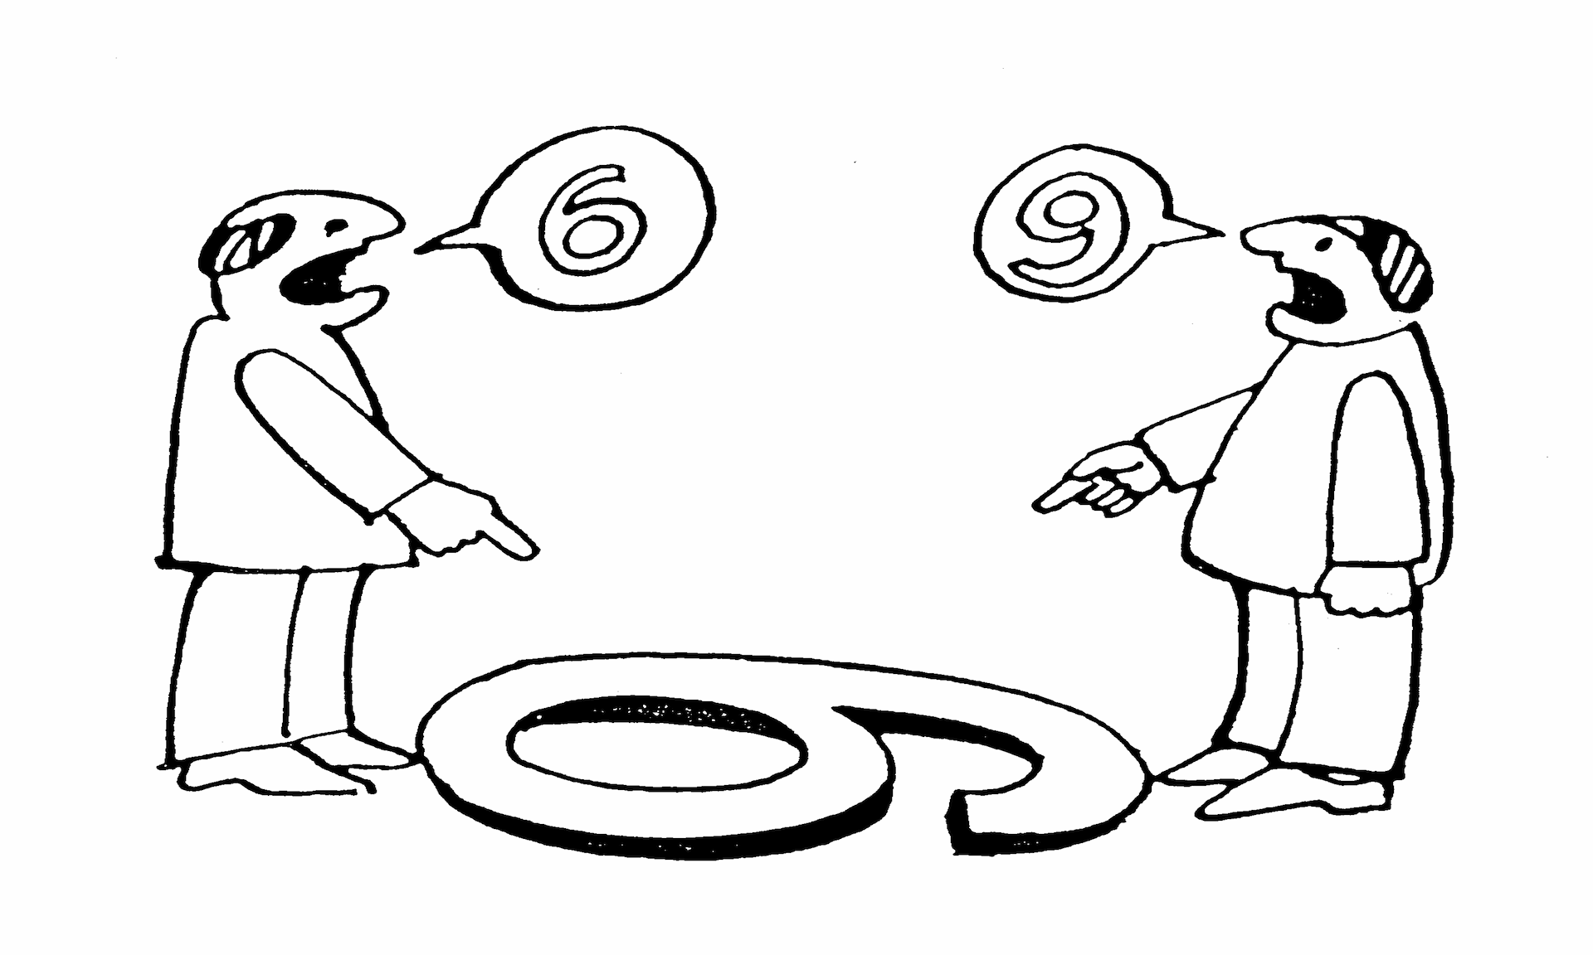
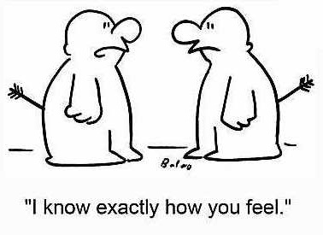
Connect
Understand
Communicate

Slide 23

Preparation
CONNECT
Prepare yourself
Prepare your information
Prepare your environment

Slide 24
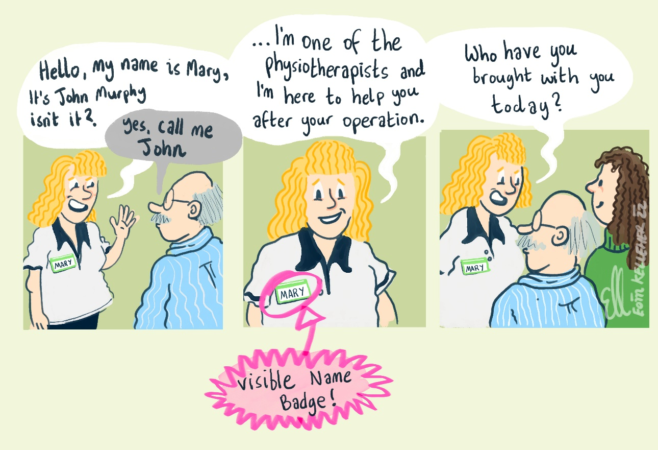
Greetings and introductions
CONNECT

Slide 25

Nonverbal communication
“
The most important thing in communication is hearing what isn’t said
PETER DRUCKER
1909 - 2005

Slide 26






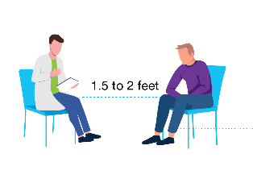
Nonverbal communication
NONVERBAL
MOVEMENT
TOUCH
PARALANGUAGE
SPACE
TIME
PERSONAL PRESENTATION
ENVIRONMENT

Slide 27
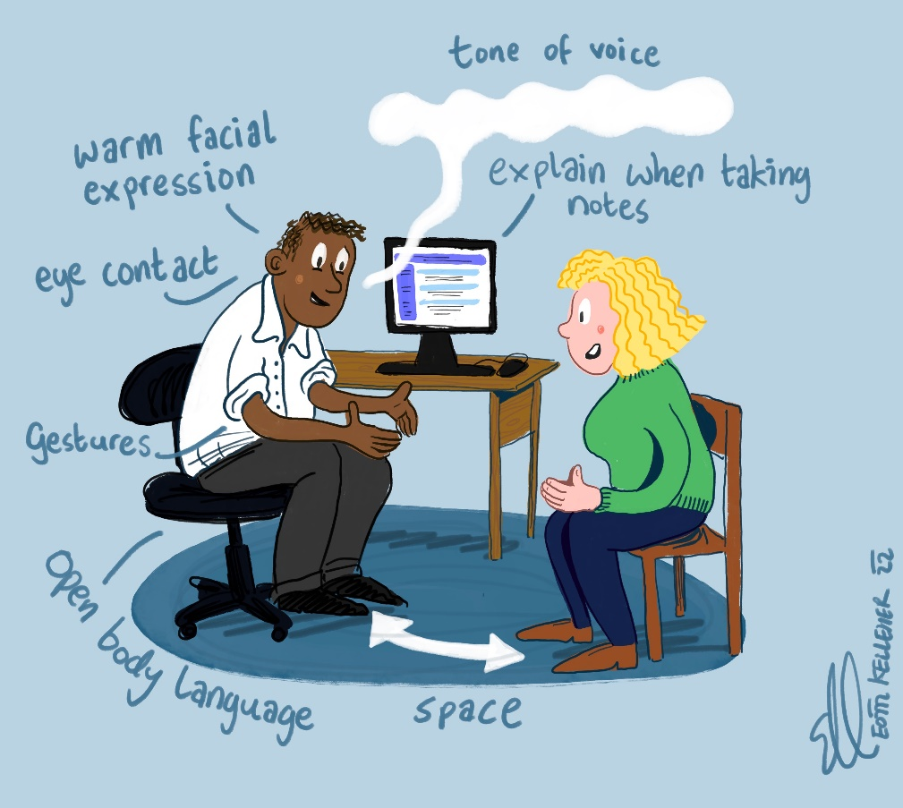
Our nonverbals
CONNECT

Slide 28
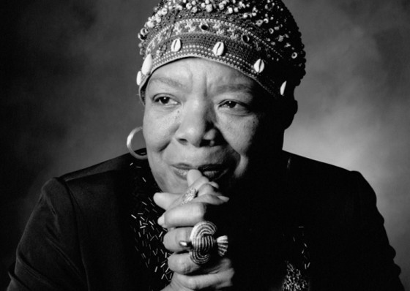
Empathy
“
I've learned that people will forget what you said, people will forget what you did, but people will never forget how you make them feel
MAYA ANGELOU
1928 - 2014

Slide 29

What is empathy?
CONNECT
Emotional component
  Reading and recognising other people’s emotions
Cognitive component
  Giving name to the emotion
Motivational component
  Exploring next steps

Slide 30
When you notice emotion
CONNECT
Section 3
G
Get it’s emotion
Pause…when you notice emotion. Don’t answer feelings with facts.
Identify the emotion
‘I hear that you’re frustrated.’ ‘I can see that you are worried’.
Validate
‘This is a lot to hear. Yes, it is scary’.
Explore
‘Tell me more – what are you most worried about?’
I
V
E

Slide 31
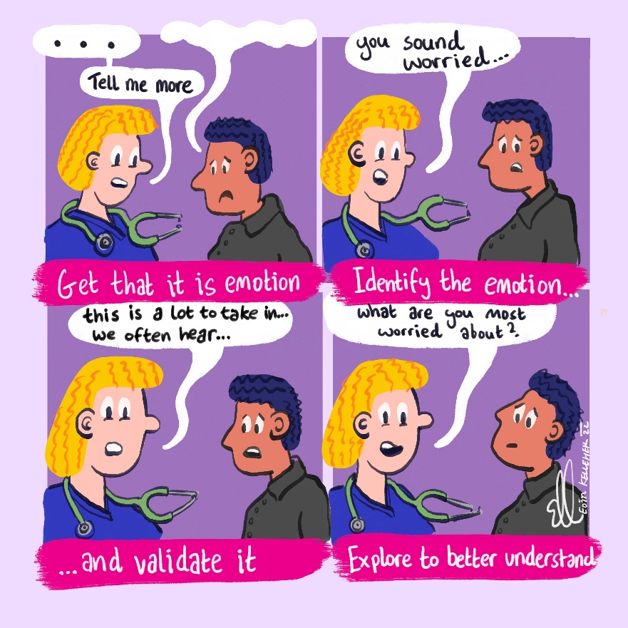
RESPOND WITH EMPATHY (G.I.V.E)
CONNECT

Slide 32
Empathic listening
UNDERSTAND
Section 2
Patient
“I am really worried about the procedure tomorrow.”
Clinician
“So you are worried about the procedure…can you tell me more about what is worrying you…?”

Slide 33
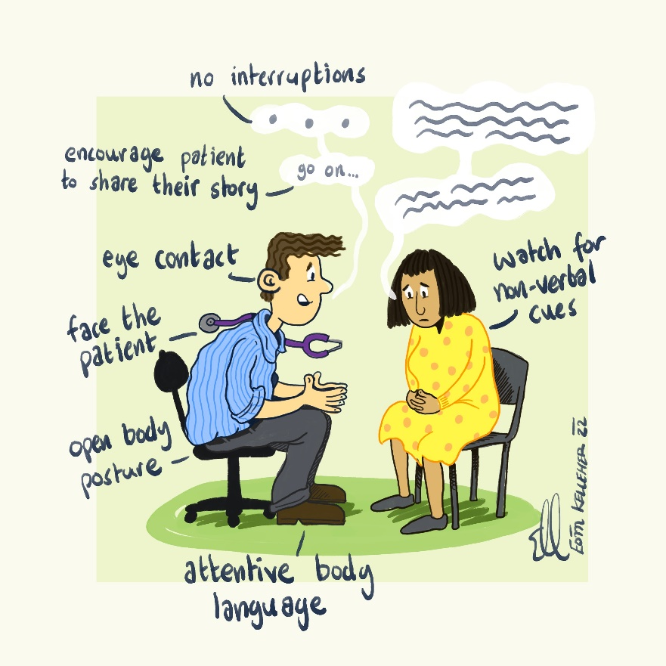
Active listening
UNDERSTAND

Slide 34
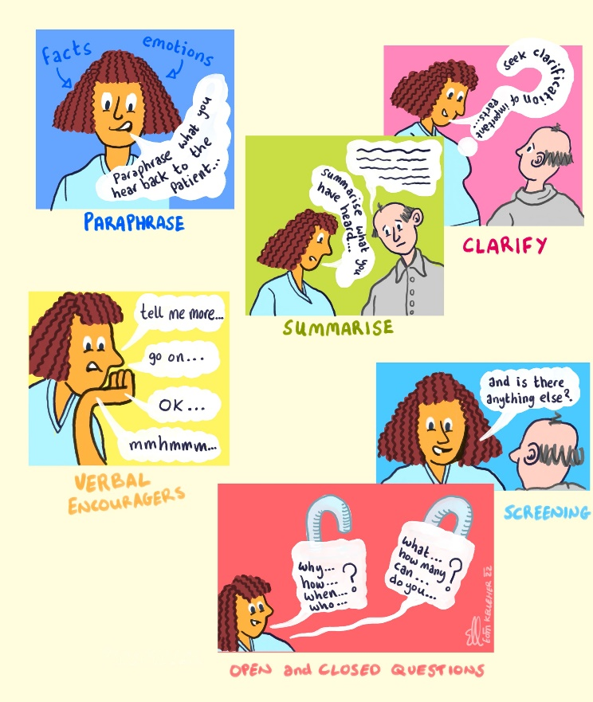
Empathic listening
UNDERSTAND

Slide 35

Communication skills
COMMUNICATE
ASK/TELL/ASK
Check starting point
Chunk
Pause
Check
Repeat
Pace
Avoid jargon

Slide 36

Closing the conversation
COMMNICATE
Agree next steps
Emphasise support
Safety-netting
Summarise
Final check
Before you leave, let’s recap. What are the 3 main things…

Slide 37

So to summarise…
Prepare
Connect
Understand
Communicate
Close the conversation

Slide 38


Activity 3: Managing Formal Open Disclosure
Key learning:
The importance of preparation for this meeting.
How the role of all members of the team e.g. lead discloser, deputy discloser and designated person support the open disclosure process
Awareness of the resources available i.e. Quick Reference Guide (including meeting checklist, template to record meeting and sample language) to support the meeting
The management of situations that may arise during the meeting.

Slide 39
Activity 3: Managing Formal Open Disclosure
Team A will be the Open Disclosure Team who will prepare for the meeting and conduct the formal open disclosure meeting.
Team B will identify a family member and support person from their group and remaining members will observe this role play.
Teams will have 5 minutes to prepare and 7 minutes for this meeting.

Slide 40

Activity 3: Group Discussion
Those involved in the role play will outline:
What did you expect would happen in this formal meeting?
What happened that you did not expect?
The learning have you gained from this exercise?
What would they do differently next time?

Slide 41
Activity 3: Group Discussion
The role play observers will outline:
Were the issues that arose managed adequately during the meeting?
How the roles of the Team members including the Designated Person impacted on this meeting?

Slide 42
Documentation of Meeting
Sample Documentation Template may be used
The record of the meeting must be maintained and a copy sent to the patient/ relevant person: including information such as the names of everyone attending, information provided, the apology, actual and potential consequences, agreed care/ treatment plan and actions agreed.
Record any patient care details in Patient Healthcare Record and the formal meeting record in the Incident Management/Open Disclosure file.
Record on NIMS or other system

Slide 43


Maintaining the Ethos of Open Disclosure
Open Disclosure: Maintaining our Values: Care, Compassion, Trust and Learning
Open Disclosure: The right thing to do.
Open Disclosure : What we would expect for ourselves or for a loved one.
Open Disclosure: The professional, ethical and humane response.
Open Disclosure: The empathic response to all those involved in and/or affected by patient safety incidents .

Slide 44


Open Disclosure Resources
HSE Open Disclosure Policy
RCPI “Gateway to Communication” programme
  https://courses.rcpi.ie/product?catalog=Gateway-to-Communication
Numerous Resources on Website including Quick Reference Guide, role and checklist for Designated person, pre/ during and post meeting checklists, patient experience survey and patient leaflet : www.hse.ie/opendisclosure
National Office: opendisclosure.office@hse.ie

Slide 45



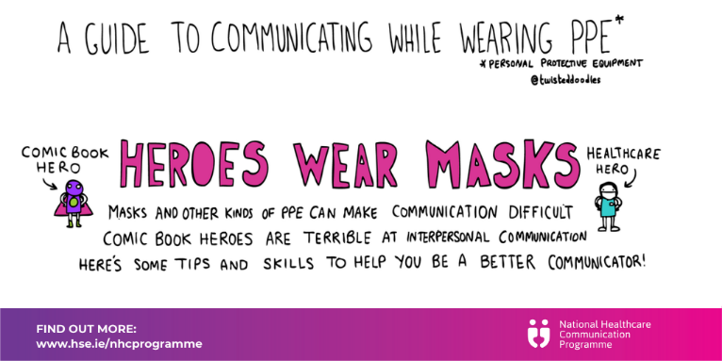

Enhance your communication skills
Section 3
SAFET & TRUST

Slide 46

Find out more
Move to a culture where communication upskilling is an essential component of continuous professional development for all healthcare workers.
Contact: Winifred Ryan and Peter Gillen
Email: Winifred.Ryan@hse.ie and pgillen@rcsi.ie
Web: www.hse.ie/nhcprogramme &www.each.eu
Twitter: @NHCProgramme

Slide 47

Evaluation of workshop
Thank you and close

