Slide 1

HSE National Open Disclosure Programme
Skills Workshop

Slide 2

Welcome and Introductions
Welcome to today’s workshop:
Introductions
Housekeeping
Participant self-reflection
CPD
Workshop Objectives
Ways of working
Resource pack

Slide 3
Objectives
The aim of this Face to Face workshop
To build the capacity of attendees to prepare for and manage open disclosure meetings with patients, services users and their relevant person following patient safety incidents. This is a follow on module to the Open Disclosure E- learning Modules 1 and 2.
By the end of the workshop participants will:
Be more knowledgeable about the National Open Disclosure programme including relevant legislation and resources.
Recognise the impact of communication and importance of being empathic, person centred and be more aware of their own communication style.
Have an opportunity to practice the key skills required to effectively manage an open disclosure meeting to get the best outcome for the patient/ relevant person and staff involved.
Be more confident in managing the open disclosure process and associated challenges as part of a team.
Be aware of the patient perspective, the support needed and supports available for them.
Recognise the importance of team dynamics, support for each other and their own support needs throughout the open disclosure process.

Slide 4
Context of the Open Disclosure Programme
A. Legislation:
The Patient Safety (Notifiable Incidents and Open Disclosure) Act 2023 makes provision for mandatory open disclosure of a number of incidents, called ‘notifiable incidents’.
The above plus Part 4 of the Civil Liability (Amendment) Act 2017 outlines how protections can be sought by healthcare practitioners for the information and apology at an open disclosure meeting
B. Regulatory:
Healthcare regulators such as HIQA, the Chief Inspector for Social Services and the MHC require health and social care providers to be open and fully inform patients/their relevant person of an incident.
Reporting notifiable incidents to the relevant regulators is also a legal requirement as per the Patient Safety (Notifiable Incident and Open Disclosure) Act 2023. The relevant regulator must be notified within 7 calendar days from when a health or social care services provider is satisfied that a notifiable incident has occurred. HSE and HSE-funded services must use the National Incident Management System (NIMS) to notify the relevant regulator of the notifiable incident.
C. The Department of Health National Open Disclosure Framework 2023
It applies to all public and private health service providers, healthcare regulators, professional regulators, academic organisations and training bodies. The Framework describes open disclosure as it applies to all patient safety incidents and adverse events.

Slide 5
Context of the Open Disclosure Programme
D. Professional regulation: Professional healthcare regulators such at the Medical Council, Nursing and Midwifery Board Ireland and CORU amongst others have incorporated the requirement for open disclosure in their various codes of conduct, ethics and practice.
E. The HSE Open Disclosure Policy: It is the policy of the HSE and HSE-funded services that staff will:
Communicate with patients in an open, honest, transparent and empathic manner following patient safety incidents and a notifiable incident as described in the Patient Safety (Notifiable Incident and Open Disclosure) Act 2023.
Provide patients with a sincere and meaningful apology when they are harmed as a result of a patient safety incident or notifiable incident.
Begin, and continue, this communication process in a timely manner.
F. Mandatory training: Open Disclosure Training is mandatory for all staff with refresher training required every 3 years.

Slide 6
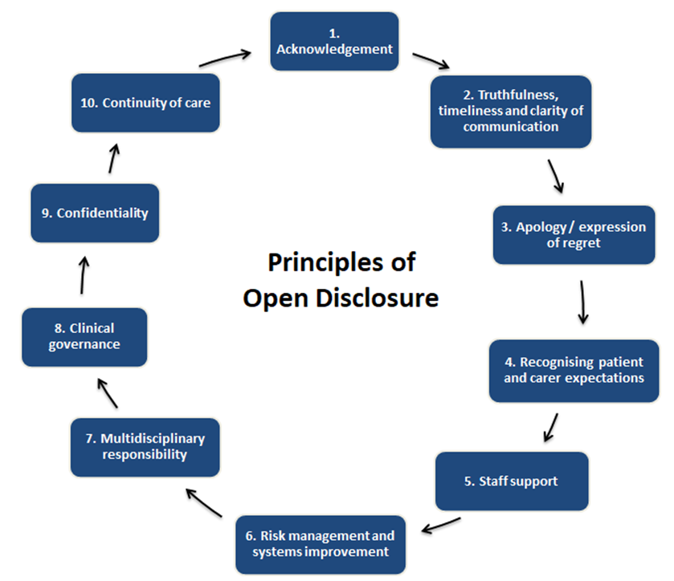
The Principles for the Management of Open Disclosure
Acknowledgement
Truthfulness, timeliness and clarity of communication
Apology/Expression of Regret
Recognise Patient and Carer expectations
Staff Support
Risk Management and Systems Improvement
Multidisciplinary Approach
Clinical and Corporate Governance
Confidentiality
Continuity of Care
CARE COMPASSION TRUST AND EMPATHY
The principles for the management of open disclosure
8. Clinical and Corporate Governance

Slide 7


Principles of the Incident Management Framework
Six key principles of a responsive and proportionate approach to the management of an incident:
Principle 1: Person- centered
Principle 2: Fair and Just
Principle 3: Open and Transparent
Principle 4: Responsive
Principle 5: Improvement focused
Principle 6: Learning
Six key principles of a responsive and proportionate approach to the management of an incident:
Principle 1- Person-centered
Principle 2 – Fair and Just
Principle 3 – Open and transparent
Principle 4 – Responsive
Principle 5 –Improvement focused
Principle 6 - Learning

Slide 8

Incident Management Process
1. Prevention through supporting a culture where safety is considered a priority.
2. Identification and immediate actions required (for persons directly affected and to minimise risk of further harm to others).
3. Initial reporting and notification.
4. Assessment and categorisation.
5. Review and analysis.
6. Improvement planning and monitoring

Slide 9
Legislation
Civil Liability (Amendment) Act 2017
(Part 4)
Commenced September, 2018
(further amended with the enactment of the PSA)
Patient Safety (Notifiable Incidents and Open Disclosure) Act 2023
Commenced 26 September 2024
Key Patient Safety Act provisions include:
Mandatory open disclosure for the 13 notifiable incidents (NIs)
Reporting NIs to the relevant regulator, via NIMS
Communicating to patients the results of the review of their cancer screening
New protections in relation to the use of clinical audit data

Slide 10
Civil Liability (Amendment) Act 2017 (CLA)
Availing of the protections of this Act is voluntary
The Patient Safety Act 2023 further amends the CLA 2017 and aligns the open disclosure process described in both pieces of legislation.
In contrast to the Patient Safety Act 2023, the CLA 2017 applies to all patient safety incidents that are not notifiable incidents. Additionally, staff can choose to apply the CLA 2017 and its application is not legally mandated.
Staff can choose to apply the CLA 2017 where they want to seek the protections of the CLA 2017.
Protective legislative provisions in Part 4 of the CLA
Information provided and an apology given at an open disclosure meeting:
shall not constitute an express or implied admission of fault or liability in relation to the incident or any clinical negligence action arising from the incident
will not be admissible as evidence of fault or liability in Court in relation to the incident or clinical negligence action arising from the incident
will not invalidate the indemnity or insurance cover of the health service provider
shall not constitute an express or implied admission of fault, professional misconduct, poor professional performance or unfitness to practice in relation to any complaint made by the patient to a regulatory body subsequently.
shall not be admissible as evidence of fault, professional misconduct, poor professional performance, unfitness to practise a health service, or other failure or omission, in proceedings to determine a complaint, application or allegation

Slide 11
Amendment to the Civil Liability (Amendment) Act 2017 (CLA)
Part 4 of the Civil Liability (Amendment) Act 2017 has been revised to align it with the provisions of the Patient Safety Act and the legal protections provided within that Act.
The key difference is that the written communication following open disclosure must reference that the open disclosure meeting was held in compliance with Part 4 of the Civil Liability Amendment Act and the HSE Open Disclosure Policy 2024. Similar to the Patient Safety Act this must be shared within 5 calendar days, following the meeting.
The Patient Safety Act commenced on 26th September 2024, therefore the revised process for the CLA applies to all patient safety incidents which occur on or after 26th September 2024, if staff involved wish to seek the protections.
For any patient safety incidents which occurred before 26th September 2024, the previous process and the Civil Liability Regulations 2018 (Prescribed Statements) applies, if staff involved wish to seek the protections.

Slide 12
The Patient Safety Act provides a legal framework for:
the mandatory open disclosure, by health services providers, of certain incidents occurring in the course of the provision of a health service to a person. Specifically, the Act describes 13 different incidents, termed notifiable incidents, whereby open disclosure must take place in line with the legislation;
organisations to report notifiable incidents to regulators, specifically the Health Information and Quality Authority, Chief Inspector of Social Services and the Mental Health Commission, and it requires such notifications to be made via the National Incident Management System (NIMS);
legal protection in relation to the information shared at the time of open disclosure and any apologies made in the course of such disclosures;
provisions for procedures in respect of clinical audit, and the data obtained in clinical audits;
amendments to the Health Act 2007 to adapt the threshold for Health information and Quality Authority (HIQA) to carry out statutory investigations and expansion of monitoring into private hospitals.
Not commencing at this time - the discretionary power of the Chief Inspector to conduct a review of specified incidents that may have resulted in death or serious injury where some or all of the care was delivered in a designated centre such as a nursing home.
amendments to Part 4 of the Civil Liability (Amendment) Act 2017.
the mandatory (communication/open disclosure), by health services providers, of reviews carried out in relation to cancer screening that were requested by the patient (breast, bowel and cervical screening);

Slide 13
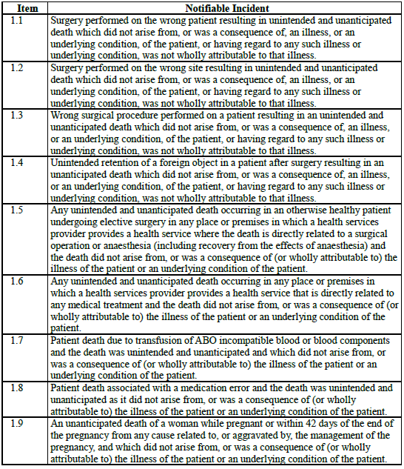
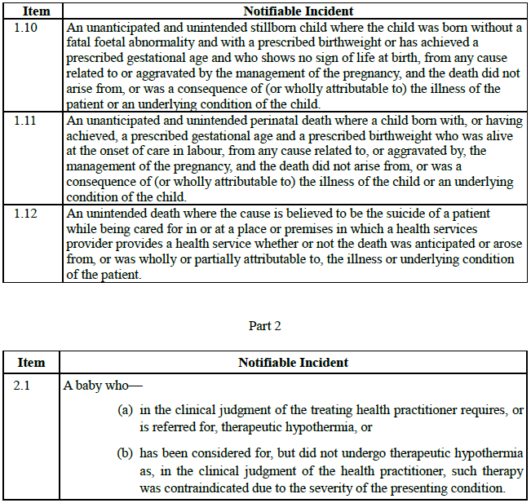
Schedule 1: Notifiable Incidents
Patient Safety (Notifiable Incidents and Open Disclosure) Act 2023
Schedule 1
Notifiable Incidents Part 1 and 2

Slide 14

Notifiable Incidents
List of Current Notifiable Incidents (13 in total) in PSA
Unintended and unanticipated patient death which did not arise from/was a consequence of an illness/underlying condition, including:
  Surgery performed on the wrong patient
  Surgery performed on the wrong site
  Wrong surgical procedure
  After unintended retention of foreign object after surgery
  Undergoing elective surgery where the death is directly related to the surgical operation or anaesthesia (including recovery from the effects of anaesthesia) in otherwise well patient
  Directly related to any medical treatment
  Due to transfusion of ABO incompatible blood or blood components
  Associated with a medication error

Slide 15
Notifiable Incidents (continued)
List of Current Notifiable Incidents (13 in total) in PSA
NOTE: The Minister has reserved the right to make further regulations (additions to the list)
Unanticipated death of a woman while pregnant or within 42 days of the end of pregnancy from any cause related to, or aggravated by, the management of the pregnancy
Stillborn child born without fatal foetal abnormality and with a prescribed gestational age or birth weight, and who shows no sign of life at birth, from any cause related to or aggravated by the management of the pregnancy, not related to underlying condition of the child
Perinatal death of a child born with, or having achieved, a prescribed gestational age and a prescribed birthweight who was alive at the onset of care in labour, from any cause related to, or aggravated by, the management of the pregnancy, not related to an underlying condition
Unintended death where the cause is believed to be the suicide of a patient while being cared for in or at a place or premises in which a health services provider provides a health service
A baby who, in the clinical judgement of the health practitioner:
  requires or is referred for therapeutic hypothermia,
  or has been considered for, but did not undergo therapeutic hypothermia as such therapy was contraindicated due to the severity of the presenting condition.

Slide 16
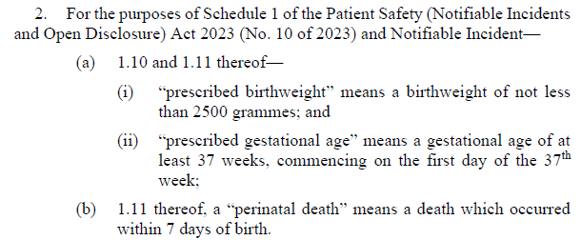
Patient Safety (Notifiable Incidents and Open Disclosure) Regulation - Statutory Instrument 501/2024
These Regulations define “prescribed birthweight” and “prescribed gestational age” for the purposes of Notifiable Incident 1.10 and 1.11 in Schedule 1 of the Patient Safety (Notifiable Incidents and Open Disclosure) Act 2023, only.

Slide 17
Notification Requirements of the Patient Safety Act 2023
The provisions of the 2023 Act define the reporting obligations of health, mental health, and social care services.
From commencement, community mental health services will no longer be required to submit notifications to the MHC through CIS.
The 2023 Act requires community mental health services to submit the notification of a notifiable to HIQA.
Health and care services provider | Regulator to notify
Approved centre | Mental Health Commission
Designated Centre | The Chief Inspector of Social Services
All other health and care settings (including community mental health services) | HIQA

Slide 18
Managing the Open Disclosure of a Patient Safety Incident or Notifiable Incident
Arrange for the Open Disclosure to the relevant person:
Who makes the Open Disclosure? The patient’s principal healthcare practitioner or another healthcare practitioner deemed appropriate
Who is the open disclosure made to? Patient, their Relevant Person or Patient and their Relevant Person
When (Timing of Open Disclosure)
  As soon as practicable and as deemed appropriate by health services provider
  It is not necessary to know all of the information relating to the incident to initiate this meeting.
Preparation for Open Disclosure:
Preparation: Make an assessment of all the circumstances of the patient and nature of the incident
Consult with any person as appropriate.
Consider who the open disclosure will be made to.
Determine whether it is appropriate for an apology to be made
Consider how the information can be relayed in a manner that is clear and understandable
Appoint a Designated Person

Slide 19
Managing the Open Disclosure of a Patient Safety Incident or Notifiable Incident
Preparation for Open Disclosure (continued)
Appointment of a Designated Person:
  Designate a person to liaise with the patient and/or relevant person
  This designation must be made in writing and kept on record
  The designated person will assist the patient/relevant person in preparing for and attending the open disclosure meeting
How an Open Disclosure is made:
  Generally the open disclosure meeting is to be held in person with the patient/relevant person
  The patient/relevant person can request (orally) to have the meeting other than in person e.g. telephone, virtual – this request must be recorded in writing by the health services provider and kept on record.

Slide 20
ASSIST Model
The Open Disclosure Process using the MPS
ASSIST Model of Communication
A – Acknowledge – what has happened and the impact
S – Sorry – express regret
S – Story – hear their story and summarise back to them
I – Inquire – seek questions to be answered, provide answers,
give information
S – Solution – seek their agreement for the way forward – agree a plan
T – Travel – avoid abandonment – outline plan for their continued care and contact arrangements

Slide 21

Role Play Activities
Warning
During this workshop, we will be discussing some challenging conversations and scenarios. These may echo with some experiences in your life which may be upsetting. If this happens, please feel free to let us know, to take time out from the workshop as required.

Slide 22
Activity 1: Managing Open Disclosure for no or minor harm patient safety incidents
Managing Open Disclosure for incidents of no harm or minor harm using the ASSIST Model of Communication
Where a minor harm patient safety incident is reported, or in some instances no harm incidents, then a low level response is required (predominately Category 3 incidents as per the HSE Risk Impact Table). A low level response may involve just one meeting to discuss what has happened. The need for a further meeting can be assessed at this meeting in discussion with the patient/relevant person.
Key Learning:
Participants have an opportunity to use the ASSIST Model of Communication to support and guide an open disclosure discussion with a patient following a low level incident.

Slide 23

Activity 1- Role Play
Please break into groups of three.
Conduct the role play in your group with each group member playing each role in this activity.
Identify roles of patient / service user, discloser and observer using the role sheets provided.
Conduct a 3 minute role play followed by 2 minute discussion and then rotate roles and repeat.

Slide 24
Activity 1- Group Discussion
What communication skills did you observe that supported the process?
How do you feel the ASSIST Model supported the interaction between the discloser and the patient/ service user/relevant person?
How will this meeting be documented?

Slide 25
Activity 2: The Open Disclosure Process
Managing the Open Disclosure Process following a Patient Safety Incident resulting in harm or a Notifiable Incident
A high level response involves the full open disclosure process and is initiated for patient safety incidents where the patient has suffered a moderate or higher level of harm (i.e. Category 1 and Category 2 Incidents as per the HSE Risk Impact Table).
This approach will also be implemented following the identification of a notifiable incident, and will follow the process set out in the Patient Safety Act.
This level of response may involve an initial discussion with the patient to acknowledge that a patient safety incident or notifiable incident has occurred followed by further OD meeting(s) to update the patient as additional information becomes available.

Slide 26


Activity 2: Managing Emotions
Focus on managing the emotions and feelings of all those affected
Prioritise the immediate clinical needs of the patient
Consider the importance of being aware of the impact of patient safety incidents on the staff involved and the management of their emotions/feelings.
Consider how the ASSIST ME model of staff support may be used to support a colleague.
Demonstrate awareness of the emotional needs of the patient/ relevant person following patient safety incidents and how to respond to their needs with compassion and empathy.
Consider the key communication skills involved.

Slide 27
Activity 2: Managing Emotions
Two Groups
Review scenario and time allocated: 10 minutes
Group A to:
Review role card, consider this incident from the perspective of the staff member(s) involved, the impact on them, possible reactions and use of the ASSIST Me Model of staff support.
Group B to:
Review role card, consider the impact of this incident on the patient / service user (emotional, psychological, social and physical impact) and their reaction and what communication skills the disclosure team will need to use to manage the various reactions/responses.
Conduct a 5 minute Role Play of the initial discussion with family.

Slide 28
Activity 2: Group discussion
What communication skills were used during the role play to manage the patient’s/relevant person’s emotions and responses?
How do the team support each other before and during this meeting?
How does the ASSIST ME Model of staff support assist the management of emotions?

Slide 29



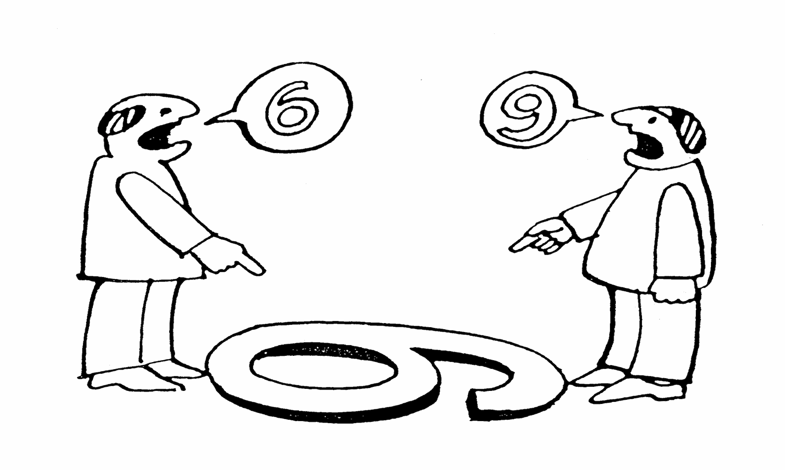
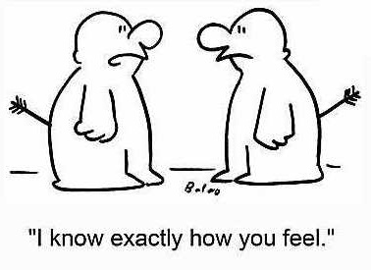
Connect
Understand
Communicate

Slide 30

Preparation
CONNECT
Prepare yourself
Prepare your information
Prepare your environment

Slide 31

Nonverbal communication
“
The most important thing in communication is hearing what isn’t said
PETER DRUCKER
1909 - 2005

Slide 32
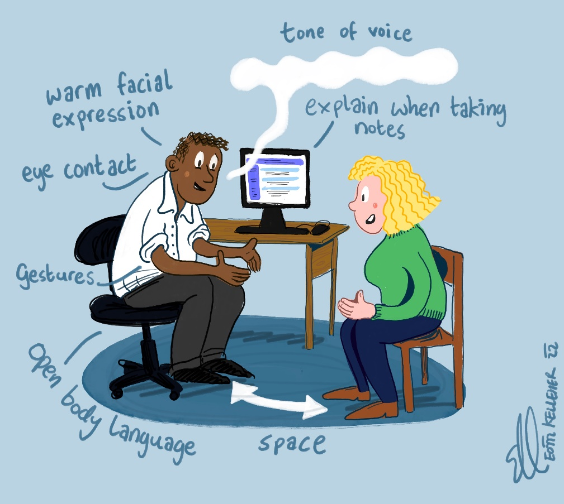
Our nonverbals
CONNECT

Slide 33

Empathy
“
I've learned that people will forget what you said, people will forget what you did, but people will never forget how you make them feel
MAYA ANGELOU
1928 - 2014

Slide 34
When you notice emotion
CONNECT
Section 3
G
Get it’s emotion
Pause…when you notice emotion. Don’t answer feelings with facts.
Identify the emotion
‘I hear that you’re frustrated.’ ‘I can see that you are worried’.
Validate
‘This is a lot to hear. Yes, it is scary’.
Explore
‘Tell me more – what are you most worried about?’
I
V
E

Slide 35

Communication skills
COMMUNICATE
ASK/TELL/ASK
Check starting point
Chunk
Pause
Check
Repeat
Pace
Avoid jargon

Slide 36

Closing the conversation
COMMNICATE
Agree next steps
Emphasise support
Safety-netting
Summarise
Final check
Before you leave, let’s recap. What are the 3 main things…

Slide 37


Activity 3: Managing the Open Disclosure Meeting
Key learning:
The importance of preparation for this meeting.
How the role of all members of the team e.g. lead discloser, deputy discloser and designated person support the open disclosure process
Awareness of the resources available i.e. Quick Reference Guide (including meeting checklist, template to record meeting and sample language) to support the meeting
The management of situations that may arise during the meeting.
Additional steps required to comply with legislation

Slide 38
Activity 3: Managing the Open Disclosure Meeting
Team A will be the Open Disclosure Team who will prepare for the meeting and conduct the formal open disclosure meeting.
Team B will identify a family member and support person from their group and remaining members will observe this role play.
Teams will have 5 minutes to prepare and 7 minutes for this meeting.

Slide 39

Activity 3: Group Discussion
Those involved in the role play will outline:
What did you expect would happen in this meeting?
What happened that you did not expect?
The learning have you gained from this exercise?
What would they do differently next time?

Slide 40
Activity 3: Group Discussion
The role play observers will outline:
Were the issues that arose managed adequately during the meeting?
How the roles of the Team members including the Designated Person impacted on this meeting?

Slide 41
Open Disclosure of a Notifiable Incident:
compliance with legislation
The Open Disclosure Process in the Act for Notifiable Incidents is closely aligned with HSE Open Disclosure Policy for Patient Safety Incidents
There are some additional requirements under the legislation as follows:
Notification of Notifiable Incidents to the relevant regulatory body within 7 days from when the health services provider is satisfied that a notifiable incident has occurred in the course of the provision of health services via the National Incident Management System
Legal requirement for appointment of a designated person.
Written statement/record of the open disclosure meeting to be provided at the meeting or within 5 days of the meeting happening.
Record keeping legal requirements throughout all stages of the process.
Offences and Penalties apply for non compliance.

Slide 42
Documentation of Meeting
Sample Documentation Templates available
The record of the meeting must be maintained and a copy sent to the patient/ relevant person: including information such as the names of everyone attending, information provided, the apology, actual and potential consequences, agreed care/ treatment plan and actions agreed.
The patient safety incident or notifiable incident must be recorded in the patient’s healthcare record. This includes any record of the open disclosure meeting(s).
Record on NIMS

Slide 43


Maintaining the Ethos of Open Disclosure
Open Disclosure: Maintaining our Values: Care, Compassion, Trust and Learning
Open Disclosure: The right thing to do.
Open Disclosure : What we would expect for ourselves or for a loved one.
Open Disclosure: The professional, ethical and humane response.
Open Disclosure: The empathic response to all those involved in and/or affected by patient safety incidents .

Slide 44


Open Disclosure Resources
HSE Open Disclosure Policy
Numerous Resources on Website including Quick Reference Guide, role and checklist for Designated person, pre/ during and post meeting checklists, patient experience survey and patient leaflet : www.hse.ie/opendisclosure
National Office: opendisclosure.office@hse.ie

Slide 45



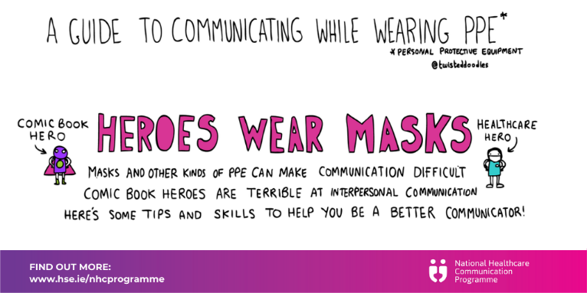

Enhance your communication skills
Section 3
SAFET & TRUST

Slide 46

Find out more
Move to a culture where communication upskilling is an essential component of continuous professional development for all healthcare workers.
Contact: Winifred Ryan and Peter Gillen
Email: Winifred.Ryan@hse.ie and pgillen@rcsi.ie
Web: www.hse.ie/nhcprogramme &www.each.eu
Twitter: @NHCProgramme

Slide 47

Evaluation of workshop
Thank you and close

