Slide 1

Do’s and Don’ts of Measment for Improvement

Slide 2
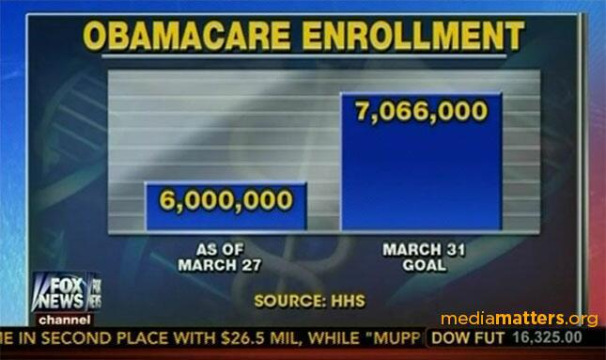
Do: Start the X-axis at Zero (Bar Charts)
The difference between the two columns is just under 18% - yet the 7 million plus column is almost three times the height of the 6 million column

Slide 3
Presenting data in tables
If the value is zero, Do show it
If there is no data available, then say ‘no data available’
With empty cells, it is impossible to know which of the two scenarios above apply.
No blank cells

Slide 4
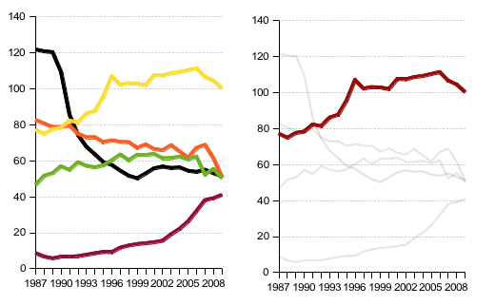
Do: Highlight what’s important
Tell one story. Don’t over-complicate unnecessarily.

Slide 5
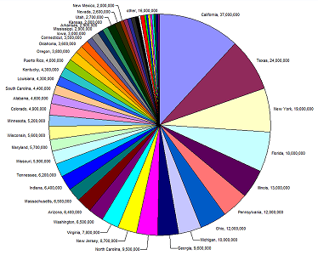
Don’t: use pie charts
It is difficult for us to interpret pie charts accurately
Tufte: “the only worse design than a pie chart is several of them.”

Slide 6
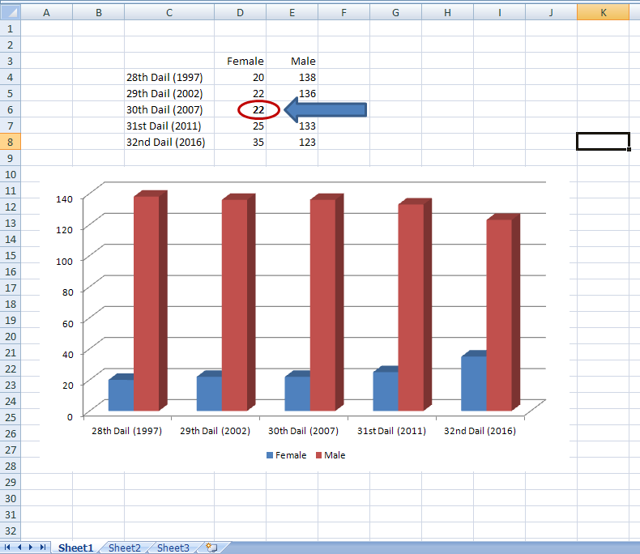
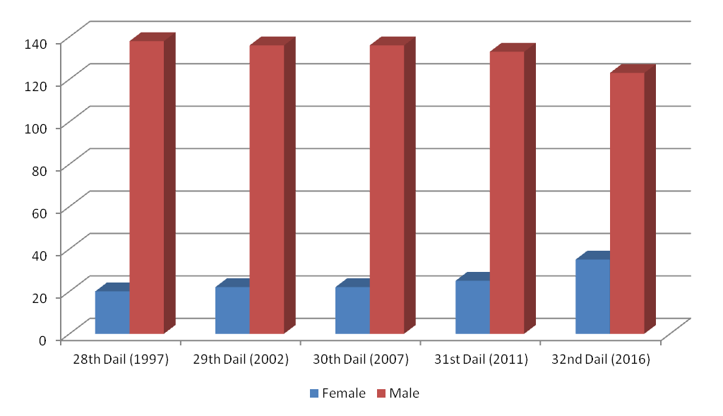
3D graphs
e.g. The number of Female and Male TDs
Q: How many Female TDs were elected to the 30th Dail (2007)?
A: 18 B: 19 C: 20 D: 22

Slide 7
Percentages
“The rate of surgical site infection decreased from 10% to 5%”
Q: Is this
  (a) a 5% decrease
  (b) a 5% increase
  (c) a 50% decrease
  (d) a 100% decrease

Slide 8
Don’t: calculate the average of the averages
Each average (or mean) is already a calculation
Note: for this reason, it is always important to store all your raw data, not just the average values.

Slide 9
% on a scale bar
If it is not possible to get more than 100%, then don’t have the upper limit of the scale bar at >100%

Slide 10
Calculating percentages
Change from 6% to 10%
  (10-6)/6*100 = 66.6% Increase
Change from 10% to 6%
  (10-6)/10*100 = 40% Decrease

Slide 11
Line graphs
Try and have your data in the middle third of the graph.
This rule would be overwritten by the need to use the same scale on a number of graphs that you present together

Slide 12
Using Colours in charts
Use different colours for different categories rather than for different values in a range
Don’t use too many colours on a single chart (ideally use 6 or less)
If the chart is to be included in a printed document or report, don’t rely on how it looks on a computer screen – test print to make sure the colours are distinguishable in print.

