Slide 1
Using Qualitative Methods in Quality Improvement
Dr. Gemma Moore PhD
QPS Intelligence
National Quality and Patient Safety Directorate
Health Service Executive

Slide 2
Outline
What are Qualitative Methods?
When to use in QI projects?
Steps using Qualitative Methods
Determine Purpose
Choose your Sample Size and Participants
Choose Appropriate Method
Determine Questions or Topic Guide
Gain Informed Consent
Gather Data
Analyse your Data: Thematic Analysis
Present your results

Slide 3
Qualitative Methods
Non-numerical information gathered to capture and understand people's experiences, thoughts, ideas & perspectives
Best way to capture patient and staff perspectives and voice
Qualitative Methods
Interviews
Focus Groups
Observation
Documentary Analysis
Visual Methods

Slide 4
Using Qualitative Methods in QI
Ideally used at all stages of improvement interventions from conceptualisation, implementation and evaluation
Useful for capturing insights into the ‘story’ or context behind quality improvement work and numerical measurement data
Eg. The challenges associated with a QI project
Eg. What worked well or what didn’t work?
Eg. Considerations for sustaining and spreading

Slide 5
1. Determine Purpose
Determine what you are trying to find out more about:
Ideas for QI projects
Capture patient or staff perspective, voice or ‘story’
Understand the context behind quality improvement work
Find out more about numerical measurement data
The challenges and enablers associated with a QI projects
The impact of a QI project
Notes:
Good way of including the voice of the patient
Curriculum Reference: 2.3 (i), 2.3 (ii)

Slide 6
2. Choose Sample Size and Participants
Sample size determined by purpose of the project, time, resources, sample accessibility or when data saturation is reached
A small number of in-depth interviews or focus groups will gather a large amount of rich data
3 main types of sampling:
Purposive Sampling
Sample chosen who fit criteria relevant to the purpose
Quota Sampling
Takes into account percentage of sample population
Snowball or Chain-Referral Sampling
Participants refer on to their contacts

Slide 7
3. Choose Appropriate Method
Qualitative Methods
Interviews
Focus Groups
Observation
Documentary Analysis
Visual Methods

Slide 8
Qualitative Methods and QI
Face-to-Face, Telephone or Video Call interviews following a set of pre-determined questions provide rich insights through in-depth discussion
Focus groups led by a facilitator are useful way for teams to discuss what went well, what didn’t go so well, learnings and opportunities for improvement in their QI projects
Observing a real situation can help to identify potential QI projects or understand any challenges associated with QI work is in real situations

Slide 9
Interview Types
Face-to-Face, Telephone or Video Call
Tape record with participant’s permission and/or take notes
Unstructured
Focus on a broad area for discussion
Semi-Structured
Common set of questions for each interview
Flexibility re order of questions
Follow up on topics that emerge
Structured or Focused Interview
Identical set of questions for each interview asked in the same order
Interviews provide rich insights through in-depth discussion

Slide 10
Focus Groups
A type of group interview, typically tape or video recorded (with permission) seeking to generate discussion among the group
Usually 5 to 13 participants (ideal = 6-8)
Typically less than 1 hour in length
Facilitator can follow a set of questions or topic guide
Can include tasks for the group to complete eg. ranking/prioritising a list, buzz groups, etc.
Focus groups useful way for teams to discuss their QI work to find out what went well, what didn’t go so well, learnings and opportunities for improvement

Slide 11
Facilitating Focus Groups
Encourage members of the group interact
Discussion stays focused on the topics
Don’t lead or influence the discussion
Aware of the group dynamics
Time management
Ensure all members participate
Managing disagreements
Facilitating tasks
Managing the discussion

Slide 12
Interview Skills
Use of Probes
Non-Verbal Messages
Sensitivity to Interviewer/ee Interaction
Listening Attentively without Passing Judgement
Without affecting neutrality
Re-Focusing and Mainlining Control
Encouraging Responses Non-Verbally
Flexibility
Purpose of interview to hear participant’s perspective, experience and views
If going off topic given limited time
To illicit further information & get examples
Researching up, across or ‘down’?
Establishing Rapport
Participant's body language if uncomfortable with a question
To not interrupt - eye contact, head nodding, ‘um huh’
To adapt to what emerges during the interview
Encouraging Responses
Expressions of understanding and interest, echoing their words, summarizing
Learning the Language
Sensitive to cultural setting and discourse commonly used

Slide 13
Observation
Observation is the act of observing a real situation and recording events as they happen
Can provide detailed rounded picture of phenomena or situation
Data recorded in situ
Rich data collected
Can help to identify potential QI projects or understand any challenges associated with QI work is in real situations

Slide 14
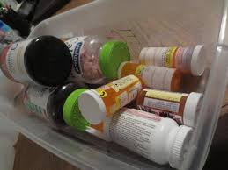
Other Methods
Narratives or Stories
Participant Diaries
Participant Photos
Document Analysis
Notes:
Participants can generate their own data capturing their views, insights, challenges and opportunities for improvement
Written records
Policy and guidelines
Numerical data (census of population or surveys)
Qualitative data (report & findings of other research)
Mass media: newspaper, TV, documentaries, films
Personal documents (letters, diaries)
Visual or audio material
Can provide insight into the context and background of quality improvement work

Slide 15
4. Write Questions or Topic Guide
Questions should help you answer your purpose
Develop questions in consultation with subject matter experts such as patients, clinicians and other staff
Determine whether different questions are required for different participants
Develop open questions to encourage discussion
Test out questions with some colleagues to ensure they are easy to understand

Slide 16
Open Questions
Can you tell me about...?
When did you notice...?
Why do you think that happened...?
What do you think...?
How did you know...?
Did that affect....?
How did you feel...?
What impact did that have on....?
Who else was there,
What did you see as the main...?
Where was that....?
What did you think....?
What happened then...?

Slide 17
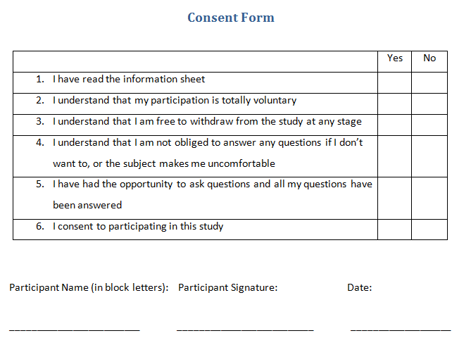
5. Gain Informed Consent
Invite participants to take part – voluntary informed participation
Provide information on the purpose of the interview, focus group etc
Explain how their data will be used, stored and who will view it
Provide a consent form they can sign
Provide opportunity for them to ask questions
Supply contact details so the can contact you at a later date

Slide 18
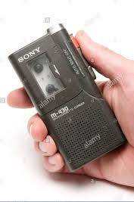
6. Gather Data
Arrange interview or focus group at a time and location convenient for participants
Ensure rooms are accessible for participants or travel to a location suitable for their requirements
Tape or video record when possible, or take notes
As soon as possible afterwards, make notes of what you remember and things you would like to follow up with other participants

Slide 19
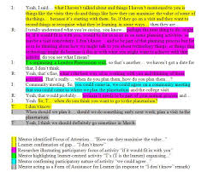
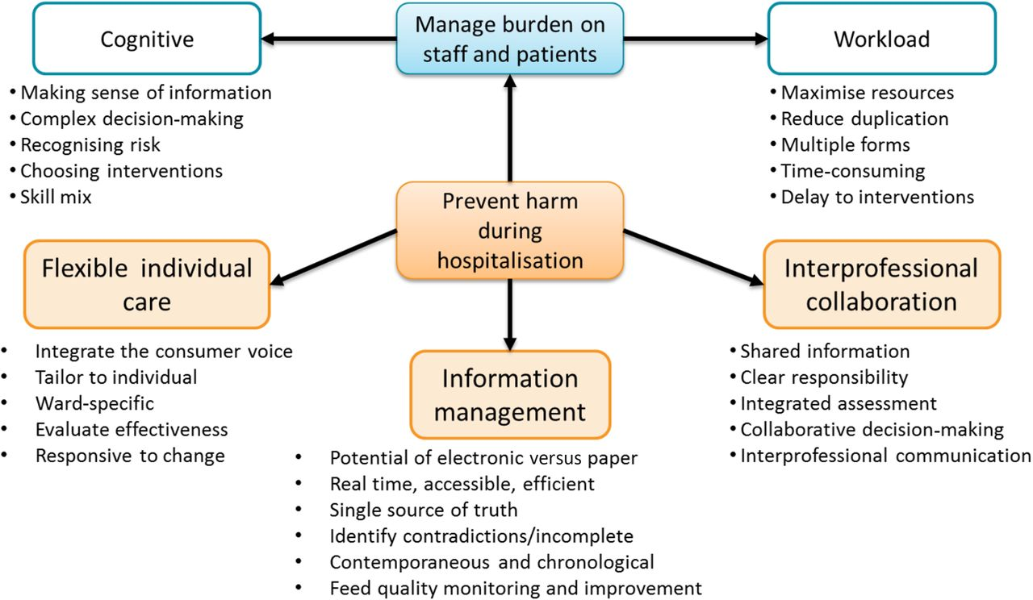
7. Analyse Data
Thematic Analysis
Read through data to become familiar
Make notes/memos of your thoughts as you go
Start developing initial codes
Refine codes as analysis progresses
Sort codes into groups or categories
Refine into themes

Slide 20
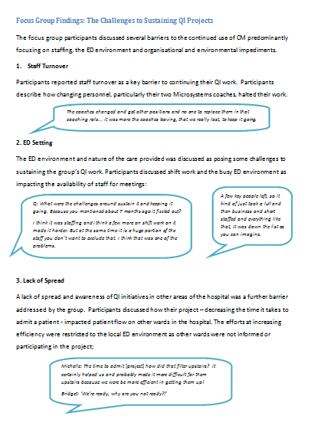
8. Report Qualitative Findings
Write up your analysis using quotes to illustrate

Slide 21
Thank You!
Email: gemma.moore2@hse.ie

