Slide 1
COVID-19 Vaccines
Direct Provision and Migrant Health service providers and support groups– 13th April 2021

Slide 2
Outline of talk

Slide 3
Why is it important to get a COVID-19 vaccine?

Slide 4
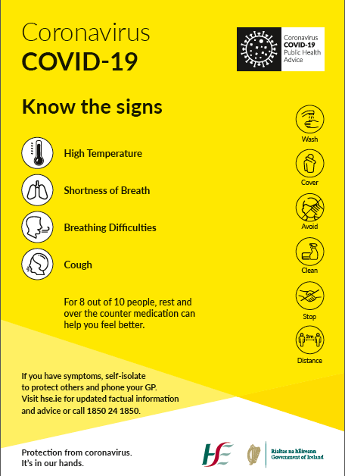
What we know about COVID-19
COVID-19 has been in Ireland since late February and early March 2020.
It usually causes symptoms like
Cough
High Temperature (38C or higher)
Shortness of Breath or difficulty breathing
Loss of Taste or Smell
For most people symptoms can be managed with rest and over the counter medication….BUT It can be more serious and result in people having to go to hospital and in some cases unfortunately die.

Slide 5
The impact of COVID-19 – Direct Provision
78 outbreaks of Covid-19 in Direct Provision, with approx. 772 cases up to end of March
Increase in outbreaks in Direct Provision since mid December ‘Wave 3’
Cross transmission – staff, healthcare workers, factory workers, community
Low hospitalisation rate: < 2.4%
No ICU or deaths from Covid-19

Slide 6
The light at the end of the tunnel…?
COVID-19 vaccines

Slide 7
Another weapon in our armour
Handwashing
Covering our coughs and sneezes
Face coverings
Keeping our distance
5. COVID-19 Vaccines

Slide 8
How do vaccines work?

Slide 9
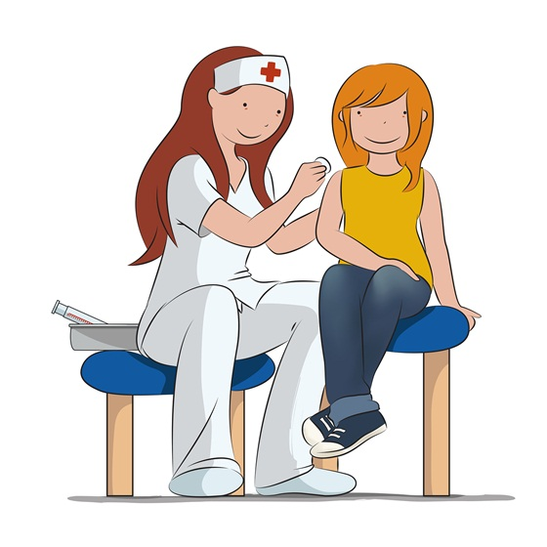
Vaccines are like a personal trainer for your immune system!
Vaccines “train” your immune system by teaching it how to react to a particular germ or invader.
Vaccines stimulate your immune system and get it working hard to protect you!
If you do come across the virus in future, your immune system will respond faster.

Slide 10
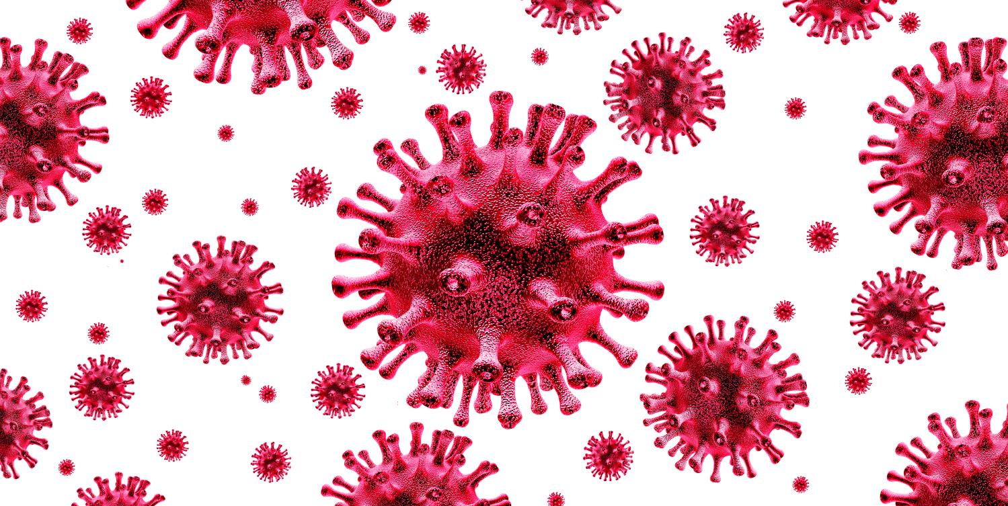

Slide 11
What types of COVID-19 vaccines are there?

Slide 12
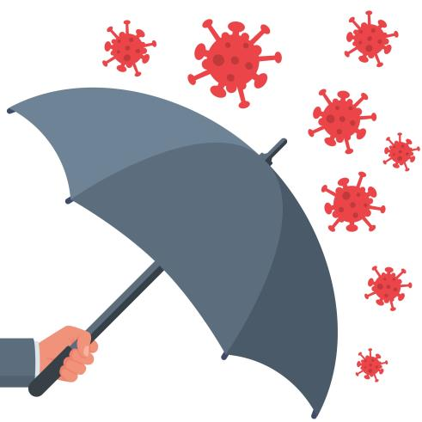
Types of vaccines against COVID-19
Currently in Ireland there are 4 COVID-19 vaccines being used:
mRNA Vaccines:
Pfizer/BioNTech
Moderna vaccines
Viral vector vaccines:
Oxford/Astra Zeneca,
Janssen (J&J) vaccine
All the vaccines in use in Ireland have gone through very close testing, review and ongoing monitoring by the European Medicines Agency to make sure they are safe and they work.

Slide 13
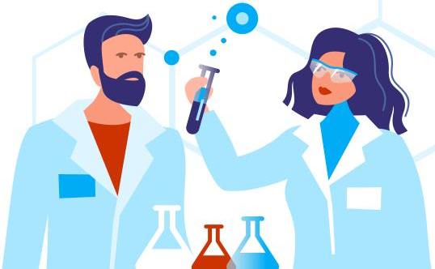
Update to Astra Zeneca COVID-19 Vaccine
In March 2021, a number of European countries reported small number of unusual blood clots and low levels of a blood cell involved in clotting (platelets) in a small number of people vaccinated with COVID-19 Vaccine AstraZeneca
Following its investigation, the European Medicines Agency released a statement on April 7th 2021 in response to these cases.

Slide 14
Update to Astra Zeneca COVID-19 Vaccine
There have been a few reports of very rare cases of blood clots associated with low levels of blood platelets (elements in the blood that help it to clot) including rare cases of clots in the blood vessels in the brain.
Benefits of the vaccine bigger than the risks
Very rare: 4-10 people will get an unusual blood clot for every 1,000,000 people vaccinated. 1 will die
Remember the vaccine protects against COVID-19. COVID-19 can make people very sick
If you are age 60, you are 85 times more likely to die from COVID-19 than to get a clot from AstraZeneca
NIAC: people under 60 getting will be offered alternative vaccine to AstraZeneca vaccine

Slide 15
Update to Astra Zeneca COVID-19 Vaccine:
What I need to know
Even though the risk of blood clots is extremely low, you should know the signs to watch out for.
Get urgent medical help if you get any of these symptoms after the COVID-19 Vaccine AstraZeneca:
• breathlessness
• pain in the chest or stomach
• swelling or coldness in a leg
• severe or worsening headache or blurred vision
• persistent bleeding, under the skin where there was no previous injury
• multiple small bruises, reddish or purplish spots, or blood blisters under the skin
More details on this vaccine safety update are available here.

Slide 16
Is there anyone who shouldn’t get COVID-19 vaccines?
There are very few people who are advised not to get the vaccine
These are people who have had a severe allergic reaction to this vaccine or parts of this vaccine in the past.
This is a specific type of allergic reaction called “anaphylaxis” which would have needed emergency treatment or admission to hospital.
It is very rare
People with less severe types of allergic reaction or allergic reactions to food or other medicines can still take the vaccine but will be observed for a little longer (30 minutes vs 15 minutes)
The Doctor / nurse / healthcare worker will make sure the vaccine is suitable for the person before giving it

Slide 17
Are there any side effects to the vaccines?

Slide 18
Side effects from COVID-19 vaccines
Mild side effects (more common)
a sore or itchy arm
swelling of lymph nodes/glands in the armpit
feeling tired or sick.
feeling hot and cold
pains in your muscles or your joints
vomiting or diarrhoea
a headache
Other side effects (very few people get these)
You may find it difficult to sleep for a while afterwards.
You may have a reduced appetite.
You may feel dizzy.
You may sweat or have a rash.
You may feel a weakness in your face muscles for a while afterwards, but this is rare, and happens as frequently in the general population who haven’t been vaccinated
Serious side effects (like allergic reactions) are very rare
These are usually mild and go away after a few days.
Older people are less likely to experience these side effects

Slide 19
What sort of questions do people have about COVID-19 vaccines?

Slide 20
Questions people may ask about Covid-19 vaccine
Do the vaccines work?
Were they tested properly?
When can I get it?
Do I have to get the vaccine?
Do I still need to get the vaccine if I had Covid-19 before?
Can I still get Covid-19?
Do I still need to keep my distance and wear a mask?
What about if I am pregnant or planning a pregnancy?
Will the vaccine affect my fertility?
Are there aborted foetal cells in the vaccine?

Slide 21
Do the COVID-19 vaccines work?
All of the COVID-19 vaccines currently licenced in Ireland are extremely effective at preventing death and hospitalisation.
mRNA vaccines lower the risk of COVID-19 by around 95% after two doses
The Oxford/Astra Zeneca vaccine lowers the risk by around 82% after two doses.
All the vaccine reduced the risk of severe COVID-19/hospitalisation by 100%

Slide 22
Are the COVID-19 vaccines safe? Were they tested properly?
All of the Covid-19 vaccines used in Ireland are safe. All vaccines used in the Republic of Ireland must be approved by the European Medicines Agency (EMA). The EMA only approves vaccines once they are satisfied that they are safe and effective.
COVID-19 vaccines that are used in Ireland and approved by the EMA must still go through the same safety and effectiveness assessments that all other vaccines and medicines go through before they are approved.
The EMA’s normal rigorous safety standards have NOT been lowered due to the pandemic

Slide 23
When can I get the COVID-19 vaccine?
A COVID-19 vaccine is being offered first to people aged 70 years and older, healthcare workers, and people under 65 with serious medical conditions.
People who live and work in crowded settings will also be offered the vaccine.
The HSE or a person’s GP will let them know when it’s their turn to get the vaccine.
Visit www.gov.ie to find out when we are likely to contact you about getting a COVID-19 vaccine.

Slide 24
Do I have to get one of the COVID-19 vaccines?
It is your choice whether to get it.
Agreeing to get a vaccine is called “giving your consent”.
To give your consent you might need to click a box on the computer.
Or you will asked by the person who gives you the vaccine if you consent to get the vaccine
Ask the person vaccinating you any questions you might have.

Slide 25
How long does the vaccine protect me for?
We still don’t know exactly how long immunity from COVID-19 lasts after the vaccine.
Clinical trials are continuing to follow people up for a number of years after they received their vaccines.
The results of these trials, and of other research, will help doctors and scientists decide if booster doses might be needed in the future.
For now the EMA is not recommending booster doses once you have completed your vaccination schedule (two doses for most of the vaccines).

Slide 26
Could I still get COVID-19 even though I have had the vaccine?
All the Covid-19 vaccines being used in Ireland are very effective.
There's a small chance you might still get COVID-19 even if you have been vaccinated.
But even if you do become infected, the vaccine will protect you from the serious illness the virus can sometimes cause.

Slide 27
Do I need the vaccine if I’ve had COVID-19 already?
Yes you should still get the COVID-19 vaccine to protect you against infection.
You need to wait 4 weeks after the start of symptoms or being diagnosed

Slide 28
The COVID-19 vaccine cannot give you COVID-19
The vaccines being used in Ireland do not contain any of the live virus that causes COVID-19. This means that a COVID-19 vaccine cannot make you sick with COVID-19.
It typically takes a few weeks for the body to build immunity after vaccination. That means it’s possible a person could be infected with the virus that causes COVID-19 just before or just after vaccination and still get sick. This is because the vaccine has not had enough time to provide protection.

Slide 29
After I get the COVID-19 vaccine, can I stop wearing my mask?
Unfortunately no!
There is still a small chance you might get COVID-19 after you have had the vaccine.
There is also a chance that you might spread COVID-19, even if you don’t get sick yourself.
That is why it is so important to wash your hands, keep your distance and wear a face covering.

Slide 30
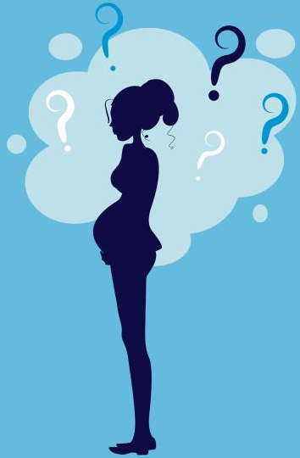
Are the COVID-19 vaccines safe in pregnancy and for breastfeeding mothers?
If you are pregnant you can get COVID-19 vaccines. Your GP, midwife or obstetrician can give you more information
Getting the vaccine will stop you becoming very unwell from COVID-19.
Being unwell from COVID-19 can cause complications like premature labour.
Because the vaccines are still new, we are still learning about them as pregnant women were not included in original trials.
But all the information we have at the moment tells us that if you get COVID-19 vaccine during your pregnancy there will be no effect on your baby.
Make sure the person giving you the vaccine knows you are pregnant. This is because the vaccines should be given between 14-36 weeks of pregnancy.
The vaccines are also safe if you are breastfeeding.

Slide 31
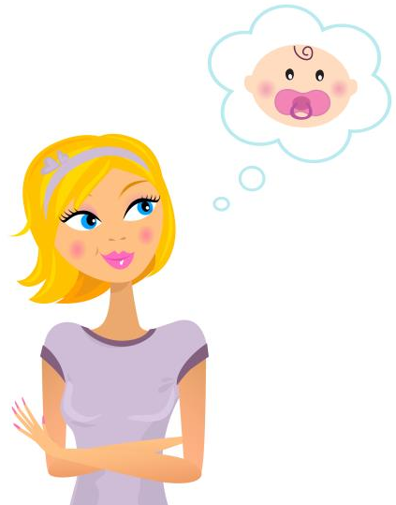
Do the Covid-19 vaccines affect fertility?
There has been a lot of “fake news” about the effects of Covid-19 on fertility
But we can reassure people that there is no evidence that any of the Covid-19 vaccines in use in Ireland will affect your fertility.
You don’t need to leave a gap between having the vaccine and trying to conceive, or having fertility treatments like IVF.

Slide 32
How to talk to people who are unsure about COVID-19 vaccines

Slide 33
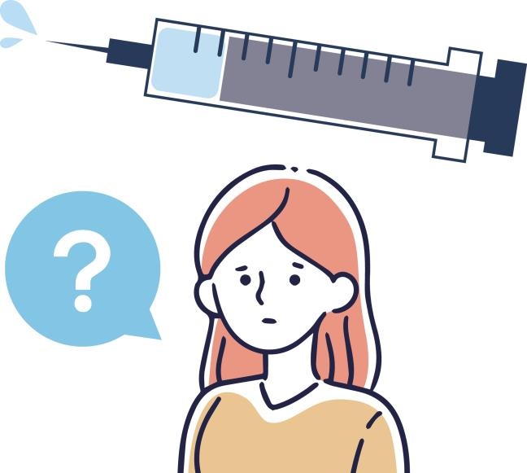
I am still worried…. I don’t think I want to get the vaccine

Slide 34
You have a really important role to play:
A recommendation by a trusted source to get the vaccine has been shown to increase the chances that someone gets a vaccine
Good communication about vaccines makes a difference
Further slides on communication will be shared after the webinar
What you say and how you say it really matters!

Slide 35
Translated Covid-19 & Vaccine information
Vaccination information Booklets in 36 languages
Vaccination videos in 36 languages
Covid-19 Vaccine Video (general)
Covid-19 Vaccine Video for those in Direct Provision
Other information re. Covid-19

Slide 36
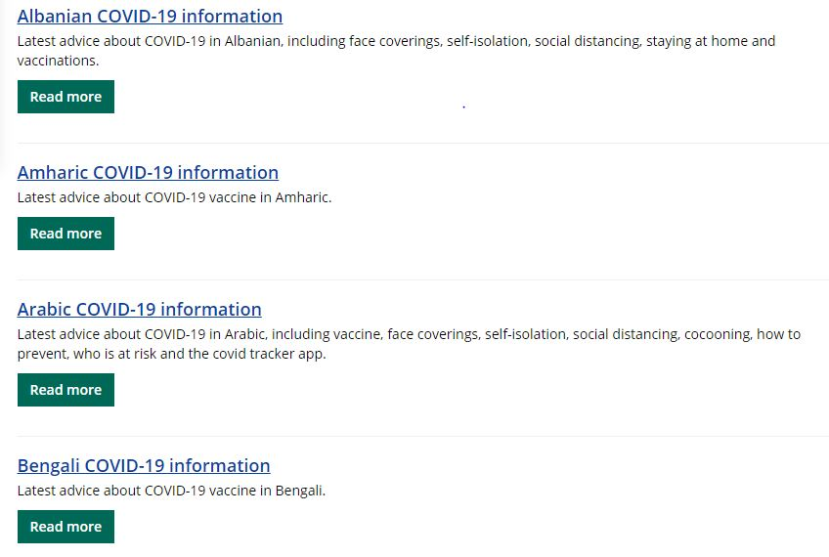
Translated Covid-19 & Vaccine information

Slide 37
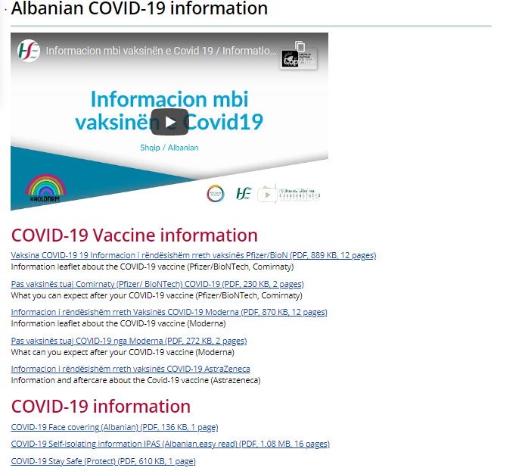
Translated Covid-19 & Vaccine information

Slide 38
Translated Booklets on Covid-19 Vaccines
Information and aftercare booklet about the Covid-19 vaccine:
Astrazeneca
Pfizer/BioNTech, Comirnaty
Moderna
In 36 languages

Slide 39
Useful links
https://www.hse.ie/eng/services/covid-19-resources-and-translations/translated-covid19-information/
http://www.hpra.ie/homepage/medicines/covid-19-updates/approval-of-covid-19-vaccines-frequently-asked-questions
https://www.ema.europa.eu/en/human-regulatory/overview/public-health-threats/coronavirus-disease-covid-19/treatments-vaccines-covid-19

Slide 40
Any Questions?

