Slide 1



COVID-19 Vaccines
Another weapon in our armour
March 10 2021

Slide 2

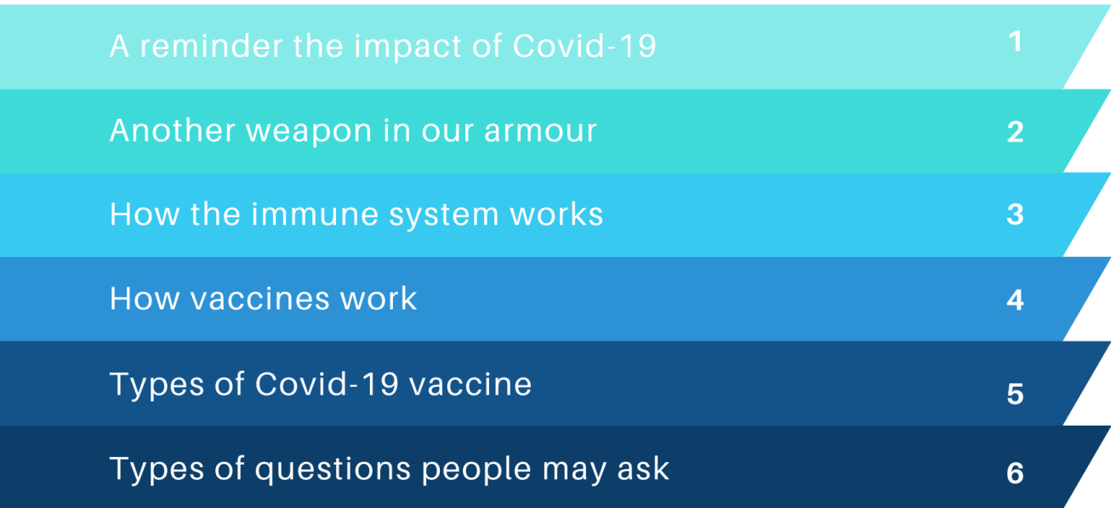

Outline of talk

Slide 3
Why is it important to get a COVID-19 vaccine?

Slide 4
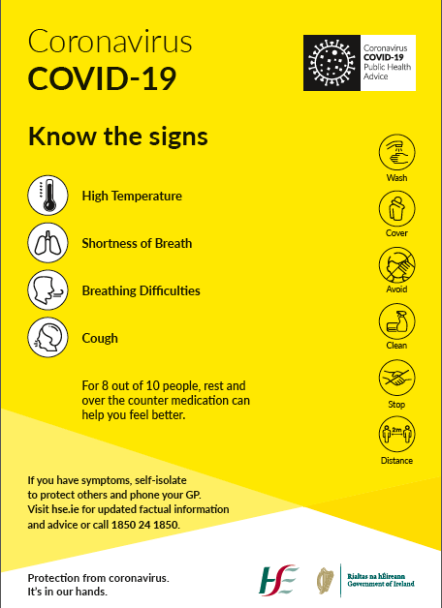
What we know about COVID-19
COVID-19 has been in Ireland since late February and early March 2020.
It usually causes symptoms like
  Cough
  High Temperature (38C or higher)
  Shortness of Breath or difficulty breathing
  Loss of Taste or Smell
For most people symptoms can be managed with rest and over the counter medication….BUT

Slide 5
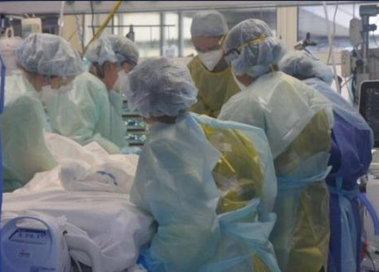
What we know about COVID-19
COVID-19 is more than a cold!
  If someone catches COVID-19 it can result in more severe disease.
  This means some people may need to be admitted to hospital and in some cases they may unfortunately die.
  This is more common in people with COVID-19 than in people with the flu for example.
  Older people and people with other diseases are at higher risk for more severe disease, but it can happen to anyone.
In Ireland, as of March 2021
  4,396 people have died from Covid-19.
  13,024 people with COVID-19 needed admission to hospital.
Long term complications
Picture – RTE Investigates

Slide 6
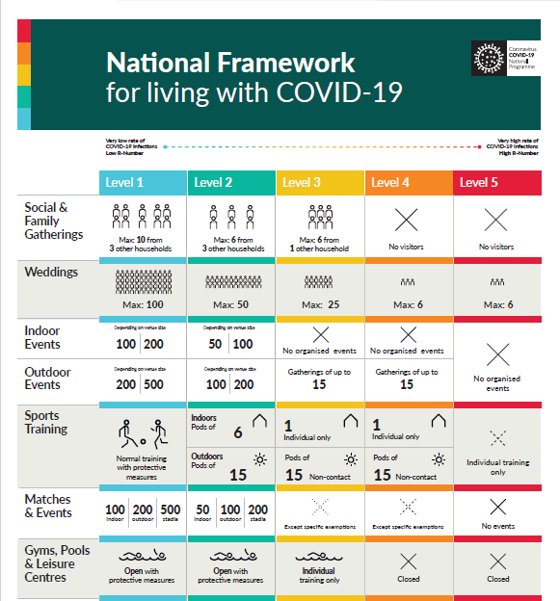
What we know about COVID-19
To try and stop the spread of COVID-19 in Ireland a number of lockdowns were introduced between March 2020 and January 2021.
This was effective in controlling the numbers of COVID-19 in Ireland but it has had other effects on our society…

Slide 7

COVID-19: The Ripple Effect
The economy
Our psychosocial health
Impact on employment
The vulnerable in society
Healthcare
(Covid and non-Covid)
Education
Travel
Our hairstyles!

Slide 8
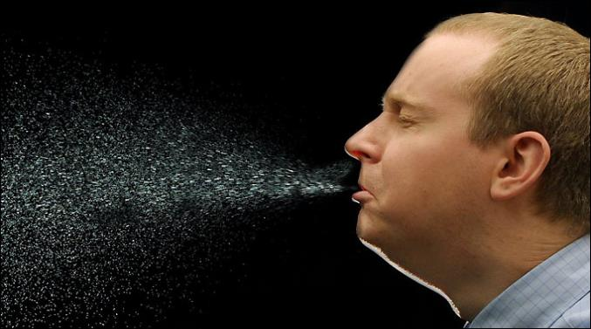
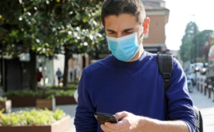
How Covid-19 “goes viral” – which man has Covid-19?
BOTH!

Slide 9
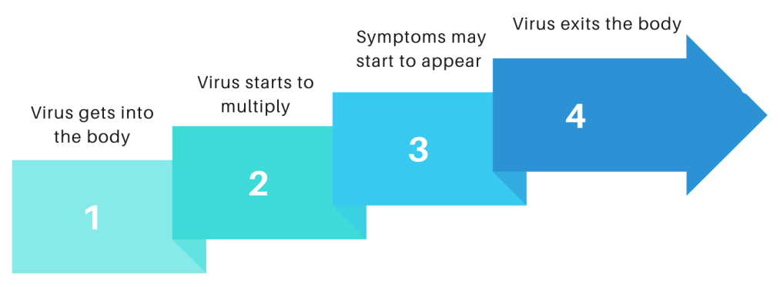
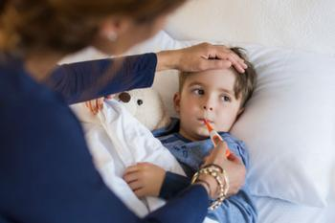
Journey of the virus that causes COVID-19
The incubation period is the time between catching the infection and symptoms appearing. Some infections (like Covid-19) may be contagious during the incubation period before symptoms appear.

Slide 10

The consequences of “ natural COVID-19” COVID-19
Immunity… for ? 6 months
May be innocuous (“you might be grand”)
BUT....
May cause serious disease
May cause permanent damage to your lungs
May cause “long Covid”
May cause death
AND
You can spread it to other people who could be very sick and vulnerable and so might then have serious complications
“Natural immunity” to Covid-19 comes at a very high price (and may not last very long)

Slide 11

The light at the end of the tunnel…?
COVID-19 vaccines

Slide 12

Another weapon in our armour
Handwashing
Covering our coughs and sneezes
Face coverings
Keeping our distance
5. COVID-19 Vaccines

Slide 13
How do vaccines work?

Slide 14
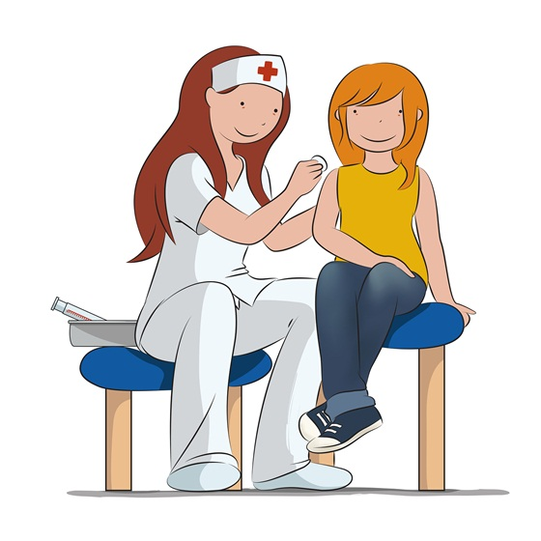
Vaccines are like a personal trainer for your immune system!
Vaccines “train” your immune system by teaching it how to react to a particular germ or invader.
Vaccines stimulate your immune system and get it working hard to protect you!
If you do come across the virus in future, your immune system will respond faster.

Slide 15
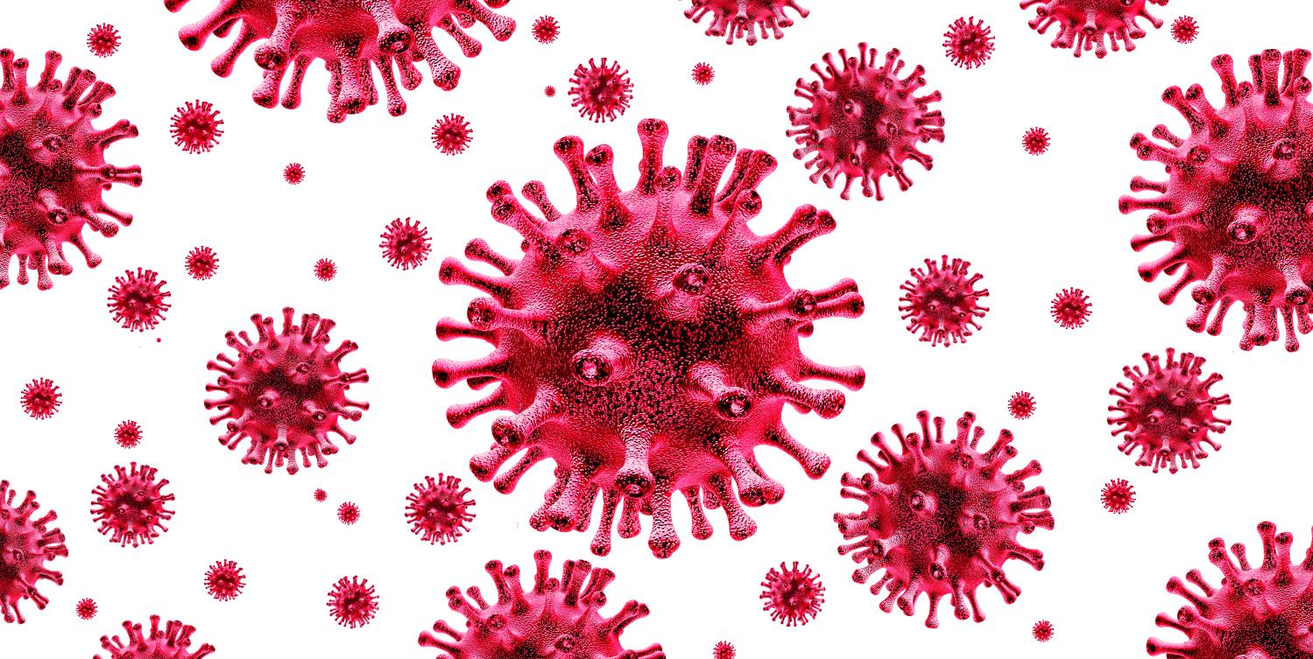

Slide 16
The immune system sounds great… why bother with a vaccine at all?!
Some people won’t be able to take the COVID-19 vaccine
  Usually this is because they have had very severe allergic reactions to this vaccine in the past, they have an underlying disease that means they can’t take vaccines or they are receiving treatment for some cancers.
  To protect these people from infection they need as many as possible to get the vaccine.
  This will reduce the amount of COVID-19 virus that is “circulating” through the population and reduce the chance of these people coming in contact with someone infected with COVID-19.
  This is called “herd immunity” and is one of the reasons why as many people as possible take the vaccine as it protects some of our most vulnerable citizens from COVID-19 infection.

Slide 17
What types of COVID-19 vaccines are there?

Slide 18
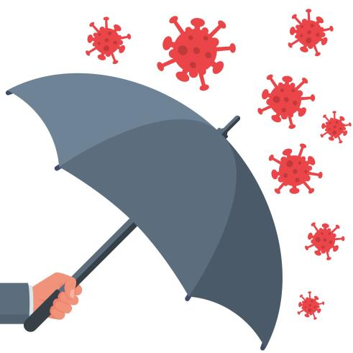
Types of vaccines against COVID-19
Currently in Ireland there are 3 COVID-19 vaccines being used:
mRNA Vaccines:
  Pfizer/BioNTech
  Moderna vaccines
Viral vector vaccines:
  Oxford/Astra Zeneca,
  Janssen (J&J) vaccine expected to be approved by European Medicines Agency soon
All the vaccines in use in Ireland have gone through very close testing and review by the European Medicines Agency to make sure they are safe and they work.

Slide 19

Update to Astra Zeneca COVID-19 Vaccine
In March 2021, a number of European countries (not including Ireland) reported blood clots and low levels of a blood cell involved in clotting (platelets) in a small number of people vaccinated with COVID-19 Vaccine AstraZeneca developed.
To allow this finding to be investigated fully, the National Immunisation Advisory Committee (NIAC) advised pausing the use of COVID-19 Vaccine AstraZeneca in Ireland on March 14th 2021.
Following its investigation, the European Medicines Agency released a statement on March 18th 2021 in response to these cases.

Slide 20
Update to Astra Zeneca COVID-19 Vaccine
  There have been a few reports of very rare cases of blood clots associated with low levels of blood platelets (elements in the blood that help it to clot) with or without bleeding, including rare cases of clots in the blood vessels in the brain.
  We don’t know yet if these very rare clots are anything to do with the vaccine, or if they would have happened anyway,
  The reports are really rare (in more than 20 million doses of the vaccine there were only 18 unusual clots reported)
  The benefits of the vaccine are much greater than the extremely small possibility of developing these clots.
  Remember the vaccine protects you against COVID-19. COVID-19 can make people very sick

Slide 21
Update to Astra Zeneca COVID-19 Vaccine:
What I need to know
Even though the risk of blood clots is extremely low, you should know the signs to watch out for.
Get urgent medical help if you get any of these symptoms after the COVID-19 Vaccine AstraZeneca:
• breathlessness
• pain in the chest or stomach
• swelling or coldness in an arm or leg
• severe or worsening headache or blurred vision
• persistent bleeding, under the skin where there was no previous injury
• multiple small bruises, reddish or purplish spots, or blood blisters under the skin
More details on this vaccine safety update are available here.

Slide 22
Is there anyone who shouldn’t get COVID-19 vaccines?
There are very few people who are advised not to get the vaccine
  These are people who have had a severe allergic reaction to this vaccine or parts of this vaccine in the past.
  This is a specific type of allergic reaction called “anaphylaxis” which would have needed emergency treatment or admission to hospital.
  It is very rare
  People with less severe types of allergic reaction or allergic reactions to food or other medicines can still take the vaccine but will be observed for a little longer (30 minutes vs 15 minutes) after the vaccine to make sure there are no problems.
  The Doctor / nurse / healthcare worker will make sure the vaccine is suitable for the person before giving it

Slide 23
Are there any side effects to the vaccines?

Slide 24
Side effects from COVID-19 vaccines
Mild side effects (more common)
a sore or itchy arm
swelling of lymph nodes/glands in the armpit
feeling tired or sick.
feeling hot and cold
pains in your muscles or your joints
vomiting or diarrhoea
a headache
Other side effects (very few people get these)
You may find it difficult to sleep for a while afterwards.
You may have a reduced appetite.
You may feel dizzy.
You may sweat or have a rash.
You may feel a weakness in your face muscles for a while afterwards, but this is rare, and happens as frequently in the general population who haven’t been vaccinated
Serious side effects (like allergic reactions) are very rare
These are usually mild and go away after a few days.
Older people are less likely to experience these side effects

Slide 25
What sort of questions do people have about COVID-19 vaccines?

Slide 26

Questions people may ask about Covid-19 vaccine
Do the vaccines work?
Were they tested properly?
What are the side effects?
When can I get it?
Do I have to get the vaccine?
Do I still need to get the vaccine if I had Covid-19 before?
Can I still get Covid-19?
Do I still need to keep my distance and wear a mask?
What about if I am pregnant or planning a pregnancy?
Will the vaccine affect my fertility?
What if I have an underlying condition – for example immunosuppressed?
I don’t like putting chemicals into my body…
Are there aborted foetal cells in the vaccine?

Slide 27

Do the COVID-19 vaccines work?
All of the COVID-19 vaccines currently licenced in Ireland are extremely effective at preventing death and hospitalisation.
We know that the mRNA vaccines lowers the risk of COVID-19 by around 95% after two doses of the vaccine have been given
The Oxford/Astra Zeneca vaccine is also very effective; the risk of developing COVID-19 is reduced by 82% once 2 doses of the vaccine have been received.
All the vaccine reduced the risk of severe COVID-19/hospitalisation by 100%

Slide 28


Are the COVID-19 vaccines safe? Were they tested properly?
All of the Covid-19 vaccines used in Ireland are safe. All vaccines used in the Republic of Ireland must be approved by the European Medicines Agency (EMA). The EMA only approves vaccines once they are satisfied that they are safe and effective.
Because COVID-19 has caused a crisis all around the world, experts all over the world have worked together to develop safe vaccines as quickly as possible.
COVID-19 vaccines that are used in Ireland and approved by the EMA must still go through the same safety and effectiveness assessments that all other vaccines and medicines go through before they are approved.
The EMA’s normal rigorous safety standards have NOT been lowered due to the pandemic

Slide 29
Are COVID-19 vaccines safe (continued)?
All medicines and vaccines have some side effects.
Thankfully serious side effects from Covid-19 vaccines are rare.
If you do get side-effects from the vaccine, they are likely to be mild. And many people don’t get any side-effects at all.
The side effects from a COVID-19 vaccine are similar to the side effects that you can get from other vaccines.
We know about side effects from looking at the results of clinical trials, and from the reports from people who have already been vaccinated (over 300 million doses have been given worldwide already)
The Health Products Regulatory Authority (HPRA) in Ireland makes sure that any side effects that people get are reported and followed up www.hpra.ie

Slide 30
When can I get the COVID-19 vaccine?
A COVID-19 vaccine is being offered first to people aged 70 years and older, healthcare workers, and people under 65 with serious medical conditions.
People who live and work in crowded settings will also be offered the vaccine. This includes people living on halting sites/direct provision
The HSE or a person’s GP will let them know when it’s their turn to get the vaccine.
Visit www.gov.ie to find out when we are likely to contact you about getting a COVID-19 vaccine.

Slide 31
Do I have to get one of the COVID-19 vaccines?
When the vaccine is available for you, it is your choice whether to get it.
Agreeing to get a vaccine is called “giving your consent”.
To give your consent you might need to click a box on the computer.
Or you will asked by the person who gives you the vaccine if you consent to get the vaccine
It is important that you have all the information you need to help you make the decision that is right for you. Never be afraid to ask the person vaccinating you any questions you might have.

Slide 32
How long does the vaccine protect me for?
We still don’t know exactly how long immunity from COVID-19 lasts after the vaccine.
Clinical trials are continuing to follow people up for a number of years after they received their vaccines.
The results of these trials, and of other research, will help doctors and scientists decide if booster doses might be needed in the future.
For now the EMA is not recommending booster doses once you have completed your vaccination schedule (two doses for most of the vaccines).

Slide 33
Could I still get COVID-19 even though I have had the vaccine?
All the Covid-19 vaccines being used in Ireland are very effective.
There's a small chance you might still get COVID-19 even if you have been vaccinated.
But even if you do become infected, the vaccine will protect you from the serious illness the virus can sometimes cause.

Slide 34
Do I need the vaccine if I’ve had COVID-19 already?
Yes you should still get the COVID-19 vaccine to protect you against infection.
You need to wait 4 weeks after the start of symptoms or being diagnosed

Slide 35

The COVID-19 vaccine cannot give you COVID-19
The vaccines being used in Ireland do not contain any of the live virus that causes COVID-19. This means that a COVID-19 vaccine cannot make you sick with COVID-19.
It typically takes a few weeks for the body to build immunity after vaccination. That means it’s possible a person could be infected with the virus that causes COVID-19 just before or just after vaccination and still get sick. This is because the vaccine has not had enough time to provide protection.

Slide 36
After I get the COVID-19 vaccine, can I stop wearing my mask when I go to the supermarket?
Unfortunately no!
There is still a small chance you might get COVID-19 after you have had the vaccine.
There is also a chance that you might spread COVID-19, even if you don’t get sick yourself.
That is why it is so important to hold firm, and continue to follow HSE and government advice about washing your hands, keeping your distance and wearing a face covering.
Remember the vaccine is one weapon in our armour of protection against COVID-19 but we still need to follow the other advice to protect ourselves and others

Slide 37
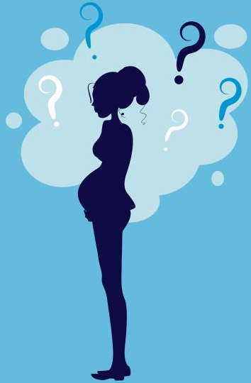
Are the COVID-19 vaccines safe in pregnancy and for breastfeeding mothers?
If you are pregnant you can get COVID-19 vaccines. Your GP, midwife or obstetrician can talk to you about the benefits of getting the vaccine for you
Getting the vaccine will stop you becoming very unwell from COVID-19.
Being unwell from COVID-19 can cause complications like premature labour.
Because the vaccines are still new, we are still learning about them as pregnant women were not included in original trials.
But all the information we have at the moment tells us that if you get COVID-19 vaccine during your pregnancy there will be no effect on your baby.
Make sure the person giving you the vaccine knows you are pregnant. This is because the vaccines should be given between 14-33 weeks of pregnancy.
The vaccines are also safe if you are breastfeeding.

Slide 38
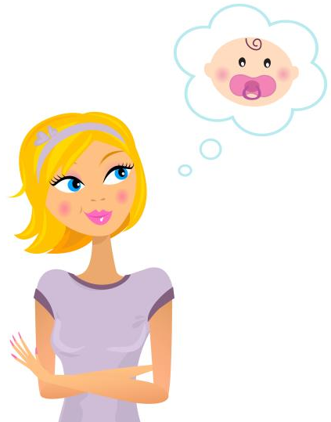
Do the Covid-19 vaccines affect fertility?
There has been a lot of “fake news” about the effects of Covid-19 on fertility
But we can reassure people that there is no evidence that any of the Covid-19 vaccines in use in Ireland will affect your fertility.
You don’t need to leave a gap between having the vaccine and trying to conceive, or having fertility treatments like IVF.

Slide 39
What if I have an underlying condition –
for example immunosuppressed.
People with underlying conditions are more at risk of becoming seriously ill from COVID-19 so getting the vaccine is really important for themitoffered to you
If you have a weakened immune system, your COVID-19 vaccine may not work as well for you. But there is no extra risk in getting it
Talk to your GP or hospital consultant if you have questions about the vaccine

Slide 40
I don’t like putting chemicals into my body….
We are surrounded by chemicals, the water we drink, the air we breathe, the food we eat…
Most vaccines have the antigen (the bit that triggers your immune system to get to work) and suspension fluid (water, saline etc)
Sometimes there are small traces of other ingredients.
The HSE website has lots of information about the ingredients of all the COVID-19 vaccines used in Ireland
None of the vaccines contain eggs, preservatives or latex.
Very rarely trace ingredients in a vaccine can cause an allergic reaction.
Remember why we are offering you COVID-19 vaccines, to protect you against what can be a very serious infection

Slide 41
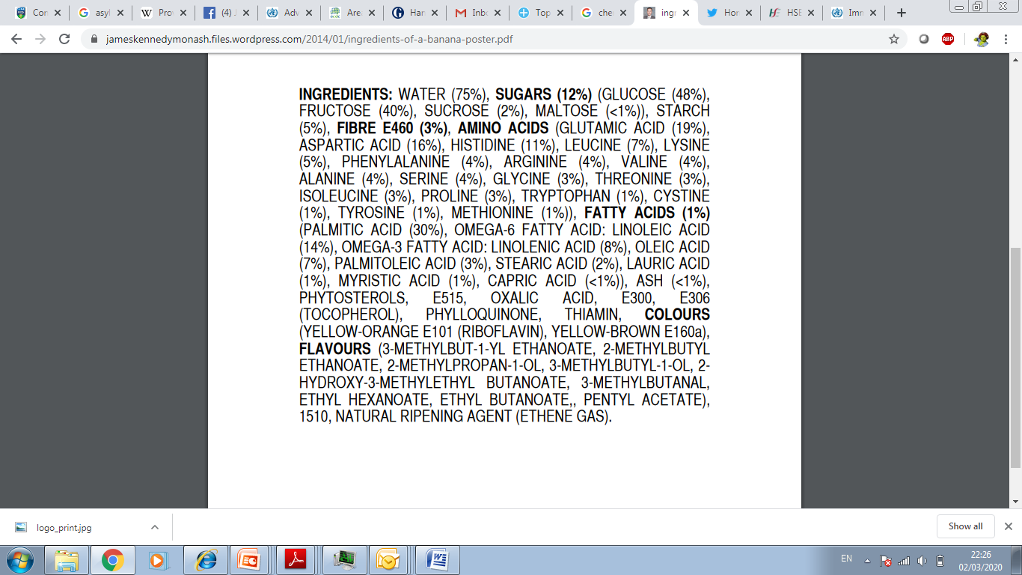
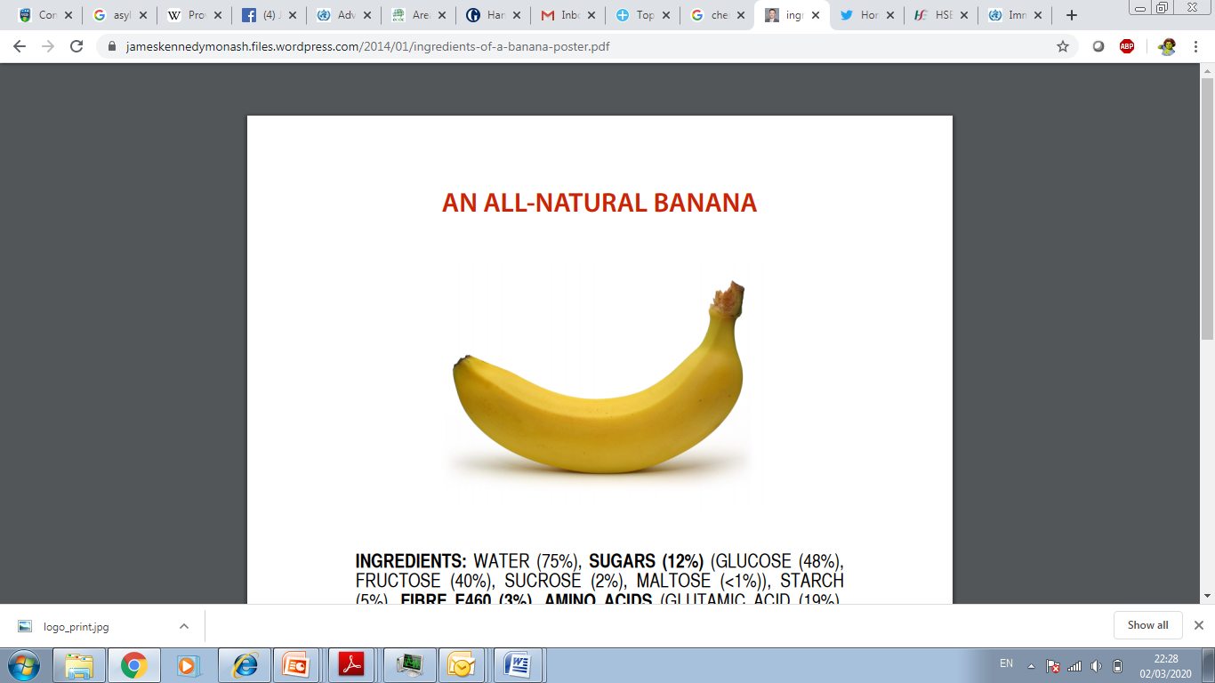

Slide 42
How to talk to people who are unsure about COVID-19 vaccines

Slide 43
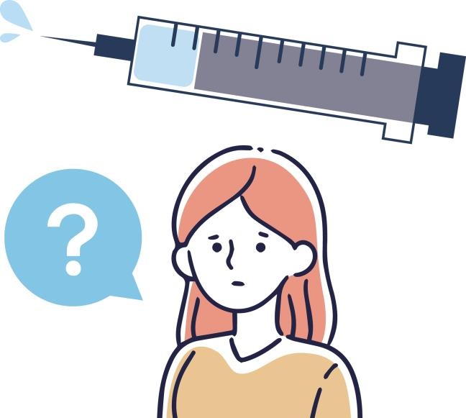
I am still worried…. I don’t think I want to get the vaccine

Slide 44
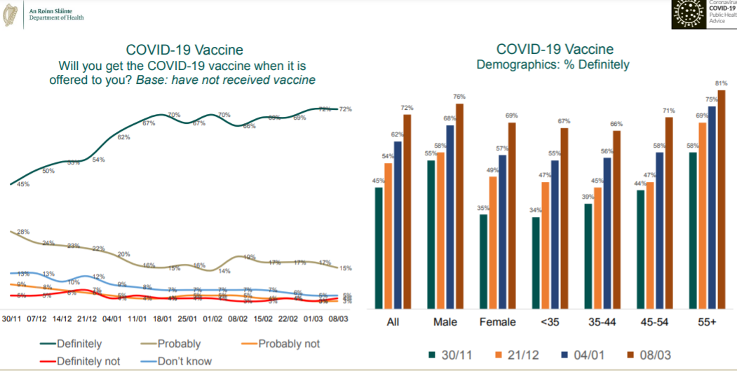
Amárach Survey Results
Most people in Ireland want to be vaccinated

Slide 45
Vaccine Hesitancy
Convenience
Complacency
Confidence
Why might someone not get a vaccine when it’s offered to them?
They worry about whether a vaccine is safe and effective (confidence)
They don’t think the disease the vaccine protects against is serious (complacency) or
They aren’t able to easily access the vaccine e.g. clinic is too far away, or it’s inconvenient (convenience)
Lots of influences:
Culture
Distrust of government/institutions
Family, peer group
Media/social media
Etc.

Slide 46
You have a really important role to play:
A recommendation by a trusted healthcare worker to get the vaccine has been shown to increase the chances that someone gets a vaccine
Good communication about vaccines makes a difference
What you say and how you say it really matters!

Slide 47
How does the person feel about COVID-19 vaccines
You can make the difference here!
Refuse but unsure
Accept some, delay / refuse some
Accept but unsure
Refuse all
Accept all
Vaccine hesitancy: delay in acceptance or refusal of vaccines, despite availability of vaccination services
Complex and context specific, varying across time, place and vaccine

Slide 48
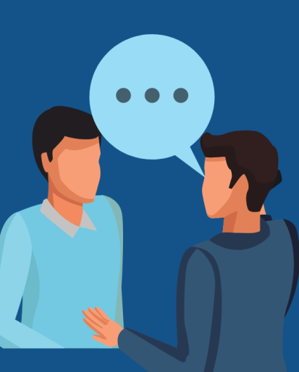
Conversation about COVID-19 vaccines: First… listen!
1. Ask open ended questions:
Can I ask you what you are worried about?
2. Let them know you understand:
It can be worrying when you hear/read things like that online…
3. Address their specific concern:
I know you are worried about X, but I can reassure you that ….
4. Don’t bring up new concerns- may spread myths and untruths
5. Leave the door open to come back if they have questions
6. Point them in the direction of accurate and trusted information on HSE.ie
RECOMMEND the vaccine
Tell them you’ve been vaccinated and where they can be vaccinated if you have that information

Slide 49

Refuse: How To Proceed?
Refuse
all
Non-judgemental | “I can see that you feel strongly about this and that you want to do the best for your health”
Ask permission to discuss | “Would it be ok with you to talk about vaccination against Covid-19 ?”
If agree, focus on their specific concerns | “ Can I ask what are your concerns about the vaccine?”
Do not enter into a debate/argument | “I can see that you feel strongly about this”
Leave space for any future discussion | “Please know that if you ever want to talk about vaccination, you are welcome to come back.”
Maintain the relationship with the patient so the door remains open

Slide 50

Tips for effective communication about vaccines
Partnership approach to decision making
Recognise factors affecting an individual’s decision making and explore any specific concerns
Present risks and benefits accurately, consequences of not vaccinating.
Clear language, plain English and check understanding.
Be well-informed, confident, competent, empathetic, open and honest.
Engage with current and up to date evidenced based information.
Module on HSELand
Provide written information leaflets and recommend other reliable sources of information www.immunisation.ie -WHO accredited

Slide 51

Signposting to reliable information
There is so much information out there, it is hard to know what information to trust.
Speaking to GP, practice nurse or pharmacist is a good place to start.
Tell the person that, if they do go on-line, make sure they go to a reliable website that is truthful and based on science.
The hse.ie website hse.ie has lots of information about COVID-19 and the COVID-19 vaccine. This information has been prepared by vaccine experts who work in Ireland, and is based on the most up-to-date research. You can also call HSELive on 1850 24 1850.
More detailed information is available at immunisation.ie.
If you want to read more detail about the COVID-19 vaccines, there is excellent information available on the website of the European Medicines Agency https://www.ema.europa.eu/enYou can also find information on the World Health Organisation website.

Slide 52
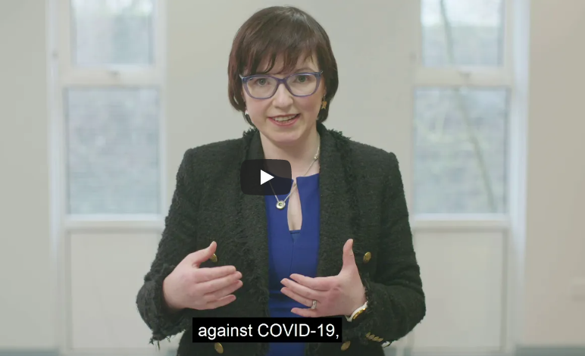
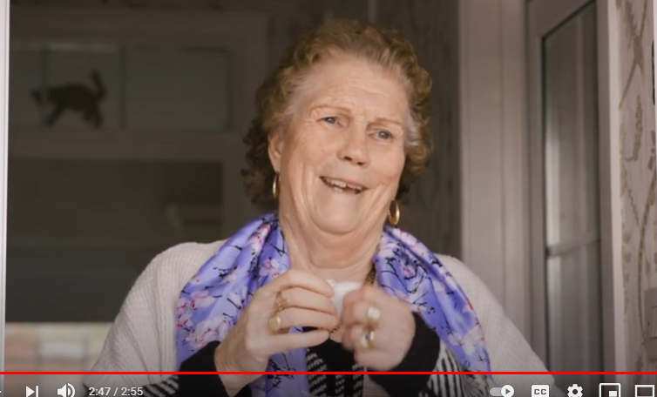
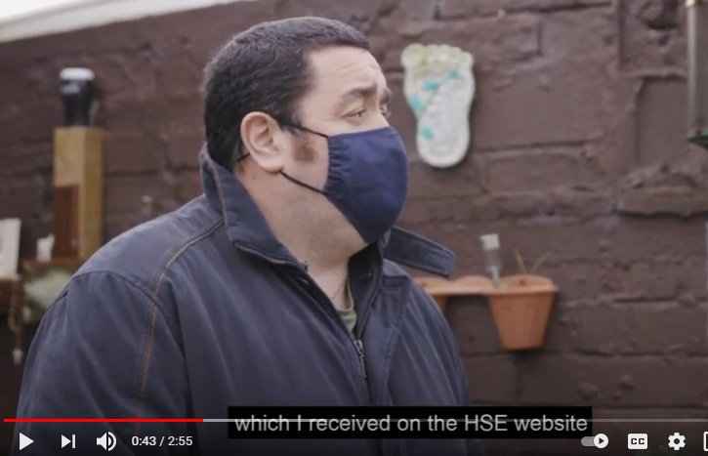
NSIO Traveller & Roma specific vaccine information
https://www.hse.ie/eng/about/who/primarycare/socialinclusion/travellers-and-roma/irish-travellers/covid-19-vaccination-programme.html
https://www.hse.ie/eng/about/who/primarycare/socialinclusion/travellers-and-roma/roma/covid-19-vaccination-programme.html

Slide 53
Useful links
www.hse.ie/covid-19-vaccine/
http://www.hpra.ie/homepage/medicines/covid-19-updates/approval-of-covid-19-vaccines-frequently-asked-questions
https://www.ema.europa.eu/en/human-regulatory/overview/public-health-threats/coronavirus-disease-covid-19/treatments-vaccines-covid-19

Slide 54
BOTTOM LINE
It's not a debate, it's a conversation.
Being right isn't enough.
How you have that conversations really matters, because it can affect what the person decides to do.

Slide 55

Any Questions?

