Slide 1
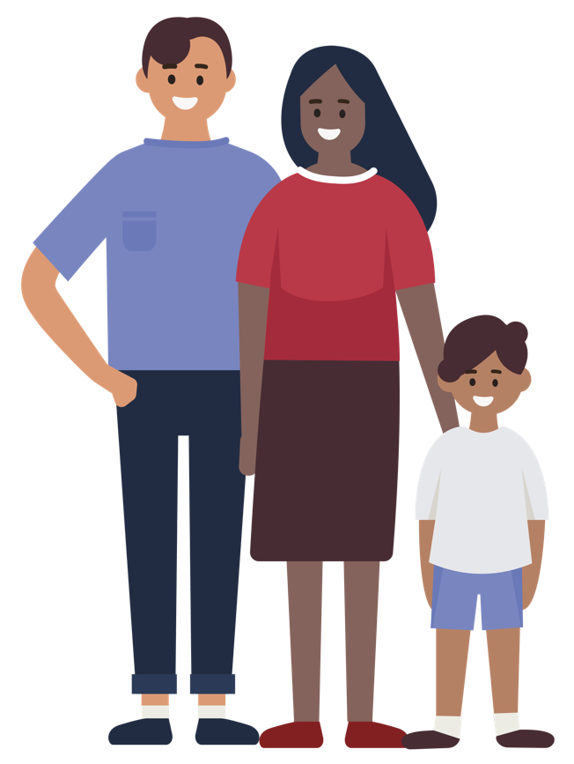
Childhood Vaccination
This deck was created on 15/05/2024 and presented at the Roma Health Network meeting by Dr Louise Lyons Mehl, Senior Medical Officer, National Immunisation Office. The content is correct at the time of publishing.
If you have suggestions or feedback, please feel free to share them with immunisation@hse.ie. Thank you.
Notes:
This presentation may help you to answer some of the common questions parents in the Roma community may have about vaccination. I will also give you a copy of the slides in case you might find them useful.
In this presentation, I will be talking to you today about childhood vaccinations and some practical information about the childhood immunisation schedule and about some of the diseases vaccines prevent, why vaccines are important, some side effects of vaccines, and what patients can expect as part of the baby vaccine appointment and at the end we will go through some vaccine services and where you can get more information including translated vaccine information. .

Slide 2
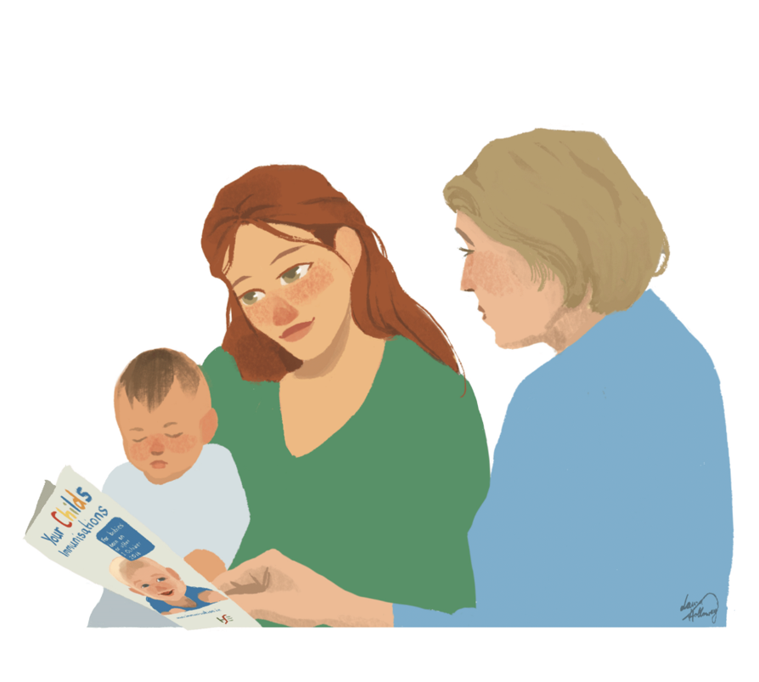
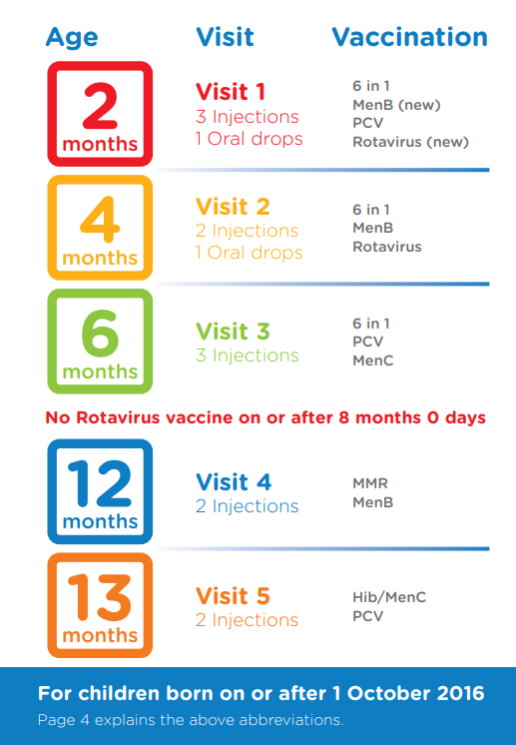
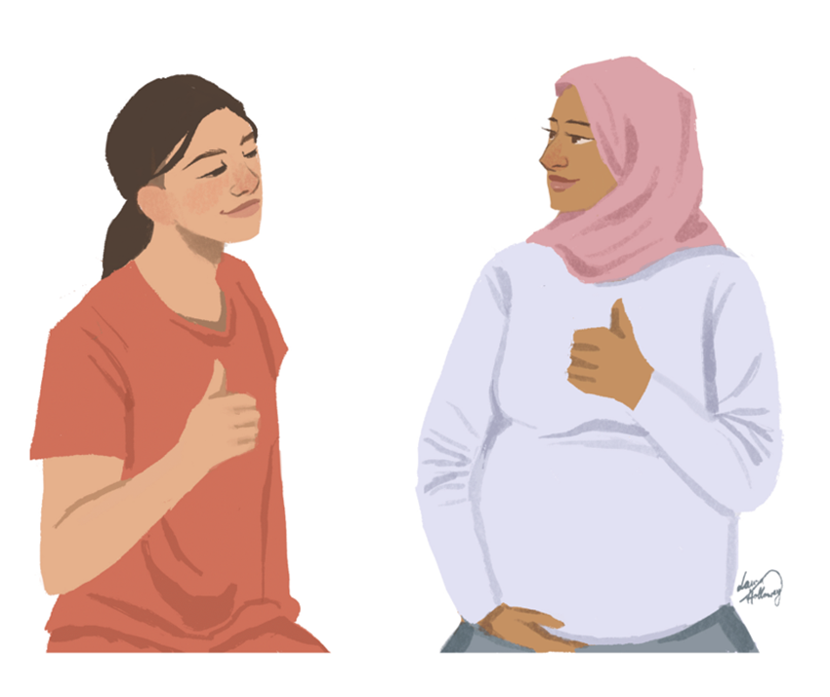
What vaccines are available during early childhood?
5 visits to the GP
At 2 months to 13 months.
Protection against polio, diphtheria, tetanus, meningitis, measles pneumonia
Get vaccines on time as the youngest babies are most at risk
If vaccines are missed, can catch-up
Advise to talk to your GP or GP nurse
Notes:
I know a lot of you will be talking with Roma families about getting the vaccines.
I am sure a lot of you are familiar with the vaccine schedule offered to all babies in Ireland.
When you are talking about vaccination you could explain that
The schedule is a little different in every country, but in Ireland we offer vaccines over 5 visits to babies from the age of 2 months to 13 months..
To get all the vaccines, the parent can book the child in with the GP nurse or GP doctor for the vaccines.
The baby will get 2 or 3 vaccine injections per visit and oral drops as well at two of the visits.
It’s important to explain to parents that getting these vaccines will protect their baby from getting 12 diseases and will protect their baby from getting very sick.
The vaccines protect the child from catching diseases including, diphtheria, tetanus, pertussis polio, measles, meningitis and pneumonia.
The vaccines schedule starts at a young age as the youngest babies are most at risk.
The vaccines are all safe.
All the vaccines and the appointments for the vaccines are free.

Slide 3
What if a baby missed some or all of the childhood vaccines?
Advise that they speak to their GP or GP nurse, to catch up with the vaccinations.
If they do not have a GP see if its possible for them to visit one of the free Roma GP clinics. Information available at www.hse.ie/roma
Notes:
Some parents may not have got some of the vaccines or may be late getting the vaccines or missed some or all of the vaccines.
It is important to explain to parents not to be afraid to talk to their GP nurse or GP doctor to discuss the vaccines or book in for the vaccines for their child and that there is no problem if some of the vaccines are missed, that the child will be able to catch up with the missed vaccines.
Now I’m going to tell you a little bit about the diseases that the vaccines protect against.
Some of these diseases are rare, because of high levels of vaccinations in the community for years has resulted in the numbers catching these diseases to be low and others diseases we will discuss are still common in Ireland, so it’s important to get all the vaccines.

Slide 4
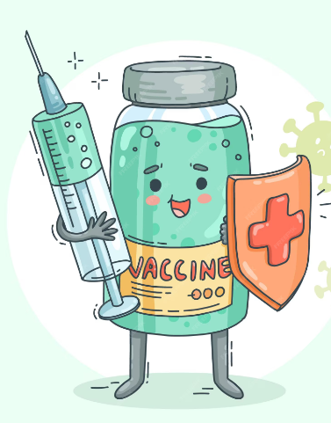
Diseases vaccines prevent
Complications of diseases vaccines prevent
MMR
Ear infections
Chest infections
Infection or swelling in the brain
(Meningitis, encephalitis)
Seizures or fits
Infection or swelling in the brain
(Meningitis or Encephalitis)
Swollen testicles
Infertility
Deafness
Measeles
Mumps
Birth defects (if pregnant women catch Rubella)
such as
Blindness
Deafness
heart defects
Brain swelling
100 day cough
Pneumonia
Death in Infants
Infection in the brain
Infection in blood (Septicaemia)
Swelling in the throat (Epiglottis)
Pneumonia
Infection joints and skin
Infection in linings of heart
Paralysis
Infection in the brain (Meningitis)
Rubella
Notes:
Vaccines protect babies from catching infections and diseases. The next few slides look at these infections.
The MMR vaccine prevent the child from catching the 3 diseases, measles, mumps and rubella.
Rubella can cause birth defects if a pregnant woman catches rubella.
Mumps can cause infections in the brain, infertility in men and deafness
We will look a bit closer at measles.

Slide 5
Diseases vaccines prevent
Measles Virus
Very contagious and spreads really easily between people who are not vaccinated.
Almost 100% of non immune people who come in contact with an infected person will catch the disease.
Measles spreads through the air by coughing and sneezing.
Fever, cough, runny nose, red eyes, then a few days later may get a rash on face, neck, spreading down body.
Measles is a dangerous infection and can cause ear infections, chest infections, fits (seizures), swelling of the brain and brain damage.
Measles is worst for children<1 year, pregnant and those with weak immune systems
MMR
Paralysis
Infection in the brain (Meningitis)
Notes:
This is a virus that is spread by close contact with an infected person.
The measles virus is very contagious and spreads really easily between people who are not vaccinated.
Almost 100% of non immune people who come in contact with an infected person will catch the disease.
Measles spreads through the air by coughing and sneezing.
It causes a fever, a cough, runny nose and a rash and the rash often starts on the face or neck and spreads down the body.
It is a dangerous infection and can lead to ear infections, chest infections, or swelling in the brain and fits or seizures and brain damage.
Measles is worse for children under 1 year, pregnant women and those with weak immune systems.
Luckily, the MMR vaccine protects against this.
So it is really important that children in the Roma community are up to date with their MMR vaccines, one dose age 12 months old with the routine baby vaccines and one dose age 4-5 years in junior infants. Adults in the Roma community may also need vaccination if they have not already got 2 doses of the MMR vaccines since they were 12 months of age.

Slide 6
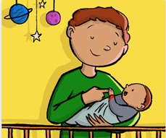
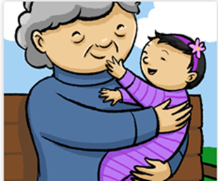
Measles: Keeping everyone safe
There are measles cases in Ireland.
Some Roma community members/families have measles.
Public health doctors and nurses are working to try to find cases and others at risk (contacts) to ensure measles doesn’t spread further and to offer advice to families.
We encourage those working with Roma community
To encourage MMR vaccination to protect against measles.
To encourage families to engage with public health doctors and nurses when they contact them.
They may be offered MMR vaccine or other preventative treatments called Immunoglobulins, if they cannot receive the MMR vaccine.
To encourage families to contact their GP if they are unwell.
MMR
100 day cough
Pneumonia
Death in Infants
Infection in the brain
Infection in blood (Septicaemia)
Swelling in the throat (Epiglottis)
Pneumonia
Infection joints and skin
Infection in linings of heart
Paralysis
Infection in the brain (Meningitis)
Notes:
There are measles cases in Ireland. The latest figures of cases notified to the Health Protection surveillance centre as of the 13th May is 26 cases so far in Ireland and this includes 5 family outbreaks.
As you know some Roma community members and families have measles.
To keep everyone safe, Local Public health doctors and nurses are working to try to find cases of measles and others who came in contact with those with measles who are at risk and are offering advice to families to ensure measles doesn’t spread further.
We are encouraging those working with the Roma community to really encourage uptake of MMR vaccine- which is a safe vaccine and given to millions of people and no evidence of long term effects.
To encourage families to engage with public health doctors and nurses when they contact them (if there is suspected measles case). In this situation, they may be offered MMR vaccine or if they cannot get the MMR vaccine (if they are currently pregnant or under 6 months old or have a weak immune system) they may be offered other preventative treatments called immunogloblulins.
Lastly we encourage you to encourage families to contact their GP if they are unwell to seek care early.

Slide 7
Diseases vaccines prevent
Complications of diseases vaccines prevent
6 in 1
Polio
Tetanus
Whooping Cough (Pertussis)
Diphtheria
Hib
(Haemophilus Influenzae b)
Hepatitis B
100 day cough
Pneumonia
Death in Infants
Infection in the brain
Infection in blood (Septicaemia)
Swelling in the throat (Epiglottis)
Pneumonia
Infection joints and skin
Infection in linings of heart
Paralysis
Infection in the brain (Meningitis)
Breathing problems
Painful muscle spasms
Death in 1 in 10
Breathing difficulties
Heart failure
Neurological disease
Liver failure
Notes:
One vaccine called the 6 in 1 vaccine prevents the child from catching all of the 6 diseases listed on this slide in the blue circles .
The 6 diseases are Polio, tetanus, whooping cough(also called pertussis), diphtheria, Hepatitis B and Hib (also called haemophilus influenza b)
These diseases can make the baby very sick.
For example polio can cause paralysis and hepatitis B can cause liver failure. We will take a closer look at whooping cough on the next slide.
One vaccine called the 6 in 1 vaccine, given 3 times in childhood and the boosters in primary and secondary school can protect their children from catching all of the diseases on this slide

Slide 8
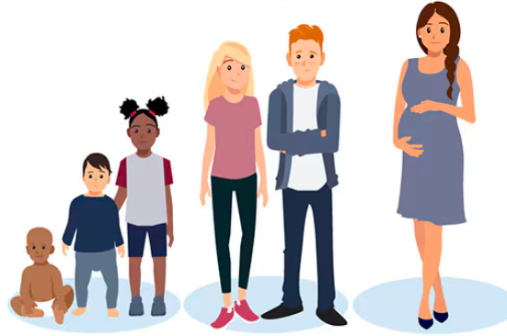
Diseases vaccines prevent:
Whooping Cough (Pertussis)
6 in 1
Vaccines against whooping cough
In pregnancy
At 2, 4 and 6 months
At age 4-5 years in junior infants
In 1st year secondary school
Increase in cases in Europe and in Ireland.
Severe and prolonged coughing attacks:
Provoke vomiting
Result in a red or blue face
End with a high-pitched "whoop" sound during the next breath of air
A hacking cough may be only sign that an adolescent or adult has whooping cough.
Babies may not cough at all. Instead, they may struggle to breathe, or they may even temporarily stop breathing.
Liver failure
100 day cough
Pneumonia
Death in Infants
Notes:
There are increasing cases of whooping cough in Ireland.
Whopping cough causes severe and prolonged coughing attacks, may provoke vomiting, cause a red or blue face and end in a high pitch ‘whoop sound during the next breath of air.
For adults and adolescents, a cough may be the only symptom.
Babies may not even cough at all but may struggle to breath or even temporarily stop breathing.
It’s really important that we prevent whooping cough with the available vaccines- so the . 6 in 1 vaccine for babies given at 2,4 and 6 months and boosters in junior infants and 1st year of secondary school. In addition, all pregnant women are offered whopping cough vaccine by their GP and the protection passes to the baby so they are protected when they are born until they are old enough to get the baby vaccines at 2 months

Slide 9
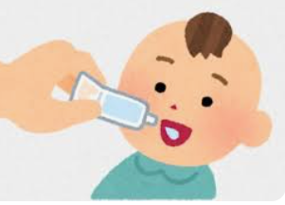
Diseases vaccines prevent
Complications of diseases vaccines prevent
Meningococcal disease
Rotavirus
Pneumococcal disease
Pneumonia
Blood poisoning (Septicaemia)
Brain infection (Meningitis)
Fever, vomiting and diarrhoea
Dehydration
Hospital Admission
Infection in the brain (meningitis)
Infection in the blood (Septicaemia)
Death in 1 in 20
In survivors, 1 in 5 have long term effects such as:
hearing loss
limb amputations
Skin scars
Seizures
Brain damage
MenB
100 day cough
Pneumonia
Death in Infants
nfection in the brain
Infection in blood (Septicaemia)
Swelling in the throat (Epiglottis)
Pneumonia
Infection joints and skin
Infection in linings of heart
Paralysis
Infection in the brain (Meningitis)
Dehydration (from diarrhoea, vomiting and fever)
PCV
MenC
Rota
Notes:
This slide shows another 4 vaccines in the childhood schedule and the disease they prevent.
These 4 vaccines also protect against a lot of diseases that can babies very sick.
For example the MenB and MenC vaccines protect against Meningococcal disease, which can cause infection in the blood or blood poisoning, and infection in the brain which can be very serious and can cause brain damage, hearing loss and the need for limb amputations.
Another example is the rotavirus vaccine, which is actually oral drops instead of an injection and prevents the rotavirus infection, causes vomiting and diarrhoea and sometimes babies may need to be treated in hospital with this.

Slide 10
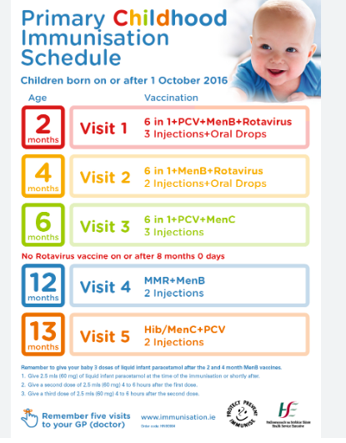
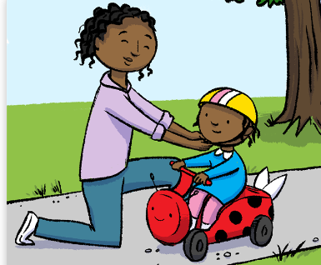
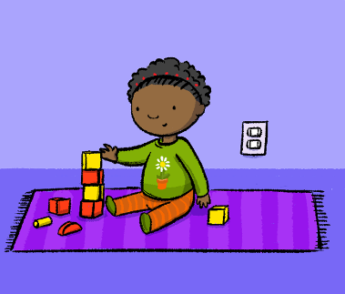
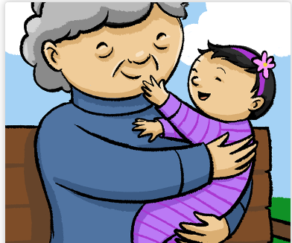
Important to get the vaccinations
on time
Ideal timing
Prevent complications
Early Protection
Best protection
Long term protection
Spreading illness
Text in Arial Bold 16 point text
Text in Arial Bold 16 point text
Notes:
Some parents may ask you why the vaccines are important or may say they want to delay the vaccines you can explain to them that:
It is important to get the vaccines on time if possible, which gives the baby the best protection.
The vaccine schedule gives the vaccines at the ideal time to protect the baby.
Giving the vaccines on time protects young babies who are at highest risk of disease complications
Giving the vaccines on time gives early protection before the child is exposed to these diseases
Receiving all the recommended doses, gives their child the best protection and long term protection.
Children who are not vaccinated on schedule are not only at risk of getting sick themselves, but they can also spread illness to others, so you can advise parents by getting their child’s vaccines on time they are not only protecting their baby, but also helping to protect their friends, family, and community, too.
However, it’s important to say if the child has not received all their vaccines on time, not to worry, that they can visit their GP nurse or GP to get the vaccines to catch up with the schedule.
Resource
https://www.cdc.gov/vaccines/parents/schedules/reasons-follow-schedule.html

Slide 11
Vaccine side effects
Very common but mild
Discomfort, redness, swelling where injection given
Fever
Diarrhoea
Rash
Irritable
What can help
Plenty to drink
Make sure not too warm
Make sure clothes not rubbing against injection area
Text in Arial Bold 16 point text
Notes:
Sometimes parents may ask about side effects of vaccines. So now I will discuss Vaccine side effects. Side effects after the baby vaccines are usually mild and go away on their own.
After the vaccine injection, children may have discomfort, redness and swelling where the injection was given.
They may be irritable and have a fever.
To help them, after vaccination, the child will need plenty to drink and the parents will need to Make sure their baby is not too warm and that their clothes are not rubbing against the injection area.
The parents can also give them infant paracetamol, which we will go through in a minute.
Allergic reactions are very rare and all doctors and nurses giving the baby vaccines are trained to treat allergic reactions if they occur but they are very rare.
Vaccines are safe and are given to billions of children all over the world and have been tested for safety and are all safe. They do not cause long term problems and are safe.
As you can see the common vaccine side effects are mild. And the vaccines protect against very dangerous diseases with serious complications which can make children very sick as we went through earlier.
Later we will go through the simple things that parents can do if their child gets any of these mild side effects after the vaccine.

Slide 12
Before Immunisation Information What to expect when vaccinating a child How to Prepare
To Prepare – advice to
Bring the child’s vaccine passport to the appointment (received from public health nurse)
Bring liquid infant paracetamol, to give after the vaccinations at 2 and 4 months
Ask the nurse any questions about the vaccinations.
Notes:
You can explain to parents that while it may be difficult to watch their child receive the injection or vaccine, certain things can be done to make the experience easier.
First, you can remind them that they are protecting their child from a disease or diseases that would be much more painful and longer lasting than a vaccine injection
Second, by being prepared for the visit, they will be more comfortable and relaxed and their child will detect this.
For the parent to feel prepared there is a few thing they can do.
They can Bring their child's vaccine passport to the visit with them. They will have received one from the public health nurse when she visits them at home a few days after having the baby.
You can see a picture of the immunisation or vaccine passport on the slide.
They can Bring liquid infant paracetamol with them to the vaccine appointment. There is no need to give this in advance of the appointment. This is important to give after the 2 and 4 month vaccines as the MenB vaccine given at these visits commonly causes a fever.
They can ask the GP nurse any questions they may have about the vaccinations
The nurse will show them how to hold their baby during the vaccinations

Slide 13
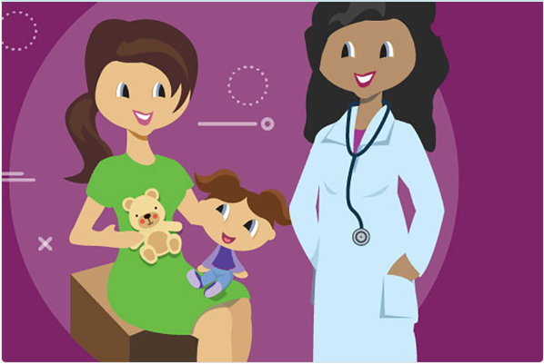
Before Immunisation Information What to expect when vaccinating a child How to Prepare
To Prepare a baby
Give them a drink of milk, bottle or breast milk, a few minutes before the vaccines
Bring along a favourite toy or blanket
Talk reassuringly to a child, make eye contact with, smile at, and cuddle a child leading up to and immediately following vaccination.
After vaccination, a baby can be breast or bottle fed.
Notes:
You can advise parents that they can do a few simple things to help to prepare their infant or toddler about the vaccines.
They can bring along the childs favourite toy or blanket.
Talk reassuringly to their child. Also, make eye contact with, smile at, and cuddle their child leading up to and immediately following the vaccinations.
The parent can talk with the nurse on how to best hold their child during the vaccination to keep your child most comfortable and safe.
You can remind parents that taking their children to get vaccines protects them from something much worse than the pain of the vaccine injection
Resource
Childrens hospital of Philadelphia
https://www.chop.edu/centers-programs/vaccine-education-center/age-groups-and-vaccines/birth-2-years

Slide 14
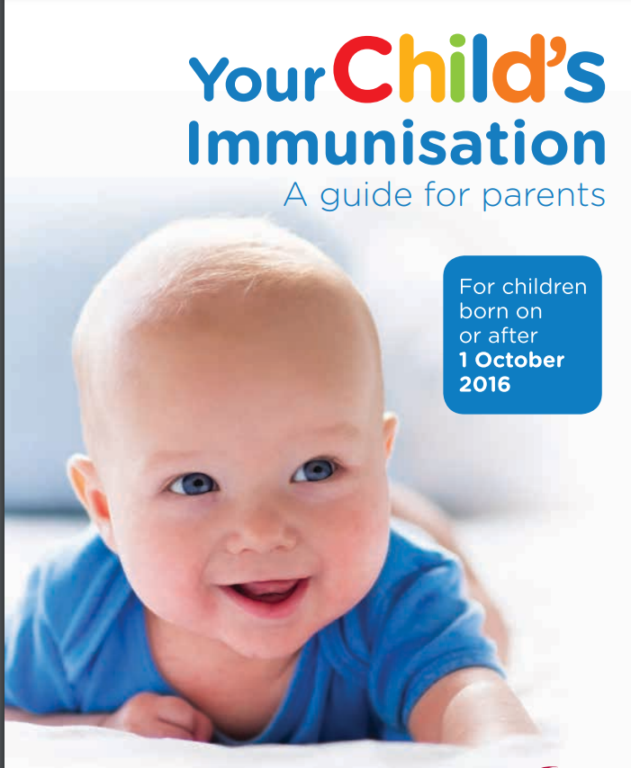
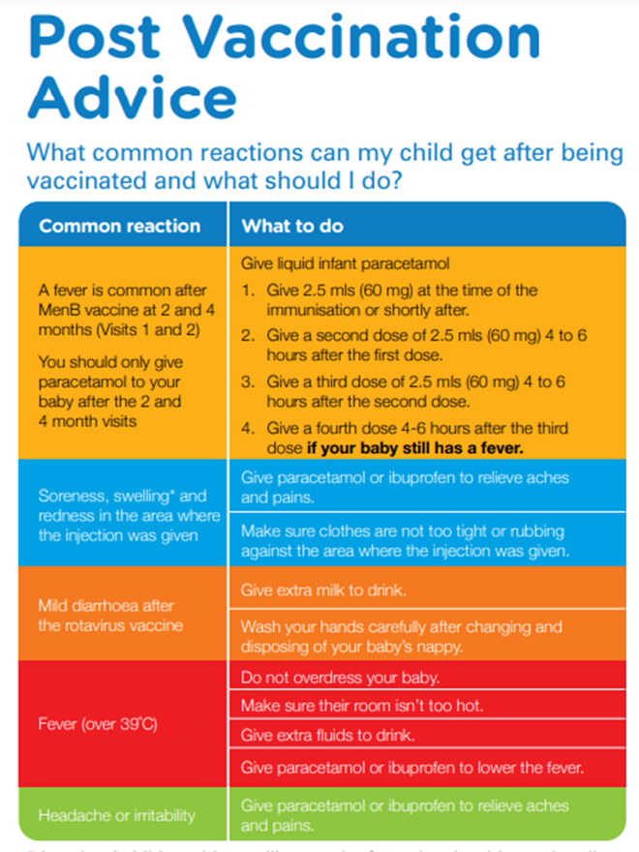
After Immunisation Information What to expect when vaccinating a child
After Vaccination
May be more tired or cranky than usual
May want to be held more
May have a sore leg where the injection was given
May get a temperature
can give infant baby paracetamol
the amount to give is based on baby’s age
written at the back of the box
drink plenty of fluids
make sure the room is not too hot
do not overdress baby
If there are any concern call a GP nurse or GP
Notes:
After the vaccinations, when parents get home, the child may be more tired or cranky than usual. The child may want to be held more and may be sore in the arm or leg where the vaccine was given.
The area where the vaccine injection was given may be red, sore or swollen, so parents can make sure clothes are not rubbing against the area, and encourage ongoing playing and movement.
The parents can give their child plenty of fluids and be aware that they may be less interested in food over the next 24 hours.
After the 2 and 4 month vaccine visits it is recommended to give the baby infant liquid paracetamol after the vaccines. They can also give the liquid paracetamol after the other visits at 6, 12 and 13 months if they wish.
The amount of infant paracetamol to give their baby depends on the baby’s age and is written at the back of the box, and can repeat the dose every 4-6 hours (with a maximum of 4 doses in 24 hours)
Also, parent should encourage their baby to drink plenty of fluids, make sure the room is not too hot and make sure not to overdress their baby.
You can remind parents, if they are concerned to call their child’s doctor who can tell them what to expect and what to do.
If their baby is very unwell after getting a vaccine, they may be sick for some other reason so if they are worried about their baby, then they will need to contact their GP (doctor), practice nurse or public health nurse for further advice.
Resource
Childrens hospital philadephia
https://www.chop.edu/centers-programs/vaccine-education-center/age-groups-and-vaccines/birth-2-years
https://www.hse.ie/eng/health/immunisation/pubinfo/pcischedule/preimmtp.pdf

Slide 15
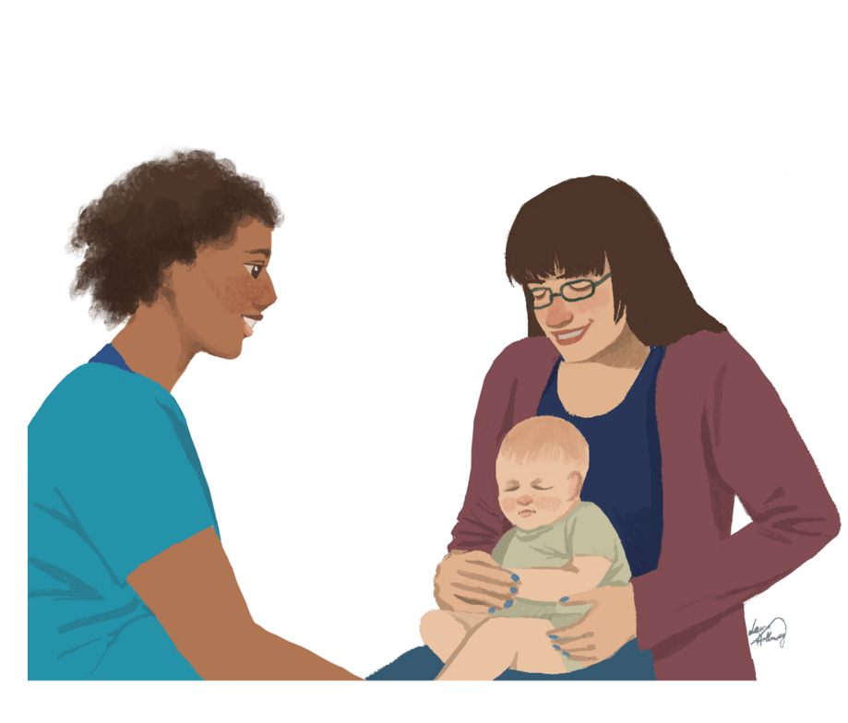
Where can you get the vaccines?
If they are registered with a GP they can book an appointment for vaccinations
Those who do not have a GP or a medical card may be able to attend one of the free GP clinics. GP clinic details are available at www.hse.ie/roma in English, Romanian, Czech and Slovak.
Notes:
Parents may ask you where they can get the vaccines and you will be aware of services locally and can advise them.
In general, they can attend their GP nurse or GP to book an appointment for the baby vaccines. If they are registered with a GP they can attend that practice.
They also have the option of attending one of the free GP clinics which offers free GP care for those who do not have a medical card and a list of these can be found on the HSE website.

Slide 16
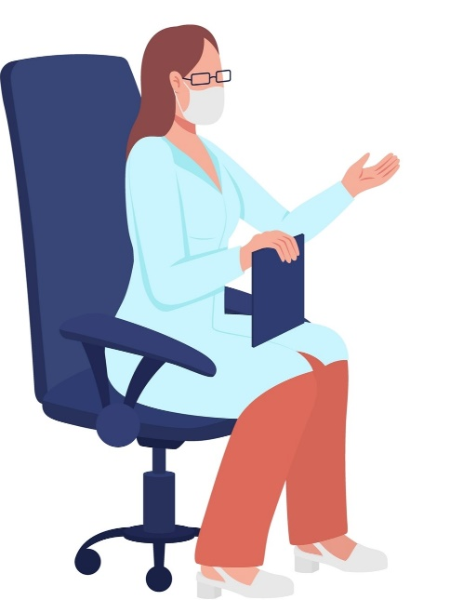
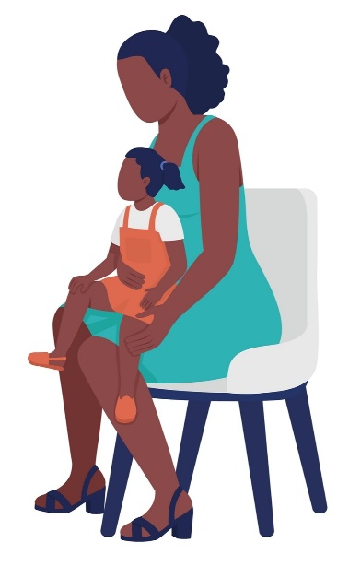
Free GP clinics
Safetynet Primary Care Inclusion Health Hub, Summerhill Health Centre, 90-92 Summerhill, Dublin 1, D01HN35. Phone: 087 607 4632
Tallaght. Phone: 01 795 7501 https://www.tallaghtcrossdoctors.ie/
Dublin North County Inclusion Health Hub, 53 Hampton Street, Balbriggan, K32X092
Safetynet Primary Care GP, The Capuchin Day Centre, 29 Bow Street, Dublin 7, D07WY43. Phone: 01 8733301
Safetynet Primary Care Roma GP Clinic, Carrickmacross Primary Care Centre, Oriel Road, Carrickmacross.
Notes:
A few of the free clinics for those with no GP or no medical card include the clinics in Dublin that you may have heard of include the HSE Inclusion health hub in Balbriggan, Safety net Inclusion health hub in Summerhill in Dublin 1 and the Safetynet Capuchin centre in Dublin 7 and the Roma clinic in Tallaght.
There is also a safety net clinic in Carrackmacross in co monaghan
Reference
https://www.hse.ie/eng/services/mhml/roma-health/useful-contacts/free-gp-clinics/free-gp-clinics.html
Or alternatively if they are registered with their own GP, they can book an appointment there for the baby vaccines.

Slide 17
Childhood vaccinations Why are vaccines important
When there is a decrease in the number of children who got all their childhood immunisations, it can result in infection outbreaks and the disease spreading.
Infections we haven’t seen in Europe and other countries for many years, have re-occurred in recent years due to lower vaccination rates:
Diphtheria in Austria 2022
Polio in Ukraine 2021
Polio in wastewater in London 2022
Measles Ireland 2023
Notes:
It is really important for every child in the community to get vaccinated.
When there is a decrease in the number of children who got all their childhood vaccines, it can results in infection outbreaks and the disease spreading.
We are lucky in Ireland that vaccines are available to us and that they are free.
Some infections that we previously have not seen in Europe for many years due to vaccination, have come back again due to dropping levels of vaccination in the community
Examples include outbreaks of diphtheria in Austria in 2022 and polio in Ukraine in 2021 and more recently you may have heard about the outbreaks of measles in the UK, Romania and Ireland and may European countries.
So we can see that although some of the diseases that vaccines prevent are rare they can still come back if the community is not vaccinated.
So it’s really important for all children to be vaccinated.
Resources
https://www.who.int/europe/news/item/21-09-2023-polio-outbreak-in-ukraine-closed-a-success-story-for-public-health-despite-extreme-challenges-of-war
https://www.eurekalert.org/news-releases/985738#:~:text=Austria%20reported%2062%20cases%20of,among%20people%20living%20in%20Austria.
https://www.thelancet.com/journals/lancet/article/PIIS0140-6736(22)01804-9/fulltext

Slide 18
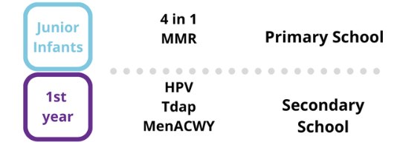
What vaccines are available for school age children?
Vaccines in School
Junior infants
MMR, 4 in 1
Senior infants
LAIV nasal flu vaccine
1st year secondary school
Tdap, MenAXWY, HPV
Vaccines in GP/Pharmacy/CVC large vaccine centres
COVID-19 vaccine
Nasal flu vaccine
Notes:
As we discussed there are 5 vaccine visits between the age of 2 months and 13 months for baby vaccines.
This slide just shows other free vaccines offered to children when they are in school including booster vaccines in junior and senior infants and in first year of secondary school.

Slide 19
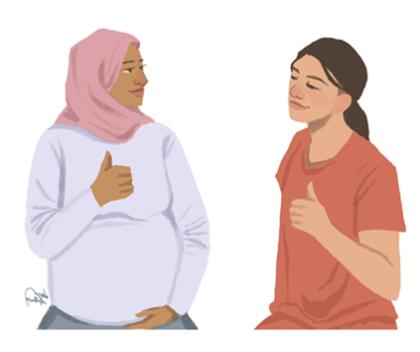
What vaccines are available for pregnant women?
Vaccines offered to all pregnant women
Whooping cough (pertussis) vaccine
Flu vaccine
COVID-19 vaccine
Vaccines offered after pregnancy (to some women)
Immunity to rubella is tested during pregnancy
MMR vaccine is needed in those who have not had at least 1 dose of the MMR
vaccine and are found to not have immunity to rubella when tested
The MMR will protect baby against rubella in future pregnancies
Notes:
In addition, all pregnant women are offered vaccines for free including the flu and whooping cough and Covid-19 vaccines during pregnancy.
After the pregnant woman is vaccinated, the pregnant woman is protected from whooping cough, flu and whooping cough and importantly protection (antibodies) is passed from the mother to the baby before birth and help protect the little baby from diseases during the first months of life, before they receive their own vaccines.
Some mums may need MMR vaccines after pregnancy if they haven’t had it before, to protect the baby in future pregnancies.
Resources
https://www2.hse.ie/pregnancy-birth/pregnancy-care/vaccines-needed/
MMR Vaccine - HSE.ie

Slide 20
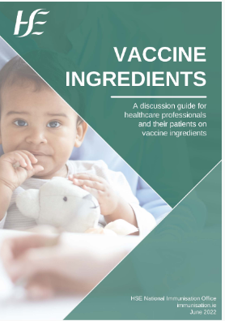
Where can I get more information?
Advise to speak to
GP nurse
GP
Public Health Nurse
Reliable information about vaccination available on
www.immunisation.ie
Patient leaflet called ‘Your Childs Immunisation’ https://www.hse.ie/eng/health/immunisation/pubinfo/pcischedule/engyourchildsimm.pdf
Vaccine Ingredients leaflet https://www.hse.ie/eng/health/immunisation/hcpinfo/vaccineingredients/
Translated information on vaccines in different languages available at:
https://www.hse.ie/eng/health/immunisation/infomaterials/translations/translate.html
Notes:
You can advise parents they can get more information on vaccinations by speaking to their local GP, GP nurse and public health nurse.
There is also reliable information about vaccines on the HSE website and on the immunisation.ie website.
There are also several resources on the HSE website including translated information on vaccines in different languages, which we will have a closer look at in later slides.
I have included the links on these slides and we will share the slids after the presentation so you can easily find the information by clicking the links and all of the information is all available on the HSE website.

Slide 21
Where can I get more information?
Reliable information about vaccination available on
www.immunisation.ie
Patient leaflet called ‘Your Childs Immunisation’
https://www.hse.ie/eng/health/immunisation/pubinfo/pcischedule/engyourchildsimm.pdf
Notes:
This is the booklet parents will get from your public health nurse about childhood vaccinations called ‘Your child’s immunisation’ and it is also available on the HSE website.

Slide 22
Where can I get more information?
Measles Information Leaflets
for the Roma Community (November 2023) are also available on the HPSC Information Leaflets for the General Public webpage, in Czech, Romanian, and Slovak.
Notes:
This is the booklet about measles and is translated to Romanian Czech and Slovak and it is also available on the HPSC website.

Slide 23
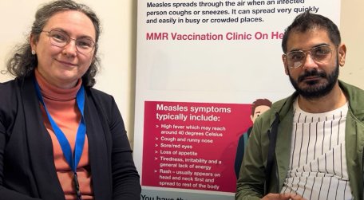
Where can I get more information?
Measles Information Video
In this measles information video in English & Romanian Alex Petrovics, Roma Health Team Lead, HSE Social Inclusion South East Community Healthcare (SECH) interviews Dr. Carmel Mullaney, Consultant in Public Health Medicine and Area Director for the Department of Public Health HSE Dublin and South East (April 2024).
They discuss measles signs and symptoms, and the MMR vaccine.
*also available via HSE PH Dublin-SE YouTube channel
Notes:
CHO5 South East Community Healthcare collaborated on a number of the resources for the Roma community on the HSE website- some of them are on the next few slides.
One of these is a measles information video in English and Romanian on Youtube. Alex Petrovics the Roma health lead in in Social Inclusion South East interviews Dr Carmel Mullaney, Consultant in Public Health Medicine and they discuss the measles signs and symptoms and the MMR vaccine.

Slide 24
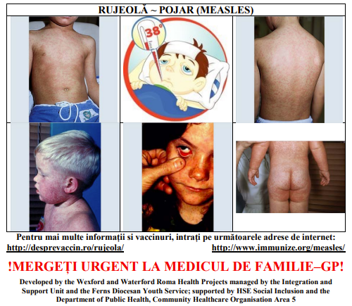
Where can I get more information?
Meningitis, measles, mumps, rubella
Wexford and Waterford Roma Health Projects have developed a pictorial infographic for meningitis, measles, mumps and rubella. The complete infographic is available at https://www.hse.ie/eng/health/immunisation/infomaterials/translations/romainfo.pdf
Notes:
On the HSE website there is also a pictorial infographic created by Wexford and Waterford Roma Health Project in South East Community Healthcare for meningitis, measles, mumps and rubella infections so you can pictures of what the rash and other disease features look like.

Slide 25
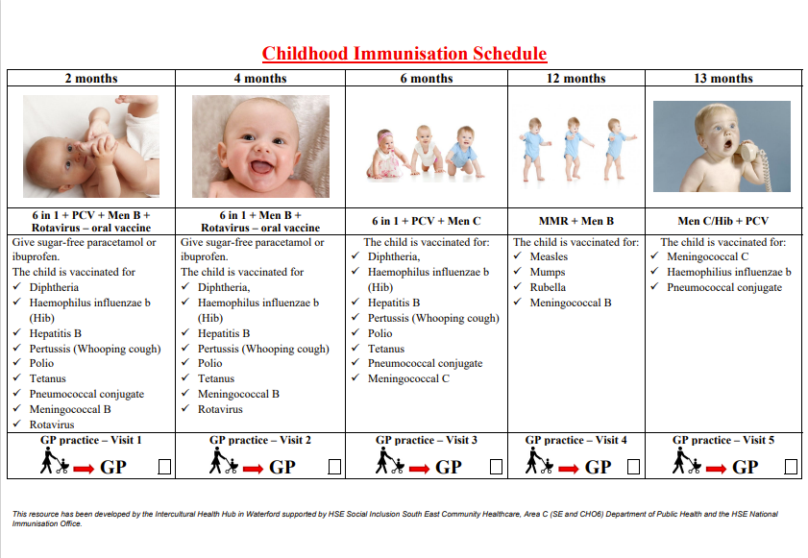
Where can I get more information?
Immunisation Schedule
The Intercultural Health Hub in Waterford, supported by HSE Social Inclusion SECH (South East Community Healthcare) has developed this resource outlining the Childhood Immunisation Schedule in Ireland.
Available in:
English Childhood Immunisation Schedule
Czech Dětský očkovací kalendář
Romanian Programul de vaccinare împotriva bolilor din copilărie
Slovak Imunizačný program pre deti
Notes:
On the HSE website under translated immunisation materials, the childhood vaccine schedule is translated into Romanian, Czech and Slovak. I have a picture of the leaflet on the slide.

Slide 26
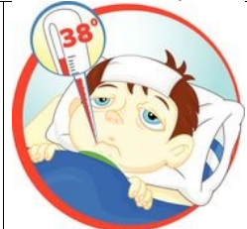
Where can I get more information?
Reliable information about vaccination available on
Translated information on vaccines in different languages available at:
https://www.hse.ie/eng/health/immunisation/infomaterials/translations/translate.html
Vaccine Information Translations - HSE.ie
Diseases vaccines prevent
Pictures of how to recognise some of the diseases we discussed
romainfo.pdf (hse.ie)
Notes:
The HSE website also has translated materials available in various languages.

Slide 27
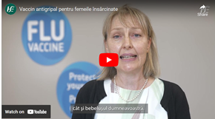
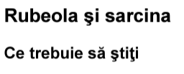
Where can I get more information?
Translated information on vaccines in different languages available at
https://www.hse.ie/eng/health/immunisation/infomaterials/translations/translate.html
Vaccine Information Translations - HSE.ie
Vaccines in pregnancy
Pertussis vaccination in pregnancy in Romanian
Pertussis in Pregnancy - HSE.ie
Patient leaflet Flu vaccine in pregnancy
in Romanian
fluvaccineleafletpregnancyrom.pdf (hse.ie)
Short video on why it is important pregnant women
to get the flu vaccine (Romanian)
Vaccine Information Translations - HSE.ie
Patient leaflet Rubella in pregnancy in Romanian
MMR Vaccine - HSE.ie
Notes:
On the HSE website there is also information leaflets in Romanian on vaccines offered in pregnancy including the whooping cough vaccine and flu vaccine offered to all pregnant women and the MMR vaccine, sometimes offered after giving birth.
There is also a video in Romanian, on why it is important for pregnant women to get the flu vaccine.

Slide 28
Do you have any questions?
Let us know how we can help
www.immunisation.ie

