Slide 1
Roma Health Network Evaluation Survey
Dr Louise Lyons Mehl, Senior Medical Officer, National Immunisation Office

Slide 2
Roma Health Network Evaluation Survey
National Vaccination Webinar Information Session for Roma Health Service Providers and Staff, organised and chaired by NSIO
Wednesday 15th May 2024, 15:00 – 16:00
Pre-session and post-session survey for NIO vaccination sessions (Childhood vaccination and Vaccine Acceptance):
Survey Objectives: To find out:
RHN workers including Peer Support workers attitudes to vaccination.
Usefulness of Immunisation.ie materials for those working with the Roma Community.
Suggestions on the information required to encourage Childhood Vaccination in the Roma community.
How best to reach people in the Roma community with information about childhood vaccination.
Pre session survey respondants: N=27
Post session survey respondants: N=7

Slide 3
Peer workers: attitudes & beliefs about vaccination
How important do you think childhood vaccination is?
Would you recommend childhood vaccination to parents?
How confident do you feel to talk to someone who is hesitant about childhood vaccinations?
Is the information on HSE.ie or immunisation.ie useful?
84%
Highlight a fact or statistic with a short statement

Slide 4
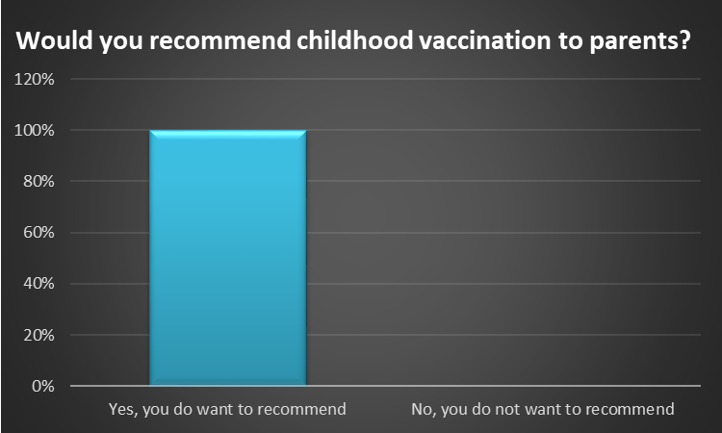
Would you recommend childhood vaccination to parents?
Pre-session survey (N=27)
Notes:
This question was not asked in the post session survey

Slide 5
How important do you think childhood vaccination is?
Pre-session survey (n=27)
Post-Session Survey (n=7)

Slide 6
How confident do you feel to talk to someone who is hesitant about childhood vaccinations?
Pre-session survey (N=27)
Post-session Survey (N=7)

Slide 7
Is the information on HSE.ie or immunisation.ie useful?
Pre-session survey (N=27)
Post-Session Survey (N=7)

Slide 8
Is the information on HSE.ie or immunisation.ie useful?
Pre-session survey (N=27)
Post-Session Survey (N=7)

Slide 9
Open Text Responses:
Q1)What information do you think is needed to encourage childhood vaccination in the Roma community?
Q2)How do you think is it best to reach people in the Roma community with information about childhood vaccination?
84%
Highlight a fact or statistic with a short statement

Slide 10
Open Text Responses:
Direct quotes
Q1)What information do you think is needed to encourage childhood vaccination in the Roma community?
Content of Information
Immunisation Materials
In-Person sessions
84%
Highlight a fact or statistic with a short statement

Slide 11
Q1) What information do you think is needed to encourage childhood vaccination in the Roma community?
Content of Information
Safety
Side effects
Benefits
Tailored
In-Person Sessions
Own language
Peer led
One-to-one or group
Community or home settings
Immunisation Materials
Translated
Images
Videos- native language or cartoon
Translated voice notes and use of social media
Testimonies and success stories
84%
Highlight a fact or statistic with a short statement

Slide 12
Open Text Responses:
Direct quotes
How do you think is it best to reach people in the Roma community with information about childhood vaccination?
Culturally appropriate
Community leaders
Peer Support Workers +/- links community healthcare workers
Trusted Organisations
Other approaches
84%
Highlight a fact or statistic with a short statement

Slide 13
Q2) How do you think is it best to reach people in the Roma community with information about childhood vaccination?
Peer Support Workers +/- links community healthcare workers
Peer support workers.
With a community health care workers.
With linkage to community nurses or public health nurses.
With support with translator if required.
Trusted Organisations
NGOs.
Roma health Network.
Other approaches
Ongoing provision of information for number of weeks/months/years so people will have time to think, understand and make decisions.
Using a multifaceted approach providing information in different ways.
Targeted work including community
Culturally appropriate
Culturally appropriate and linguistically friendly manner.
Training healthcare workers in cultural competence.
Community leaders
More Roma national representatives partaking in the promoting of the vaccination.
Trust must be built and promoted from within the community.
Elders, grandmothers, church leaders.
84%
Highlight a fact or statistic with a short statement

Slide 14
We are using these suggestions to inform planning.
Thank you for participating in the survey.
Any questions?
84%
Highlight a fact or statistic with a short statement

