Slide 1
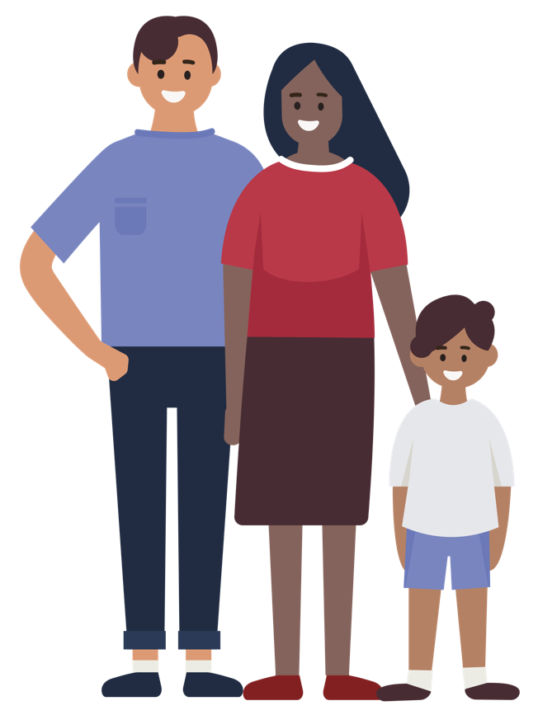


Why are some people hesitant about vaccines?
And what can we do to help?
Dr Chantal Migone. Consultant in Public Health Medicine. National Immunisation Office

Slide 2
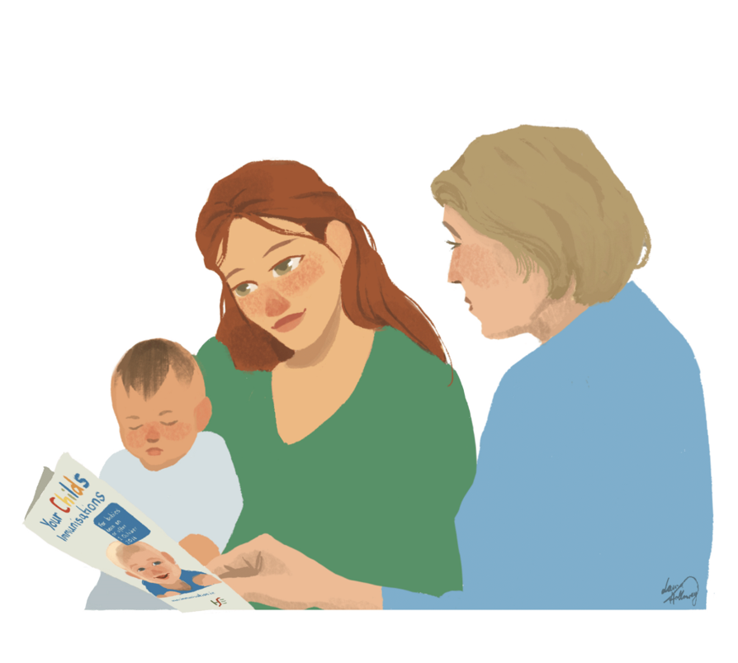
There is a lot of information out there that vaccination is so important………
The Childhood Vaccinations protect against 13 diseases.
Childhood vaccination has saved billions of lives.
We have a lot of information about the safety of childhood vaccines. They have been given to millions and millions of babies over many years
Remain as important as ever. Illnesses prevented by vaccination haven’t gone away: measles, whooping cough/pertussis

Slide 3
Why might someone not be vaccinated or not have their baby vaccinated?
Most people are not “anti-vaccine”
May not know about vaccines…our information may not be understandable or accessible
May not be convinced that they/their baby needs vaccines
Worried about side effects of the vaccine- there may be vaccine misinformation circulating
They don’t trust the health service or the government
Getting vaccinated takes planning and effort. It’s not easy or convenient to get the vaccine e.g. travel, time off work, family to look after
Have other things going on and vaccination is low on their list of priorities e.g. family or financial difficulties, homelessness
Some people have difficulty making decisions— so instead they do nothing

Slide 4

What can we do?
Make vaccination as easy and as accessible as possible – provide information about the practical aspects, help to navigate appointments etc.
Build trust- where healthcare and community health workers are so important

Slide 5

You have a really important role to play:
A recommendation by a trusted healthcare worker to get the vaccine has been shown to increase the chances that someone gets a vaccine.
Good communication about vaccines makes a difference.
E.G. using communication techniques like the ones we are going to talk about, increased vaccination by 10% (MOTIVE study)

Slide 6

What can we do that helps?
“When it comes to vaccines, people think with their heart not their head”
TRUST is key
“A one to one conversation with somebody that they trust can be very influential in a person’s decision to accept a vaccine.
If people like me from my own community are getting a vaccine, I am more likely to get it.
Communication techniques are designed to build trust- It’s not just about giving information (what you say), it’s about how you say it

Slide 7
How does the person feel about vaccines
<1.5%
Most people who are hesitant
Refuse but unsure
Accept some, delay / refuse some
Accept but unsure
Refuse all
Accept all
Vaccine hesitancy: delay in acceptance or refusal of vaccines, despite availability of vaccination services.

Slide 8
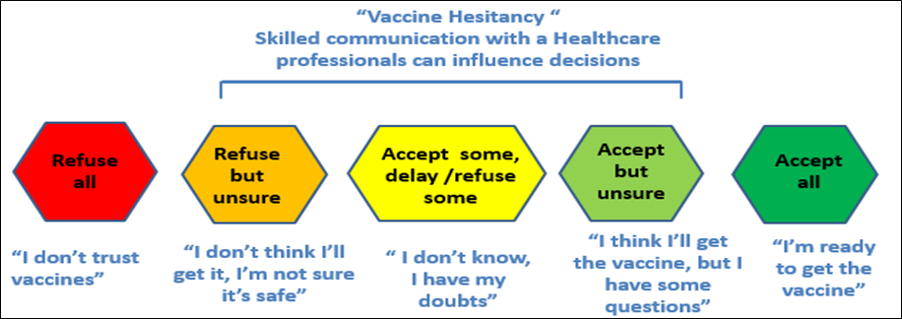
Communication with someone who is hesitant

Slide 9
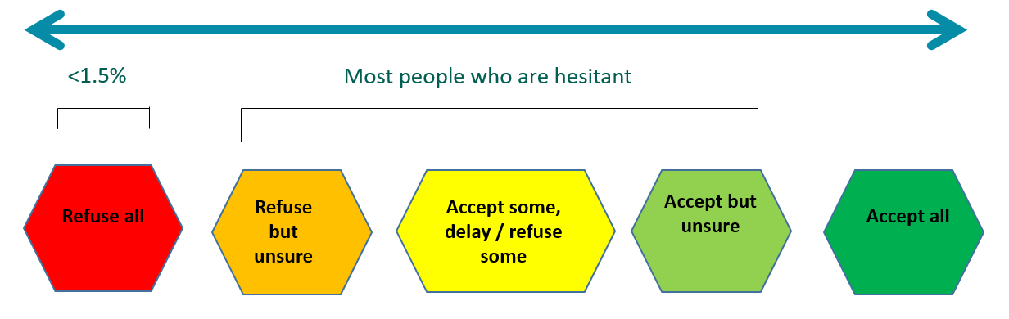
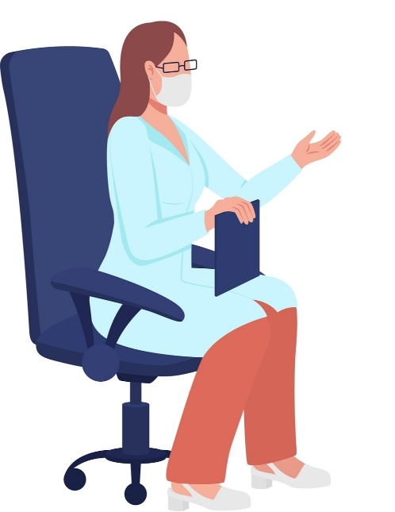
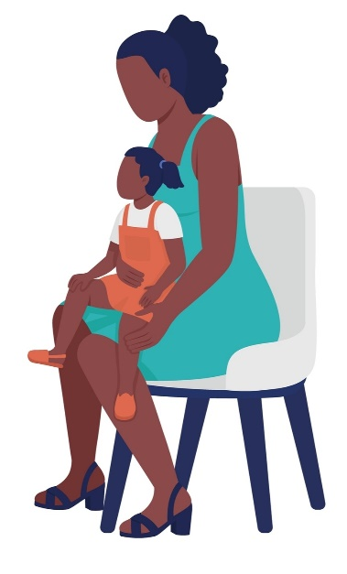

Case:
Family measles outbreak
Local public health recommend unvaccinated children receive MMR vaccine
Family are unsure about vaccination
Peer support worker asked to speak to the family
How would you approach this case?

Slide 10
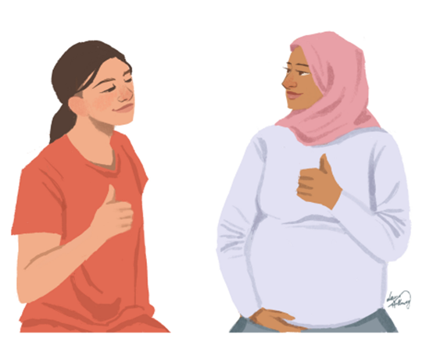
Motivational Interviewing- approach recommended by the WHO
Respectful and collaborative approach-brings the person to make a decision (positive) about vaccination.
Ask open ended questions.
Stress the positives- what they are doing right.
Confirm you understand their worries (without agreeing with them).
Summarise what they have said to you to make sure you understand.
Offer information.
Describe the next steps.
www.hseland.ie

Slide 11
Tips for communication
Ask open-ended questions to find out what their specific concerns are:
“Can I check with you what you’re worried about?”
Stress the positives of what they are doing: “It’s good you’re asking questions”. “I know you want to do the best for you and for your family”.
Confirm you understand their worries (without agreeing with them). “It can be worrying when you read about things like that”.
Summarise what they have said to you to make sure you understand. “From what you’ve told me, you read on Facebook about a side effect of MMR that worries you, is that right?”
Offer information. Stress the positives and use examples: "Could I tell you about when I got my baby vaccinated?”
Describe the next steps: “So you’re going to go down to the GP and talk to the nurse about the vaccine a bit more”

Slide 12
Do
Give information about the specific concern the person shared. You can use information available on www.immunisation.ie If you don’t feel able to answer their questions, advise them to talk to GP, GP nurse, pharmacist or public health nurse.
Share your own experience. Telling a story can be very powerful e.g. “I had some questions too, but I talked to my GP and she answered my questions. My baby had a fever for a day but then was fine. I’m happy because my baby is protected against measles and we are helping to protect our family.”
Give examples of others in your community who have been vaccinated. It can really help when vaccination is seen as the normal thing to do in your own community.

Slide 13
Do
Give practical information: “Your GP down the road gives vaccines, you can make an appointment/ they’ll give you information”
Offer a leaflet or share information they can read at home.
Visit https://www.hse.ie/eng/health/immunisation/infomaterials/translations/
Information available in different languages and in different formats.
Finally, leave the door open. If the person remains unsure let them know they can come back and talk to you about the vaccines again at any time.

Slide 14
DOESN’T HELP
Don’t get into an argument or a debate-it doesn’t work.
Don’t bring up concerns that the person has not brought up themselves, even if rumours are circulating in your community (it can actually help to spread that rumour).

Slide 15
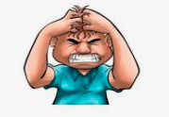
What if someone is “anti-vaccine”
e.g. strong beliefs in conspiracy theories
The goal is to maintain the relationship and build trust.
  Affirm positives (without agreeing) “ You’ve thought about this a lot”
  Ask permission “Would it be ok with you to talk a little bit about the vaccine?
    If they say no- that’s ok
    If they say yes- move to motivational interviewing approach but if becomes a debate or an argument, don’t continue: “I can see you have made a decision”
  Leave the door open- If you ever want to talk to me again, I’d be really happy to answer any questions.
  Offer advice e.g. about measles, to attend GP or GP nurse if baby becomes sick.

Slide 16

Signposting to reliable information
There is so much information out there, it is hard to know what information to trust.
Speaking to GP, practice nurse, public health nurse or pharmacist is a good place to start.
Tell the person that, if they do go on-line, make sure they go to a reliable website that is truthful and based on science.
The hse.ie website has lots of information about vaccines. More detailed information is available at immunisation.ie and mychild.ie

Slide 17
Back to the Case:
MMR Recommended Family Members in measles outbreak

Slide 18
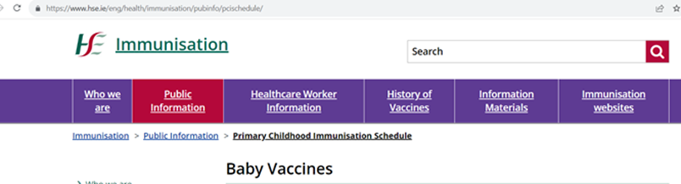
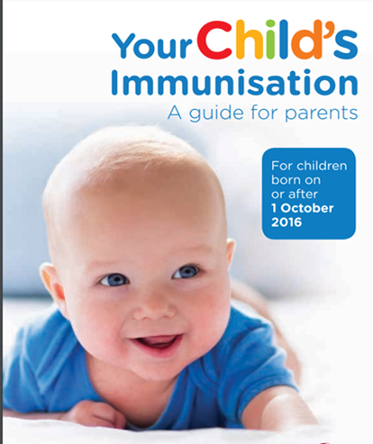
Further Information
Videos, leaflets, easy read
https://www.hse.ie/eng/health/immunisation/
Vaccine Information Translations
https://www.hse.ie/eng/health/immunisation/infomaterials/translations/
HSE National Social Inclusion Office
https://www.hse.ie/eng/about/who/primarycare/socialinclusion/

Slide 19

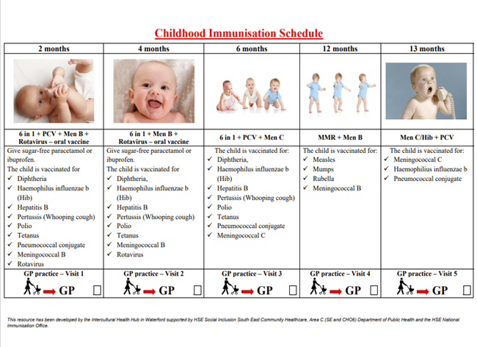
Roma specific vaccine information
HPSC measles leaflet (updated August 2023):
https://www.hpsc.ie/publications/informationleafletsforthegeneralpublic/
Measles leaflet - Roma community - Czech
Measles leaflet - Roma community - Romanian
Measles leaflet - Roma Community – Slovak
Pictorial infographic for meningitis, measles, mumps and rubella: Wexford and Waterford Roma Health Projects have developed a pictorial infographic for meningitis, measles, mumps and rubella
https://www.hse.ie/eng/health/immunisation/infomaterials/translations/romainfo.pdf
Childhood immunisation schedule in Ireland: The following resource has been developed by the Intercultural Health Hub in Waterford supported by HSE Social Inclusion South East Community Healthcare, Area C (SE and CHO6) Department of Public Health and the HSE National Immunisation Office -
Childhood Immunisation Schedule - English
Programul de vaccinare împotriva bolilor din copilărie - Romanian
Imunizačný program pre deti - Slovakian
Dětský očkovací kalendář - Czech
Measles information video https://youtu.be/7Apq4W2pS7g?si=3vf7KCxPmkcnzi-_
In English and Romanian

Slide 20

Do you have any questions?
Let us know what can we do to help?

