Slide 1
ROMA & VACCINATIONS South East Community Healthcare (SECH)
Presentation by Alex Petrovics, Roma Team Lead & Acting Intercultural Health Team Lead in association with HSE Social Inclusion South East
15th May 2024

Slide 2
OVER VIEW OF PRESENTATION
Quick introduction
Our learning in the South East on vaccination since 2016
Background to identification of need in 0-4 years
Who is involved
Methodology (how)
Intended outcomes

Slide 3
introduction
According to 2022 Census there are 16,000 Roma in Ireland and the most common country of citizenship of the Roma population was Ireland (28%), followed by Romania (22%), Italy (10%), Poland (9%), and Lithuania (7%).
Roma in South East, are from various European countries, such as Romania, Czechia, Slovakia, Bulgaria, Hungary, Sweden, Ukraine and Turkey.
Social determinants of health are a huge factor in poor health status of Roma, such as accommodation, overcrowding, poverty and low income or educational outcomes.
Chronic and infectious diseases are higher in Roma Communities compared to rest of population. (PMC – 1ST May 2023 )

Slide 4
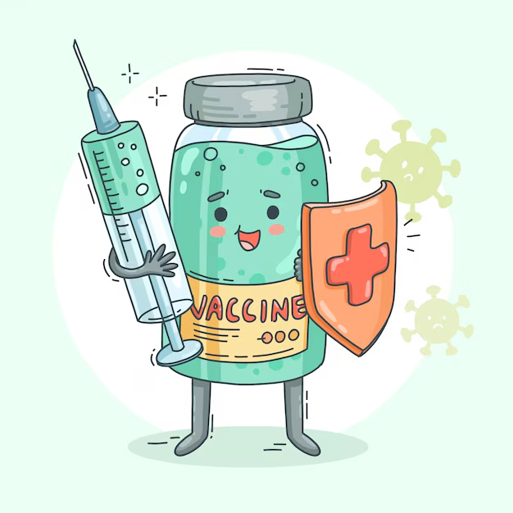
PILOT vaccination PROJECT
1. Pilot childhood VACCINATION project
In 2016 a collaboration between Social Inclusion, Roma Health Projects and Public Health was undertaken to close identified gaps in childhood vaccinations –
This involved desk research to establish baselines of current immunisation take up of Roma children in Wexford and Waterford.
The Roma Health Advocates then offered parents a free confidential service to determine the status of their children’s vaccinations.
And then supported parents to make vaccinations appointments
Whilst the rates of immunisation were below that of the general population there was an increase from the baseline as a result of the pilot project.
Therefore the vaccine coverage for the population included in the study rose from 37% to 49% for Polio (assuming these children will complete their vaccination course) [12% increase] and from 46% to 59% for MMR1 [13% increase].

Slide 5
Learning from 2016
It is important to know the fears and concerns of a community in relation to a vaccine i.e. what prevents up-take (this can be particular to a group and be cultural in nature or generalised).
Roma are very influenced by social media / platforms in their country of origin as well as conspiracy theories re vaccination and this has to be kept in mind when promoting up-take.
Some people can feel targeted for vaccinations because they belong to a certain group and this is off putting.
Key health messages are more readily received and taken on board when they are delivered by a trusted person i.e. a peer health worker or a trusted health professional e.g. Public Health Nurse or GP.
How to give information: It’s important not to overwhelm Roma when promoting vaccine up-date: too much information and too many procedures can put people under pressure.
Avoid putting people on-the-spot to make a decision as this usually leads to them adopting the fight or flight response.
It is important to give people time to think about the information and follow up afterwards.
People must be clearly directed to trusted sources of information
Many Roma do not speak / understand English even if they’ve lived in Ireland for a long number of years. People sometimes try to cover this up and convey that they do understand a communisation, when they actually don’t.
Key health messages are more readily received and taken on board when they are delivered by a trusted person i.e. a peer health worker or a trusted health professional (e.g. Public Health Nurse or GP)
How to give information: It’s important not to overwhelm people when promoting vaccine up-date: too much information and too many procedures can put people under pressure. Avoid putting people on-the-spot to make a decision as this usually leads to them adopting the fight or flight response. It is important to follow up after health information is given.
People must be clearly directed to trusted sources of information
Many people do not speak / understand English even if they’ve lived in Ireland for a long number of years. People sometimes try to cover this up and convey that they do understand a communisation, when they actually don’t.

Slide 6
LEARNING FROM 2019-2020: FlU
2. Flu vaccination
During 2019/2020 we undertook consultations with members of multicultural communities, local GP’s and Intercultural Health Advocates and we received feedback that videos posted on social media are a very effective way of communicating information to multicultural community members.
In particular, we have found that animated cartoon type videos with voice overs translated into different languages are particularly effective (although expensive).
We have recently worked with the National Immunisation Office who has produced these type of resources in a number of languages to promote up-take of the flu vaccine

Slide 7
COVID RESEARCH WITH ROMA IN SOUTH EAST 2021
a) Why people got COVID-19 vaccination:
Personal protection (21%) •
Trust in GP (18%)
Protection of children protection (15%)•
Fear of Covid-19 (15%)•
Digital Certificate (9%)
Trust in a family member (9%)
Trust in science (3%) •
Work related (3%)
b) Source of Information
GPs (39%)
TV in their country of origin(33%)
Family (27%)
Roma Health Projects (27%)
Facebook / Social Media (27%)
Official News (12%)
Friends (12%)
HSE website (9%)
Other (3%)

Slide 8
LEARNING from covid 2021
WHO: Importance of GPs and Roma Health Advocates in providing information and advocating for vaccination
HOW: taking account of literacy and language
“…vaccination campaigns would possibly be more successful if HSE information is presented in a format more perceptive for the Roma community, e.g. testimonies on benefits of vaccination from persons known to be trusted by Roma individuals, such as GPs, vaccinated Roma Health Advocates, etc., and through continued use of translated videos on HSE information and benefits of vaccination”.
DO NOT talk about Covid vaccination when talking about childhood vaccinations – KEEP THEM SEPARATE

Slide 9
Vaccination hesitancy

Slide 10
Vaccine Hesitancy - Consideration of Wider issues
Covid-19 reduced trust in vaccinations for Roma in SECH. When children are being offered vaccinations, parents refuse as they think health professionals might give them COVID vaccinations.
The concept of vaccine hesitancy emphasises the importance of individual behaviour and individual attitudes, and does not explicitly take into account key factors including social inequalities, discrimination, socio-demographic factors or historical influence.
For example, In Czechia & Slovakia, health care providers forcibly sterilized Romani women during other ob/gyn services or surgeries without seeking their consent. Hundreds of women have been illegally sterilized without their informed choice or consent, and nobody has ever been held responsible.

Slide 11
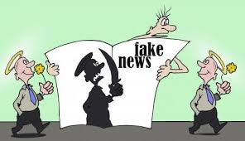
Misinformation and disinformation played a role in vaccine HESITANCY

Slide 12
We found that the changes in vaccination schedules caused Roma to mis-trust vaccines as they can believe there is something wrong with them if they have to changed frequently

Slide 13
TASK & WHAT We hope to achieve – vaccination project 2024
Task:
To provide information and then seek consent form Roma parents to identify gaps in childhood immunisation schedules and then support parents to close gaps.
Building on learning to date, Public Health wrote to GP’s that have large numbers of Roma and informed them that an education awareness work has been done requesting their support with offering vaccines to all Roma.
Expected Outcomes:
Deliver accurate information in a culturally accessible way so Roma can make informed decisions
Improved trust in childhood immunisations
Greater vaccination uptake in the Roma community.

Slide 14
WHO IS INVOLVED
Roma health advocates
HSE Social Inclusion SECH
Roma Community
Public Health
HSE Health and Wellbeing

Slide 15
How / METHODOLOGY
DATA
DATA
DATA
vaccination
DATA

Slide 16
THANK YOU!
ALEX PETROVICS – Roma Team Lead / Acting Intercultural Health Team Lead
E: alex.petrovics@hse.ie
M: 0874532048

