Slide 1

Tobacco Free Campus Overview
Your Name / Trainers name
(Your Role)

Slide 2

Tobacco Free Ireland Programme
Tobacco Free Ireland Programme (TFIP):
  Improve the health and wellbeing of the population
  Reduce smoking prevalence to less than 5% of the population
  Protect the next generation of Irish Children from
    taking up smoking
    second hand smoke
  Achieve a complete Tobacco Free Health Service

Slide 3
Tobacco Free Campus Policy
The HSE Tobacco Free Campus Policy has been developed to:
  Help change social norms around tobacco and e-cigarette use
  Protect and improve the health, safety and welfare of staff, patients / service users, visitors, contractors and the wider community
  To minimise the risk of fire related incidents, injuries and deaths caused by smoking within our Health Service
  Provide a better health outcome for patients / service users by treating tobacco addiction as a care issue

Slide 4
Tobacco Free Campus Policy
  Create a supportive environment for patients / service users and staff to stop smoking
  Support management and staff in the implementation of Tobacco Free Campuses across the organisation
  Provide clarity to managers, staff and all other stakeholders on their role in the implementation of a Tobacco Free Campus, and in promoting and supporting healthier lifestyles
  To prevent second hand smoke exposure

Slide 5

SHS policy
  A further policy, “Protecting HSE Staff from Second-hand Smoke in Domestic Settings” Policy was developed particularly for those working in the community and in Primary care. The purpose of the policy is to protect HSE staff who deliver services in service users’ homes from the harmful effects of secondhand smoke.

Slide 6

TFC Toolkit
Tobacco Free Campus Implementation Guidance Document
Put in place across the HSE in 2015
Comprehensive & Easy to use
‘whole organisation’ approach
Buy-in of all service users
All healthcare staff to embrace their potential as
positive role models

Slide 7

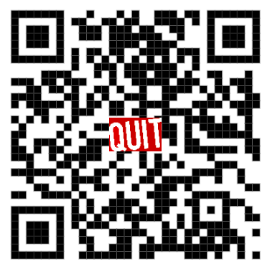
Signage & QR Codes
New standard templates for signage
  https://www.hse.ie/eng/about/who/tobaccocontrol/campus/
Use of QR codes
To give TFC Feedback

Slide 8
Resources
  National Tobacco Free Campus Policy https://www.hse.ie/eng/staff/resources/hrppg/national-tobacco-free-campus-policy---april-2012.pdf
  Protecting HSE Staff from Second-hand Smoke in Domestic Settings https://www.hse.ie/eng/about/who/tobaccocontrol/shspolicy/shspolicydoc.pdf
  Tobacco Free Campus Toolkit Guidance Document https://www.hse.ie/eng/about/who/tobaccocontrol/campus/tobacco-free-campus-toolkit-guidance-document-oct-16.pdf
  National Stop Smoking Clinical Guidelines to Help People Stop Smoking https://www.gov.ie/en/publication/4828b-stop-smoking/
  New Signage - https://www.hse.ie/eng/about/who/tobaccocontrol/campus/

Slide 9
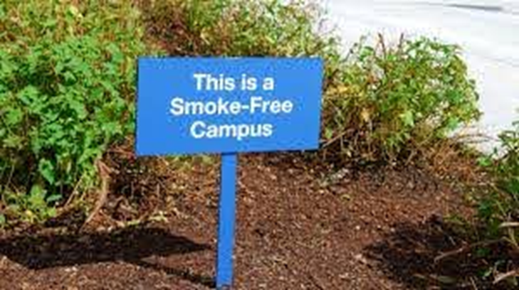
TFC Bursary
The initiative was first launched in December 2018
The strategy chosen for 2019 was ‘Incentivisation’ and the GNTH Global Standards were used as the framework for audit
Sites were invited to engage in a process whereby they worked on various aspects of tobacco free campus policy development over a specified timeframe with the incentive of a potential €5000 bursary
The headings were Sustainability, Innovation and Engagement of Stakeholders & Monitoring & Compliance Building
Many Health Promotion & Improvement (HP&I) staff also used the bursary process to build relationships and engage new services in TFC policy implementation

Slide 10
Assessment of TFC Implementation
What criteria do we use to assess TFC implementation?
The Global Network for Tobacco Free Healthcare Services (GNTH) mission is to advocate, recruit and enable healthcare services and professionals globally to implement and sustain effective tobacco management and cessation policies in accordance with the WHO Framework Convention for Tobacco Control (FCTC).
Through a systematic approach based on a framework of eight standards, the Global Network supports individual member healthcare services and networks to integrate comprehensive action on tobacco and provide evidence based care to all tobacco users.

Slide 11
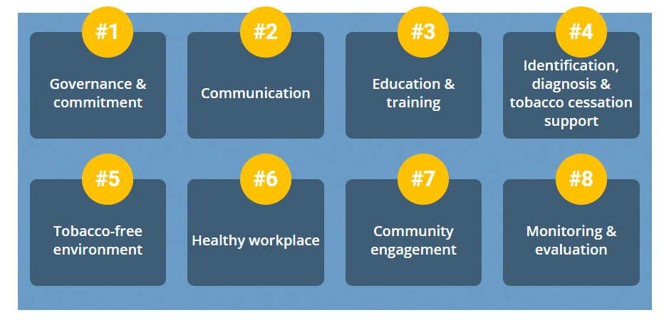
GNTH 8 Standards

Slide 12

Key Steps/Dates
Baseline self audit QIP using GNTH online tool (smart survey application) – Deadline 30th June 2022
Repeat self Audit/QIP Submission for review - 31st January 2023
Prep financial allocation of Funds (TFIP): 31st March 2023
Funds to be issued by (TFIP): 09th April 2023

Slide 13
TFC Bursary
The self audit / Quality Improvement Plan can now be completed online using Smart Survey:
  https://www.smartsurvey.co.uk/s/CFKKYL/
All of the applications will be independently assessed by an external provider
Scores to be awarded based on three criteria;
  Sustainability and Leadership
  Innovation and Engagement of Stakeholders
  Monitoring and Compliance Building
The score sheet and feedback will be provided to all services

Slide 14

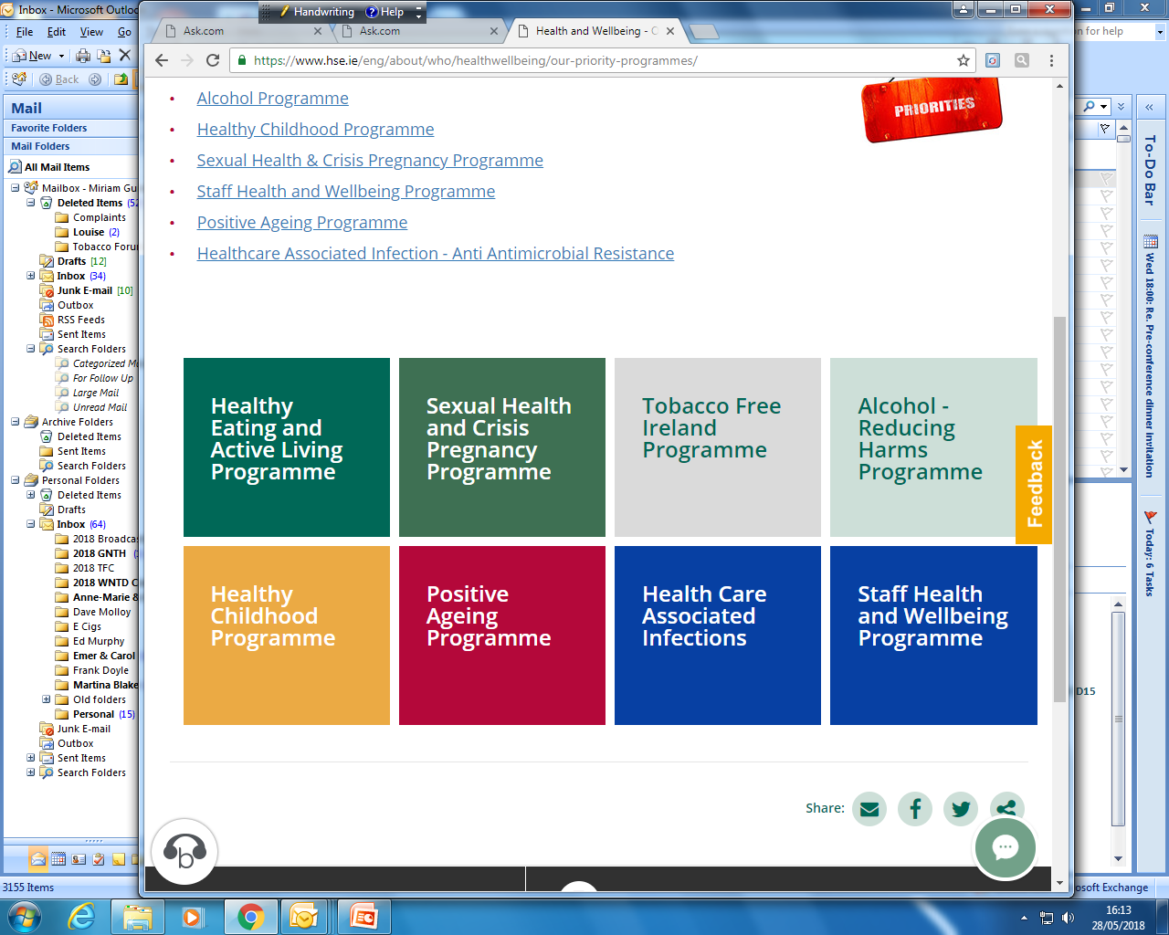

Past Key Achievements and Learnings
Creative and innovative approaches by staff to policy improvement
Enhanced working partnerships between operational staff and HP&I staff
Implementation and achievement of other priority programmes, targets and commitments for example MECC training

Slide 15
More Resources
  Quality Improvement Plan Application form via Smart Survey https://www.smartsurvey.co.uk/s/CFKKYL/
  Quality Improvement Plan - word document will be circulated
  Quality Improvement Bursary information flier with Q&A section - flier will be circulated
  Recording of this meeting - will be circulated
  TFC and Bursary slides - will be circulated
  Information on Section 38 and Section 39 agencies – pdf will be circulated
  Tobacco Free Campus Implementation 2019 Book of Abstracts https://www.hse.ie/eng/about/who/tobaccocontrol/campus/tobacco%20free%20campus%20abstracts%202019.pdf

