Slide 1
We Can Quit Train the Trainer
Induction for new community facilitators

Slide 2
Aims of Induction
To provide you with an brief overview of the We Can Quit programme and the role of the community facilitator in delivering the programme
To outline the training requirements

Slide 3
Aim of We Can Quit, Train the Trainer
To provide you with the:
knowledge,
information and
skills
to deliver a community and peer led week stop smoking programme to men and/or women who want to quit smoking.

Slide 4
What is covered in the WCQ training…
Behavioural support techniques for stop smoking
Core components of the WCQ programme
The link between gender and smoking
Social Determinants of Health
Skills in Brief Intervention
The health risks of tobacco use
The benefits of quitting and barriers to quitting.

Slide 5
At the end of the training you will…
Know how to deliver the WCQ programme
Know how to apply behavioural support techniques for stop smoking to people who want support to quit smoking
Be able to describe the medications used to support people to quit smoking
Be able to use the CO monitor and explain how this can support men and women on their quit smoking journey
Know gender specific issues to health – Social Determinants of Health
Describe the health risks of tobacco use, the benefits of quitting and the barriers and facilitators to quitting
Know how to provide one to one motivational support
Know how to monitor client progress

Slide 6
What is We Can Quit?
Community stop smoking programme for men/women
Delivered over 7, 10 or 12 weeks
Peer led and facilitated by community facilitators
Meets the Quality assurance standards for the delivery of stop smoking services

Slide 7
We Can Quit - Why?
Smoking is the leading cause of preventable death in Ireland
Smoking causes 90% of all lung cancers
Smoking is a health inequalities issue
First delivered in 2013 to tackle health inequalities and to help address the issue of the high smoking prevalence among women living in disadvantaged communities in Ireland
In 2021, 1st men only programme piloted

Slide 8
What participants have said about WCQ…
‘Very informative’
‘The facilitators were great’
‘Loved the programme’
‘I made new friends’
‘It was great to be part of a group of ladies sharing their stories. It was inspiring and we all tried to help each other’
‘I would not have quit without the support’
‘Great tips’

Slide 9
Partnership approach to delivery
County Councils
Local Area Partnerships
Family Resource Centres
Community Centres
Local Pharmacies
HSE Health Promotion and Improvement

Slide 10
Core Components of WCQ
Core components
Group support
One-to-one support
Free stop smoking medication

Slide 11
Role of the WCQ Community Facilitator
I think you should speak to… Here is the number for…
Notes:
Provide one to one support – motivational interviewing
Listen
Provide information and facts
Keep records
Report – Quit Manager
Provide support and a helping hand
Refer – your role is a stop smoking advisor. If an issue outside of this arises during the group or in a one to one, find out what supports are available and give this information to the participant. Your local coordinator will be able to support you with this.

Slide 12
Responsibilities of the WCQ Community Facilitator
Help with recruitment of participants
Plan and deliver the 7/10/12 week WCQ programme
Provide support to and build confidence of participants during the sessions and on a one to one basis
Manage group dynamics
Report on the progress of the group and any issues arising to your local coordinator
Manage and record client data using QUITManager
See pages 10 and 11 of the Facilitator’s Pack

Slide 13
Skills and attributes of the WCQ Community Facilitator?
Skills
Communication
Listening
Knowledge
Managing conflict
Reflective practice
Evaluation skills
Organisational skills
Attributes
Empathy
Patience
Self-awareness
Non-judgemental
Sense of humour

Slide 14
Time commitment - course delivery
Recruitment, information sessions and registration, 6 - 10 hours prior to the programme
Programme delivery 3 hours per week (group and one-to-one)
Planning, preparation and reporting – up to 3 hours per week
Post programme up to 6 hours for evaluations and debriefing
Attend training as appropriate/required
Notes:
Community Facilitators are responsible for the overall delivery of the We Can Quit programme with their co-facilitator. This involves the facilitation of a weekly, 90 minute group based session; and provide weekly one to one follow up to participants, either by phone, text, email or face to face.
The 12 week programme, is delivered in line with messages and activities presented in the WCQ resource pack, tailoring it to reflect the needs of the women in your community, and take note of any changes made to the programme.

Slide 15
WCQ Training for Trainers Outline
Topic | Length of time | Method of assessment
Online MECC | 3 to 6 hours | Completion of MECC
Online NCSCT | 6 to 8 hours | Completion of assessment
WCQ information session | 3 hours | Participation in session
NCSCT Level 3 | 2 days | Peer assessment
QuitManager | 1.5 to 2 hours | Online
Facilitation Skills * | 12 hours | Facilitations skills practise
*This element is optional for those with no prior facilitation skills training or experience
Notes:
Explain to the group that the training will be completed over 6 weeks. MECC and the online NCSCT must be completed before attending the Face to Face NCSCT.
Reading should start once they have been given access (during Induction) and if possible, they can try to complete the assessment.

Slide 16
On completion of training
Once you have completed the pre-training, you must co-facilitate your first two courses with an experienced facilitator or HSE stop smoking advisor.

Slide 17
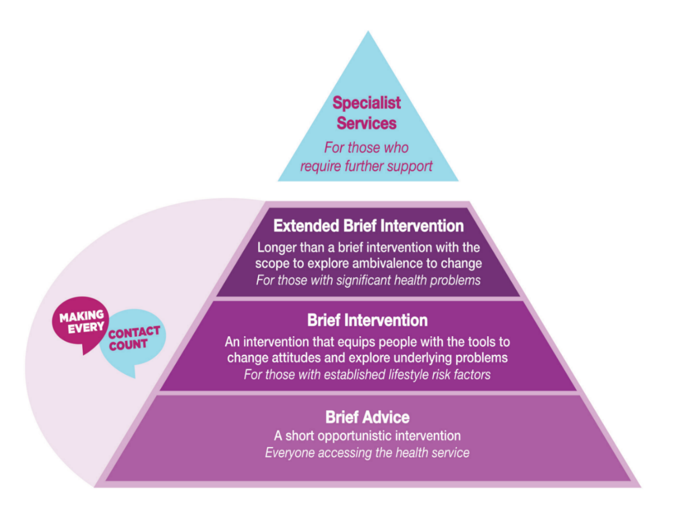
Make Every Contact Count - MECC
www.hseland.ie

Slide 18
National Centre for Smoking Cessation and Training
Practitioner Training - online
Speciality courses in “mental health and smoking”, and “pregnancy and smoking”
Skills to practice - Two day face-to-face training

Slide 19
NCSCT access and registration
Access: www.ncsct.co.uk/ireland
Passcode: IRL2020

Slide 20
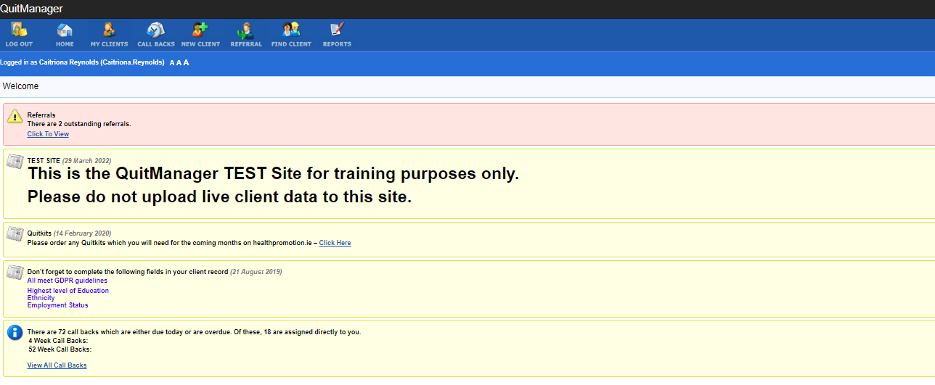
QuitManager training
E-Learning module www.hseland.ie

Slide 21
Dates and venues for training
Notes:
If you have dates for this training, add to this slide

Slide 22
Thank you!
Questions?

Slide 23
NCSCT slides

Slide 24
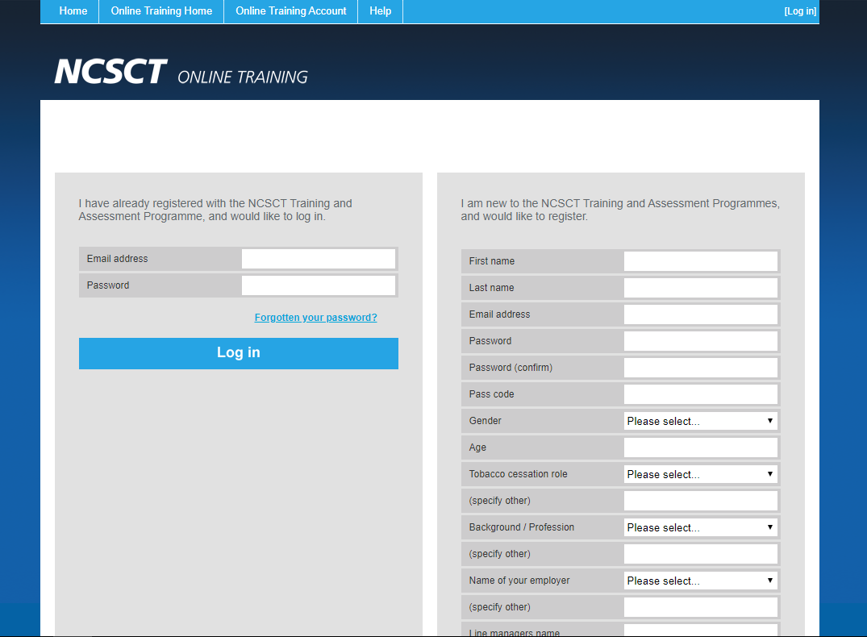

Slide 25
Chose
“Specialist/ Practitioner Role”

Slide 26
Chose
“Tobacco Cessation Specialist”

Slide 27
Chose
“Voluntary Organisation”

Slide 28
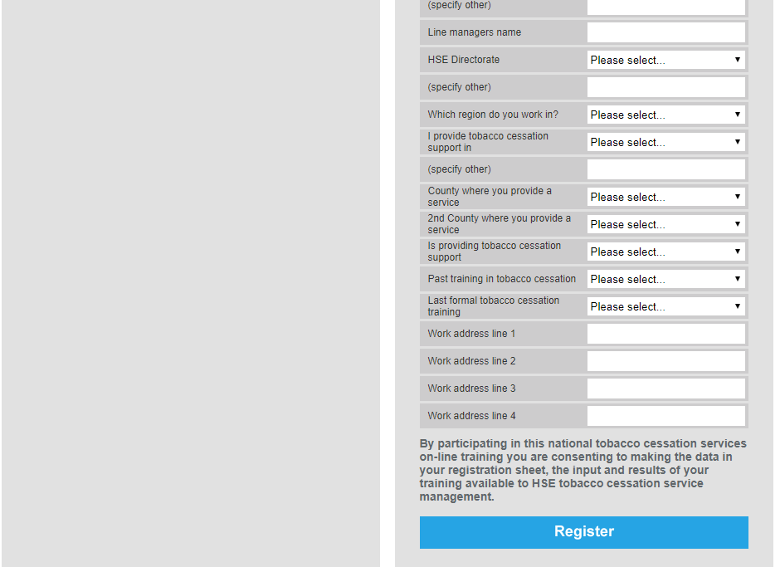
Chose
“Health and Wellbeing Directorate”

Slide 29
Chose
“Voluntary organisation”

