Slide 1
Lymphoedema/lipoedema
education for
undergraduate programmes

Slide 2
Learning objectives
1. Anatomy and physiology of the lymphatic system
2. Pathophysiology of lymphoedema
3. Recognise that there are various causes of oedema which may co-exist with lymphoedema
4. Explore the education needs of individuals who have, or at risk of developing lymphoedema and how these might be met
5. Explore the basics of lymphoedema management
Notes:
2. Identify primary and secondary forms of lymphoedema, including those related to cancer, filariasis and venous disease.
List the consequences of lymphostasis in terms of skin and tissue changes,
Cellulitis
Identify groups at risk
3. Describe the clinical features of early and late presentations of lymphoedema
Identify symptoms associated with lymphoedema
Identify features of cellulitis as a cause or complication of lymphoedema
Identify symptoms that may be experienced by a person with lymphoedema
Causes of oedema
4. Identify suitable sources of information on reducing the risk of lymphoedema and/or exacerbation and how to access treatment
5. Identify the core components of lymphoedema management
Recognise the psychosocial and financial impact of lymphoedema
Recognise the need for long term monitoring and maintenance for lymphoedema
Identify the urgency for treatment of cellulitis, and the treatment options
Identify limitations of own role and when and where to refer to a qualified lymphoedema practitioner.

Slide 3
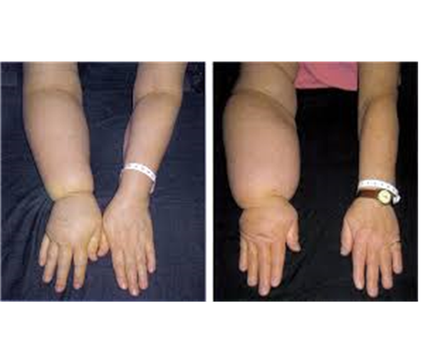
Incidence in Ireland
Estimated:
12,380 people with lymphoedema
1,451 per year hospitalized with cellulitis related to lymphoedema
Average LOS is 11 days
Cost €3.6 million annually
HSE lymphoedema/lipoedema Model of Care, 2018

Slide 4
1. Anatomy and function of the lymphatic system
Learning outcomes
Explain the basic anatomy of the lymphatic system
Explain the function of the lymphatic system

Slide 5
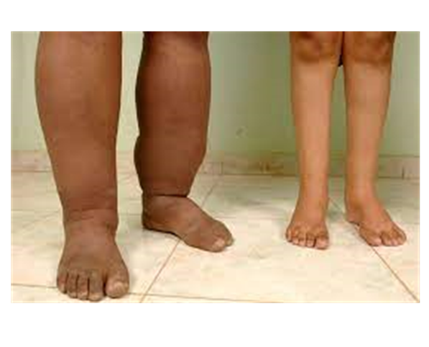
What is Lymphoedema?
Lymph= straw coloured fluid collected by the lymphatic system (contains proteins, fats, white blood cells, cellular waste)
Oedema= swelling
Lymphoedema= a type of swelling due
to a defective/ overloaded lymphatic system
Lymphoedema can develop anywhere in
the body but mainly in the arm, the leg,
the face and genitals,

Slide 6
Anatomy of the lymphatics

Slide 7
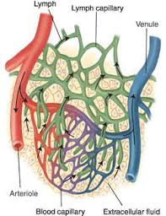
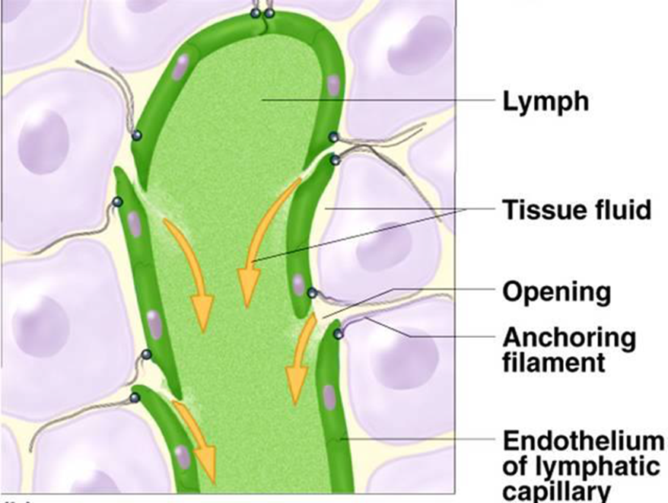
Collection of interstitial fluid by small lymphatic filaments

Slide 8
Lymph nodes
Lymph nodes are filtering stations of the lymphatic system. There are about 600-700 lymph nodes in the body which appear as chains or groups along the lymph vessels
Functions:
Filtration (filters out harmful substances)
Concentration, (removes water)
Activation of immune system, (T and B lymphocytes)

Slide 9
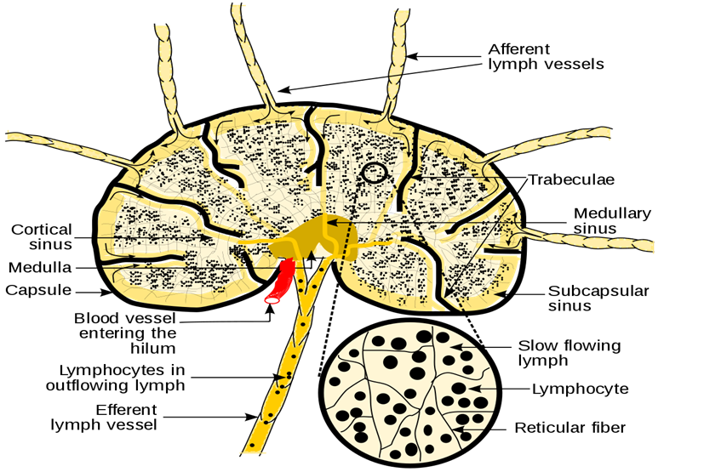
Lymph node

Slide 10
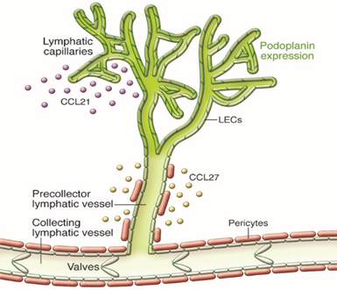
Normal lymphatic flow
Suggested videos;
The lymphatic system 3D animation - Bing video
The lymphatic drainage system - Bing video
Notes:
Superficial lymphatics drain the skin, subcutaneous layers and drain to deep lymphatic vessels
Superficial lymphatics are assisted by movement of skin, interconnected to each other, drain to deep lymphatic vessels
Deep lymphatics start as capillaries, drain to precollectors, to collectors, to nodes, to trunks
Collectors have pump activity in their smooth muscle (10-12 contractions/min)
Deeper structures always drain to deep lymphatic system
Deep lymphatics follow veins in the limbs, also drain the deep organs. Nodes are part of this deep system.

Slide 11
Lymphatic system function
Involved with fluid removal from limbs (~4 litres/day) and returns this fluid to venous system
Also waste products from cells therefore important part of immune system
Absorbs lipids from the blood and returns them to circulatory system
Lymph is high in protein, water, fatty acids, salt, white blood cells, microorganisms (straw coloured fluid)
Subject to oncotic and hydraulic pressures

Slide 12
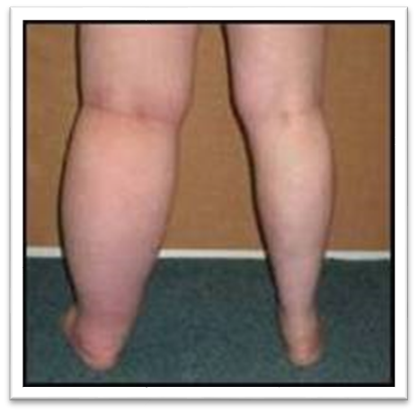
2. Pathophysiology of lymphoedema
Expected learning outcomes
Identify primary and secondary forms of lymphoedema
Stages of lymphoedema
Signs and symptoms

Slide 13
Types of lymphoedema
Primary lymphoedema is present from birth involving impaired or absent lymph vessel and/or lymph node development.
Secondary lymphoedema is caused by some form of pressure or trauma to the lymphatic system e.g surgery or vascular insufficiency.

Slide 14
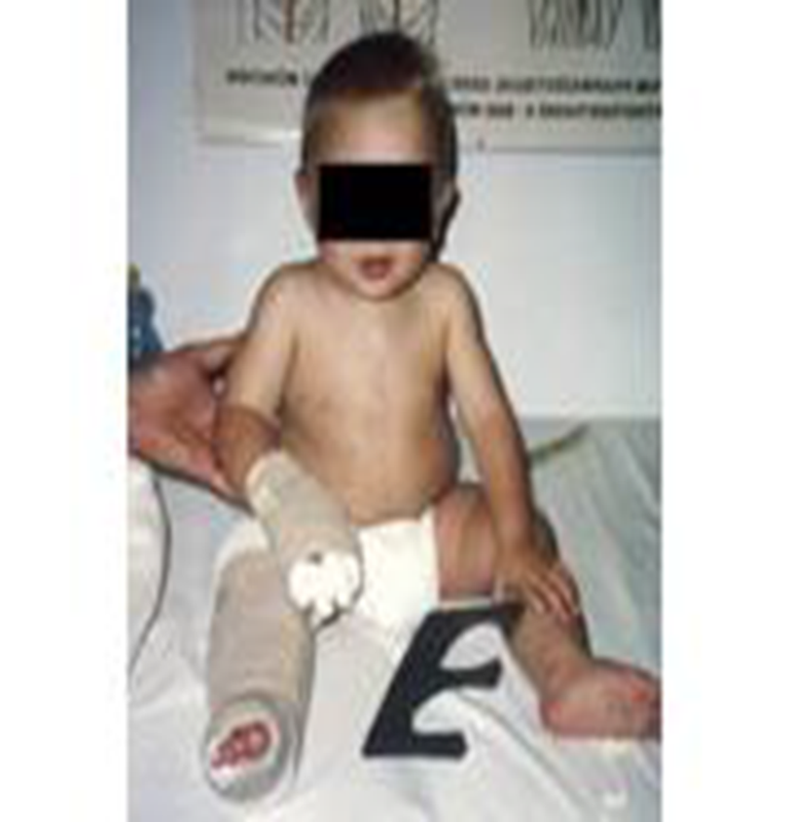
Primary Lymphoedema
Primary lymphoedema is rare, affecting 1 in 100,000 people, however the true incidence is likely significantly underestimated.
It may be present at birth or develop later in life, and often occurs as a result of a genetically determined malformation of the lymphatic system.
All Ireland lymphoedema clinical guidelines 2022
Notes:
Some patients may have a level of lymphatic dysfunction not attributable to other recognisable causes. This may be related to a low level of primary dysfunction not associated with a recognised syndrome.
Symptoms may develop in teenage years due to hormone changes and increase fluid, usually ‘fat ankles’
Some patients may have no symptoms until mid life when the venous system slows down. The lymphatic system is overloaded and they have chronic oedema and often recurrent cellulitis.
Risk of ulcers
Early intervention of skin care, exercise and compression garments can prevent lymphoedema progressing and avoid complications

Slide 15
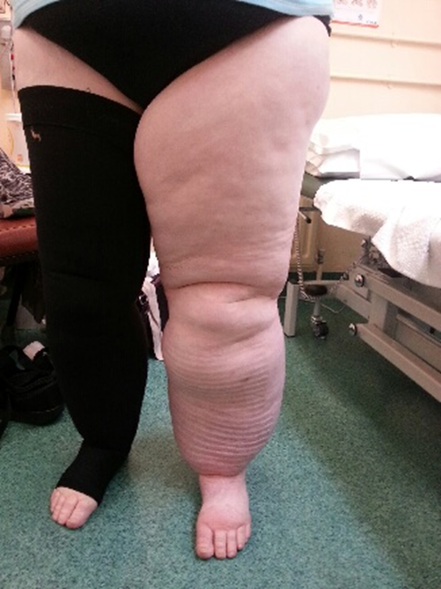
Secondary lymphoedema causes
Obesity
Cancer - surgery/radiation/induced
Injury/trauma
Infections
Chronic venous insufficiency
Heart failure
Filariasis – parasitic, sub tropical regions

Slide 16
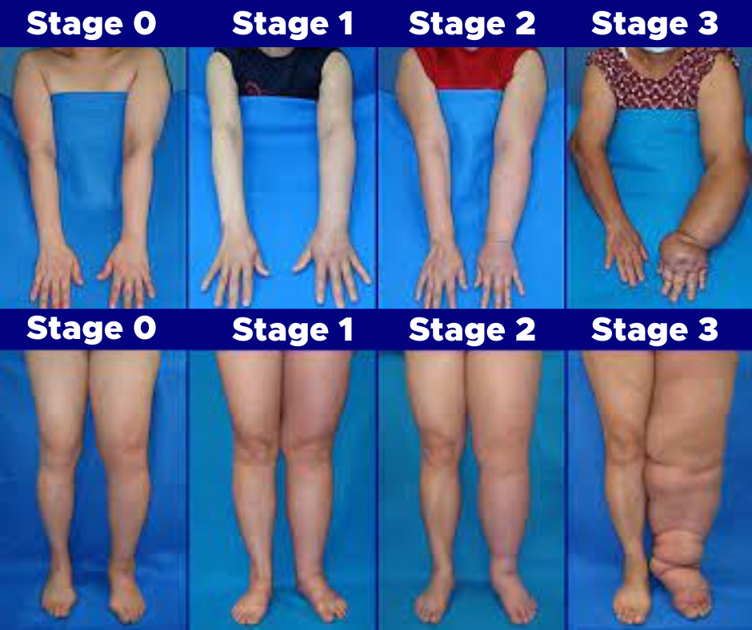
Stages of lymphoedema
Notes:
Stage 0 : a subclinical stage where swelling is not evident despite impaired lymph transport, may exist for months or years.
Stage I: early onset where there is an accumulation of tissue fluid that subsides with limb elevation. Oedema may be pitting at this stage.
Stage II: Limb elevation alone rarely reduces swelling and pitting is manifest.
Stage III : the tissue is hard (fibrotic) and pitting is absent. Skin changes such as thickening, hyperpigmentation, increased skin folds, fat deposits and warty overgrowths develop.

Slide 17
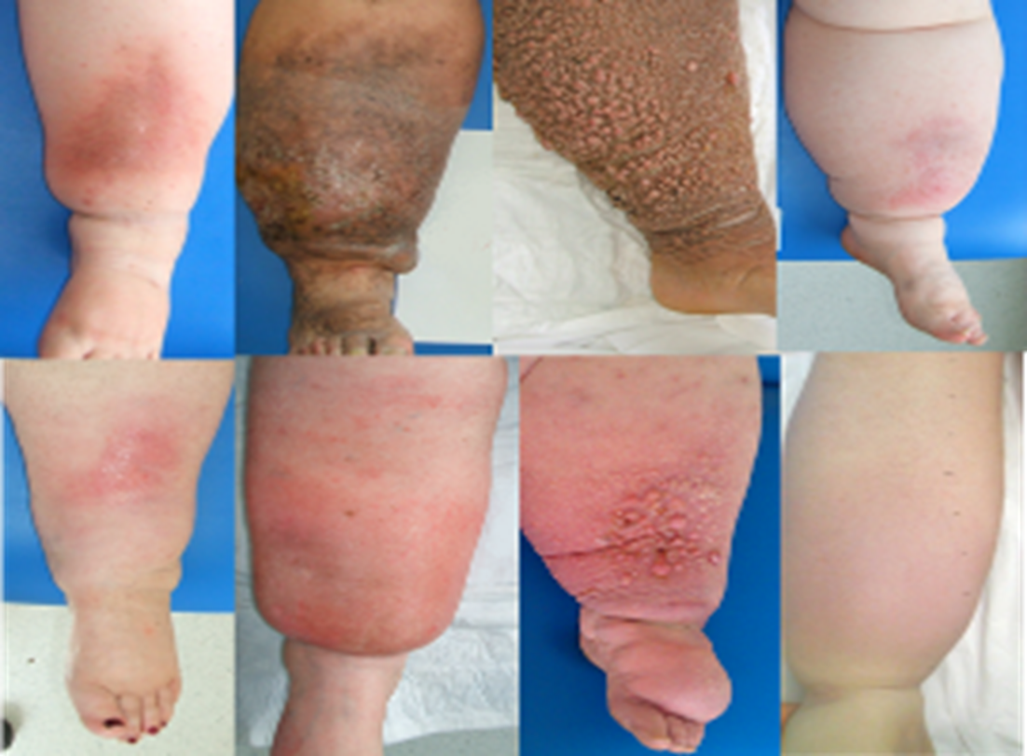
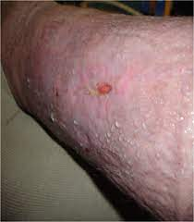
Skin conditions associated with lymphoedema
Haemosiderin staining
Papillomatosis
Lymphorrhoea

Slide 18
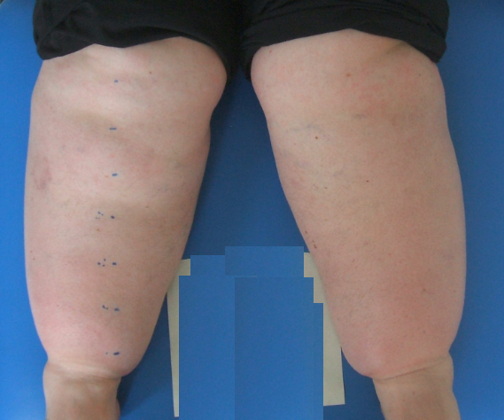
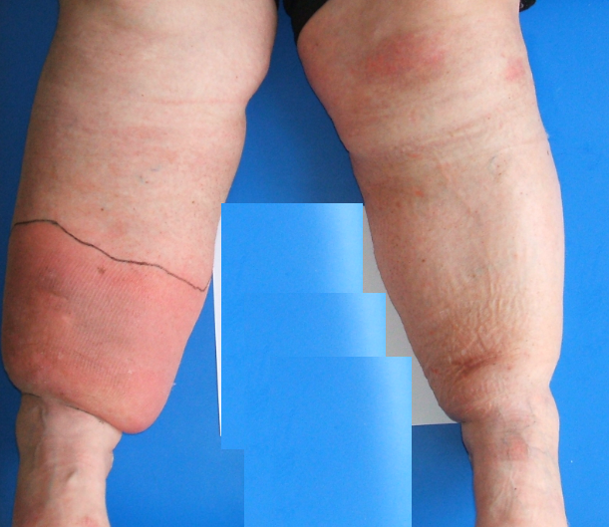
Obesity related lymphoedema
People living with obesity may have:
Impaired lymphatic flow - abdominal adiposity
Abnormal inflammatory responses
Reduced ability for lymphatic regeneration
Prevalence (BMI >40kg/m²):
Lymphoedema: 33%, Lifetime hx of cellulitis: 18.7%
Associated with worse physical function, independent of BMI.
O’Malley, E., et al. "Obesity-related chronic lymphoedema-like swelling and physical function." QJM: An International Journal of Medicine 108.3 (2015): 183-187
Notes:
The fact that six out of every ten of our population is overweight or obese means that Ireland faces a dramatic increase in chronic diseases. increased significantly between 1990 and 2011 from 1.4% to 3.6%2 . This increase in prevalence is a concern as class 2 and 3 obesity is associated with a higher risk of ill health and premature mortality than class 1 obesity7. (Clinical Practice Guidelines – Epidemiology of Adult Obesity in Ireland 2022 )

Slide 19
Oncology related lymphoedema
Surgery may remove lymph nodes
Radiotherapy may damage lymph nodes
Scars/burns on skin (surgery and radiotherapy) may affect
lymphatic flow
Chemotherapy may cause additional swelling

Slide 20
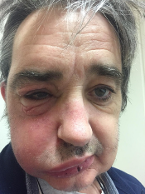
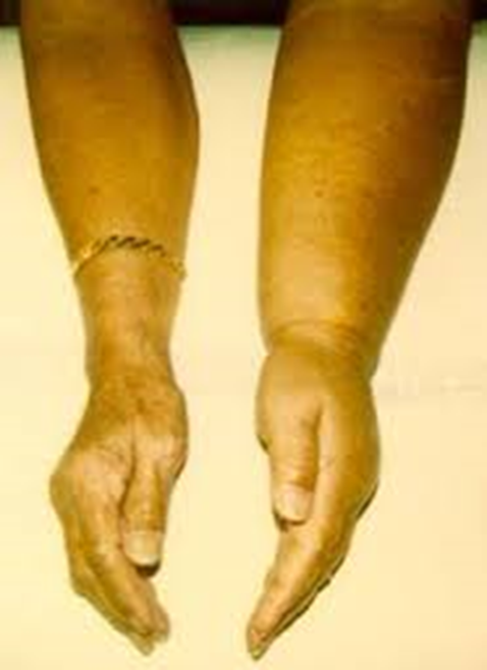

Slide 21
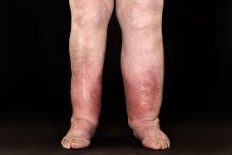
Vascular insufficiency
For blood to be effectively taken against gravity back to the heart the body needs valves in the veins to prevent the backflow of blood
When the deep system has faulty valves (the valves do not close tightly allowing the blood to leak) changes can start to occur within the legs. This is known as venous insufficiency and results in venous hypertension which overloads the lymphatic system.
Notes:
High incidence in later life due to slowing of the vascular system, immobility and co morbidities.

Slide 22
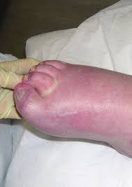
Lymphoedema related to immobility
Reduced movement can lead to lymphoedema due to lack of muscle pump
Typically seen in the elderly as they become less mobile.
Sleeping in a chair
E.G. Spina bifida,
Spinal cord injuries

Slide 23
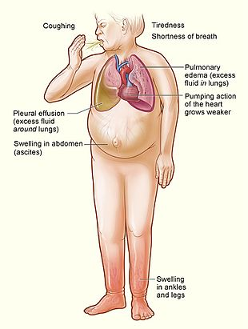
Lymphoedema related to heart failure
Decompensation or Heart Failure
Weakened heart muscle with cardiac congestion
This leads to increased pressure in the venous system, thus leading to poor venous drainage

Slide 24
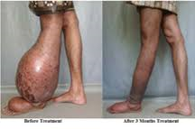
Filariasis
Lymphatic filariasis is a parasitic infection caused by small worms (nematodes) and transmitted by mosquitoes.
When lymphatic filariasis becomes chronic, it causes lymphedema or elephantiasis (swelling of the skin and other tissues) of limbs and hydrocele.
Notes:
Adult worms lodge in the lymphatic vessels and disrupt the normal functioning of the lymphatic system. The worms can live an average of six to eight years and throughout their life produce millions of small larvae (microfilariae) that circulate in the blood.

Slide 25
Lymphoedema in palliative care
Lymphoedema in palliative care is a significant problem.
In non-cancer patients an oedema prevalence of 50% is reported near the end of life.
This may occur months prior to death and may be amenable to management during that time.
Best, Megan, et al. "Lower-limb oedema at the end of life: how common is it?." Journal of Lymphoedema 13.1 (2018).

Slide 26
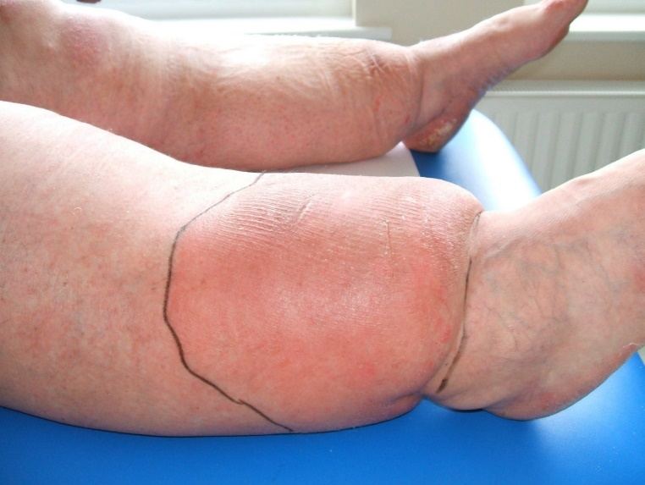
Complications- Cellulitis
Cellulitis- egg or chicken? Vicious circle
Lymphoedema a major factor in 18% of lower limb cellulitis
50% of lower limb cellulitis is recurrent and is thought to be associated with lymphatic stasis
40% of lymphoedema patients will have at least one episode of cellulitis per year
If you suspect cellulitis refer to the GP to avoid sepsis.

Slide 27
Complications- wounds
Lower limb lymphoedema can lead to a risk of ulceration.
Of 7077 patients with chronic leg oedema, 12.70% had wounds.
Controlled swelling was associated with a 50% lower risk of wounds.
Burian, Ewa Anna, et al. "Wounds in chronic leg oedema." International wound journal 19.2 (2022): 411-425.

Slide 28
4. Education needs of individuals who have, or at risk of developing lymphoedema
Know who is at risk of lymphoedema
Know what advice to give to people at risk
Identify suitable sources of information on reducing the risk of lymphoedema and how to access treatment

Slide 29
Strategies to reduce risk
Meticulous skin, nail care, moisturise
Movement/activity
Strengthening - Low weights and go slow
Regular exercise e.g. swimming (high hydrostatic pressure)
Anything that is enjoyable
Immediate antibiotics if signs of infection
Maintain or reduce weight

Slide 30
Reducing the risk of lymphoedema in oncology
In some cases the risk of lymphoedema can be reduce if detected when subclinical (stage 0) with short term treatment
If lymphoedema develops, it can be treated early to reduce progression.
Stage 1 lymphoedema can be self managed with support for compression garments

Slide 31
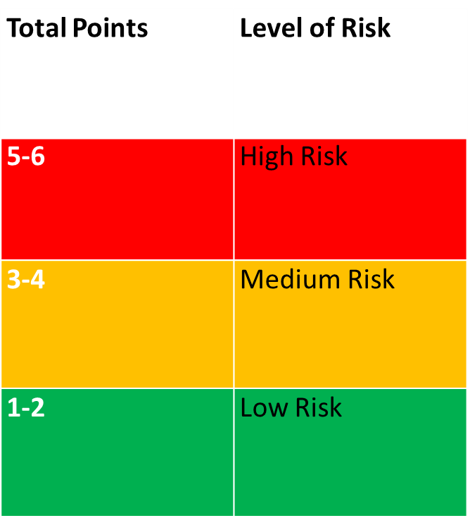
What is the risk of lymphoedema after breast surgery
All lymph nodes from the armpit removed and or Radiation therapy =High Risk
Some lymph nodes removed
Chemotherapy
BMI > 30
Seroma/cording after your surgery
Age > 65 years
Sedentary lifestyle
Scores
Each item form 1-6 equals one point - add scores and see the table

Slide 32
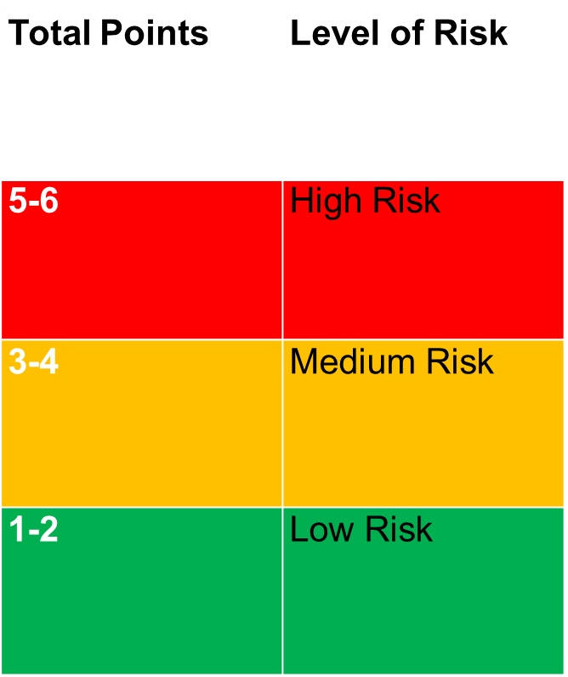
What is the risk of developing lymphoedema in my leg?
All lymph nodes removed from the groin = High Risk
Radiation to your groin- High Risk
Drainage of excess fluid after surgery and/or infection
Chemotherapy
BMI > 30
Age > 65 years
Sedentary Lifestyle
Scores
Each tick from 1-6 equals one point- add scores and see the table

Slide 33
4 key points to discuss with patients to reduce risk
Meticulous skin care
Activity (including breathing exercises)
Manage weight
4. Patient advice booklets
Available to order at healthpromotion.ie or to download at hse.ie/lymphoedema

Slide 34
Risk reduction booklets
Notes:
Hse.ie/lymphoedema

Slide 35
Early symptoms of lymphoedema
A feeling of heaviness in the limb
Tingling or tightness/fullness in the limb
Swelling –rings/clothes feeling tighter on affected side
Discomfort in the limb

Slide 36
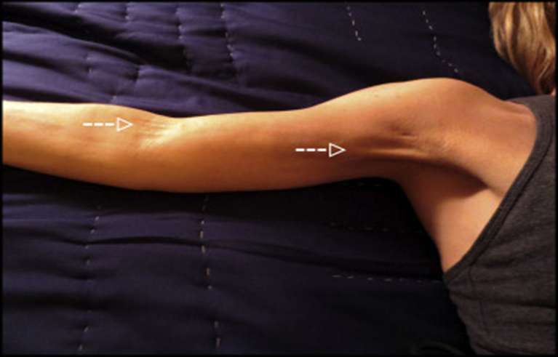
Cording
Interruption/trauma to lymphatic vessels during biopsy or axillary lymph node dissection causing inflammation, scarring, fibrosis
Usually occurs within 2 – 8 weeks post surgery
Incidence : around 30%
Brunelle, Cheryl L., et al. "Patients who report cording after breast cancer surgery are at higher risk of lymphedema: results from a large prospective screening cohort." Journal of surgical oncology 122.2 (2020): 155-163.
Refer to a physiotherapist for treatment
Notes:
Limited ROM
Pain
Can be very distressing to the patient.
Can occur after SLNB

Slide 37
Scar management
Scarring can cause issues for patients with their range of motion, pain and also with the superficial lymph flow.
Patients should be taught self management of scars to prevent adhesions
ROM restriction refer to physiotherapy

Slide 38
Non oncology higher risk areas for lymphoedema
Obesity services
Older people (increases co-morbidities)
Vascular services
Paediatrics (genetic syndromes and oncology)
Neurology- immobility related e.g. spina bifida
Trauma
Post op e.g. TKR
Dermatology
Notes:
Discuss why each area is at risk of lymphoedema
TKR oedema >3 months

Slide 39
5. Explore the basics of lymphoedema management
Recognise the need for long term monitoring and maintenance for lymphoedema
Identify the urgency for treatment of cellulitis and the treatment options
Identify limitations of own role and when and where to refer to a qualified lymphoedema practitioner.
Recognise the psychosocial and financial impact of lymphoedema

Slide 40
Lymphoedema management
There are 2 stages of lymphoedema treatment
Maintenance treatment
For Stage 1 and early stage 2 lymphoedema with supported self management
Intensive treatment (specialist services)
For stage 2 and Stage 3 to decongested the area.
Once the oedema is under control or treatment plateaus then care continues as for maintenance with supported self management

Slide 41
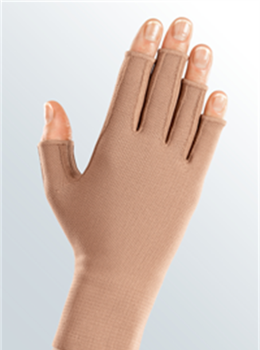
Maintenance treatment
Skin care
Regular exercise
Compression; garments, wraps, pumps
Self massage
Aids for getting garments on/off
Patients at this stage should be self managing with 6 month follow up for review and support.

Slide 42
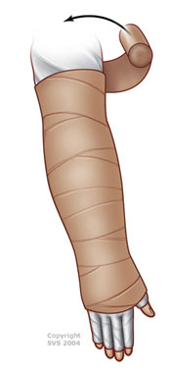
Specialist treatment
Compression- bandages
Manual Lymphatic Drainage (MLD)
Exercise
Skin care
Treatment is ideally daily or 3 times a week for MLD and bandage changes.
Once stabilised and there is no more reduction in volume then supported maintenance treatment starts.

Slide 43
The role of all healthcare professionals
Education for patients with lymphoedema
Exercise/movement/activity
Skin care
Elevation
Weight management if applicable
Know how to get a compression garment on and off. (video link at end)
Refer to a lymphoedema specialist. (current services listed at hse.ie/lymphoedema)
Notes:
Motivation and as with any chronic condition

Slide 44
Treatment outcomes

Slide 45
Treatment outcomes

Slide 46
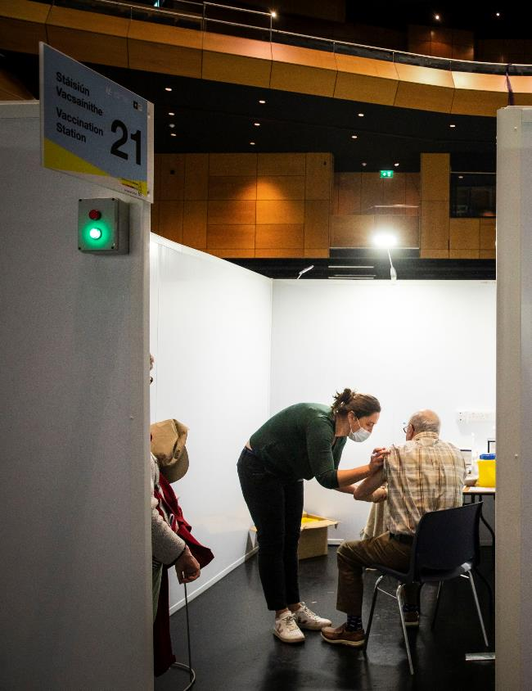
All Ireland Lymphoedema Guideline
Collaboration with Northern Ireland.
Endorsed by Lymphoedema stakeholders in Ireland
Available at hse.ie/lymphoedema

Slide 47
Lymphoedema ELearning module

Slide 48
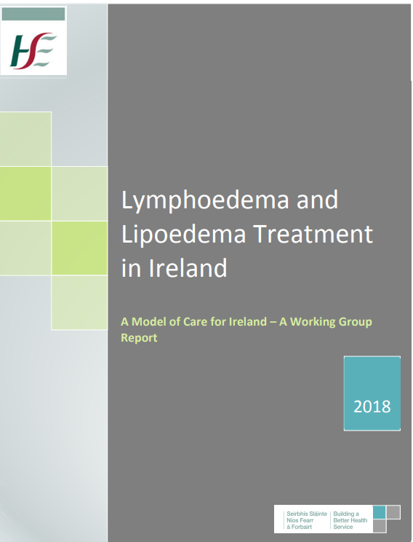
HSE Model of care

Slide 49
References
Best, Megan, et al. "Lower-limb oedema at the end of life: how common is it?." Journal of Lymphoedema 13.1 (2018).
Brunelle, Cheryl L., et al. "Patients who report cording after breast cancer surgery are at higher risk of lymphedema: results from a large prospective screening cohort." Journal of surgical oncology 122.2 (2020): 155-163.
Burian, Ewa Anna, et al. "Wounds in chronic leg oedema." International wound journal 19.2 (2022): 411-425.
Health Service Executive (HSE) Ireland – Model of Care for Lymphoedema and Lipoedema Treatment in Ireland 2018
HSE "All-Ireland Lymphoedema Guidelines 2022.“
O’Malley, E., et al. "Obesity-related chronic lymphoedema-like swelling and physical function." QJM: An International Journal of Medicine 108.3 (2015): 183-187.

