Slide 1


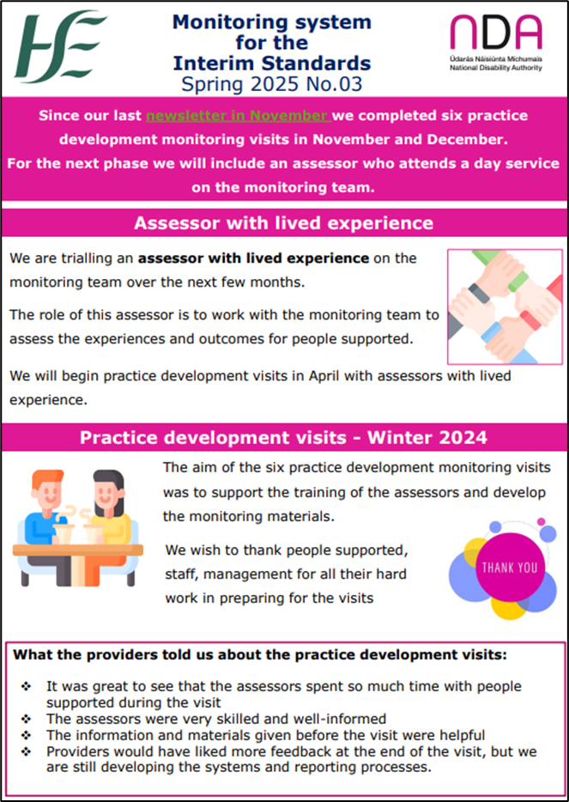

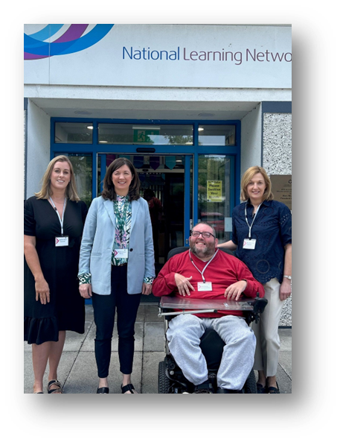
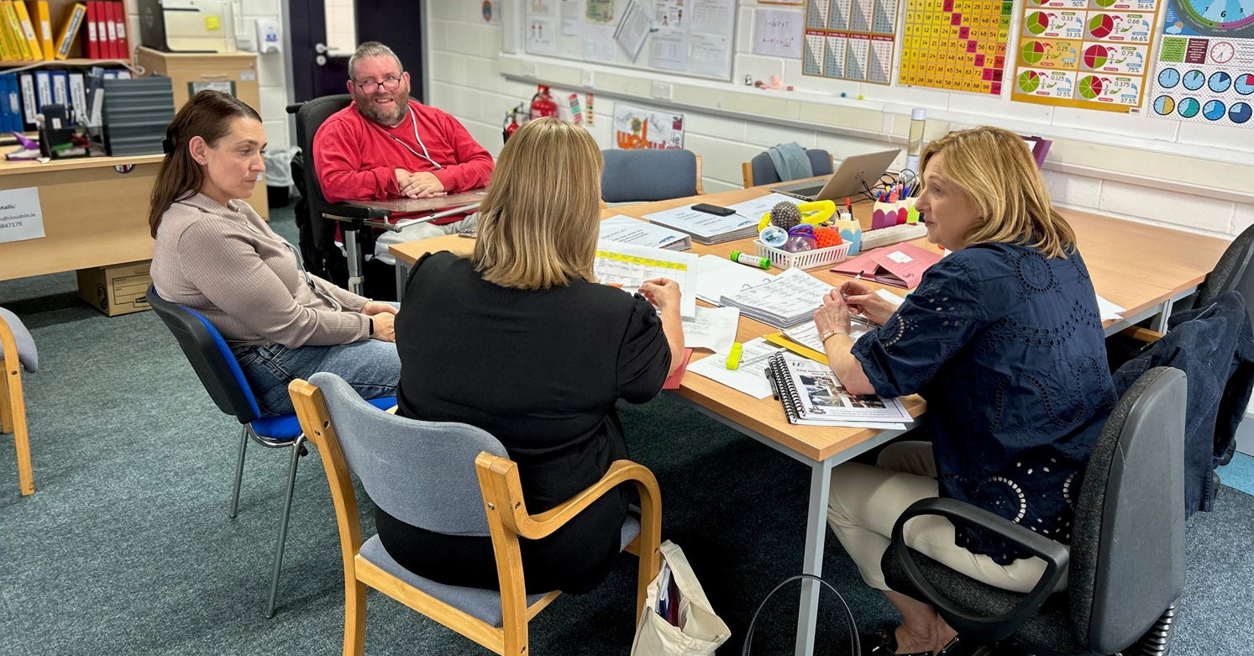
Day Services - Monitoring Update
Autumn 2025
Since our last Spring newsletter, there have been 11 monitoring visits from April to June in Block 1 of the trial.
The aims of Block 1:
Develop the assessor with lived experience role.
Trial how the assessor team gathered information during a monitoring visit.
Assessor with Lived Experience Role
Assessors with lived experience:
Were recruited, trained and paid for the new role.
Helped prepare for the monitoring visits.
Met with people who attend day services and listened to their stories and experiences during the visit.
Provided feedback to the National Disability Authority to improve the monitoring process.
From left: Martina Canna, Martina Lanigan, Jack Kenny, Mary Mulrooney
Monitoring team in action!

Slide 2


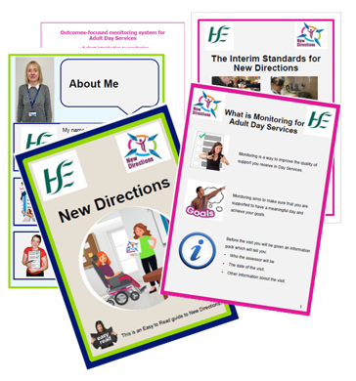

People who attend day services told us:
The visits went well and were enjoyable.
They would like it if there were more Assessors with Lived Experience.
Assessors with lived experience told us: The monitoring visit was a positive experience and a meaningful way to connect with people, but it can be a long day.
Assessors with lead responsibility told us: The different ways of gathering and sharing information worked well. Scheduling dates for visits can be challenging.
Providers who had a visit told us:
The information given before the visit was helpful. They would like feedback after a visit but understand that it is a trial.
We wish to thank people supported, staff and management for welcoming us and for all their hard work in preparing for the visits.
Day Services Monitoring Visits - Summer 2025
What we were told about the monitoring visits:

Slide 3
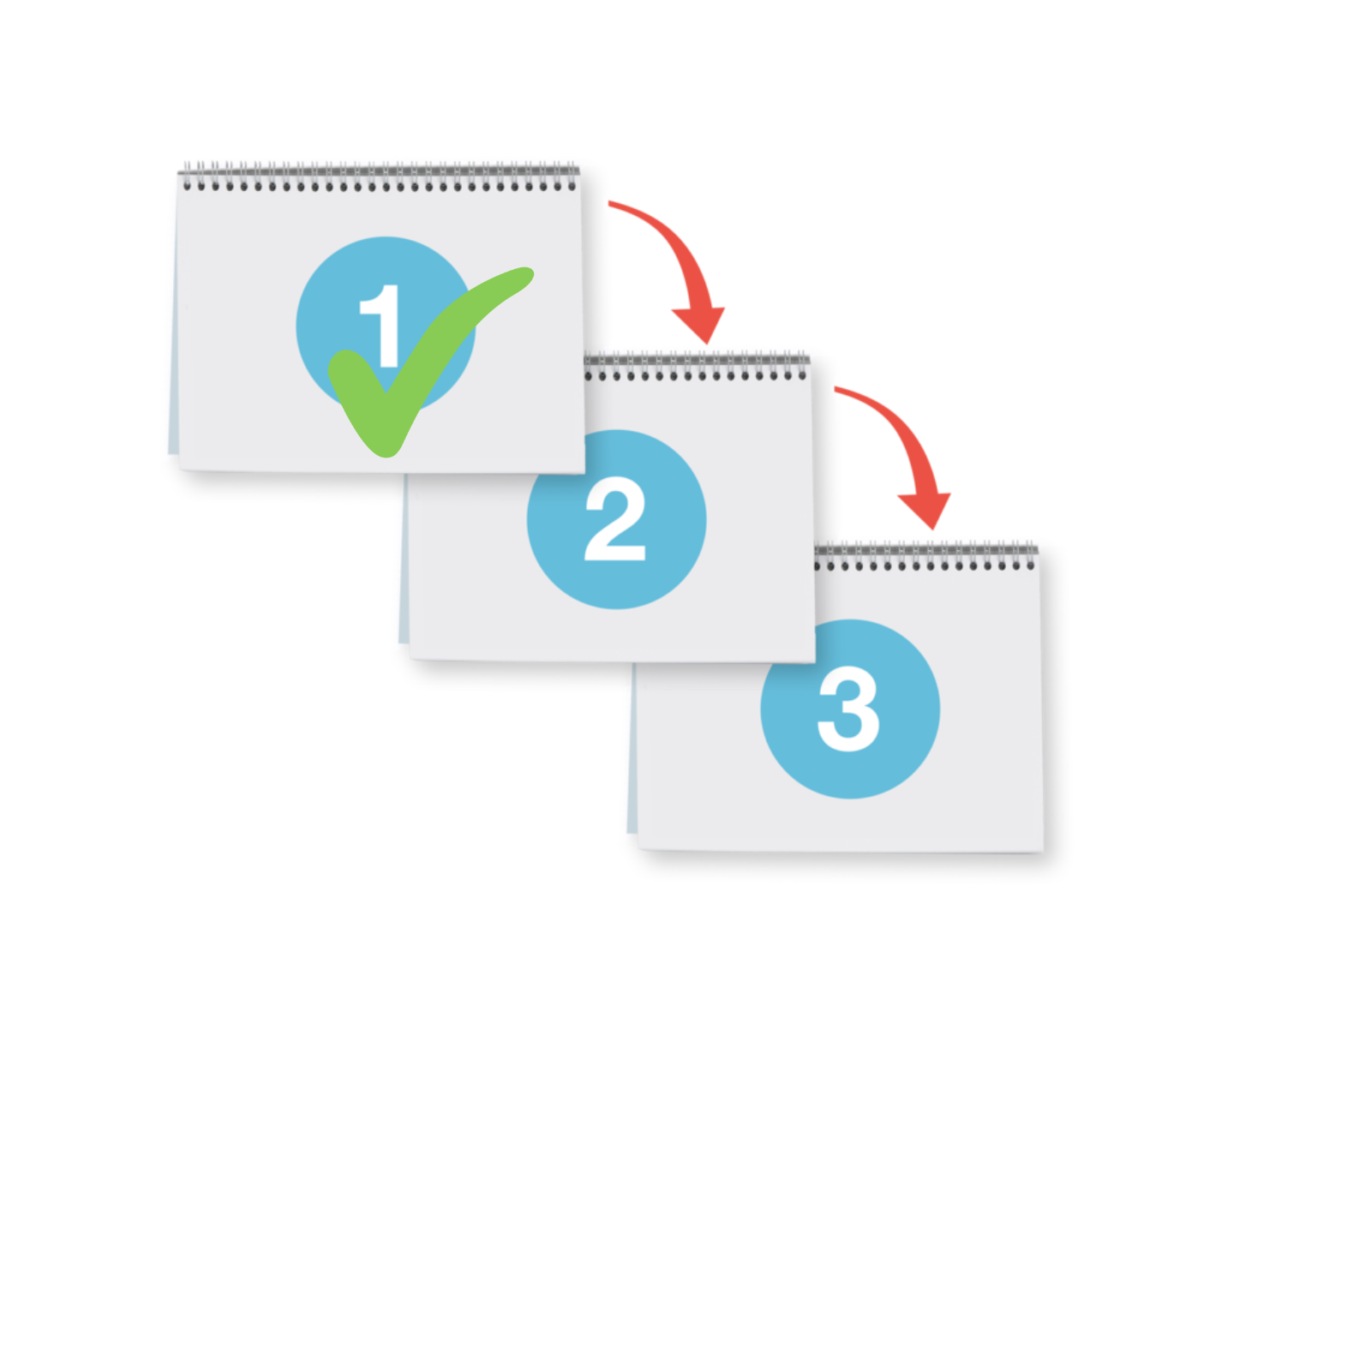
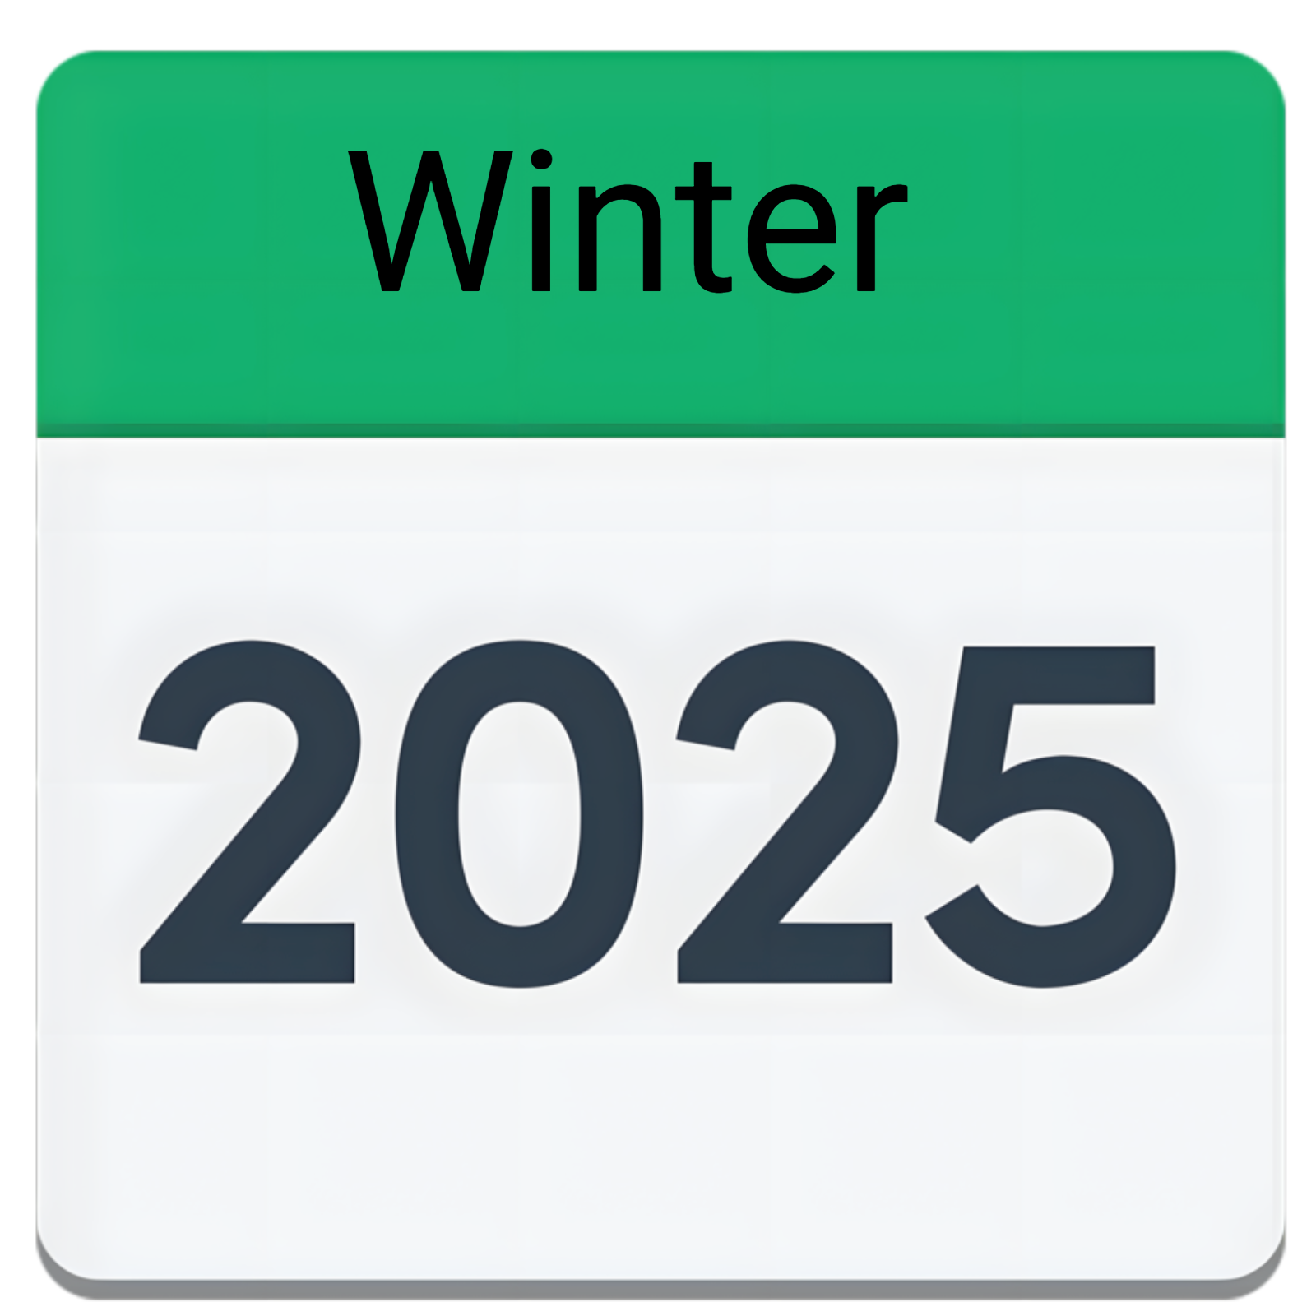

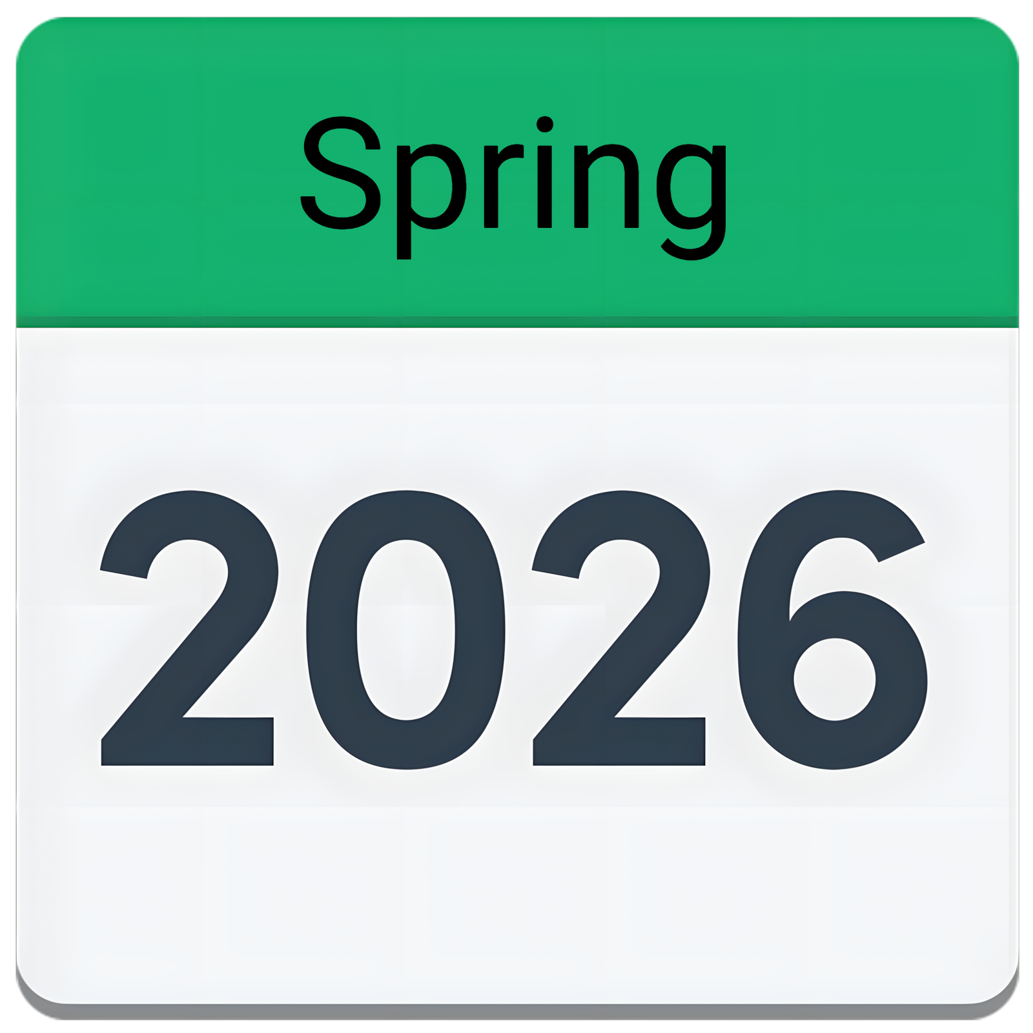

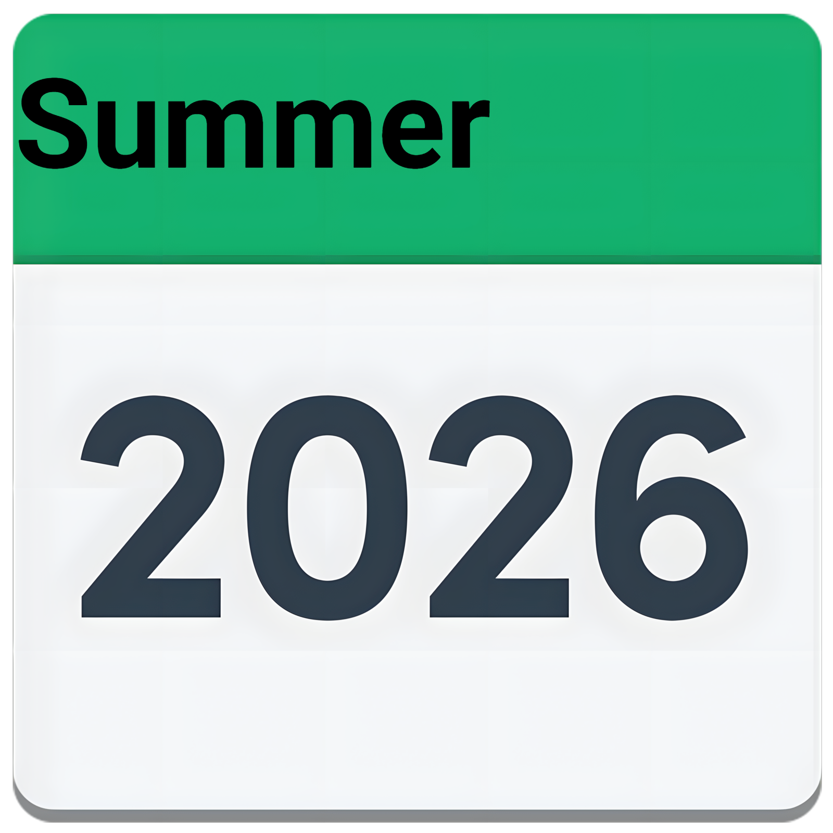
Monitoring Trial - 2025/2026 Plan
The trial has three Blocks.
Block 1 is complete.
We are preparing for Block 2.
Block 3 will happen in 2026.
Block 2 of the trial will take place from
Winter 2025 until Spring 2026.
During Block 2 the monitoring team will:
Ensure all assessors understand their role.
Be clear about what information the team is collecting.
Check the information carefully.
Use the information to see how people are supported in line with the Interim Standards for New Directions.
Block 3 of the trial is planned to take place in 2026. An update on timelines will be provided in the next newsletter.
Block 3 of the trial will focus on feedback and reporting. After visiting a day service, the monitoring team will give feedback and write a report on the visit.
Block 2
Block 3
Selecting Locations for the trial
In February 105 providers said that they wanted to be part of the trial.
The National Disability Authority and HSE is picking the locations from this list using a selection criteria.

Slide 4





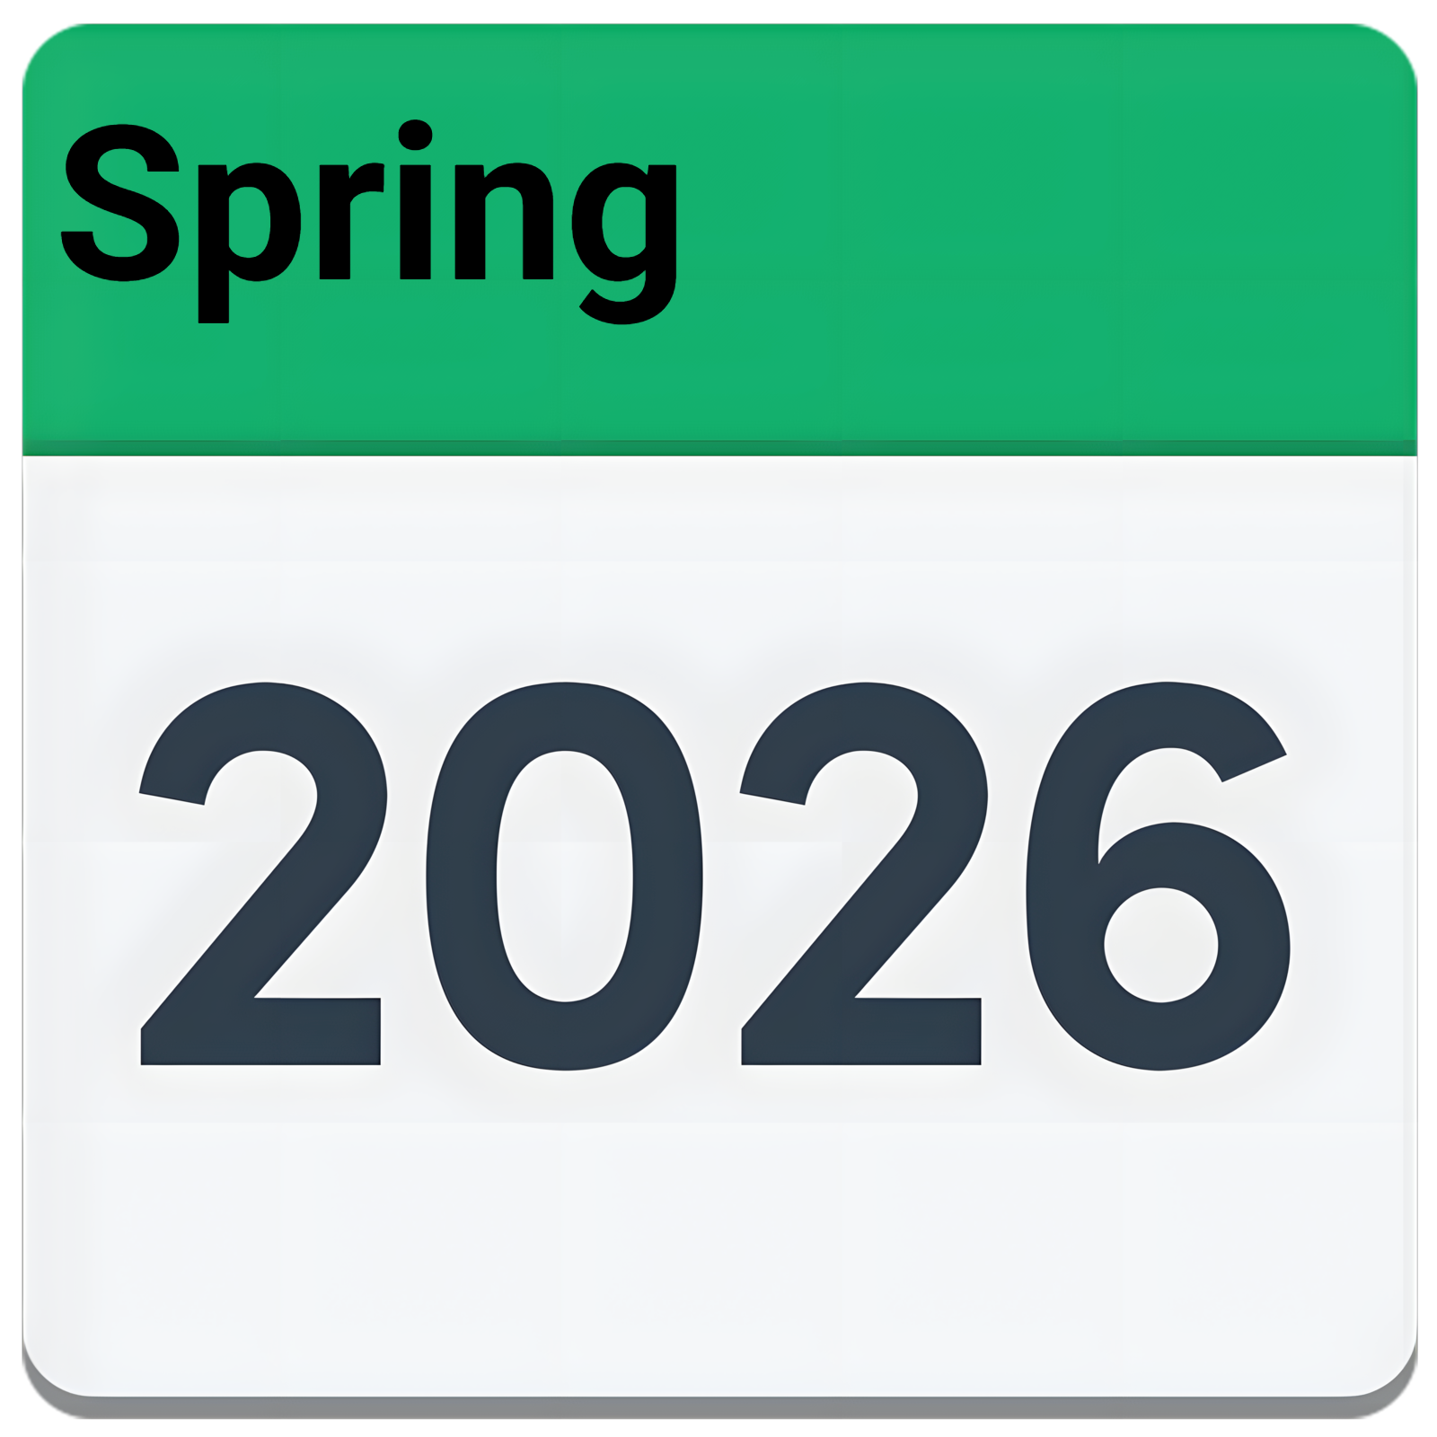

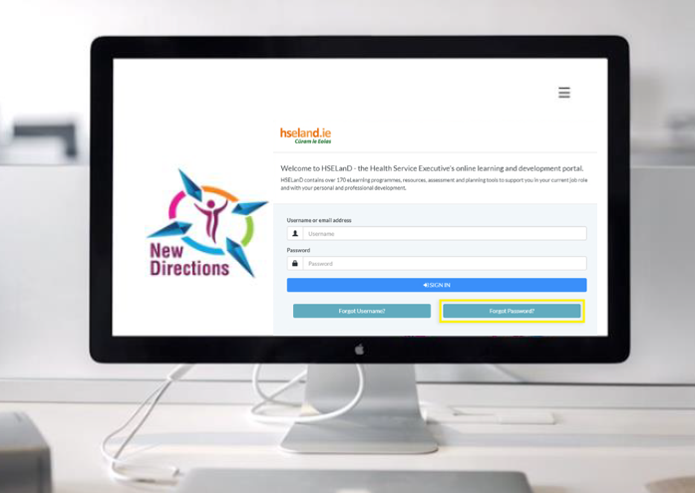
Next Steps
As we prepare for Block 2, we will continue to provide training and development for the monitoring team and help prepare day services for their visit.
The National Disability Authority, HSE, The Monitoring Working Groups & ACE Communications are working together to lead the developments for Block 2 based on feedback gathered in Block 1.
Communications
Our next Newsletter will be issued in the Spring of 2026.
Recent communications include:
Monitoring Newsletter Spring 2025
Easy to read guide to New Directions
New Directions explainer video
Easy to Read guide to the Interim Standards for New Directions
02
01
02
01
03
03
For More Information
If your Location would like to participate in the trial an expression of interest will be issued in Q1 2025
Visit New Directions website www.hse.ie/newdirections
Email: DayServicesMonitoring@hse.ie

