Slide 1
NGO strategy implementation monitoring report – Q2 2022
HSE National Office for Suicide Prevention

Slide 2
Table of Contents
1
Introduction and overview this quarter
4
2
Overview of progress on strategic goals
5
3
6

Slide 3
1: Introduction
Many of our NGO partners work with specific priority groups that have been identified in CfL, for example, people with mental health problems, those bereaved by suicide, the LGBTI+ and Traveller communities and younger people.
Our NGO partners offered a diverse range of interventions to services users / clients this quarter, including psychotherapeutic counseling, bereavement supports, addiction and wraparound supports, helplines, email and text supports.
Although Covid 19 was still very much present, in Q2 there was a cautious return to more face to face supports and service provision. Covid outbreaks in services continued to have impact and resulted in reduced staff capacity for some.
This is second implementation monitoring report for Connecting for Life (CfL) for the activities of our NGO partners. Comprehensive work is being carried out by our NGO partners and this report does not capture everything. It provides a broad overview of reach and developments in Q2 2022.
NOSP works to ensure that funded initiatives align to the strategic objectives of CfL. A Service Level Agreement (SLA) is in place with all funded NGOs, The NOSP aims to work collaboratively with our NGO partners and to facilitate opportunities for networking, sharing knowledge and learning, resources and expertise. The NOSP continues to facilitate and support monthly networking calls with representatives from all funded NGO partners and to have NGO representation on the National CfL Cross Sectoral Steering and Implementation Group.

Slide 4
This quarter updates were received from 17 CfL NGO implementation partners:
Aware
BeLonG To
Dublin Simon Community
Exchange House Ireland
First Fortnight
Family Resource Centre (FRC)
ISPCC Childline
LGBTIreland
Men's Health Forum in Ireland (MHFI)
MyMind
Pieta House
The Samaritans
Shine
Spunout
Suicide or Survive (SOS)
USI
Turn2Me

Slide 5
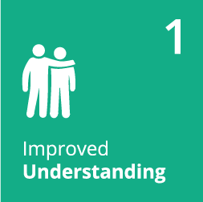
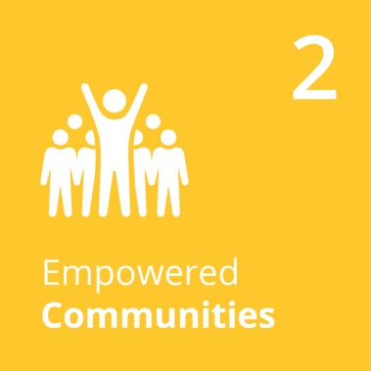
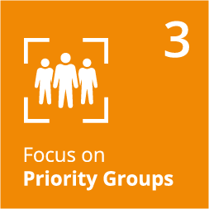
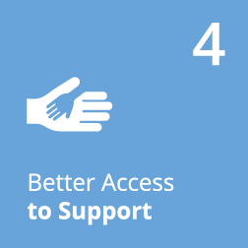
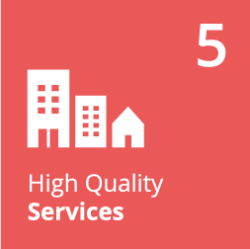
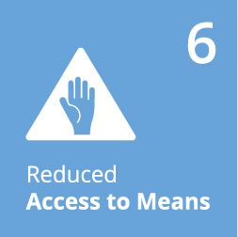
2: Overview of progress on CfL strategic goals

Slide 6
Goal 1: Improved understanding
1.1 Understanding suicidal behaviour | 1.2 Awareness of services | 1.3 Reducing stigma | 1.4 Media and reporting
MHFI Cairde Project - Signposting staff on the construction sites to existing mental health and suicide prevention resources, training and support services - as an interim measure before the CAIRDE package is fully operational. Samaritans collaborated with MHFI to support Men’s Health week in June. Also continues their relationship with the GAA and the development of 'Huddles' upskilling Health & Wellbeing officers in clubs and empowering them to engage in mental health discussions with players | Childline.ie has added new information articles including: How to combat Automatic Negative Thoughts; How to handle traditional or ‘off-line’ bullying; The importance of having a hobby or interest that you love; 7 simple things you can do to improve your day. There were 274 contacts during this period relating to suicide Spunout continued provision of specific information to at-risk groups who require more targeted information services (e.g. Disability, Traveller, LGBTI+, Migrants, BIPOC) Samaritans - Continued training and awareness sessions with the IMI & INOU staff,’ Continue to support 6 other helplines with their callers out of hours. And launched the "Talk to Us" campaign in July highlighting Samaritans 24/7 support BeLonG To continued to run awareness raising and help seeking encouragement campaigns through social media. Website Visitors: 13,958; Started to plan the annual 'Better Out Than In' digital campaign for September which promotes help-seeking behaviour among LGBTQ+ young people and utilises organic and paid social to do so. | Shine – launched the month long Green Ribbon campaign Sept 1st . The See Change project continues to deliver their workplace programme, 11 workshops and 234 managers participated. The Ambassador Programme training offering included topics on: What is stigma, Self care, telling your story and Headline media guidelines Turn2me in collaboration with Exchange House have completed the series of 3 films and the final was launched in Q2 USI - Resource hub for student union officers developed & launched. Mental Health Campaign ‘Open Up’ continues & Reflect event held in February | Shine’s Headline Project: Reviewed 3,053 online articles (538 articles were logged for non-compliance with guidelines during this period (18% of articles) Reviewed 225 broadcast segments from 187 separate TV and radio shows. 25 pieces (13%) were logged for non-compliance with guidelines during this period (5 TV & 20 radio) Delivered 4 workshops/ information sessions Collaboration with The Samaritans and the BAI's Media Literacy Network ongoing to expand the current Press Council Code of Practice to include self-harm and attempted suicide. Mental Health Media Awards planning underway. New 'audience choice' category included

Slide 7
Goal 2: Empowered Communities
2.1 Multiagency community responses | 2.2 Accurate information and guidance | 2.3 Education and training
BeLonG To held 3 National network meetings during Q2 to provide a forum for knowledge exchange, peer support, and collective planning. This included an in-person meeting where Youth Workers worked on the priorities of the network, and also participated in a resilience workshop. 736 people from the National Network youth groups across Ireland came together to celebrate Dublin Pride. BeLonG To facilitated care and support to front line youth workers through peer support and facilitated access to MyMind for frontline workers in need. | FRC’s Mental Health Promotion Project: delivered 3 x Suicide Prevention Code of Practice workshops to 32 participants. These sessions were co-facilitated by the three HSE Resource officers for Suicide Prevention in these areas (Dublin South, Northside FRC Limerick, Silver Arch FRC Nenagh) 22 people participated self care sessions 41 participants in the WRAP programme co-facilitated with Mental Health Ireland 30 participants in the online wellbeing programme – 30 minutes for me! | SOS (Suicide or Survive) training and education offering continued in Q2 as follows: 10 Wellness Webinars were delivered to the community and in partnership with other mental health service providers, charities, statutory and voluntary organisations in Q2 attended by 227 participants. WRAP - 7 programmes were delivered, 4 to the general public, 2 to Eden programme participants, and 1 to frontline workers. 149 people completed. Online Wellness Workshop - 1567 people availed of the online version of the Wellness Workshop for those over the age of 18 years (www.wellnessworkshop.ie) and 158 availed of the online Wellness Workshop for people aged 16 to 25 (www.youmatter.ie) Eden programme continues in Q2 (26 week educational programme with a therapeutic element for people who have attempted or contemplated suicide) – 9 people participating in Q2

Slide 8
Goal 3: Focus on Priority Groups
3.1 Reducing suicide among priority groups | 3.3 Supports for young people
The Exchange House duty service (Phone & drop ins) supported 95 clients in Q2. Main areas of focus - 67% Accommodation, 10% mental health including suicidal ideation. Presenting issues - homelessness, depression, suicidal crisis, addiction, financial pressure, child protection issues, discrimination, legal/justice issues, sexual abuse, family relationships, grief loss, physical health Aware continued to deliver its CBT based Adult Life Skills programme: 22programmes delivered to 377 participants. Life Skills Online: 1 programme to 363 participants. Living Well with Bipolar Disorder: 5 programmes delivered to 53 participants LGBTIreland trained 180 professionals across 9 training workshops. 1 in person healthcare conference (110 participants); 2 in person seminars (72 participants); 20 Pride Workplace Talks (839 attendees). 5 peer support groups were facilitated over 15 meetings and attended by 117 people. | Spunout - Mental Health content readership total: 125,691 includes Lived Experience Content; Mental Health Literacy; Mental Health Crisis Factsheets. Continuing to promote and signpost towards critical mental health services, and monitoring of frequency that services are signposted. Spunout – launched the “Tune in to Burnout” campaign which aims to equip young people with awareness on how to recognise and prevent burnout, as well as the individual, environmental and societal factors that lead to it. Prior to campaign launch, we conducted a wellbeing survey with 1,000 young people, showing that 85% of 16-25 year olds are currently experiencing at least one of the main symptoms of burnout. In response, our campaign published 6 new factsheets, 7 ‘voices’ pieces from young people, a one-off video recorded podcast, one lived-experience video piece, and 7 TikTok videos taken from interviews with 2 subject matter experts. Childline.ie had 21,687 users in Q 2, with 113 page views relating to suicide. Continued promotion of the Childline listening service and online resources across social media through promoted and organic posts on Facebook, Twitter and Instagram. 2005 helpline texts were received and 3890 online chat conversations Childine 24 hr listening service received 26,601 calls

Slide 9
Goal 4: Better access to support
4.2 Therapeutic Interventions | 4.3 Support Services
Dublin Simon had 73 new referrals for counselling services & delivered 554 hours of 1:1 to referred clients (face to face 308 / remote 246). Main reasons for referral to service was depression-Anxiety-Addiction. Total Drop-in Visits: 272 , 149 of which were to the Out of hours service (all drop-in clinics are now operating on site again) First Fortnight delivered 153 creative therapy sessions and attended to a minimum of 185 calls over Q2. other work in Q2 includes: committed to ensuring its creative therapy service is trauma informed in line with best practice and commenced using an evaluation tool, to be reviewed at end of year. launched its outreach adult creative therapy service provision in Exchange House. This builds on our commitment to work in partnership with our NOSP partners in extending our creative therapy provision to at risk populations in line with CfL. The Music in Mind Programme was implemented in a partner DEIS 1 school. Music in Mind is a partnership programme between the National Concert Hall and First Fortnight. This included a singing and drumming programme (each consisting of 8 workshops for 20-25 children). A total of 45 children engaged in the programme. Currently reviewing the programme evaluations . MyMind provided approx 10,381 appointments of which 2,769 were at low fees. The Free session (Pilot Priority Group Project) provided 627 free appointments in Q2. Pieta House has worked with 2,629 unique intervention clients requiring support for suicidal ideation and/or self harm (1,058 Under 18; and 1,571 Adults). 10,027 calls were made to Pietas helpline during this reporting quarter (Average 110 calls per day). They also received and responded to 14,445 text messages in the period. Pieta's bereavement counselling service worked with 376 unique clients (58 Under 18; 318 Adults). 1,803 appointments were attended (147 of these were initial assessments) Turn2Me delivered 1,335 Adult counselling sessions and 79 support groups in Q2 | The Samaritans answered 96,239 calls and 1,234 emails this quarter and provided 16,263 volunteer Listening hours Pieta House Suicide Bereavement Liaison Service (SBLO) worked with 236 households in this quarter, delivering 1,174 client facing hours in the reporting period .

Slide 10
Goal 5: High quality services
5.4 Best practice among Practitioners
MHFI continues to progress its CAIRDE project, which aims to reduce male suicide in the construction sector. In Q2 developments included: Securing a PhD Scholar grant from the Irish Research Council (under their Employment-Based Postgraduate Programme) to focus on the development of the universal suicide awareness resource materials. Conducting research on 27 new construction sites - using materials translated into the main languages spoken (i.e. English, Polish, Romanian, Latvian, Lithuanian and Brazilian Portuguese). Received 519 completed questionnaires (in addition to the 615 from Q1) the focus of which was on their personal circumstances in relation to the construction sector, as well as their experience of anxiety, depression and suicidal behaviour (using validated scales). Starting the process of inputting data and identification of key emerging trends Started systematic review of selective suicide prevention approaches in the construction sector. Planning a recruitment strategy for qualitative interviews with male construction workers who have had suicidal ideation or been affected by suicide.

Slide 11
Goal 6: Reduced access to means
6.2 Lethal methods
The Samaritans continue linking with wider Samaritans work on High Risk Locations;

Slide 12
Goal 7: Better data and research
7.4 Research and Evaluation Plan
Samaritans - submitted the application for ethical approval for the Samaritans ‘Self Harm & stigma’ research project; BeLonG To - LGBT Ireland Report #2 commenced . Research instrument and questions finalised. Reviewing the survey questions for module 2 which is on the attitudes of the general public towards LGBTQI+ identities, experiences etc. Working on the brand identity for the research and website development. Expect to commence recruitment in September 2022. BeLonG To - Have commenced recruitment for the 2022 School Climate Survey to gather the experiences of LGBTQ+ students in Ireland including the impact of their school experience on their mental health. Findings will be launched in November 2022 during Stand Up Awareness Week. LGBTIreland - LGBTI+ Traveller & Roma peer research closed 4th July, after Dublin Pride; the FIRST ANALYSIS is on-going . The Research subgroup aims to launch the full report in October to mark National Coming Out Day and Positive Mental Health Week

Slide 13
HSE National Office for Suicide Prevention –
September 2022

