Slide 1





Contact Details
Urology Nurse:
Contact No:
Urology Department No:
Consultant Urologist:
Other:
Other:
Follow-up
Following completion of your treatment, your healthcare team will arrange for you to have your bladder checked again.
The information contained in this leaflet is intended
to support and not replace the treatment and care discussed with you and your healthcare team.
At this point, your healthcare team might recommend ongoing maintenance chemotherapy treatment.
What you need to know about your
CHEMOTHERAPY
treatment for
Non-Muscle Invasive Bladder Cancer
Scan the QR code to access the digital version of this information leaflet
The information contained in this leaflet is intended to support and not replace the treatment and care discussed with you and your healthcare team.
Chemotherapy PIL: Version 1
Published: June 2025
Review Date: June 2028
PIL No: NCCP-COM-106

Slide 2



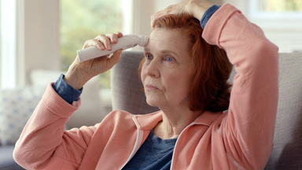
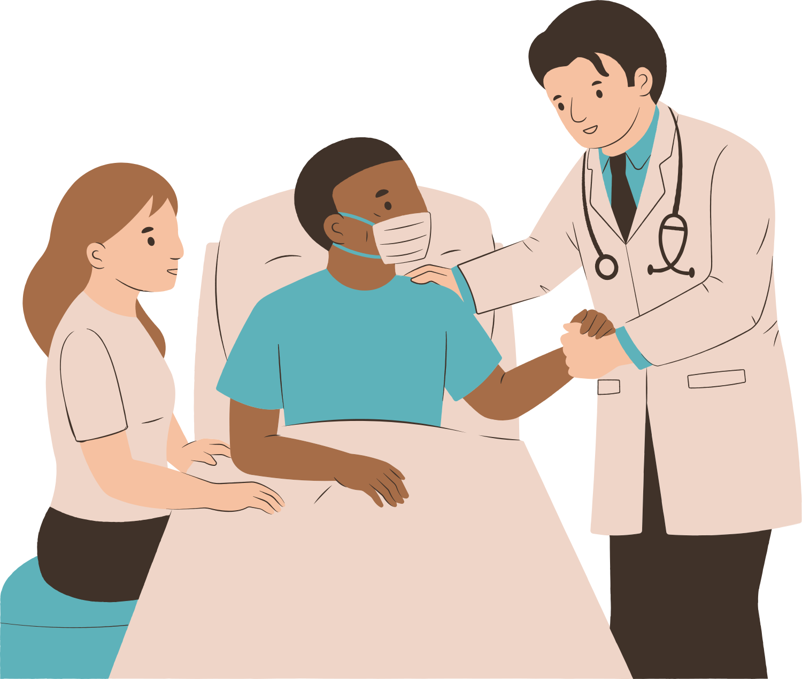
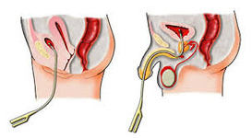
What you need to know about your Chemotherapy treatment
Most common side effects
You have had surgery to remove bladder cancer. Now you will get additional treatment to reduce the risk of the bladder cancer returning.
Your healthcare team will advise you how to manage side effects. These may include:
  Pain when passing urine
  A strong urge to pass urine
  Passing urine more often
  Blood in urine after treatment
  Flu-like symptoms, such as feeling tired and having a fever
  Possible skin rash and redness or swelling of the palms of hands and soles of feet
This is a chemotherapy treatment. You will attend one day a week for six weeks for this treatment.
  The treatment you will receive is called chemotherapy, which aims to destroy any remaining cancer cells in your bladder.
  You may require more treatment which your healthcare team will discuss with you.
What you need to know after your treatment
What you need to know before your treatment
  After 1 hour, you must pass urine to empty your bladder.
  For up to 6 hours after the treatment you should pass urine while sitting on the toilet to minimise the risk of splashing urine which may contain chemotherapy.
  Flush the toilet twice with the lid closed.
  Clean any skin that comes in contact with urine and wash your hands with soap and water after using the toilet.
  It is important to drink plenty of fluids for 48 hours after treatment. This helps to reduce the risk of side effects.
  Your healthcare team will discuss the necessary protective contraception you and your partner will need to use for the duration of your treatment course, and for one week after treatment finishes.
* These symptoms should improve after 48 hours
  Tell your healthcare team about your past medical history and medications, especially anticoagulants (blood thinning medication).
  If you take diuretics, (medication to help you produce more urine), you should take them after your treatment.
  Do not drink fluids for 4 hours before your treatment, unless you need to take small sips of water with your regular medication. This will help you hold your urine and prevents diluting the chemotherapy in your bladder.
  To check for signs of infection, you will be asked for a sample of urine before each treatment.
  Your genital area will be cleaned and, while you are lying down, a catheter will be inserted into your bladder.
You should attend your local Emergency Department if you experience any of the following.
  Severe allergic reaction
  Difficulty breathing, including shortness of breath
  Passing little or no urine
  The chemotherapy is put into your bladder through the catheter (max of 50 mls of fluid).
  The catheter is removed.
  The chemotherapy should remain in your bladder for up to 1 hour.
Catheter
Image 1

