Slide 1


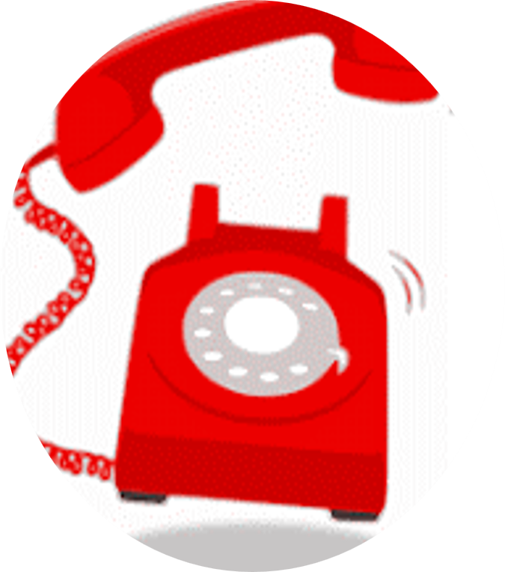
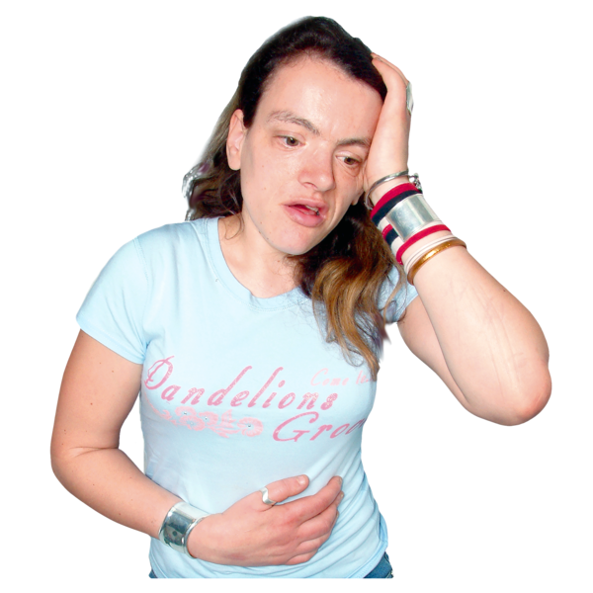
SOS Hotline for Cancer Patients
The SOS Hotline is a phone number that cancer patients can ring for advice and support.
SOS stands for Sort Out Symptoms.
Symptoms are the way you feel or things you experience when you are not well.
For example, feeling sick, hot, tired, or pain.
1

Slide 2
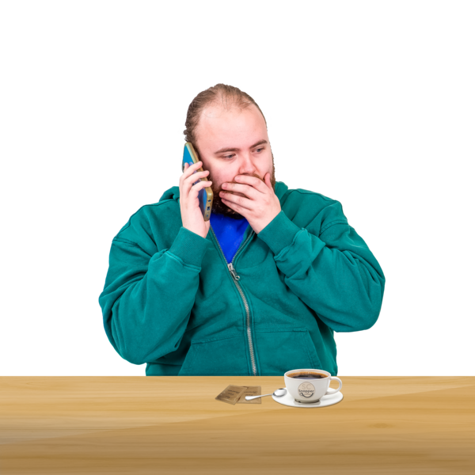
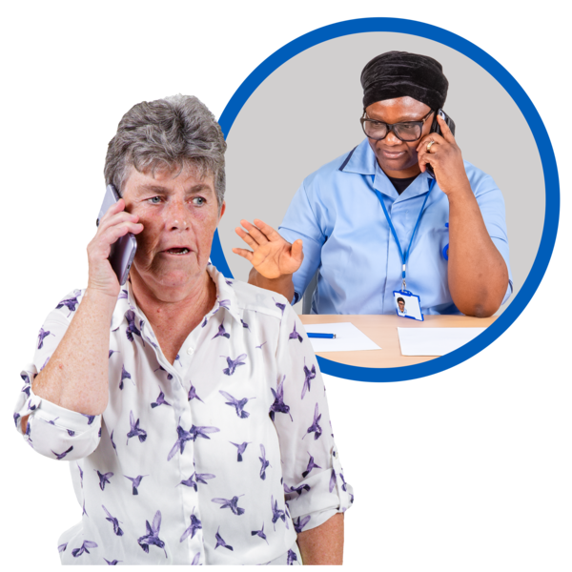
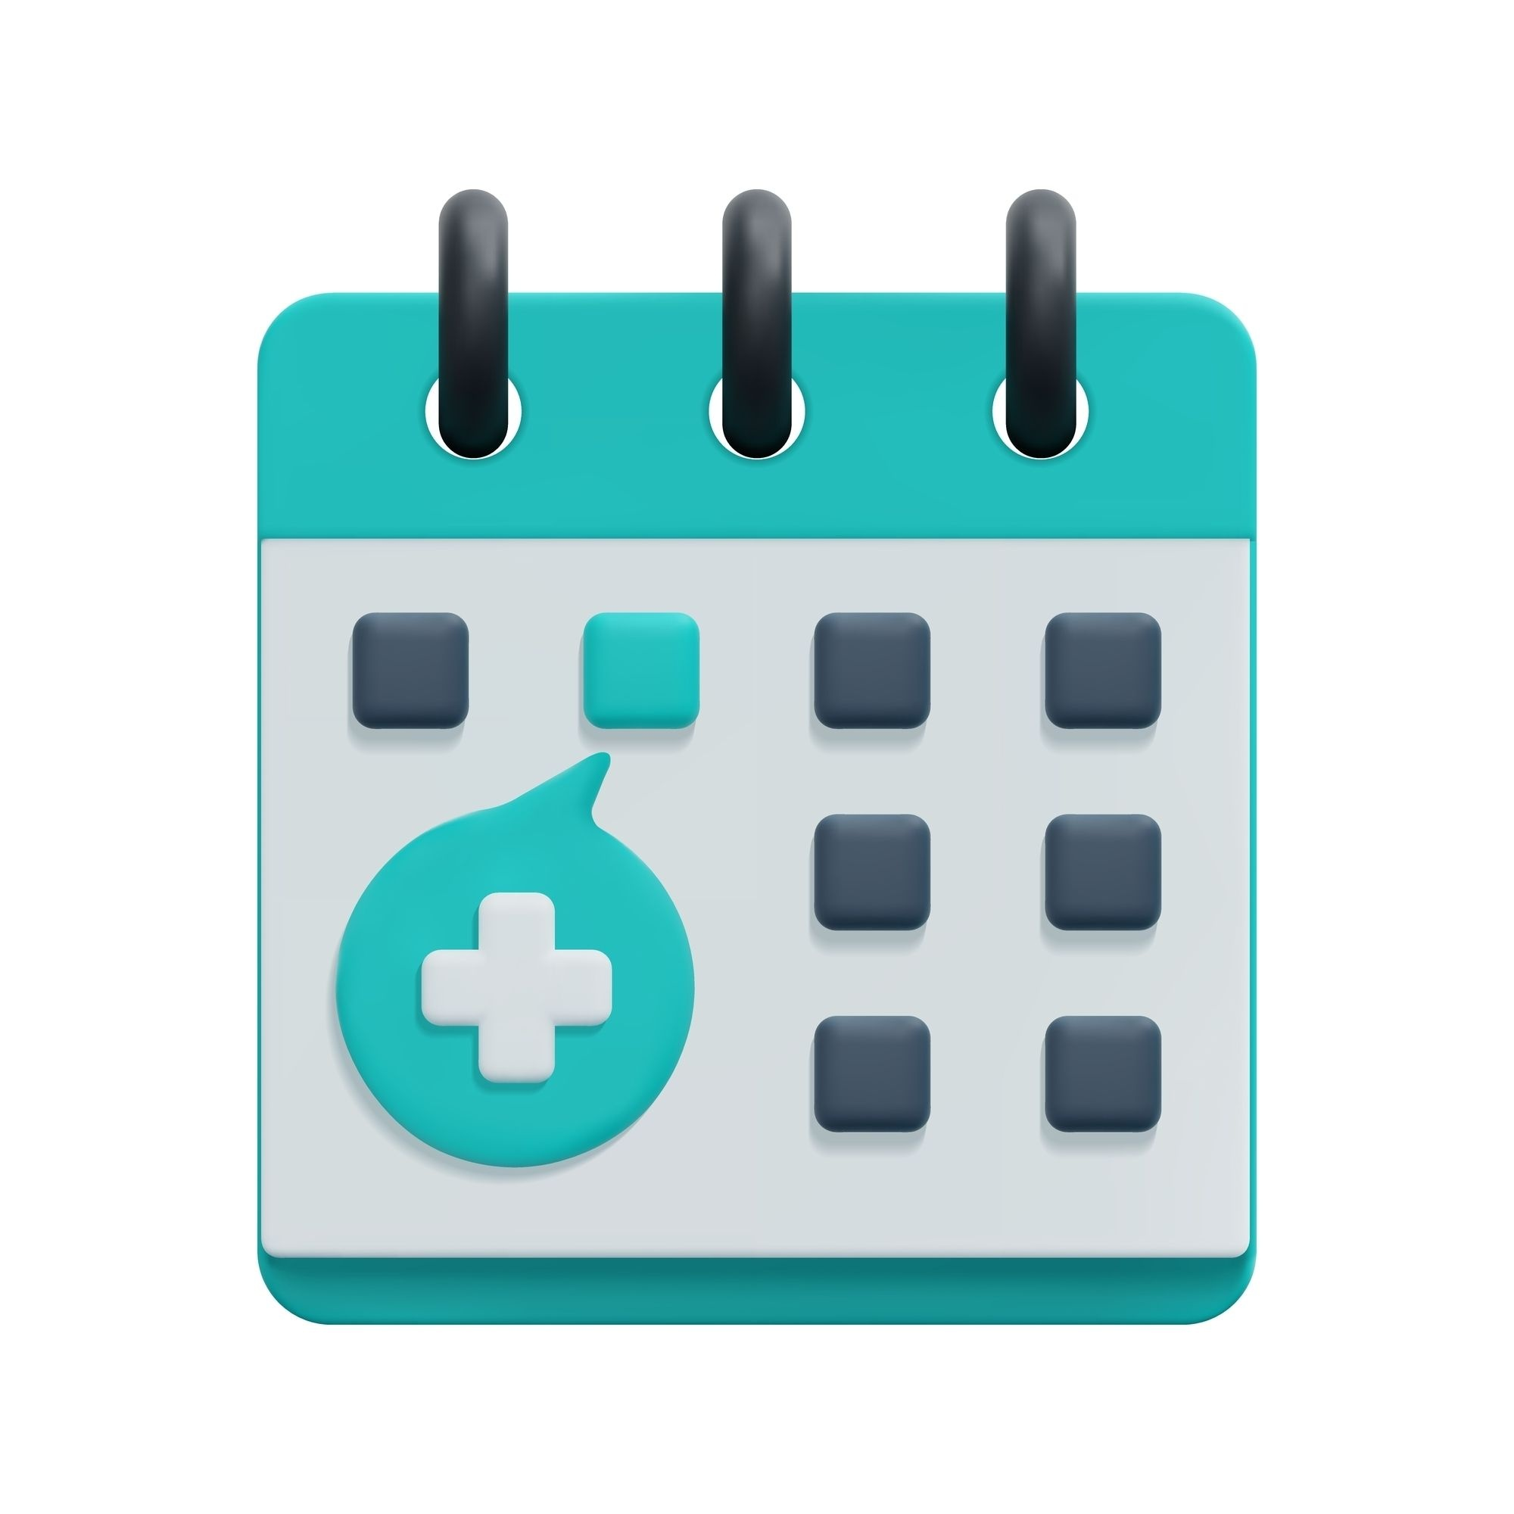

Cancer patients can phone the Hotline if they feel unwell or are worried about symptoms.
You can talk with a Nurse.
You don’t have to wait for your next appointment.
This phone number is not for repeat prescriptions, questions about appointments, or general questions.
2

Slide 3
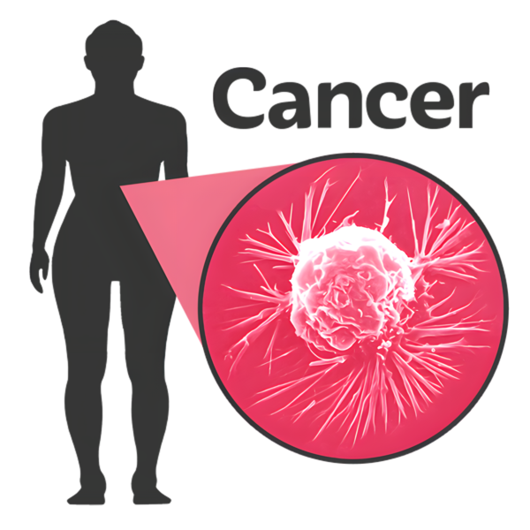
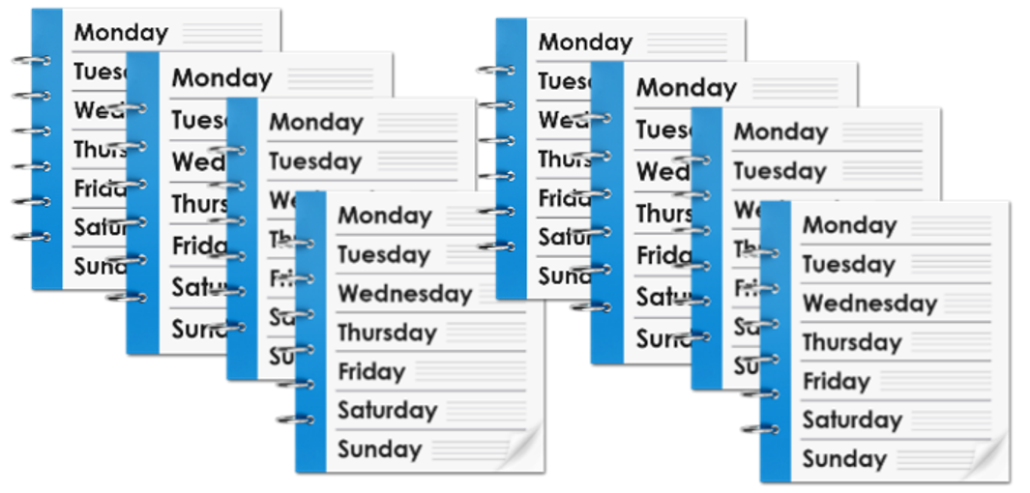
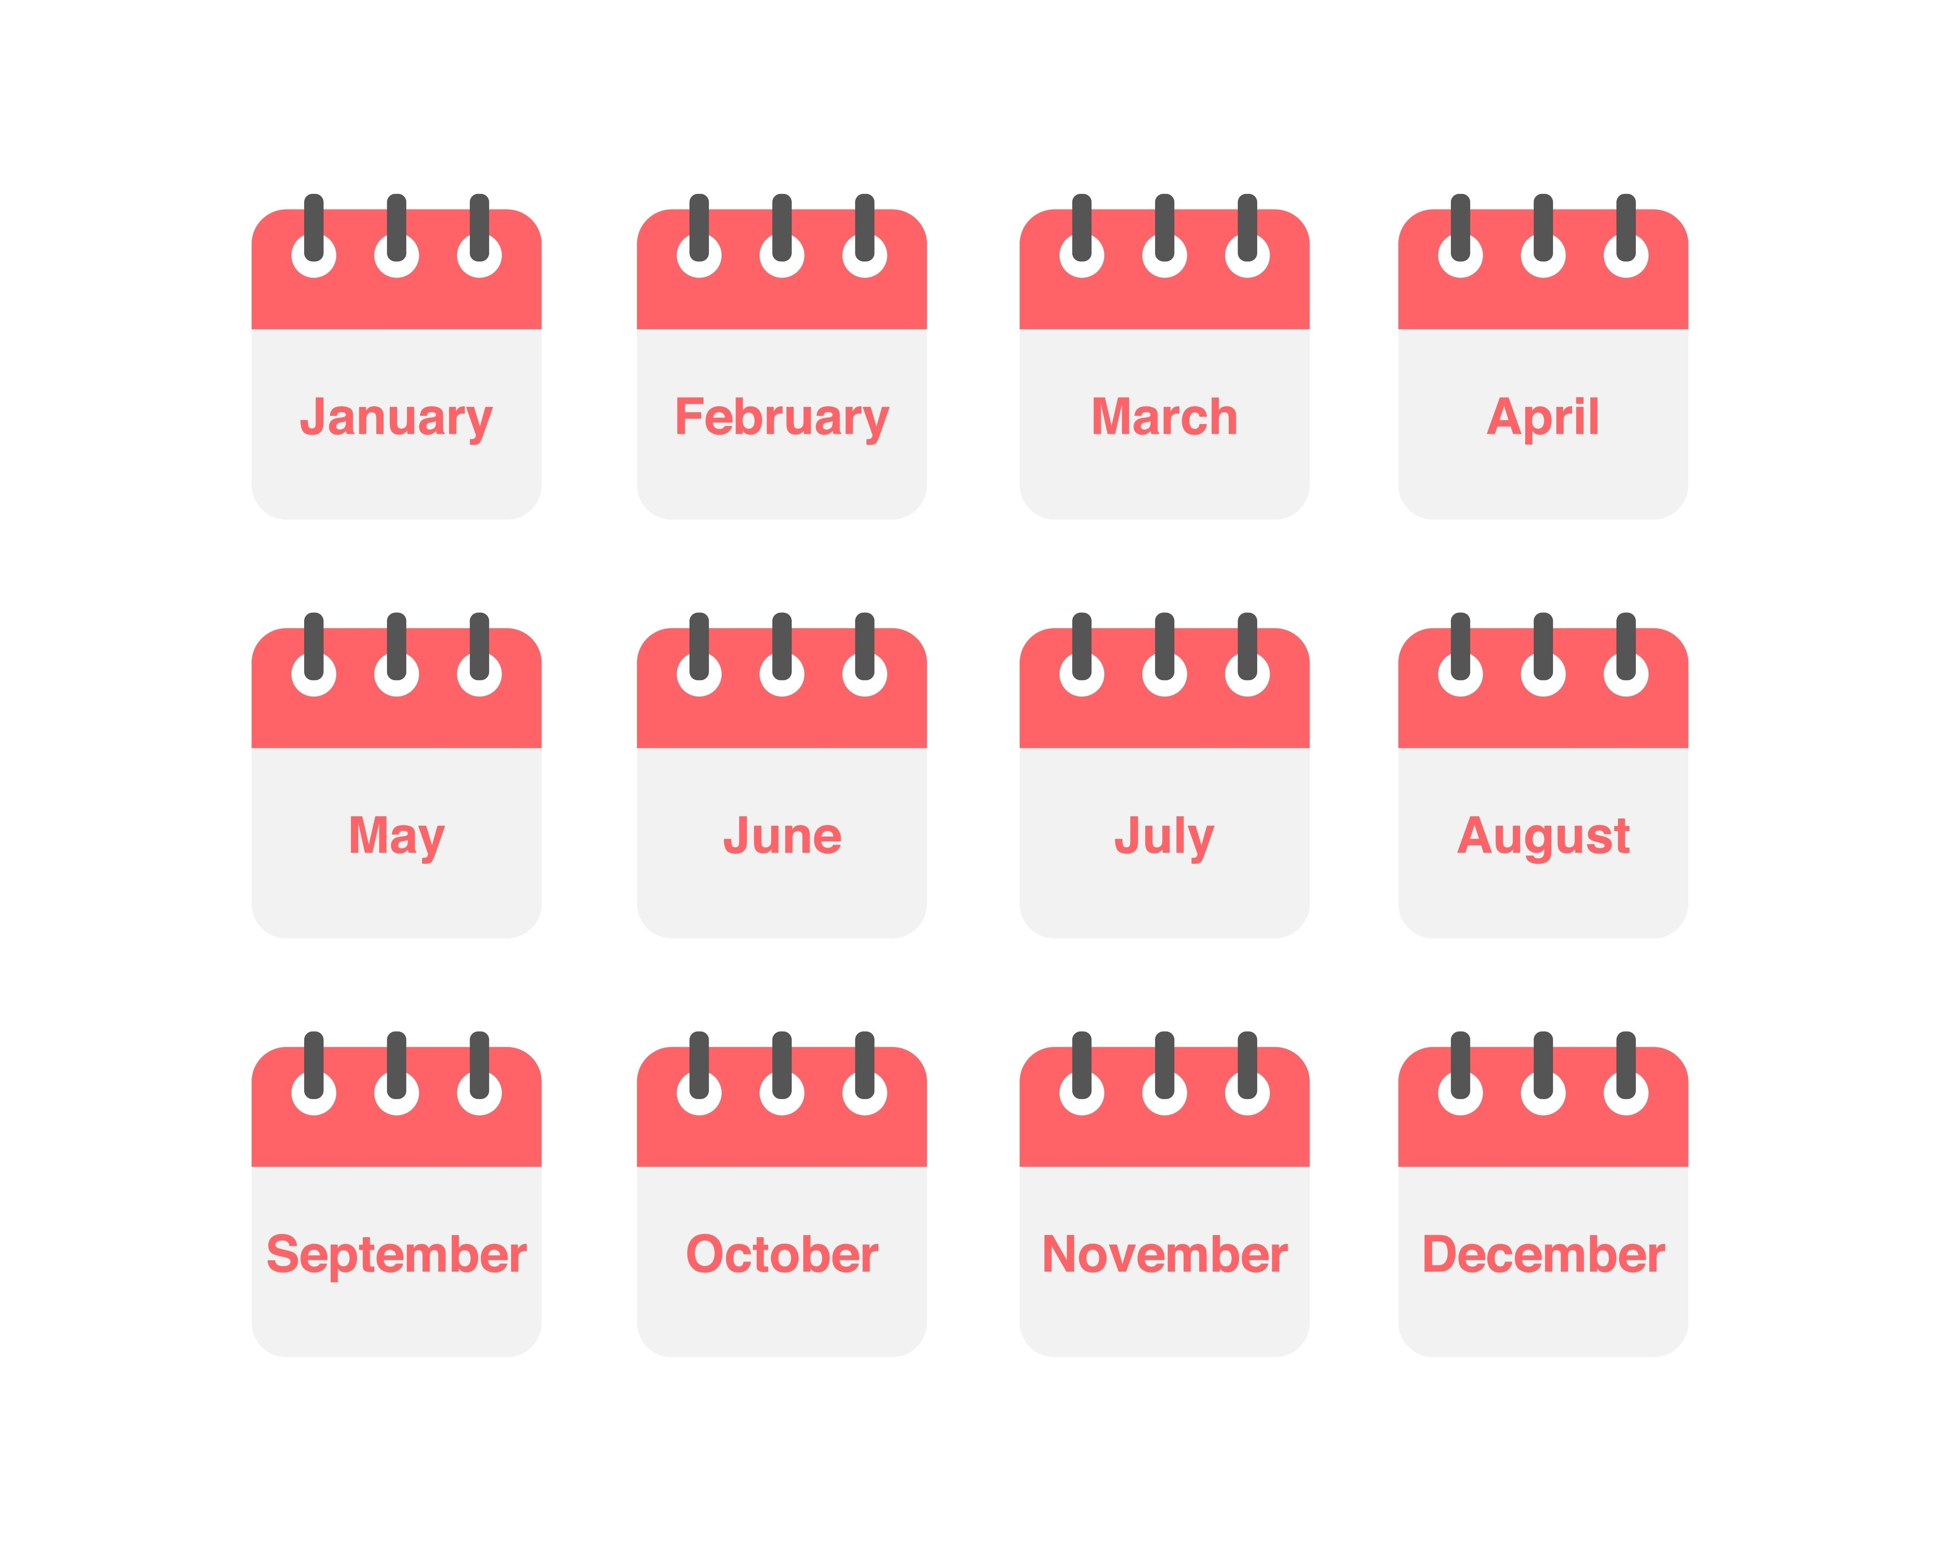

When should I call?
You can call if you are unwell and are having treatment for cancer.
You can call if you are unwell and you finished cancer treatment up to 8 weeks ago.
You can call if you are unwell and you had immunotherapy up to 1 year ago.
Immunotherapy is a type of treatment for cancer.
If you are not sure, phone the Hotline.
If in doubt, check it out!
3

Slide 4

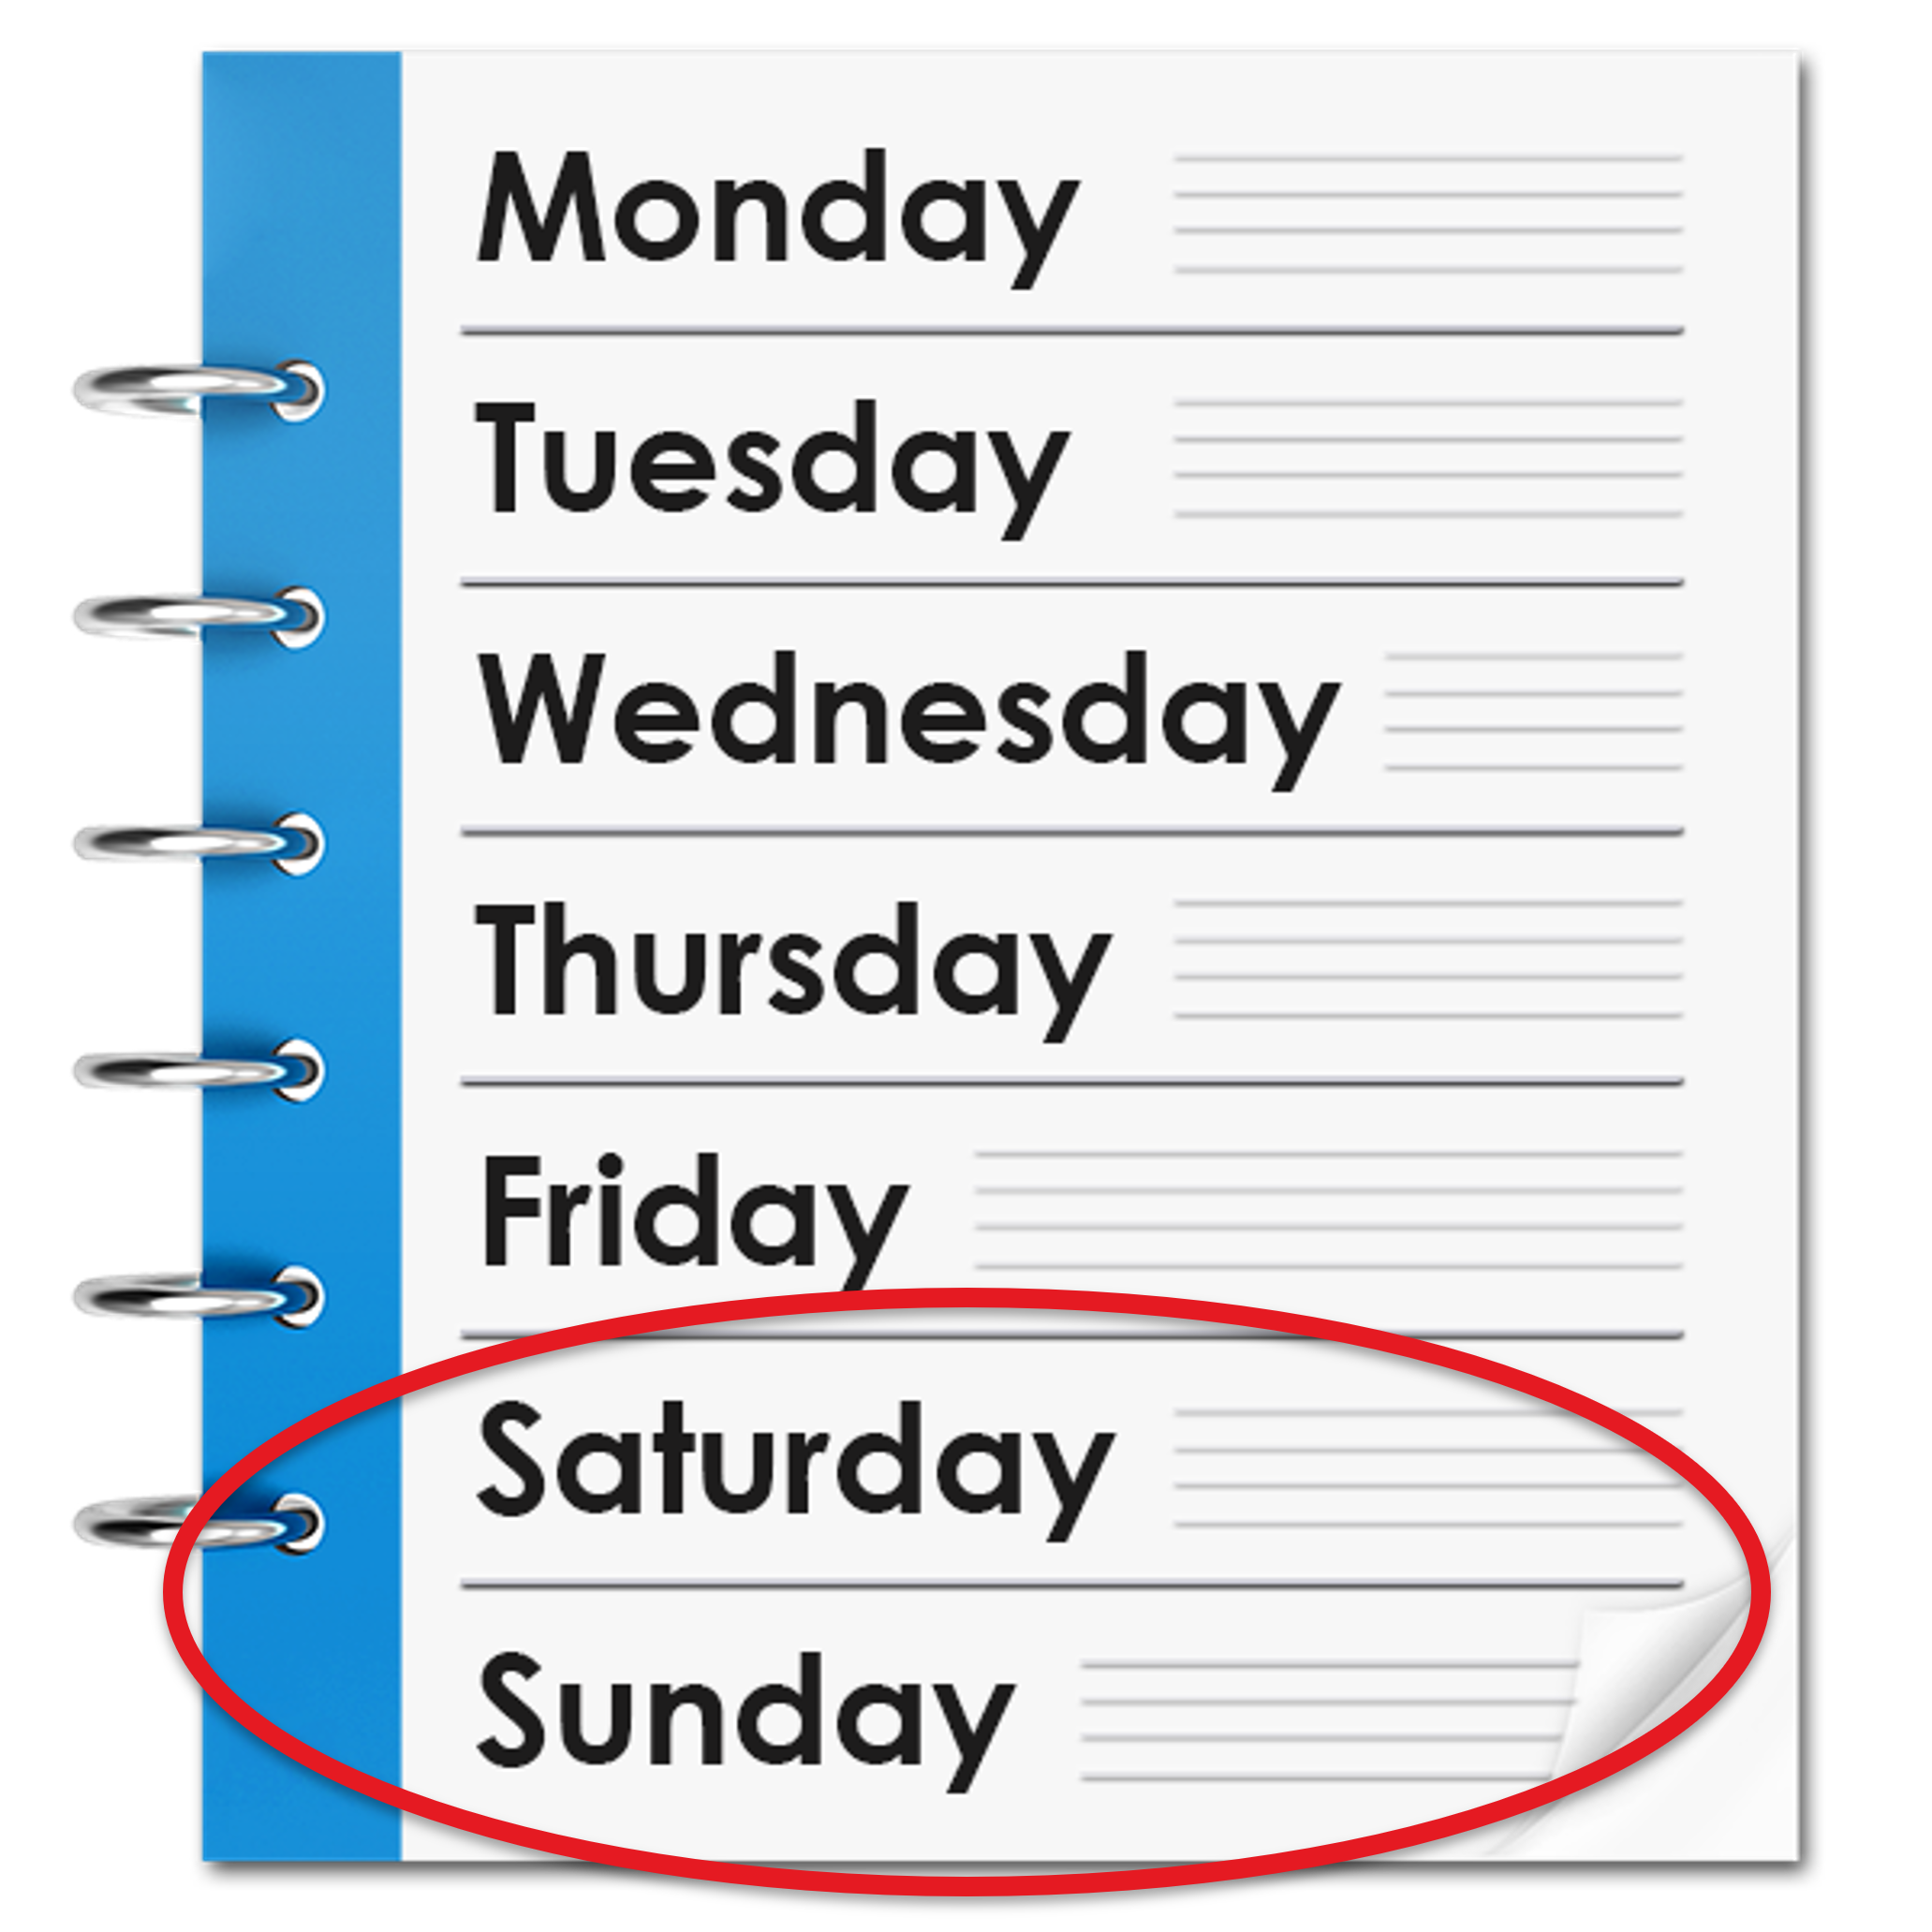

What number should I call?
Monday to Friday from 8am to 4pm
Call 0800 1600
Monday to Friday after 4 pm
Call
Weekends
Call
Bank Holidays
Call
4

Slide 5
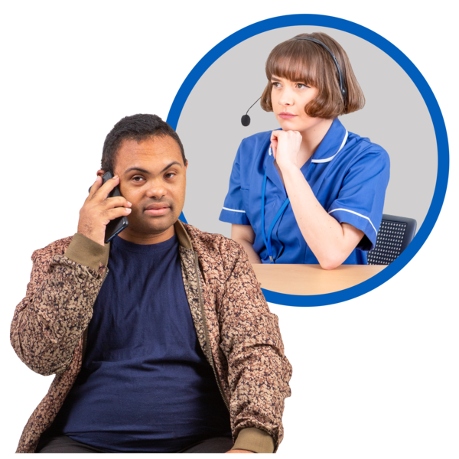

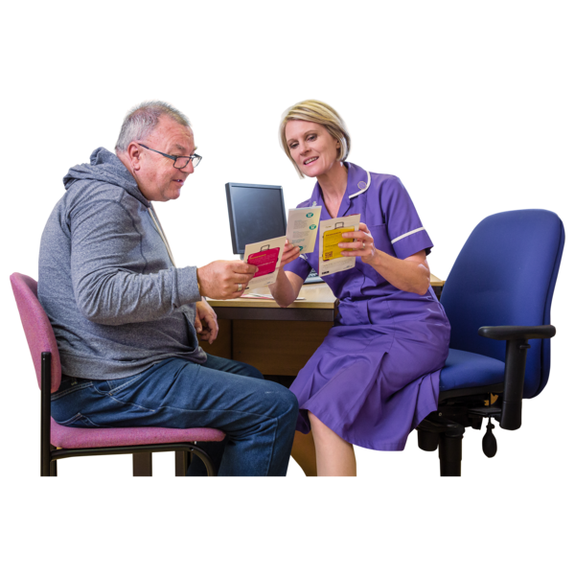
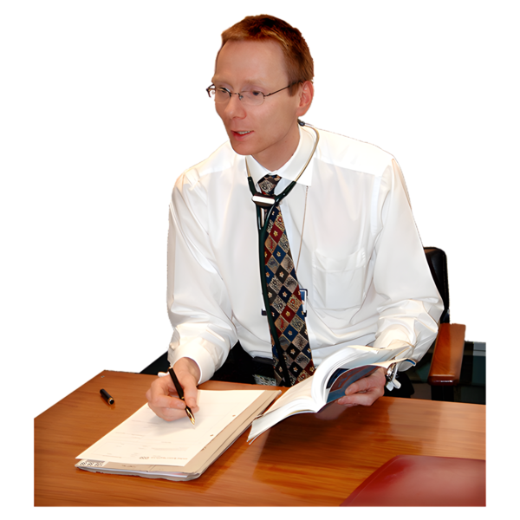
What happens when I call?
The nurse will ask you questions about the symptoms you have.
You may be given advice over the phone.
You may be asked to go to your Nurse Specialist.
You may be asked to go to your Doctor or to the Emergency Department at the hospital.
5

Slide 6
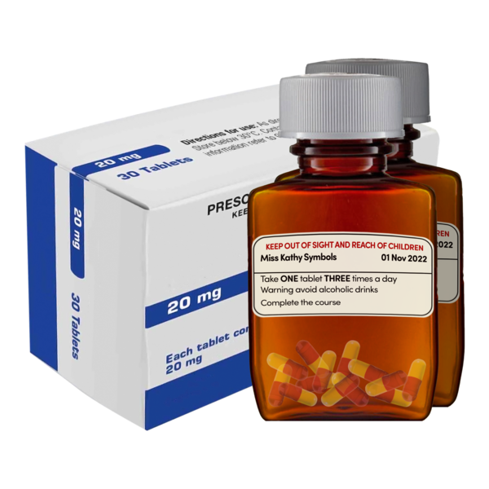
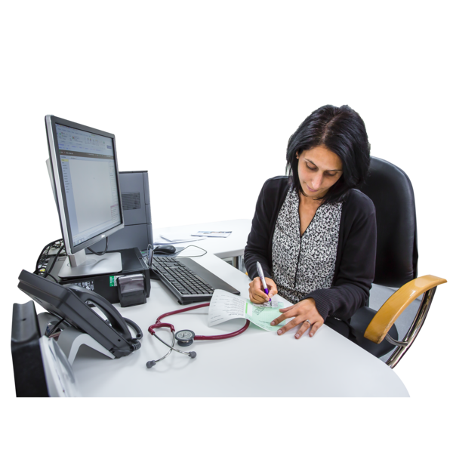


Please bring your medications and a list of your medications with you to the hospital.
You can get a list of your medications from your Doctor.
Show your alert card to any health staff that support you.
We use a traffic light system to help you to know what to do if you have symptoms.
6

Slide 7
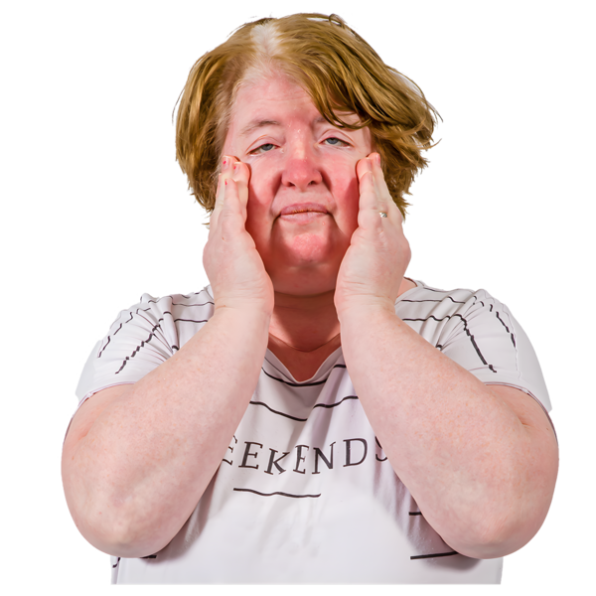
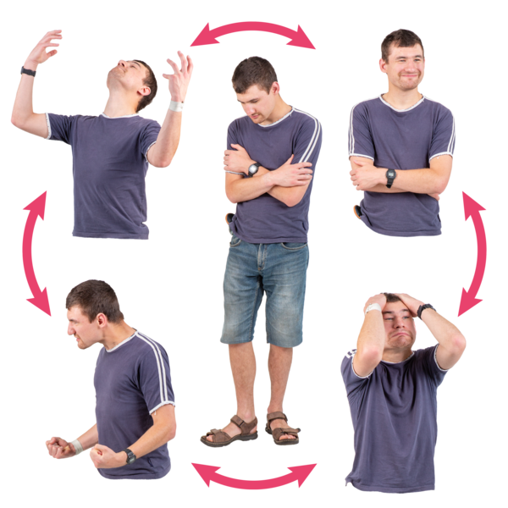
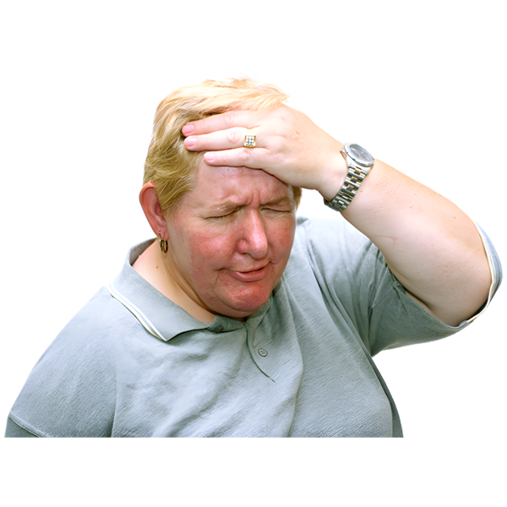
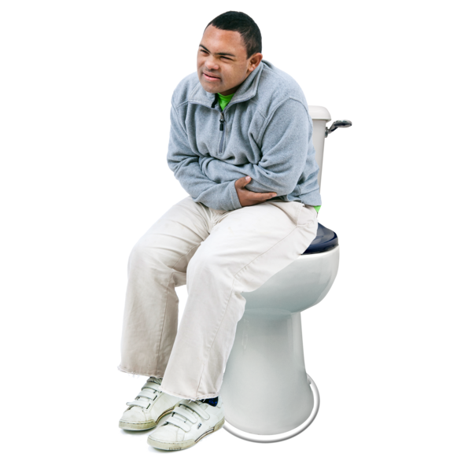
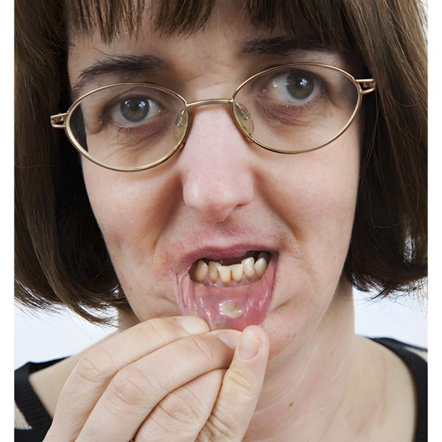
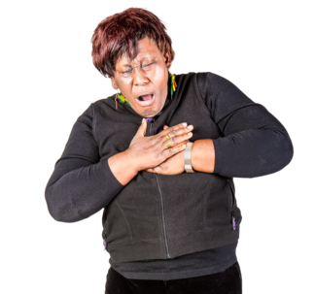
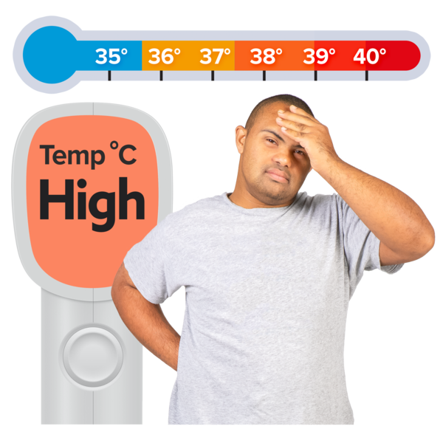
Green means be alert.
If you get symptoms, call the SOS Hotline.
  Feeling tired
  Not feeling hungry
  Skin changes that are not itchy or painful
  Difficulty in coping with the treatment
  Mood changes.
Amber means call the Hotline if you have:
New pain
Shivers and feel hot and cold
Vomiting, Diarrhoea
Problems going to the toilet
Bleeding
Swollen arms or legs
Sore mouth
Skin changes or rashes.
Red means call 999 or 112 straight away if:
You are suddenly unwell
You have chest pain
You find it hard to breath
You lose power in your arms or legs.
Call the Hotline if:
Your temperature is high or low.
7

