Slide 1
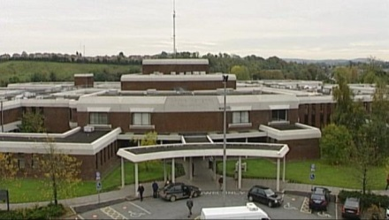
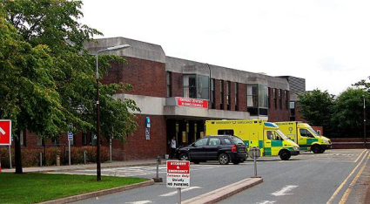
National Sepsis Compliance Audits 2016 Emergency Department Cavan General Hospital
Ashraf Butt
Consultant in EM

Slide 2
Overall Objective
To improve:
Detection of sepsis among patients presenting to Emergency Department (ED) Cavan General Hospital (CGH) by using the national ED Sepsis Screening Form (SSF)
Time from detection of sepsis to administration first dose IV antibiotics
Sepsis classification and documentation
Notes:
Correct sepsis classification and documentation are not only important in terms of patient management and escalation of treatment but also from a monetary point of view. Every patient that is admitted to the hospital generates money for the hospital through the HIPE coding system. A failure to document a patient’s diagnosis correctly or to record all pertinent information about a patient’s treatment will lead to a loss of revenue for the hospital.

Slide 3
Introduction
National Sepsis Team – 2016 series planned audits
Audits performed in April and July 2016 at Emergency Department CGH to monitor compliance with National Clinical Guidelines No 6: Sepsis Management (2014)
Notes:
Roll-out of SSF targeted ED & AMAUs – these were to be audited in Q1 & Q2 audits

Slide 4
Q1 Audit Objectives
SIRS criteria were identified and documented, prompting timely management
SSF completed and filed in the notes
SSF signed by a doctor
First dose IV antimicrobials administered within 1 hour of diagnosis
Notes:
SSF = Sepsis Screening Form

Slide 5
Q1 Audit Methodology 21/03/16 – 03/04/16
1282 patients seen in ED
85 Blood cultures taken
18% (n11) randomly selected (Excel 2010 RANDOM function)
2 patients excluded – not eligible (No SIRS criteria or risk factors & no antimicrobials commenced)
Snapshot of practice
Methodology has limitations
Notes:
It is unclear why both of the excluded patients had blood cultures taken when there were no indications. Was this just routine practice?
Limitations - Some patients may not have had blood cultures taken but are sepsis

Slide 6
Q1 Results – SIRS Criteria Present

Slide 7
Q1 SIRS Criteria General Variable Not Measured
Blood glucose – 44% not measured at triage

Slide 8
Q1 Use of the Sepsis Screening Form

Slide 9
Q1 SSF Used/Completed
 | Q1
No of patients | 9
Forms used | 44% (n4)
Forms completed (SIRS & Sepsis Six) | 75% (n3)
Completed & Signed | 50% (n2)

Slide 10
Q1 Time to First Dose IV Antimicrobials

Slide 11
Q1 Time to First Dose IV Antimicrobials
 | Q1
Range of antimicrobials (in mins) | 30-340
Mean Time | 89.5
% antimicrobials given within recommended 60 mins | 56% (n5)

Slide 12
Disappointing results

Slide 14
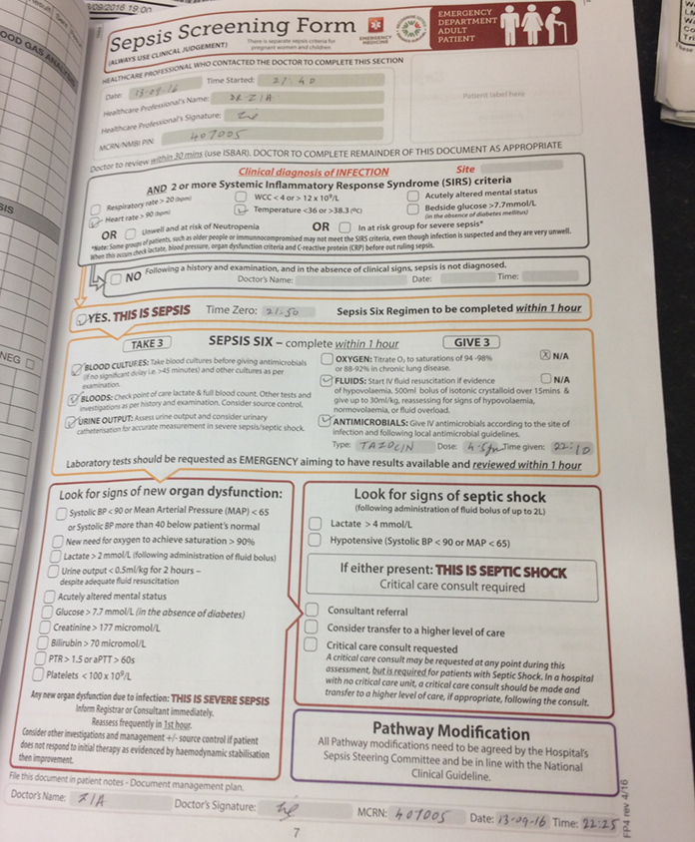
SEPSIS SCREENING FORM
Added to ED Chart
Easy access when required
Good reference point for staff

Slide 15
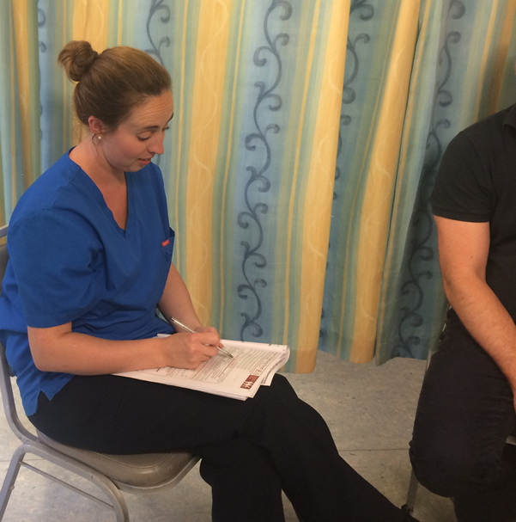
Reinforcement of Practice
Nursing Staff
Triage nurse and ED nurses initiate SSF and inform doctors on duty.

Slide 16
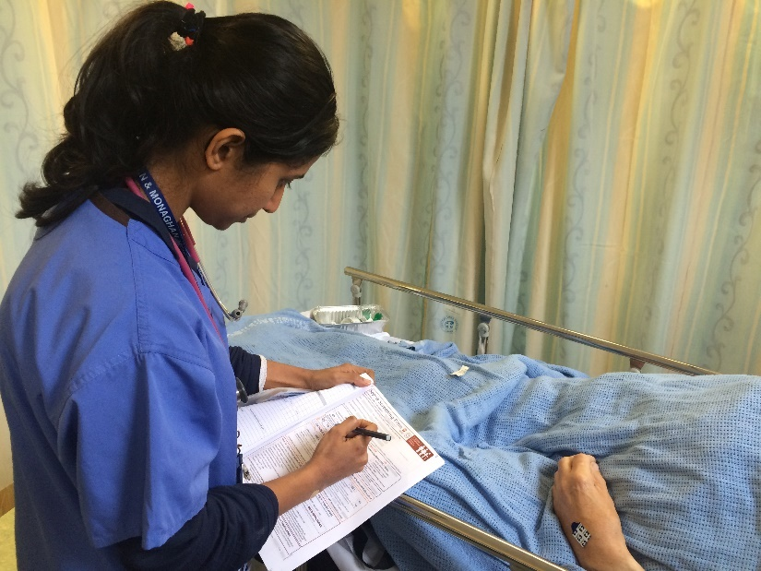
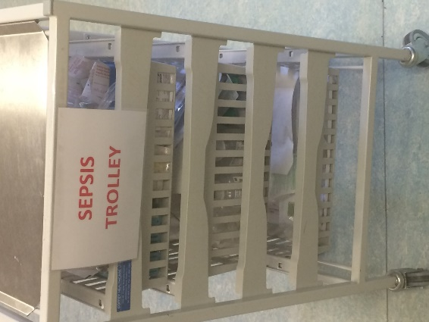
Reinforcement of Practice
NCHDs
NCHDs to complete the form on every patient with suspicion of infection or if patient triggers SIRS criteria (or neutropenic or at risk group)

Slide 17
Reinforcement of Practice
Antimicrobials within 60 minutes
Use of antimicrobial guidelines (App) for appropriate antimicrobials

Slide 18
Education
SEPSIS
In-house sessions – EM Consultant & Sepsis ADON
Compass training
NCHD Induction – Sepsis ADON
External Education Sessions – 2 evening sessions
All staff invited – well attended
CPD Points
Nice hotel & dinner!

Slide 19
Reminders
Daily board rounds
Handover time
Weekly teaching sessions
Email updates – NCHDs
Individual reinforcement

Slide 20
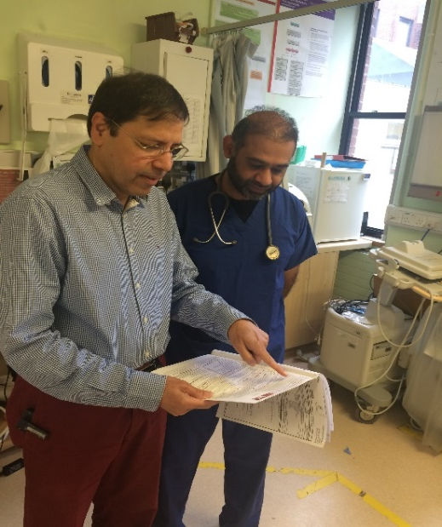
Daily Surveillance
Review
Daily ED Card Check
Action

Slide 21
Q2 Audit Objectives
SIRS criteria were identified and documented, prompting timely management
SSF was completed and filed in the notes
SSF was signed by a doctor
The first dose of antimicrobials was administered within 1 hour of diagnosis
The patient was correctly risk stratified as per the NCG, as evidenced by the sepsis classification documented in the patient notes
Notes:
Only new point from Q1 audit was the last point in red

Slide 22
Q2 Audit Methodology 20/06/16 – 03/07/16
1261 patients seen in ED
44 Blood cultures taken
36% (n16) randomly selected (Excel 2010 RANDOM function)
All patients eligible for audit
Snapshot of practice
Methodology has limitations
Notes:
Again some patients may not have had blood cultures taken but are sepsis
?Improvement in selection of patients for blood cultures – all patients eligible for the audit in Q2

Slide 23
Q2 SIRS Criteria Present

Slide 24
Q2 SIRS Criteria General Variable Not Measured
Blood glucose – 43% not measured at triage
Notes:
This scored 44% in Q1 audit

Slide 25
Q2 Sepsis Form Used/Completed
Notes:
1 patient decision

Slide 26
Q2 SSF Used & Completed
 | Q2
No of patients | 16
Forms used | 94% (n15) 113% increase in use of forms
Forms completed (SIRS & Sepsis Six) | 93% (n14)
Completed & Signed | 87% (n13)

Slide 27
Q2 Time to First Dose IV Antimicrobials
Notes:
1 patient form not used = 1/7 hx feeling unwell & nausea Hx malignant biliary stricture – not on chemo. SIRS – HR 112 all other criteria within normal limits. No SSF used and abx given at 145 mins. The doctor recorded biliary sepsis as diagnosis

Slide 28
Time to First Dose IV Antimicrobials
 | Q2
Range of antimicrobials (mins) | 1-145
Mean Time | 37
% antimicrobials given within recommended 60 mins (all patients) | 94% (n15)
%/No antimicrobials administered within recommended 60 mins SSF Used | 100% (n15)

Slide 29
Improvements Q1 Vs Q2

Slide 30
Sepsis Form Completed

Slide 31
Sepsis Forms Completed
 | Q1 | Q2
No of patients | 9 | 16
Forms used | 44% (n4) | 94% (n15)
Forms completed (SIRS & Sepsis Six) | 75% (n3) | 93% (n14)
Completed & Signed | 50% (n2) | 87% (n13)

Slide 32
Time to First Dose IV Antibiotics

Slide 33
Time to First Dose IV Antimicrobials
 | Q1 | Q2
Range of antimicrobials (mins) | 30-340 | 1-145
Mean Time | 89.5 | 37
% antimicrobials within recommended 60 mins | 56% (n5) | 94% (n15)

Slide 34
Time of Antimicrobials With/Without SSF
%/No received antimicrobials within recommended 60 mins | Q1 | Q2
With SSF | 75% (n3) | 100% (n15)
Without SSF | 40% (n2) | 0%

Slide 35
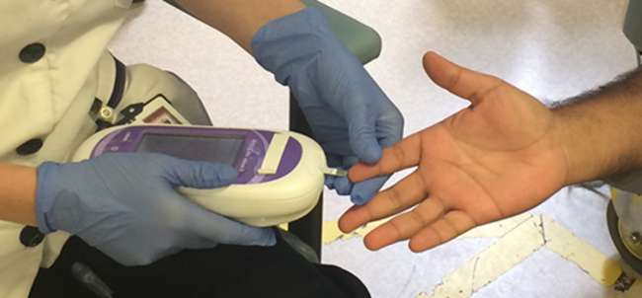
Most frequent SIRS Criteria not measured at triage
Q1 – blood glucose 43%
Q2 – blood glucose 44%

Slide 36
Sepsis Recognition & Documentation
1 pt = sepsis documented as infection
1 pt = infection documented as sepsis

Slide 37
Sepsis Recognition & Documentation
88% (n14) patients documented with correct sepsis classification (as per NCG)
Why important?
Sepsis NOT documented in notes | € | Sepsis documented in notes | €
6/7 admission Hx UTI | 2655 | 6/7 admission Hx UTI & Sepsis | 6120
4/7 admission Hx Gall stones | 1845 | 4/7 admission Biliary sepsis | 4410

Slide 38
Discussion
Completion of SSF improved from 44% to 94%.
Most common SIRS criteria not measured – blood glucose
Average antibiotic time improved from 90 minutes to 37 minutes.
Use of Sepsis form also improved antibiotic administration time.
Need to classify patient into sepsis, severe sepsis and septic shock on diagnosis.

Slide 39
Limitations
Data collection based on blood culture collected.
If sepsis is missed, no blood culture will be performed.

Slide 40
Conclusion
Significant improvement in sepsis detection and treatment time from behavioural reinforcement and constant reminder at every opportunity.

Slide 41
Acknowledgments
Mary Bedding RSCI HG Sepsis ADON for conducting audits
Medical Records staff for notes retrieval.
Surveillance Scientist for blood culture information.

Slide 42
Thank You

