Slide 1
Sepsis Alert – Clinical Decision Support Maternal Newborn eHR
Richard A Greene
Maternal Newborn Clinical Management System
National Project Team,

Slide 2
Outline
Sepsis
Clinical Decision Support
Some Evidence
The MNCMS Project
Sepsis Alert
Base criteria
Function
Documentation

Slide 3
Sepsis
Sepsis is an uncontrolled inflammatory response to an infection.
The systemic inflammatory response syndrome (SIRS) may be triggered by an infection, trauma, burn, or other offenses
Treatment delay – rapid advance to septic shock, multiple organ dysfunction syndrome (MODS), and death.
Estimated 5-year mortality rate for patients with severe sepsis is about 60%;
Survivors experience much lower physical quality of life
Interval from diagnosis to treatment affects short- and long-term patient outcome

Slide 4
Screening tool – Early recognition of sepsis
Twice daily screening – Surgical ICU
Pulse, Temp, RR and WCC
Each abnormal scores 1
Score of 4 Identify Source
Intensivist advised - ? Commence sepsis protocol
Sepsis mortality decreased 33% (35% down to 23%)
Moore J et al, J Trauma, 2012

Slide 5
Electronic tool – Sepsis identification
Randomized trial – ICU setting
Detection SIRS – alert to the physician via eHR
No management advice or recommendations
442 patients over 4 months
Feasible/Safe
Interventions and outcomes (LOS, Mortality) – no difference
Hooper M et al, Crit Care Med, 2012
Alert, no decision support

Slide 6
Alert System and Goal directed therapy
Training on alert and Sepsis bundle
Sepsis Management Alert Response Team – Code SMART
Med (CC), Sepsis nurse, Resp Technician, Pharmacist
No differences in positive cultures, infection source, Shock
Significant Improvement in Sepsis Bundle compliance
Significant reduction in sepsis related mortality
La Rosa JA et al, Crit Care Res Pract, 2012

Slide 7
Evaluation for sepsis—screening Tool.
Instructions: Use this screening tool to screen patients for sepsis.
(1) Is the patient's history suggestive of a new infection:
□ no
□ yes, if yes suspected source
□ Pneumonia, empyema
□ Urinary tract infection
□ Acute abdominal infection
□ Meningitis
□ Skin/soft tissue infection
□ Bone/joint infection
□ Wound infection
□ Bloodstream catheter infection
□ Endocarditis
□ Implantable device
□ Other
(3) Are any of the following organ dysfunction criteria present AND acute:
□ SBP < 90 mmHg or MAP < 65 mmHg
□ SBP decrease >40 mmHg from baseline
□ Bilateral pulmonary infiltrates with a new (or increased) oxygen requirement to maintain SpO₂ > 90%
□ Creatinine > 2 mg/dL or Urine Output < 0.5 mL/kg/hr for more than 2 hours
□ Bilirubin > 2 mg/dL
□ Platelet count <100,000
□ Coagulopathy (INR > 1.5 or aPTT > 60 secs)
□ Serum lactate > 2 mmol/L
➢If suspicion of infection is present AND organ dysfunction is present, the patient meets criteria for Severe sepsis.
➢If patient meets Severe sepsis criteria, AND has refractory hypotension (>60 min AND/OR unresponsive to fluid bolus of 20 mL/kg), the patient meets criteria for Septic shock.
Initiate and complete the severe sepsis protocol.
(2) Are any two signs and symptoms of infection present AND new to the patient?
□ Hyperthermia (>101°F or 38.3°C)
□ Hypothermia (<96.8°F or 36°C)
□ Tachycardia (>90 bpm)
□ Tachypnea (>20 bpm)
□ Acutely altered mental status
□ Leukocytosis (WBC count >12,000)
□ Leukopenia (WBC count <4,000)
□ >10% immature neutrophils
If the answer is yes to both questions 1 and 2, suspicion of infection is present:
□ Obtain: serum lactate, blood cultures, CBC with diff, basic chemistry labs, bilirubin
□ Pertinent diagnostic tests ___________________________________

Slide 9
HAVE YOU HEARD ABOUT MN-CMS?
Maternal Newborn Clinical Management System

Slide 10
Description and benefits
The MN-CMS Project is the design and implementation of an electronic health record (EHR) for all women and babies in maternity services in Ireland. This record will allow all information to be shared with relevant providers of care as and when required.
The key benefits include:
Improved patient care as a result of better communication, supported decision making and effective planning of care.
More effective and efficient recording of information reflecting best standards in documentation.
Enhanced clinical audit and research locally as a result of better quality data.
Informed business intelligence that will drive local and national management decisions.

Slide 11
Objectives of MN-CMS project
The core objective of the MN-CMS project is to implement Cerner’s Millennium product (Millennium) in all 19 maternity hospitals in Ireland. Millennium is a highly scalable system and will be configured to meet the main objective of the HSE, namely to have a single national centralised database for Maternity and Neonatal services in Ireland.
Other key objectives include;
Implement a fully integrated maternal and newborn clinical management system to support the business and service objectives of the Hospital.
Phase out of the paper chart into MN-CMS.
Integrate MN-CMS with all required 3rd party systems
Implement the necessary infrastructure to support the project.
Train all staff required to use the system in an appropriate manner.
Maintenance & Support.

Slide 12
Clinical Decision Support for early Recognition of Sepsis
5 hospitals General hospital population
6200 patient admissions
CDS began silent surveillance when a patient’s initial diagnostics were in their EHR. The sepsis CDS methodology captured results, clinical events, and time stamps.
817 (13%) patients screened-in – 51% not yet recognized by staff
Identified 379/459 sepsis patients (Sens 82%; PPV 46%)
Of the 5383 patients without an alert, 80 patients had a sepsis-associated discharge code
5303 true negatives and 80 false negatives (99% NPR)
Amland RC & Hahn-Cover KE, Am J Med Qual, 2014

Slide 13
Clinical Decision Support in an eHealth Record
Sepsis program enabled by computerized CDS and a cloud-based surveillance capability
expedited recognition
reduced ICU services
improved in-hospital survival
increased likelihood of discharge home in patients with sepsis.
Amland R et al, J Hosp Med(pending)

Slide 14
Sepsis Recognition
Commercial Provider of Millennium - MNCMS

Slide 15
Diagnostic Criteria - Pregnancy

Slide 16
Discern Alert - SIRS

Slide 18
Reminder & Direct link to documentation

Slide 23
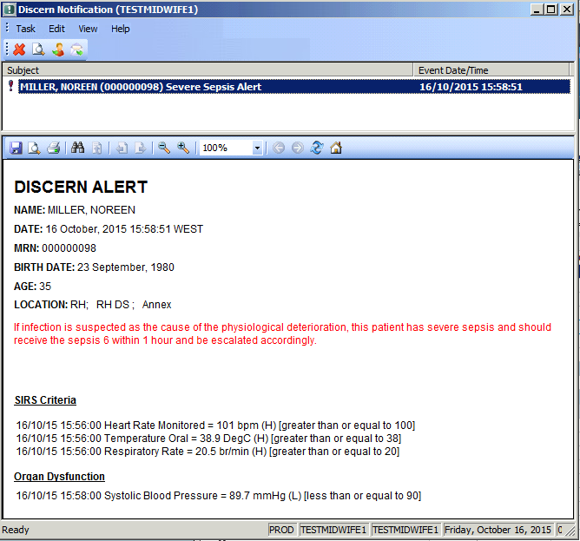

Slide 24
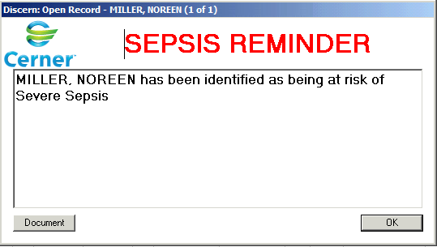
Medical log in:

Slide 29
Diagnosis – once documented - Coded

Slide 30
Sepsis Alert and Clinical Decision Support
Should aid early recognition of Sepsis
Especially in a low risk group where sepsis is more likely to be ‘missed’
Will enhance response to a diagnosis of sepsis
Alerts and support orientated documentation
Will allow audit of sepsis in maternity services
Will allow assessment of the criteria which have not been validated for maternity patients

Slide 31
Thank You!
Questions/comments
r.greene@ucc.ie

